Slide 1
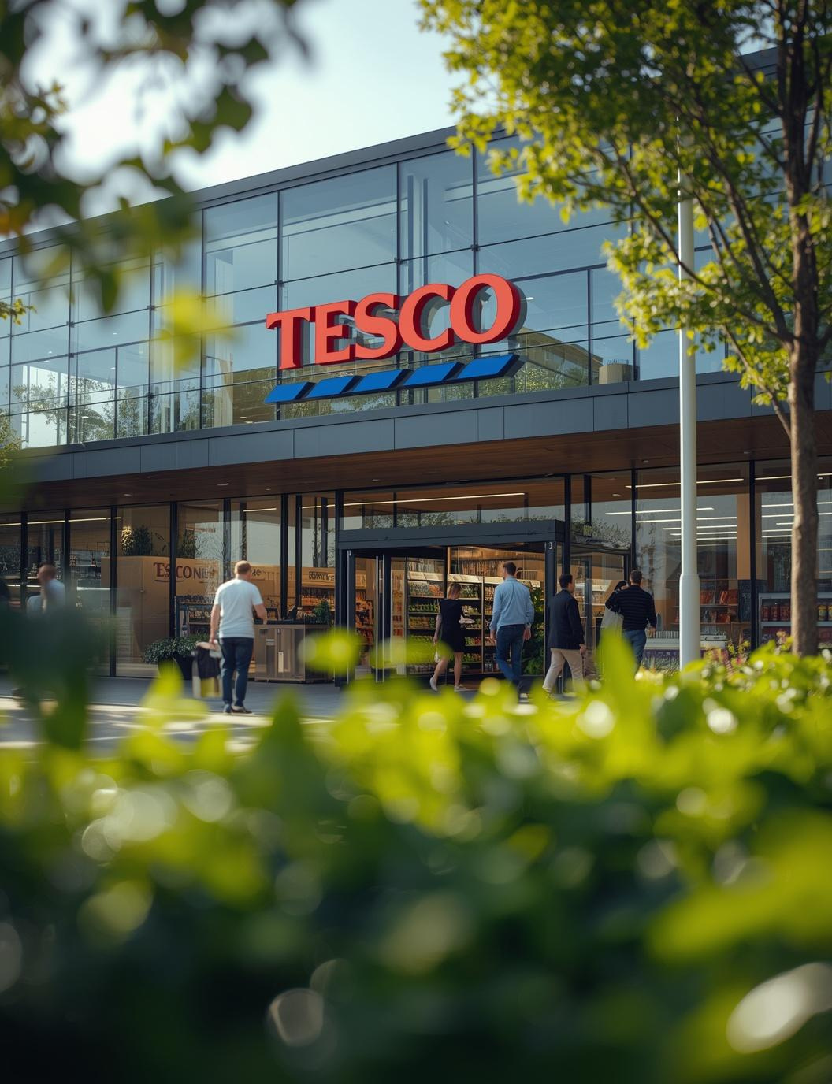
Introduction To Leadership And Management
Component 1: Presentation
Christvit L. KANGA. 2441744
23-03-2026

Slide 2


Introduction
Planning is a key management activity that was identified by Henri Fayol (1916) as a starting point of all other managerial functions. This presentation analyses the importance of planning in Tesco plc and how it facilitates the strategic and operational objectives of the organisation based on practical examples.
Notes:
Planning is a key management activity that was identified by Henri Fayol (1916) as a starting point of all other managerial functions. This presentation analyses the importance of planning in Tesco plc and how it facilitates the strategic and operational objectives of the organisation based on practical examples.

Slide 3
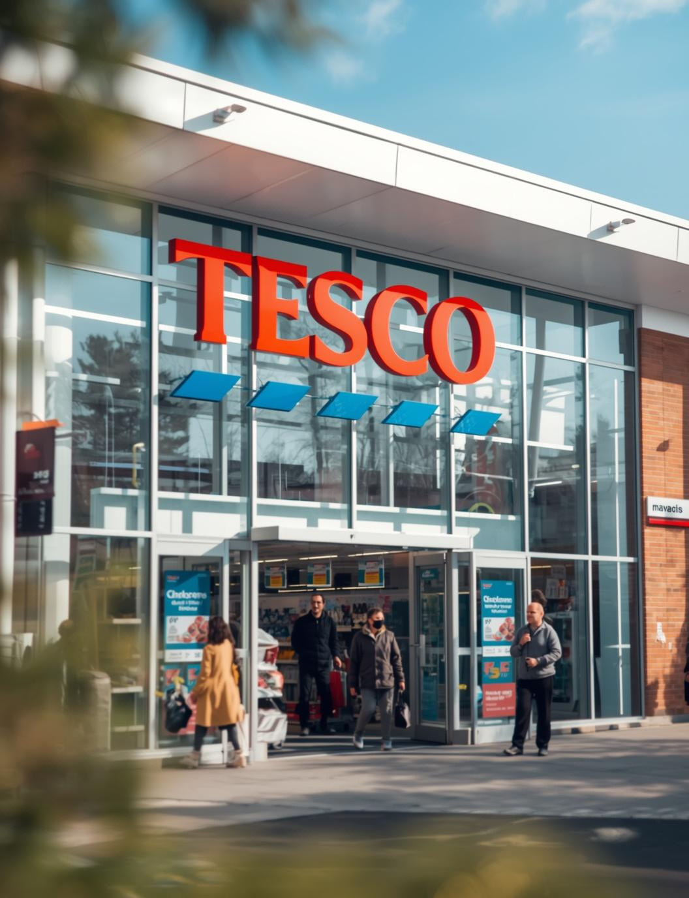

Overview of Tesco
Tesco plc is a major retail organisation of the United Kingdom which has got supermarkets, convenient stores, and online platforms.
Tesco, which was founded in 1919, has been able to gain a powerful presence in the market through its commitment to customer satisfaction, affordability and innovation.
It is a very competitive retail industry, so the company is obliged to constantly adapt to the demands and trends of consumers, all the novelties of technologies, and the problem of sustainability (Tesco Plc, 2024).
Consequently, planning is important in influencing the long-term growth and performance of Tesco.
Notes:
Tesco plc is a major retail organisation of the United Kingdom which has got supermarkets, convenient stores, and online platforms. Tesco, which was founded in 1919, has been able to gain a powerful presence in the market through its commitment to customer satisfaction, affordability and innovation. It is a very competitive retail industry, so the company is obliged to constantly adapt to the demands and trends of consumers, all the novelties of technologies, and the problem of sustainability (Tesco Plc, 2024). Consequently, planning is important in influencing the long-term growth and performance of Tesco.

Slide 4

Planning as a Core Management Function
Planning refers to the process of identifying the goals and identifying the steps involved in attaining them (Robbins and Coulter, 2021). It functions on three levels, strategic, tactical and operational.
Strategic is long-term oriented planning, tactical is a translation of strategies into departmental activities, and operational planning is day-to-day activities orientation.
Proper planning helps Tesco to lessen uncertainty, allocate resources in an efficient way, and be able to react proactively to environmental changes.
It is also useful in coordination between departments and alignment of organisational goals and activities (Neck et al., 2023).
Within the Tesco context, planning is a key factor to its continued existence by remaining competitive and ensuring sustainability.
Notes:
Planning refers to the process of identifying the goals and identifying the steps involved in attaining them (Robbins and Coulter, 2021). It functions on three levels, strategic, tactical and operational. Strategic is long-term oriented planning, tactical is a translation of strategies into departmental activities, and operational planning is day-to-day activities orientation. Proper planning helps organisation to lessen uncertainty, allocate resources in an efficient way, and be able to react proactively to environmental changes. It is also useful in coordination between departments and alignment of organisational goals and activities (Neck et al., 2023). Within the Tesco context, planning is a key factor to its continued existence by remaining competitive and ensuring sustainability.

Slide 5
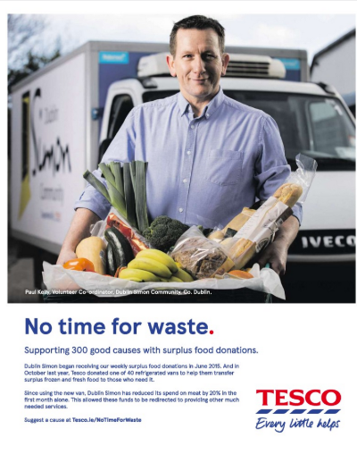
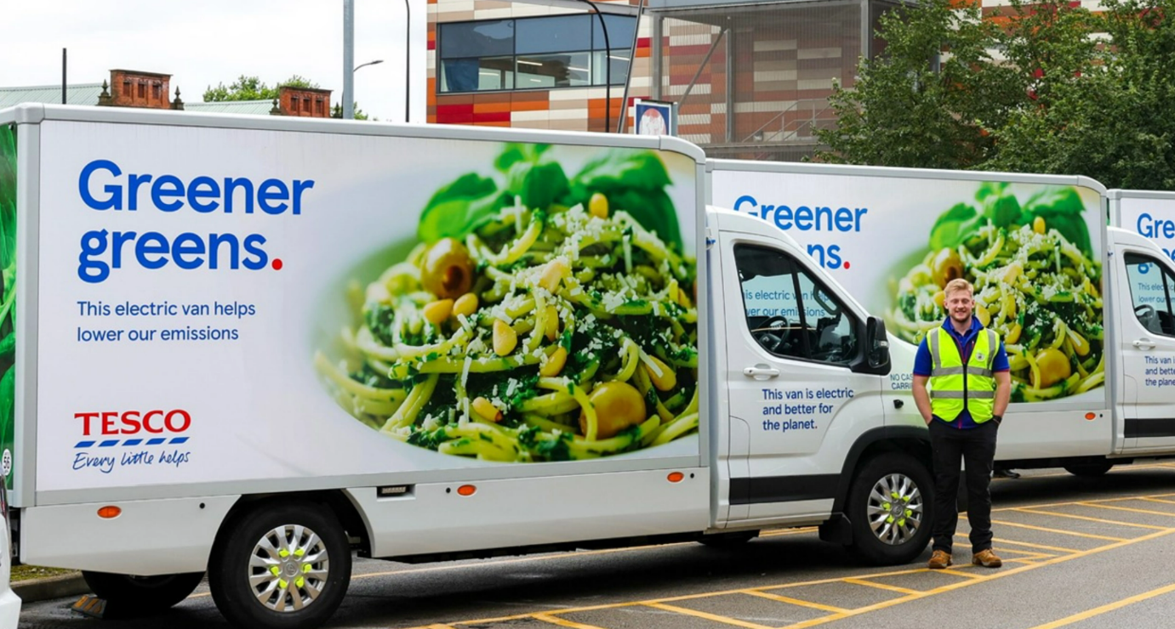

How Planning Supports the Organisational Goals at Tesco
On the strategic level, the company has come up with a net zero carbon strategy, which focuses on ensuring that the company operations are carbon neutral by 2035 and the entire supply chain by 2050 (Tesco Plc, 2022).
On the operational level, Tesco has implemented new energy efficient technologies saving up to 30% of energy and showing how short-term planning is beneficial to the long-term organisational objectives (Tesco, 2025).
Another example of good planning is seen in Tesco committing in electric delivery vehicles. This is an indication of how the organisation has been able to adjust to the shifting consumer behaviour as well as meet environmental issues.
Tesco has adopted the programme of No Time to Waste, through which it redistributes excessive food to charities as well as predicts demand more precisely, with the help of data analytics (Tesco, 2022).
Lastly, Tesco has also experimented with carbon footprint labelling of products, which helps customers to make greener buying choices.
Notes:
Tesco shows how planning can be applied in various real-life projects. On the strategic level, the company has come up with a net-zero carbon strategy, which focuses on ensuring that the company's operations are carbon neutral by 2035 and the entire supply chain by 2050 (Tesco Plc, 2022). This is a long-range plan that is conducive to visionary decision-making and environmental conformity with the global standards. On the operational level, Tesco has implemented new energy-efficient technologies in the stores, such as LED lighting and refrigerator doors. These actions save up to 30% of energy, showing how short-term planning is beneficial to the long-term organisational objectives (Tesco, 2025). Another example of good planning is seen in Tesco's commitment to electric delivery vehicles. As the amount of online grocery shopping grew, the company was going to electrify its delivery cars to minimise the amount of air pollution and to enhance the quality of air in cities. This is an indication of how the organisation has been able to adjust to the shifting consumer behaviour as well as meet environmental issues. Also, Tesco has adopted the programme of No Time to Waste, through which it redistributes excessive food to charities as well as predicts demand more precisely, with the help of data analytics (Tesco, 2022). Lastly, Tesco has also experimented with carbon footprint labelling of products, which helps customers to make greener buying choices. This illustrates the fact that planning goes beyond the internal processes to affect consumer behaviour and facilitate the sustainability goals of the long term.

Slide 6

Conclusion
To sum it up, planning is an essential management activity that supports organisational success. Tesco plc is an adequate strategic, tactical and operational planner in order to attain its business objectives. By investing in its net zero agenda, use of renewable energy, energy efficient retail outlets and its waste minimisation programmes, among others, Tesco shows how planning assists in achieving sustainability, efficiency and competitiveness.
Notes:
To sum it up, planning is an essential management activity that supports organisational success. Tesco plc is an adequate strategic, tactical and operational planner in order to attain its business objectives. By investing in its net zero agenda, use of renewable energy, energy efficient retail outlets and its waste minimisation programmes, among others, Tesco shows how planning assists in achieving sustainability, efficiency and competitiveness.

Slide 7
References
Fayol, H. (1916). General and industrial management. Mansfield Centre, Ct Martino Publ.
Neck, C.P., Houghton, J.D. and Murray, E.L. (2023). Organizational Behavior. SAGE Publications.
Robbins, S.P. and Coulter, M.K. (2021). Management. 15th ed. New York, NY: Pearson Education.
Tesco (2022). No time for waste as Tesco pledges to halve food waste five years early. [online] www.tescoplc.com. Available at: https://www.tescoplc.com/no-time-for-waste-as-tesco-pledges-to-halve-food-waste-five-years-early/ [Accessed 21 Mar. 2026].
Tesco (2025). Making a positive impact. [online] Available at: https://www.tescoplc.com/media/wvkj1yic/tesco-sustainability-report-2025.pdf [Accessed 21 Mar. 2026].
Tesco Plc (2022). Climate change. [online] Tesco PLC. Available at: https://www.tescoplc.com/sustainability/planet/climate-change/ [Accessed 21 Mar. 2026].
Tesco Plc (2024). Our History. [online] Tesco PLC. Available at: https://www.tescoplc.com/about/our-history [Accessed 21 Mar. 2026].

Slide 8


