Slide 1

Marketing, Micro and Macro Overview

Slide 2
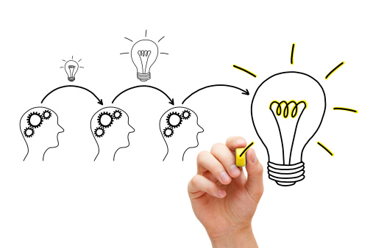
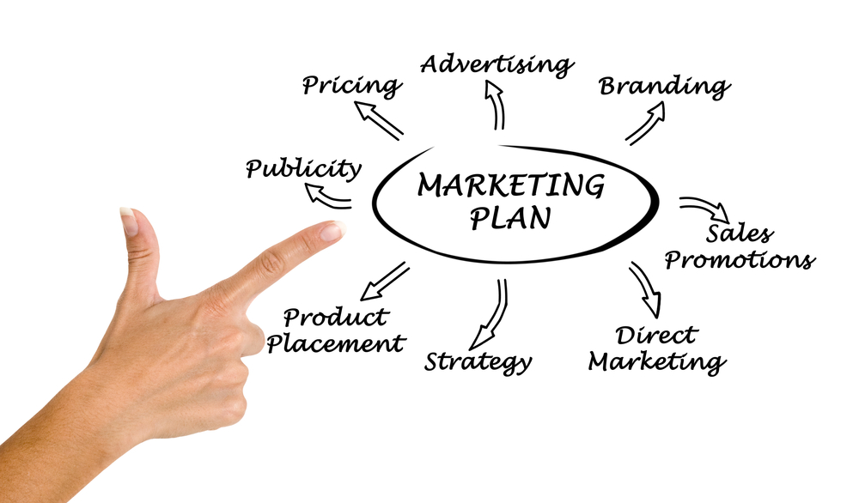
We are all marketers BUT we are developing our skill, knowledge and understanding of the discipline.

Slide 3
Definitions
“The management process responsible for identifying, anticipating and satisfying customer requirements profitably” CIM (2016)
Marketing is the activity, set of institutions, and processes for creating, communicating, delivering, and exchanging offerings that have value for customers, clients, partners, and society at large
American Marketing Association (2013)

Slide 4
Forms of Marketing
Traditional
View - Making a sale
Contemporary
View - Satisfying customer needs
Abundance of products in the nearby shopping centers
Television, magazine, and direct-mail ads
Imaginative web sites and mobile phone apps, blogs, online videos, and social media
Reach customers directly, personally, and interactively
Notes:
Marketing comes in two forms—traditional and contemporary.
In the traditional form, marketing is seen in abundance at shopping malls and in magazine, television, and direct-mail advertisements. Therefore, marketing in the old sense refers to making a sale—“telling and selling”.
In the contemporary form, marketers have assembled a host of new marketing approaches—imaginative Web sites, mobile phone apps, blogs, online videos, and social media. Thus, marketing in the new sense involves satisfying customer needs.

Slide 5
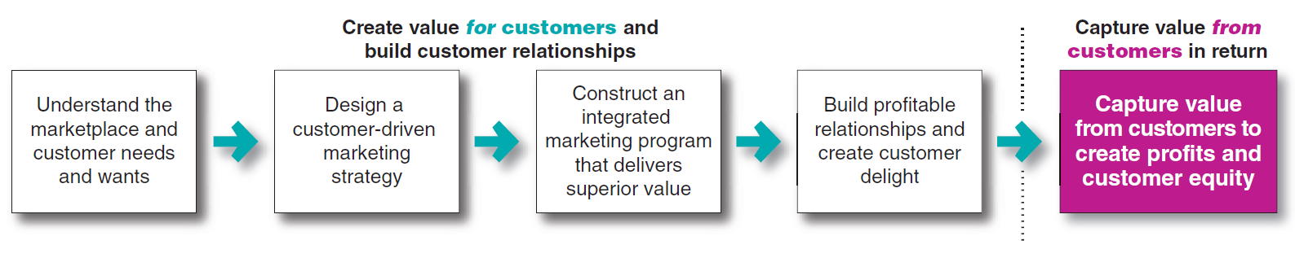
Figure 1.1 - The Marketing Process:
Creating and Capturing Customer Value
Notes:
This figure presents a simple, five-step model of the marketing process for creating and capturing customer value. In the first four steps, companies work to understand consumers, create customer value, and build strong customer relationships. In the final step, companies reap the rewards of creating superior customer value. The rewards are in the form of sales, profits, and long-term customer equity.

Slide 6
Customer Needs, Wants, and Demands
Needs
States of felt deprivation
Wants
Form taken by human needs when shaped by culture and individual personality
Demands
Human wants that are backed by buying power
Physical needs - Food, clothing, warmth, and safety
Social needs - Belonging and affection
Individual needs - Knowledge and self-expression
Notes:
Customer needs are the states of felt deprivation. They include basic physical needs for food, clothing, warmth, and safety; social needs for belonging and affection; and individual needs for knowledge and self-expression.
Wants are the form human needs take as they are shaped by culture and individual personality. For example, an American needs food but wants a Big Mac, French fries, and a soft drink. Wants are shaped by one’s society and are described in terms of objects that will satisfy those needs.
When backed by buying power, wants become demands. Given their wants and resources, people demand products and services with benefits that add up to the most value and satisfaction.

Slide 7
Types of Markets
Consumer
Business
Product – Tangible or Intangible
Not for Profit – e.g charities
Government – e.g public health, defence
Public Sector – same as government but on a more local scale
Global Markets

Slide 8
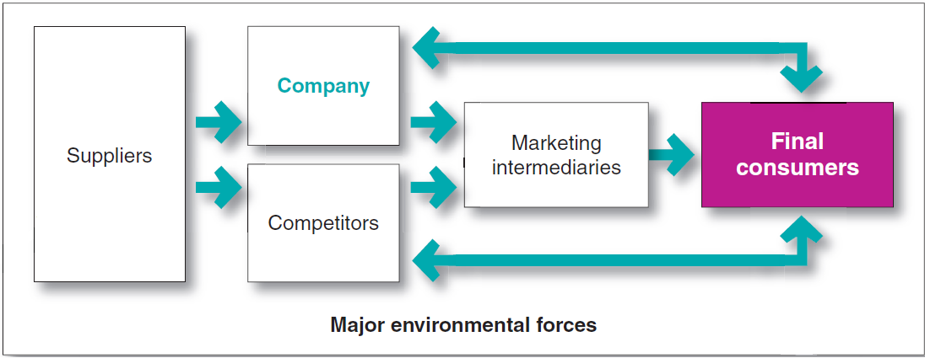
Figure 1.2 - A Modern Marketing System
Notes:
This figure shows the main elements in a marketing system. Each party in the system adds value for the next level. The arrows represent relationships that must be developed and managed. Thus, a company’s success at building profitable relationships depends not only on its own actions but also on how well the entire system serves the needs of final consumers.

Slide 9

Two Questions for Marketers
How can we serve these customers best?
What markets will we serve?

Slide 10
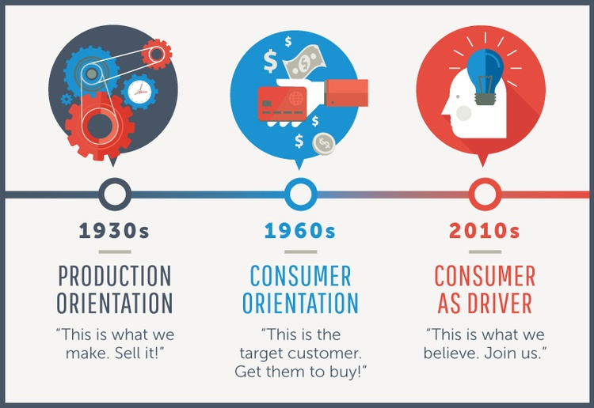
Evolution of Marketing

Slide 11
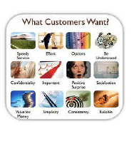
Marketing concept
Customer centred –market sensing and responding
Takes an outside-in perspective
Well-defined market, customer needs and integration of marketing activities
Creating lasting relationships based on customer value and satisfaction
Delivering better ‘value’ than your competitors

Slide 12
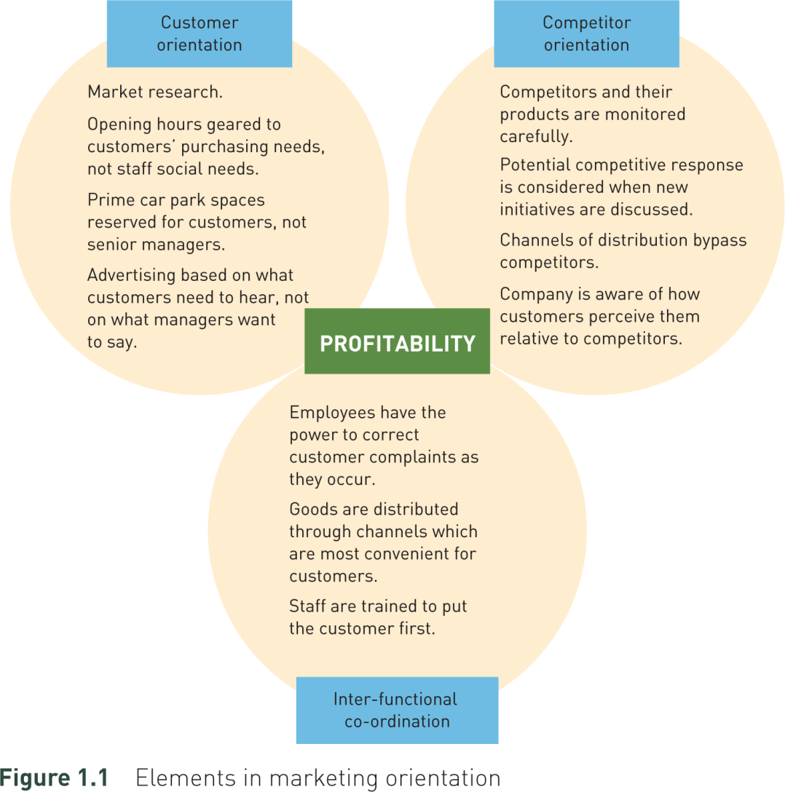
Ref: Jim Blythe Principles and Practices of Marketing 2014

Slide 13
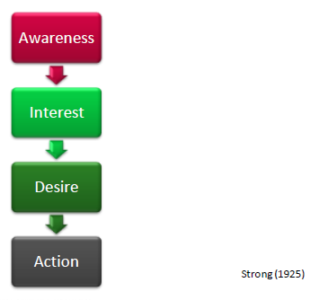
An early model: AIDA
A -: attract the attention of the customer.
I - : raise customer interest by focusing on and demonstrating advantages and benefits (instead of focusing on features, as in traditional advertising).
D -: convince customers that they want and desire the product or service and that it will satisfy their needs.
A -: lead customers towards taking action and/or purchasing.

Slide 14
The changing marketing landscape
Economic Environment
Digital Age
Rapid Globalisation
Not for profit marketing
Ethics/sustainable marketing
Increased customer knowledge
Increased customer expectations

Slide 15
Changing media landscape
Historically one channel was enough
Fragmentation of channels leads to increased channels required
Will need broad range of channels to reach same amount of people
1
1
1
2
3
2
Waste Reduction
4
Coverage of target
5
3
6
7
8
Mass Communication
Mass Customisation
No of channels used over time

Slide 16
Marketing Analysis
Current position of the organisation
Situational Analysis
Internal Analysis
External Analysis

Slide 17
Strategic Analysis
The Organisation
Micro Environment
Macro Environment

Slide 18
Internal Analysis
Competences
Assets
Resources
Strategic Capabilities
Summarises the Strengths and Weaknesses of the organisation
Strengths Inform the Company’s Strategy !

Slide 19
The Micro Environment
The Environment that is closest to the organisation
The company can have a limited impact on the in Micro Environment
Micro Environment
Competitors
Suppliers
Retailers
Customers
Distributors
Stakeholders

Slide 20
Macro Environment
The Environment that concerned with broader societal issues
The company can have no impact on the in Macro Environment
Macro Environment
Economic
Social
Environmental
Political
Technological
Legal

Slide 21
Political
Direct State Involvement
High
Defence Industry
Canal Industry
Food Industry
Hotel Industry
Political Exposure
High
Low
Low

Slide 22

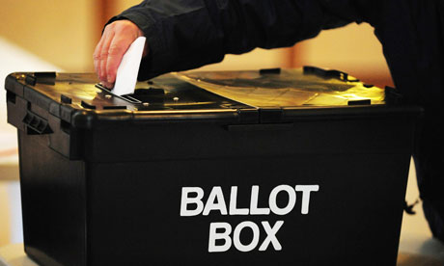
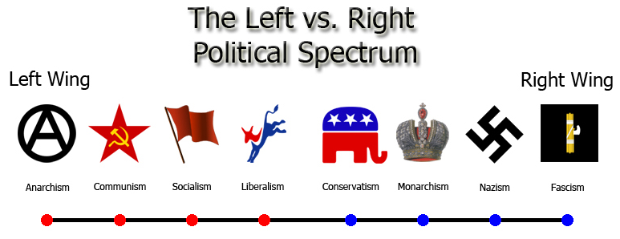
Political

Slide 23
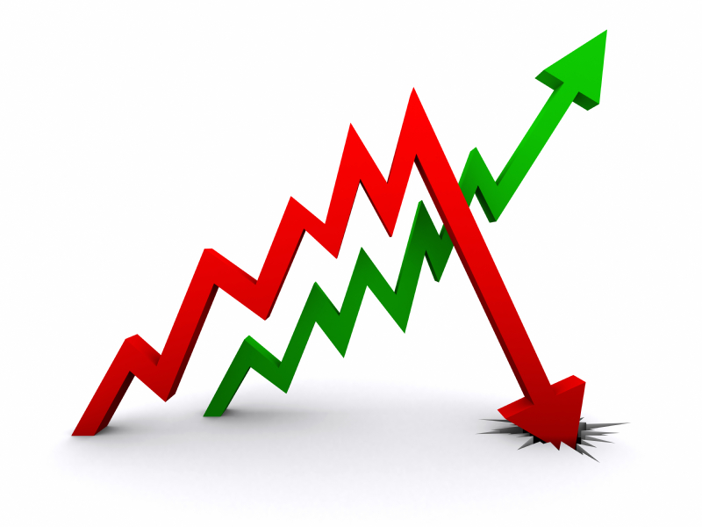
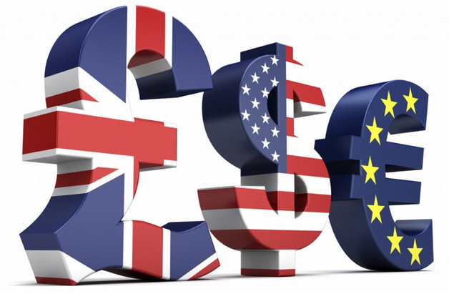

Economic

Slide 24
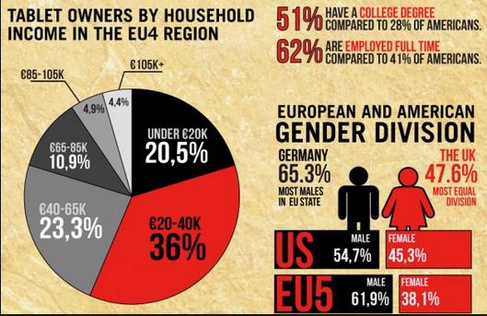
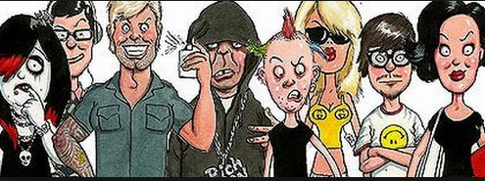
Social

Slide 25

Technological

Slide 26


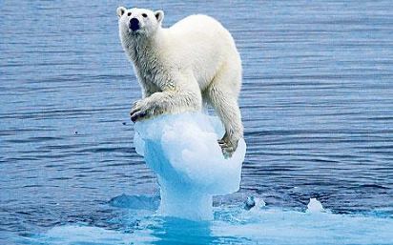
Environmental

Slide 27



Legal

Slide 28
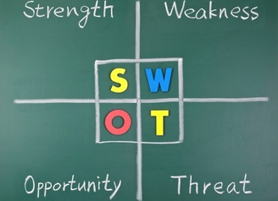

Slide 29

Market Segmentation
Market Segmentation involves dividing a market into small segments of buyers with distinct needs, characteristics, or behaviours that might require separate marketing strategies or mixes

Slide 30
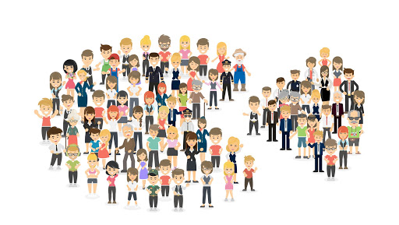
Market Segmentation
Involves the division of a diverse market into a number of smaller submarkets that have common features.
The objective is to identify groups of potential customers with similar requirements.
Market segmentation provides a commercially viable method of serving customer needs.
Segmentation is at the heart of strategic marketing

Slide 31
Major Segmentation Variables
Geo-graphic
Demographic
Psycho-graphic
Behavioural

Slide 32

Geographic Segmentation
Geographic segmentation calls for dividing the market into different geographical units such as nations, regions, states, counties, cities, or even neighbourhoods

Slide 33

Demographic Segmentation
Age
Gender
Family Size
Family Life Cycle
Income
Occupation
Education
Religion
Race
Generation
Nationality

Slide 34

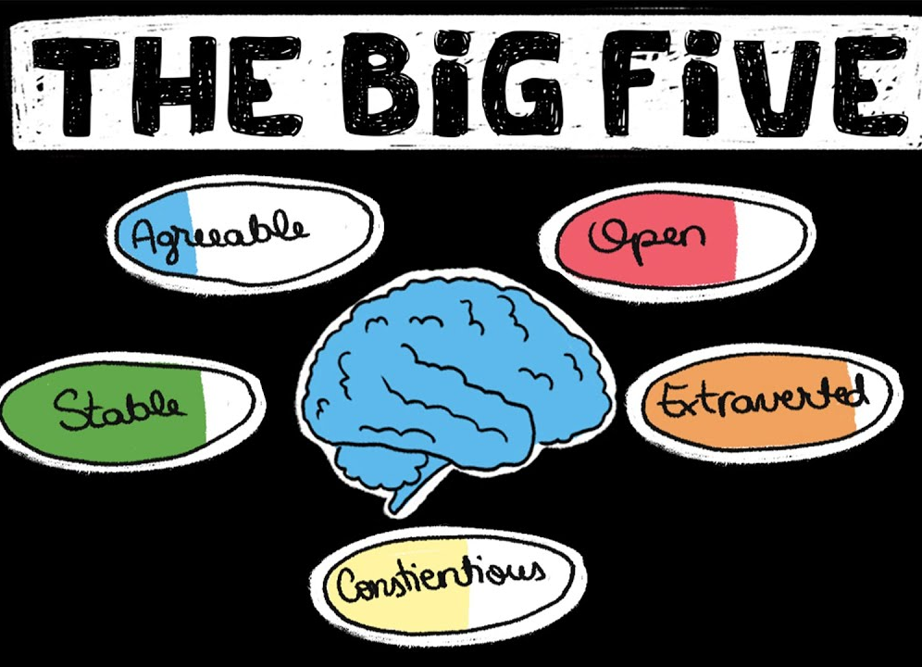
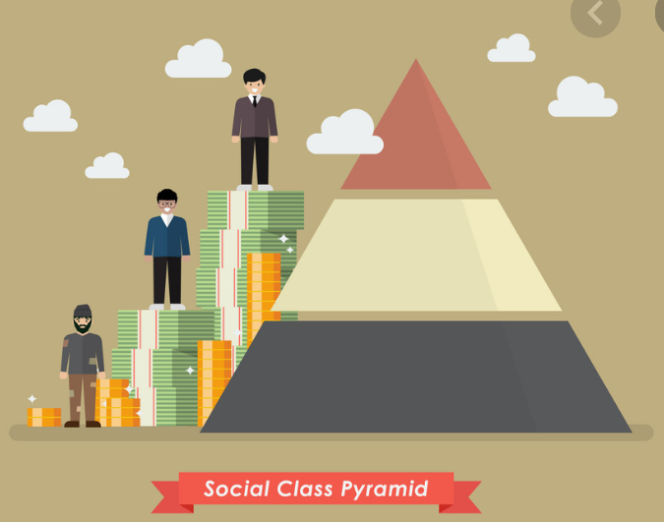
Psychographic Segmentation

Slide 35
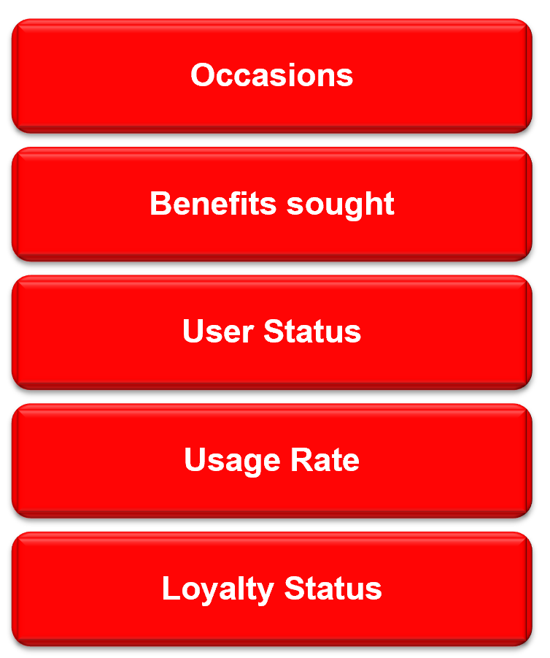
Behavioral Segmentation
Behavioral segmentation divides a market into segments based on consumer knowledge, attitudes, uses, or responses to a product.

Slide 36
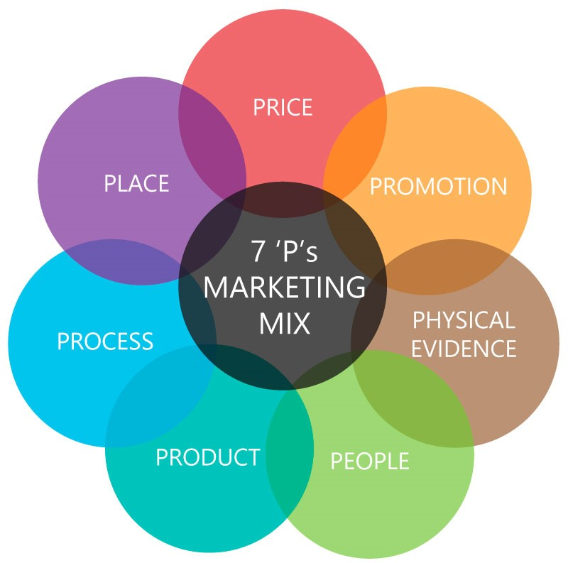
The Marketing Mix

Slide 37

Product
Product Design – Features, Quality
Product range
Branding packaging
Labeling
Complementary Services
Product Life Cycle

Slide 38

Price
Price strategy
Price tactics
Allowances – e.g. rebates for distributors
Discounts – for customers
Payment terms – credit, payment methods

Slide 39
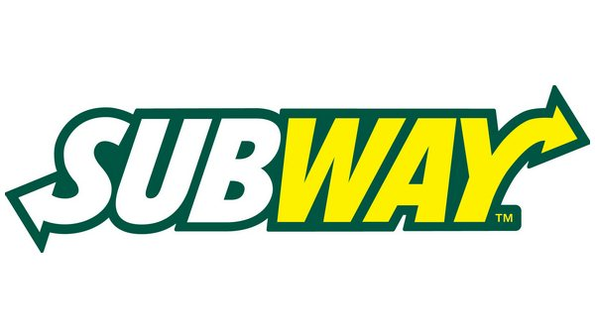
Place
Distribution Strategy
Franchising
Market coverage
Sales Channels
Location decisions
Inventory
Transport, warehousing and logistics

Slide 40

Promotion
Promotional mix - appropriate balance of advertising, PR, direct marketing and sales promotion
Message strategy - what is to be communicated
Channel/ media strategy - how to reach the target audience
Message Frequency

Slide 41

People
Staff recruitment and training
Uniforms
Scripting
Queuing systems, managing waits
Handling complaints, service failures
Managing social interactions

Slide 42

Process
Process design
Blueprinting (i.e. flowcharting)
Standardization vs customization decisions
Monitoring and tracking service performance
Analysis of resource requirements and allocation
Creation and measurement of (KPIs)
Alignment with Best Practices
Preparation of operations manuals

Slide 43

Physical Evidence
Facilities (e.g. furniture, equipment, access)
Spatial layout (e.g. functionality, efficiency)
Signage (e.g. directional signage, symbols, other signage)
Interior design (e.g. furniture, colour schemes)
Ambient conditions (e.g. noise, air, temperature)
Design of livery (e.g. stationery, brochures, menus, etc.)
Artefacts: (e.g. souvenirs, mementos, etc.)

Slide 44
What is a brand?
– A definition of brand
Key Concepts in Marketing states:
“A brand can be a name, place, person, term, symbol or design (or combination of these) which is intended to identify the product or devices of one seller or a group of sellers.”

Slide 45
Identity is for recognition
“aoccdrnig to a rschechaer at Cmabrigde Uinervtisy, it deosn’t mttaer in what oredr the ltteers in a wrod are, the olny iprmoetnt tihng is that the frist and lsat ltteer be at the rghit pclae. The rset can be a toatl mses and you can still raed it wouthit a porbelm. This is bcuseae the huamn mnid deos not raed ervey lteter by istlef, but the wrod as a wlohe.”
What this means is that shape and form are key elements for memory, now look at what marketers do in producing brand identity……

Slide 46




Branding

Slide 47

Brand Identity
To help customers to recognise brands, we use:
A logo
A specific layout/ design
The same font and colours
Try to create a memorable strapline
In essence marketers are trying to make it easy for people to recognise their brand.

Slide 48
What is a brand?
– A further definition of a brand
Key Concepts in Marketing states:
“A brand can be a name, place, person, term, symbol or design (or combination of these) which is intended to identify the product or devices of one seller or a group of sellers.”
But it also says.......
“Branding is the adoption of values, image, awareness, recognition, quality, features, benefits and name, for a product or service.”

Slide 49
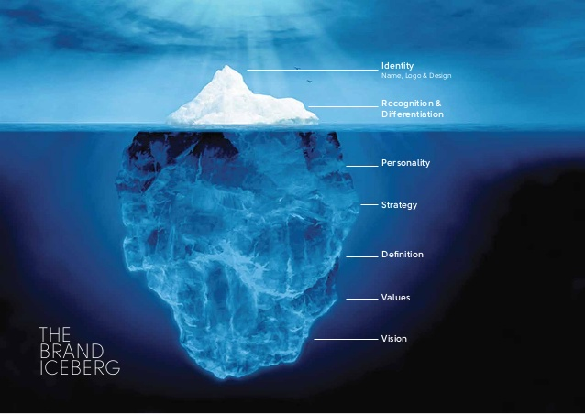
Brand Associations
A successful brand works on many levels:
Functional benefits – rational expectations
Attributes – features/benefits for choosing
Values of users – what users care about most
Emotional rewards – psychological associations
Personality – it’s human characteristics
Essence – the brand soul

Slide 50
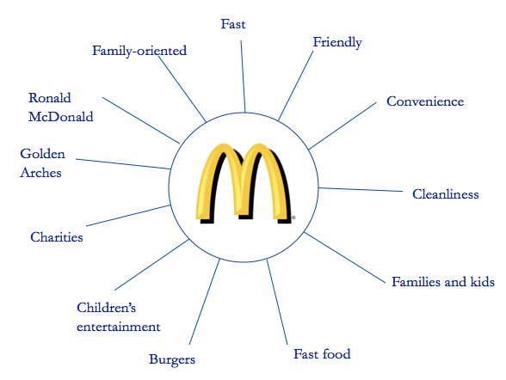
Brand Associations

Slide 51

Brand values using a name
Nike is a good example of how important a brand can be for an organisation:
How did the company start? (Who? & When?)
Who or what is NIKE?
Does calling the product NIKE have any impact on the company and how it operates?
How do the marketers want you to think about NIKE and what do they do to achieve this?
STUDENT ACTIVITY FOR NEXT WEEK: What associations do YOU make with the NIKE brand?

Slide 52


