Slide 1
Early experiences
Notes:
The foundational importance of a child's early years experiences is explored within this lecture. Both negative and positive experience shapes the child's life trajectory fundamentally. Early intervention and excellent early years professional practice can profoundly influence a child's life. We will be talking about potentially sensitive issues, regarding adverse childhood experiences.

Slide 2
Structure of the evening:
. Adverse learning experiences 5:30-6:30
. Break 6:30-6:50
. Adverse learning experiences (continued) 6:50-7:30
. Poverty – 7:30-8:30
. Assignment support – 8:30-9:00

Slide 3
Beginnings
Parental Lifestyle.
Culture.
Socioeconomic factors.
Family Structure.
What are the positive and negative factors/effects?
Notes:
Discuss each of these in groups, using flipchart. Positive and negative effects/factors. Take 20 minutes or so that these factors are fully explored. Then ask groups to feedback and discuss.

Slide 4
Adverse Childhood Experiences (ACE)
What are ACEs?
What kinds of experiences are ACEs?
Can you link ACEs to relevant theories (of human development)?
Notes:
It is important to allow a good exploration of this. Group work with flip charts. Thank back to other modules for example human development. Can the students link to theories e.g. Bowlby, Bandura etc.
Experiences of physical, sexual or emotional abuse, or growing up in a household of drug or alcohol abuse, criminality or domestic violence. Multiple ACEs, at any one time, alongside intersection. Important to remember that certain levels of stress are good for us (being uncomfortable), but the problem lies where children are regularly exposed to prolonged stress or extreme situations.

Slide 5
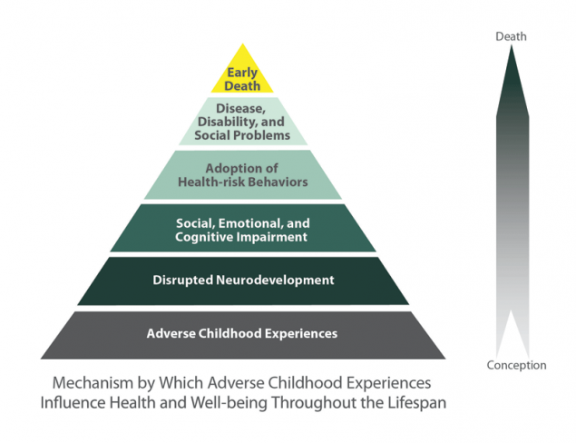
Notes:
“Everybody was a child once”
What does the pyramid tell us? – childhood experiences are formative, making interventions early

Slide 6
Aces too high

Slide 7
Adverse Childhood Experiences
  Nadine Burke Harris Ted Talk

Slide 8
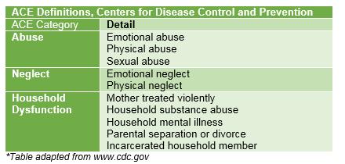

Slide 9
The role of Early Years Practitioners
How can we support and prevent ACEs?
Notes:
Discussion links to professional roles.

Slide 10
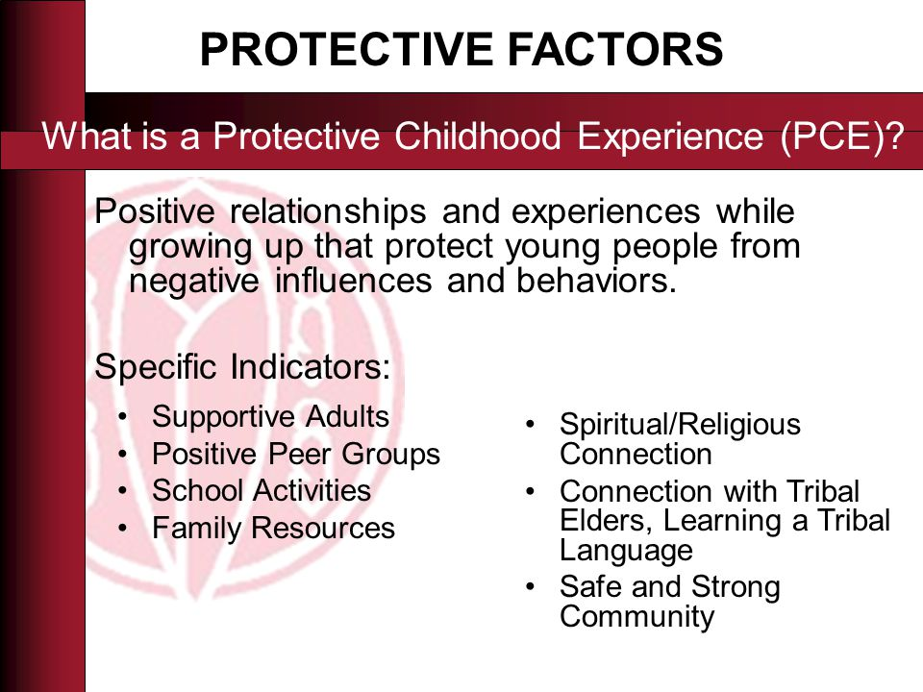
Notes:
Discuss

Slide 11
Ante Natal
Adequate maternal nutrition throughout pregnancy
Avoidance of maternal and passive smoking
Moderate maternal alcohol consumption
Maternal MMR vaccination
Social support to mothers from partners, family and external networks
Good access to ante-natal care
Interventions to prevent domestic violence

Slide 12
Pre School
High quality pre-school day care
Preparatory work with parents on home-school links
Pairing with resilient peers
Availability of alternative caregivers
Food supplements
Links with other parents, local community networks and faith groups
Community regeneration initiatives
Notes:
Discuss

Slide 13
Resilience (at a practitioner level)
What is resilience?
How can resilience be nurtured?
Notes:
Certain levels – and periods – of stress are considered to be normal and indeed good for us. They teach children to cope with uncomfortable situations and build long-term resilience. However, extreme or prolonged stress changes a child at a cellular level.
Resilience is the ability to bounce back after challenges and tough times. Resilient children can recover from setbacks and get back to living life. Resilience develops when children experience challenges and learn to deal with them positively. Strong relationships are the foundation of children's resilience
Make connections – build relationships
Help your child by having them help others – foster and model a caring approach
Maintain a daily routine – routines provide structure, normality and consistency
Take a break – allow opportunities for relaxation and contemplation
Teach your child self-care – good self care care allow children to regulate their own emotions
Move toward your goals – set goals and plan how they are going to be achieved
Nurture a positive self-view – support children to view themselves positively, praise and reward
Keep things in perspective and maintain a hopeful outlook, look for the positives and be optimisitc
Validate feelings - know that it is ok to have both negative and positive feelings and emotions
Accept change – change is inevitable, accept it and embrace it

Slide 14
Relationship to professional practice
In groups discuss the relevance of this lecture to your role as Early Years Practitioners.
Where (if at all) could this fit into your assignment?
ACEs – why are they significant? – says who? – what can we do?

Slide 15
Adverse Childhood Experiences and their impact on health-harming behaviours in the English population
National household survey of adverse childhood experiences and their relationship with resilience to health-harming behaviors in England
Service needs of young people affected by adverse childhood experiences (ACEs): A systematic review of UK qualitative evidence
What helps to support people affected by adverse childhood experiences? A review of evidence
Notes:
This is an ideal reference point for information and further study.

