Slide 1
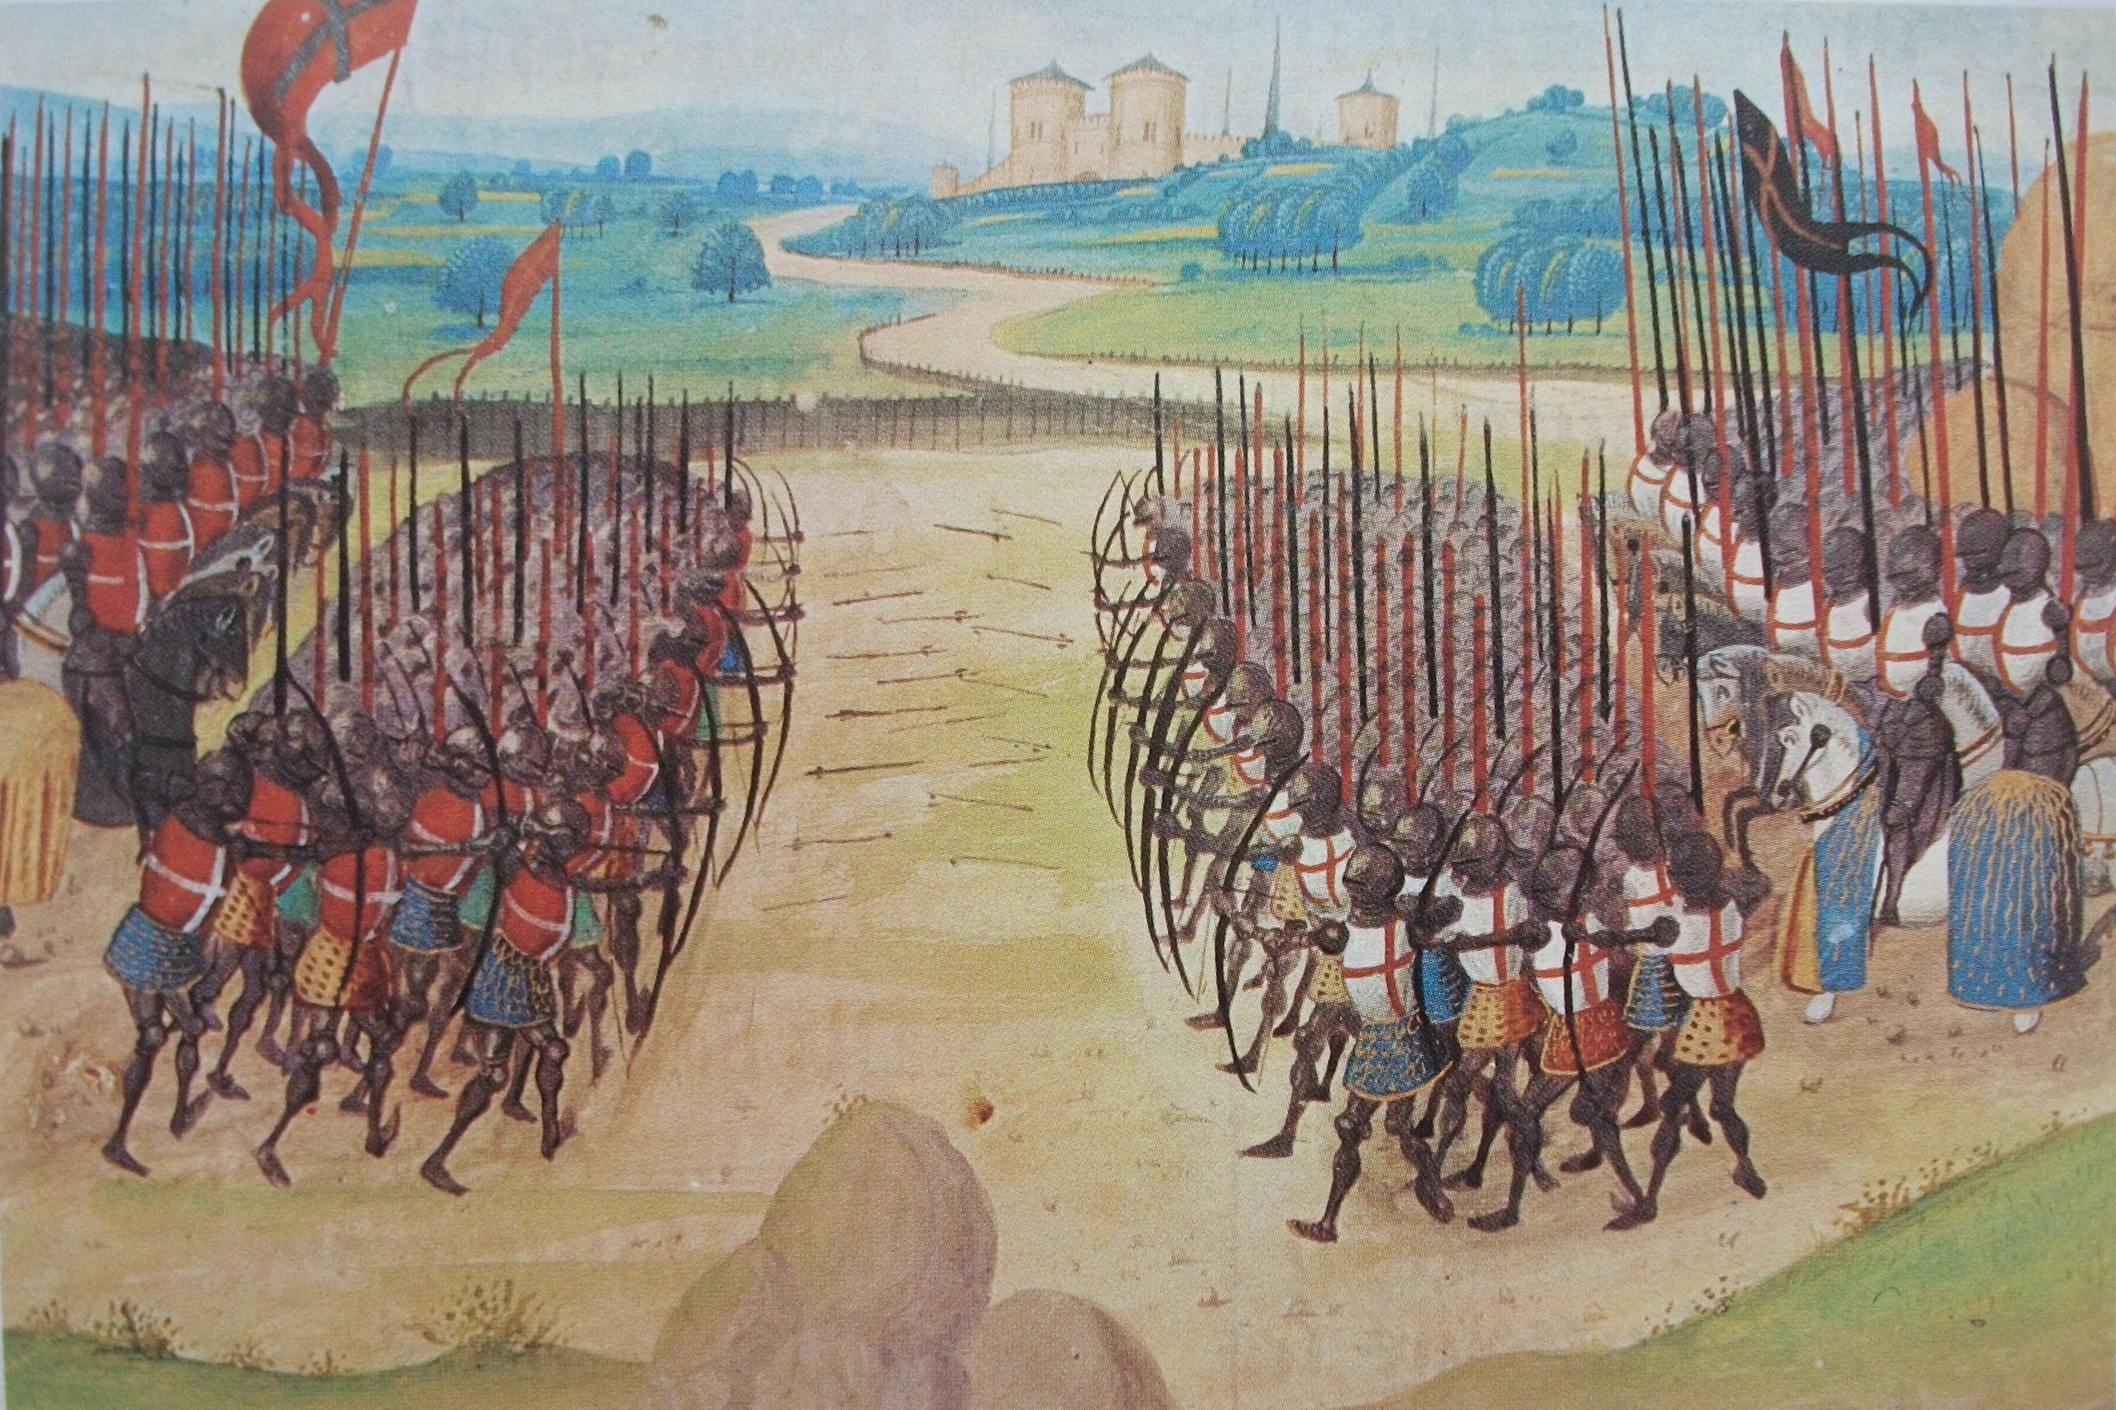
The Decisiveness of the English Longbow in the Battle of Agincourt
Jordan Hayston 1910612

Slide 2
Introduction and Context
Took place 25th October 1415
The 42nd major battle in the Hundred Years’ War 1337-1453
  A series of conflicts between the Kingdom of England and the Kingdom of France
  Followed the Siege of Harfleur (18 August – 22 September 1415)
King Henry V became king in 1413, and wanted to reassert his authority
  Broke the truce declared in 1396 by taking Harfleur, Normandy in August 1415
Mid-September 1415, the English were successful but at a heavy cost of men and resources
  King Henry V marched half of his army toward the English-held port Calais
French defences diverted them inland, where they were intercepted by the village of Agincourt

Slide 3


The Forces in Play
England
Around 6000 men led by King Henry V
  A strong and effective leader
  5000 archers
  1000 men-at-arms / foot soldiers
Many suffering from dysentery following the Siege of Harfleur and the 200-mile march to Agincourt
Deployed a defensive formation, taking advantage of the narrow battlefield
France
Estimated 20,000 – 30,000 men led by constable Charles d’Albret and marshal Jean II le Meingre (Boucicaut)
  A mixture of heavily armoured knights, men-at-arms and archers
Substantial fleet of heavily armoured cavalry

Slide 4
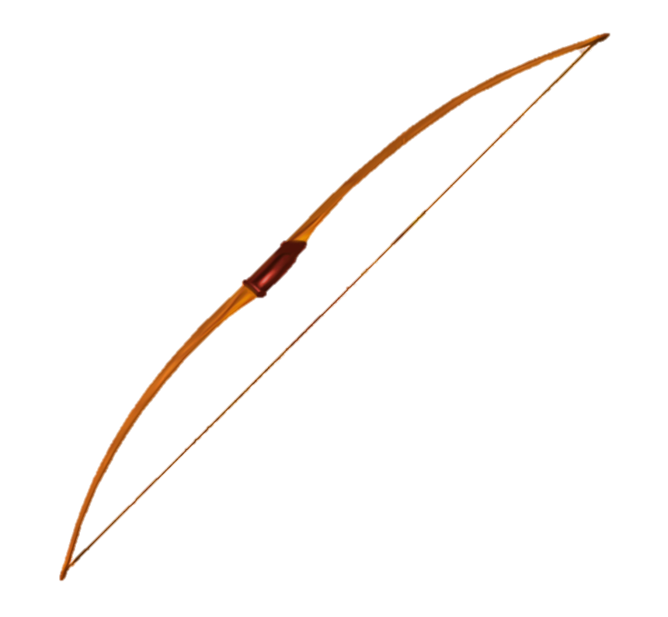
The English Longbow
Crafted with yew wood
  Strong and flexible
Average 6ft in length
Draw weight ranging 80-180lbs
Notable range, firing accurately up to 250m
Required extensive training to master
  English archers renowned for their level of skill
Fire rate of up to 10-12 arrows per minute
Provided a tactical advantage over enemies

Slide 5
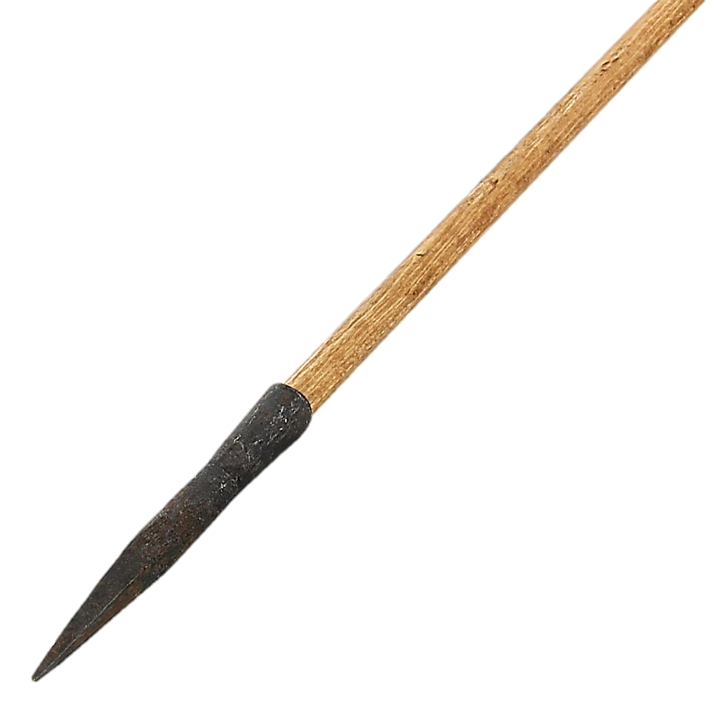
Needle Bodkin Tip
Made using wrought iron or steel
Designed for armour penetration
  Narrow and pointed
  Differs to broadhead
Typically good at punching through gaps in armour and finding weak points
Estimated to travel around 53m/s from the English longbow

Slide 6
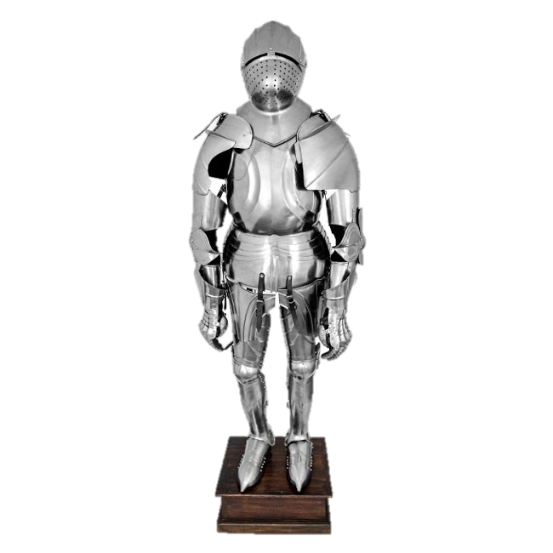
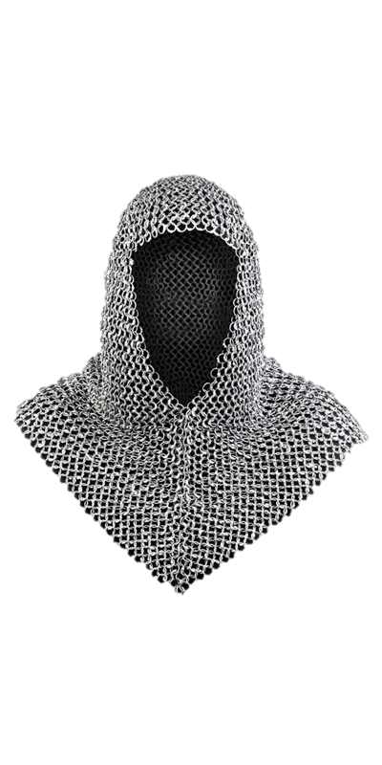
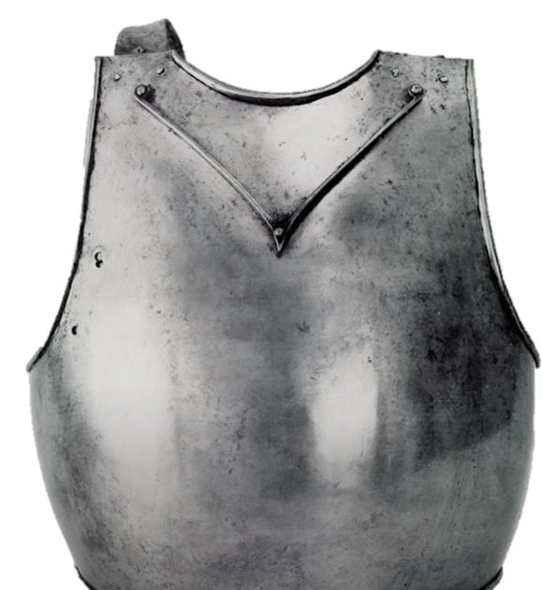
Armour
Plate
  Full plate
  Partial plate
  Wrought iron (0.05% carbon) or hardened steel (0.64% carbon)
  V-shaped guards on chest plate
  Horses also plate armoured
Chainmail
  Hauberk
  Coif

Slide 7
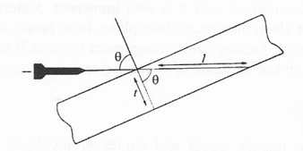


Armour Penetration
Where l = path length through armour
t = armour thickness
θ = angle of attack
Armour thickness was between 2.5-4mm
Angle of obliquity of impact was 30°
$$l=\frac{t}{\cos{θ}}$$
$$l=2.9mm to 4.6mm$$

Slide 8

Armour Penetration
Impact Velocity, $V=V1+V2$
Arrow Velocity = 53.34m/s
Knight on Horseback Velocity = 8.95m/s
Foot Soldier Velocity = 0.9m/s
Impact Velocity with Knight on Horseback = 62.29m/s
Impact Velocity with Foot Soldier = 54.24m/s

Slide 9

Armour Penetration
KE on Knight on Horseback
mass, m = 0.116Kg
velocity, v = 62.29m/s
Kinetic Energy of Arrow, KE = 225J
Kinetic Energy, KE $=\frac{1}{2}mv^{2}$
KE on Foot Soldier
mass, m = 0.116Kg
velocity, v = 54.24m/s
Kinetic Energy of Arrow, KE = 170J

Slide 10
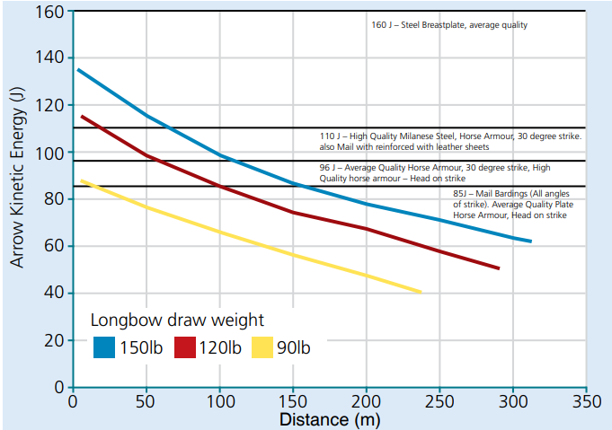
Armour Penetration
KE on Knight on Horseback = 225J
KE on Foot Soldier = 171J
As the arrow travels, the velocity decreases and therefore so does the kinetic energy it carries.

Slide 11
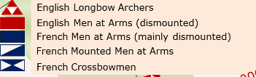
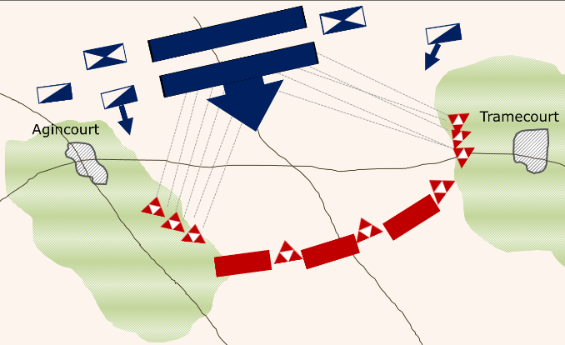
Other Reasons for Defeat
Weather and Terrain
Battle tactics
  The English pushed their front line forward into a defensive formation with archers positioned on the flanks protected by wooden stakes.
  The French retaliated to the rain of arrows, sending their cavalry through the middle of the battlefield, toward the well-prepared English army.
Heavy vs Light Armour
Fortifications – wooden stakes

Slide 12
Questions?

