Slide 1
Student Name: Gabriela Florentina Niculae
Student ID: 2525169
Lecturer’s Name: Annamarie Dufficy
Module Code:
LCLM 4004
Module Name:
Problem Solving and Decision-Making
Component 1:
Basil’s Bakery

Slide 2
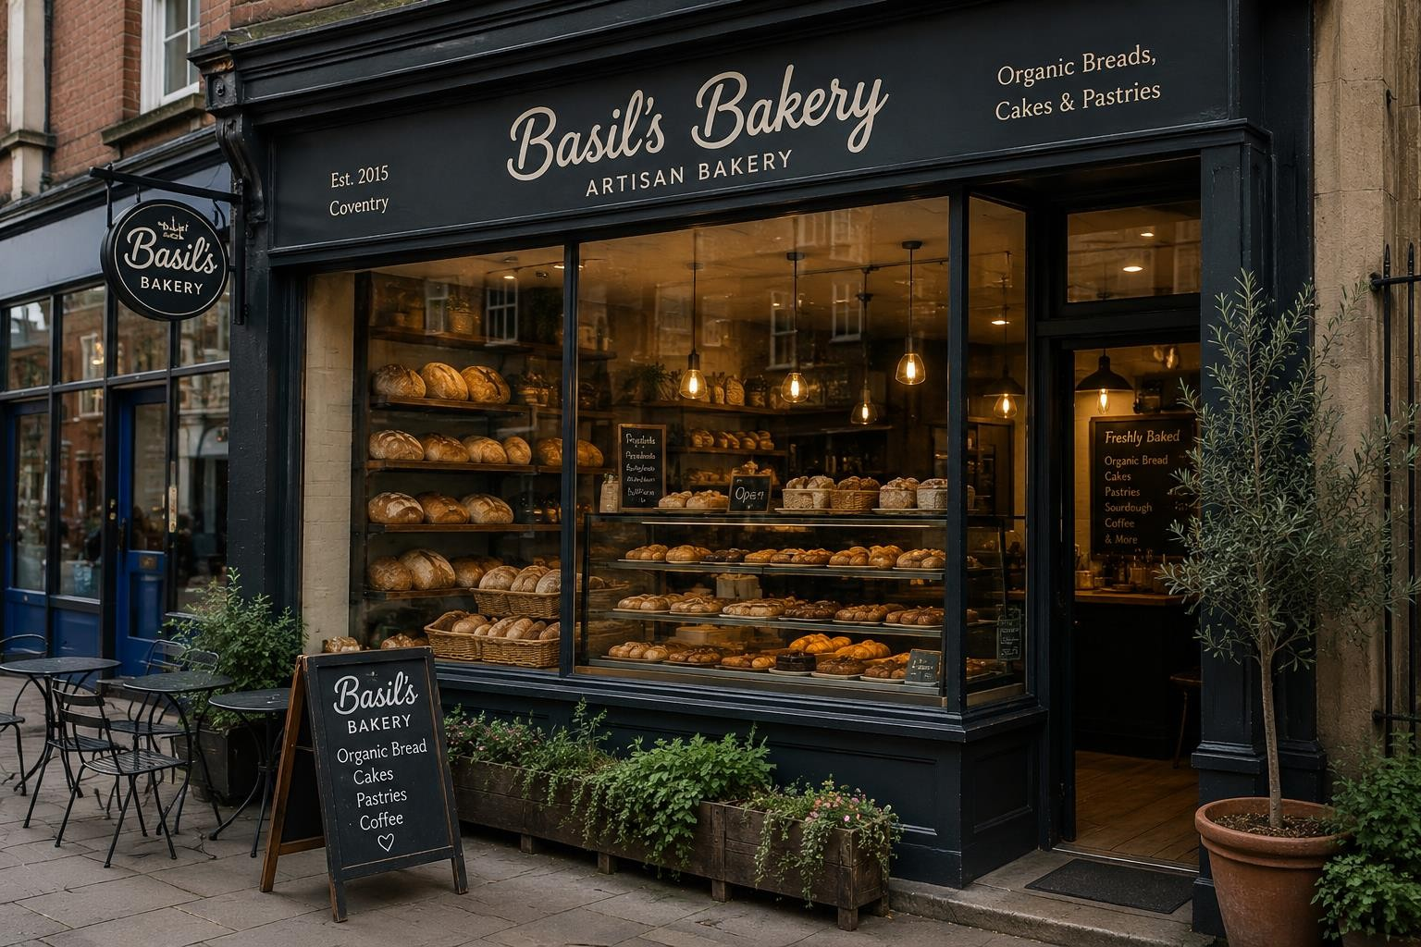
Introduction & Presentation Structure
"Basil's Bakery is a small independent artisan bakery located in Coventry, UK. Established in 2015, the business is known for its high-quality organic bread, cakes, and pastries. Before the COVID-19 pandemic, the bakery experienced steady growth and built a loyal customer base. However, changing customer habits, lower visitor numbers, and rising business costs have created significant challenges for the business."
Context
Independent bakery in Coventry.
Opened in 2015.
Strong growth until COVID-19.
Sales remain around 25% below 2019
levels.
This presentation will:
Examine factors affecting sales.
Apply PESTEL analysis.
Apply Fishbone analysis.
Present key findings.

Slide 3
Issues Affecting Sales
Nature and Scope of the Problem
External issues
Lower retail park footfall.
Store closures.
Remote working.
Cost of living pressures
Internal issues
No delivery service.
Limited pre-order system.
Rising operating costs.
Dependence on Basil himself.
Sales Performance Trend
120
100
80
60
40
20
0
2019 2020 2023-2025
Source: Author's illustration based on the Basil's Bakery case study.

Slide 4
Controllable and Uncontrollable Factors
The challenges facing Basil's Bakery can be divided into factors that the business can control and factors that are outside its control.
Controllable Factors
Uncontrollable Factors
Limited pre-order system
No delivery service
No online ordering system
Dependence on Basil
Remote working trends
Reduced retail park footfall
Shop closures
Inflation and rising living costs

Slide 5
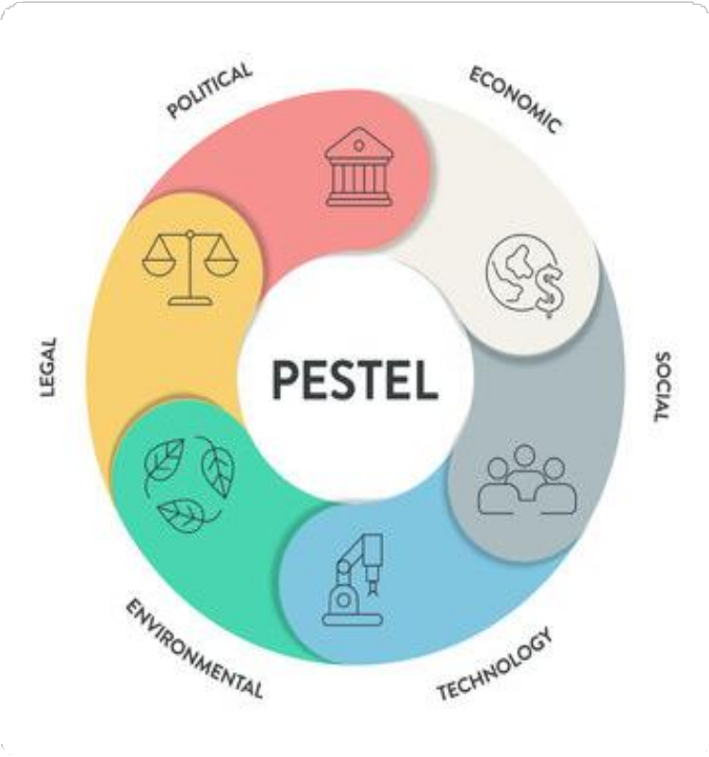
PESTEL Analysis
PESTEL Analysis is a business tool used to identify external factors that can affect a company. PESTEL stands for Political, Economic, Social, Technological, Environmental, and Legal factors. It helps businesses understand the opportunities and challenges in the external environment.
Why is it used?
  Helps businesses understand the external environment.
  Supports strategic decision-making.
Benefits
    Identifies external influences.
    Helps recognise opportunities and threats.
    Supports business planning.
Limitations
  Does not prioritise factors by importance.
  External factors can change quickly.
  Results may be subjective.
(Johnson et al., 2017)

Slide 6

PESTEL Analysis
This PESTEL analysis has been applied to Basil's Bakery to identify the external factors affecting the business and its sales performance.
Legal Factors
Food safety laws must be followed. Employment laws increase operating costs. Health and safety regulations require compliance.
Political Factors | Economic Factors | Social Factors | Technological Factors | Environmental Factors
Higher business rates. Food and hygiene regulations increase costs. Government policies affect small businesses. | Inflation increases ingredient prices. Higher rent and utility bills. Customers may spend less due to the cost of living. | More people work from home. Fewer shoppers visit the retail park. Customers want delivery and pre- order services. | No online ordering system. No delivery service. Limited ability to take phone orders during busy periods. | Organic ingredients are affected by crop failures. Supply shortages increase costs. Bad weather can affect food production.

Slide 7
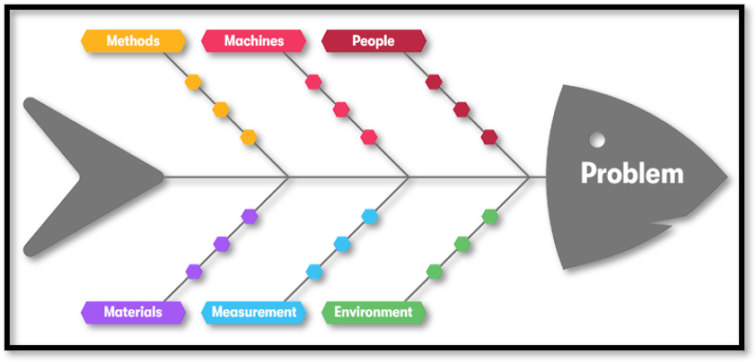
Cause-and-Effect diagram
A Fishbone Diagram is a tool used to identify and organise the possible causes of a specific problem. It is also known as the Ishikawa Diagram.
(Sproull, 2018, page 22)
Why do we use a Fishbone Diagram?
Encourages brainstorming and teamwork.
Helps identify root causes of problems.
Shows relationships between different causes.
Provides a clear visual overview.
How is a Fishbone Diagram constructed?
Identify the problem.
Create the main cause categories.
Add specific causes under each category.
Analyse how the causes contribute to the problem.
(Sproull, 2018, page 22 - 25)
It is also known as a Fishbone diagram.

Slide 8
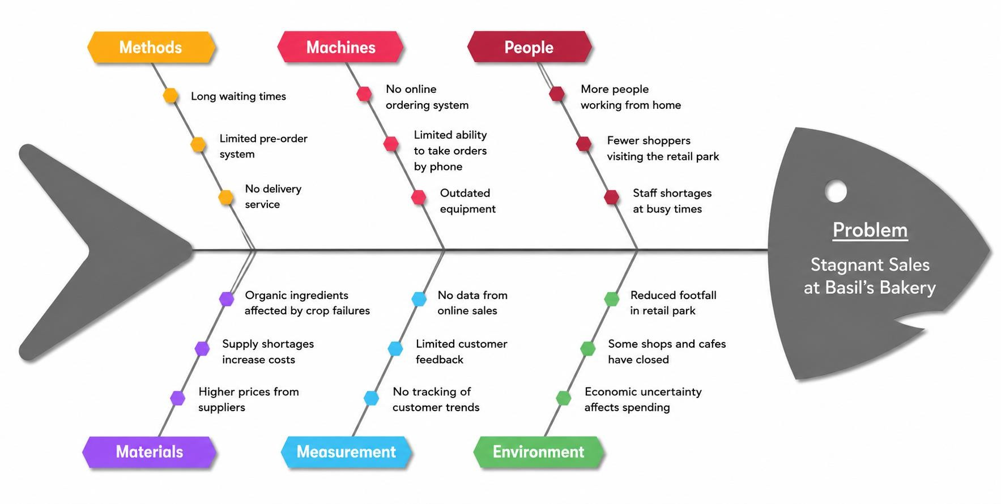
The Fishbone Diagram has been applied to Basil's Bakery to identify and analyse
the root causes of its stagnant sales performance.
Super series Solving Problems and Making Decisions (2013, page 31)

Slide 9
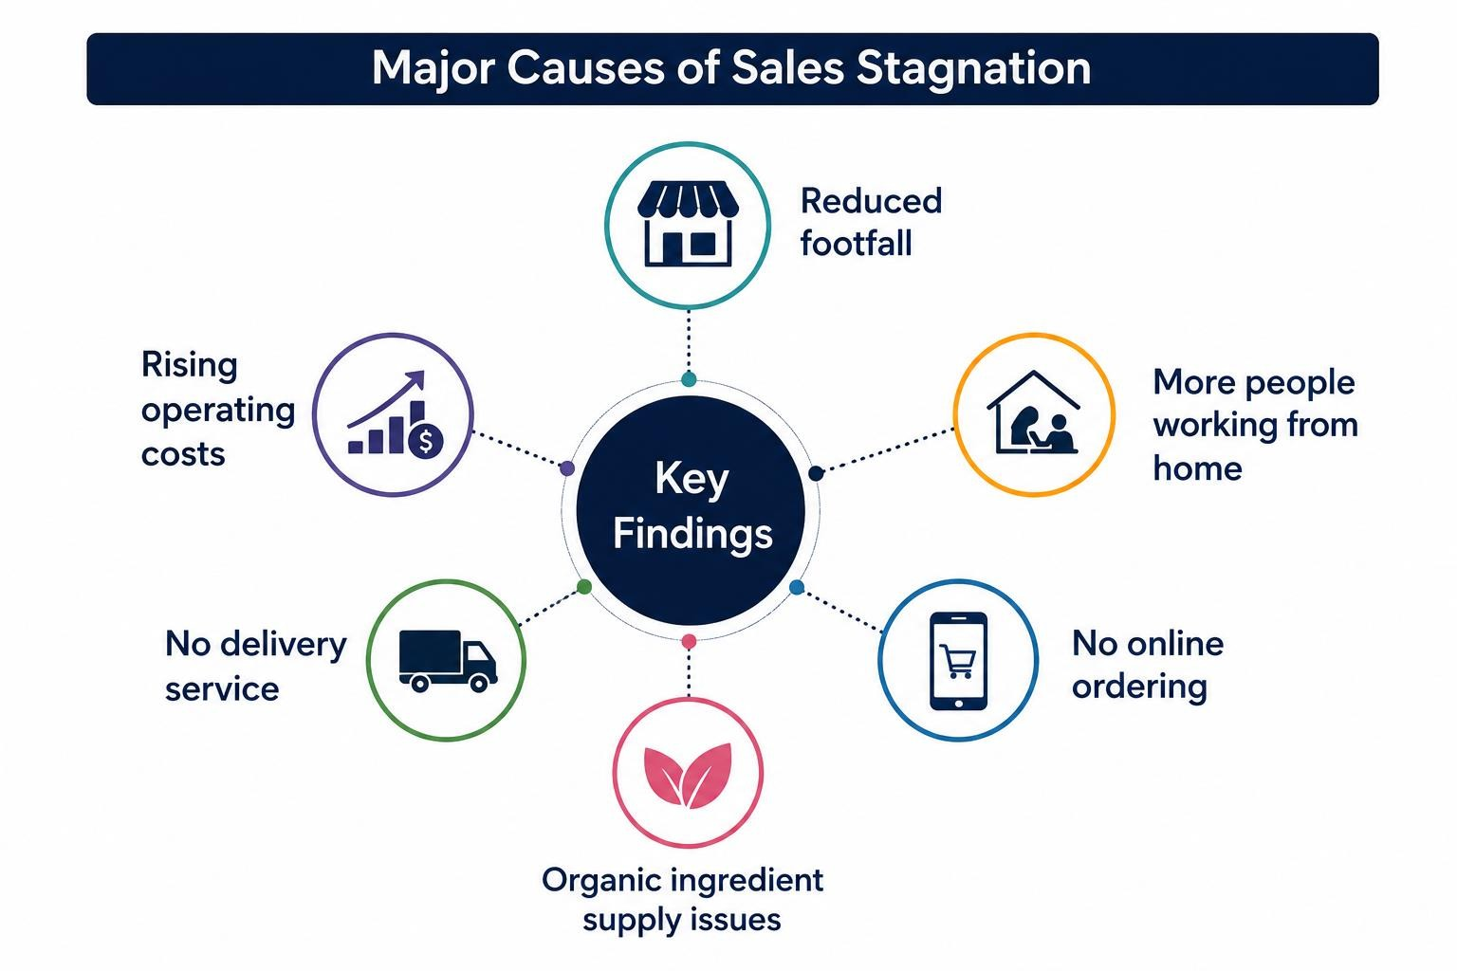
The analysis identified five key factors responsible for Basil's Bakery's stagnant sales performance
Major Causes of Sales Stagnation

Slide 10
Reference List:
CIPD(2024)PESTLE analysis. Available at:
https://www.cipd.org/uk/knowledge/factsheets/pestle-analysis-factsheet/ (Accessed: 14 June 2026).
Sproull, N.L. (2018)Handbook of Research Methods: A Guide for Practitioners and Students in the
Social Sciences. 2nd edn. Lanham: Scarecrow Press.
Basil's Bakery Case Study (2026). Assessment case study provided as part of the module materials.
Johnson, G., Scholes, K. and Whittington, R. (2017) Exploring Strategy. 11th edn. Harlow: Pearson.
Kotler, P. and Keller, K. (2016) Marketing Management. 15th edn. Harlow: Pearson.

Slide 11
Thank you for your attention!
I'm happy to answer your questions!

