Slide 1
Jewish Worship and Spirituality
Synagogues, Prayers and Festivals

Slide 2
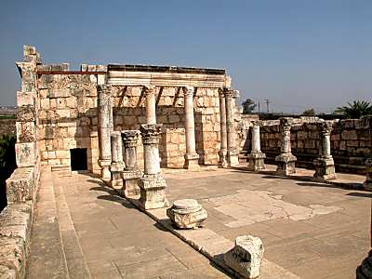
The Jewish Synagogue
Babylonian Jews (6th century BCE): institution of synagogues for public worship, study and prayer.
Synagôgê = Greek: ‘assembly’.
Co-existence of Temple and synagogue worship in Second Temple Judaism

Slide 3
History of the Synagogue
Around 400 synagogues in Jerusalem at the time when the Temple was destroyed.
Evidence of synagogues in Egypt (3rd century BCE).
Rome (cf. Philo in 1st century CE).
Synagogues become the focal point of Jewish life.
Need for a quorum. (minyan) of ten men for synagogue worship.
It could be led by a lay person.

Slide 4
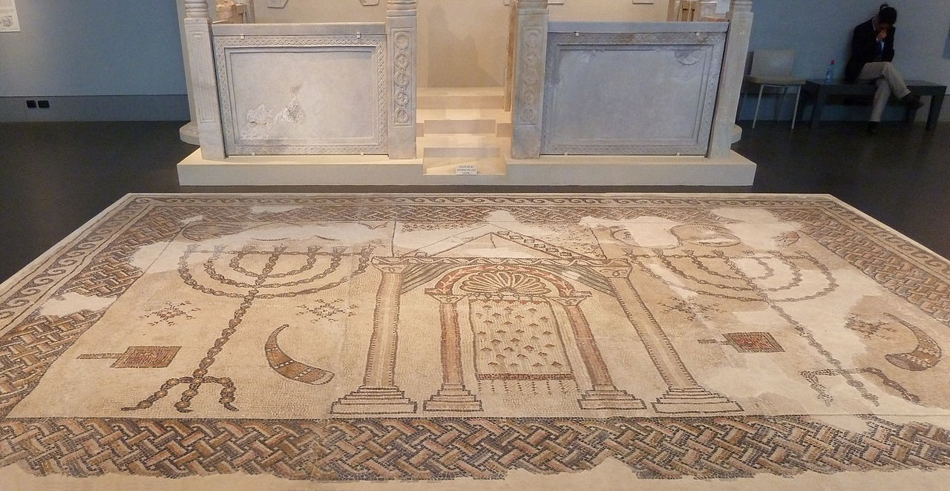
History of the Synagogue
100 synagogues in Galilee (3rd – 8th century CE).
Basilica with hall divided by two rows of pillars (with two aisles).
No separate area for women.
Plain interiors, but gradual introduction of intricate mosaic floors.

Slide 5
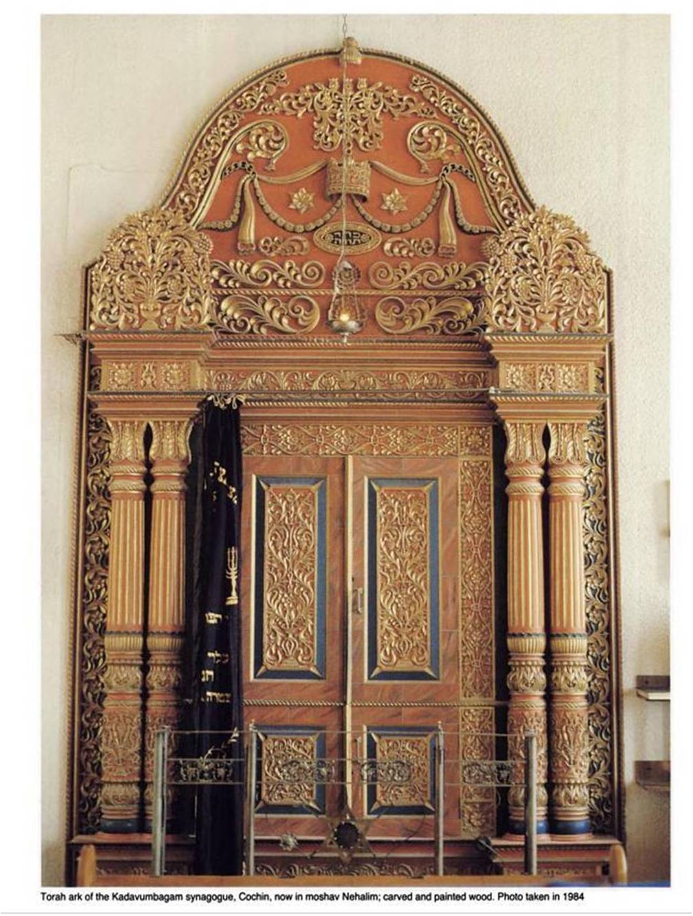
Tabernacle and Temple in the Synagogue
Holy Ark (Holy of Holies), on the wall facing Jerusalem.
Eternal light above the Ark (light of the sanctuary)

Slide 6
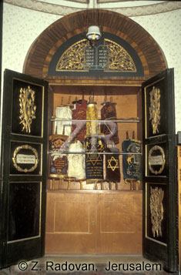
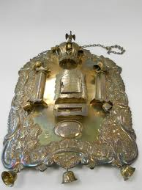
Tabernacle and Temple in the Synagogue
Torah (placed in the Ark)
Breastplate covers the Torah and various silver ornaments (priestly ornaments)

Slide 7
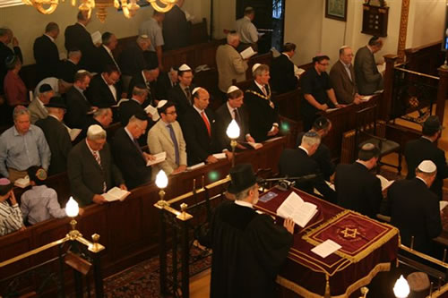
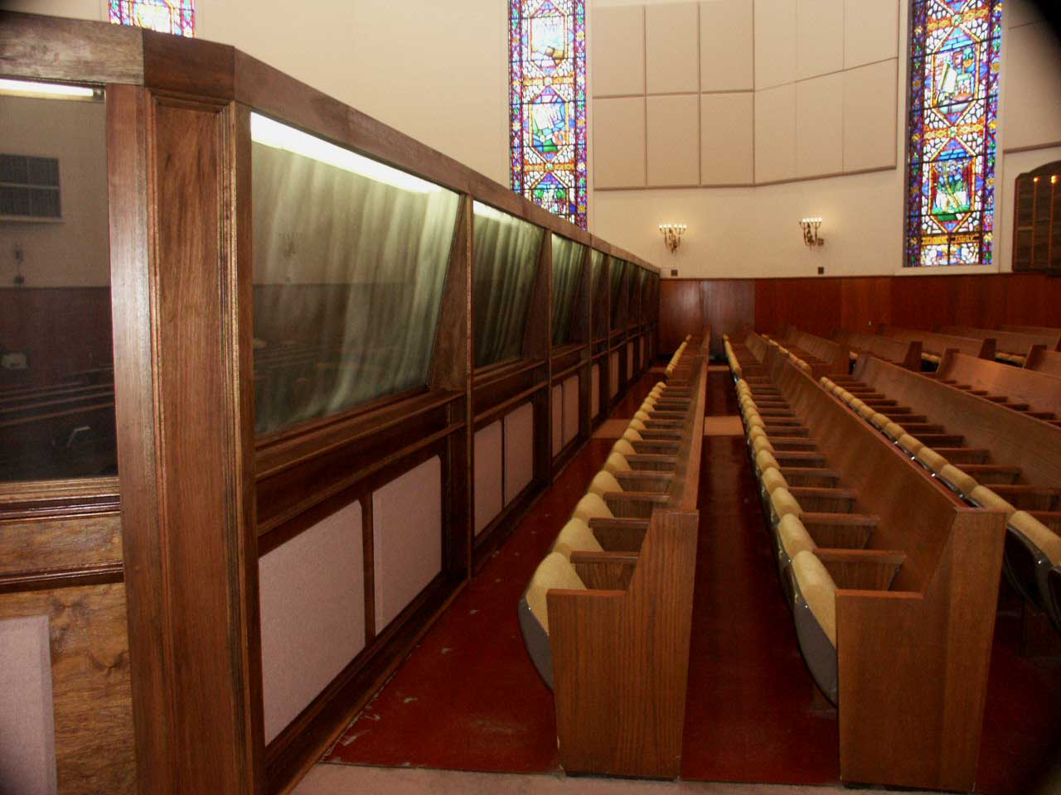
Temple and Tabernacle in the Synagogue
Platform for reading the Torah and the Prophets
Separation between men and women
Balcony
Division
Holiness of the synagogue

Slide 8
Jewish Prayer
Pattern of formal prayers recited at fixed times.
Individual and collective prayers.
Tefillah (prayer) comes from the verb falal (‘think/judge’) – self-reflection.
Numerous prayers in the Hebrew Bible, particularly in the Psalms (praise, petition, thanksgiving).
No reference in ancient times to:
- liturgy
- standard texts
- fixed times

Slide 9
Development of Jewish Prayers
Dead Sea Scrolls: many prayers.
Jamnia: main foundations of Jewish prayers (fixed times and order for prayers).
Prayers as replacement for sacrifices (‘service of the heart’).
Talmud: details on worship, but no full text of liturgy.
Set of guidelines on prayer but exact wording left to the worshipper.
Middle Ages: words and regulations set out in prayer books.

Slide 10
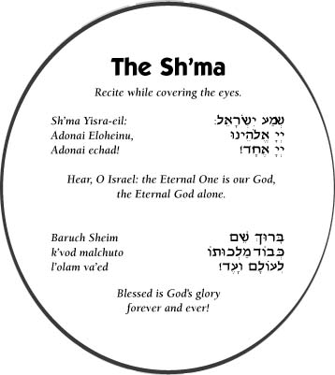
The Shema
Shema is recited every morning and evening.
First word from the opening scriptural passage: ‘Hear, O Israel, the Lord is our God, the Lord is one’ (Deut. 6:4-9).
Other Torah sections:
- Deut. 11:13-21 (acceptance of the yoke of the commandments).
- Numbers 15:37-41 (commandment to place fringes or tassels on the corners of garments).
Shema is expression of the duty to study Torah.

Slide 11
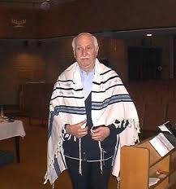
Symbols of Jewish Piety
Tallit: prayer shawl worn by orthodox Jewish men at some services. It is a shawl made of wool with fringes (tzitzit) at each of its four corners (cf. Numbers 15:37-41).

Slide 12
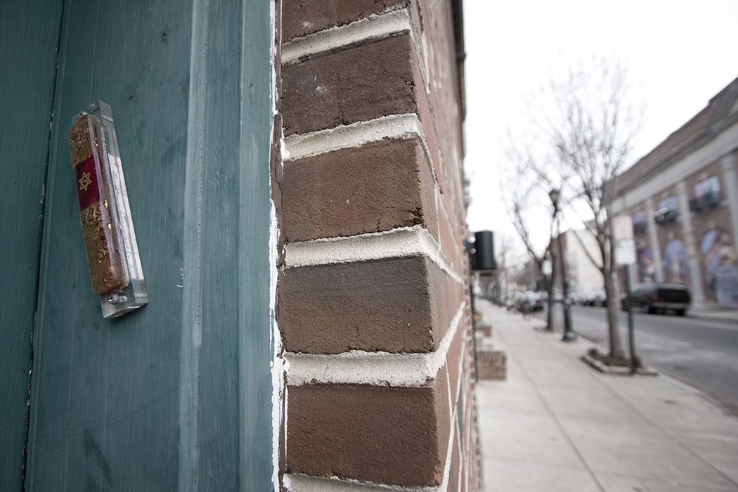
Symbols of Jewish Piety
‘And you shall write them [God’s words] on the doorposts of your house and upon your gates’ (Deuteronomy 6).
Mezuzah: Parchment containing 1st two paragraphs of the Shema are placed in a container and affixed to the right hand of the door frame at least two-thirds of the way up.

Slide 13
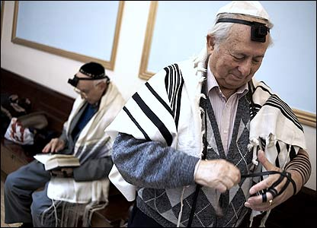
Symbol of Jewish Piety
Tefillin: Two leather prayer boxes with straps; they contain the 4 biblical passages which include the instruction: ‘you shall bind them as a sign upon your hand, and they shall be as frontlets between your eyes’ (Deut. 6:8). At the weekday morning service men bind one around the left arm (opposite the heart) and other on the forehead.
They are worn during morning prayer (apart from Sabbath and festivals).

Slide 14
Jewish Prayer: Tefillah
Recited every morning, afternoon and evening (on the pattern of offering sacrifices in the Temple).
Also known as the Shemoneh Esreh (Eighteen Benedictions).
Reached their present form in the 2nd century CE; composed by a rabbi called Samuel the Small.
Three blessings
Requests for divine assistance
Three prayers of thanksgiving
Additional benediction dealing with heretics.
First and last three blessings are recited at every service.
Others are only recited on weekdays.
It is recited while standing (Amidah).

