Slide 1

Presents

Slide 2


CARK-E
KEY TO THE FUTURE

Slide 3
Dan Algie – Database Designer / Marketing
Ryan Morgan – Web Designer / Printing Engineer
Nathan Morgan – Engineer / Programmer
Martin Dunn – Programmer / Marketing
Anthony Smith – Database Designer / Printing Engineer
RESOURCES
https://www.flaticon.com/

Slide 4
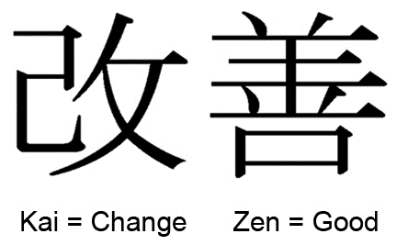

Business: further production
Kaizen business methodology stems from the Japanese word kaizen, this means change for better and ultimately will shape our further production to improve our design, our production efficiency and increase our profits by reducing overheads.
1801338 Nathan Morgan

Slide 5
Business: Mission statement & Objectives
We aim to increase the safety of every road user
Reduce the amount of drunk drivers on the road
Reduce the amount of people operating vehicles without authorisation
Reduce car theft
An intuitive product that is easy to use
Nathan Morgan 1801338

Slide 6
Business (references and research)
https://electronics.howstuffworks.com/gadgets/qaautomotive/wearable-blood-alcohol-sensor-replace-breathalyzer.htm
https://www.scramsystems.com/images/uploads/general/research/the-determination-of-blood-alcohol-concentration-by-transdermal-measurement.pdf
https://electronics.howstuffworks.com/gadgets/other-gadgets/wearable-tech-analyze-sweat-data.htm
https://gadgetsandwearables.com/2019/06/03/wearable-breathalyzer/
https://pubs.acs.org/doi/abs/10.1021/acssensors.6b00356?journalCode=ascefj
https://books.google.co.uk/books?id=SNkDAAAAMBAJ&pg=PA118&lpg=PA118&dq=chrysler+1949+ignition&source=bl&ots=AMEvo2dVrL&sig=TT42Ak65ZtXZttgzFhP1xsG2sYU&hl=en&ei=4FZwTLjpL8H7lweHyqT-DQ&sa=X&oi=book_result&ct=result&redir_esc=y#v=onepage&q=chrysler%201949%20ignition&f=false
https://www.leanproduction.com/kaizen.html
https://en.wikipedia.org/wiki/Kaizen
Nathan Morgan

Slide 7
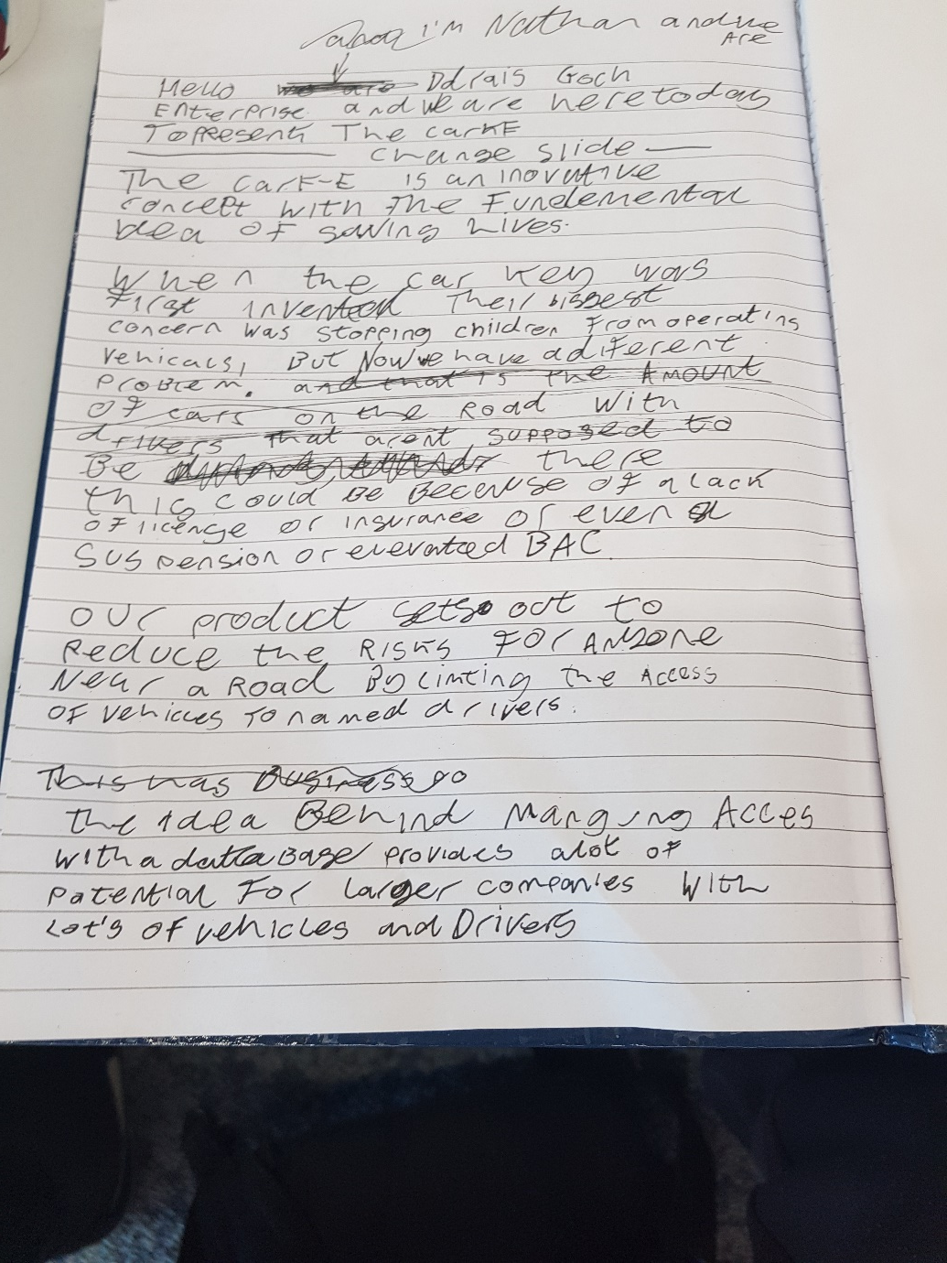

Slide 8
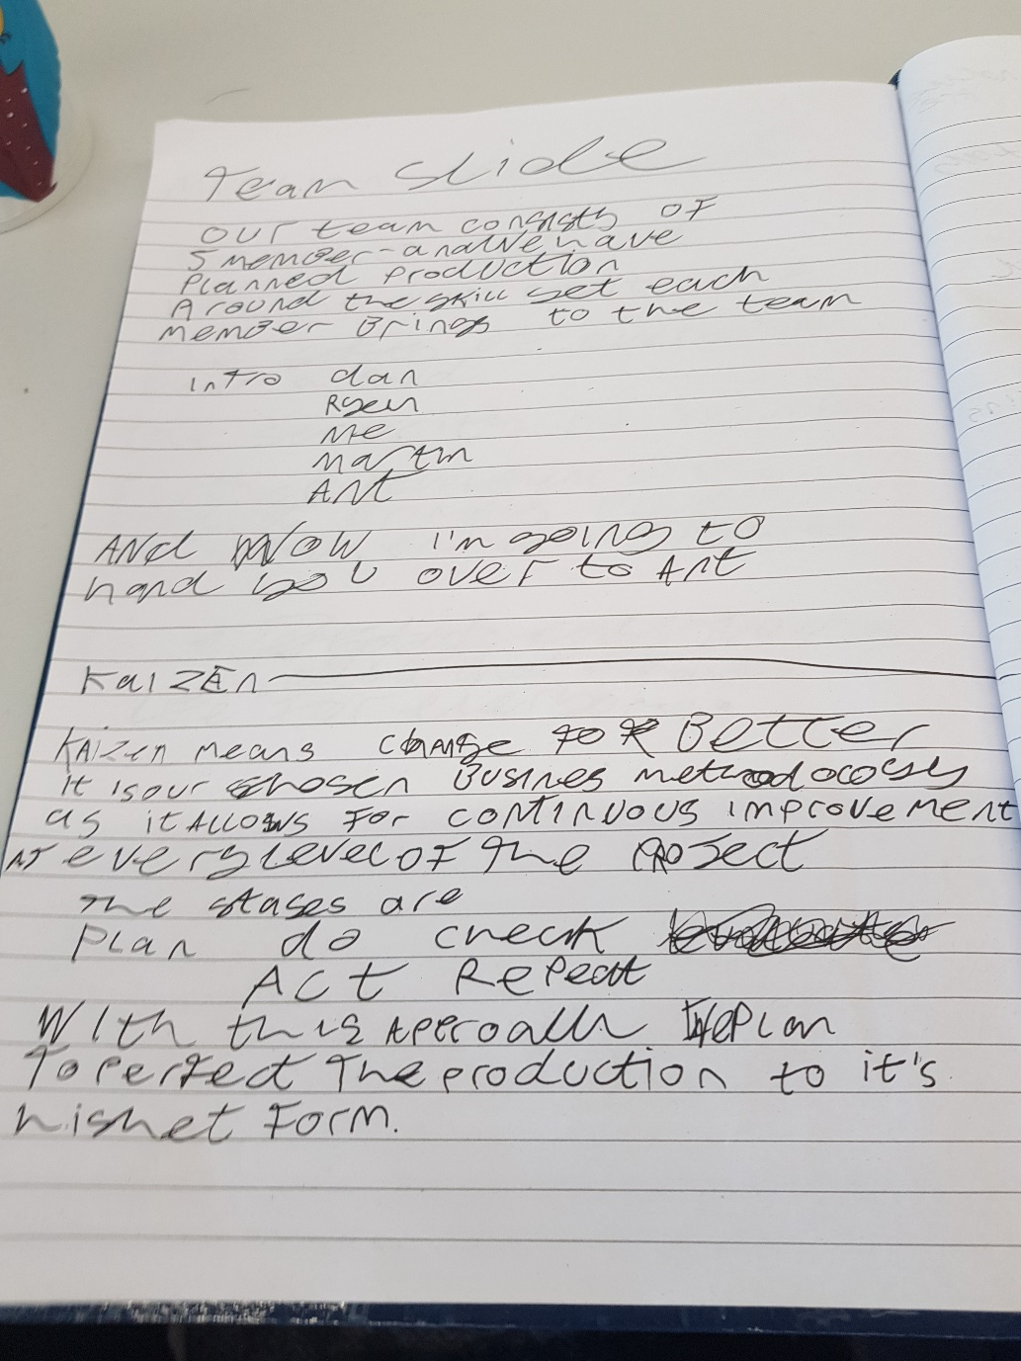

Slide 9


