Slide 1


Expressive Arts
Y Celfyddydau Mynegiannol
Music
Cerddoriaeth
BA1
Sharon Stace-Smith
sharon.stace-smith@uwtsd.ac.uk
StaceS@hwbcymru.net

Slide 2

Contents
Cynnwys
What are the Expressive Arts?
Why do we need to teach them?
How do we teach them?
Ideas
Music
Next steps…
Beth sydd y Celfyddydau Mynegiannol?
Pam rydyn ni’n ei ddysgu?
Sut rydyn ni’n dysgu eu?
Syniadau
Cerddoriaeth
Cam nesaf…

Slide 3

What do you think of when you hear the words Expressive Arts?
Beth dych chi’n ei gwybod pan dych chi’n clywed y geiriau ‘Celfyddydau Mynegiannol’?

Slide 4
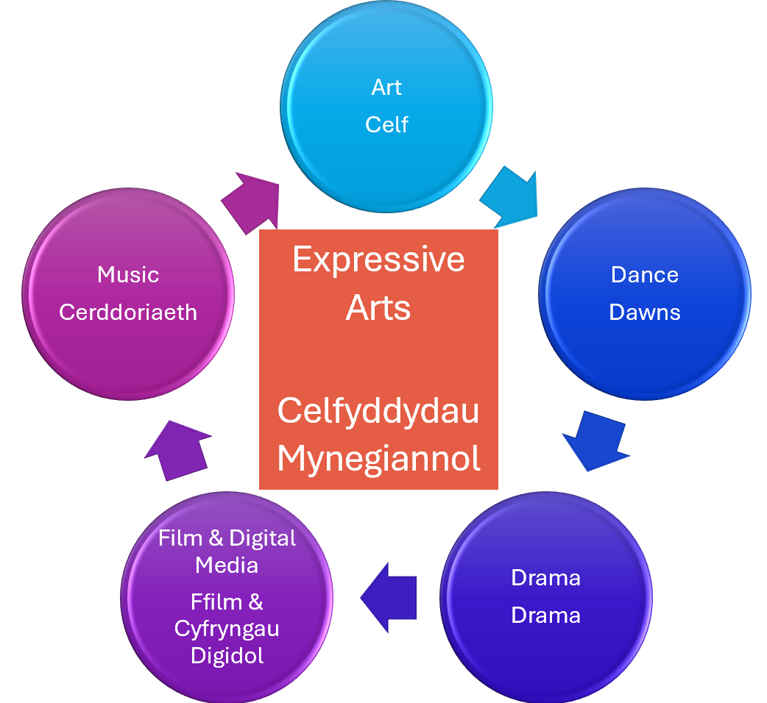
What are the Expressive Arts?
Beth sydd y Celfyddydau Mynegiannol?
Expressive Arts: Introduction - Hwb (gov.wales)
Y Celfyddydau Mynegiannol: Cyflwyniad - Hwb (gov.wales)
‘The Expressive Arts Area of Learning and Experience (Area) spans five disciplines: art, dance, drama, film and digital media and music. Although each discipline has its own discrete body of knowledge and body of skills, it is recognised that together they share the creative process.’

Slide 5
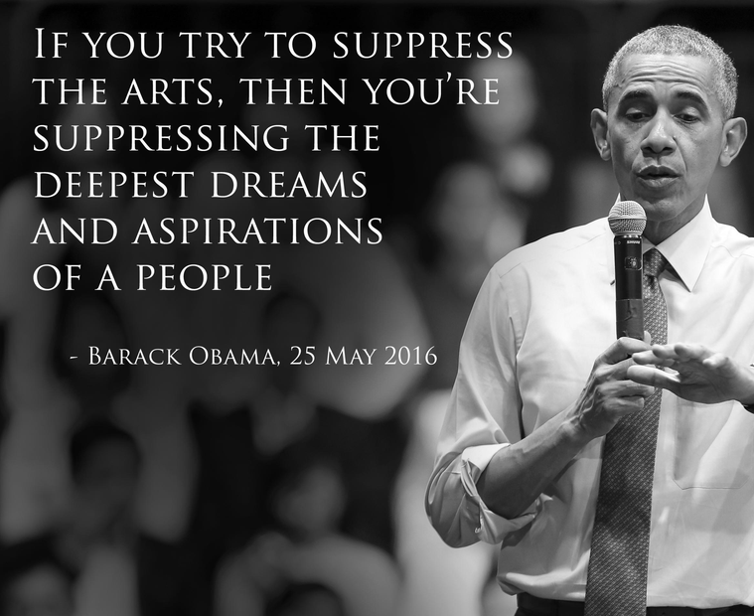
Why bother? Pam?
‘The dynamic nature of the expressive arts can engage, motivate and encourage learners to develop their creative, artistic and performance skills to the full.’
    Expressive Arts: Introduction - Hwb (gov.wales)
Social and mental health – the Covid factor
What price creativity?
Inclusivity
Truly cross-curricular
Good PR
Express yourself – whoever, wherever, whenever, however
In answer to the question, ‘Do you like Expressive Arts and why?
  “Yeah. Team building and camaraderie – forms relationships, friends. It’s fun, enjoyable and it’s not like a typical way of learning because you don’t feel like you’re learning because you’re wandering around having fun – like.”
    IP, Yr 6

Slide 6
Pam ffwdanu?
‘Gall natur ddeinamig y celfyddydau mynegiannol ysgogi ac ennyn diddordeb dysgwyr a’u cymell i ddatblygu i’r eithaf eu sgiliau creadigol ac artistig ynghyd â’u sgiliau perfformio..’
    Y Celfyddydau Mynegiannol: Cyflwyniad - Hwb (gov.wales)
Iechyd cymdeithasol ac iechyd meddwl – ffactor Covid
Pa bris a roddir ar greadigrwydd?
Cynwysoldeb
Gwirioneddol draws-gwricwlaidd
Cysylltiadau cyhoeddus (PR) da
Mynegwch eich hun – pwy bynnag, ble bynnag, pryd bynnag, sut bynnag
Mewn ymateb i’r cwestiwn, ‘Ydych chi’n hoffi’r Celfyddydau Mynegiannol a pham?’
  “Ydw. Mae’n meithrin tîm a chyfeillgarwch – ffurfio perthnasoedd a gwneud ffrindiau. Mae’n hwyl, yn ddifyr, ac mae’n ffordd wahanol o ddysgu oherwydd dydych chi ddim yn teimlo fel eich bod chi’n dysgu am eich bod yn crwydro o gwmpas yn cael hwyl.”
    IP, Blwyddyn 6

Slide 7
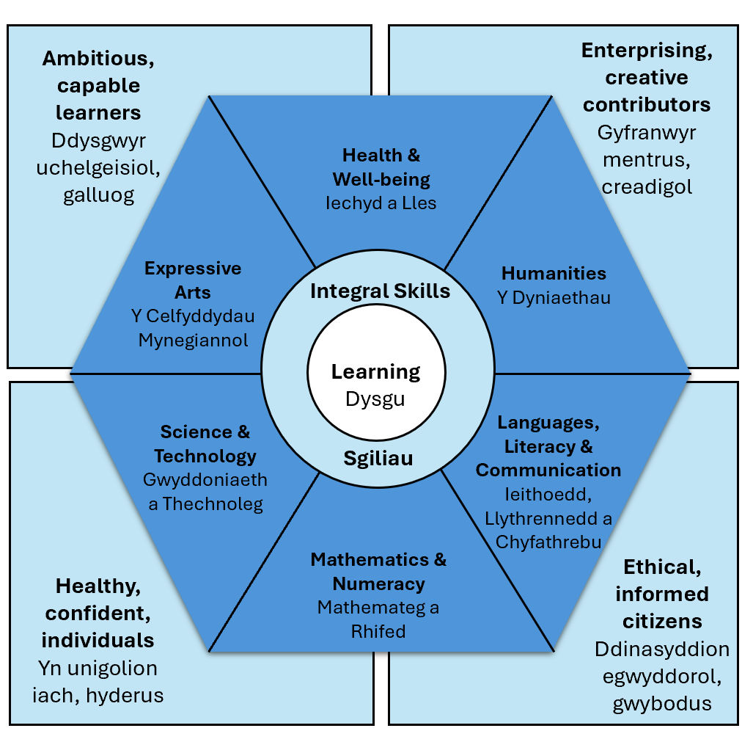
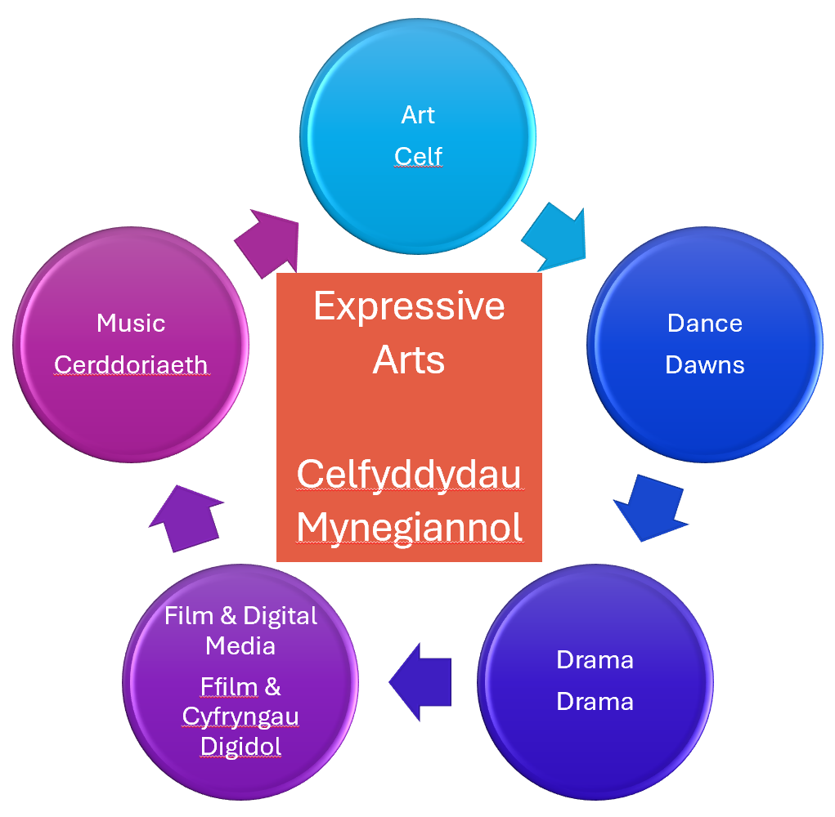
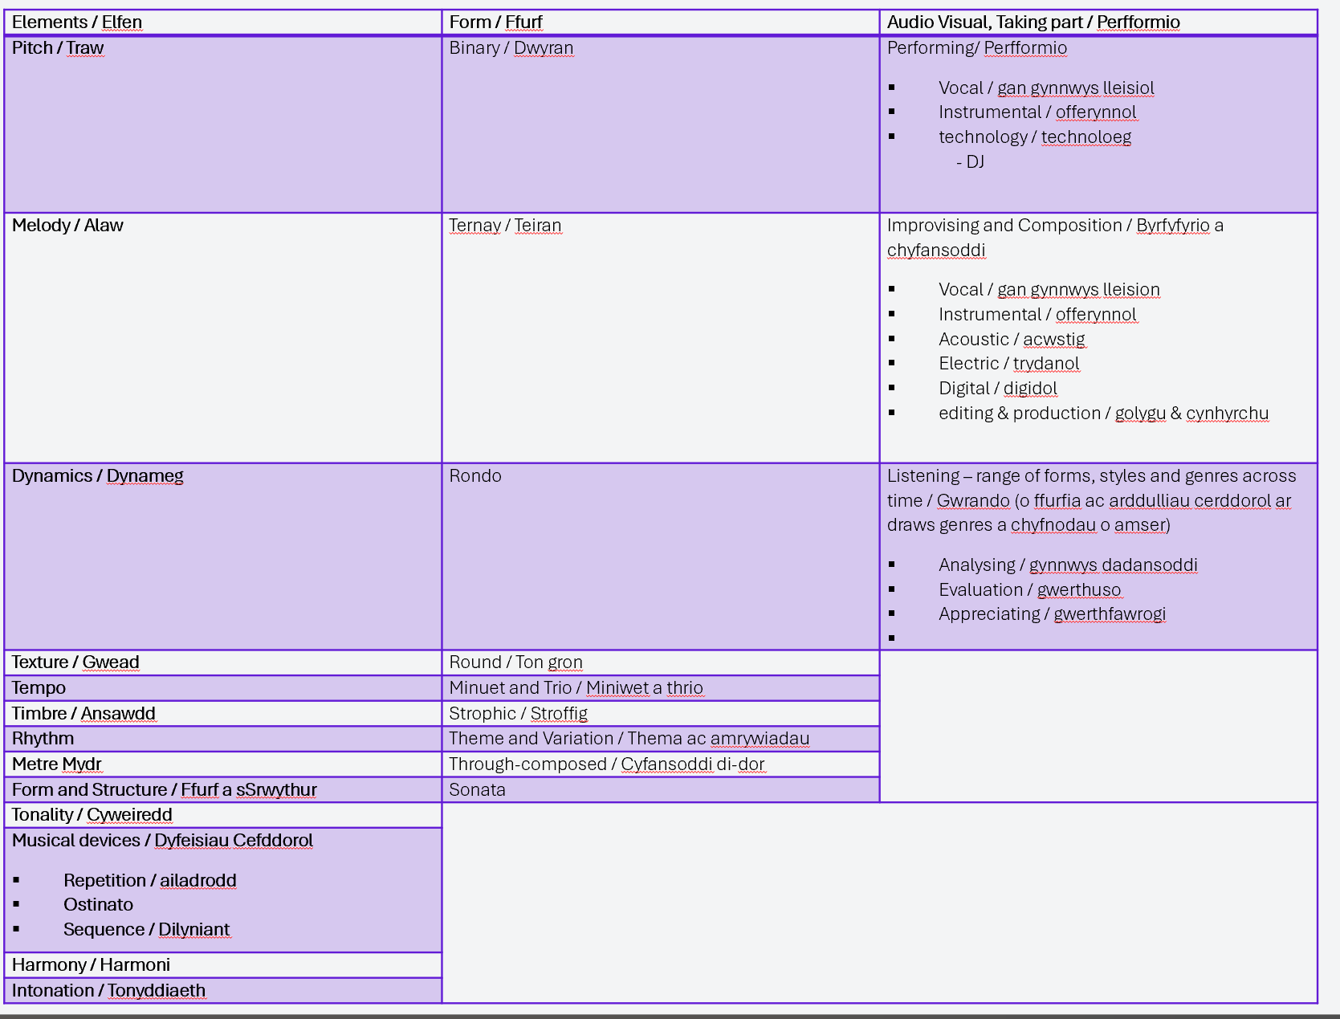
How do we teach the Music in the Expressive Arts?
Sut rydyn ni’n ddysgu Cerddoriaeth yn y Celfyddydau Mynegiannol?
Cross Curricular
Trawsgwricwlaidd
Cross AoLE
Traws MDaP
Discipline Specific
Ystyriaethau sy’n benodol i ddisgyblaethau

Slide 8
An Integrated Approach to Learning and Teaching…
Trawsgwricwlaidd
Curriculum for Wales – Hwb
Cwricwlwm i Gymru - Hwb
4 Purposes
Developing a vision for curriculum design - Hwb
AoLEs
Curriculum for Wales – Hwb
Cwricwlwm i Gymru - Hwb
Integral Skills
Developing a vision for curriculum design – Hwb
Datblygu gweledigaeth ar gyfer cynllunio cwricwlwm – Hwb
LNF / RVE / RSE
Cross-cutting themes for designing your curriculum - Hwb
Themau trawsgwricwlaidd ar gyfer cynllunio eich cwricwlwm - Hwb
Learning
Statements of What Matters / Progression Steps
Enterprising, creative contributors
Gyfranwyr mentrus, creadigol
Skills integral to the Four Purposes:
Sgiliau sy’n hanfodol i’r pedwar diben:
Creativity and innovation / Creadigrwydd ac arloesi
Thinking and problem solving / Meddwl yn feirniadol a datrys problemau
Personal effectiveness / Effeithiolrwydd personol
Planning and organisation / Cynllunio a threfnu
Ambitious, capable learners
Ddysgwyr uchelgeisiol, galluog
Health & Well-being
Iechyd a Lles
Expressive Arts
Y Celfyddydau Mynegiannol
Humanities
Y Dyniaethau
Integral Skills
Learning
Dysgu
Mandatory cross-curricular skills:
Sgiliau trawsgwricwlaidd:
Literacy / Llythrennedd
Numeracy / Rhifedd
Digital Competence / Cymhwysedd Digidol
Science & Technology Gwyddoniaeth a Thechnoleg
Languages, Literacy & Communication
Ieithoedd, Llythrennedd a Chyfathrebu
Sgiliau
Mathematics & Numeracy
Mathemateg a Rhifed
Ethical, informed citizens
Ddinasyddion egwyddorol, gwybodus
Healthy, confident, individuals
Yn unigolion iach, hyderus
What Matters Statements
Datganiadau o’r hyn sy’n bwysig
Principles of Progression
Egwyddorion cynnydd

Slide 9
Cross AoLE Ideas
Syniadau Traws MDaP
?
Street dance
Street Dance Masterclass - BBC Teach
Dance
Music genres
Music form
Clothes and styling
Culture and society
?
?
Drama
Create / act the scene to match the music
Mr. Bean - Playing the Invisible Drums (1991) (youtube.com
?
?
Art / Celf
Drama / Drama
Film & Digital Ffilm & Cyfyngau Digidol
Dance / Dawns
Music / Cerddoriaeth
?
Film Music
John Williams, Hans Zimmer, Video game music– research and appreciation / evaluation
How to compose a soundtrack - BBC Bitesize - composing
?
?
Story & Narrative
Peter & the Wolf / Sorcerer’s Apprentice
Write / storyboard the story to the music.
?
Art
Pictures at an Exhibition / Night on a Bare Mountain – draw / paint / sculpt the scene inspired by the music.
?

Slide 10
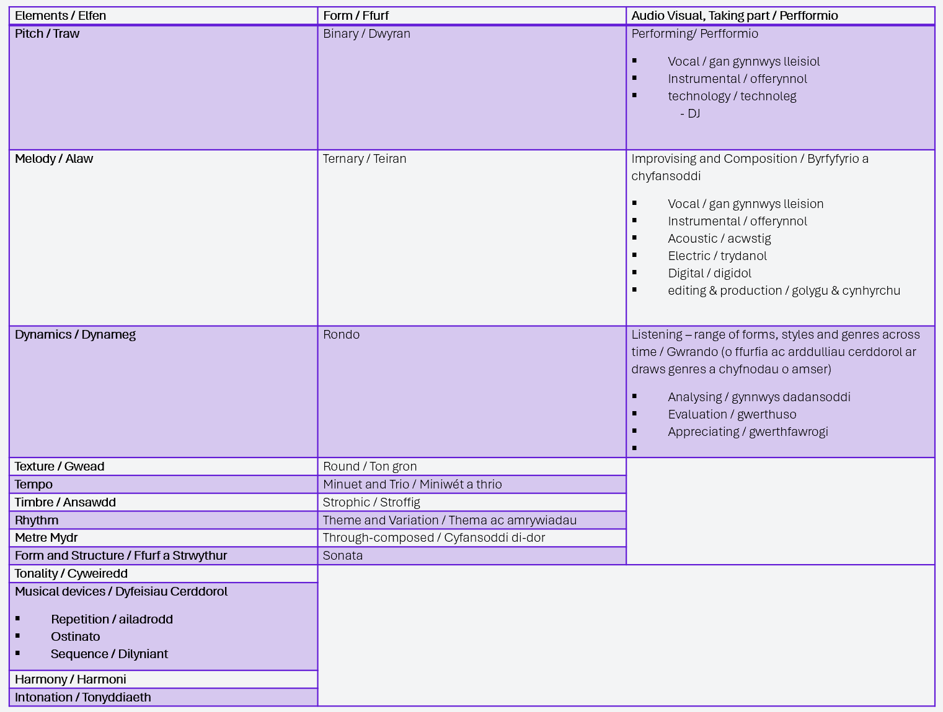
Music
Discipline-specific considerations
Cerddoriaeth
Ystyriaethau sy’n benodol i ddisgyblaethau

Slide 11
Music Glossary
Pitch: high or low
Melody: tune
Dynamics: loud and soft (quiet) loud = forte (f), soft = piano (p)
Texture: thickness or thinness of the music – 1 instrument = thin / whole orchestra or band = thick.
Tempo: the overall, underlying speed of the music – fast, slow etc (get children to march to the music to find the beat).
Timbre: the quality of the sound
Rhythm: the pattern of sounds or notes tapped out.
Metre: the phrases / number of beats in a bar – usually, 2, 3 or 4 eg, 1 2 3 4 | 1 2 3 4 | 1 2 3 4
Tonality: major (happy) or minor (sad).
Musical devices
Repetition: the music uses a repeating pattern, phrase, rhythm eg. Coldplay Paradise https://music.youtube.com/watch?v=1G4isv_Fylg
Ostinato: the music has un underlying pattern, often in a rhythm, that carries on through the whole piece eg. Bon Jovi, Livin’ on a Prayer, Ravel Bolero https://youtu.be/xhD_MrR8YHI , Duel of the Fates https://youtu.be/xlYCxbBZUCY
Sequence: music repeats a phrase or pattern at a higher or lower level eg. Beethoven 5th Symphony https://youtu.be/jv2WJMVPQi8 / Come Alive, The Greatest Showman https://music.youtube.com/watch?v=BURBlSYPmBU
Harmony: combination of notes to make a chord or group of notes.
Intonation: whether a note is in tune or if it is slightly too high (sharp) or slightly too low (flat)

Slide 12
Geirfa
Traw: uchel neu isel
Alaw: tôn
Dynameg: cryf ac ysgafn (tawel), cryf = forte (f), ysgafn = piano (p)
Gwead: pa mor drwchus neu denau yw’r gerddoriaeth – 1 offeryn = tenau / cerddorfa neu fand cyfan = trwchus.
Tempo: cyflymder sylfaenol y gerddoriaeth yn gyffredinol – cyflym, araf ac ati (gofynnwch i’r plant orymdeithio i’r gerddoriaeth i ganfod y curiad).
Ansawdd (Timbre): ansawdd y sain
Rhythm: patrwm y synau neu’r nodau wedi’u tapio.
Mydr: y brawddegau / nifer y curiadau mewn bar– fel arfer, 2, 3 neu 4 ee, 1 2 3 4 | 1 2 3 4 | 1 2 3 4
Tonyddiaeth: mwyaf (hapus) neu leiaf (trist).
Dyfeisiau Cerddorol
Ailadrodd: mae'r gerddoriaeth yn defnyddio patrwm, brawddeg, rhythm ailadroddus e.e. Coldplay Paradise https://music.youtube.com/watch?v=1G4isv_Fylg
Ostinato: mae gan y gerddoriaeth batrwm sylfaenol, yn aml yn y rhythm, sy’n parhau trwy’r darn cyfan e.e. Bon Jovi, Livin’ on a Prayer, Ravel Bolero https://youtu.be/xhD_MrR8YHI , Duel of the Fates https://youtu.be/xlYCxbBZUCY
Dilyniant: mae’r gerddoriaeth yn ailadrodd brawddeg neu batrwm ar lefel uwch neu is e.e. Beethoven 5th Symphony https://youtu.be/jv2WJMVPQi8 / Come Alive, The Greatest Showman https://music.youtube.com/watch?v=BURBlSYPmBU
Harmoni: cyfuniad o nodau i wneud cord neu grŵp o nodau.
Tonyddiaeth: p'un a yw nodyn mewn tiwn neu os yw ychydig yn rhy uchel (siarp) neu ychydig yn rhy isel (fflat)

Slide 13
Music / Cerddoriaeth
Music activities to try / Gweithgareddau cerddorol i ceisio
Body percussion
Wellerman
https://youtu.be/S0dF6Ns-Pl0
Watermelon
https://youtu.be/ILvOptdBU60#
Action Songs
Five Little Speckled Frogs
My Bonnie Lies Over The Ocean
The Wheel on the Bus etc
Action songs - BBC Teach
Un bis, dau bis, tri bis yn dansio
Playlists - CSC (cscjes-cronfa.co.uk)
Classical Music to make an impression
  Holst, Mars https://youtu.be/vzXX9XFyemg
  Mendelssohn, Fingal’s Cave
  Sibelius, The Swan of Tuonela
  Mussorgsky, Night on a Bald Mountain
  Mussorgsky, Pictures at an Exhibition
  Saint-Saens, Carnival of the Animals
  Prokofiev, Peter and the Wolf
  Dukas, The Sorcerer’s Apprentice
Games
Sing it high, sing it low
My turn, your turn (call and response)
Follow-my-leader
In the style of…
Find the beat
Clap the rhythm
Don’t clap this one back
Singing in a Round
Popocatapetl https://youtu.be/dgSZzQe0X9s
Calyspo https://youtu.be/zoLTvvVwDeE

Slide 14
Music Games and Activities
Sing it high, sing it low
Good for starting a singing session; a singing version of My Turn, Your Turn, that sees children repeating back high notes, low, notes, quiet, loud, singing patterns etc.
My turn, your turn (call and response) Can be used in a multitude of situations and is useful for maintaining homogeneity in class.
A simple call and response activity; teacher gives a pattern/phrase, children repeat back.
Follow-my-leader
Nominate a child to be leader, they set a pattern, rhythm etc and the others have to join in and follow. Leadership is then passed onto someone else. Choose carefully to begin with, then add les confident children as confidence levels rise.
In the style of… (also good for drama)
Good for singing/oracy/diction – repeat a phrase or passage in the style of different characters – pirate, opera singer, pop singer, very young child, stern parent, animals etc.
Find the beat
Children have to find the beat and tempo to a piece of music. Play the music, children ‘march / walk’ around the hall/room. Vary the speed/tempo. If this is too difficult, begin by banging a drum in a regular beat.
Clap the rhythm
Similar to My Turn Your Turn, but with clapping only. Variation: add body percussion.
Don’t clap this one back
Practise the rhythm ‘Don’t clap this one back’, then play ‘My Turn, Your Turn’ with children listening to avoid playing the rhythm, Don’t clap this one back. Children have a forfeit if they play the rhythm by accident.

Slide 15
Gemau a Gweithgareddau Cerddorol
Canu'n uchel, canu'n isel
Mae'n dda ar gyfer dechrau sesiwn ganu; fersiwn canu o Fy Nhro i, Eich Tro chi, sy'n gweld plant yn ailadrodd nodau uchel, nodau isel, tawel, cryf, patrymau canu ac ati.
Fy nhro i, eich tro chi (galw ac ateb) Gellir ei ddefnyddio mewn llu o sefyllfaoedd ac mae'n ddefnyddiol ar gyfer cynnal cydrywiaeth yn y dosbarth.
Gweithgaredd galw ac ateb syml; mae'r athro'n rhoi patrwm/brawddeg, mae'r plant yn ailadrodd hynny.
Dilyn yr arweinydd
Enwebwch blentyn i fod yn arweinydd, sydd yn gosod patrwm, rhythm ac ati ac mae'n rhaid i'r lleill ymuno a dilyn. Yna trosglwyddir yr arweinyddiaeth i rywun arall. Dewiswch yn ofalus i ddechrau, yna ychwanegwch blant llai hyderus wrth i lefelau hyder godi.
Yn arddull… (hefyd yn dda ar gyfer drama)
Da ar gyfer canu/llafaredd/ynganiad - ailadroddwch frawddeg neu ddarn yn arddull gwahanol gymeriadau – môr–leidr, canwr opera, canwr pop, plentyn ifanc iawn, rhiant llym, anifeiliaid ac ati.
Canfod y curiad
Mae'n rhaid i'r plant ganfod curiad a thempo darn o gerddoriaeth. Chwaraewch y gerddoriaeth, a chael y plant i ‘orymdeithio / cerdded’ o amgylch y neuadd/ystafell. Amrywiwch y cyflymder/tempo. Os yw hyn yn rhy anodd, dechreuwch trwy guro drwm mewn curiad rheolaidd.
Clapio'r rhythm
Yn debyg i Fy Nhro i, Eich Tro chi ond gyda chlapio yn unig. Amrywiad: ychwanegu offerynnau taro'r corff.
Dim clapio hwn yn ôl
Ymarferwch y rhythm ‘Dim clapio hwn yn ôl ', yna chwaraewch ‘Fy Nhro i, Eich Tro chi’, gyda'r plant yn gwrando er mwyn osgoi chwarae'r rhythm, Dim clapio hwn yn ôl. Mae plant yn cael fforffed os ydyn nhw'n chwarae'r rhythm trwy ddamwain.

Slide 16
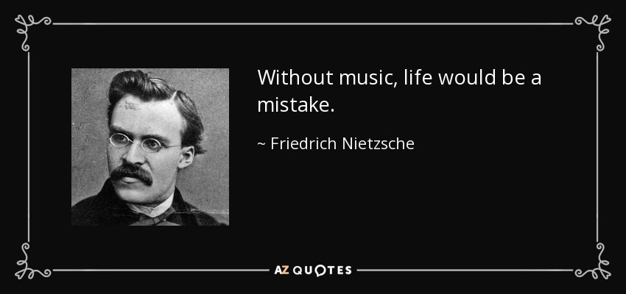

Expressive Arts
Y Celfyddydau Mynegiannol
Music
Cerddoriaeth
Sharon Stace-Smith
sharon.stace-smith@uwtsd.ac.uk
StaceS@hwbcymru.net
BA1

