Slide 1
ECAD4007
Who am I teaching?
Exploring the influence of the environment on the individual learner

Slide 2
Human development is a cultural process. As a biological species, humans are defined in terms of our cultural participation. We are prepared by both our cultural and biological heritage to use language and other tools and to learn from each other.
Barbara Rogoff (2003:03)
Notes:
Emphasize that we favour a holistic view of child development.
Rogoff points out some interesting points on what is acceptable / unacceptable in different cultures.
E.g. In some Ecuadorian communities children between 5 and 10 become skilled caregivers to babies and younger children, whereas in UK ir is illegal to leave a child under14 without adult supervision.
Also – many cultures encourage familiarity with knives and cutting implements, even machetes, so that children can learn to feed themselves.
So what of our culture here today and the learning child ……move on to next slide.

Slide 3
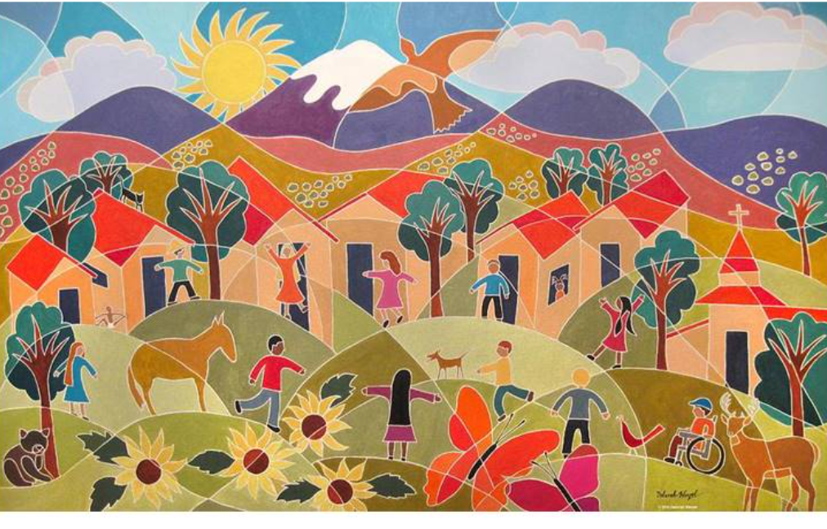

Slide 4
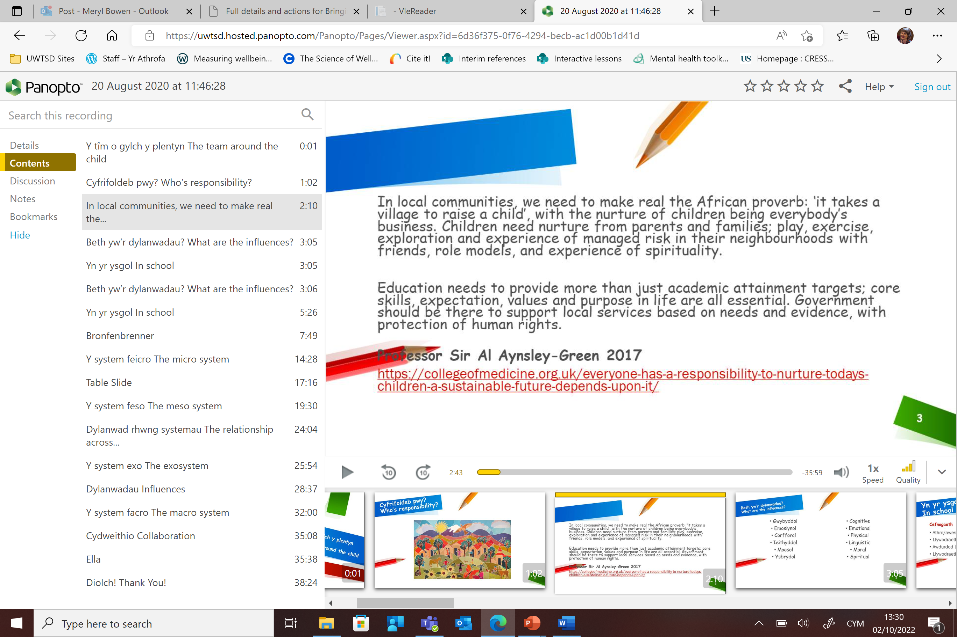
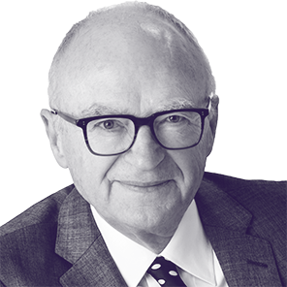
Professor Sir Al Aynsley-Green 2017

Slide 5
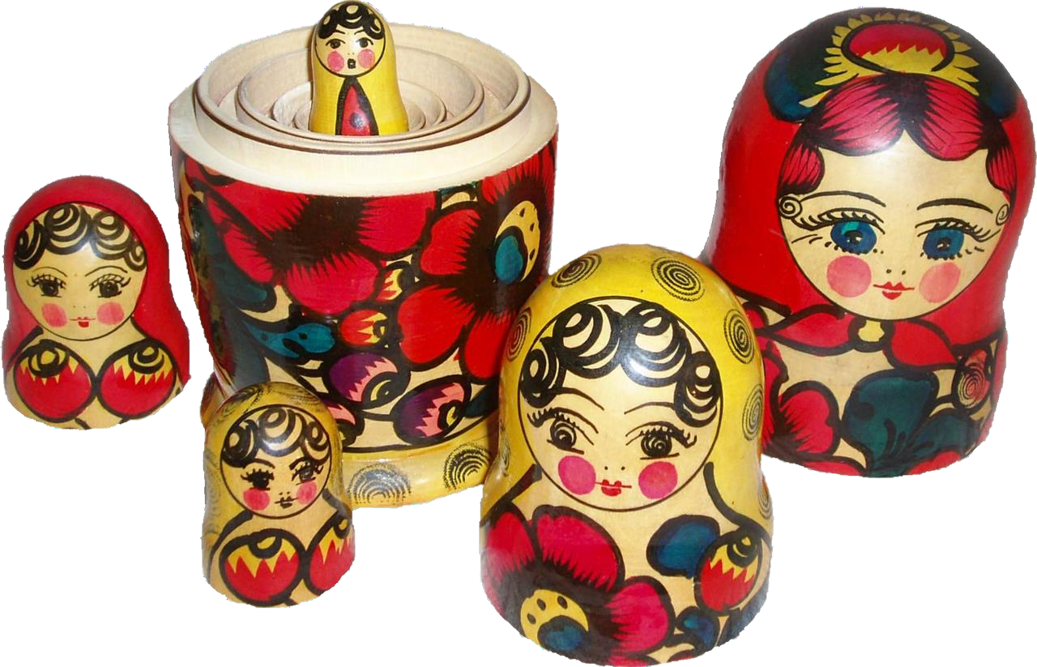
The team around the child
Create a diagram of the team / people and the world surrounding the child. Group and categorise the various influences.
Which influences might be the greatest?
Notes:
Lecturer invite shared responses illustrating the complex nature of the possibilities. Positives and negatives.
Before introducing the next slide.
This will have nuances according to secondary / primary phase.

Slide 6
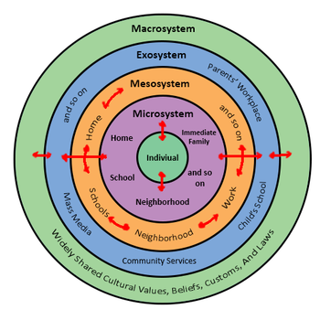
Bronfenbrenner’s Ecological Systems Theory (1979)
The interaction between factors in the child’s maturing biology, their immediate family/community environment, and the societal landscape fuels and steers development.
To study a child’s development then, we must look not only at the child and their immediate environment, but also at the interaction of the larger environment as well
Notes:
Urie Bronfenbrenner - Ecological Systems Theory of Development.
/
Students have come across this in their first module – ECAD6007, Who am I teaching? What do they remember?
The mesosystem refers to the point in which two social microsystems merge. One example of a mesosystem is the combination of the home and school environments. These intersect and become a mesosystem when events, situations, work and friendships cross back and forth between both environments.
Exosystem (y system ecso): Involves links between social settings that do not involve the child. For example, a child's experience at home may be influenced by their parent's experiences at work. A parent might receive a promotion that requires more travel, which in turn increases conflict with the other parent resulting in changes in their patterns of interaction with the child.
The macrosystem (y system facro) includes things such as the relative freedoms permitted by the national government, cultural values, the economy, wars, etc. These things can also affect a child either positively or negatively.
The microsystem (y system feicro) are things that a child may encounter on a daily basis in an immediate surrounding.
Moreover, a child’s biological and socially influenced characteristics like habits, temperaments, physical characteristics and capabilities influence the child’s behaviour and also the people who are around the child.

Slide 7
Bronfenbrenner’s Ecological Systems Theory (1979)
The closer a circle or level is to the child, the greater is the degree of immediate influence it has on the development of the individual.
Changes or conflict in any one layer will ripple throughout other layers.

Slide 8
The microsystem are aspects that a child may encounter on a daily basis in their immediate surroundings.
A child’s socially influenced characteristics like habits, temperaments and capabilities influence the child’s behaviour.

Slide 9
More nurturing and supportive interactions and relationships will likely to foster a better environment for development.
Bronfenbrenner proposed that many of these interactions are bi-directional: how children react to people in their microsystem will also affect how these people treat the children in return.

Slide 10

So now we understand that Ella is not just a passive recipient –she’s an active participant in this ecological model.
The way she responds to family, friends and teachers has an impact.
Ella’s behaviour influences how others interact with her. Educators and parents for example.

Slide 11
One of the most significant findings that Urie Bronfenbrenner unearthed in his study of ecological systems is that it is possible for siblings who find themselves in the same ecological system to experience very different environments.
Therefore, given two siblings experiencing the same microsystem, it is not impossible for the development of them to progress in different manners. WHY?

Slide 12
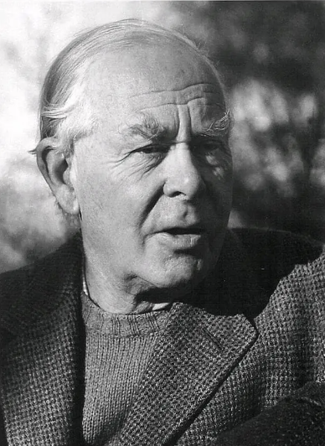
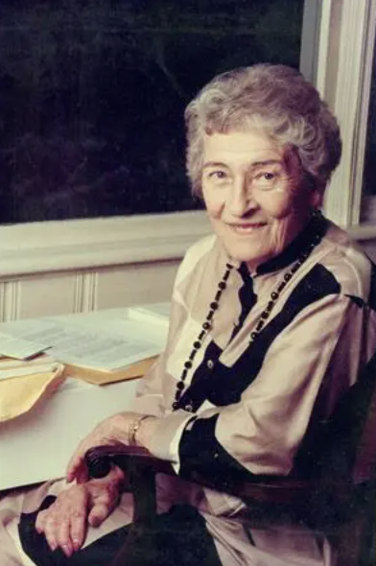
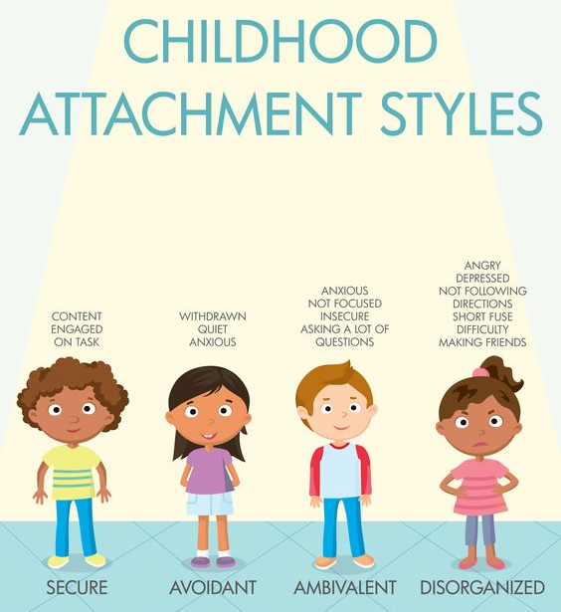
John Bowlby Mary Ainsworth
Attachment theory is focused on the relationships and bonds between people, particularly long-term relationships, including those between a caregiver and child.

Slide 13
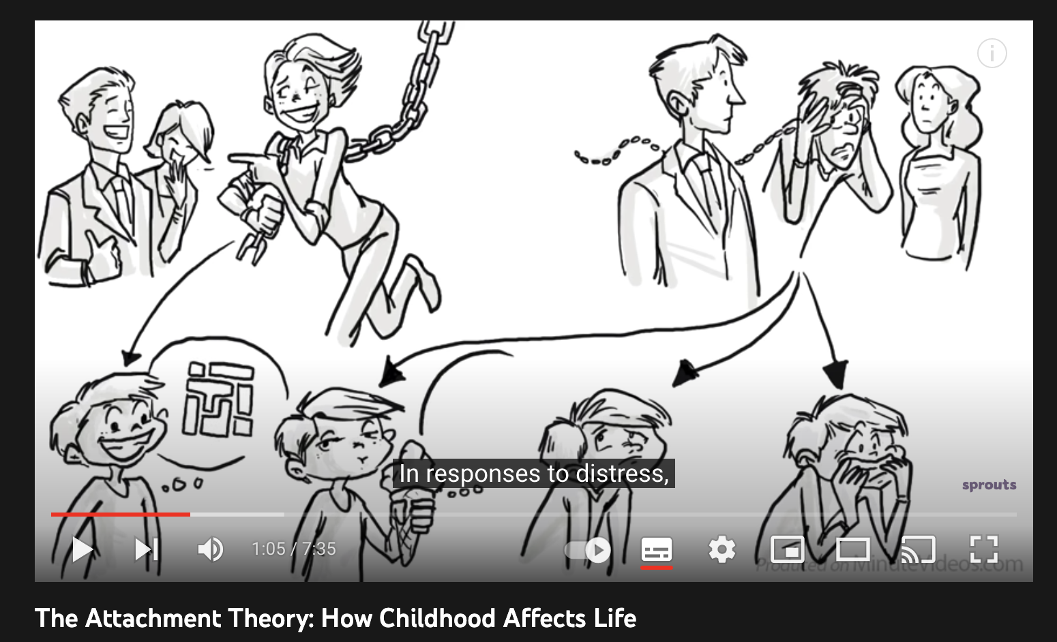

Slide 14
Take a little time to explore Ella’s profile and discuss possible connections with attachment theory.

Slide 15
The mesosystem refers to the point in which two social microsystems merge.
One example of a mesosystem is the combination of the home and school environments. These intersect and become a mesosystem when events, situations, work and friendships cross back and forth between both environments.

Slide 16

0-3yrs – Deprived areas – ensures early learning

Slide 17
How did your school interact/ engage with the local community?

Slide 18
Exosystem: Involves links between social settings that do not involve the child. For example, a child's experience at home may be influenced by their parent's experiences at work. A parent might receive a promotion that requires more travel, which in turn increases conflict with the other parent resulting in changes in their patterns of interaction with the child.

Slide 19
The macrosystem includes things such as the relative freedoms permitted by the national government, social norms, cultural values, policies, the economy, wars, etc.
These things can also affect a child either positively or negatively.

Slide 20
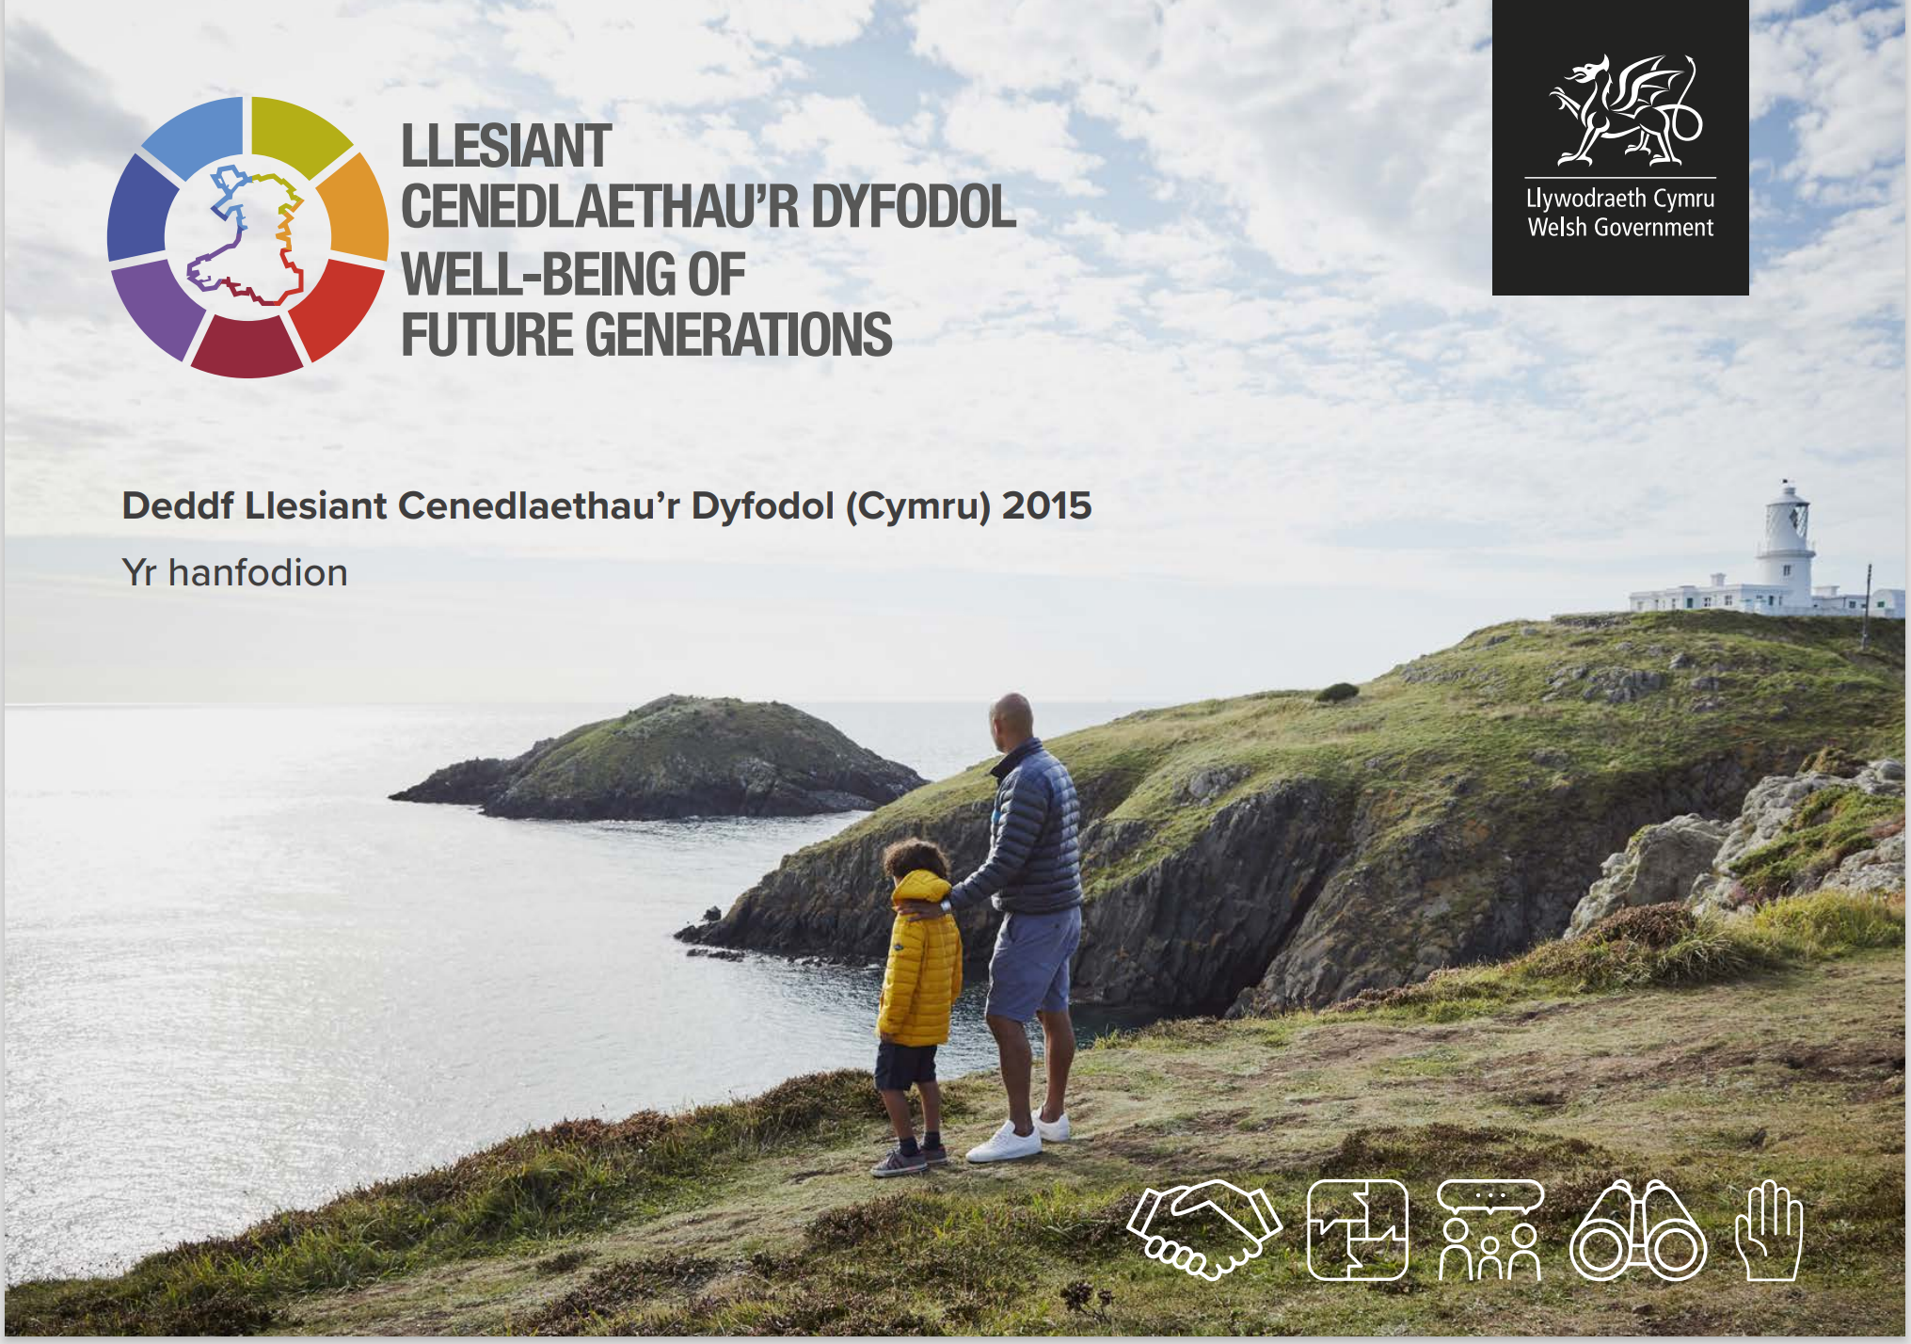
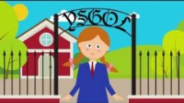
deddf-llesiant-cenedlaethaur-dyfodol-cymru-2015-hanfodion-2021.pdf
https://www.youtube.com/watch?v=rFeOYlxJbmw

Slide 21
Were would you place the child’s best friend who is always coming round their house?
Were would you place the introduction of the new Curriculum for Wales?

Slide 22
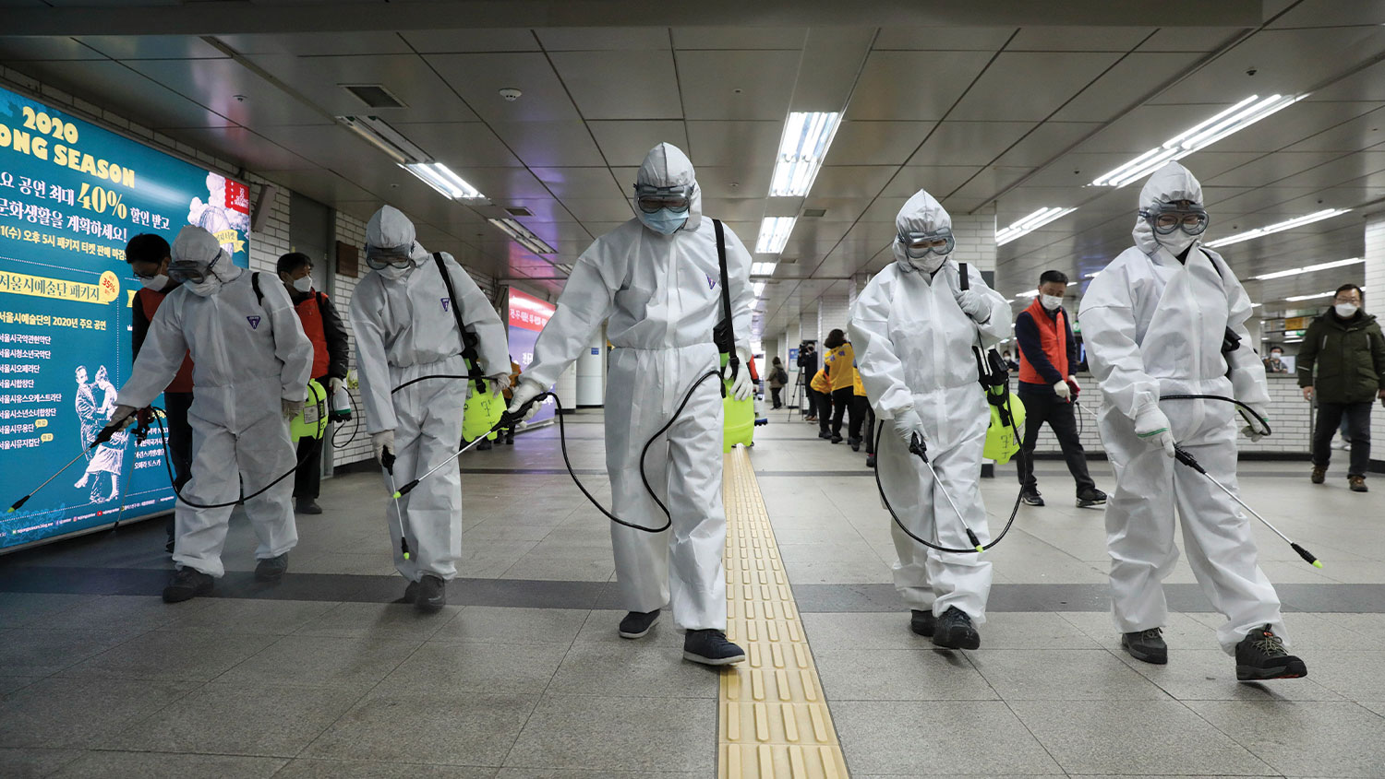
Take some time to discuss which possible layers where impacted by the Covid 19 pandemic?

Slide 23
Criticism of the model?
Notes:
Bronfennbrenner (and Evans) later revised elements of the theory to include time –
As pointed out by Ashiabi and and O’Neil (2015) ‘more concern was given’ to related concepts including time in later versions.
Christensen J. (2016) includes the point on an ‘entrepreneurial’ ex-macro layer provided by the individual – Malmo University Sweden.

Slide 24
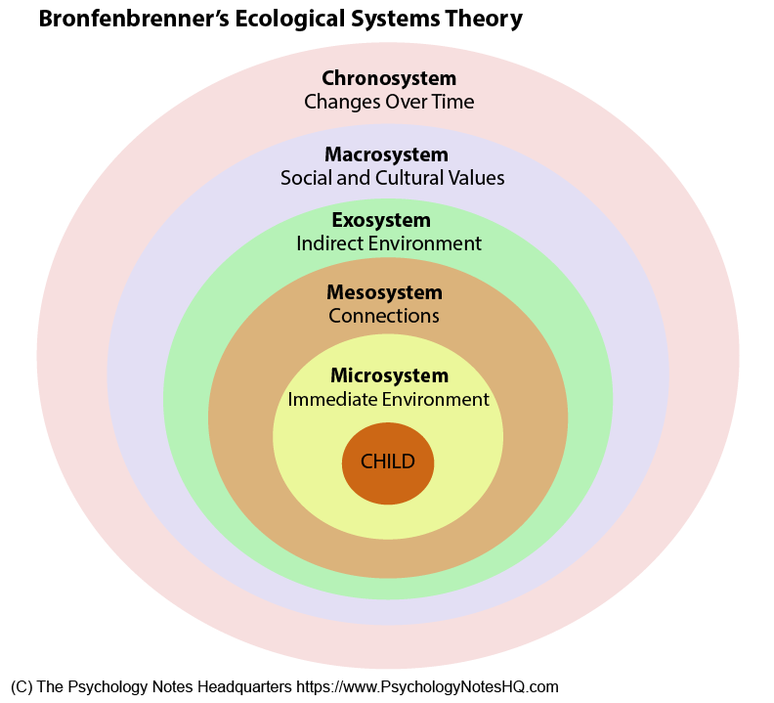
Criticism of the model
Some critics considered a chronosystem to be a necessary addition. Bronfenbrenner (and Evans) later revised elements of the theory to include time
The timing of a significant event on an individual.
It’s not a static system…layers change over time.
The individual also interacts with each layer in different ways and is impacted in different ways as they grow and mature.
Notes:
Bronfenbrenner (and Evans) later revised elements of the theory to include time –
As pointed out by Ashiabi and O’Neil (2015) ‘more concern was given’ to related concepts including time in later versions.
Christensen J. (2016) includes the point on an ‘entrepreneurial’ ex-macro layer provided by the individual – Malmo University Sweden.
Worth mentioning that the chronosystem theory also relates to events of great import to young people in their development, and that the timing of the event can have a different impact – think covid for EYFS, compared to a year 6 to year 7 transition compared to GCSEs

Slide 25
Criticism of the model
Others see the need to include an ex-macro layer to account for the way individuals may influence themselves.
Christensen J. (2016)
Notes:
Bronfenbrenner (and Evans) later revised elements of the theory to include time –
As pointed out by Ashiabi and O’Neil (2015) ‘more concern was given’ to related concepts including time in later versions.
Christensen J. (2016) includes the point on an ‘entrepreneurial’ ex-macro layer provided by the individual – Malmo University Sweden.
Worth mentioning that the chronosystem theory also relates to events of great import to young people in their development, and that the timing of the event can have a different impact – think covid for EYFS, compared to a year 6 to year 7 transition compared to GCSEs

Slide 26

So what do we know about Ella and the influences on her?
Does she have siblings?
Is she Welsh?
What do we know? What don’t we know?

Slide 27
So what do we know about Ella and the influences on her?
Mum working?
Does she have siblings?
Friends?
Is she Welsh?
What laws/ conventions?
Area living?

Slide 28
ECAD4007
Who am I teaching?
Exploring the influence of the environment on the individual learner

