Slide 1
EMPLOYEE ENGAGEMENT PRESENTATION

Slide 2

Introduction
Employee Engagement is a crucial factor in any depart and plays an important role to run a business
This study aims to state a broad idea about Employee Engagement and its function in the hotel industry
Due to a lack of Employee Engagement hotel industries survive a lot and this study targets those key issues and provides an effective solution concerning those issues
Employee engagement has a role to develop an effective workforce and commitment, psychological factors are associated with this (Lee et al., 2020)
Notes:
Employee engagement has an important role to maintain the workforce of an organisation and this study aims to state those perspectives which are relevant to employee management.

Slide 3
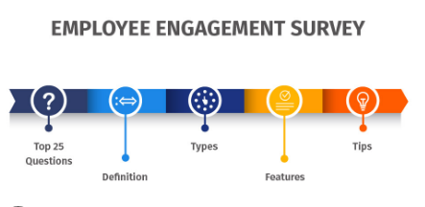
Employee Engagement
Employee engagement is part of Human Resource Management and it describes the dedication and enthusiasm of employees in an organisation
Employee engagement is linked with job satisfaction and employee motivation which is critically associated with the success of an organisation
In an organisation, “internal social media” has a role to determine employee engagement (Men et al. 2020)
Engaged employees are generally productive and give a high level of performance as well
Notes:
Employee engagement influences a lot to enhance the productivity of an employee. On the other hand, internal social media assists to develop internal communication that has a significant role to engage employees.

Slide 4
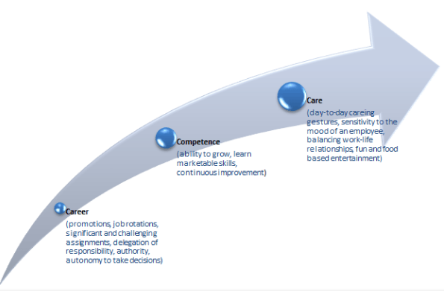
Three C’s in Employee Engagement
Work engagement has depicted healthy and pathological factors in a heavy and hard work environment (Di Stefano and Gaudiino, 2019)
An engaged employee has a greater attachment to the job as well as the organisation and several factors also play an important role to manage employee engagement
The three C's of employee engagement are Career, Care, and Competence
Based on career, rewards and resignation, the purpose of care a caring gesture, and the ability to learn and grow are dependent on the competence and they all influence being engaged
Notes:
All mentioned facts can enhance employee engagement in an organisation.

Slide 5
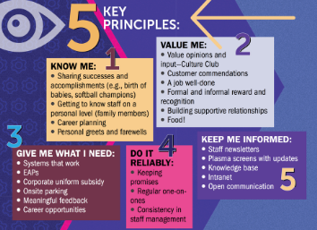
Key Principles of Employee Engagement
The key principles of employee engagement are Thinking, Behavior, Relation, and Emotions
Employee engagement decreases the rate of employee turn over and that is why it can be said that employee engagement is associated with employee retention, recruitment, and more
As per the report by Tatum (2022), engaged employees are happiest, satisfied as well as enjoy their work in a proper way
Employee engagement is associated with energy and based on that it can be said that there are required to give in attention to mental, physical, and emotional energy to engaged employees
Notes:
Physical and mental energies are related to the factor of employee engagement in an organisation and the company should focus on behaviour, relation, and emotions.

Slide 6
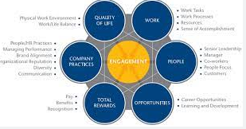
Role of Employee Engagement in the Hotel Industry
In the hotel industry, there are required to recruit more engaged employees and that also creates an open communication
"High-Performance Work System (HPWS)" has a significant role to enhance the commitment among employees in the hotel and hospitality industry (Teo et al. 2020)
In the hotel industry communication is considered an important factor and with the help of engaged employment, organisations get a chance in retaining customers for a long time
An engaged employee provides his or her best service and creates open communication for customers and that enhances the customer satisfaction rate
Notes:
If employees feel engaged with an organisation then they serve a better service to the customer which leads to generating more revenues for hotel industries as well.

Slide 7

One Engagement Theoretical Model
On the purpose of establishing a good employee engagement practice in an organisation “The Zinger Model” plays an important role
According to Hussainy (2020), David Zinger was a management consultant and he highlighted the various aspect of maintaining employee engagement as well as involvement and dedication
This model represents a pyramid and all the build blogs of that paranoid show the basic needs of an employee and it helps a lot in fostering management practice in an organisation
Notes:
This model is essential to understand the importance of employee engagement in an organisation.

Slide 8
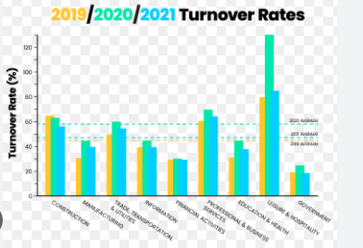
Challenges of employee engagement in the hotel industry
In the year 2022 hotel and hospitality industry experienced a lots amount of employee turnover and in the hotel industry that amount is 5% (McAllister, 2022)
Unsatisfied employees have a low amount of morale and that leads to not getting any incentives as well as rewards from the company and customers and that is considered another important challenge faced by the hotel industry
Shortage of capable and skilled employees, it becomes very difficult to maintain a healthy workforce
On the other hand, lacking employee engagement hotel industry faces loss and that enhances the risk factor of not getting salaries on time that leads to dissatisfaction among employee
Notes:
Due to Covid-19 UK faced lots of issues with employee engagement.

Slide 9
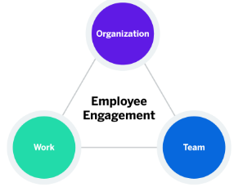
Examples of best practices to engage employees from the hotel industry(align with the above model)
It is required to have the best relationship with the other employees in an organisation (Corporateculture, 2022)
A healthy relationship with the line manager and other staff can increase the employee engagement
Based on this model it can be said that an organisation needs to have a basic knowledge of their employee's need
In the company of Holiday Inn, employees are very much engaged with “Community Outreach Activities” per week
Notes:
The mentioned organisation has great practice in employee engagement.

Slide 10
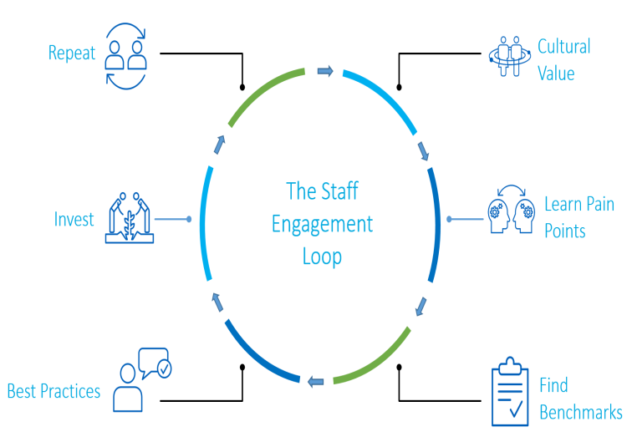
Examples of best practices to engage employees from the hotel industry contd…
Nowadays, the UK hotel industry has faced a very crucial time and requires “urgent support” to protect against widespread devastation (BBC, 2022)
In the hotel industry, they experience a lack of employees due to the dissatisfaction of employees
On the other hand, practising job security and a good job environment assists to retain employees at Holiday Inn
Notes:
A shortage of skilled employees creates trouble in hotel industries and leads to employee turnover.

Slide 11
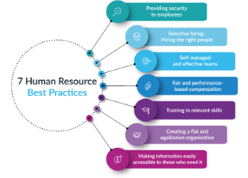
Conclusion and Recommendation
Based on the above discussion it can be said that employee engagement reduces the risk of losing the customer base
A good HR practice can mitigate all issues that are influenced by a lack of employee engagement
An organisation can promote rewards, Feedback, and other practices to overcome the recent challenges in the hotel industry
Training and development and talent acquisition are also other effective paths to increasing employee engagement in an organisation
Notes:
After completing the entire study it can be said that employee engagement is a vital part to run a business smoothly and the above-mentioned points assist to meet them.

Slide 12
References
BBC, 2022. UK hospitality industry calls for 'urgent' support. Available at: https://www.bbc.com/news/business-53297651 [accessed on: 30 November 2022]
Corporateculture, 2022. Employee engagement and experience. Available at: https://corporateculture.co.uk/corporate-culture/employee-engagement-and-experience/?utm_source=google&utm_medium=cpc&utm_campaign=16450334130&utm_content=142499013588&utm_term=employee%20engagement&gclid=Cj0KCQiA4aacBhCUARIsAI55maEQ4UJmWd9biEbl3psMrVeJ-z6-9JBzk6On2xA1ZNckFleD9yzcb-oaAifNEALw_wcB [accessed on: 30 November 2022]
Di Stefano, G. and Gaudiino, M., (2019). Workaholism and work engagement: How are they similar? How are they different? A systematic review and meta-analysis. European Journal of Work and Organizational Psychology, 28(3), pp.329-347.
Hussainy, S.S., (2020). Review on Motivational Theories & Models: Its application for Employees’ Retention in Organizations. International Journal of Business and Applied Social Science, 6(1), pp.40-46.
Lee, J.Y., Rocco, T.S. and Shuck, B., (2020). What is a resource: Toward a taxonomy of resources for employee engagement. Human Resource Development Review, 19(1), pp.5-38.
McAllister. J., (2022), High rates of hospitality staff turnover persist as headcounts rise. Available at: https://www.bighospitality.co.uk/Article/2022/08/02/high-rates-of-hospitality-staff-turnover-persist-as-headcounts-rise#:~:text=With%20regards%20to%20staff%20turnover,with%20a%205%25%20leaver%20rate. [accessed on: 30 November 2022]
Men, L.R., O’Neil, J. and Ewing, M., (2020). Examining the effects of internal social media usage on employee engagement. Public Relations Review, 46(2), p.101880.
Tatum, M., 2022. How going above and beyond at work became required. Available at: https://www.bbc.com/worklife/article/20220921-how-going-above-and-beyond-at-work-became-required [accessed on: 30 November 2022]
Teo, S.T., Bentley, T. and Nguyen, D., (2020). Psychosocial work environment, work engagement, and employee commitment: A moderated, mediation model. International Journal of Hospitality Management, 88, p.102415.

Slide 13


