Slide 1

MODULE NAME : DIGITAL SKILLS
MODULE CODE LCLM 4002
STUDENT NAME :SARA DIT ADAMA CAMARA
STUDENT ID : 2541389
GROUP 7
LECTURER NAME KAUSHIK MODAK
DS3 COURSE WORK

Slide 2

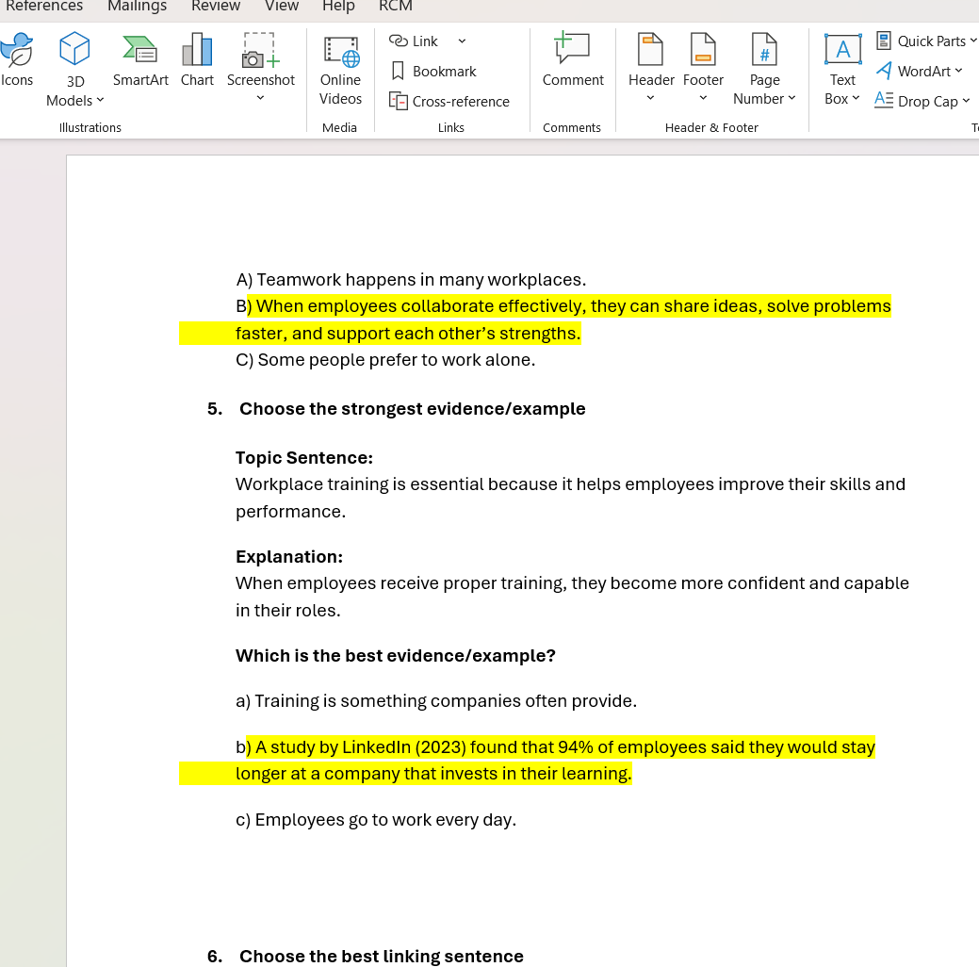

This is a MS-Word document. At first I found it quite difficult because I didn’t have la lot of knowledge in it. Microsoft word offers a possibility to create professional documents, and you can also make report. I think I have improved in word because before I could not make bullet points I did not know how to make a word bolder but now I can navigate word easier.

Slide 3
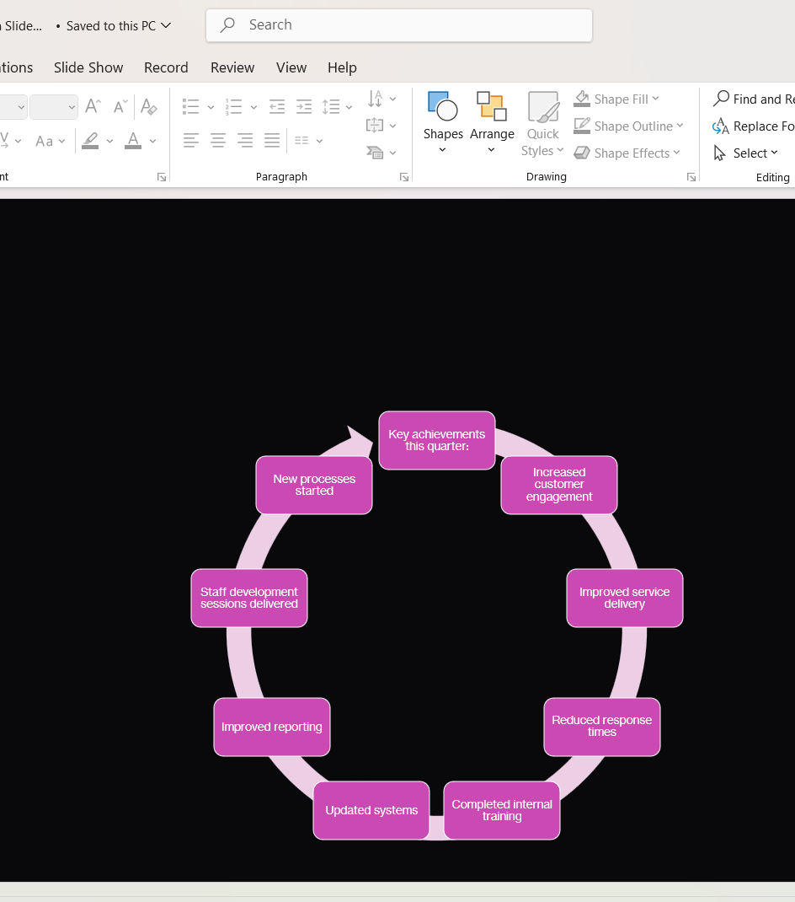
PowerPoint is a software used to create slide shows. using PowerPoint you can present information clearly to an audience using computer or mobile device. Powerpoint can used to show words, pictures layouts , add videos or sound registrations.You can also work woth others online at the same time. Before the course I didn’t know how to do diagrams but now I am better at it.
s
p

Slide 4
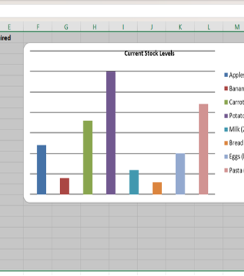
You can use Excel to organize, calculate, and analyze data. With Excel you can do basic math or complex calculations. You can present informations in columns or/and in bar charts that make them clear for the users. It was challenging for me to present information in bar charts. But now I find it easier. This is an Excel document I used in the DS2.

Slide 5
My portfolio
My portfolio includes three examples:
a word document,
a powerpoint slide,
And an Excel table .
I chose these examples because they are one of the main things i have been learning throughout the course .

