Slide 1
Experimental Research Proposal Presentation
Andrew Robson 1703364
Feasibility study
Can hand grip strength determine the effectiveness of a 12- week body weight exercise programme to improve muscular mass and strength?

Slide 2
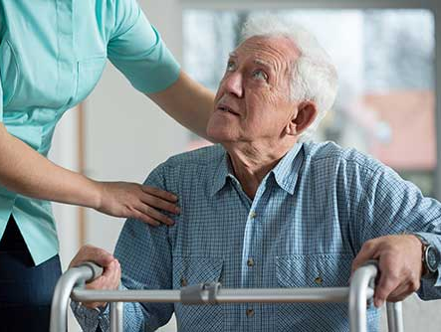

The aging process isn’t the same for everyone
Maintaining muscle mass in the elderly can be challenging
Nutritional status
Psychological barriers
Appropriate and effective training
Growing elderly population
Increase life span but not increase health span (Hansen and Kennedy 2016)
Increased health care costs (Hazra et al., 2018)
Ernestine Shepherd 80 years old

Slide 3
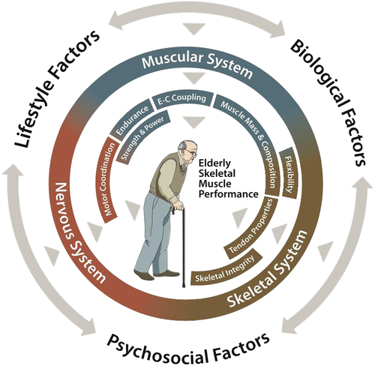
The potential protective effect of maintaining muscle mass and strength
Allows independence and prevents social isolation (Gale et al., 2018)
Ability to perform physical activity promotes well being (Seco et al., 2013)
Skeletal muscle protective and can delay the onset of cognitive decline
(Liu et al., 2019)

Slide 4
Study Design Method and Aim
Feasibility study, exercise intervention 7 minutes body weight programme self administered using a demonstration video.
Participants recruited via word of mouth and at a local social club, with an age range between 40 and 79 years old
Baseline data collection of hand grip strength repeated every 4 weeks to week 12
Adherence to exercise programme is measured via self maintained daily diary
Can this 7 minute body weight exercise programme performed daily for 12 weeks improve upper body muscular strength as measured by hand grip strength

Slide 5
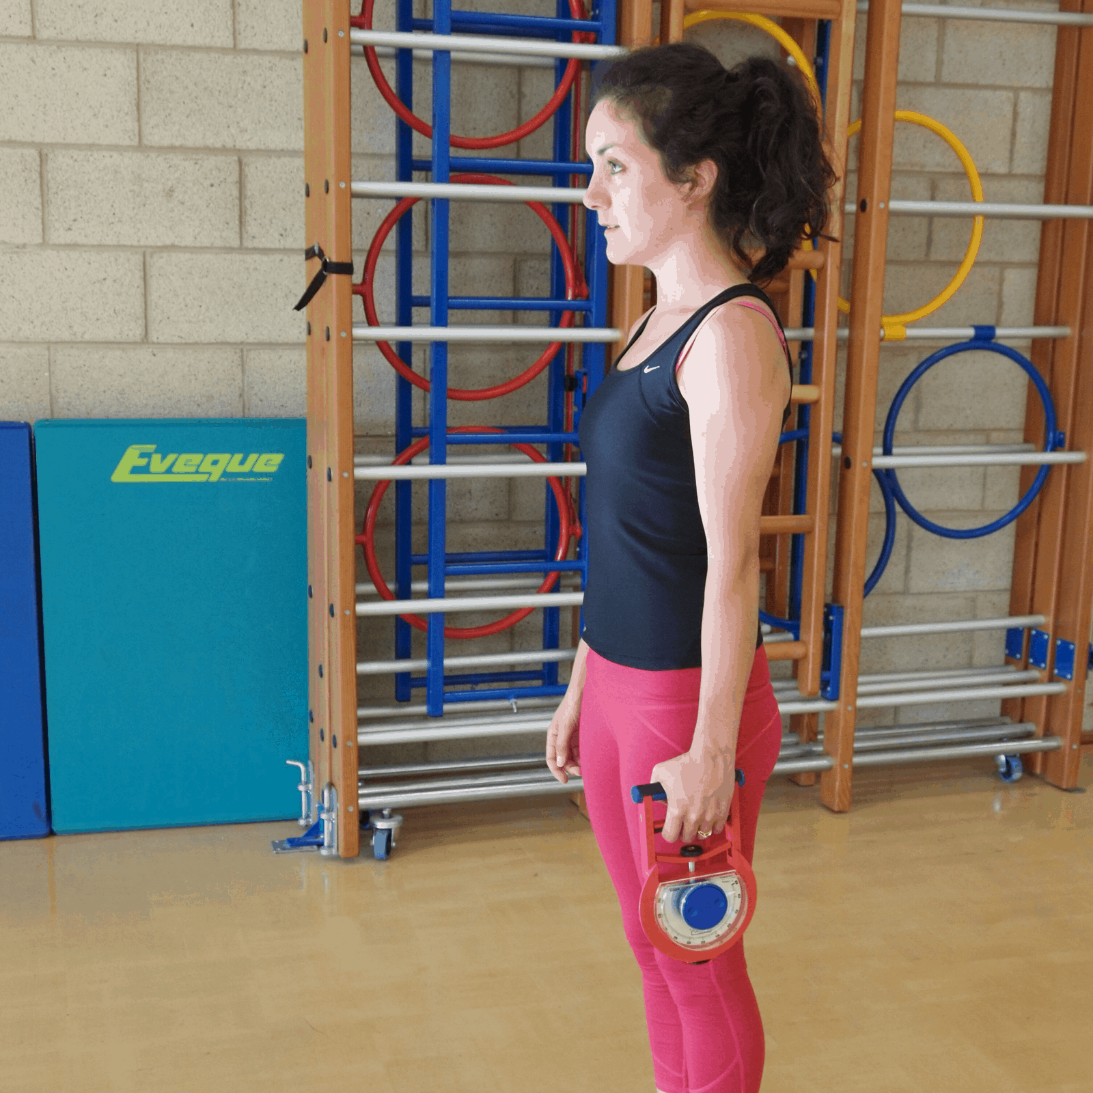
Why use a hand grip strength?
Reliable measurement of upper body skeletal muscular strength
Validated and extensive normative data
Non-invasive and easily administered
High satisfaction rating with participants
If used in a clinical setting low cost

Slide 6
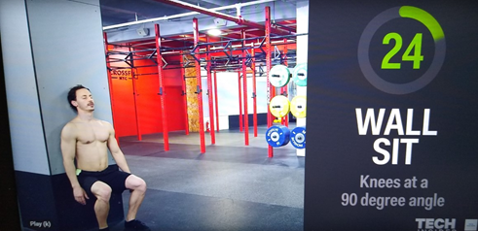
Seven minute body weight exercise
https://www.youtube.com/watch?v=FKJstVC2mF4&t=207s
Performed daily for 12 weeks
Group and individual video presentations
Individual coaching to ensure good technique
Adaptations to all exercises were demonstrated

Slide 7
Data collection and analysis
Data collection will be inputted into Microsoft Excel and SPSS. Assuming the data has normally distributed assumptions (parametric data) a one-way analysis of variance (ANOVA) will be performed and any correlations identified.
Results to presented using hysterograms and scatter plots

Slide 8
Ethical considerations
To follow UWTSD ethical guidelines at all time
To consider physical and psychological well being of participants
To manage participants expectations
To respect participants ability to perform the programme and identify and manage any limitations
To manage personal data in accordance with data protection legislation
Consent forms, information sheets, PAR-Q and feedback forms including the option to opt out of the intervention at any stage

Slide 9
References
A full reference list that accompanies this presentation is available on request from Andrew Robson Email 1703364@student.uwtsd.ac.uk

