Slide 1

Understanding Race
Workshop Week 5

Slide 2
Class Discussion - LBC Video: RPReplay_Final1666537625.mov - Google Drive
What can you see going on here?
Do you agree that the comments made are racist?
What connections does this person make between race, nationality, ethnicity?
How are we seeing him construct a version of race and identity?
What theories we have discussed before can you see being demonstrated here?

Slide 3

Hate Crime
The law recognises five types of hate crime on the basis of:
Race
Religion
Disability
Sexual orientation
Transgender identity

Slide 4
Police and the CPS Hate Crime
agreed the following definition for identifying hate crimes:
"Any criminal offence which is perceived by the victim or any other person, to be motivated by hostility or prejudice, based on a person's disability or perceived disability; race or perceived race; or religion or perceived religion; or sexual orientation or perceived sexual orientation or transgender identity or perceived transgender identity."

Slide 5
Law changes
The Criminal Justice Act 2003 introduced these changes following the enquiry of the death of Stephen Lawerence and where the Met Police was famously branded as ‘institutionally racist’
George Floyd
https://irr.org.uk/article/deaths-with-a-known-or-suspected-racial-element-2000-onwards/
Notes:
https://www.bbc.co.uk/news/uk-16438933
https://www.standard.co.uk/hp/front/jailed-for-life-boy-16-who-stabbed-14yearold-to-death-over-a-dirty-look-6935304.html

Slide 6
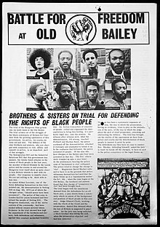
Mangrove Nine
A group of British Black activists tried for inciting a riot at a 1970 protest against the police
Trial lasted 55 days and involved various challenges by the Nine to the legitimacy of the British judicial process
They were all acquitted of the most serious charges and the trial became the first judicial acknowledgement motivated racial hatred by the Met Police
Joseph Arthur de Gobineau (1816 – 1882)
Notes:
Notting Hill, London
Joseph Arthur de Gobineau (1816 – 1882 – Father of modern racism - white people possessed superior intelligence, morality and will power, while black people were the least capable, had “animal” nature, no morality and emotional instability.

Slide 7
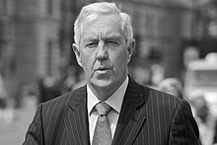
Metropolitan Police 1995
The then Met police commissioner Paul Condon said that the majority of robberies in London were committed by black people.
Op Trident March 1998 by the Met Police to investigate gun crime in London's black community after black-on-black shootings.
In 2003, Lee Jasper, Senior Policy Advisor on Equalities to the London mayor, said drugs and gun crime were the "biggest threat to the black community since its arrival here".

Slide 8
Tony Blair 2007
The then PM commented:
"The black community, the vast majority of whom in these communities are decent, law-abiding people are horrified at what is happening – need to be mobilised in denunciation of this gang culture that is killing innocent young black kids. But we won't stop this by pretending it isn't young black kids doing it.“

Slide 9

Judge Lady Hale 2007/2008
Stated in the Supreme Court:
"It must be borne in mind that many of these gangs are largely composed of young people from black and minority ethnic groups".
Use this as justification for Stop and Search cases on minority groups, saying:
"put bluntly, it is mostly young black lives that will be saved if there is less gang violence in London and some other cities"

Slide 10
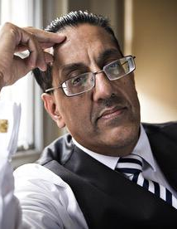
Sexual Grooming Cases UK
2017 report "Group Based Child Sexual Exploitation – Dissecting Grooming Gangs" - claimed 84% of offenders were of South Asian heritage – some criticism
Home Office – most sexual abuse cases are by white men.
Nazir Afzar CPS state:
“It confirms that white men remain the most common offenders, which is something rarely mentioned by right-wing commentators. However, it is not shy in reflecting that south Asian and British Pakistani men are disproportionately found in high-profile cases".
Rochdale/Halifax/Birmingham grooming cases.

Slide 11
How much hate?
Year ending March 2024, there were:
140,561 hate crimes recorded by the police in England and Wales (-5%)
Year before there were 147,645 hate crime offences
98,799 race hate crimes
10,484 religious hate crimes – increase by 25% offences and was driven by a rise in offences against Jewish
Sexual orientation hate crimes fell by 8%
Transgender hate crimes fell by 2%
Disability hate crimes fell by 18%
Notes:
Hate crime, England and Wales, year ending March 2024 - GOV.UK

Slide 12
April 21/March 22 Arrests
646,292 arrests in England and Wales – a rate of 12 arrests per 1,000 people
overall, men were 6 times as likely to be arrested –
  20 arrests for every 1,000 men
  3 arrests for every 1,000 women
Black men were over 3 times as likely to be arrested as white men –
  54 arrests for every 1,000 black men
  15 arrests for every 1,000 white men
  17 arrests for every 1,000 people with mixed ethnicity

Slide 13
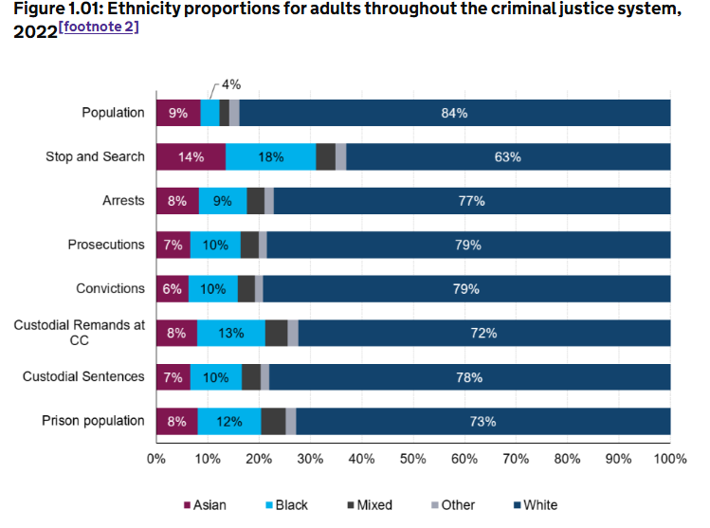
Notes:
Statistics on Ethnicity and the Criminal Justice System, 2022 (HTML) - GOV.UK

Slide 14
Police Activity
Between 2019/20 and 2022/23, the proportion of stop and searches for people from the white ethnic group increased from 60% to 69%.
In 2022/23, white individuals accounted for 78% of arrests,
8% were of black individuals,
8% were of Asian individuals,
4% were of mixed ethnicity individuals and
2% were of other ethnicity individuals.
In 2022/23, 69% of children arrested in London were from ethnic minorities
Notes:
Statistics on Ethnicity and the Criminal Justice System, 2022 (HTML) - GOV.UK

Slide 15
Defendants
In 2020, 40% of White defendants were remanded in custody compared to 51% of Chinese/Other and 49% of Black defendants.
White offenders had an ACSL of 19.6 months in comparison with 26.8 for Black offenders, 28.6 for Asian offenders, and 24.4 for offenders of Mixed and Chinese or Other ethnic groups.
higher proportion of prosecutions for Black and Mixed ethnic groups were against children, 12% and 14% respectively, compared to 5% for White defendants
The reoffending rate for Black adult offenders was highest for 18-20 year olds at 35%. For White adult offenders, the reoffending rate was highest for those aged 35-39 at 35%.
Notes:
https://www.gov.uk/government/statistics/ethnicity-and-the-criminal-justice-system-statistics-2020/ethnicity-and-the-criminal-justice-system-2020
Average Custodial Sentence Lengths

Slide 16
Offender Management
A greater number of children in prison were from minority ethnic groups
Black prisoners served the greatest proportion of their original sentence in custody
In the 2020/21 HM Inspectorate of Prisons survey, prisoners from ethnic minority groups reported more negative results across the survey

Slide 17
Offender Characteristics
All males prosecuted for an indictable offence 75% were White, whilst for all females prosecuted 86% were White
Minority ethnic children also had a higher proportion remanded in custody, had a higher custody rate and received on average longer custodial sentences
The reoffending rate for Black adult offenders was highest for 18-20 year olds at 35%.
  For White adult offenders, the reoffending rate was highest for those aged 35-39 at 35%

Slide 18
Whiteness
In 2022 survey of legal professionals found that 56% had witnessed at least one judge acting in a racially biased way, with 52% witnessing discrimination in judicial decision-making, most frequently directed towards Asians and black people
2019 - 92.6% of judges in England and Wales were white and 7.4% were from a BME background.
2020 92.7% of police officers were white and 7.3% were from BME backgrounds.
Whiteness as something that places white people in dominant positions
Notes:
display.aspx (manchester.ac.uk)

Slide 19
BME staff and Discipline
Black officers were 81% more likely to face disciplinary action
New ethnic recruits over 120% more likely to be served with a Regulation 13 (‘unsuitable for policing’) notice than their white counterparts.
Black prison staff stated said they experienced discrimination that hindered their career profession, adding that they were viewed by colleagues with the same suspicion that affected black prisoners and worried about being accused of corruption.

Slide 20
Bianca Williams & Ricardo dos Santos
Stop & Search - officers who claimed to smell cannabis
Two were returning from training, with their baby, which officers claimed could be linked to gang activity
PC Jonathan Clapham, 31, and PC Sam Franks, 29 had lied and were guilty of gross misconduct
  Stopped and detained for 45 minutes, and handcuffing the athletes was so unjustified that it amounted to gross misconduct
Ricardo stopped more than 20 times
https://www.bbc.co.uk/news/av/uk-67221218
Notes:
https://www.theguardian.com/uk-news/2023/oct/25/met-officers-guilty-of-gross-misconduct-over-stop-and-search-of-black-athletes
https://www.bbc.co.uk/news/av/uk-67221218

Slide 21
Questions?
Thanks for coming
Assignment submission 7th March 2025

