Slide 1
Employment Law
Discrimination – Part 1
30.01.2023
Alex Christen
  Senior Associate
    Employment & Immigration
    Capital Law

Slide 2
Agenda
Legal Framework – The Equality Act 2010
Protected characteristics
Direct discrimination
Indirect discrimination
Harassment
Victimisation

Slide 3
The Equality Act 2010
An amalgamation and harmonisation of previous discrimination law:
The Race Relations Act 1976
The Sex Discrimination Act 195
The Disability Discrimination Act 1995

Slide 4
Protected characteristics

Slide 5
Protected characteristics
9 protected characteristics:
Race
Sexual orientation
Sex
Religion/philosophical belief
Disability
Pregnancy & Maternity
Marriage / Civil partnership
Gender reassignment
Age

Slide 6
Age: a reference to a person who has a particular protected characteristic is a reference to a person of a particular age group.
Sex: A reference to a person who has a particular protected characteristic is a reference to a man or to a woman.
Sexual orientation: sexual orientation is defined as a person's sexual orientation towards:
persons of the same sex
persons of the opposite sex
persons of either sex.
Protected characteristics

Slide 7
Religion or philosophical belief: "Religion" means any religion, and a reference to religion includes lack of religion.
"Belief" means any religious or philosophical belief and a reference to belief includes lack of belief.
Pregnancy and maternity: there is no definition of pregnancy and maternity – but you’re only protected during the “protected period” i.e. whilst you’re pregnant and on maternity leave.
Gender reassignment: proposing to undergo, is undergoing or has undergone a process (or part of a process) for the purpose of reassigning the person's sex by changing physiological or other attributes of sex.
Forstater v CGD Europe and others
Mackereth v Department for Work and Pensions
Protected characteristics
Notes:
NB – protected period extended for a further 6 months for those returning from maternity leave but facing a redundancy situation (similar for adoption and shared parental leave)
Gender reassignment – terminology in the EqA is outdated. Preferred umbrella term is ‘trans’ and gender after transitioning referred to acquired or affirmed gender.
Latest on this area:
Still need to get a diagnosis of gender dysphoria to get a Gender Recognition Certificate
Have to live in acquired gender for 2 years
Need to be 18+
Scottish draft bill to change all of this (live in acquired gender for 3 months, reduce age to 16). Got assent in Scotland but blocked by UK govt. Concerns about impact it would have on single sex organisations / women’s rights/ equal pay. Scotland likely to go for judicial review.

Slide 8
Marriage and Civil Partnership: all persons who are married or in a civil partnership have the protected characteristic of marriage and civil partnership. Single people and divorcees do not have this protected characteristic.
Race: colour, nationality, ethnic or national origins.
Disability: a person has a disability if they have a physical or mental impairment, and the impairment has a substantial and long-term adverse effect on their ability to carry out normal day-to-day activities.
Protected characteristics

Slide 9


Slide 10
Casamitjana Costa v League Against Cruel Sports ET/3331129/18
The claimant’s veganism was a philosophical belief and therefore protected. He:
only worked in the field of animal protection and avoided relationships with non-vegans.
ate a 100% vegan diet, avoided foods that could potentially harm animals in their production e.g. figs, and would not allow any food or product containing animal products into his home.
avoided using products tested on animals, wearing animal-derived products, financial products which invested in companies that carried out animal testing, or using bank notes manufactured using animal products.
walked rather than used public transport for journeys under one hour to avoid accidental crashes with wildlife

Slide 11
Protected characteristic
Less favourable treatment must be because of a protected characteristic.
An employer does not need to know that they are consciously discriminating. An employee does not need to prove this to bring a claim.
Unconscious or subconscious discrimination is still prohibited.

Slide 12
Direct discrimination

Slide 13
  Direct Discrimination
    Direct Discrimination is where you are treated worse than another person or other people because:
    you have a protected characteristic
    someone thinks you have that protected characteristic (known as discrimination by perception)
    you are connected to someone with that protected characteristic (known as discrimination by association)
    A employee claiming direct discrimination must show that they have been treated less favourably than a real/ hypothetical comparator.

Slide 14
Perceived Discrimination
Perceived discrimination is when someone treats you less favourably because of a characteristic (that is protected) which you are perceived to have.
Example from EHRC Code:
An employer rejects a job application from a white woman who he wrongly thinks is black, because she has an African-sounding name.

Slide 15
Associated Discrimination
Associated discrimination is when you are treated less favourably because a colleague, associate, family member or friend has a protected characteristic.
Example from EHRC Code :
A manager treats a worker (who is heterosexual) less favourably because she has been seen out with a person who is gay
Coleman v Attridge Law:
Ms Coleman was treated less favourably because she had a disabled son.

Slide 16
Less favourable treatment
(LFT)
Treatment that puts an employee at a clear disadvantage compared with others, is usually classed as LFT. LFT could also involve being deprived of choice and opportunity.
Treating two people differently does not in itself mean that one has been treated less favourably than the other.
Less favourable treatment cannot be "cancelled out" by more favourable treatment.

Slide 17
Smith v Rees
ET/2501040/12; [2013] EqLR 74
A female employee was given a top she felt was too revealing to wear.
Her employer told her not to be a prude.
Her employer suggested she wear red lipstick to “tart herself up a bit”
She was dismissed for not wearing her uniform.
Employment Tribunal concluded that a male employee would not have been required to wear a uniform that was “skimpy and inappropriate” and therefore the waitress had been treated less favourably because of her sex.

Slide 18
Comparator
It is not always possible to identify an actual comparator.
For direct discrimination purposes, an employee does not need to show that there is an actual person with whom their treatment can legitimately be compared.
Where no appropriate real comparator can be identified, the tribunal will consider whether a case could be made out based on a "hypothetical comparator”.
The comparator can be hypothetical.

Slide 19
Jessica Sturgent, a shop worker is 2 months pregnant.
She makes a mistake on the till, resulting in a small financial loss to her employer Noris Bronson. Noris then dismisses Jessica. The situation has not arisen before, so there is no actual comparator.
However 4 months earlier, Noris gave a written warning to another worker Clark Drakeford for taking stock ( four bottles of lager) home without permission.
Could Clark’s treatment be used as evidence that Noris would not have dismissed a hypothetical worker who is not pregnant for making an error on the till?
Comparator
Case study

Slide 20
Indirect discrimination

Slide 21
Indirect discrimination happens when there is a provision, criterion or practice that applies in the same way for everybody but disadvantages a group of people.
It unfairly affects a group who share a protected characteristic and are put at a particular disadvantage.
Indirect discrimination can be defended if the employer can show that the provision, criterion or practice is a proportionate means of achieving a legitimate aim.
Indirect discrimination

Slide 22

Is a beard ban discriminatory?
Mears construction banned its workers from having beards, citing health and safety grounds.
Unite criticised the decision saying:
“The arrogance of Mears is hair-raising.”
PCP
Case study

Slide 23
Claimant’s disadvantage
The PCP that puts members of a protected group at a particular disadvantage must also put (or would put) the claimant at that disadvantage.
Applicants who only apply for a job to bring a claim will not be protected under the law..

Slide 24
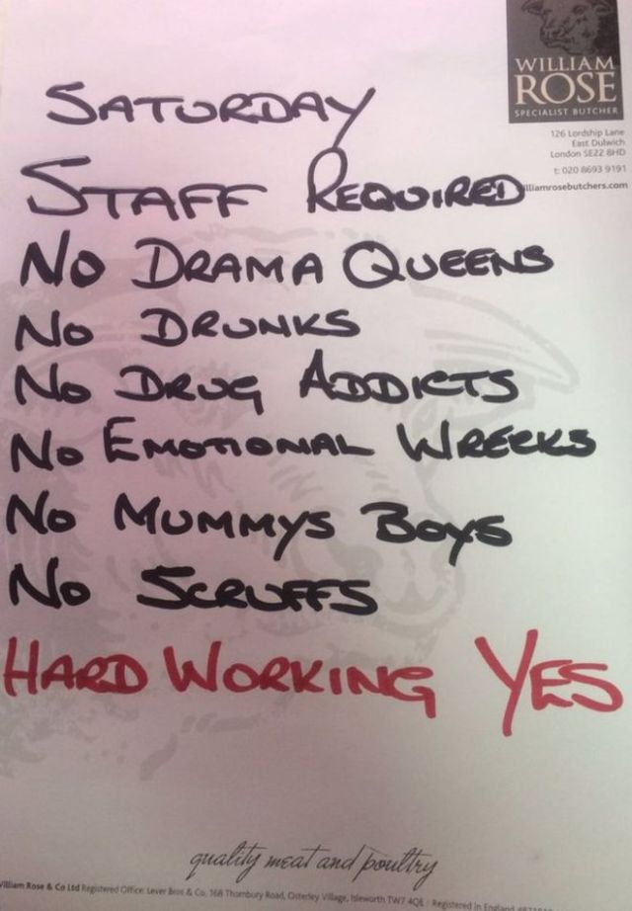
Genuine occupational requirement

Slide 25
Positive discrimination occurs where a disadvantaged or under-represented group that share a protected characteristic are treated preferentially in order to address inequality
Positive discrimination is unlawful (except in relation to disabilities), HOWEVER, positive action (in the circumstances set out in the Equality Act 2010) is permitted
Positive action in recruitment is only allowed where:
A is as qualified as B to be recruited or promoted
The employer does not have a policy of treating persons who share the protected characteristic more favourably in connection with recruitment or promotion than persons who do not share it
Taking the action is a proportionate means of achieving a legitimate aim
Positive discrimination/
action in recruitment

Slide 26
Harassment

Slide 27
A harasses B where A's conduct has the purpose or effect of violating B's dignity or creating an intimidating, hostile, degrading, humiliating or offensive environment for B.
A’s conduct will only be harassment if it relates to a protected characteristic.
The law protects an employee against harassment based on someone else's protected characteristic, or based on the perception that they have a protected characteristic.
A one-off incident can be harassment.
Harassment
Key issues

Slide 28
Relating to a protected characteristic:
EHRC guidance
A Muslim worker has a conversation with a colleague about ''Islamic State" fighters. The worker mentions to the colleague some comments made by a journalist about Islamic State fighters which are of a positive nature.
Later that month the colleague approaches the worker and asks, "Are you still promoting Islamic State?". The worker is upset at the allegation that he promotes Islamic State and brings a claim of harassment related to religion/belief.
The tribunal finds that the colleague asked that question because of the worker’s previous comments, not because the worker is a Muslim or because of anything related to the worker’s religion. The question was therefore not harassment.

Slide 29
“Unwanted" means the same essentially as "unwelcome" or "uninvited”.
The person does not have to expressly object for the conduct to be unwanted.
Examples:
Spoken words/banter
Aggression
Physical behaviour towards a person/their property
Physical gestures / facial expressions
Jokes or pranks
Imagery / graffiti
Written words
Posts on social media
Unwanted conduct

Slide 30
Case study on banter:
Evans v Xactly Corporations Ltd
There was an office culture of banter. Employees would “give as good as they got”. The claimant was called a “fat ginger pikey”.
The tribunal had been entitled to find that the comments were not unwanted as the claimant was an active participant in the banter culture, and it did not have the purpose or effect of violating his dignity or creating an intimidating, hostile, degrading, humiliating or offensive environment for him.

Slide 31
The fact that a claimant has put up with the conduct, or joined in with "banter", does not necessarily mean that the conduct is not "unwanted”.
There may be circumstances in which a course of conduct is not unwanted in the earlier stages, but at some point "oversteps the mark".
Cases are fact-sensitive.
Banter - beware

Slide 32
A engages in unwanted conduct which has the purpose or effect of violating B's dignity or creating an intimidating/ hostile/degrading/humiliating or offensive environment for B.
Where A's conduct is not shown to have the purpose, the effect of their conduct on B must be looked at.
A tribunal must take the following into account:
B's perception (subjective viewpoint)
The other circumstances of the case
Whether it is reasonable for the conduct to have that effect
Purpose or effect of violating dignity or creating proscribed environment
.

Slide 33
At a club meeting, the club manager makes derogatory comments and jokes about women to a mixed audience of men and women. It is not the club manager’s purpose to offend or humiliate anyone in the audience.
This may amount to harassment where the effect of the jokes/comments creates a humiliating or offensive environment for a man or woman in the audience (remember, you don’t have to have the protected characteristic in question).
Assessed from B's subjective viewpoint BUT also consider whether viewpoint is reasonable
Case study

Slide 34
The employer can be liable for harassment committed by their employees, whether or not the harassment is done with the employer's approval.
There is a defence available to an employer if it can show that it took "all reasonable steps" to prevent the employee from doing the discriminatory act or from doing anything of that description.
Employers should also take reasonable steps to ensure that their employees do not harass third parties with whom they come into contact with during their employment
Harassment
final notes

Slide 35
Sexual
harassment
A engages in unwanted conduct of a sexual nature which has the purpose or effect of violating B's dignity or creating an intimidating/ hostile/degrading/humiliating or offensive environment for B.
The harassment can be by persons of the same or opposite sex.
Similar principles to non-sexual harassment.

Slide 36
Victimisation

Slide 37
Victimisation
Victimisation occurs where a person (A) subjects another person (B) to a detriment because either:
B as done a ‘protected act’ or
A believes that B has done or may do a protected act.

Slide 38
Bringing proceedings under the EqA 2010
Giving evidence or information in connection with proceedings under the EqA 2010
Doing any other thing for the purposes of or in connection with the EqA 2010
Alleging (whether expressly or otherwise) that the respondent or another person has contravened the EqA 2010
Making a relevant pay disclosure
Giving false evidence/ information, or making a false allegation
NB will not be a protected act if done in bad faith
A claimant does not need to have a protected characteristic in order to be protected against victimisation.
Protected Acts
- What are they?

Slide 39
Claimant only needs to show that they have been subjected to a detriment because of a protected act.
No comparator required.
Victimisation need not be consciously motivated. A's reason for subjecting B to a detriment may be unconscious.
The protected act need not be the main or only reason for the treatment; victimisation will occur where it is one of the reasons.
Detriment

Slide 40
Like harassment, an employer is legally responsible for victimisation committed by their employees in the course of employment.
It does not matter whether the employer knows about or approves of the acts of their employee.
There is a potential defence available to an employer, if it can show that it took "all reasonable steps" to prevent the employee from doing the discriminatory act or from doing anything of that description.
Victimisation by Colleagues

Slide 41
Remedies

Slide 42
Remedies under the Equality Act 2010
Discrimination claims can attract potentially uncapped compensation awards:
“Injury to feelings” (Vento guidelines)
Financial losses
Recommendations
Declarations

Slide 43
Thank you, any questions?

Slide 44
Resources
The Equality Act 2010: https://www.legislation.gov.uk/ukpga/2010/15/contents
ACAS Guidance: https://archive.acas.org.uk/media/4267/Equality-and-discrimination-understand-the-basics/pdf/Equality_and_discrimination_understand_the_basics_-_July_2019.pdf
https://www.personneltoday.com/ (useful HR resource)
Casamitjana v The League Against Cruel Sports, case no: 3331129/2018
Ali and Hextall Court of Appeal Judgement: https://www.bailii.org/ew/cases/EWCA/Civ/2019/900.html
Mr D P Evans v Xactly Corporation Ltd: UKEATPA/0128/18/LA

