Slide 1
LCMB7002
FINANCIAL MANAGEMENT
WEEK 8
Part 1

Slide 2
Learning outcomes
Discuss the Importance of investment decisions
identify and evaluate the four main investment appraisal methods found in practice
use each of the four main investment appraisal methods to reach a decision on a particular investment opportunity;
Explain the advantages and disadvantages of each method

Slide 3
INVESTMENT APPRAISAL
Investment appraisal involves a number of techniques used to identify the attractiveness of an investment. It helps you to assess whether or not to pursue a particular investment based on alignment with strategy, prioritisation of options, affordability and acceptable returns versus unacceptable risk.
Investment decisions:
Expansion of product lines
New products
New production methods
Replacement of fixed assets

Slide 4
INVESTMENT APPRAISAL
Why is it important?
  Large amounts of resources are often invested
  Often difficult/expensive to bail out of the investment once started
Investments decisions must be consistent with the objectives of the business
  Maximising the wealth of the owner/s of the business

Slide 5
METHODS OF EVALUATING PROJECTS
Payback period (discounted or non-discounted)
Accounting rate of return - ARR (based on average investment or initial investment)
Net present value - NPV
Internal rate of return - IRR

Slide 6
METHODS OF EVALUATING
PROJECTS
Consider the changing value of money | Ignores the changing value of money
Discounted Payback | Payback
NPV | ARR based on average investment
IRR | ARR based on initial investment

Slide 7
EXAMPLE
A haulage company has three potential projects planned. Each will require investment in a refrigerated vehicle at a total cost of £120,000. The vehicle has a three year life. At the end it can be sold for £30,000. The company has already spent £6,000 on market research. The company has a cost of capital of 10%. The three projects are:
Project A | Expected cash inflow after deducting all expected cash outflows are £60,000 per annum.
Project B | Expected cash inflow after deducting all expected cash outflows are £45,000 per annum.
Project C | Expected cash inflow after deducting all expected cash outflows are £40,000 in year 1, £70,000 in year 2 and £80,000 in year 3.

Slide 8
PAYBACK PERIOD
The payback period is the length of time it takes for an initial investment to be repaid out of the net cash inflows of a project.

Slide 9
CALCULATIONS FOR PAYBACK
CASH FLOWS | PROJECT A (£000) | PROJECT B (£000) | PROJECT C (£000)
OUTLAY | 120 | 120 | 120
CASH INFLOW
YEAR 1 | 60 | 45 | 40
YEAR 2 | 60 | 45 | 70
YEAR 3 | 60 | 45 | 80
PAYBACK PERIOD | 2 YEARS | 2 YEARS 244 DAYS | 2 YEARS 46 DAYS
WORKINGS | 60+60 = 120 | 45+45+30/45 | 40+70+10/80

Slide 10
ADVANTAGES OF PAYBACK
Quick and easy to calculate
Easily understood
Concentrates on earlier cash flows
  Accuracy
  Economically more attractive

Slide 11
DISADVANTAGES OF PAYBACK
Ignores timing within payback period
Ignores cash flows after payback
Not concerned with profitability

Slide 12
ARR ON INITIAL INVESTMENT
ARR is calculated by taking the average annual profits expected from a project as a percentage of the capital invested.
Profit is NOT the same as cash flow

Slide 13
CALCULATIONS OF ARR ON INITIAL INVESTMENT
CASH FLOWS | PROJECT A | PROJECT B | PROJECT C
OUTLAY (a) | £120,000 | £120,000 | £120,000
PROFIT( after depreciation)
YEAR 1 | £30,000 | £15,000 | £10,000
YEAR 2 | £30,000 | £15,000 | £40,000
YEAR 3 | £30,000 | £15,000 | £50,000
AVERAGE PROFIT(b) | £30,000 | 15,000 | 33,333
ARR - (b/a) x 100% | 25% | 12.5% | 27.8%

Slide 14
CALCULATIONS OF ARR ON AVERAGE INVESTMENT
CASH FLOWS | PROJECT A | PROJECT B | PROJECT C
OUTLAY | £120,000 | £120,000 | £120,000
SALVAGE VALUE | £30,000 | £30,000 | £30,000
AVERAGE INVESTMENT (120+30)/2 (a) | £75,000 | £75,000 | £75,000
PROFIT
YEAR 1 | £30,000 | £15,000 | £10,000
YEAR 2 | £30,000 | £15,000 | £40,000
YEAR 3 | £30,000 | £15,000 | £50,000
AVERAGE PROFIT (b) | £30,000 | £15,000 | £33,333
ARR – (b/a) x 100% | 40% | 20% | 44%

Slide 15
ADVANTAGES OF ARR
Simple to calculate
Widely understood
Consistent with measuring the overall performance
Ensures profitability

Slide 16
DISADVANTAGES OF ARR
Ignores time factor of money
Based on accounting profits not cash flow
Takes no account of size of investment

Slide 17
TIME VALUE OF MONEY
This leads to the idea of compounding and discounting.
  Compounding
    How much will an amount NOW be worth in the FUTURE
  Discounting
    How much will an amount receivable in the FUTURE be worth NOW (PRESENT VALUE)

Slide 18

PRESENT VALUE
To calculate a present value, we need a DISCOUNT FACTOR/DISCOUNT RATE
    The cash equivalent now of a sum receivable or payable at a future date
PV – present value
FV – future value
i – represents the annual rate of interest (discount rate)
n – represents the time period when the cash flow will be received

Slide 19
DETERMINATION OF DISCOUNT RATE
Discount rate should be cost of capital
Depends on
  Financing structure
  Interest rates
  Risk

Slide 20
NET PRESENT VALUE
It takes into account all cash flows over the life of the project and makes allowance for the time value of money.
The net present value of a project is equal to the present value of the cash inflows minus the present value of the cash outflows, all discounted at the cost of capital.

Slide 21

CALCULATION OF NPV PROJECT A
END OF YEAR | CASH FLOW £ | DISCOUNT FACTOR | PRESENT VALUE £
0 | (120,000) | 1 | (120,000)
1 | 60,000 | 0.909 | 54,540
2 | 60,000 | 0.826 | 49,560
3 | 60,000 | 0.751 | 45,060
3 | 30,000 | 0.751 | 22,530
NET PRESENT VALUE |  |  | +£51,690

Slide 22
CALCULATION OF NPV PROJECT B
END OF YEAR | CASH FLOW £ | DISCOUNT FACTOR | PRESENT VALUE £
0 | (120,000) | 1 | (120,000)
1 | 45,000 | 0.909 | 40,905
2 | 45,000 | 0.826 | 37,170
3 | 45,000 | 0.751 | 33,795
3 | 30,000 | 0.751 | 22,530
NET PRESENT VALUE |  |  | +14,400

Slide 23
CALCULATION OF NPV PROJECT C
END OF YEAR | CASH FLOW £ | DISCOUNT FACTOR | PRESENT VALUE £
0 | (120,000) | 1 | (120,000)
1 | 40,000 | 0.909 | 36,360
2 | 70,000 | 0.826 | 57,820
3 | 80,000 | 0.751 | 60,080
3 | 30,000 | 0.751 | 22,530
NET PRESENT VALUE |  |  | +56,790

Slide 24
NPV DECISION RULE
Where the NPV of the project is positive, accept the project.
Where the NPV of the project is negative, reject the project.
Where NPV of the project is zero, the project is acceptable in meeting the cost of capital but gives no surplus to its owners.

Slide 25
ASSESSMENT OF NPV
Advantages
Takes timing of cash flows into account
Includes all relevant cash flows
Aligned to interests of owners
Disadvantages
More difficult to understand

Slide 26
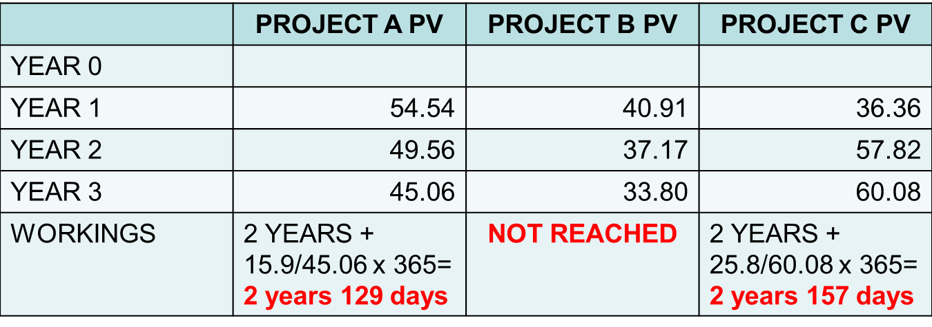
DISCOUNTED PAYBACK PERIOD
Initial investment is £120,000
Ignore the scrap value

Slide 27
EVALUATION
RANKINGS | PROJECT A | PROJECT B | PROJECT C
PAYBACK | 1st | 3rd | 2nd
ARR ON INITIAL INV | 2nd | 3rd | 1st
ARR ON AVERAGE INV | 2nd | 3rd | 1st
DISCOUNTED PAYBACK | 1st | 3rd | 2nd
NPV | 2nd | 3rd | 1st

