Slide 1
MANAGING MENTAL HEALTH AND LEARNING DIFFICULTIES
WK 6

Slide 2
Contents
  Essay guidelines
  No Health without Mental Health UK Strategy 2011
  The Case for Change for Mental Health in London - 2011

Slide 3
1948

Slide 4
No Health without Mental Health UK strategy 2011
The strategy seeks to improve mental health in general and more specifically to promote recovery and improve the outcomes and experience of services
The importance of the wider determinants of health e.g. employment, housing and debt and the physical health of those with a long term mental health condition are central to improve health of indviduals
The drive to build services around the individual, their family and friends, with possibilities for the use of personal budgets to buy services from a range of sources

Slide 5
Fewer people will suffer from stigma and discrimination by improving public and professional attitudes and reducing the institutionalised discrimination inherent in many organisations,
Services should be designed around the needs of individuals, ensuring appropriate, effective transition between services when necessary, without age-based, professional or organisational barriers and attitudes getting in the way;
Promoting mental health across the life course;
Improved services will result in fewer people suffering harm from the care and support they receive
Wherever possible, services should listen to and involve carers and others with a valid interest and provide them with information about the patient’s care, to ensure that ‘confidentiality’ does not become an obstacle to delivering safe services;

Slide 6
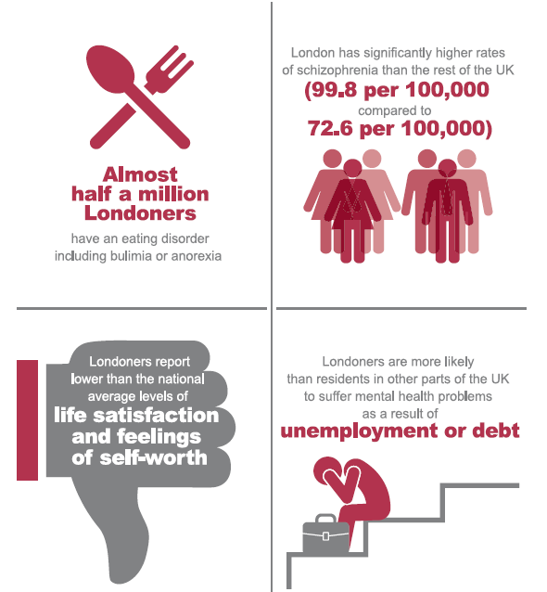
Mental Health figures - London

Slide 7
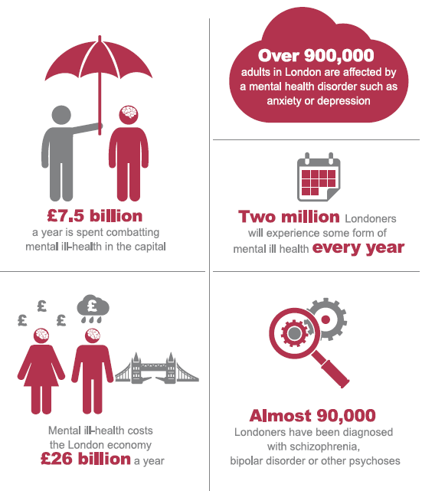

Slide 8
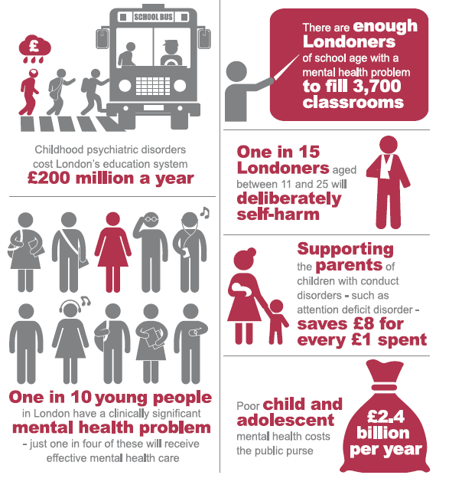

Slide 9
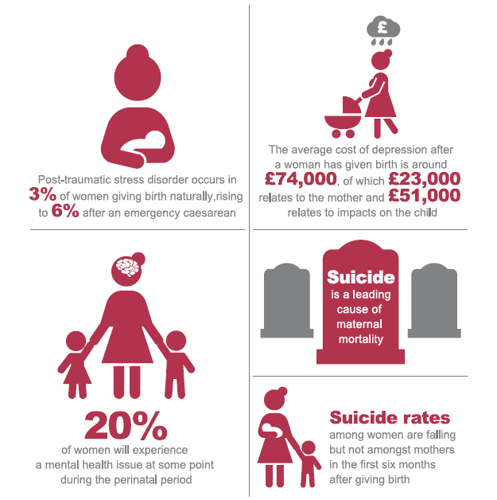

Slide 10
Project: The Case for Change for Mental Health in London - 2011
A wide range of interested parties to provide input
Services users
Relatives
Friends
Carers
A range of clinicians
A range of service providers
Academics
Commissioners

Slide 11
Consultations identified two aspects of current services for review
  services for people experiencing crisis (today’s focus)
  Services for people with a long term mental health condition
Improvements in services for those with a long term condition should lead to less need to use crisis services.
Effective crisis services should point people to effective long term services where necessary once the crisis has been resolved.
Crisis services operate within community as well as hospital settings and need to be able to effectively connect with the range of services considered in the long term conditions model.
Actions need to refocus on existing services and those who work in them rather than creating additional services and interfaces

Slide 12
Aims
improve communication between primary and secondary care, the voluntary and community sector, commissioning and local authorities
support and involve family, friends and carers where appropriate
reduce stigma as more people using services will receive the support they need in non-stigmatising settings
ensure that physical health needs are properly assessed and addressed by all services
promote a personalised recovery approach supported by appropriate services and an appropriate workforce
promote the routine use of outcome measures
contribute to the delivery of the government’s mental health strategy seeking to improve health, social and public health outcomes for individuals including those using services.
contribute to Quality Innovation Productivity & Prevention (QIPP) plans for mental health

Slide 13
Crisis
Adults who are experiencing a period of acute psychological distress, associated with a mental health problem (which may or may not have been given a formal diagnosis). The crisis may be a sudden deterioration of an existing mental health problem or they may be experiencing mental health problems for the first time. They need immediate treatment and/or care and/or support in order to prevent further damage to their mental wellbeing.

Slide 14
Some facts
people using services, their families, friends and carers and non-mental health professionals report a mismatch between how they expect mental health crisis services to operate and their actual experience
many people experiencing crisis do not know which services can meet their needs and how to access them
many of those involved in referring to crisis care do not always have the knowledge to advise people where to get help
there are delays in getting access to the right care and then too often the person is not seen by someone with sufficient skills or experience
some groups of people are more likely to reach crisis point before accessing services, and tend to access non health related services in crisis, particularly those from black, minority ethnic and refugee (BMER) communities
many specialist mental health services say that referrals of people experiencing crisis often do not meet the referral criteria for their teams
Services generally fell below recommended standards and there were frequent gaps in service provision.

Slide 15
Causal factors
secondary mental health services (including community mental health teams (CMHTs), spend much time supporting individuals living with long term mental health conditions and have limited capacity to respond in a timely manner to those presenting in a crisis
slow and delayed assessments of most appropriate services as there is no agreed model for systematic expert assessment and little use of modern assistive technologies and methods, e.g. expert tele-triage used internationally

Slide 16
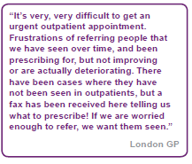
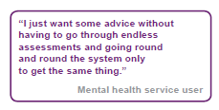
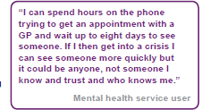

Slide 17
Key changes required
Health and social care commissioners create a whole system response commissioning plan for people experiencing crisis both encompassing the conventional “health” element of the pathway and the alternatives available to those who need a more “psychosocial” intervention
An informative, up-to-date pan-London Directory of Services (DoS) will be accessible to relevant professionals working in services where people experiencing crisis
The DoS will be accessible but restricted to agreed users such as GPs and primary care staff, acute hospital staff including those in A&E departments, the police, London Ambulance Service, social services out of hours teams, specialist mental health staff and approved crisis telephone lines
Sound working relationships between police services, mental health services and other relevant services at the local level are critical to the prevention and resolution of mental health crisis situations

Slide 18
There will be telephone advice and/ or support for anyone in a mental health crisis (111)
All people receiving support from mental health services will have personalised joint crisis plans
There will be sharing of information between relevant agencies to more effectively support people experiencing crisis (consent from individuals)
There will be collaboration between agencies and services, both statutory and non-statutory, to find more effective ways of meeting the needs of those in mental health crisis, e.g. though the creation of protocols and guidance
Frontline staff in services identified as access points such as A&E departments and GP surgeries, but also including housing, employment or benefits offices, should undertake training so that they have (as a minimum) a basic awareness of mental health problems and communication skills that avoid exacerbation of the crisis

Slide 19
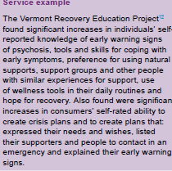
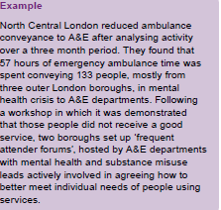

Slide 20
Impact of changes
Teams e.g. CMHTs, crisis resolution teams, home treatment teams would have greater capacity to work with those presenting in crisis and give appropriate support to families
The principle is ‘easy in, easy out’, with highly skilled and experienced secondary care mental health professionals providing timely expert assessment in times of crisis followed by a rapid route back to primary or shared care, with voluntary and community sector support where appropriate

Slide 21
The case for change identified several groups of people who are more likely to reach crisis point before seeking help and are present in large numbers in London: people from some ethnic backgrounds, refugees and asylum seekers, homeless people and lesbian, gay, bisexual and transgender (LGBT) people
Include guidance on how to identify these local groups most at risk, what services currently exist for those groups and what evidence is available about the types of services most likely to meet their mental health needs.
Include guidance how to incorporate this in Joint Strategic Needs assessment (JSNA) process

Slide 22
Monitoring duties
To identify the quality and financial gains arising from the plans e.g.
Health and Wellbeing Boards
  commissioning plans and their impact on the wider health and social care system
NHS Commissioning Board
  their contribution to the achievement of the NHS Outcomes Framework

Slide 23
2015 Refocus on Mental Health
Initiative - the Mental Health Crisis Care Concordat - a commitment to bridging what remains as one of the biggest gaps between the treatment of mental and physical health i.e. emergency care
In 2012-13, police made nearly 22,000 detentions under Section 136 of the Mental Health Act (Police power of arrest). Two thirds of these people were taken to hospital, one third were taken to police cells – inappropriate environment for someone experiencing a mental health crisis. London has done an exceptional job in addressing this, such that using a police cell as a place of safety would now not be considered.

Slide 24
The Strategic Clinical Network’s commissioning standards – a set of recommendations for commissioning mental health crisis services across London. Representatives from 22 organisations including Mind, the Metropolitan Police, the NHS, social care, housing and local councils met in spring 2015 to agree an action plan for implementation

Slide 25
Q&A
Any Questions?

Slide 26
Sources
Crisis resolution/home treatment teams and psychiatric admission rates in England, Glover Gyles et al. (2006)
House of Lords scrutiny report MCA 2013 (online)
No Health Without Mental Health: A call to action, report (2011)
Cavendish Square Group, the London Mental Health Factbook, 2015 (+ Mental Health support groups/ organisations) http://www.wlmht.nhs.uk/wp-content/uploads/2015/08/London-Mental-Health-Fact-Book-Cavendish-Square-Group.pdf
Mental Health Models of Care in London, NHS, London Health Programmes, (2011) online

