Slide 1


HAPPY JOURNEY
ONLINE PACKAGE TOUR OPERATOR

Slide 2

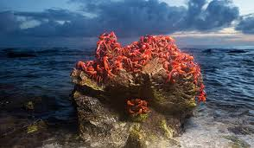
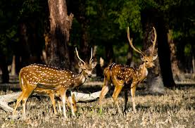
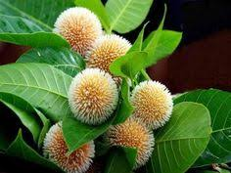

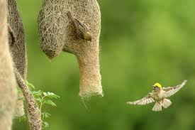
DISCOVER THE TRASURE OF BANGLADESH

Slide 3

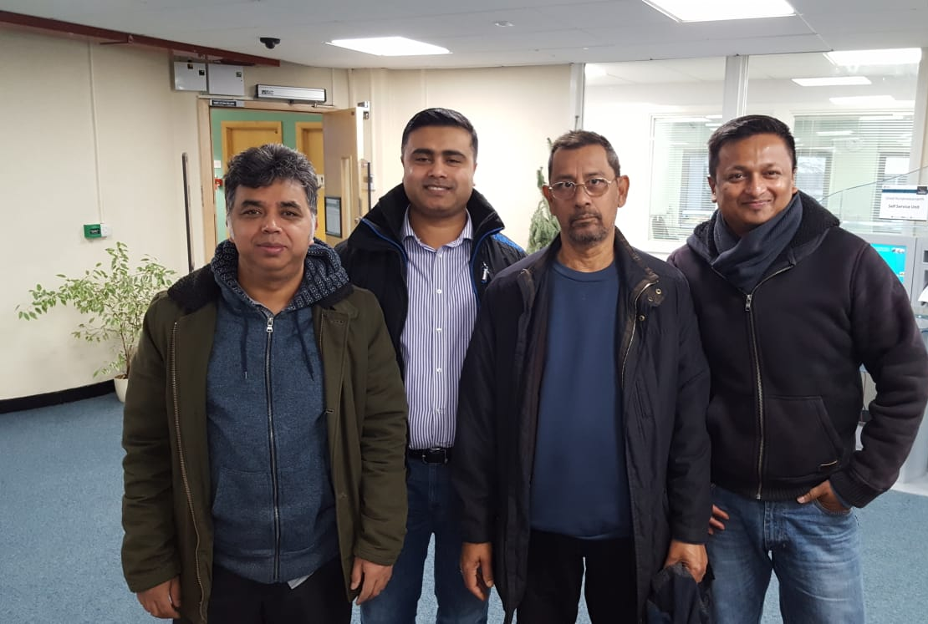
HAPPY JOURNEY LIMITED
BOARD OF DIRECTORS
Abdul Momin HR Director
Amin Shah Finance Director
Abul Kashem Operation Director
Tariqul Islam Marketing Director

Slide 4
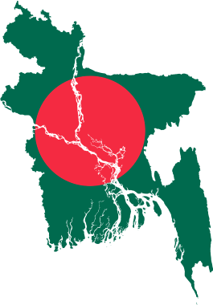

ABOUT US
HAPPINESS HAS NO REASON AND LIMIT, AS A ONLINE PACKAGE TOUR OPERATOR HAPPY JOURNEY WOULD LIKE TO OPEN THE DOOR OF UNLIMILTED ENJOYMENT AND HAPPINESS FOR THE HOLIDAY FINDER
WE AIM TO INTRODUCE THE TRAVELLERS ABOUT THE 4000 YEARS HISTORICAL AND CULTURAL HERITAGE OF BAY OF BENGAL
TO DISCOVER THE NATURE AND WILD LIFE OF THE BIGGEST MANGROVE-FOREST IN THE WORLD
TO SEE THE BEAUTIFUL SUNRISE AND SUNSET IN FRONT OF THE UNBROKEN LONGEST SEA BEACH IN THE WORLD
THE LAND OF SURPRISES, TO TREASURE THE BEAUTIFUL MEMORIES IN THEIR LIFE TIME

Slide 5
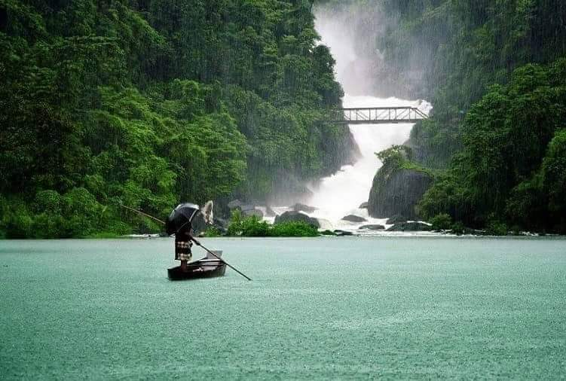
ABOUT US
WE ARE DELITED TO OFFER THE HOLIDAY LOVERS
THE BREATHTAKING DESTINATIONS!! IN BANGLADESH
COX'S BAZAR
THE WORLD'S LONGEST UNBROKEN 70 MILES (120 KM ) SEA BEACH IN BANGLADESH FOR NATURE AND WILDLIFE LOVERS
SUNDARBAN
THE BIGGEST MANGROVE FOREST IN THE WORLD, FOR THOSE WHO LOVE THRILLING ADVENTURES AND TO DISCOVER THE ROYAL BENGAL TIGERS ALONG WITH IT'S WILD HERITAGE OF THE JUNGLE

Slide 6

HAPPY JOURNEY
OVERVIEW OF

Slide 7
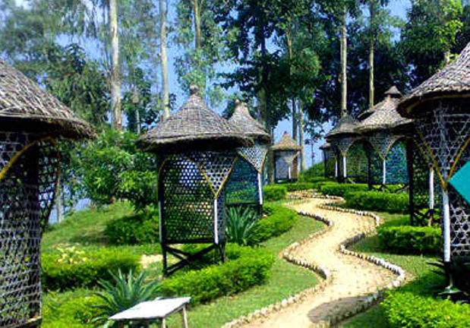
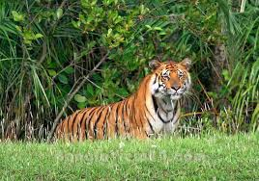
OUR MISSION
TO INTRODUCE AMAZING BANGLADESH WORLD WIDE AND TO GIVE EVERY TOURIST THE MOST BEAUTIFUL EXPERIENCES AND UNFORGETABLE MEMORIES IN THEIR LIFE TIME

Slide 8


AIMS
SELL PACKAGE HOLIDAY ONLINE AND LOCALLY AT AN AFFORDABLE PRICE TO THE POTENTIAL CUSTOMERS
OBJECTIVES
PROMOTE PACKAGES TO THE POTENTIAL CUSTOMERS
INCREASE MARKET SHARE
TO CREATE A BRAND NAME IN THE TOURISM MARKET IN NEXT 3 YEARS AND FINANCIALLY SOLVANT

Slide 9

OUR UNIQUE
DESTINATIONS

Slide 10
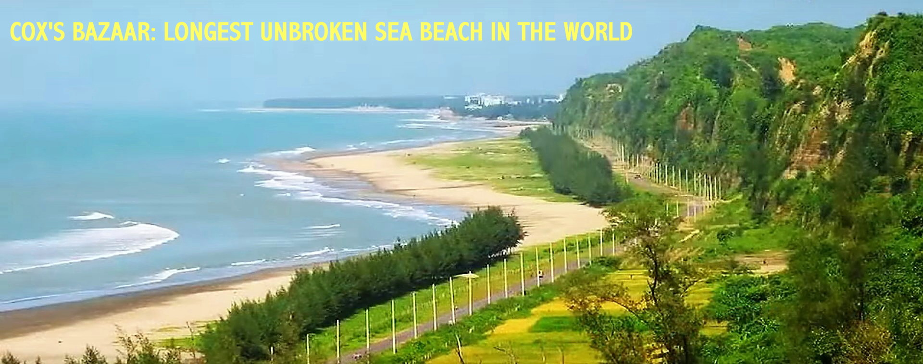
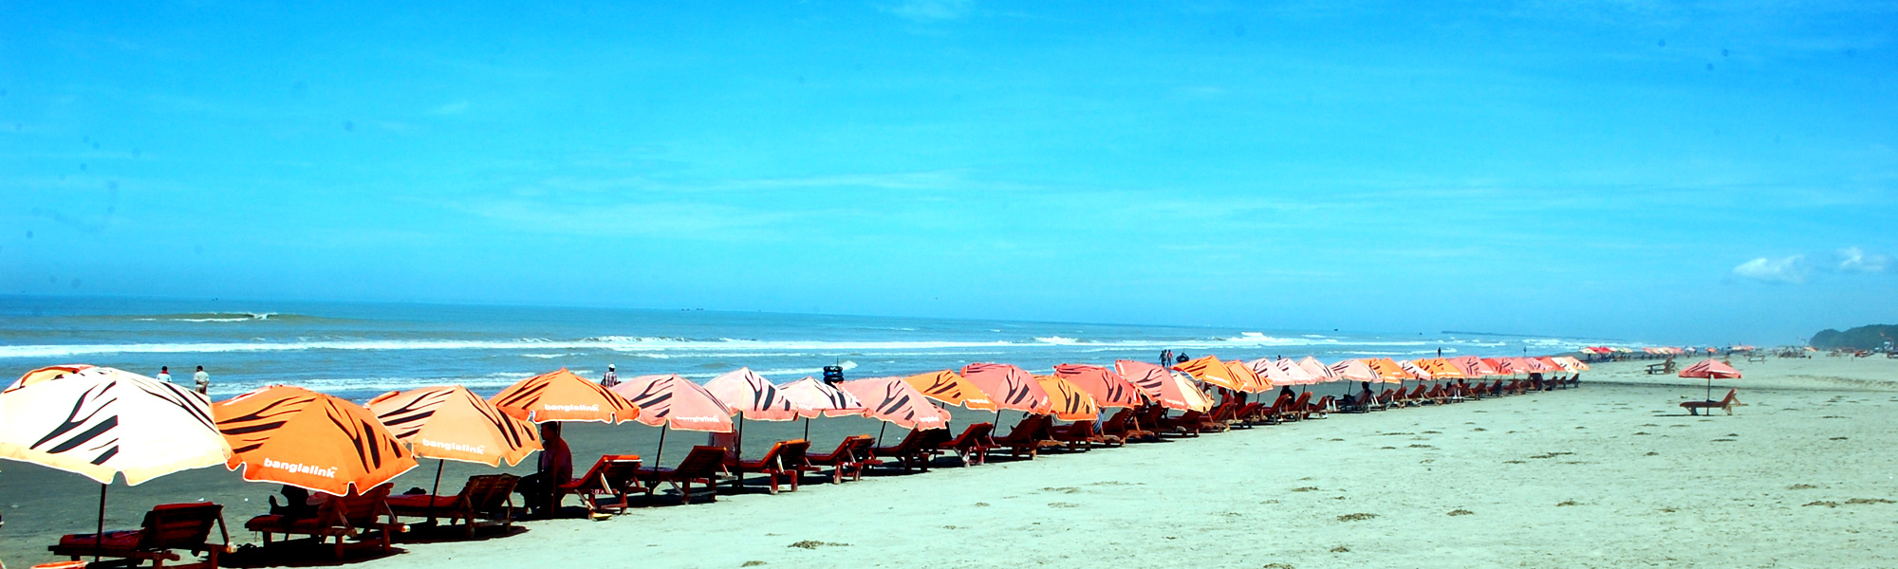
COX'S BAZAR
Cox's bazaar The longest sea beach in the world. Cox's bazaar is sandy and has a gentle slope and an unbroken length of 75 miles (120km). Cox's bazaar is also known as a fishing port , a city for holiday enjoyers , nationally and internationally.

Slide 11
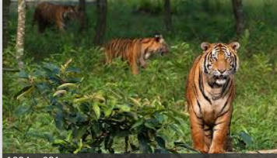
SUNDARBAN
Bangladesh is a land of scenic beauty , a beautiful country in south Asia and blessed with natural beauty that has attractions like The Sundarban , one of the largest mangrove forests in the world, a UNESCO world heritage . This unique mangrove forest is like no other forest in the world which has around 440 Royal Bengal tigers left in Bangladesh.

Slide 12


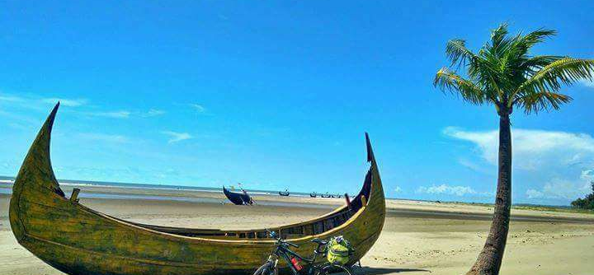
Choose your destination and fly with us....
Cox's Bazar
Explore the beauty of cox's bazar
Sundarban
The man-eating royal bengal tiger

Slide 13

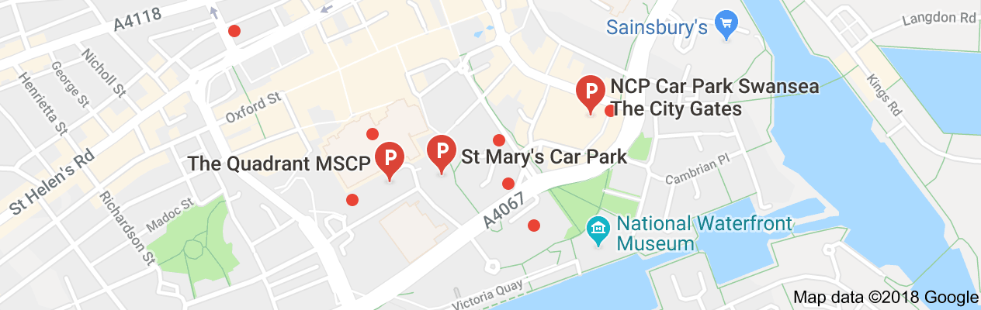
FIND US ON WEB www.happyjourney.bd.uk
FOLLOW US ON
FACEBOOK, TWITTER, INSTAGRAM AND LINKEDIN
WE ARE LOCATED IN SWANSEA CITY CENTRE, WALES,UK
Contact us

Slide 14
ABDUL MOMIN
DIRECTOR OF HUMAN RESOURCE

Slide 15
PLAN OF ACTION FOR HAPPY JOURNEY
HR GUIDE
THE DIRECTORS OF HR, FINANCE, MARKETING AND OPERATION ARE EXPERIENCED BUT REQUIED A CURRENT TRANING FOR THE PROPOSED BUSINESS
IT EXPERT HAS BENN SELECTED
A TRAINING PLAN HAS DEVELOPED TO MANAGE THE TEAM PERPORMANCE EFFECTIVELY
A GUIDE LINE HAS CREATED FOR HAPPY JOURNEY LTD, ALSO GOVERNMENT RULE AND REGULATIONS HAS FOLLOWED ACCORDINGLY FOR THE EMPOLYEES OF THE COMPANY

Slide 16
HR GUIDE
ESTABLISH EMPLOYEES TERMS AND CONDITIONS FOR HAPPY JOURNEY LTD AND TO IMPLEMENT THIS PROPERLY
HR WILL BE RESPONSIBLE FOR RECRUITING LOCALLY AND INERNATIONAL

Slide 17
HR GUIDE
WILL FOLLOW THE GUIDE LINE FOR GOVERNMENT SUCH AS
DBS CHECK
NATION WAGES REGULATION
LEGAL RIGHT TO WORK
EMPOLYEES LIABILITY INSURANCE
HEALTH AND SAFETY RELATED AFFAIRS

Slide 18
Example of National wages
Year | 25 and over | 21 to 24 | 18 to 20 | Under 18 | Apprentice
April 2018 (current rate) | £7.83 | £7.38 | £5.90 | £4.20 | £3.70
April 2019 | £8.21 | £7.70 | £6.15 | £4.35 | £3.90
Current rates
These rates are for the National Living Wage and the National Minimum Wage. The rates change every April.

Slide 19
START UP COST PROJECTION FOR HAPPY JOURNEY
HR start up cost
Total
£3,000
Expenditure for Happy Journey | Cost
Office stationaries, printing expenses | £500
IT expert remuneration | £2,500
Directors remunerations | £0,00 FOR FIRST (3)THREE MONTHS

Slide 20
ABUL KASHEM
DIRECTOR OF OPERATIONAL RESOURCES

Slide 21

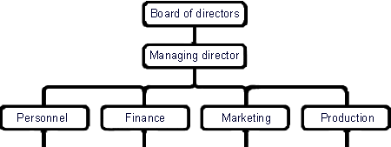
Management over view of
HAPPY JOURNEY
Team and local partners
OPERATIONAL DIRECTOR WILL PERFORM AS MD
IT SPECIALIEST
INTERNATIONAL
PARTNERS

Slide 22
OPERATIONAL RESOURCES OF
HAPPY JOURNEY
HAPPY JOURNEY WILL BE A ONLINE PACKAGE TOUR OPERATER.
PACKAGES WILL BE SOLD ONLINE, ALSO FROM THE BASED OFFICE AT SWANSEA
WE HAVE DESIGNED OUR BUSINESS TO OPERATE FROM SWANSEA CITY CENTRE
THE MAIN OPERATING OFFICE WILL BE RENTED, MODERN, WELL FURNISHED AND HIGHLY TECHNOLOGY FACILITED

Slide 23

START UP OPERATIONAL COST FOR
HAPPY JOURNEY
 | Total
 | £8470
 | Rent and rate | £450
 | Furniture’s | £1000
 | Computer and Electronics | £4000
 | Telephone and Internet | £60
 | Utility Bills | £100p/m
 | Transport (hire) | £350
 | Insurance such as (Employee, Building, Consumer, transport and others) | £200p/m
 | Fuel cost | £200
 | Licenses, Company and VAT reg | £550
 | Domain rent | £60
 | Miscellaneous and Commissions | £1500

Slide 24
Our Product and Seasons
Based on the months
February, April, July, October and December
Tour in Cox’s bazar
AND
Explore Sundarban

Slide 25
Product selection and Sales Plan
The product selection, pricing and sales will be made in co-operation with Marketing, finance, HR and operational division.
Sales will be made through the year, based on online selling, such as via webpage, social media also locally from Swansea head office.

Slide 26
Product and Customer service
Marketing division will be responsible for marketing the product and other promotional activities but FINANCE, HR and OPERATIONAL division also monitor and help each other to launch the product.
Our local and international partners will create facilities to support our customers during the holiday period and operational division will organise and liaison with the partners and also with customers.

Slide 27

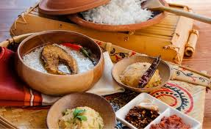


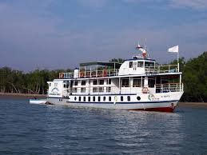
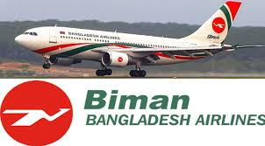
OUR PARTNERS
BANGLADESH PARJATON
BIMAN
NIJHOOM TOURS BD

Slide 28
TARIQUL ISLAM
MARKETING DIRECTOR

Slide 29
MARKETING ACTIVITIES

Slide 30
PRODUCTS AND PRICE
TOUR IN COX'S BAZAR
7nights £1450
EXPLORE SUNDARBAN
7nights £1650
( all inclusive such as flights, transportation, 4* hotel and standard accommodation and meal )

Slide 31
TARGET MARKET
Locally and Online across the UK
Such as
Families, Groups, Organisations and Individuals
An Online Market research has done via Google forms about our destination of Bangladesh !!

Slide 32
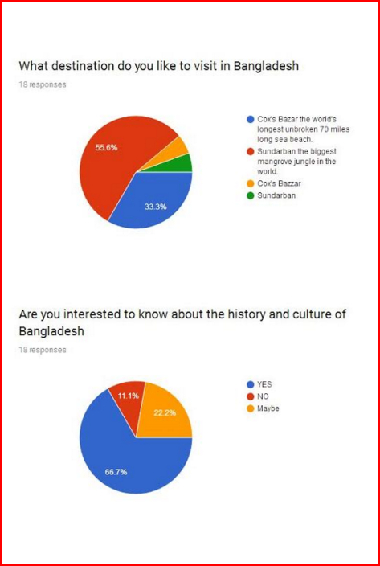
MARKET POSITION
Establishing the brand image and identity of our product according to the needs of customers
research
rersearch

Slide 33
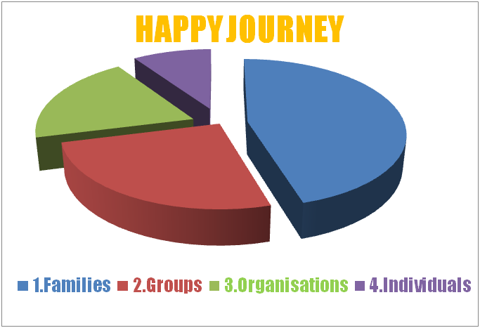
MARKET SEGMENTS OF HAPPY JOURNEY
Research

Slide 34
PRICING STRATEGIES
COST LEADERSHIP
Highly effective in gaining market share as well as drawing the customers' attention
Achieve through economics of scale, technological change like online bookings and payment
PENETRATION
Enter the market for the first time, Lower the price
Expansion strategy
PREMIUM PRICE ( Exclusive Tourism Experience )
Status reason, Impress others, Save time, feel special and niche interest

Slide 35
Marketing mix- 7 P'S
PRODUCT
Introducing 2 destination in Bangladesh, which is full of enjoyment, adventure and 4000 years of cultural and historical treasure also recognised as a UNESCO world heritage
PRICE
Affordable, In return we will give our customers wonderful memories and a peace of mind
PROMOTION
Practice a 30 second commercial, organise a promotional night, create monthly e- mail news letter, add variety to social media post, setup a booth at a local trade show, shopping mall and in the city centre, start referral program fair, give aways, leaflets, exchange business card, advertise locally and online

Slide 36
7 P'S
PLACE
Bangladesh
PEOPLE
An experienced team in customer services and we listen carefully to our customer's wishes
PROCESS
To attract families and groups, increase market share and establish a BRAND NAME in exchange of price for product
PHYSICAL EVIDENCE
Our services and product make it tangible and measurable to our clients also helps in the positioning of our brand name in the market

Slide 37
METHODS OF MARKETING
ONLINE
VIA OUR WEBSITE
www.happyjourney.bd.uk
Advertise VIA online such as Google, Youtube, Facebook, Twitter and other social media; locally in newspaper, radio, television

Slide 38

METHODS OF MARKETING
PROMOTIONAL ACTIVITIES
Give aways such as small travel kit
Open a booth at a tourism fair and organise a promotional night offer discounts for packages
Sponsor quiz competitions, social events and charity organizations
Distribute leaflets and exchange visiting cards

Slide 39
MARKETING
START UP COST FOR MARKETING OF PACKAGES AND REVENUE FOR FIRST (1 )MONTH
Total
£14,700 |  | Targeted package sell P/M for 12 months | Revenue P/M
Marketing cost for Happy Journey | Cost | Cox's bazar / Sundarban | Amount
Branding is the first impression outdoor signs, brochures, business cards etc. | £3000 | 5+5=10 | £16000
Website messaging, positioning, SEO, content, site upkeep fees | £2500
Social media platforms | £1000
Traditional Advertising including print, social media posts, outdoor, digital | £3000
Content marketing through Google. | £200
Event marketing / Promotional | £4000
Other expenses | £1000
OVER VIEW OF
MARKETING
EXPENDATURE
AND REVENUE

Slide 40

WHY PEOPLE WILL TRAVEL
WITH US ?
INTRODUCING THE UNIQUE DESTINATION IN BANGLADESH AS WELL UNESCO WORLD HERITAGE SITES
WE ASSURE THE BEST PRICE AND TO MAKE THEIR DREAMS TRUE
WE KNOW THE DESTINATION AND WE HAVE THE BEST TEAM TO SERVE
WE WILL GIVE OUR CUSTOMERS THE BEST EXPERIENCE EVER HAD
WE ASSURE A SECURE PAYMENT TRANSACTION ONLINE AND BUYING WITH US AT THE DESK
WE LOOK AFTER OUR CLIENTS AND CARE ABOUT THEIR HEALTH AND SAFETY WHILE TRAVELLING WITH US

Slide 41
AMIN SHAH
DIRECTOR OF FINANCE

Slide 42
FINANCIAL RESOURCES
To start up the business we have decided to self-finance the business from our own resources where each director will invest £15,000 each giving a grand total of £60,000 Thousand to start the business.
We looked at obtaining the finance to start up the business from Banks and Government backed personal loan schemes. After some research we found out there where advantages and disadvantages in these processes we have listed them below:

Slide 43
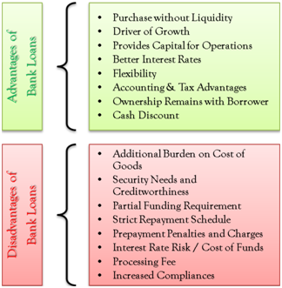
ADVANTAGES AND DISADVANTAGES
OF BANK LOAN

Slide 44
Government backed loan scheme
Advantages
All partners can individually apply for up to £25,000, with a maximum of
£100,000 per business.
The loan is unsecured, so there’s no need to put down personal assets or guarantors to support an application.
Disadvantages
Application has to be successful in order to get the start-up loan.
Rate of interest on loan for 5 years is 6%.
Induvial will be liable if loan is not repaid.
After considering all of these things we have decided to self-finance the business then we will not have to pay any interest rates or have any burden or worries to pay these debts back.

Slide 45
Estimate in terms of overall cost
After doing additional research and finding out the standard cost and factors within the tour and travel industry, we estimate it would cost us around £60,000 to set up the business.
Total Budget cost is £25,520 leaving us with £34,480 pounds in the bank.
There will also be some Legal cost such as Registering the Ltd Company, Patenting our logo, solicitor and accountant fees which we have allowed for as you can see on Graph.

Slide 46
Below I have created a graph to highlight and reflect realistic figures in setting up our tour operator business
 | Happy Journey Ltd
 | Projected Profit & Loss Statement
 | For Year Ending 30 November 2019
 |  |  |  |  |  |  |  |  |  |  |  |  |  |  |  |  |  |  | Total for Year
 |  |  |  |  | Pre-Start | Dec-18 | Jan-19 | Feb-19 | Mar-19 | Apr-19 | May-19 | Jun-19 | Jul-19 | Aug-19 | Sep-19 | Oct-19 | Nov-19 |  | 2019
 | Turnover £
 |  | Ticket Sales |  |  |  | 16,000 | 16,000 | 16,000 | 16,000 | 16,000 | 16,000 | 16,000 | 16,000 | 16,000 | 16,000 | 16,000 | 16,000 |  | 192,000
 |  |  |  |  |  |  |  |  |  |  |  |  |  |  |  |  |  |  | -
 |  | Director Introduced Funds |  |  | 60,000 |  |  |  |  |  |  |  |  |  |  |  |  |  | 60,000
 |  |  |  |  | 60,000 | 16,000 | 16,000 | 16,000 | 16,000 | 16,000 | 16,000 | 16,000 | 16,000 | 16,000 | 16,000 | 16,000 | 16,000 |  | 252,000
 | Operation Costs £
 |  | Payment to Airlines |  |  | - | - | - | 14,000 | - | - | 14,000 | - | - | 14,000 | - | - | 14,000 |  | 56,000 |  |  | 33.00%
 |  | Foreign Partners Commission |  |  | - | - | - | 2,400 | - | - | 2,400 | - | - | 2,400 | - | - | 2,400 |  | 9,600 |  |  | 13.80%
 |  | Operational Costs |  |  |  |  |  |  |  |  |  |  |  |  |  |  |  |  | -
 |  |  |  |  | - | - | - | 16,400 | - | - | 16,400 | - | - | 16,400 | - | - | 16,400 |  | 65,600
 | Gross Profit £ |  |  |  | 60,000 | 16,000 | 16,000 | - 400 | 16,000 | 16,000 | - 400 | 16,000 | 16,000 | - 400 | 16,000 | 16,000 | - 400 |  | 186,400
 | Overheads £
 |  | Director Salary |  |  |  | - | - | - | 4,000 | 4,000 | 4,000 | 4,000 | 4,000 | 4,000 | 4,000 | 4,000 | 4,000 |  | 36,000
 |  | IT Executive |  |  | 2,500 | - | - | - | - | - | - | - | - | - | - | - | - |  | 2,500
 |  | Employee Related Expenses |  |  |  | - | - | - | 552 | 552 | 552 | 552 | 552 | 552 | 552 | 552 | 552 |  | 4,968 |  |  | 13.80%
 |  | Rent |  |  | 450 | 450 | 450 | 450 | 450 | 450 | 450 | 450 | 450 | 450 | 450 | 450 | 450 |  | 5,850
 |  | Rates |  |  | - | - | - | - | - | - | - | - | - | - | - | - | - |  | -
 |  | Furniture |  |  | 1,000 | - | - | - | - | - | - | - | - | - | - | - | - |  | 1,000
 |  | IT Equipment |  |  | 4,000 | - | - | - | - | - | - | - | - | - | - | - | - |  | 4,000
 |  | Tel & Fax |  |  | 60 | 60 | 60 | 60 | 60 | 60 | 60 | 60 | 60 | 60 | 60 | 60 | 60 |  | 780
 |  | Heat & Light |  |  | 100 | 100 | 100 | 100 | 100 | 100 | 100 | 100 | 100 | 100 | 100 | 100 | 100 |  | 1,300
 |  | Transport |  |  | 350 | 350 | 350 | 350 | 350 | 350 | 350 | 350 | 350 | 350 | 350 | 350 | 350 |  | 4,550
 |  | Business Insurance, PL, EL& others |  |  | 400 | 400 | 400 | 400 | 400 | 400 | 400 | 400 | 400 | 400 | 400 | 400 | 400 |  | 5,200
 |  | Fuel |  |  | 200 | 200 | 200 | 200 | 200 | 200 | 200 | 200 | 200 | 200 | 200 | 200 | 200 |  | 2,600
 |  | Office & Stationary |  |  | 500 | 500 | 500 | 500 | 500 | 500 | 500 | 500 | 500 | 500 | 500 | 500 | 500 |  | 6,500
 |  | Marketing & Promotions |  |  | 14,700 | - | 3,000 | - | 3,000 | - | 3,000 | - | 3,000 | - | 3,000 | - | 3,000 |  | 32,700
 |  | Repairs & Renewals |  |  | 500 |  |  |  |  |  |  |  |  |  |  |  |  |  | 500
 |  | Miscellaneous and Local commissions |  |  | 500 | 200 | 200 | 200 | 200 | 200 | 200 | 200 | 200 | 200 | 200 | 200 | 200 |  | 2,900
 |  | Domain rent |  |  | 60 | 60 | 60 | 60 | 60 | 60 | 60 | 60 | 60 | 60 | 60 | 60 | 60 |  | 780
 |  | VAT reserve |  |  | 200 | 200 | 200 | 200 | 200 | 200 | 200 | 200 | 200 | 200 | 200 | 200 | 200 |  | 2,600
 |  |  |  |  |  | - | - | - | - | - | - | - | - | - | - | - | - |  | -
 |  |  |  |  |  | - | - | - | - | - | - | - | - | - | - | - | - |  | -
 |  | Accountancy / Companies House Filing |  |  |  | - | - | - | - | - | - | - | - | - | - | - | - |  | -
 |  | Pre-Start up Costs
 |  |  |  |  | 25,520 | 2,520 | 5,520 | 2,520 | 10,072 | 7,072 | 10,072 | 7,072 | 10,072 | 7,072 | 10,072 | 7,072 | 10,072 |  | 114,728
 | Total Costs £ |  |  |  | 25,520 | 2,520 | 5,520 | 18,920 | 10,072 | 7,072 | 26,472 | 7,072 | 10,072 | 23,472 | 10,072 | 7,072 | 26,472 |  | 154,808
 | Operating Profit £ |  |  |  | 34,480 | 13,480 | 10,480 | (2,920) | 5,928 | 8,928 | (10,472) | 8,928 | 5,928 | (7,472) | 5,928 | 8,928 | (10,472) |  | 71,672
 | Interest Expense £ |  |  |  | - | - | - | - | - | - | - | - | - | - | - | - | - |  | -
 | Net Profit £ |  |  |  | 34,480 | 13,480 | 10,480 | (2,920) | 5,928 | 8,928 | (10,472) | 8,928 | 5,928 | (7,472) | 5,928 | 8,928 | (10,472) |  | 71,672
 | Corporation Tax £ |  |  | 0% |  | 0 | 0 | 0 | 0 | 0 | 0 | 0 | 0 | 0 | 0 | 0 | 0 |  | 0
 | Profit after Tax £ |  |  |  | 34,480 | 13,480 | 10,480 | (2,920) | 5,928 | 8,928 | (10,472) | 8,928 | 5,928 | (7,472) | 5,928 | 8,928 | (10,472) |  | 71,672
 | Cumulative Cash in Bank £ |  |  |  | 34,480 | 47,960 | 58,440 | 55,520 | 61,448 | 70,376 | 59,904 | 68,832 | 74,760 | 67,288 | 73,216 | 82,144 | 71,672 |  | 71,672
c

Slide 47
CONCLUSION

Slide 48
SWOT
STRENGTH:
OUR OWN FINANCE, EXPERIENCED EMPLOYEES AND OUR KNOWLEDGE ABOUT BANGLADESH
WEAKNESS:
IT KNOWLEDGE, LOCAL AND FOREIGN PARTNERS, WEATHER AND LOCATION, LOCAL AND FOREIGN BANKS
OPPORTUNITY:
THERE ARE NO COMPETITOR IN THE MARKET
THREATS:
BREXIT, POLITICAL UNSTABILITY IN BANGLADESH

Slide 49
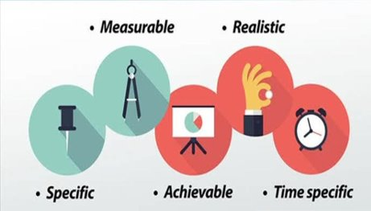
SMART OBJECTIVES OF
HAPPY JOURNEY
S M A R T
SPECIFIC: WE WANT TO LAUNCH OUR ONLIE TOUR BUSINESS
MEASURABLE: WE HAVE CREATED A GENTT CHART TO TRACK WORK PROGRESS
ACHIEVEABLE: TO CAPTURE THE MAXIMUM MARKET SHARE
WITH IN 3 YEARS
REALISTIC: WE WILL FOLLOW OUR MARKETING STRATEGIES TO BE SUCCESSFUL
TIME SPECIFIC: WE AIM TO LAUNCH OUR BUSINESS BY 20TH DECEMBER 2018

Slide 50
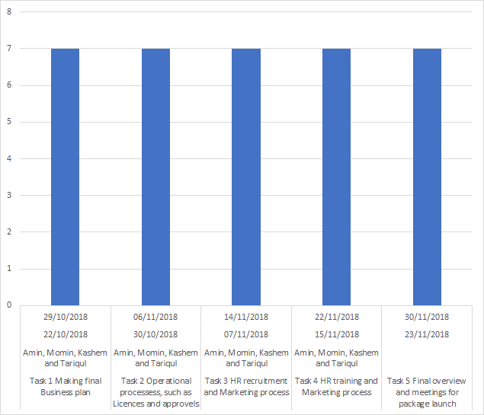
GANTT CHART FOR HAPPY JOURNEY LTD
G

Slide 51
CONTINGENCY PLAN
FOR
HAPPY JOURNEY LTD
OUR BACK UP PARTNERS AND TEAM
IN INLAND AND ABROAD
WILL BE STAND BY

Slide 52
THANK YOU ALL
ON BEHALF OF
HAPPY JUORNEY LTD

