Slide 1

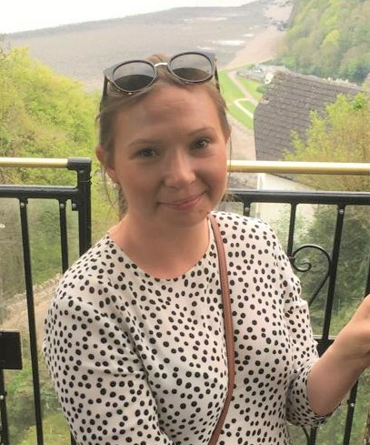

Profiad addysgu blaenorol
Previous teaching experiences
For the last 7 years I have worked as a Science Technician where I was lucky enough to help in practical lessons.
As an Co-Tutor for a form I was partly responsible for teaching 11-18 year olds our ‘Thought for the Week’. Thoughts for the week included current events, religious festivals, history, politics, and ALN Awareness. We also taught our class the Welsh language, and literacy and numeracy skills. This was always the most enjoyable and rewarding part of my day.
Amdana i
About Me
Angharad David
I love to travel and see our amazing world, but I’m also at my happiest spending time at the beach at home in Porthcawl with friends and family.
I have a real passion for geography, and am energetic, extremely organised, and excellent at multi-tasking. I’m excited to finally being able to put my love of teaching into practice.
Y math o athro hoffaf bod
The kind of teacher I aspire to be
I aspire to be a teacher that:
Treats everybody with respect and fairness
Is motivational to ensure everyone reaches their goals
Instils confidence in students
Is approachable if someone is struggling.
Is known for my passion for my subject
Inspires curiosity about the world.
Inspires pupils to love the planet as much as I do.
Is understanding
Is always learning
Rhesymau dros ddewis addysgu fel proffesiwn
Reasons for entering the teaching profession
Since university, I have been lucky enough to work surrounded by outstanding teachers and become increasingly inspired to become a teacher. My enjoyment of my form class has stimulated my desire to have a more significant role in the pupils’ school lives, helping make a difference. I recently had the opportunity to teach a young pupil in my class to tell the time. The moment he learned to put all the steps together will stay with me forever, and reinforced my love of being in the classroom.
Geography has always been a passion of mine, and this year I have been truly inspired by the next generation leading the fight against climate change. Educating and inspiring pupils to love the planet as I do will be my commitment whenever I am lucky enough to teach geography.
Cefndir academaidd
Academic history
Aberystwyth University: BSc Geography 2:1
Porthcawl Comprehensive:
A Levels: AAC – Geography, Chemistry, Economics
AS Level: Maths
GCSEs: 6A* 5A
A* - Chemistry, Physics, Biology, English Language, Maths, Welsh
A – Geography, French, German, English Literature Music
Meysydd / pynciau medraf eu haddysgu
Areas / subjects I could teach
I would love to teach Geography as that is my passion I pursued through university.
I would also happily teach Science as I thoroughly enjoyed A Level Chemistry and am familiar with the Science curriculum from working in an inspiring Science department for the past 7 years.

