Slide 1
Module Name: Electronics II
Module Code: ACDA6001
Lecture – 1- PART 2
Prepared By,
- Jenifer Prince Devaraj M.E., M.Ed.

Slide 2
Logic Gates
Logic gates perform logical operation.
Each gate has one or more input and only one output. OR, AND & NOT are basic gates.
NAND and NOR gates are known as universal gates, from which basic gates can be derived.

Slide 3
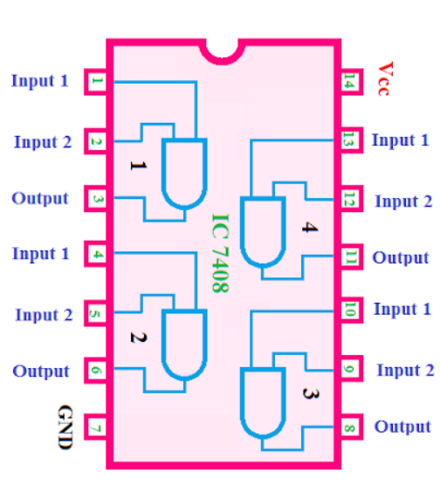
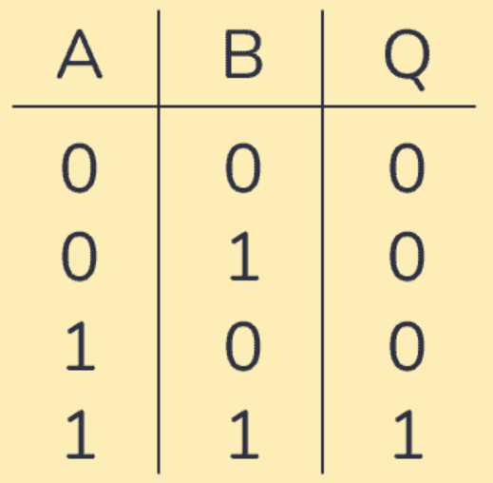
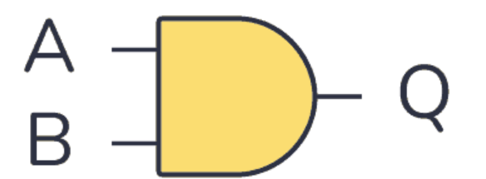

Logic Gates
Pin Diagram
Truth table
Logic symbol
$$Q=A.B$$
AND Gate
The AND gate performs a logical multiplication commonly known as AND function.
The output is high when both the inputs are high.
The output is low when any one of the inputs is low.

Slide 4
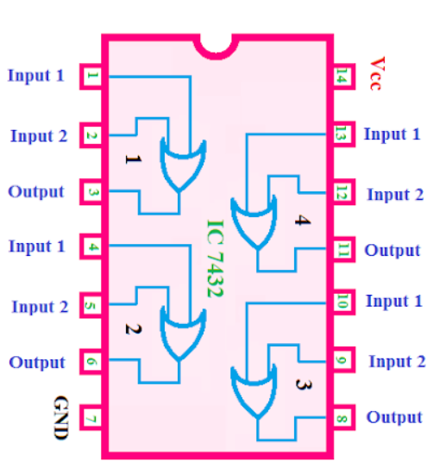
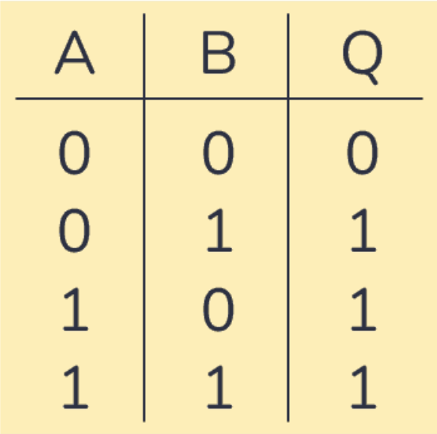
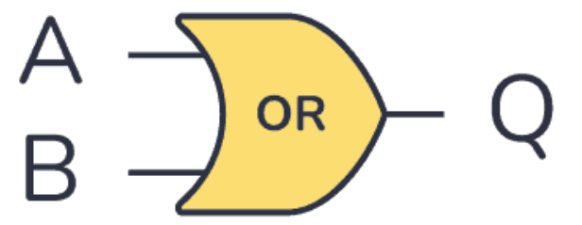

Logic Gates
Pin Diagram
Truth table
Logic symbol
$$Q=A+B$$
OR Gate:
The OR gate performs a logical addition.
The output is high when any one of the inputs is high.
The output is low when both the inputs are low.

Slide 5
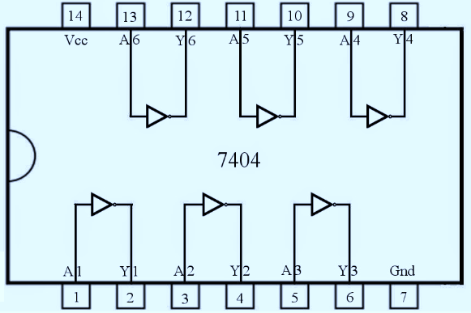
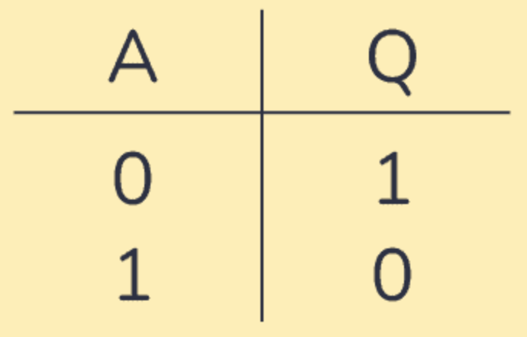
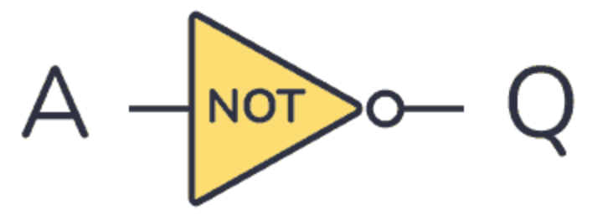

Logic Gates
Pin Diagram
Truth table
Logic symbol
$$Q=\text{Ᾱ}$$
NOT Gate:
The NOT gate is called an inverter.
The output is high when the input is low and the output is low when the input is high.

Slide 6
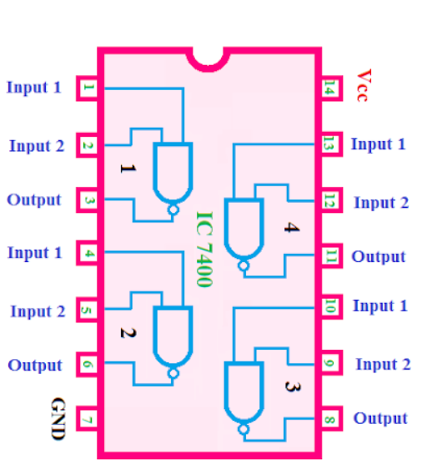
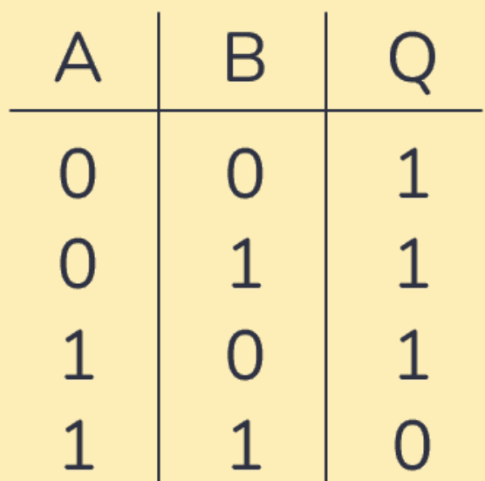
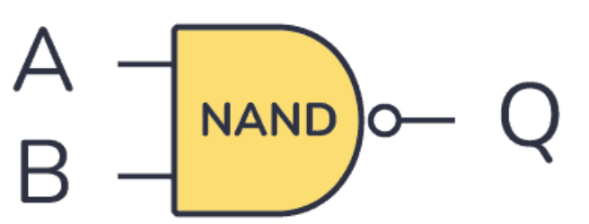
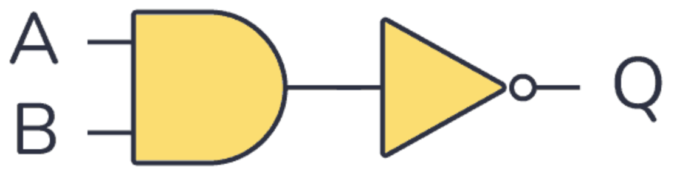

Logic Gates
Logic symbol
Pin Diagram
Truth table
$$=$$
$$Q=\overline{A.B}$$
NAND Gate:
The NAND gate is a contraction of AND-NOT.
The output is high when both inputs are low and any one of the input is low .
The output is low level when both inputs are high.

Slide 7
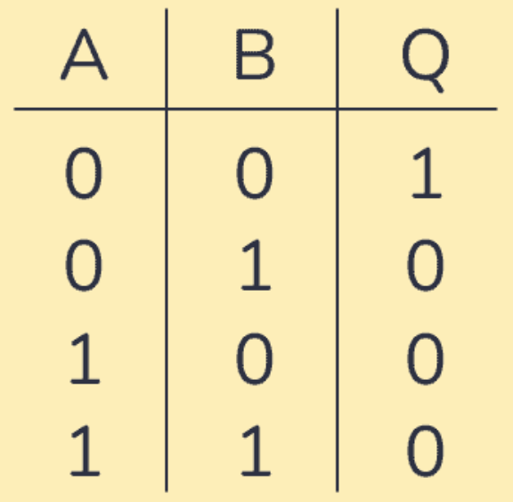
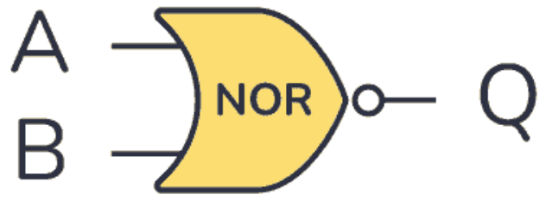
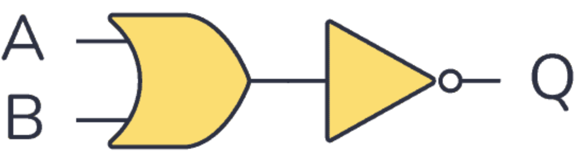
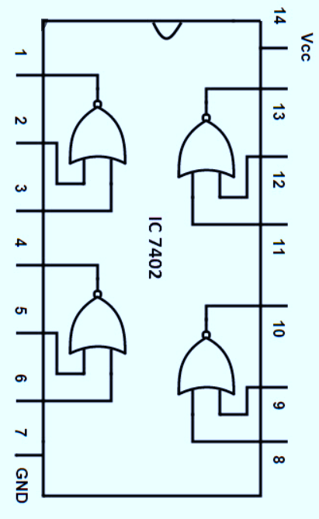

Logic Gates
Logic symbol
Pin Diagram
Truth table
$$=$$
$$Q=\overline{A+B}$$
NOR Gate:
The NOR gate is a contraction of OR-NOT.
The output is high when both inputs are low.
The output is low when one or both inputs are high.

Slide 8
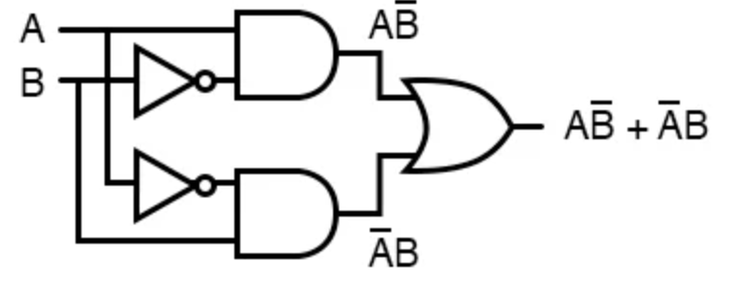
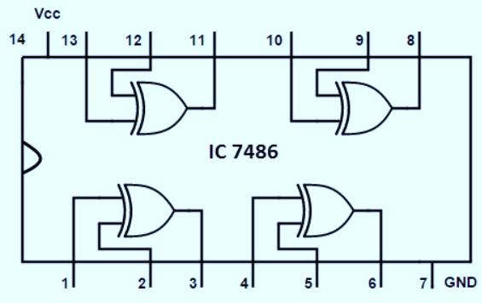
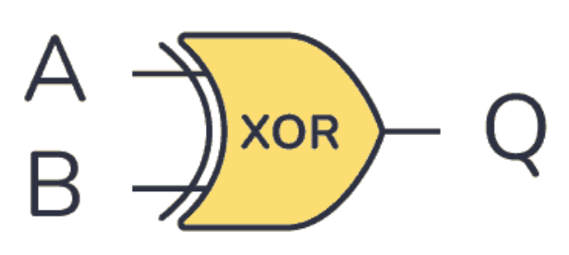
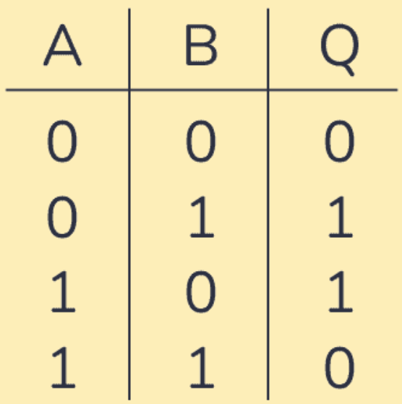

Logic Gates
Pin Diagram
Logic symbol
Truth table
$$=$$
$Q=\overline{A+B}$ = $A\overline{B}+\overline{A}B$
X-OR Gate:
The output is high when any one of the inputs is high.
The output is low when both the inputs are low, and both the inputs are high.

Slide 9
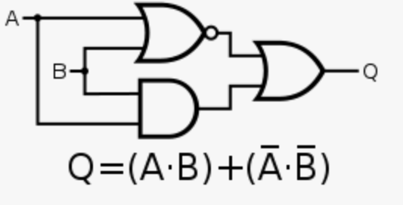
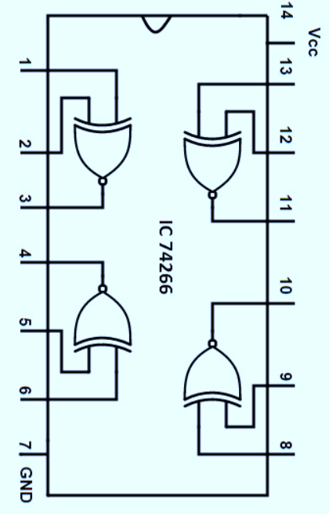

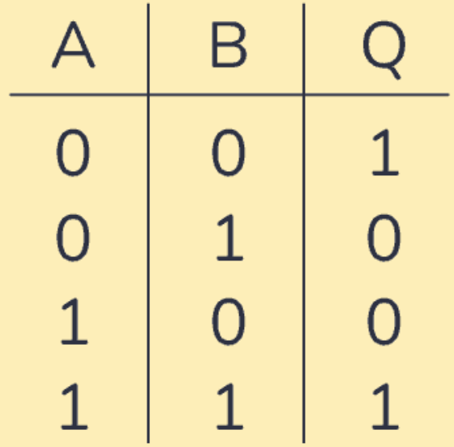

Logic Gates
Pin Diagram
Logic symbol
Truth table
$$=$$
$Q=\overline{A.B}$ = $AB+\overline{AB}$
X-NOR Gate:
The output is low when any one of the inputs is high.
The output is high when both the inputs are low, and both the inputs are high.

Slide 10
Boolean Algebra - laws
Boolean algebra simplify the output Boolean expression of the combinational network.
Laws in Boolean Algebra:
The three laws in Boolean Algebra are as follow
Commutative law
Associative law
Distributive law

Slide 11
Boolean Algebra - laws
Commutative law
Law 1: This law states that the order in which the variables are ORed makes no difference in the output.
Eg: A+B=B+A
Input |  | Output
A | B | LHS | RHS
 |  | A+B | B+A
0 | 0 | 0 | 0
0 | 1 | 1 | 1
1 | 0 | 1 | 1
1 | 1 | 1 | 1

Slide 12
Boolean Algebra - laws
Commutative law
Law 2: This law states that the order in which the variables are ANDed makes no difference in the output.
Eg: A.B=B.A
Input |  | Output
A | B | LHS | RHS
 |  | A.B | B.A
0 | 0 | 0 | 0
0 | 1 | 0 | 0
1 | 0 | 0 | 0
1 | 1 | 1 | 1

Slide 13
Boolean Algebra - laws
Associative law
Law 1: This law states that ORing of several variables, the result is the same regardless of the grouping of the variables.
Eg: (A+B)+C =A+(B+C)
Input |  |  |  |  | Output
A | B | C | A+B | B+C | LHS | RHS
 |  |  |  |  | (A+B)+C | A+(B+C)
0 | 0 | 0 | 0 | 0 | 0 | 0
0 | 0 | 1 | 0 | 1 | 1 | 1
0 | 1 | 0 | 1 | 1 | 1 | 1
0 | 1 | 1 | 1 | 1 | 1 | 1
1 | 0 | 0 | 1 | 0 | 1 | 1
1 | 0 | 1 | 1 | 1 | 1 | 1
1 | 1 | 0 | 1 | 1 | 1 | 1
1 | 1 | 1 | 1 | 1 | 1 | 1

Slide 14
Boolean Algebra - laws
Associative law
Law 2: This law state that ANDing of several variables, the result is the same regardless of the grouping of the variables.
Eg: ((AB).C) =A.(BC)
Input |  |  |  |  | Output
A | B | C | AB | BC | LHS | RHS
 |  |  |  |  | (AB).C | A.(BC)
0 | 0 | 0 | 0 | 0 | 0 | 0
0 | 0 | 1 | 0 | 0 | 0 | 0
0 | 1 | 0 | 0 | 0 | 0 | 0
0 | 1 | 1 | 0 | 1 | 0 | 0
1 | 0 | 0 | 0 | 0 | 0 | 0
1 | 0 | 1 | 0 | 0 | 0 | 0
1 | 1 | 0 | 1 | 0 | 0 | 0
1 | 1 | 1 | 1 | 1 | 1 | 1

Slide 15
Boolean Algebra - laws
Distributive law
This law state that ORing several variables and ANding the result with a single variables is equivalent to ANDing the result with a single variable with each of the several variables and then ORing the products.
Eg: A.(B+C)=AB+AC
Input |  |  |  |  |  | Output
A | B | C | B+C | AB | AC | LHS | RHS
 |  |  |  |  |  | A(B+C) | AB+AC
0 | 0 | 0 | 0 | 0 | 0 | 0 | 0
0 | 0 | 1 | 1 | 0 | 0 | 0 | 0
0 | 1 | 0 | 1 | 0 | 0 | 0 | 0
0 | 1 | 1 | 1 | 0 | 0 | 0 | 0
1 | 0 | 0 | 0 | 0 | 0 | 0 | 0
1 | 0 | 1 | 1 | 0 | 1 | 1 | 1
1 | 1 | 0 | 1 | 1 | 0 | 1 | 1
1 | 1 | 1 | 1 | 1 | 1 | 1 | 1

Slide 16
Boolean Algebra - laws
Rules in Boolean Algebra
Any single variables (or) function of several variables can have either 1 (or) 0. Its value depends on the Boolean algebra.
Complement of a variable is represented by a bar (ˉ) or dash (‘ ) over the letter. Eg: Complement of A=0, is (or) A’=1
Logical AND operator of two variables is written by a dot (.) between two variables (or) simply writing together. Eg: A.B (or) AB
The logical OR operator of two variables is written by putting a plus (+) sign in between the variables. Eg: A+B, A+B+C

Slide 17
Boolean Algebra - Rules
The logical OR operator in Boolean algebra gives following results
  0+0=0
  0+1= 1
  1+0 = 1
  1+1=1
The logical AND operator in Boolean algebra gives following results
  0×0=0
  0×1= 0
  1×0= 0
  1×1=1

Slide 18

Boolean Algebra - Rules
The NOT Operator in the Boolean algebra with variables having either 0 (or) 1 gives

Slide 19
Boolean Algebra - Rules
The following rules are formulated from the above statement
Rule 1:
0+A=A (or) A+0=A
(ie) 0+0=0 ; 0+1=1
Rule 2:
1+A=1 (or) A+1=1
(ie) 1+0=1 ; 1+1=1
Rule 3:
A+A=A
(ie) 0+0=0 ; 1+1=1

Slide 20

Boolean Algebra - Rules
0+1=1 (or) 1+0=1
Rule 5:
0.A=0 (or) A.0=0
0.0=0 ; 0.1=0
Rule 6:
1.A=A (or) A.1=A
1.0=0 ; 1.1=1

Slide 21
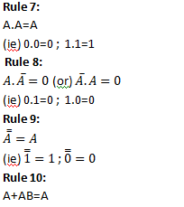
Boolean Algebra - Rules

Slide 22

Boolean Algebra - Rules

Slide 23
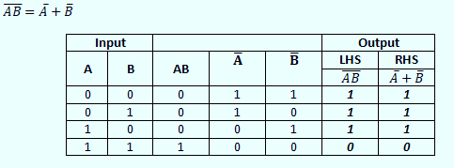
Boolean Algebra - Rules
Theorems in Boolean Algebra
Demorgan’s Theorem
Theorem 1: This theorem states that the complement of a product is equal to the sum of the complements.

Slide 24
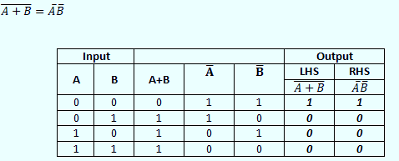
Boolean Algebra - Rules
Demorgan’s Theorem
Theorem 2: The complement of a sum is equal to the product of the complements.

Slide 25
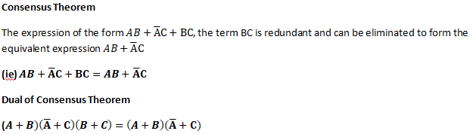
Boolean Algebra - Rules

Slide 26
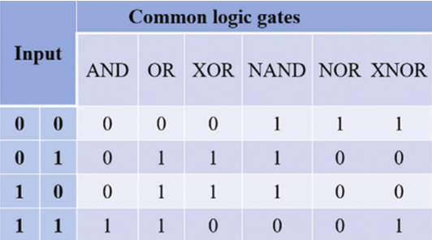
ACTIVITY
Verify the Following Gates with its truth table using Proteus
AND
OR
NOT
NAND
NOR
XOR
XNOR

Slide 27
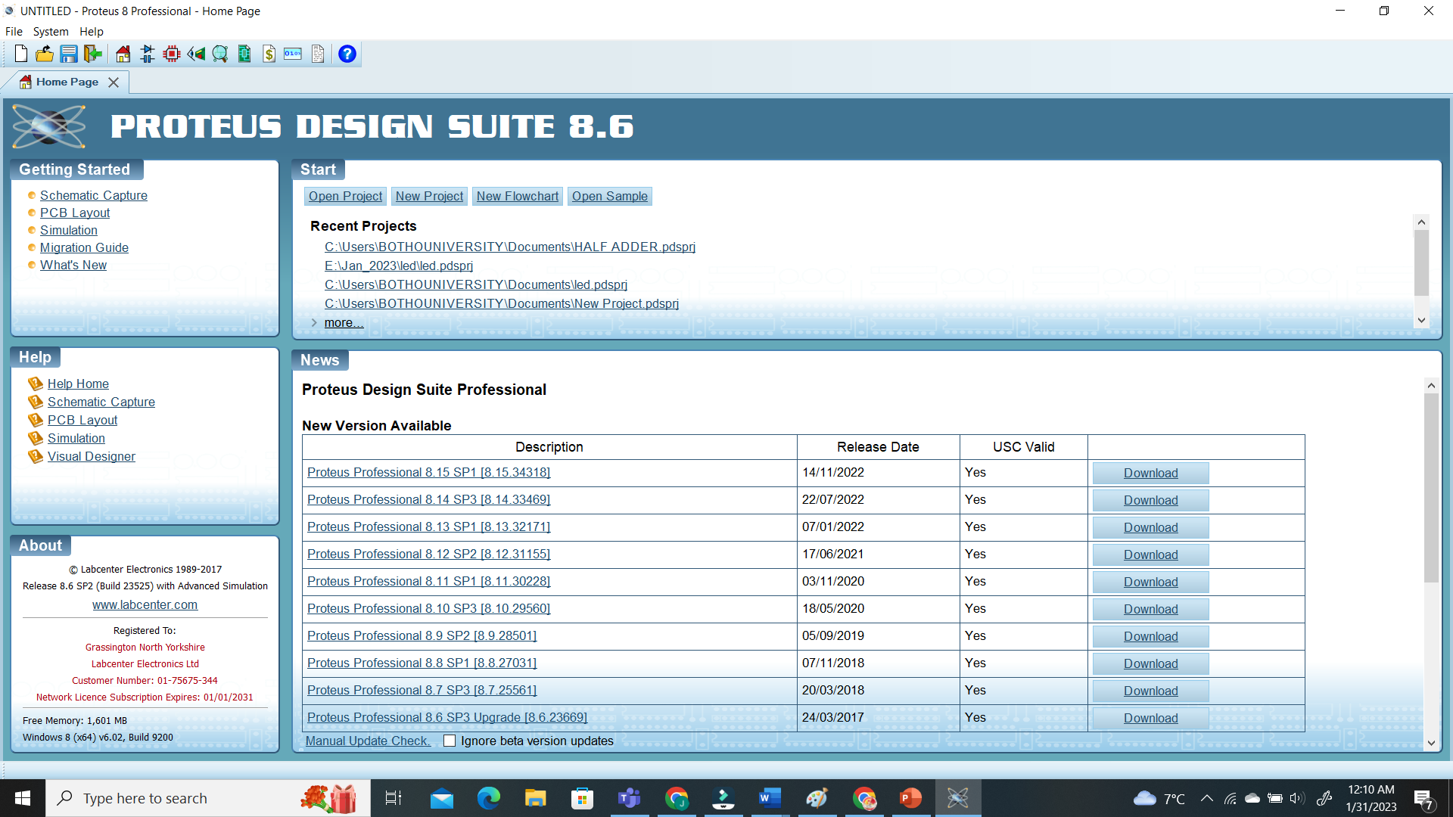
Proteus - Procedure
Step 1: Open Proteus 8.6

Slide 28
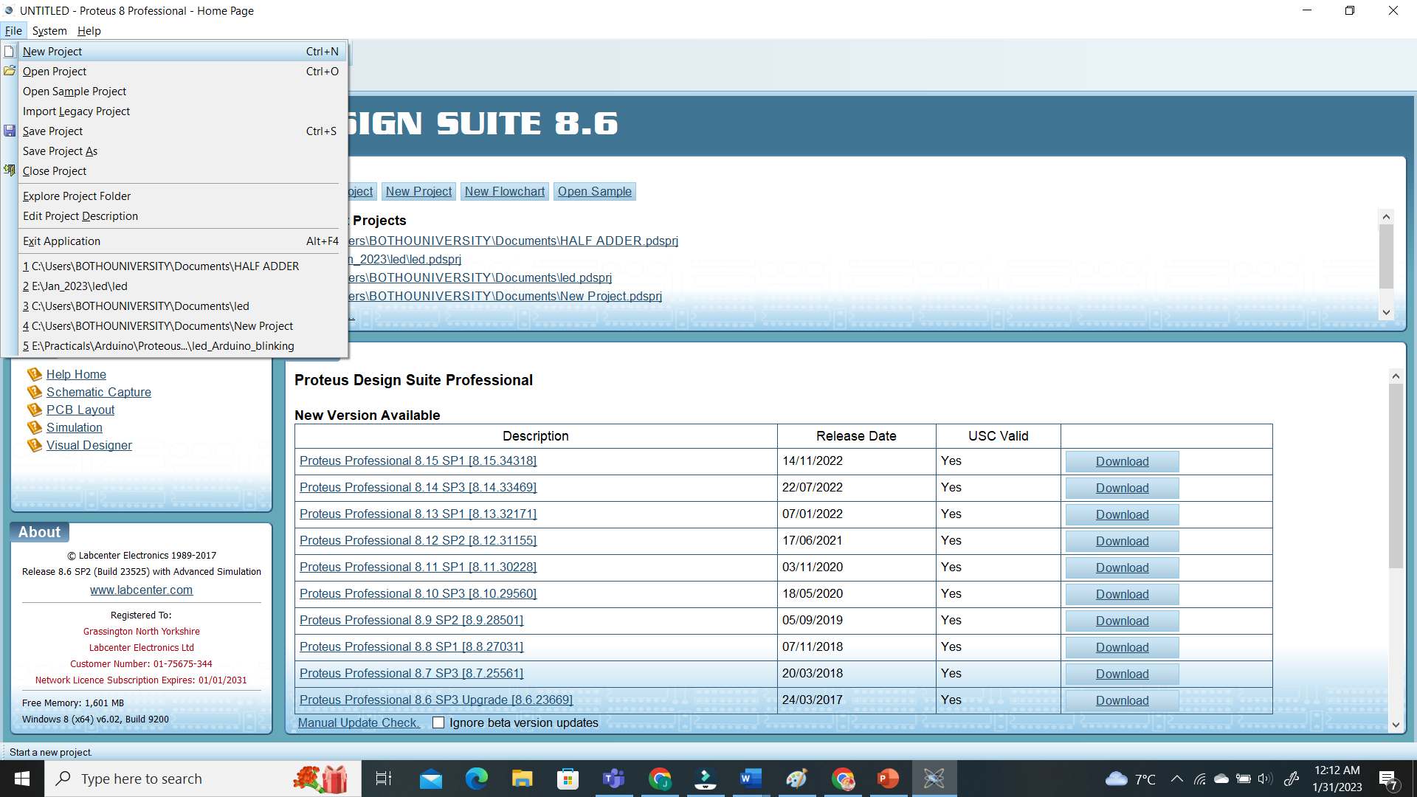
Proteus - Procedure
Step 2: Open File → New Project

Slide 29
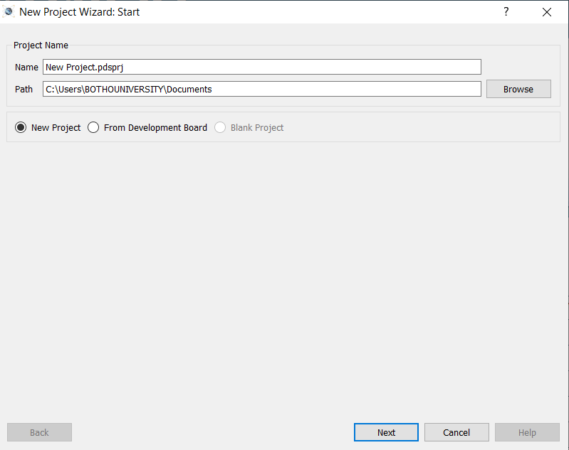
Proteus - Procedure
Step 2: Open File → New Project

Slide 30
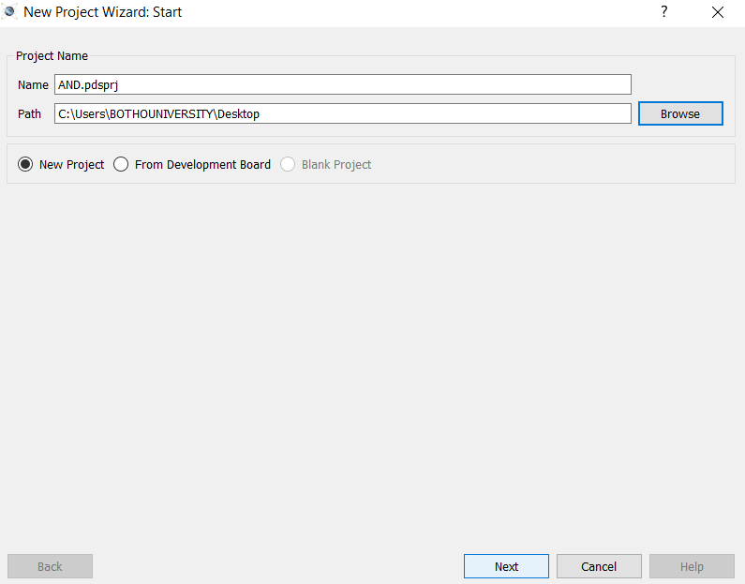
Proteus - Procedure
Step 2: Open File → New Project→ File Name

Slide 31
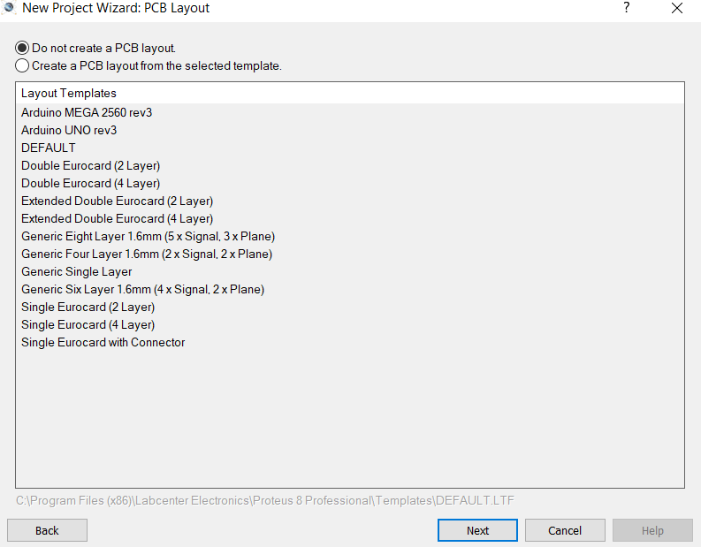
Proteus - Procedure
Step 2: Open File → New Project→ File Name

Slide 32
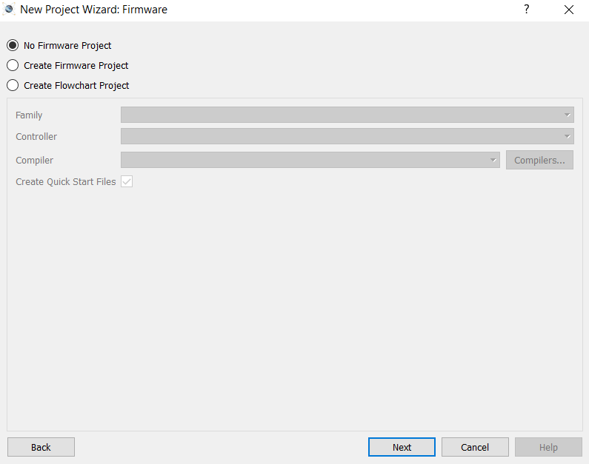
Proteus - Procedure
Step 2: Open File → New Project→ File Name

Slide 33
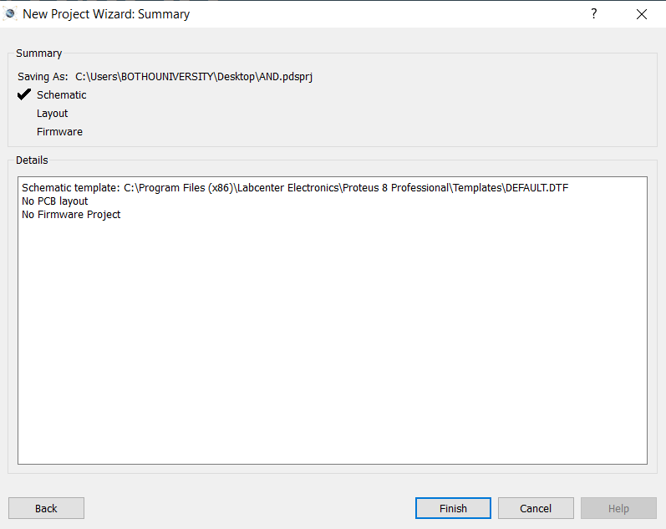
Proteus - Procedure
Step 2: Open File → New Project→ File Name

Slide 34
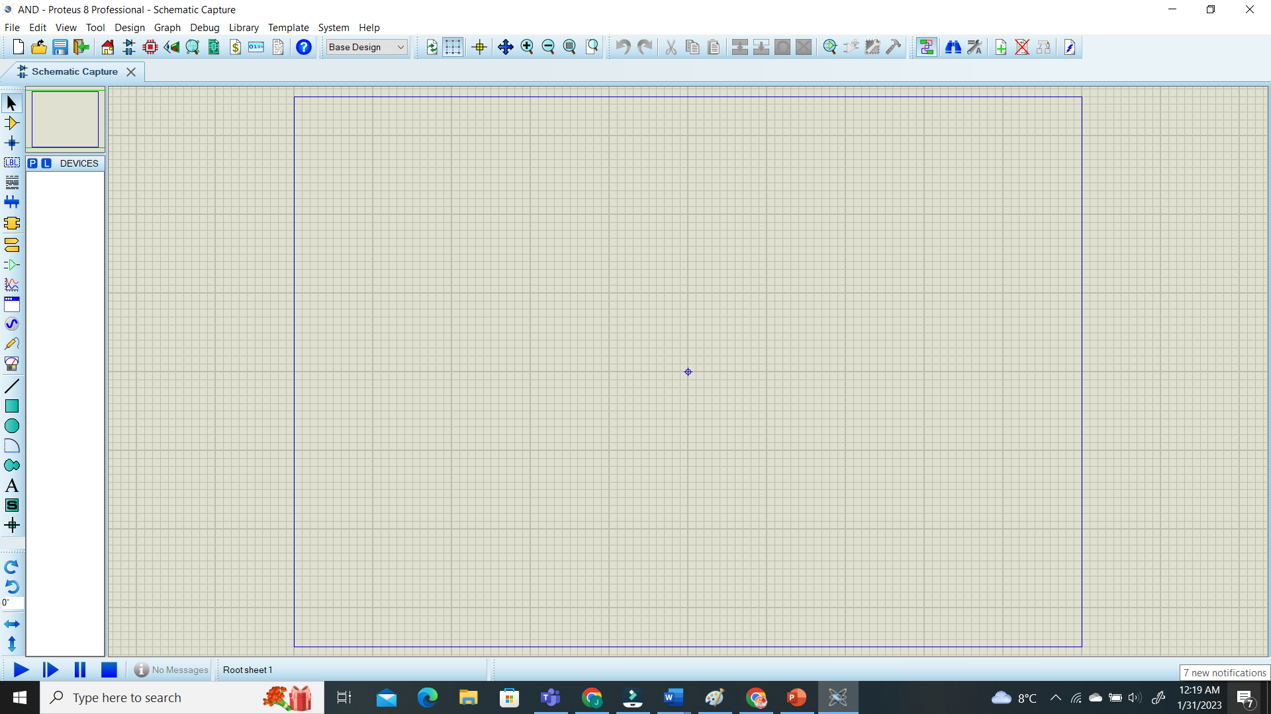
Proteus - Procedure
Step 3: Worksheet

Slide 35
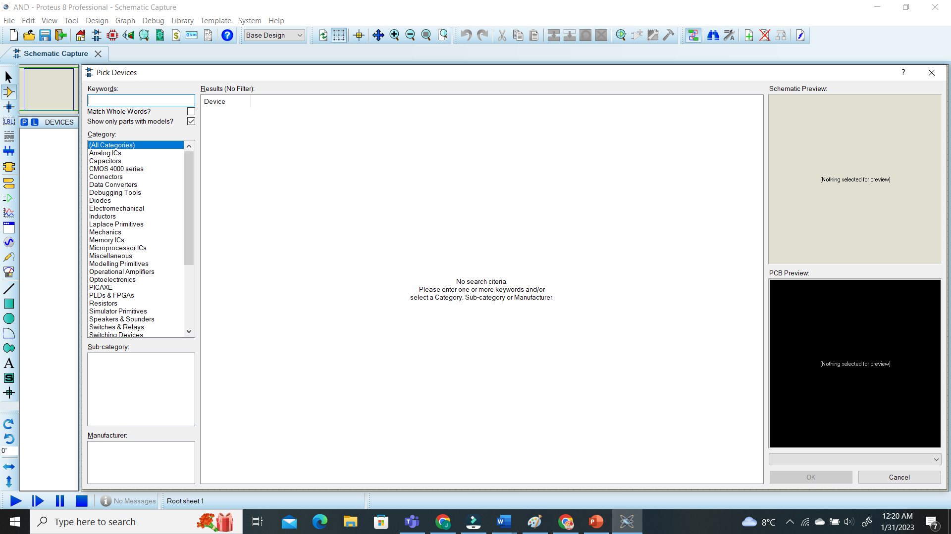
Proteus - Procedure
Step 3: To Add a Component

Slide 36
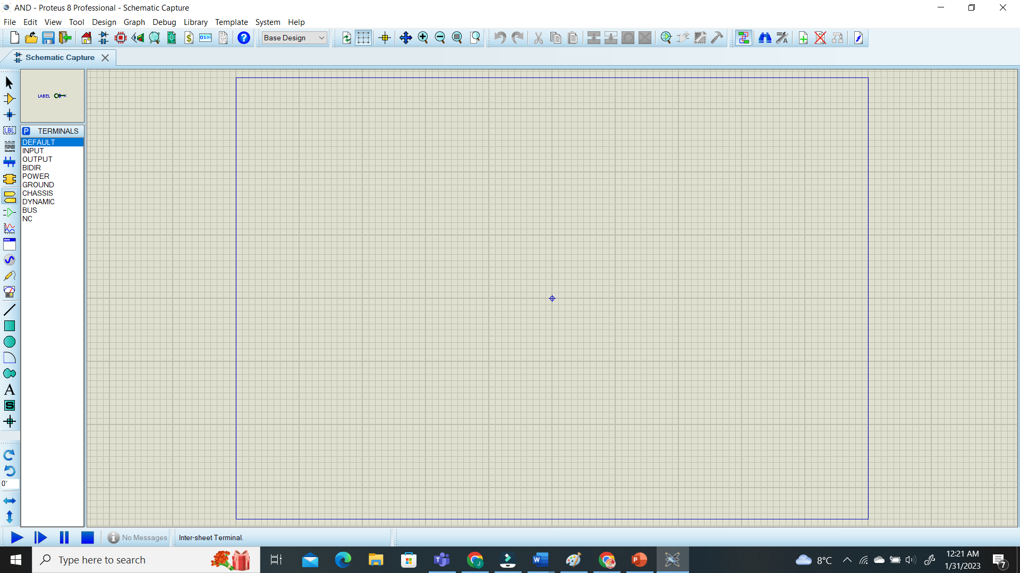
Proteus - Procedure
Step 4: To Add a terminal

Slide 37
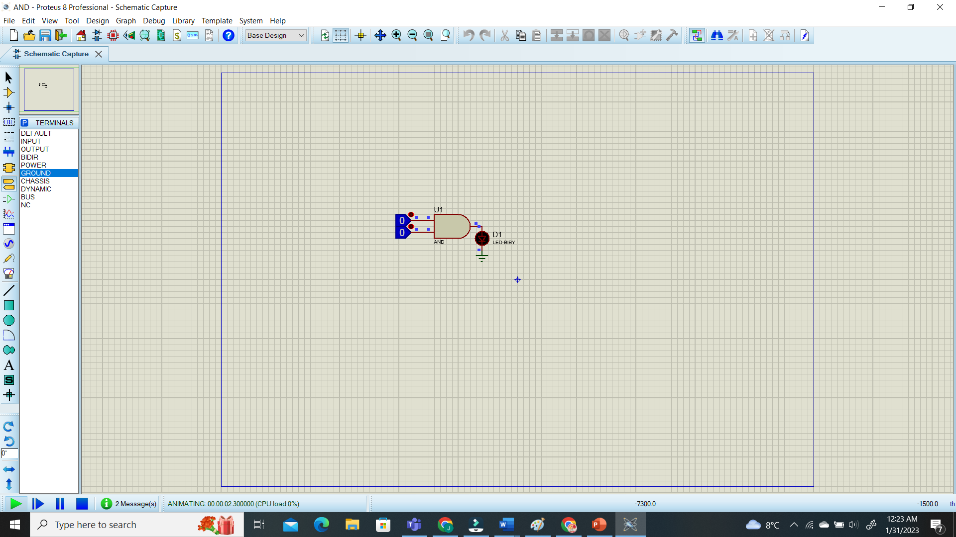
Proteus - Procedure
Step 4: To Run the Circuit

Slide 38
Thank You

