Slide 1
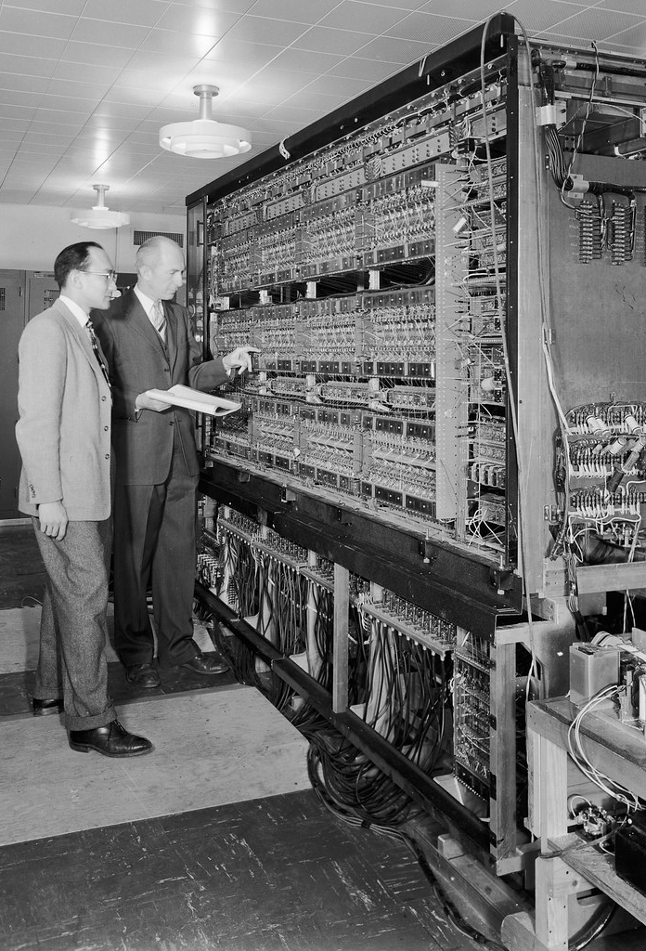
Computer & OS History & Introduction
The deck includes ‘Bg.’ supplementary slides that include additional background information.
  That is not directly covered but supports the main content and is optional reading material.
This Photo by Unknown Author is licensed under CC BY-SA-NC

Slide 2
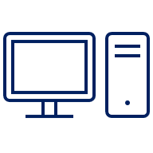
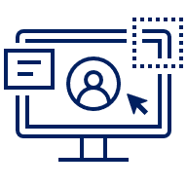
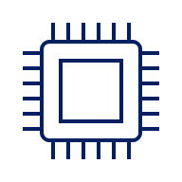

Section: Benefits of Computer Technology

Slide 3

Q. Benefits of Computers?
Reflect, consider and discuss:
Q. How are Computers & Technology improving our lives?
This Photo by Unknown Author is licensed under CC BY-NC-ND

Slide 4
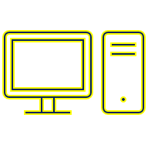
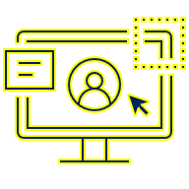
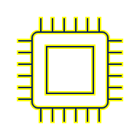

Benefits: Some ways Computers have & are improving society
4Cs: Enhanced Communication, Collaboration, Connectivity & Creativity
Enhanced learning: Access to information / knowledge
Enhanced Creativity and application of skills
Enhanced Productivity
Improved Health monitoring and modern healthcare
Automation / time-saving / making jobs easier
Meeting Social needs
Access to Entertainment, Music, Movies & Videos
Enhanced engagement, joy, fun and games.
E-commerce: Greater accessibility, choice and convenience.
… Technology is ever-evolving and meeting greater human needs than ever before.
Notes:
Bg.
14 Ways the Internet Improves Our Lives, 7 Surprising Ways Computer Science Benefits Society
5 Ways Technology Has Improved Our Quality Of Life, What is the Importance of Technology?

Slide 5
Section: History

Slide 6
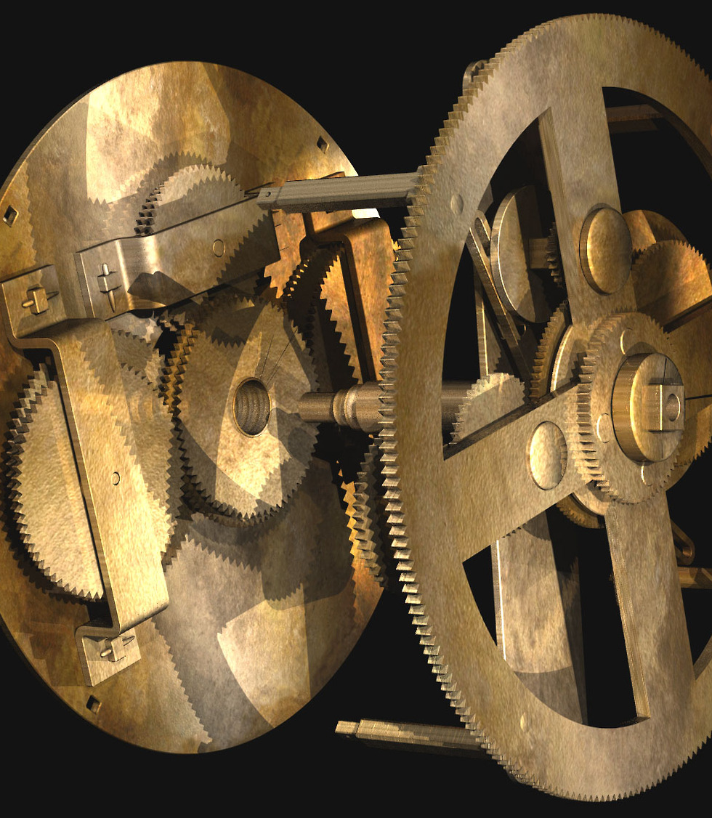
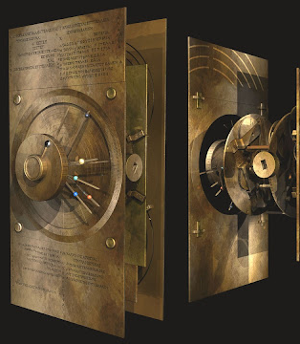
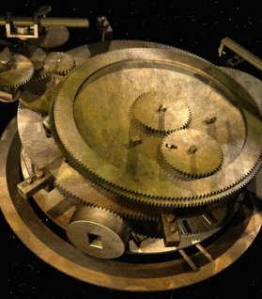
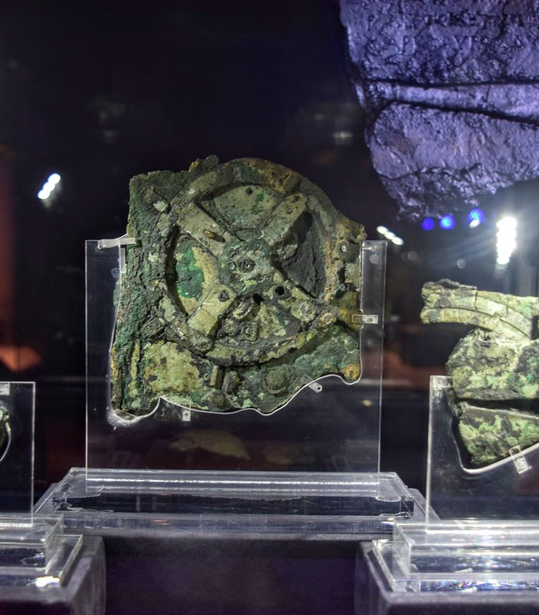
Bg. The Antikythera Mechanism
The Antikythera Mechanism is often called the world's first computer because its complex gear system was used by the ancient Greeks to predict astronomical positions, eclipses, and even the dates of the Olympics.
This 2,000-year-old device, discovered in 1901, functioned like a mechanical calendar and celestial calculator, using gear ratios to perform calculations and model the cosmos.
The Antikythera Mechanism is a Masterpiece of Engineering: It is the most complex piece of ancient engineering known, made of bronze with over 30 gearwheels.
An Mechanical Astronomical Calculator of the Cosmos: It was used to predict the positions of the Sun, Moon, and planets, as well as lunar and solar eclipses. The mechanism provided a mechanical model of the ancient Greek universe, displaying cosmic order through its intricate gearing.
Variables & Calculations: It's considered the first computer as users could input variables i.e. a date on the main gear. The mechanism then performed complicated calculations through its geared system to provide astronomical information. The same input, process and output system that are used by computers today.
Ancient Brilliance: The device showcases the advanced knowledge and ingenuity of ancient Greek astronomy and engineering.
A Precursor to Modern Technology: Its mechanical ingenuity highlights a lineage that predates mechanical calculators in Europe by over 1,600 years.
This Photo by Unknown Author is licensed under CC BY-NC-ND
This Photo by Unknown Author is licensed under CC BY

Slide 7
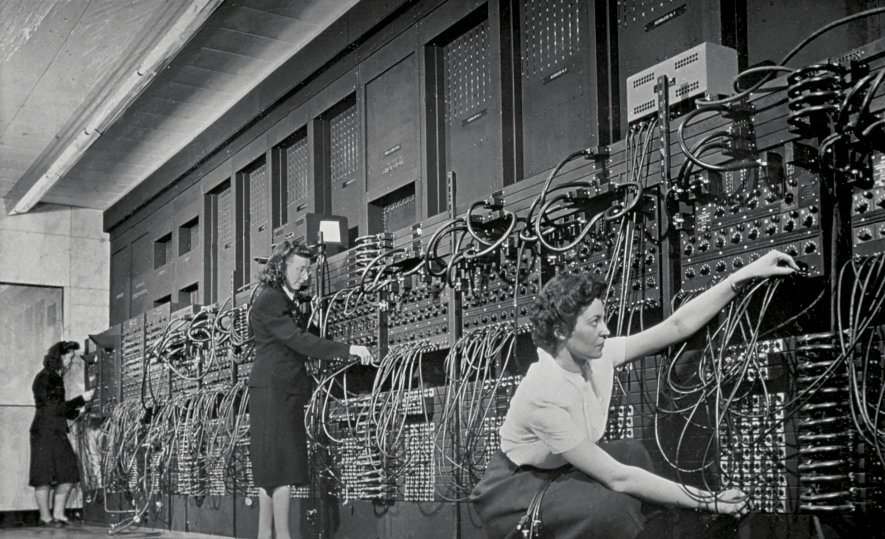
Bg. The World's first computer
The World's first computer depends on the definition
But the ENIAC (1945) is considered the first general-purpose electronic digital computer, built by Eckert & Mauchly for complex calculations
Wwhile the ancient Greek Antikythera Mechanism approx. 100 BC is recognized as the first analog computer for astronomy
Aand Charles Babbage conceptualized programmable mechanical computers in the 1830s.
This Photo by Unknown Author is licensed under CC BY-SA-NC

Slide 8
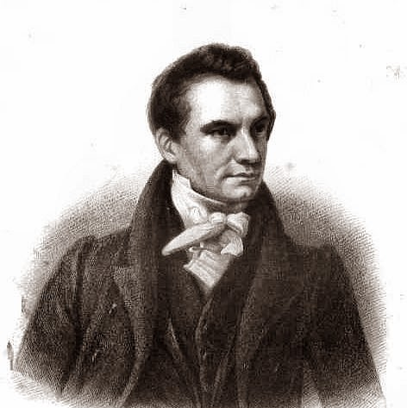
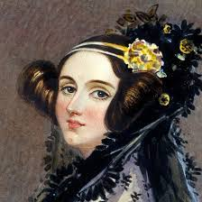
Bg. Charles Babbage & Ada Lovelace (1800s)
“English mathematician and inventor Charles Babbage (1791 – 1871) is credited with having conceived the first automatic computer / calculator. During the mid-1830s Babbage developed plans and a protype Analytical Engine, that would make calculations mechanically. Although it was never completed, it would have had most of the basic elements of the present-day computer.” [r]
Ada Lovelace (1815-1852), an English mathematician, wrote the first algorithm for Babbage’s machine in the 1800s and is considered the first computer programmer. Ada met Babbage at a party in 1833, from here they communicated and collaborated.
Video: Evolution of Operating Systems.
This Photo by Unknown Author is licensed under CC BY-SA
This Photo by Unknown Author is licensed under CC BY-SA

Slide 9
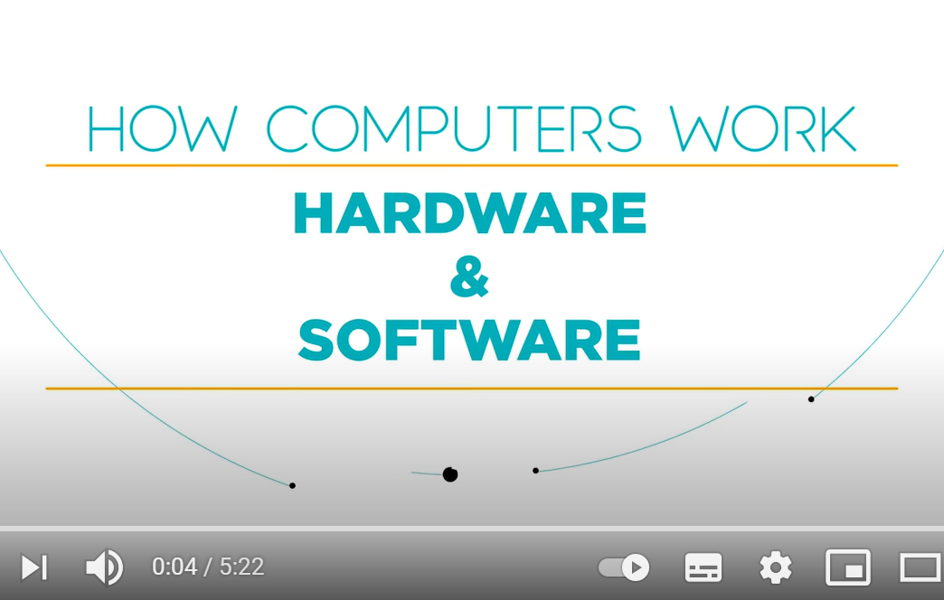

Video: How Computers Work (Hardware & Software)
This short video provides an overview of how computers work, and covers how the hardware and software aspects of Computer systems work together.
Notes:
Video for Engagement, Re-cap & Catch-up.

Slide 10
Section 4: Brief History of OSs?

Slide 11
Generations of Operating System (Brief Overview)
Operating Systems have rapidly evolved over the years, and their evolution is recorded in ‘Generations’. It is useful to have a brief understanding of the evolution and generations of OSs, and it will help us to understand the common functions of OSs today. Generations of OSs include:
  1st Gen. OSs: Approx. 1940s to 1950s: Punch cards and Single Job Processing
  2nd Gen. OSs: Approx. 1950s to 1960s: Transistors and Batch Processing
  3rd Gen. OSs: Approx. 1960s – 1970s: Multiprogramming
  4th Gen. OSs: Approx. 1970s – 1980s: Microprocessors & Personal Computers
  5th Gen. OSs: Approx. 1980s - 2000s: Networked Computing and GUIs
  6th Gen. OSs: Approx. 2000s - Present: Mobile and Cloud Computing
  7th Gen. OSs: Present – Future Now: IoT & Edge Computing, AI & Quantum Computing.
Notes:
In computing, a transistor is a microscopic electronic switch that can be turned on (1) or off (0) to create binary code, which is the language computers use to process information:
Transistors
Transistors are the basic building blocks of microchips and are found in billions in a computer's CPU. They act like light switches, controlling the flow of current or voltage in a computer.
Binary code
Binary code is a system of representing information using only the numbers 0 and 1, which represent the on and off states of a transistor. The word "binary" comes from the fact that it uses only two symbols, or "bits".
Creating information
Computers can create any number from these 1s and 0s by grouping transistors together. For example, the number 5 in base-10 is represented by the binary number 101, which is three switches in a row: on, off, on.

Slide 12
Transistors
In computing, a transistor is a microscopic electronic switch that can be turned on (1) or off (0) to create binary code, which is the language computers use to process information:
Transistors are the basic building blocks of microchips and are found in billions in a computer's CPU. They act like light switches, controlling the flow of current or voltage in a computer.
Binary code
Binary code is a system of representing information using only the numbers 0 and 1, which represent the on and off states of a transistor. The word "binary" comes from the fact that it uses only two symbols, or "bits".
Creating information
Computers can create any number from these 1s and 0s by grouping transistors together. For example, the number 5 in base-10 is represented by the binary number 101, which is three switches in a row: on, off, on.

Slide 13
Transistors
In computing, a transistor is a microscopic electronic switch that can be turned on (1) or off (0) to create binary code, which is the language computers use to process information:
Transistors are the basic building blocks of microchips and are found in billions in a computer's CPU. They act like light switches, controlling the flow of current or voltage in a computer.
Binary code
Binary code is a system of representing information using only the numbers 0 and 1, which represent the on and off states of a transistor. The word "binary" comes from the fact that it uses only two symbols, or "bits".
Creating information
Computers can create any number from these 1s and 0s by grouping transistors together. For example, the number 5 in base-10 is represented by the binary number 101, which is three switches in a row: on, off, on.

Slide 14
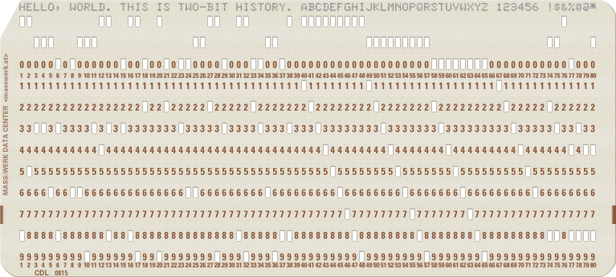
First Gen. OSs: 1940s to 1950s
Vacuum Tubes and Single Job Processing
Early computers were largely mechanical and used
vacuum tubes, like lights, for on/off 01 binary processing.
The Operating system i.e. the program that would tell the hardware what to do, it was created on punch cards and loaded into the machine along with other punch cards that included the data to work on. The punch cards worked on a binary system and the programmers wrote each task/job in binary machine code.
‘Single job’ programs were input and run using ‘punch cards’. Back then the programmer could code math calculations.
Programmers had full access to the computer hardware, which had to be setup to process 1 task at a time and were therefore very slow, relatively speaking. Although they were revolutionary at the time. A 1st Gen. computer could perform a calculation in 30 minutes that would take a team of people a whole day to complete.
The Computers were very large (entire rooms). 1 of these Computers took many intelligent people to setup and operate. There was no interface, no CLI or UI, no Programming languages.
Punch card

Slide 15
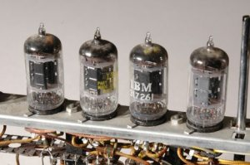
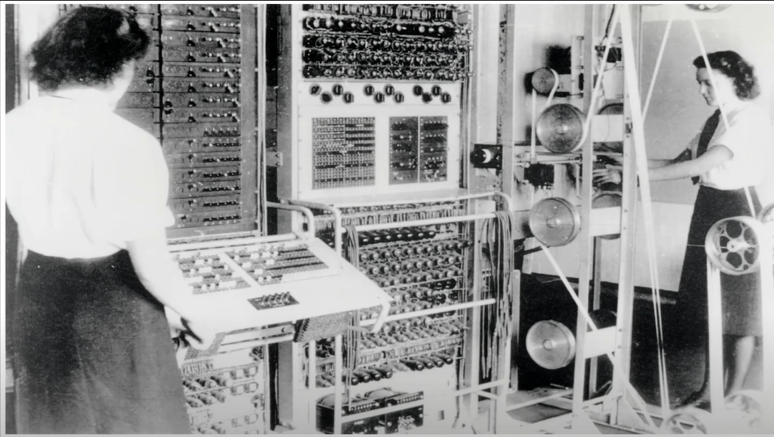
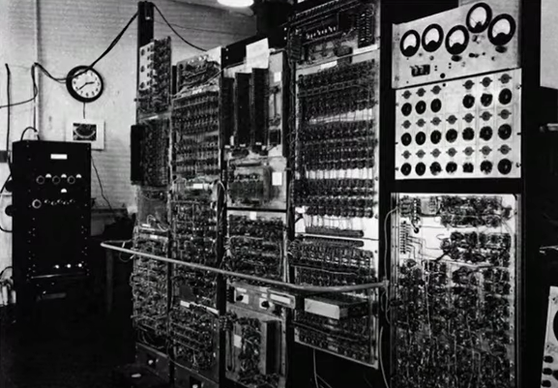

Bg.
First Gen. Comp. Architecture:
* Input (Card)
* Process (Plugs & Tubes)
* Output (Tape).
This Photo by Unknown Author is licensed under CC BY-SA
This Photo by Unknown Author is licensed under CC BY-SA
Video: First Generation Computer
Bg. Video: Why The First Computers were made out of Light Bulbs.

Slide 16
Bg. Video: First Gen. Computer & Operating System
If you have not covered this topic before and these topics are new to you and you would like more information, please watch the videos below, each one is only 1/few minutes.
The Origins of Computers before OSs: Computers Before Operating Systems (youtube.com)
ASCII System and Punch Card Computer Systems: Computers Before Operating Systems (youtube.com)
Computer History 1949 -1960: Early Vacuum Tube Computers Overview.
ENIAC: The First Computer overview.
Early Job and Batch Computer Operating Systems: What is Batch Operating System? Advantages and Disadvantages?.

Slide 17
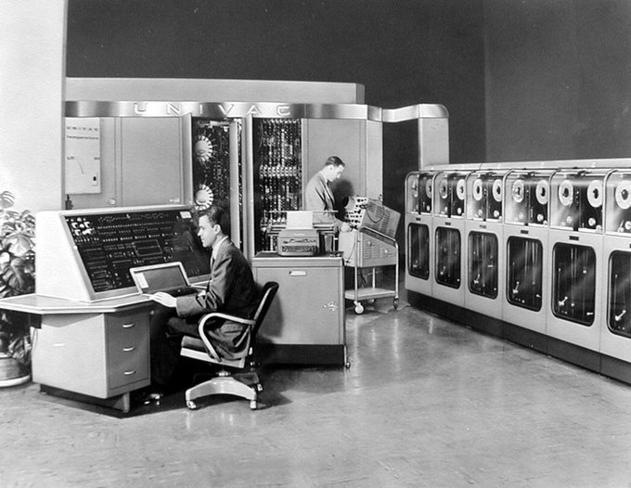
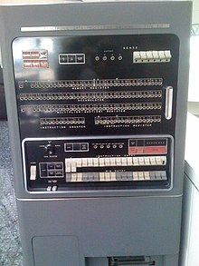
Bg. First Computers: UNIVAC1 (1951) & IBM 701 (1952)
Examples of early 1st/2nd Gen Computers were the UNIVAC1 (1951) and the IBM 701 (1952).
“UNIVAC I (Universal Automatic Computer I) was the first general-purpose electronic digital computer design for business application produced in the United States.” (r)
“IBM 701 (Electronic Data Processing Machine), known as the Defense Calculator while in development, was IBM’s first commercial scientific computer and its first series production mainframe computer” (r)
UNIVAC1
IBM 701

Slide 18
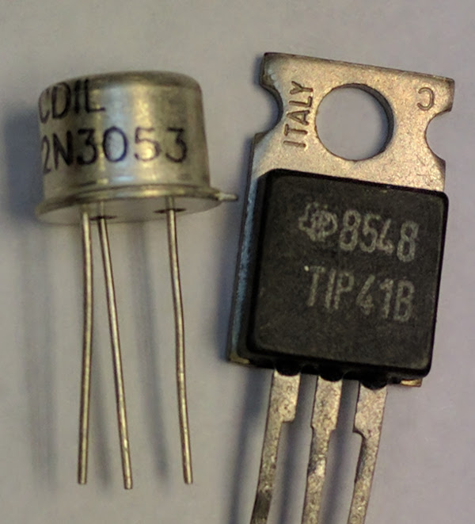
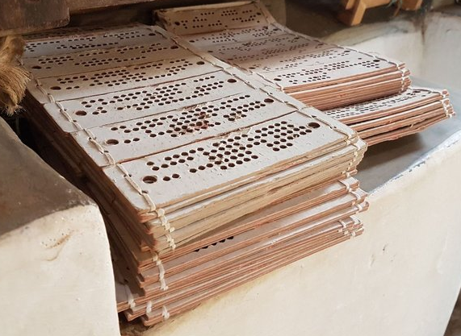
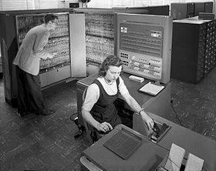
2nd Gen. OSs (50s to 60s): Batch Processing
Smaller and more reliable ‘Transistors’ replaced Vacuum tubes.
  Bg. Bell Laboratories, the research development and innovation dept. of AT&T (American
  Telecommunication Company) invented the ‘Transistor’ in 1947. Bell Labs is now owned by Finland company Nokia.
2nd Gen. OSs used a single stream ‘Batch processing system’, all similar jobs were grouped in batches of punched cards, and submitted to the OS that would tell the machine how to process the tasks. After the completion of each batch of jobs, the operating system would be wiped and re-configured for the next job.
This allowed the hardware to work on similar multiple jobs sequentially in one batch. This avoided having to reset the hardware for every single job/task.
The first OS was known as GMOS, General Motors Operating System, that GM developed for it’s IBM 704 computer (IBM were the leading provider of Computer hardware at the time).
This Photo by Unknown Author is licensed under CC BY
Bg. The Batch System was introduced to reduce time having to reset the computer for each job. A Batch (of cards) of similar jobs, was input into a tray (offline) and read into/onto magnetic tape. The tape was then mounted on a tape drive. The batch operating system was loaded in which then read the first job from the tape and ran it. The output was written on another tape. After the batch of jobs were done, the output was printed onto a thin tape that could be read by the users/programmers.
An IBM 704 computer in 1957
This Photo by Unknown Author is licensed under CC BY-NC-ND

Slide 19
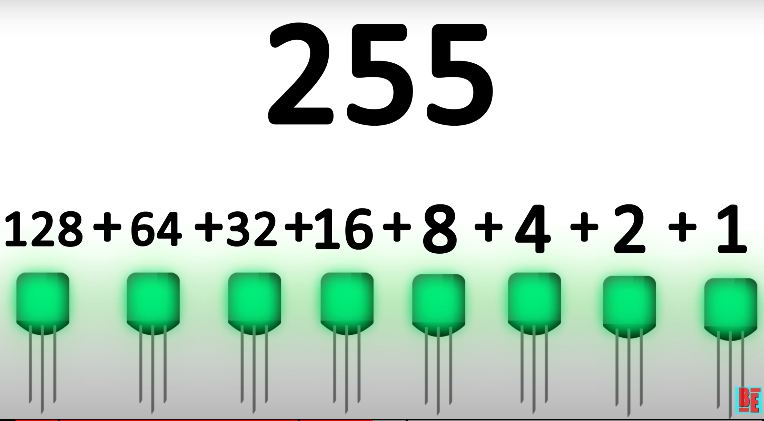

Bg. Video: Why do Computers use 1s and 0s? Binary, ASCII and Transistors Explained. = CA.
+ Transistor Computer Architecture:
Transistor demonstration
How TRANSISTORS do MATH
From Transistors To Tetris Part 1
How a Computer Works - from silicon to apps

Slide 20
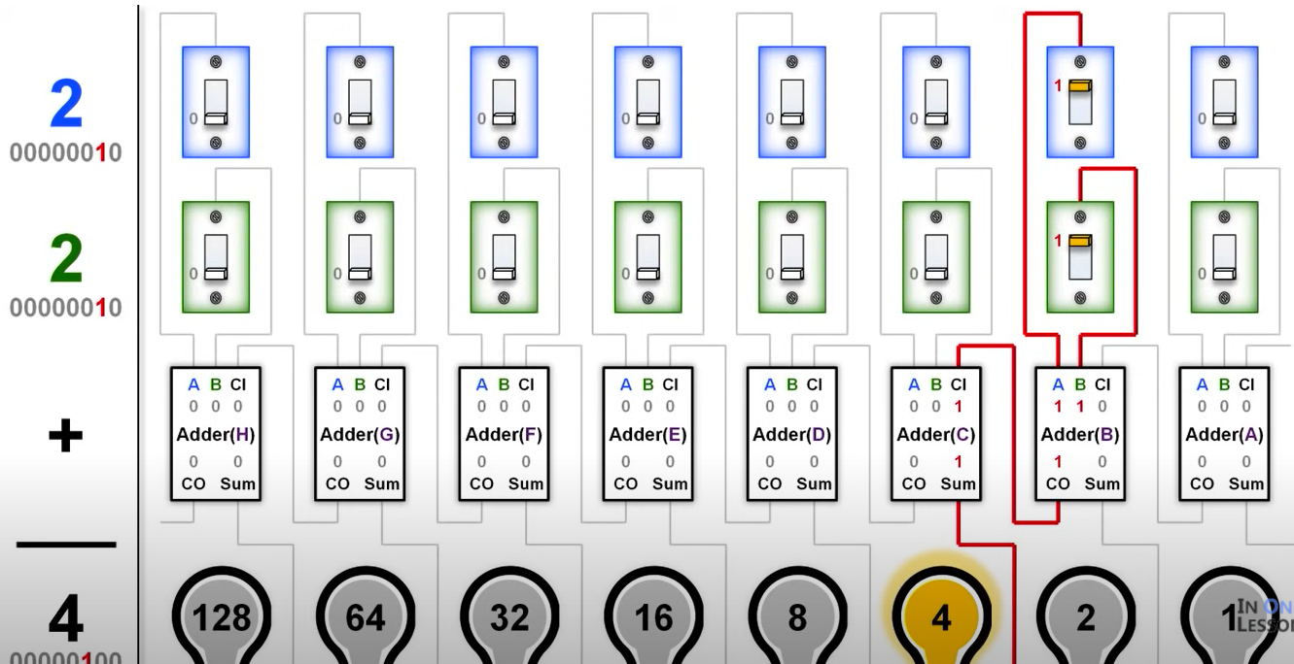
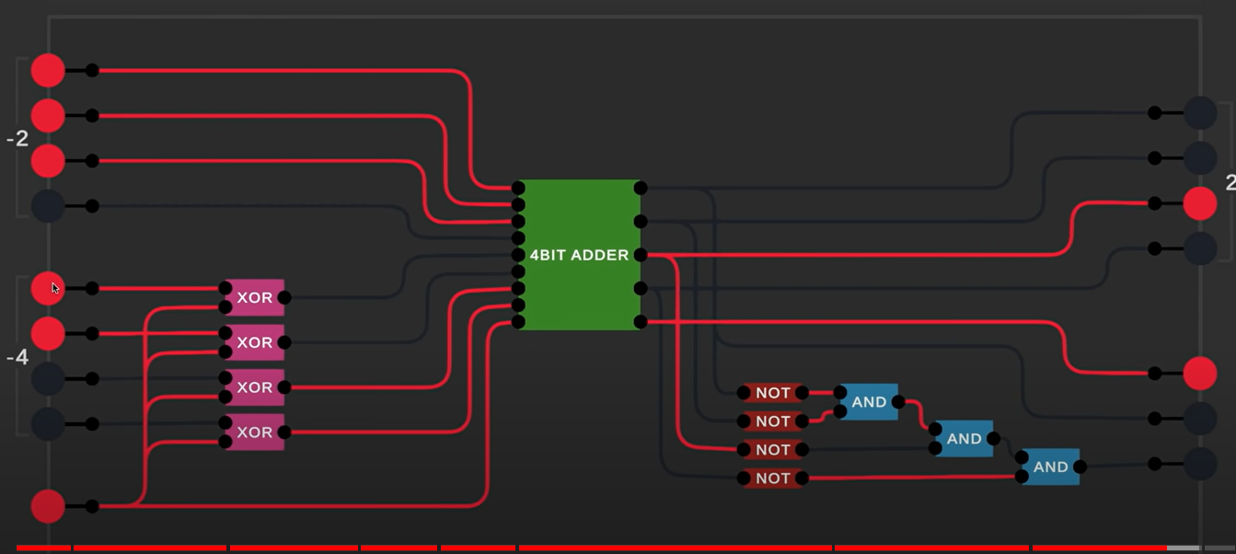
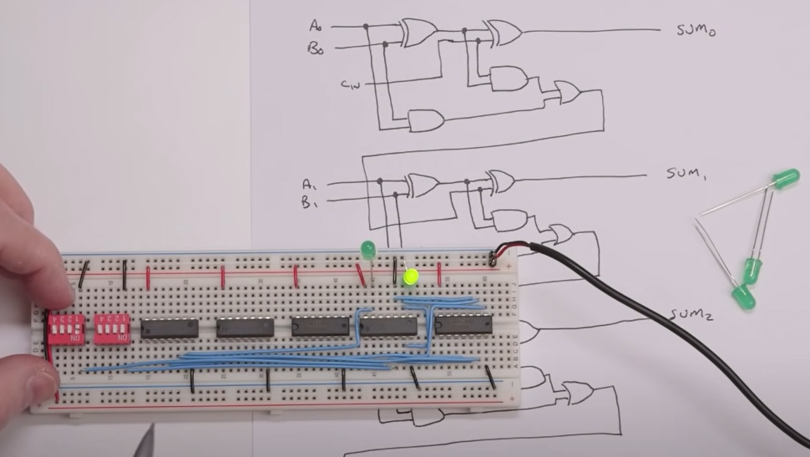
Bg. Video: How do Transistors & Computers work
How TRANSISTORS work & do MATH
How Computers Work
How computers add numbers & build a 4 bit circuit

Slide 21
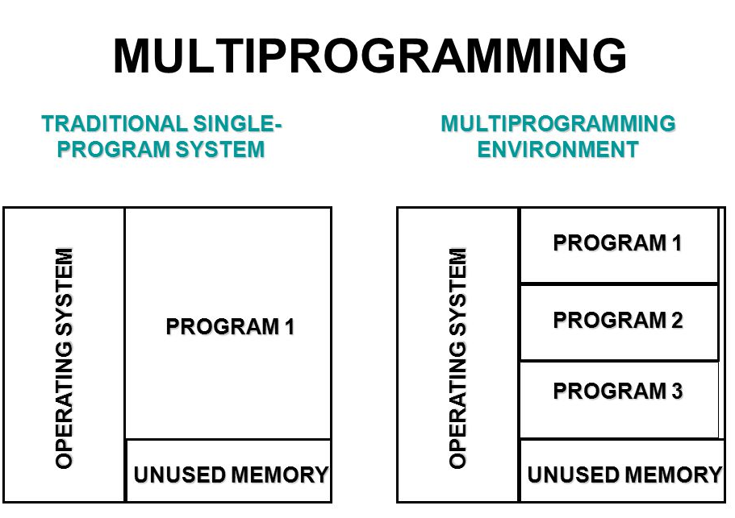
3rd Gen. OSs (60s to 70): Multiprogramming
In the 1960s, OS designers developed a Multi-layered and Multi-programming / Multi-Tasking OS that could run multiple programs on a computer at the same time, by switching between different programs when they were running, without it having to stop and wait for each program/job to fully complete. More on this next week.
  A multiprogramming OS allows 2 or more programs to be in memory/RAM at the same time, the CPU can execute one at a time, however if one program is idle or requires Input/Output, and is not being used by the CPU, the OS allocates another program for execution. This happens so quickly it appears the CPU is running many programs at the same time.
This was a significant evolutionary step in OS design that greatly enhanced CPU utilisation.
In 1969, the Unix OS was developed in Bell Labs at AT&T.
This Photo by Unknown Author is licensed under CC BY-NC
Bg. Multiprogramming is executing multiple programs in a single processor simultaneously. Earlier Single-tasking OS allows a user to perform a single task at a time. Later, Multi-Tasking OSs allow users to run multiple programs at the same time, making the computer much more efficient. Multi-Tasking OSs also allow two or more users to run different programs simultaneously on the same system.

Slide 22
Bg. OS layered architecture
Operating systems first adopted a ‘layered architecture’ in the mid-to-late 1960s, with Dijkstra's "THE" batch multiprogramming system (1965–1968) being widely cited as the first truly layered operating system.
THE (pronounced like “T‑H‑E”, not “the”) is the name of one of the first structured operating systems, created by Edsger W. Dijkstra and his team at the Technische Hogeschool Eindhoven in the mid‑1960s. The name "THE" is simply an abbreviation of the university’s Dutch name.
It is famous in computer science because it introduced layered operating system design.
THE system also introduced paged virtual memory in software.
Dijkstra also invented semaphores here, a fundamental synchronization primitive, used for coordinating processes safely. Such as Wait() to pause a process to allow another to be run.
Dijkstra’s innovations laid the foundations for modern OS design.
While the concept of Hardware Abstraction Layers (HALs) evolved from early abstraction techniques in the 1960s, formal, modern HALs that separate vendor-specific hardware from the OS kernel did not become standard until the early 1990s, most notably with Windows NT (1993).

Slide 23
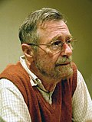
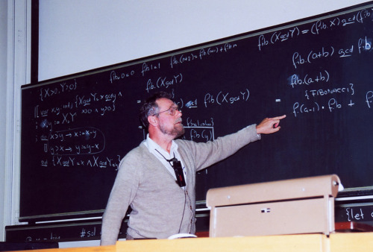
Bg. Edsger W. Dijkstra
Edsger W. Dijkstra (1930–2002) was a Dutch computer scientist and one of the most influential pioneers in computing. He made foundational contributions that shaped modern programming, operating systems, and algorithms.
He was a Dutch mathematician‑turned‑computer scientist, born in Rotterdam in 1930. [1]
He developed Dijkstra’s algorithm for finding the shortest path in a graph (1956), one of the most widely used algorithms in computing today. [2]
He introduced semaphores, a fundamental concept for synchronising processes in operating systems. [2]
He designed the influential T-H-E multiprogramming system, a layered OS that introduced structured design principles. [1]
Dijkstra spent his career at institutions including the Mathematical Centre in Amsterdam, Eindhoven University of Technology, and later the University of Texas at Austin. [2]
He received the ACM Turing Award in 1972 for his contributions.
And is remembered today as one of the greatest thinkers in computer science.
This Photo by Unknown Author is licensed under CC BY-SA
This Photo by Unknown Author is licensed under CC BY-NC-ND

Slide 24
Bg. System Services & HAL
System Services:
Are higher-level OS components that provide essential functionality to applications and users. Examples include file systems, networking services, device drivers, and security services.
They act as intermediaries between the kernel and user applications, making complex operations (like file access or network communication) easier and standardized.
Hardware Abstraction Layer (HAL):
HAL is a software layer that abstracts/separates hardware details and provides a uniform interface to the kernel and upper layers.
It hides differences between hardware platform and components (e.g., different CPUs, memory architectures, or I/O devices).
This abstraction enables portability, meaning the OS can run on multiple hardware types without major changes.

Slide 25
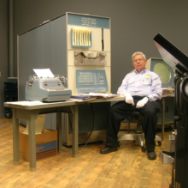
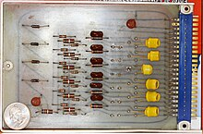
Bg. 3rd Gen.: Integrated circuits, Multiprogramming & PDP-1 Mini-Computer
“Integrated circuits brought forth the third generation of operating systems, facilitating further miniaturization and increased computational power. This marked the rise of time-sharing systems, allowing different users to interact with the computer simultaneously. ... Examples include UNIX and IBM's OS/VS.” [r]
Time-sharing refers to multiple users, using their own terminal, to access a computer system at the same time. The OS would use ‘CPU scheduling’ & multiprogramming to provide each user with an amount of CPU time.
The 3rd gen. operating systems also introduced multiprogramming. This meant that the processor was not idle while a job was completing its I/O operation. Another job was scheduled on the processor so that its time would not be wasted. [r]
For an overview of electronic components, see slide ‘Bg. Video overview: 3rd Gen Integrated Circuits + Basic Electronic component overview.’ towards the end of the slide deck.
During the third generation, Mini-Computers were created, still relatively large, about the size of a set of drawers, examples included the: with the DEC PDP-1.
PDP-1 MiniComputer
PDP-1 Circuit

Slide 26
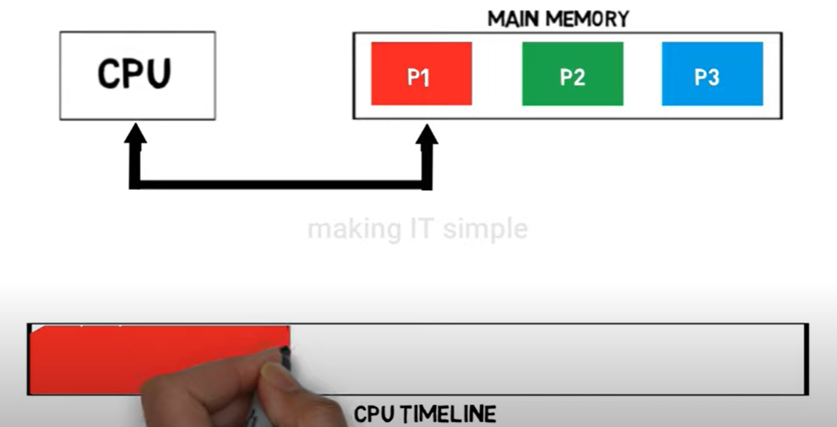
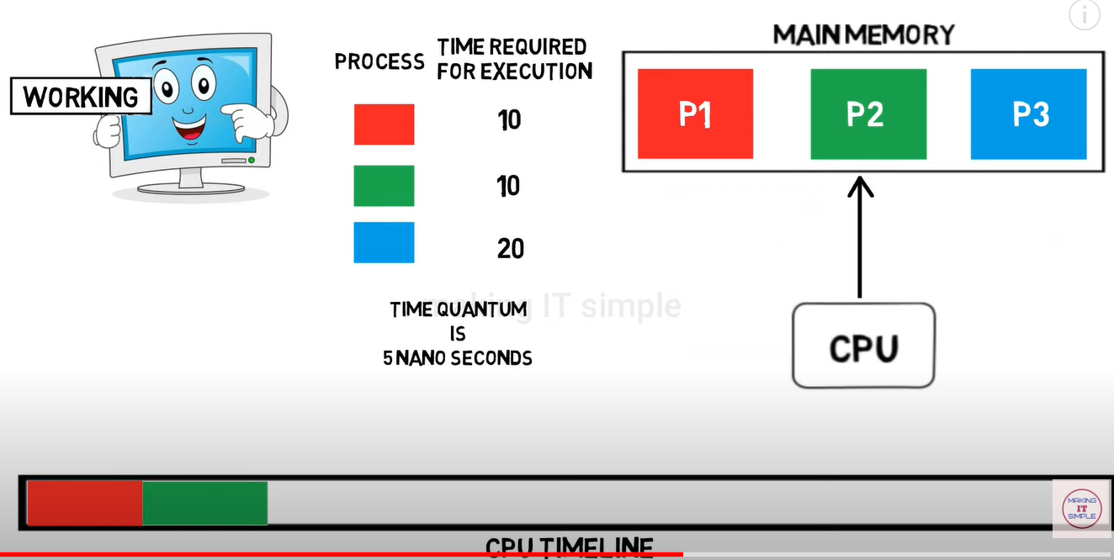
Bg. Video Overview:
Multi-Programming & Multi-Threading OS

Slide 27
Bg. Multi-programming & Multitasking
1. Multiprogramming – it’s goal is to maximize CPU utilization.
How it works: Multiple programs are loaded into memory at the same time. The CPU executes one program, and when that program waits for I/O (like reading from disk), the CPU switches to another program.
Key point: Programs appear to run simultaneously, but the CPU handles them one at a time, switching only when one is blocked.
Used in: Early operating systems (e.g., batch systems).
2. Multitasking - allow users to run multiple tasks at once.
How it works: The CPU switches between tasks very quickly using time-sharing. Each task gets a small time slice, making it feel like they run at the same time.
Key point: Switching happens so fast that users feel all tasks are running simultaneously—even if CPU time is being shared.
Used in: Modern OSs like Windows, macOS, Linux.
Notes:
* A transistor is an electronic switch that can be turned on (1) or off (0) to create binary code. CA with Gareth.
* Multiprogramming is multiple programs running simultaneously on one CPU; multitasking is multiple tasks/processes running simultaneously on one CPU, and multithreading is multiple threads simultaneously running on one CPU.

Slide 28
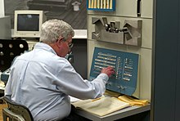
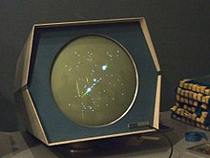

PDP-1 & First Computer game: Spacewar
The first Computer game, Spacewar, was developed in 1962 by Steve Russell and others, at American University MIT (Massachusetts Institute of Technology).
Bg.
  Spacewar was developed for the PDP-1 (Programmed Data Processor-1) computer, created by American Company: DEC ‘Digital Equipment Corporation’ in 1959.
  It cost $120 thousand dollars. Equivalent price today (in 2022) would be 1.2 million. [r]
  The OS was the ‘BBN Time-Sharing System’ created by American R&D Company ‘Bolt, Beranek and Newman (BBN)’ for the PDP-1 MiniComputer.

Slide 29
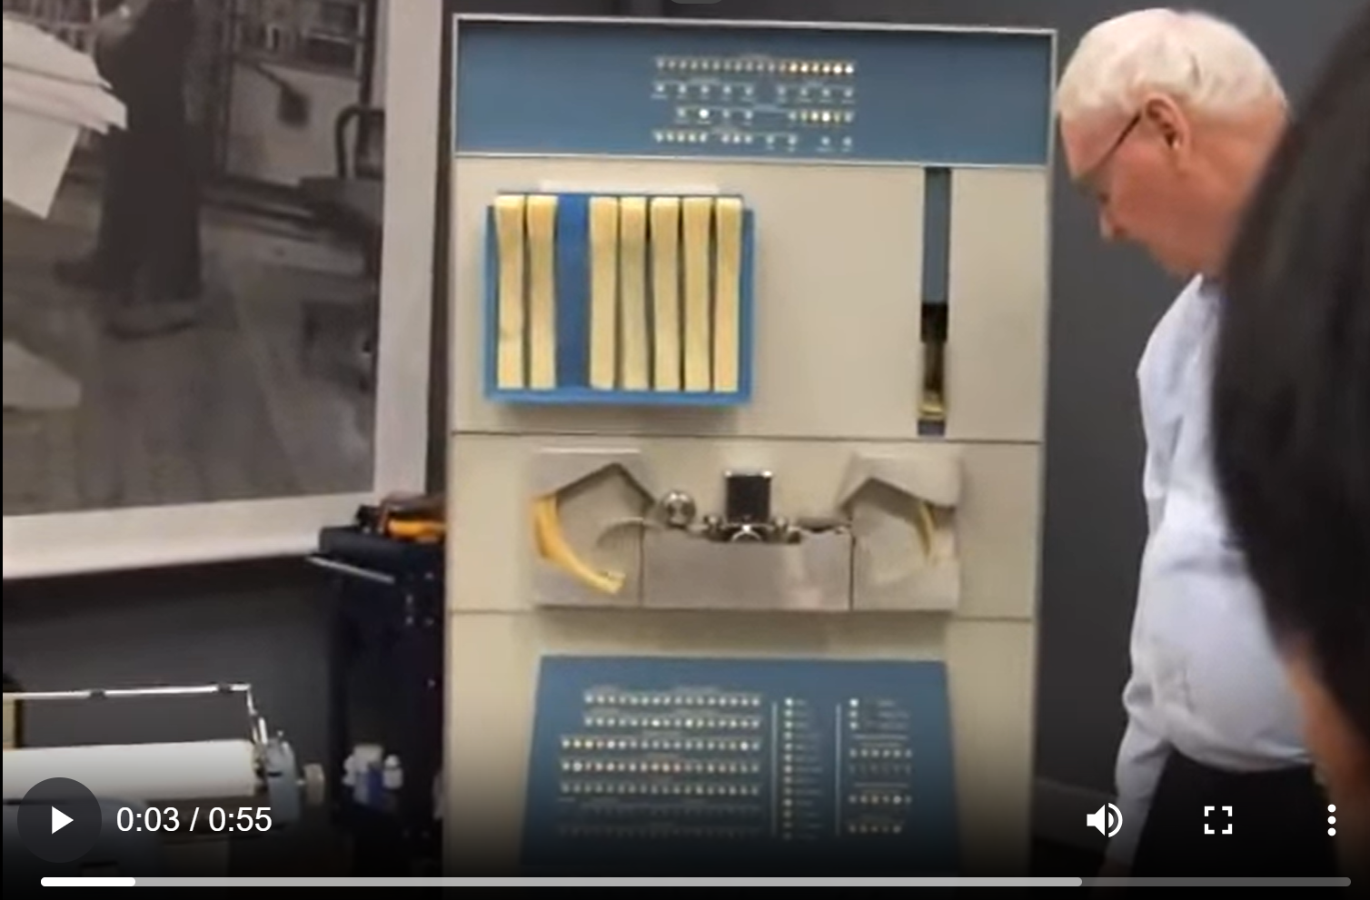
Video: PDP-1 & Spacewar demonstration
“The game features two spaceships, engaged in a dogfight while maneuvering in the gravity well of a star.
Both ships are controlled by human players. Each ship has limited weaponry and fuel for maneuvering, and the ships remain in motion even when the player is not accelerating.
Flying near the star to provide a gravity assist was a common tactic. Ships are destroyed when they collide with a torpedo, the star, or each other.
At any time, the player can engage a hyperspace feature to move to a new and random location on the screen.” [r]

Slide 30

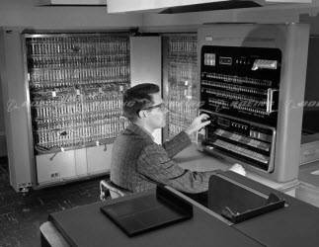
Bg. History & Examples of other OS systems used today
GM / General Motors Research Lab developed the first OS in the 1950s for their IBM 701 Computer (below).
This Photo by Unknown Author is licensed under CC BY-SA
This Photo by Unknown Author is licensed under CC BY-NC

Slide 31
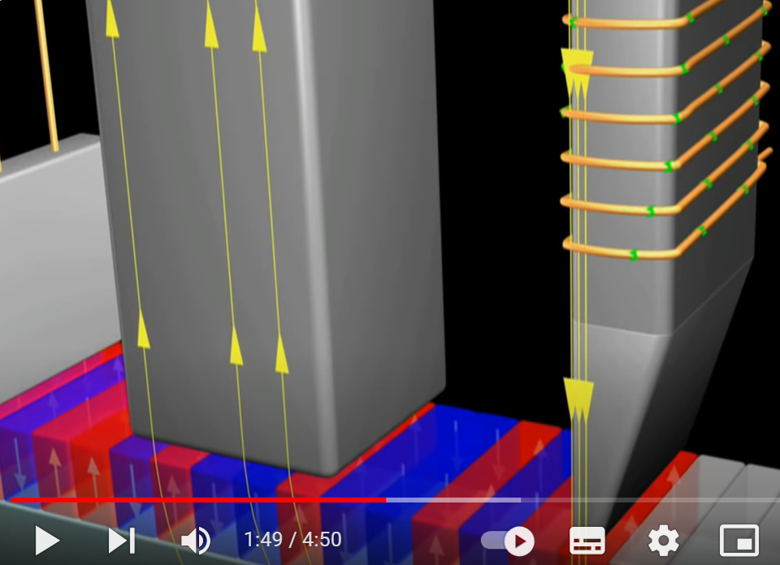
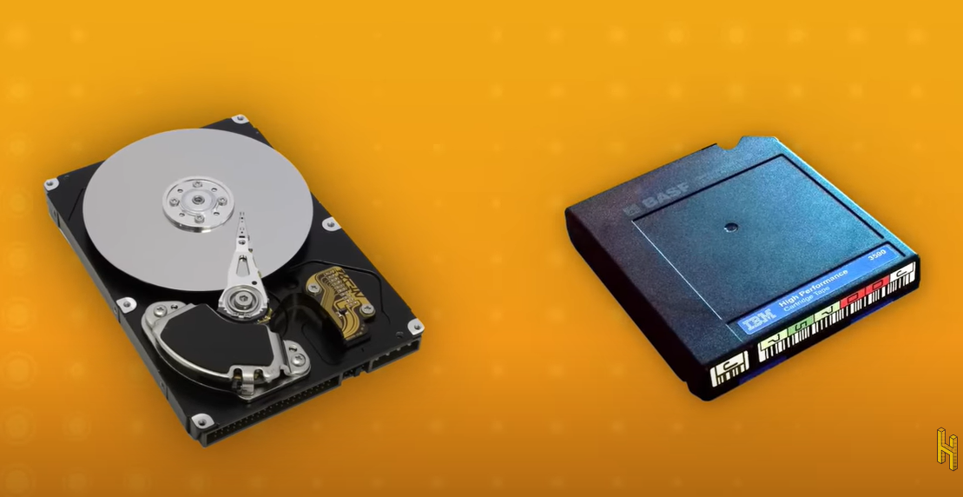
Bg. Video: Tape Storage is making a Comeback.
1. What is Tape Storage and
2. Why Tape Storage is Making a Sneaky Comeback.

Slide 32
Bg. UNIX OS
The Unix OS was developed in the late 1960s, at AT&T's Bell Labs in the US by Ken Thompson, Dennis Ritchie, Douglas McIlroy, and Joe Ossanna.
The developers created ‘Research Unix‘ a research group to develop the OS.
Due to an antitrust case (due to concerns over Monopolising the industry) AT&T was required to license the OS source code to anyone who asked. It was licensed to Universities & Companies and different versions of the Unix OS were developed.
Berkeley Unix or BSD OS (Berkeley Software Distribution) was based on the source code of the original Unix OS created by Research Unix.
FreeBSD is a free and open-source Unix-like operating system, developed in 1993, that descended from the work at Research Unix. Nintendo uses FreeBSD.

Slide 33
Bg. UNIX other OS systems in use today
Unix, created in 1969, is still used today in academic and professional settings, on Supercomputers, and it’s Open Source offspring such as FreeBSD OS are used on many web servers and used to make many other OSs such as the PlayStation Orbis OS & Nintendo Switch OS Horizon.
Berkeley Unix or the BSD OS, a variant of Unix, created by the Computer Systems Research Group (CSRG) in 1977, a research group at the University of California, Berkeley, funded by Defense Advanced Research Projects Agency (DARPA).*
Berkeley Unix / Berkeley Software Distribution OS was based on the source code of the original Unix OS. BSD discontinued in 1995. However BSD is Open Source and has been used to create many descendant Open Source OSs such as FreeBSD, OpenBSD, NetBSD, DragonFly BSD, Darwin, and TrueOS.
These descendant Open Source OSs have been used to help create and develop many commercial proprietary operating systems used today such as Apple's macOS & iOS and Microsoft Windows.
FreeBSD: is a free and open-source Unix-like operating system, developed in 1993, that descended from Unix. It is used as a desktop OS and in many Web Servers by large companies such as Netflix and Sony. It was used to make other OSs such as the PlayStation Orbis OS & Nintendo Switch OS Horizon.
Bg. * The ARPANET* was developed by the Advanced Research Projects Agency (ARPA) in the US. ARPANET was the first wide-area packet-switching network and one of the first to implement the TCP/IP protocol. These technologies are the foundation of the Internet. *The organization ARPA changed its founding name to DARPA, in 1972, changing back to ARPA in 1993, then back to DARPA in1996. DARPA reports directly to senior Department of Defense. .. The Advanced Research Projects Agency (ARPA) was the old name for the Defense Advanced Research Projects Agency (DARPA), an agency of the U.S. government responsible for developing new technology for the military.

Slide 34
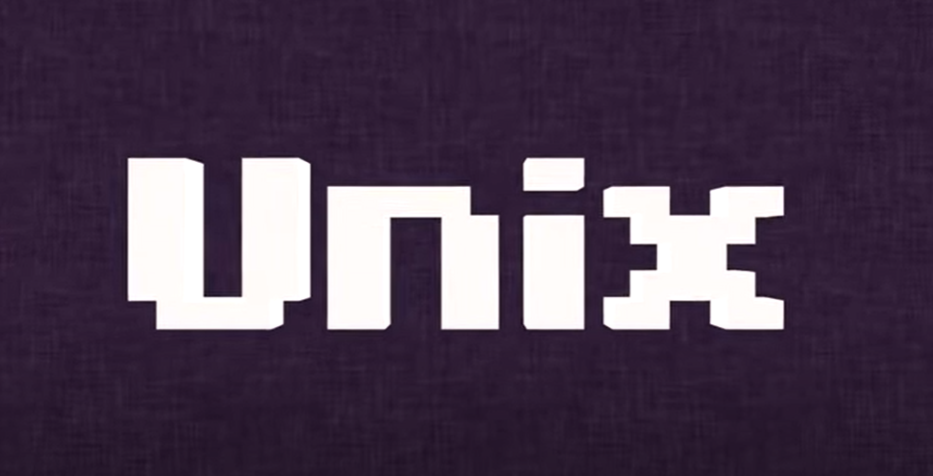
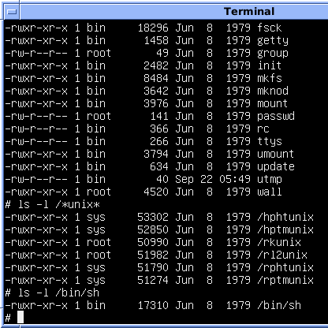
Bg. UNIX OS more on this later…

Slide 35
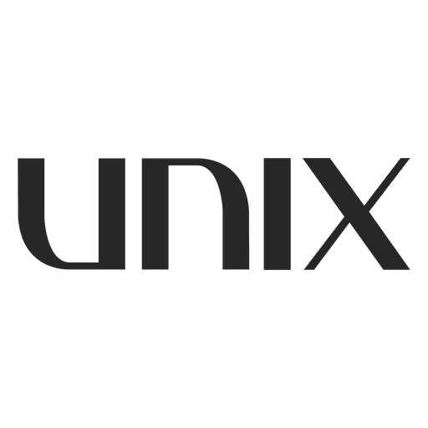
Bg. SUS / The Single UNIX Specification
SUS or the Single UNIX Specification is an Operating System standard.
In the 1980s when Computers started to boom throughout society (initially in the business world and then for education, personal and family use). Companies using computers wanted to be able to create programs that would run on the Computers from different PC manufacturers.
Unix was chosen as the standard system interface because it was manufacturer neutral. And was used to standardise operating system interfaces for software designed for Unix variant OSs.
The UNIX user group published their standardisation efforts in 1984.
And in 1988, the standardisation efforts of the UNIX user group became an official standard known as IEEE 1003 (also registered as ISO/IEC 9945) or POSIX.1-1988, which loosely stands for Portable Operating System Interface. OR the POSIX standard.
A single Unix specification ensures that a program created in one Unix system would run on another yet different Unix OS.
For more information, click here:
What is the Single Unix Specification? - Definition from Techopedia
The UNIX System -- The Single UNIX Specifications - Single UNIX Specification - POSIX

Slide 36
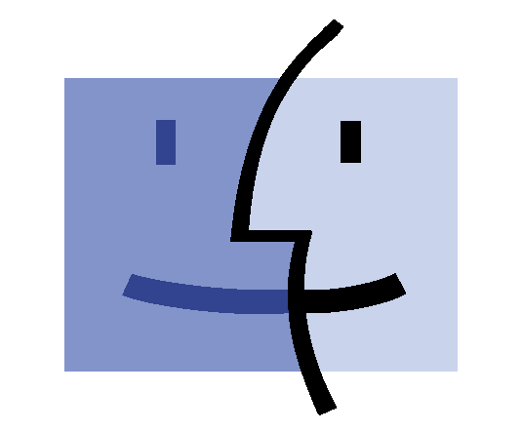
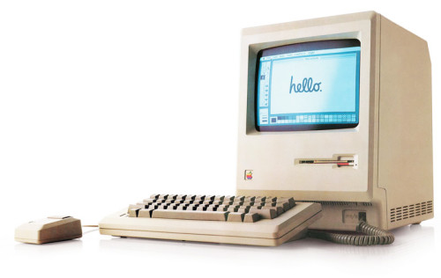
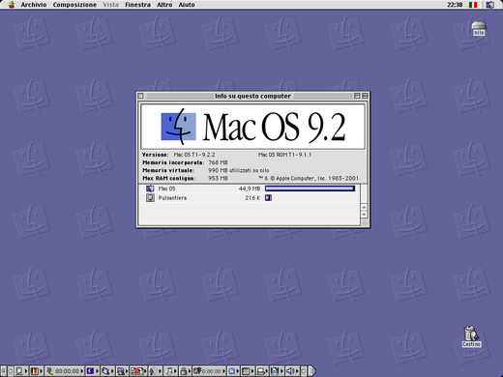
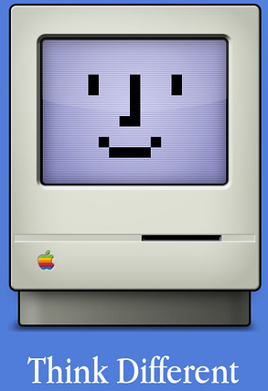
Bg. Mac OS / aka ‘Classic Mac OS’
The original ‘Mac OS’ aka today as Classic Mac OS, refers to the series of OSs developed for the ‘Macintosh’ PCs by Apple from 1984 to 2001.
The fist Mac OS was Mac OS1 and ended in 2001 with Mac OS 9.
The Mac OS and the Macintosh PCs are credited with popularising the GUI / Graphical User Interface concept.
This Photo by Unknown Author is licensed under CC BY
This Photo by Unknown Author is licensed under CC BY-NC-ND
This Photo by Unknown Author is licensed under CC BY-NC
This Photo by Unknown Author is licensed under CC BY-SA

Slide 37
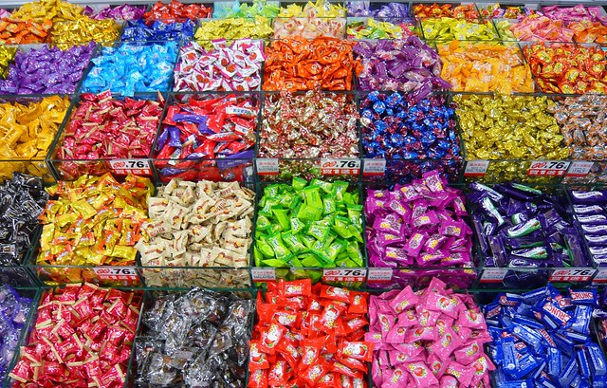
Q. Other OS systems in use today?
Android, Windows & MacOS/iOS maybe the most popular but there are others in use.
Q. Can you research and find another OS that is used today?.
This Photo by Unknown Author is licensed under CC BY-NC-ND

Slide 38
Xerox > Apple
Xerox Star GUI (1981)
  Midway through the suit, Xerox filed a lawsuit against Apple claiming Apple had infringed copyrights Xerox held on its GUI's. Xerox had invited the Macintosh design team to view their GUI computers at the PARC research lab; these visits had been very influential on the development of the Macintosh GUI. [r]
W Window System (1983) W Window System – Wikipedia
X Window System (1984) X Window System – Wikipedia
Mac/Macintosh (1984)
  when Microsoft released Windows in 1985, Jobs was furious and accused Gates of ripping off Apple's user interface. [r]
  Microsoft Windows (1985)

Slide 39
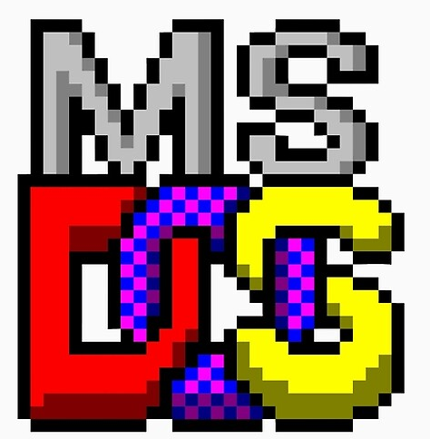

Some other OS systems in use today
Unix
Berkeley Unix aka BSD
  Nintendo uses FreeBSD OS
  PS4 & PS5 use Orbis OS (based on FreeBSD)
DOS
Solaris
Linux distributions

Slide 40


Q. What is the Linux OS?
Q. Research and document a definition of the Linux OS using two sources?
This Photo by Unknown Author is licensed under CC BY-NC-ND

Slide 41
Bg. History & Examples of other OS systems used today
Dos: Originally developed by Seattle Computer Products (SCP) for its Intel 8086-based computer, originally known as QDOS (Quick and Dirty Operating System) then renamed to 86-DOS, was purchased by Microsoft and later re-named MS-DOS and released by IBM & MS in 1981.
Linux: The Linux OS was developed in 1991 by Linus Torvalds a Finish Software Engineer. Linux is derived from Unix and it is a continuation of the Unix design. Android is based on the Linux OS and uses a modified version of it’s Kernel. More on this later.
Solaris: originally developed by Sun Microsystems in 1992 (based on Unix). In 2010, after Sun was acquired by the company Oracle, SunOS was renamed Oracle Solaris. Today it is used by many Business Organisations as an Enterprise class Operating System, particularly for Oracle Database and Java applications.

Slide 42



PureOS
PureOS (pureos.net) is a Debian-based Unix-Like Linux OS used on the modular Librem5 smartphone.
PureOS is Free Open Source software that only includes free software and focuses on privacy and security.
For example the default web browser in PureOS is GNOME Web and the default search engine is DuckDuckGo.
The PureOS uses the GNOME/KDE Plasma GUI.
It is maintained by the Company Purism (https://puri.sm) for use in the company's Librem laptop computers and Librem 5 smartphones.
Video (1min): Scroll down.

Slide 43
Bg. IoT and Edge Computing
Edge computing captures, stores, processes and analyses data near the client/edge, where the data is generated, instead of sending it to a centralized data-center/server for processing. Edge computing reduces the back and forth between the client and the Cloud / data center and enhances the speed of processing/response/action at the source of operation/client. This leads to greater action results in real time.
Edge computing enhances and has advantages in many areas, such as in the area of security and worker safety. Such as onsite cameras and sensors e.g. large industrial operations that monitors the safe operation of large heavy manufacturing machinery by employees.
Edge computing is important in time-sensitive data processing scenarios.
Edge computing is related to and part of the ‘Internet of Things’. Cloud & Edge Computing work together to create the Internet of Things (IoT).
Internet of Things (IoT) refers to a network of connected devices and the technology that allows for communication between the devices and the cloud.
IoT is a network of physical objects/things that are embedded with sensors, software, and other technologies for the purpose of connecting and exchanging data over the internet.
We can add an IoT device to any object e.g. a Car, Delivery Truck, Uber Driver, Clothing, Watch, Human, Animal, Tree, Plant, House, Lighting, kitchen appliance, baby monitors, smart doorbells, - that can measure analyse report and communicate/transmit data through a network. Digital personal assistants such as Alexa are also examples of IoT devices.

Slide 44
Bg. Edge Operating Systems
Edge devices, generally perform some data processing on the device. At the core of most IoT devices is the ability to register and connect with the cloud to send and receive data. IoT Edge devices can usually collect real-time data, analyse it, generate insights, and respond quickly to problems. All this is possible as a result of the operating system (OS).
There are a vast array of different Edge devices, as a result there are different criteria to consider when selecting an OS for an IoT device.
Some important factors to consider include footprint/size, interface, security, and maintainability. E.g. A small footprint size is often needed because Edge devices often have limited storage space, an OS with a small footprint size is an advantage. OS support might be needed for non-technical teams, does the device need a Rich-GUI or CLI.
“Another important consideration is security. Edge computing applications are more vulnerable to security threats compared to centralized systems due to their decentralized and distributed location. Therefore, it is critical that the operating system has robust security features. This includes, for example, an integrated firewall to protect the applications and the data they contain from unauthorized access.” [r]
When selecting an OS for a IoT edge device, we must ensure it supports the necessary hardware, applications, and connectivity requirements.
Example OSs include: Windows for IoT, LuBuntu, Azure IoT OSs RTOS. There are may others and each has specific features and benefits that appeal to different devices/scenarios.
For further information, please click here: [1], [2]. Windows for IoT, OS for embedded Edge.

Slide 45
Bg. Other different types of OS systems.
Other traditional names and types of OS include:
Single-user OS and multi-user OS, Single-tasking OS and multi-tasking OS;
  Bg. For example Multi-tasking or aka time-sharing OSs allow users located at a different terminals(shell) to use a single computer system (e.g. a Main frame) at the same time. The processor time (CPU) that is shared among multiple users is called time sharing.
Distributed and Templated.
  Bg. Distributed systems use many CPUs located in different machines to provide very fast computation to its user, often managed from a computer and a Distributed-OS. Another type of Distributed system is the client-server architecture commonly used on the internet today where the OS uses a Web Server.
  Bg. A Templated OS is when you create a single virtual machine image / VM image as a guest operating system, and use it for multiple running virtual machines. The technique is used in virtualization and cloud computing management, and is common in large server warehouses.
    Virtualization refers to the creation of a virtual machine that acts like a computer with an operating system. Such as a computer that is running Windows may host a virtual machine that looks like a computer with the Ubuntu Linux OS (Ubuntu is actually running in the virtual machine on the Windows system).
The differences between OS types is not absolute, some operating systems share characteristics of others e.g. general-purpose OS often today include the networking capabilities found in a NOS. Also, embedded operating systems commonly include attributes of RTOS. Mobile OSs typically run many apps simultaneously like general-purpose OSs.

Slide 46




Bg. The potential of AI for Good
The potential of AI for Good is vast.
AI is helping us solve some of the world's biggest problems, such as climate change, poverty, and disease.
AI can also help us improve our quality of life in many ways, such as by making our homes and workplaces more efficient and sustainable. (r)
Notes:
Video for Engagement, Re-cap & Catch-up.

Slide 47

Bg. Video: MS Co-pilot

Slide 48
Bg. AI in Network Operating Systems (L5/6 NOS modules)
For example: ‘Marvis Virtual Network Assistant’: provides a natural language processing (NLP), a conversational interface, prescriptive actions, and Self-Driving Network™ to enhance network, cloud and user experience. [r]
Microsoft’s Azure and Google’s TensorFlow: These offer the framework and resources required to create and implement AI for network management.
AI-powered self-healing network systems are being created that solve hardware/software/user issue before a problem occurs. AI enables a NOS/COS (Cloud Operating System) to dynamically scale network resources based on real-time and predicted demand.
“AI-powered security solutions can monitor network operations for security issues and alert network engineers or automate incident responses.” [r]
“As IoT devices proliferate, machine learning can help identify, categorise and manage them, checking for potential vulnerabilities and outdated software.” [r]
“In computer networks AI and machine learning are now being used to continuously analyse large quantities of data using sophisticated algorithms to determine what exactly is happening on the network, to make predictions and to respond to events as they happen. AI and machine learning enables network management systems, through automation, to interpret this data, to continuously improve network performance and reduce downtime.
AI and machine learning can be used to detect problems and apply solutions to common network issues without human input.
AI and machine learning can ensure performance is continually optimized. Identifying traffic patterns and understanding network trends means that more accurate forecasts can be made, significantly improving the accuracy of network capacity planning.
AI and machine learning are also playing an increasingly important role in improving network security, giving better insight into behaviour on the network so that threats can be automatically identified and acted upon quickly.” [r]

Slide 49
Bg. AI in Cloud Operating Systems (L5/6 Cloud modules)
A Cloud Operating System (Cloud OS) is a specialized software layer (usually above an underlying Network Operating System such as Windows Server / Linux) that manages and coordinates virtualized resources in a cloud computing environment.
A Cloud OS is designed to optimize the allocation of computing resources, storage, and networking in a scalable and dynamic way.
Unlike a traditional OS, a Cloud OS is accessed remotely from any device with an internet connection and web browser. The user then manages the Cloud infrastructure, applications and data via the web browser.
“A cloud OS creates the environment end-users see on their computer screens. It allows the user to do everything that is normally done through a standard, isolated operating system such as Windows or Mac OS. The difference is that the cloud OS is hosted, run, and controlled in the cloud. The machine being used by the end-user is nothing more than a terminal to access it.” [r]
Examples of Cloud Operating Systems:
Windows Azure: It is a cloud computing platform and infrastructure created by Microsoft for building, deploying, and managing applications and services through Microsoft-managed data centers.
Amazon Web Services (AWS): Is a cloud computing platform that includes a collection of remote computing services offered by Amazon.com.
Artificial Intelligence (AI) is being used in Cloud Operating Systems to optimize and streamline the allocation of computing resources, storage, and networking in a scalable and dynamic way. It is also used to develop new cloud services.
Some examples of how AI is being used in Cloud Operating Systems:
Microsoft’s Cloud Intelligence/AIOps: Aims to innovate AI/ML technologies to help design, build, and operate complex cloud platforms and services at a large scale. It provides natural language processing (NLP), a conversational interface, prescriptive actions, and Self-Driving Network™ operations to streamline operations and optimize user experiences.
Amazon Web Services (AWS): Offers a range of AI/ML services (such as Amazon SageMaker, Amazon Rekognition, Amazon Comprehend, and Amazon Lex ) that are being used to build intelligent applications quickly and easily. Some of the services include.

Slide 50

Bg. Video: Neuralink (BCI: Brain-computer interface)
Area: NeuroComputing & HCI Human–Computer interface.
“Neuralink is a startup founded by Elon Musk in 2017. It has built a brain-computer interface that helps people with traumatic injuries operate phones and PCs using only their thoughts. It implants electrodes into the brain.” [r]
* Currently in 2024, Neuralink a fully-implantable, wireless brain-computer interface (BCI), has started trials to help and support people with Quadriplegia, Spinal cord injury (SCI) or with amyotrophic lateral sclerosis (ALS)
Overview: First 50secs:
Similar BCI research at UC San Francisco and UC Berkeley.

Slide 51


Bg. World’s most powerful Computers
The IBM Quantum ‘Osprey’ computer is currently the world’s most powerful computer & Quantum computer, with 433 qubits.
IBM aims to achieve quantum systems with 4,000+ qubits by 2025.
In May 2023, IBM opened access to it’s IBM Quantum Osprey processor on IBM’s cloud. For more information, please click here and here.
“The world's fastest SuperComputers run Linux-based operating systems. [r] Bg. To view the World’s fastest 500 Computers: click-here.
As of December 2023, Hewlett Packard’s (HP’s) Frontier, is currently the world’s most powerful SuperComputer. According to all available and published test results. [r]
Quantum computers have been up against supercomputers & won.
This Photo by Unknown Author is licensed under CC BY-SA

Slide 52
The End.

Slide 53
Archive slides.

Slide 54

Video: What is an Operating System
Others:
Operating System Concepts: What is an OS (Definition).
Goals & Functions of Operating System.

Slide 55
Q. What does an Operating System do?
Q. What does an Operating System do?
Research and document a brief definition
using 2 references sources.
This Photo by Unknown Author is licensed under CC BY-NC-ND

Slide 56


Bg. Video overview:
3rd Gen Integrated Circuits + Basic Electronic component overview.
Transistors explained
What is an Integrated Circuit (IC) + What is an Integrated Circuit? - A Galco TV Tech Tip
How Integrated Circuits Work - The Learning Circuit
Explaining an Electrical Circuit - Types of Electrical Circuits
Capacitors, Resistors, and Electronic Components
How Integrated Circuits Work
PCB Board Components - 101
How to use a BreadBoard - Electronics Basics 10 + Breadboard tutorial: How to use a breadboard + How To Use a Breadboard - Breadboard Basics + How to Use a Breadboard
This Photo by Unknown Author is licensed under CC BY-SA

Slide 57
Notice:
Due to the number of students at level 4 studying the CA&OS module, I have been asked to deliver the OS Operating Systems part of the module as a 1hr Lecture and 1hr practical tutorial. Bring a connected device (ideally a laptop) to the Lecture* and headphones to the tutorial.
Lecture*: A connected device will be useful to undertake some research activities and note taking in the Lecture. A laptop would be ideal if you have one available, not essential, but useful. Ideally a Windows OS Laptop (any spec.). An alternative OS laptop other than a Windows laptop is ok. But a Windows laptop is ideal. If you do not have a laptop, a tablet device or smartphone is ok and can be used for research and note taking in the Lecture. All the computer labs for the tutorials have WinOS v10+ machines.
Tutorial: There will be access to Windows PCs in the tutorial rooms and time for students to complete the activities and practice the code covered in the Lecture sessions. Headphones may bebuseful for some activities. Please bring your own headphones. For Health & Safety reasons the University no longer provides re-usable headphones.
Due to a health issue, I will be delivering the OS Lecture and tutorials remotely via MS Teams. There will also be a Tutor in the room, in case needed. There is no change for students. All students attend the OS Lecture and tutorial on-campus as normal, as indicated on the timetable.
Notes:
To help you acquire the research and citations required to achieve a good grade in this module each week you will be guided to undertake some small activities, update your document with the relevant findings to support the completion of your assignment.

Slide 58
Bg. Lecture room
Some of the following slides ask you to Try out an activity.
If you have a laptop you can start to try it out in the Lecture.
If you don’t have a laptop with you, you can make some notes using a tablet/smartphone and try it later in the lab-based tutorial session.
We will be covering all practical areas in the tutorial session.
There will be more time to Try activities in the tutorial session.
They are just introduced in the Lecture session.

