Slide 1

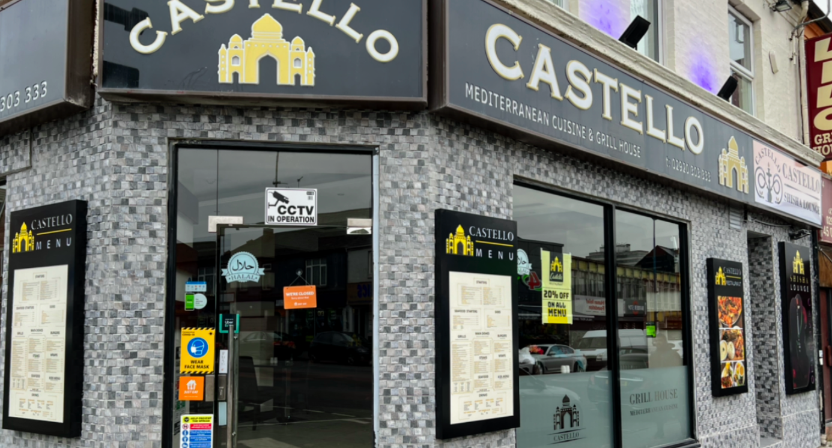

Introduction
Castello Grill House. 2022. Castello Grill House. [Accessed 01 March 2023].
Dacian Cirpaci
Secret Diner

Slide 2
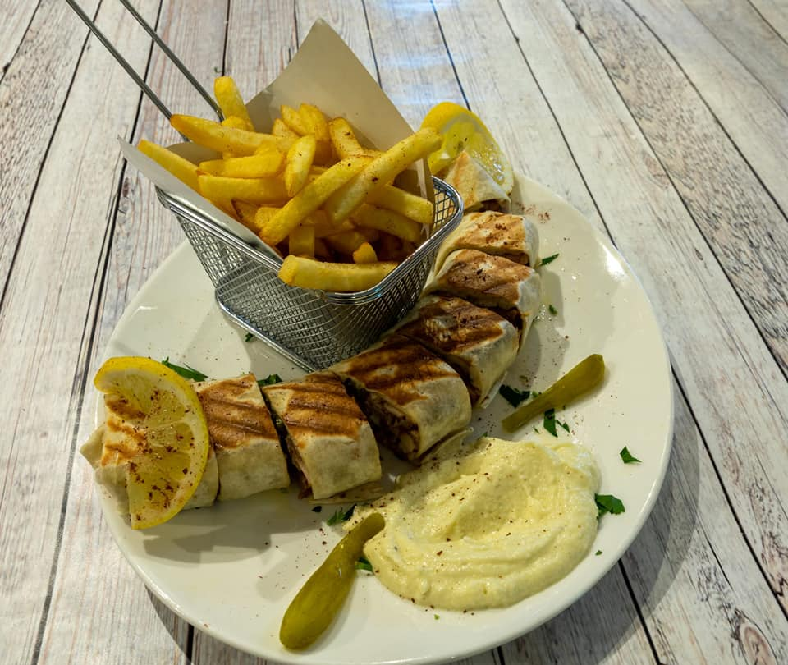
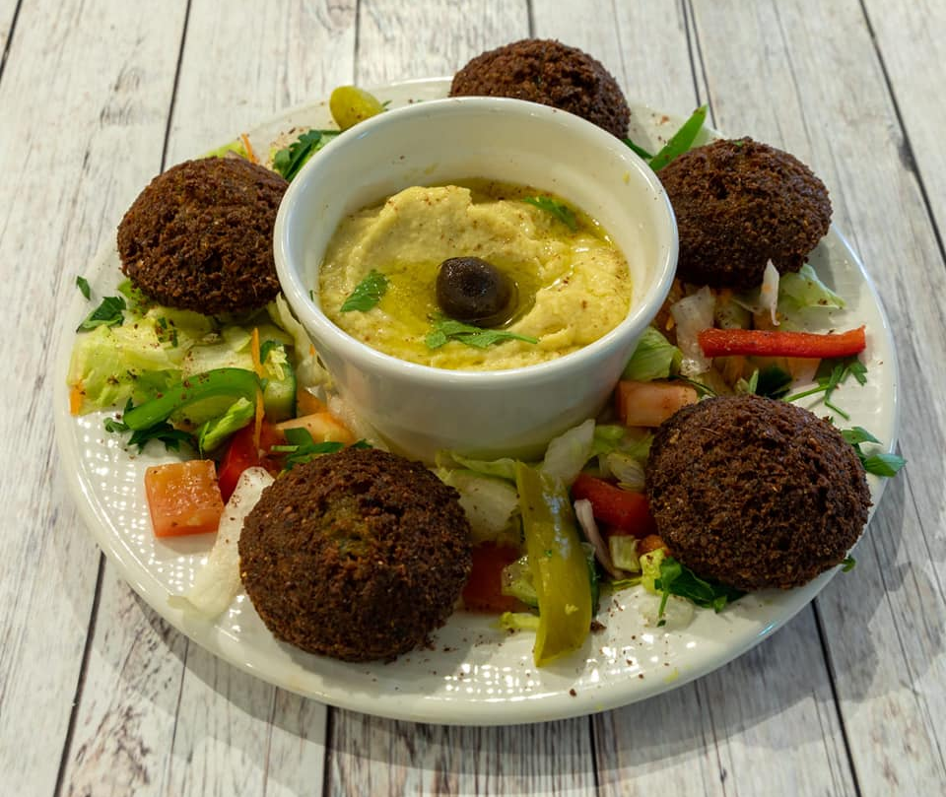
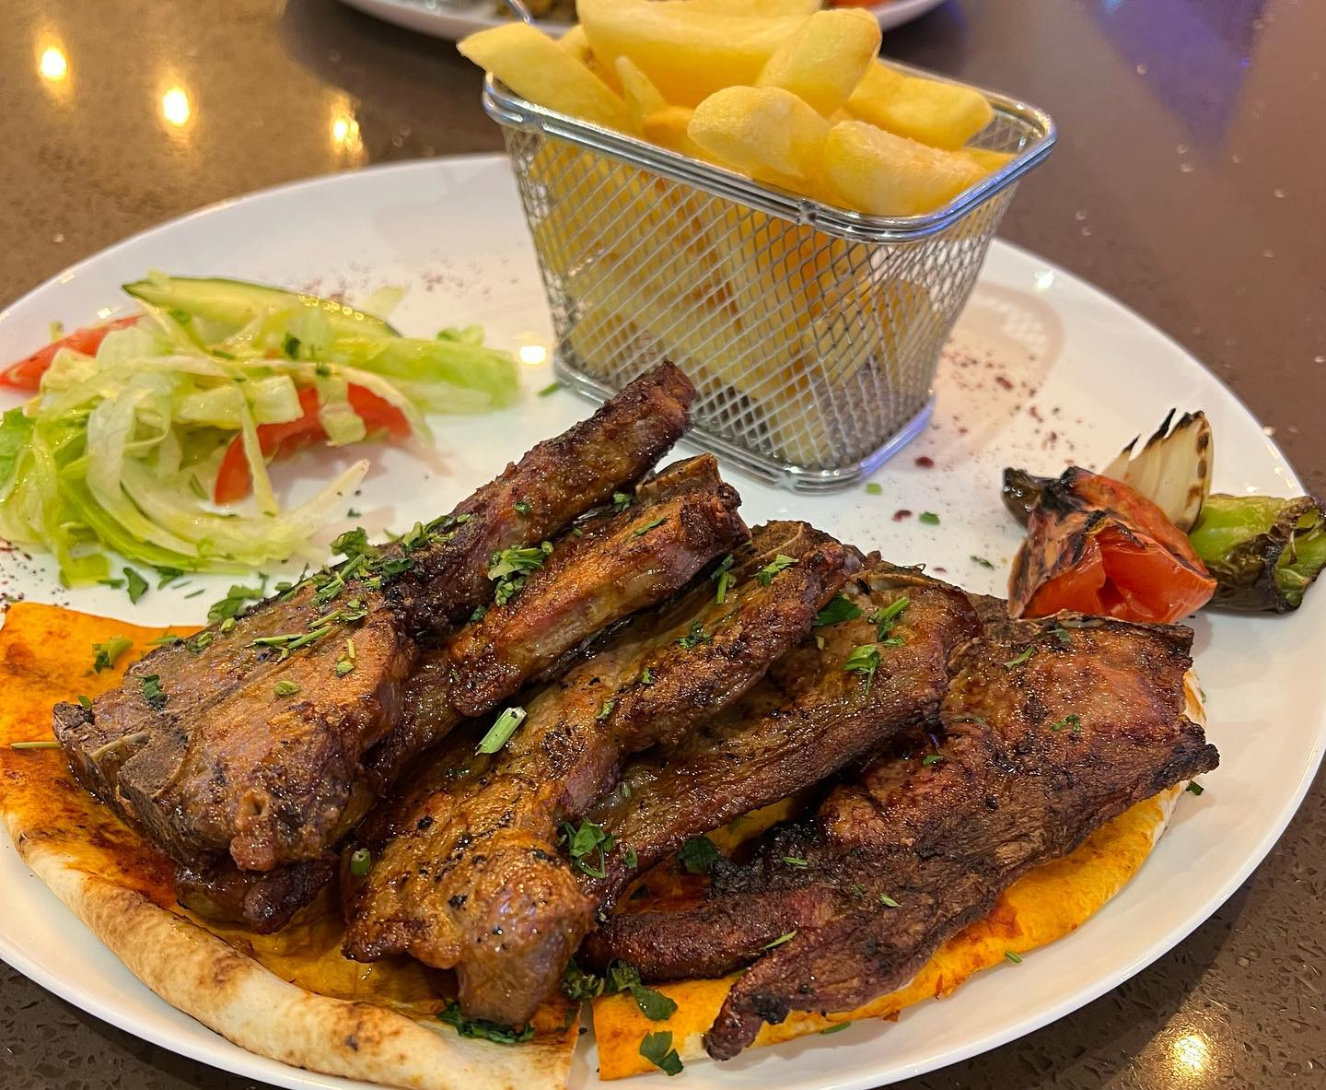
My Experience
Entered the restaurant and sat down to a table I was given from a waiter. I got the menu and ordered chicken a la cream but for a main dish no starters it took 30 minutes to arrive. The restaurant was busy with a lot of people but the service was unfortunately not the best for every customer. and that was me included and they made a difference. The dish came and it was on the good side delicious ordered a kinder bueno milkshake and that was very good as well. But I have not received a person of staff once while I was eating assuring me if its good. After I finished eating I had to go at the counter and ask for the bill by Myself. Then was greeted outside when I left.
Facebook. 2021. Castello Grill. http://m.facebook.com/story.php?story_fbid=pfbid0ZJPjw29rpYtokRkzB6jZXfVA8sA2uCRqzE17vk5FF6uhNcQKr7tisz3DXQdNg4K1l&id=102724805229825 [accessed 01 March 2023].
Castello Grill. 2021. Castello Grill. http://m.facebook.com//CastelloCardiff/photos/a.102801618555477/104640075038/?type=3 [Accessed 1 March 2023].
Castello Grill. 2021. Castello Grill. http://m.facebook.com/CastelloCardiff/photos/a.102801618555477/104640131704959/?type=3 [ Accessed 01 March 2023].

Slide 3

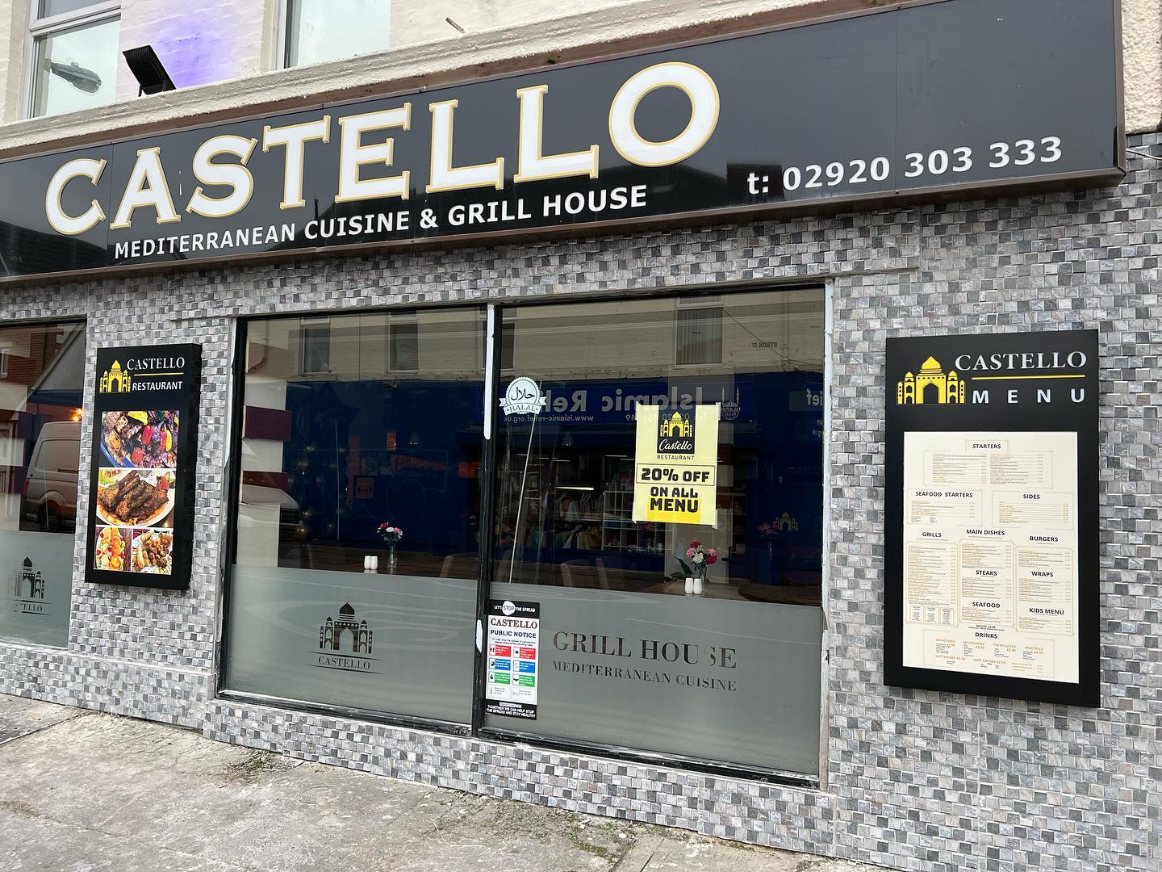
CASTELLO GRILL HOUSE
LOCATION: 76 City Road, Glamorgan, CF24 3DD
They use Takeaway Genie Uber Eats Facebook and Instagram for Advertising the restaurant
PRICES: starters are from £4.50 to £11 - main dishes from £10 to £18 – grills from £13 to £89
Castello_grill. 2022. castello_grill. http://www.instagram.com/p/CY_rk_yNzzc/?igshid=YmMyMTA2M2Y= [Accessed 1 March 2023].

Slide 4
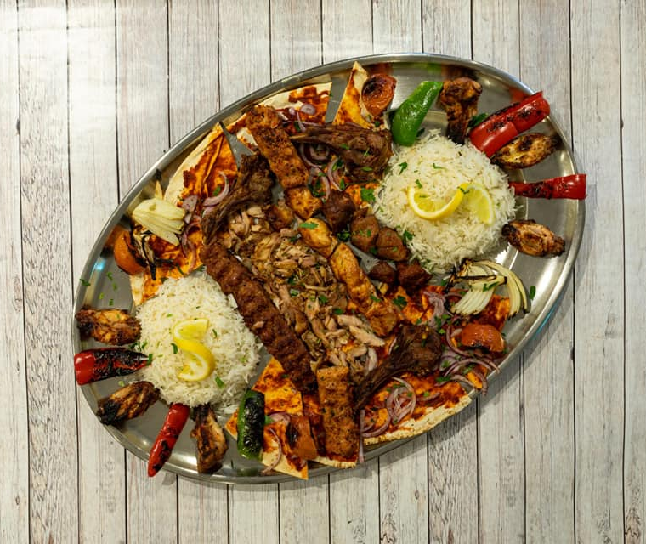
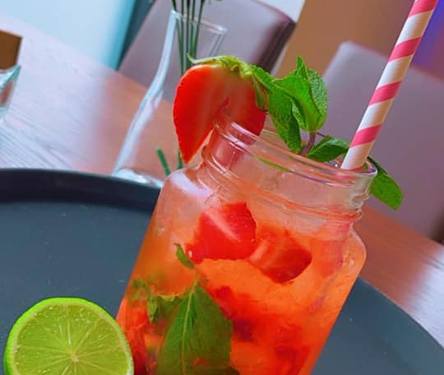

My Review the results of my secret diner role in Castello Grill House is that the food I have had was excellent. but unfortunately their service in general was bad and could use fixing. I cannot say I have had a good experience and rather a negative one because of the service. The pricing however I think was good.
Google. 2021. Castello Grill House. [Accessed 01 March 2023].
Castello Grill. 2022. Castello Grill.http://m.facebook.com/CastelloCardiff/photos/a.102724871896485/102738951895077/?type=3 [Accessed 01 March 2023].
Castello Grill. 2021. Castello Grill. http://m.facebook.com/CastelloCardiff/photos/a.102801618555477/141168148052157 [Accessed 01 March 2023].

Slide 5


The End

Slide 6
References
Castello Grill House. 2022. Castello Grill House. [Accessed 01 March 2023].
Castello_grill. 2022. castello_grill. http://www.instagram.com/p/CY_rk_yNzzc/?igshid=YmMyMTA2M2Y= [Accessed 1 March 2023].
Facebook. 2021. Castello Grill. http://m.facebook.com/story.php?story_fbid=pfbid0ZJPjw29rpYtokRkzB6jZXfVA8sA2uCRqzE17vk5FF6uhNcQKr7tisz3DXQdNg4K1l&id=102724805229825 [accessed 01 March 2023].
Castello Grill. 2021. Castello Grill. http://m.facebook.com/CastelloCardiff/photos/a.102801618555477/104640131704959/?type=3 [ Accessed 01 March 2023].
Castello Grill. 2021. Castello Grill. http://m.facebook.com//CastelloCardiff/photos/a.102801618555477/104640075038/?type=3 [Accessed 1 March 2023].
Castello Grill. 2022. Castello Grill.http://m.facebook.com/CastelloCardiff/photos/a.102724871896485/102738951895077/?type=3 [Accessed 01 March 2023].
Castello Grill. 2021. Castello Grill. http://m.facebook.com/CastelloCardiff/photos/a.102801618555477/141168148052157 [Accessed 01 March 2023].

