Slide 1

Filmiau a chrefydd?
Gan Angharad Lloyd

Slide 2
Beth fyddaf yn siarad am
Y termau (Diwilliant Poblogaidd)
Y ffordd rydym yn edrych ar crefydd
Y ffordd rydym yn edrych ar crefydd?
Y filmiau: The Prince of Egypt a Knowing
Sut all filmiau cael effaith ar y ffordd rydym yn edrych ar crefydd?

Slide 3
Y termau?
Diwilliant Poblogaidd – “the general culture of a society, including ideas, music, books, and mass media”(1)
Crefydd – “something one believes in and follows devotedly; a point or matter of ethics or conscience”(2)
Film – “consists of moving pictures that have been recorded so that the can be shown at the cinema or on television. A film tells a story.”(3)
(1) Publisher, H. Popular Culture, Collins https://www.collinsdictionary.com/dictionary/english/popular-culture
(2) Religion.Dictionary.com: https://www.dictionary.com/browse/religion
(3) Publisher, H. (n.d.). Film. Collins: https://www.collinsdictionary.com/dictionary/english/film

Slide 4
Y ffordd rydym yn edrych ar crefydd mewn film
Filmiau fel arfer yn cael i seilio o storiau’r Beibl.
Nid oes yna llawer o rhai arall.
Rhoi blaenoriaeth tuag at storiau’r Beibl, drost rhai crefyddau arall.
Fel arfer yn medru potrey neges o rhyw fath

Slide 5
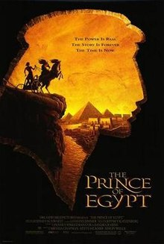
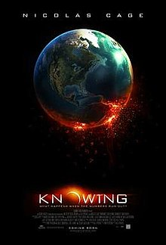
Y filmiau.
Prince of Egypt, (DreamWorks animation), Cyfeirio gan Brenad Chapman, Simon Wells a Steve Hickner (1998)(4)
Knowing, Cyfeirio gan Alex Proyas (2009)(5)
(4) The Prince of Egypt. (n.d.). IMDb: https://www.imdb.com/title/tt0120794/
(5) Knowing. (n.d.). IMDb: https://www.imdb.com/title/tt0448011/
Theatrical release poster https://en.wikipedia.org/wiki/The_Prince_of_Egypt
Theatrical release poster https://en.wikipedia.org/wiki/Knowing_(film)

Slide 6
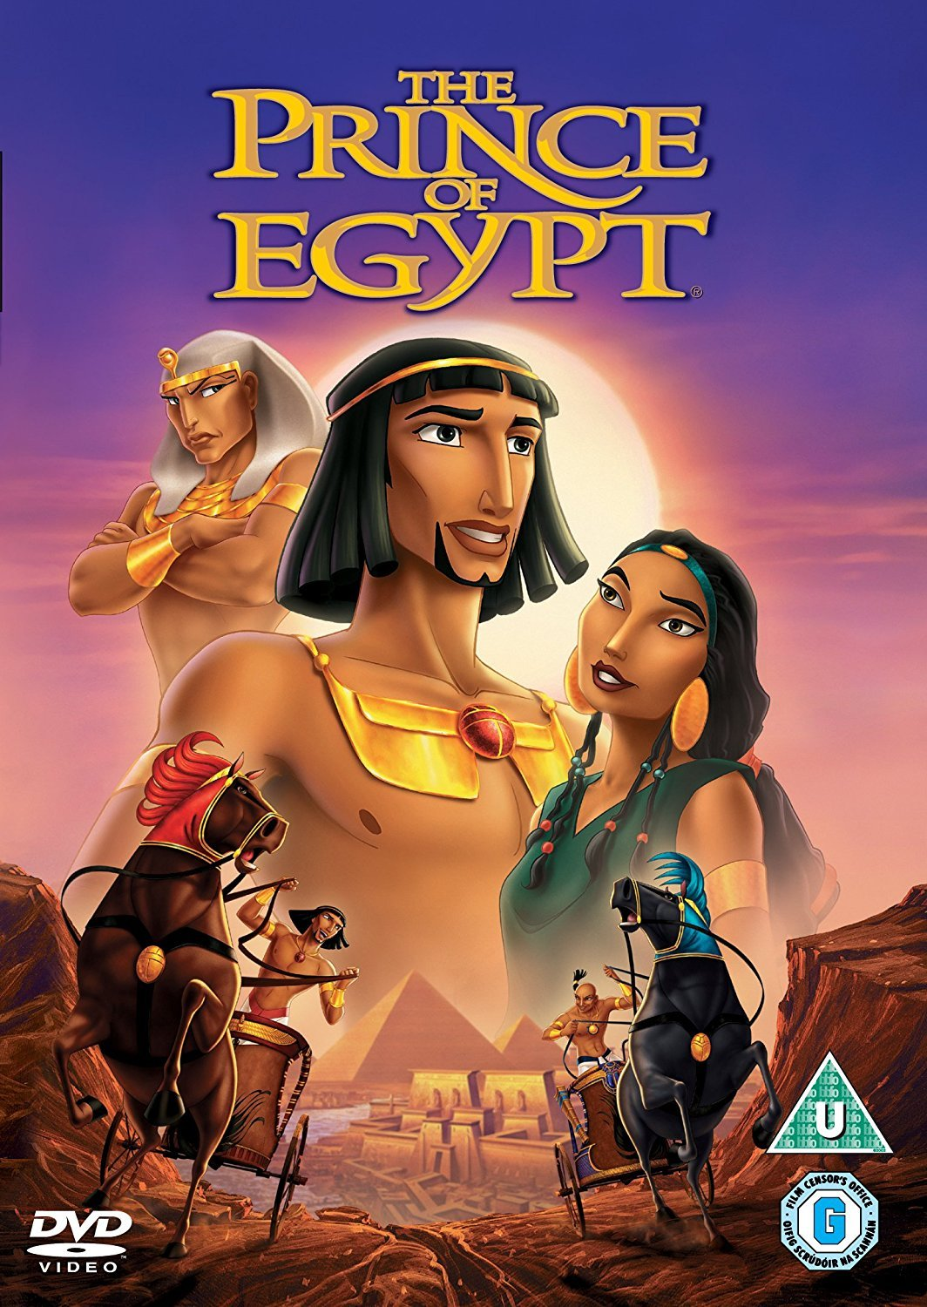
The Prince of Egypt.
Film yn cael i seilio o stori Moses yn llyfr Exodus.
Yn defnydddio animeiddiad i cyfleu’r stori i blant.
Defnyddio dyfyniadau cynnil o’r Beibl yn y film, megis y dyfyniad ‘Let my people go’ (Exo 9:1)
Defnydd o caneuon yn y film.
“main characteristic of music is that it expresses and evokes emotion”(6)
https://www.youtube.com/watch?v=g98eFTYZugs
(6) Cooke, Deryck (1959). The Language of Music. Oxford University Press.
(3) Amazon: https://www.amazon.com/Prince-Egypt-Val-Kilmer/dp/B000059HL2

Slide 7

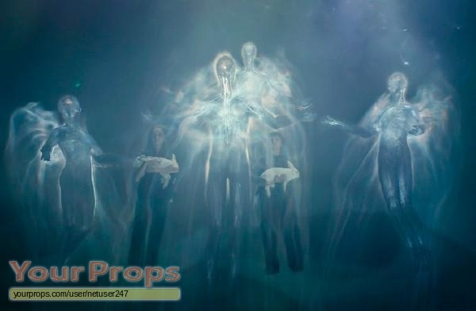
Knowing
Cael thema am diwedd y byd – cysylltu efo’r llyfr datguddiad.
Thema neu syniad o proffwyd, cael i ddangos gan y gymeriad Lucinda.(7)
https://www.youtube.com/watch?v=_pWW7Xmat6o
Tynnu ar stori creu yn Genesis ar y diwedd.
(4) Amazon: https://www.amazon.com/Knowing-Nicolas-Cage/dp/B001GCUO02
(5) https://www.yourprops.com/Abby-Lara-Robinson-Top-and-original-movie-costume-Knowing-2009-YP40442.html
(7) Knowing:: Full Cast and Crew. (n.d.). IMDb: https://www.imdb.com/title/tt0448011/fullcredits/?ref_=tt_ov_st_sm

Slide 8
Sut all cael effaith ar crefydd?
Crefydd a film yn mynd llaw yn llaw.
Ferdinand Zecca “directed what is probably the first version of Samson and Delilah”(8)
Gall cael effaith negyddol ar Crefydd.
(8) I, Butler, Religion in the Cinema, 1969 p.9

Slide 9
Unrhyw Cwestiynau?

Slide 10
Llyfryddiaeth
Bible. (n.d.).
Brenad Chapman, S. W. (Director). (1998). The Prince of Egypt [Motion Picture].
Butler, I. (1969). Religion in the Cinema.
Cooke, D. (1959). The Language of Music. Oxford: Oxford University Press.
Knowing. (n.d.). Retrieved from IMDb: https://www.imdb.com/title/tt0448011/
Knowing:: Full Cast and Crew. (n.d.). Retrieved from IMDb: https://www.imdb.com/title/tt0448011/fullcredits/?ref_=tt_ov_st_sm
Proyas, A. (Director). (2009). Knowing [Motion Picture].
Publisher, H. (n.d.). Film. Retrieved from Collins: https://www.collinsdictionary.com/dictionary/english/film
Publisher, H. (n.d.). Popular Culture . Retrieved from Collins: https://www.collinsdictionary.com/dictionary/english/popular-culture
Religion. (n.d.). Retrieved from Dictionary.com: https://www.dictionary.com/browse/religion
The Prince of Egypt. (n.d.). Retrieved from IMDb: https://www.imdb.com/title/tt0120794/
Wooding, D. (n.d.). The Prince of Egypt is a profound biblical epic and "A quantum leap in animation". Retrieved from Web.archive: https://web.archive.org/web/20030329004351/http://assistnews.net/strategic/s0000023.htm

Slide 11
Llyfryddiaeth Lluniau
Knowing . (n.d.). Retrieved from Amazon: https://www.amazon.com/Knowing-Nicolas-Cage/dp/B001GCUO02
Knowing (2009). (n.d.). Retrieved from Wikipedia: https://en.wikipedia.org/wiki/Knowing_(film)
Knowing, Abby (Laura Robbinson) Top and Hoddie. (n.d.). Retrieved from YourProps: https://www.yourprops.com/Abby-Lara-Robinson-Top-and-original-movie-costume-Knowing-2009-YP40442.html
The Prince of Egypt. (n.d.). Retrieved from Wikipedia: https://en.wikipedia.org/wiki/The_Prince_of_Egypt
The Prince of Egypt. (n.d.). Retrieved from Amazon: https://www.amazon.com/Prince-Egypt-Val-Kilmer/dp/B000059HL2

