Slide 1
Effects of Tsunami in Global Tourism: A study on the Tourism Industry.
Presented by:
Mohammed Salah Uddin
ID:- 1705014

Slide 2
Introduction
Tsunami is a Japanese word that refers to ‘harbour wave’. It is also referred as tidal waves, or sea waves by people in general. A tsunami is a series of treacherous waves. It is caused by different causes such s earthquakes, volcanic explosions under sea, landslides, and extra-terrestrial collision. All these incidents create a sudden movement on the surface of the ocean. Tsunami causes the most destruction in the countries, regions that are near sea surfaces. Throughout the history, the world has seen many destructive tsunamis. This research will discuss on how a tsunami can severely affect the global tourism industry. The report will also discuss about the future of such phenomenon in the industry. We will put much of the emphasis on the tsunami of 26th December, 2004 and how it has affected the tourism industry in Southeast Asia.

Slide 3
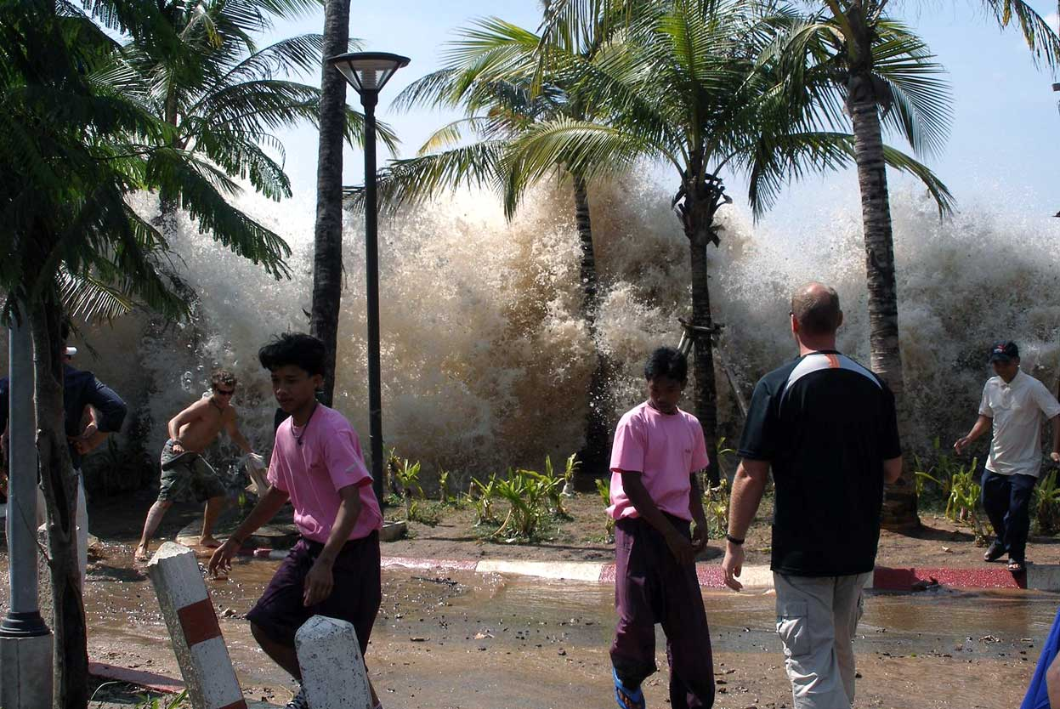
The 2004 Indian Ocean Tsunami
The tsunami of 26th December, 2004 is the most deadliest tsunami in the modern era. It is also known as the 2004 Indian Ocean Tsunami. On the date, a huge earthquake of 9.1 rector scale struck the western coast of Sumatra, Indonesia (Clark, 2017). The reason of the earthquake was the movement in tectonic plates beneath Burma, Myanmar. According to earthquake specialists and oceanographers, it caused a seafloor rift of hundreds of miles that shifted trillions of tons and rock and created the deadliest tsunami in modern history (Lotto, 2017). According to a US geological report, the tsunami had an equivalent impact of 23,000 atom bombs.

Slide 4
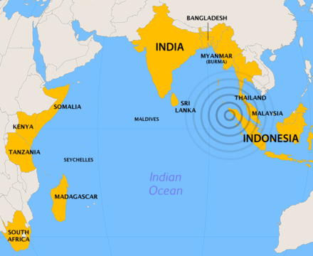
The 2004 Indian Ocean Tsunami
Hardest hit countries
The hardest hit countries were: Indonesia, Thailand, India, and Sri Lanka. Also, the tsunami had an impact on some countries of African continent, Bangladesh, and Maldives.

Slide 5
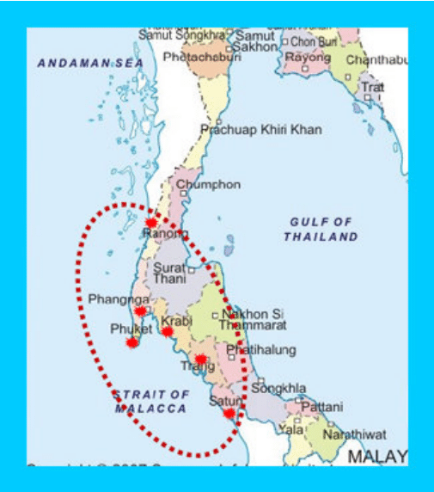
Impact on Thailand’s Tourism Industry
Tourism industry plays a significant role in the economy of Thailand.
The 2004 Indian Ocean Tsunami had a severe impact on the country’s tourism industry and their national economy.
The most damaged spots are: Southern West, Similan Islands, and Phuket, Khao Lak

Slide 6
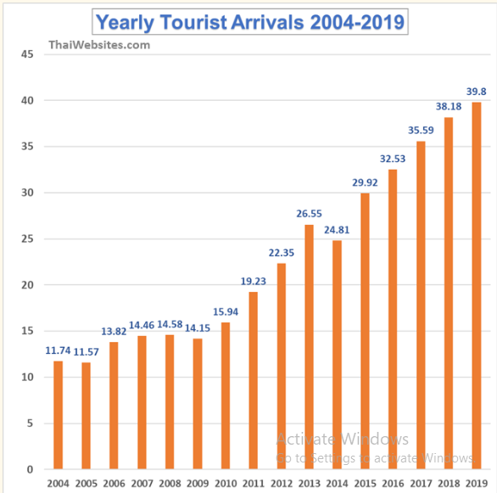
Impact on Thailand’s Tourism Industry
Drop in Tourists turnover.
Only 11-12 million visitors in 2014 and 2015
Necessary actions were taken by the government and authorities for the steady development.
Safety of the visitors ensured
Emergency warning system installed.
Significant rise from 2011.

Slide 7
Impact on Thailand’s Tourism Industry
Causes of High Death Counts in Tourists
One of the major reasons for such high number of deaths is the absence of tsunami warning system in the islands and all other tourist spots in the country. After the earthquake, there was no precaution given by the Thai or hotel authorities (Brahmana, 2016). This is a huge oversight that has been rectified soon after to ensure top level safety for the tourists. In all the tourists spots there is a warning system installed. The safety measures taken by the government gave relief to the tourists and attracted them to visit the country and all their islands. The warning alarms can now be found in Khao Lak, Phuket Islands, and Similan Islands (Clark, 2017).

Slide 8
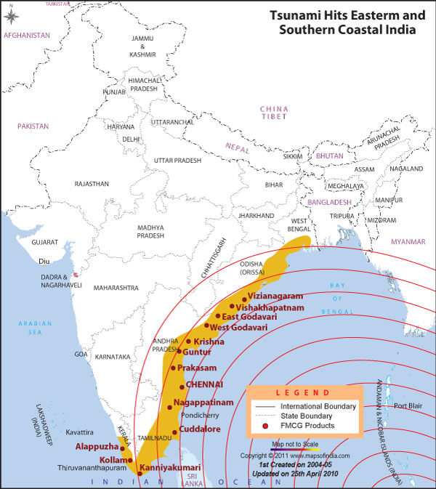
Impact on India’s Tourism Industry
Estimated death toll over 11,000.
The hardly hit regions are Tamil Nadu, Kerala, Pondicherry, and Andhra Pradesh. A&N Islands were the nearest to the epicentre of the earthquake (Dhaniya, 2020).
The damage estimated was near $350 million US Dollar.
The tourist spots were flooded and the hospitality-based organisations faced causalities (Brahmana, 2016). Many of the employees in the sector lost their jobs.
The Indian government also took necessary precautions for the safety of their tourists in future. Also, supports were provided to the hospitality organisations to carry on their business with full flow.

Slide 9
Tsunamis and Financial Risks in Global Tourism
A tsunami can cost several hundred million of USD every time (Clark, 2017).
A research predicts some of the travel destinations that are prone to tsunamis and financial costs associated with it. The listed countries from the research are:
    1. Hawaii and Los Angeles (USA),
    2. Lima (Peru)
    3. Valparaiso and Bio Bio (Chile)
    4. Guerrero and Coast (Mexico)
    5. Bali (Indonesia)
    6. Phuket (Thailand)
    7. Western coast area of Turkey
    8. Puntarenas (Costa Rica)
The same report also shows that these regions and countries have faced millions of financial cost every 10 year because of tsunamis. However, despite being such a risky place, tourists choose these destinations for their beauty and attractions (Lotto, 2017). Tourists are more eager to explore the endangered regions of the Europe, Asia, and America for their destinations.

Slide 10
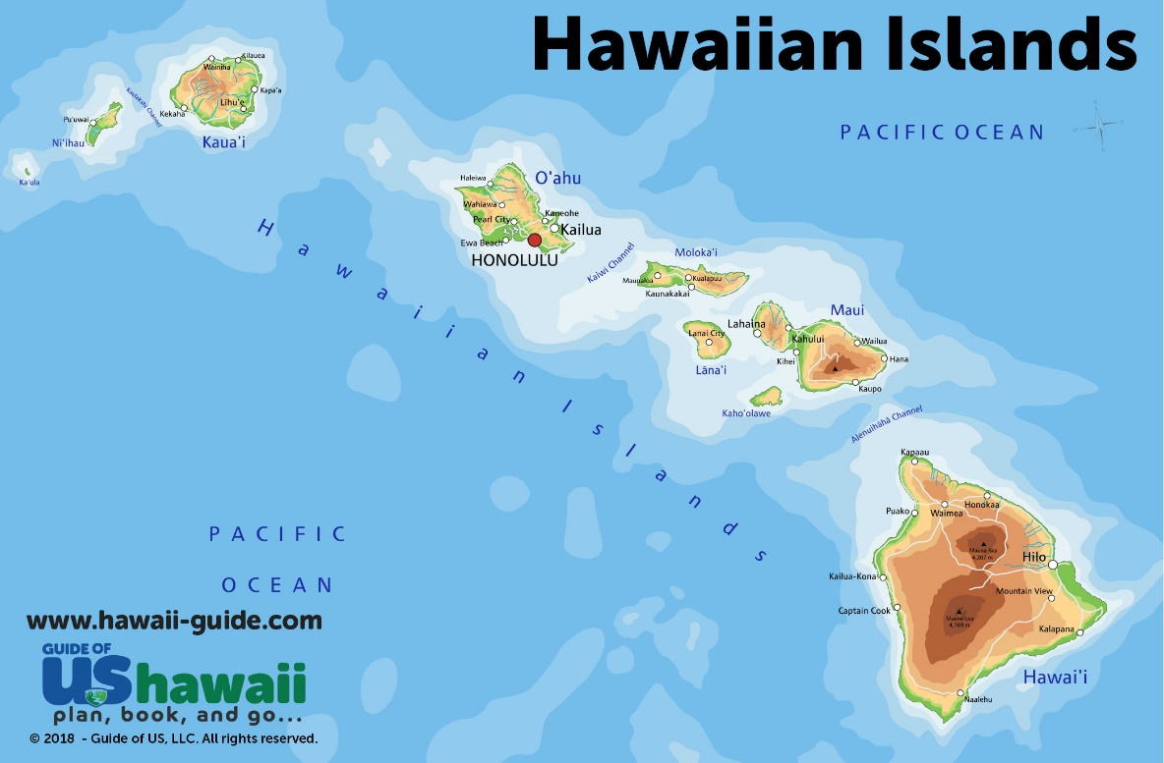
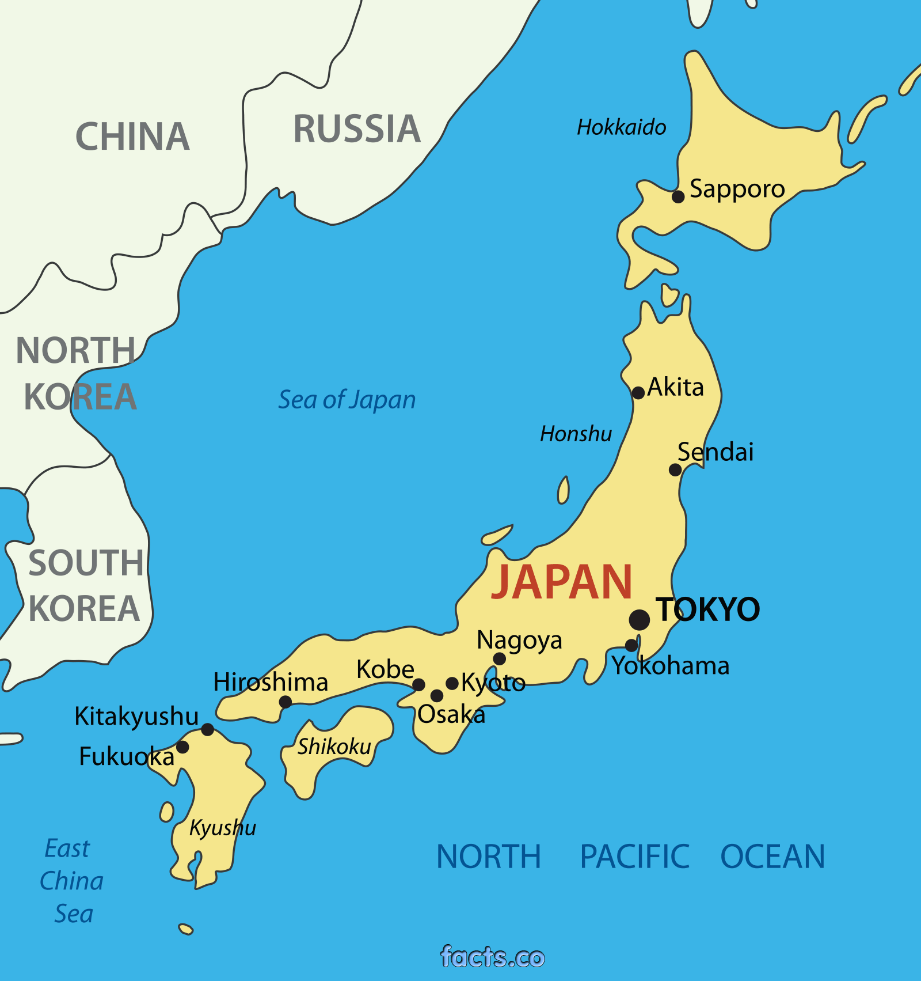
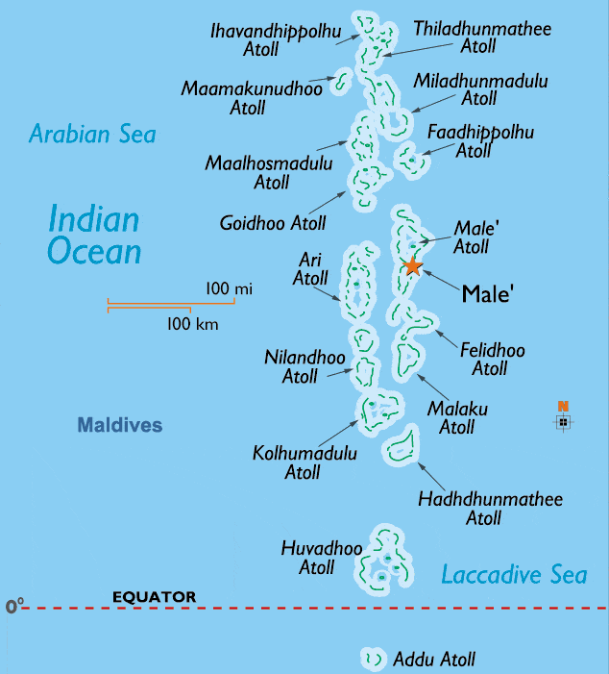
Tsunamis and Financial Risks in Global Tourism
Because of the lack in tourists and visitors, prices of the beaches and hotels fell, hotels were not able to compensate their damages, infrastructures needed to go for a development and so on.
According to Schafer, Hawaii is the most prone to the biggest financial risks for tourism and hospitality industry because of tsunami. Hawaii is situated in the middle of the Pacific Ocean which is home to many tsunami sources.
Japan, South America, Alaska and near regions are also prone to financial risks due to tsunamis and earthquakes. However, there is also some clear positive aspects in this phenomenon. The safety measures in these countries are tightened (Clark, 2017). The economic and financial loss due to natural calamities is being fought by the efficient use of warning systems in the endangered sites.

Slide 11
Conclusion
Despite all the risks and uncertainties of natural phenomena, people like to travel around, do adventure, and discover the wonders of the world.
It is the duty of government and stakeholders of hotel & industries to ensure the safety of their tourists and visitors.
Every tourist spot must have necessary precautionary systems to warn the people, take them to necessary safety in any occurrence .
Evacuation plans must be pre made to avoid any kind confusion in the situation and protect the lives of residents, tourists and mitigate the financial damages due to tsunami.

Slide 12
Recommendation
The best hotels and other hospitality businesses can do is to prepare themselves for such calamities any time
The hotels, businesses and communities use emergency services to warn the nearby people, protect the lives of the tourists and residents, safeguard the employees and the visitors.
Separate shelter houses are also being made which are established in higher regions and safe places. Evacuation management should also be practiced so that there is no panic among the people and everyone can be moved out to safety. Many countries also limit their tourism opening if the weather is not favourable so that the potential damages and risks can be easily mitigated (Clark, 2017).
Communication setup with the disaster management committee or ministry of the country. They will set out the further instructions on whether or not it is safe to go outside (Lee, 2018).

Slide 13
References
Amezquita-Sanchez, J.P., Valtierra-Rodriguez, M. and Adeli, H., (2017). Current efforts for prediction and assessment of natural disasters: Earthquakes, tsunamis, volcanic eruptions, hurricanes, tornados, and floods. Scientia Iranica, 24(6), pp.2645-2664.
Brahmana, R., Puah, C. and Chai, M., (2016). Natural disaster and local bank non-performing loan: Case of Nias tsunami 2004. Economics Bulletin, 36(4), pp.2413-2421.
Clark, K., Howarth, J., Litchfield, N., Cochran, U., Turnbull, J., Dowling, L., Howell, A., Berryman, K. and Wolfe, F., (2019). Geological evidence for past large earthquakes and tsunamis along the Hikurangi subduction margin, New Zealand. Marine Geology, 412, pp.139-172.
Dhanya, J. and Raghukanth, S.T.G., (2020). Implication of source models on tsunami wave simulations for 2004 (Mw 9.2) Sumatra earthquake. Natural Hazards, 104(1), pp.279-304.
GISCHLER, E. and KIKINGER, R., EFFECTS OFTHE TSUNAMI OF 26 DECEMBER 2004 ON RASDHOO AND NORTHERN ARJ ATOLLS, MALDIVES.
Jayasinghe, M., Selvanathan, S. and Selvanathan, E.A., The Asian Tsunami and Tourism Industry: Impact and Recovery. In Economic Effects of Natural Disasters (pp. 335-358). Academic Press.
Jitpraphai, S.M., Arunotai, N. and Tiangtrong, A., (2017). Tsunami Disaster Risk And Vulnerability In Coastal Tourism Community: The Case Of Khao Lak Area, Thailand. Tourism in Marine Environments, 12(3-4), pp.155-167.
Lee, W., Kim, J., Park, J. and Hur, D., (2018). Effects of tsunami waveform on overtopping and inundation on a vertical seawall. Journal of Korea Water Resources Association, 51(8), pp.643-654.
Lotto, G.C., Dunham, E.M., Jeppson, T.N. and Tobin, H.J., (2017). The effect of compliant prisms on subduction zone earthquakes and tsunamis. Earth and Planetary Science Letters, 458, pp.213-222.
Marthoenis, M., Yessi, S., Aichberger, M.C. and Schouler-Ocak, M., (2016). Mental health in Aceh–Indonesia: a decade after the devastating tsunami 2004. Asian journal of psychiatry, 19, pp.59-65.
Pradesh, A., INDIAN OCEAN TSUNAMI 2004.
Ramírez-Herrera, M.T., Corona, N., Cerny, J., Castillo-Aja, R., Melgar, D., Lagos, M., Goguitchaichvili, A., Machain, M.L., Vazquez-Caamal, M.L., Ortuño, M. and Caballero, M., (2020). Sand deposits reveal great earthquakes and tsunamis at Mexican Pacific Coast. Scientific Reports, 10(1), pp.1-10.
Rindrasih, E., (2019). Life after tsunami: the transformation of a post-tsunami and post-conflict tourist destination; the case of halal tourism, Aceh, Indonesia. International Development Planning Review, 41(4), pp.517-541.
Skoufias, E., Strobl, E. and Breivik Tveit, T., (2020). Flood and Tsunami Damage Indices Based on Remotely Sensed Data: An Application to Indonesia. Natural Hazards Review, 21(4), p.04020042.
Teresa, A.R.E., Vasanth, G.J. and Vidya, C., (2020). A review on the potential effects of tsunami on built environment. Materials Today: Proceedings.

