Slide 1
Anghenion Dysgu Ychwangeol a Lles
Additional Learning Needs and Well-being
ECES6021C
Iechyd Meddwl a Lles Plant a Phobl Ifance
Children and Young People’s Mental Health and Wellbeing

Slide 2





Ymlaciwch gyda gwen / Relax with a smile gwenwch / smile

Slide 3

Nod y Modiwl / Module Aim
Datblygu dealltwriaeth feirniadol o rôl ac effaith llesiant mewn addysg a dadansoddi’n feirniadol yr arferion a’r dulliau sy’n cefnogi hyn.
To develop a critical understanding of the role and impact of well-being in education and critically analyse the practices and approaches which support this.

Slide 4

Deilliannau Dysgu / Learning Outcomes
Archwilio’n feirniadol effaith deddfwriaeth a pholisi ar yr agenda llesiant yn y Deyrnas Unedig o ran addysg.
Critically examine the impact of legislation and policy on the well-being agenda in the UK in relation to education.

Slide 5

Deilliannau Dysgu / Learning Outcomes
Adfyfyrio’n feirniadol ar rôl ac effaith hunanofal i staff, plant a phobl ifanc wrth gyflawni nodau llesiant ehangach.
Critically reflect on the role and impact of self-care for staff, children and young people in achieving wider well-being goals.

Slide 6
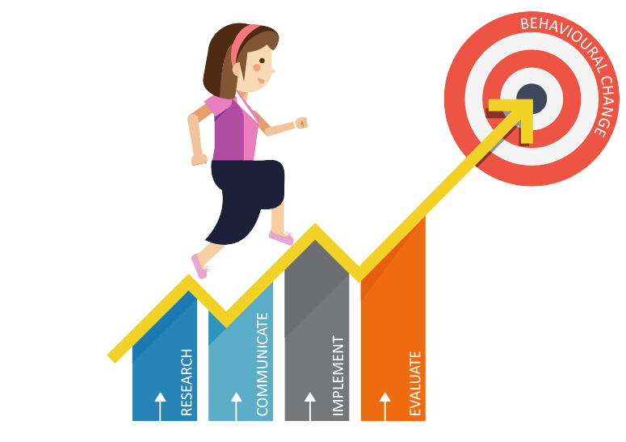
Deilliannau Dysgu / Learning Outcomes
Dadansoddi’n feirniadol ffyrdd o hyrwyddo llesiant cynaliadwy a gwerthuso deilliannau mewn amgylchedd sy’n seiliedig ar addysg.
Critically analyse ways of promoting sustainable well-being and evaluating outcomes in an education-based environment.

Slide 7

LLES? / WELL-BEING?
Mewn parau neu grwpiau bach, ystyriwch y cyflyrau hynny a drafodwyd ym modiwl ECES5006C – ‘Mae Pawb yn Golygu Pawb’.
Ydych chi’n meddwl bod y cyflyrau hyn yn gallu cael effaith negyddol ar les? Sut?
A oes Anghenion Dysgu Ychwangol eraill sy’n gallu effeitho ar les? Sut?
In pairs or small groups, consider the diagnosable conditions that we discussed in the ECES5006 module ‘All Means All’.
Do you think that these conditions could have an adverse affect on well-being? How?
Are there other Additional Learning Needs that could affect well-being? How?

Slide 8

Sesiwn heddiw / Today’s session
Today we are going to focus on some others:
ADHD
Anxiety
Heddiw rydym yn mynd i ffocysu ar rai eraill:
Anhwylder diffyg canolbwyntio a gorfywiogrwydd (ADHD)
Pryder/Gor-bryder

Slide 9

Why well-being, equity and inclusion matter
Learners have the right to the best possible health and protection from harm. Good well-being is fundamental to learners’ progress and achievement. Learners need to experience physical, psychological, emotional and social well-being in order to thrive and engage successfully with their education, society and the opportunities that life presents.
Good levels of well-being empower learners to take responsibility for their own lives and to have a positive influence on the lives of others. An equitable and inclusive school takes account of and responds to the unique challenges that present themselves to individual learners, enabling them to make good progress.
Welsh Government (2021)
Pam mae lles, tegwch a chynhwysiant yn bwysig
Mae gan ddysgwyr hawl i gael yr iechyd gorau posibl a chael eu hamddiffyn rhag niwed. Hefyd, mae lles da yn hanfodol i gynnydd a chyflawniad dysgwyr. Mae angen i ddysgwyr brofi lles corfforol, seicolegol, emosiynol a chymdeithasol er mwyn ffynnu a chymryd rhan yn llwyddiannus yn eu haddysg, mewn cymdeithas ac yn y cyfleoedd y bydd bywyd yn eu cynnig.
Bydd lefelau da o les yn grymuso dysgwyr i gymryd cyfrifoldeb am eu bywydau eu hunain ac i gael dylanwad cadarnhaol ar fywydau pobl eraill. Mae ysgol deg a chynhwysol yn ystyried yr heriau unigryw sy'n wynebu dysgwyr unigol ac yn ymateb iddynt, gan eu galluogi i wneud cynnydd da.
Llywodraeth Cymru (2021)

Slide 10
Beth all lleoliadau wneud? / What settings can do?
Creu amgylchedd ysgol gyfan sy'n pwysleisio cynhwysiant a chydweithrediad
Bod â dyheadau uchel ar gyfer pob plentyn a pherson ifanc.
Darparu rhaglenni sgiliau cymdeithasol ac emosiynol sy'n anelu at feithrin gwydnwch
Creu adolygiad rheolaidd o CDU sy'n adeiladu sgiliau gam wrth gam i wella llwyddiant
Sicrhau bod disgyblion yn gwerthfawrogi gwahaniaeth
Gwersi Iechyd a Lles o ansawdd da sy'n hyrwyddo perthnasoedd ac amrywiaeth
Create a whole-school environment emphasising inclusion and cooperation
Have high aspirations for all children and young people.
Deliver social and emotional skills programmes which aim to build resilience
Create regularly review an IDP that builds skills step by step to improve success
Ensure pupils value difference
Good quality Health and Well-being lessons promoting relationships and diversity

Slide 11
Beth all lleoliadau wneud?/What settings can do?
Cefnogi plant a phobl ifanc ag ADY i deimlo eu bod yn cael eu derbyn a'u perthyn
Mynd i'r afael â bwlio a gwahaniaethu
Gweld plant a phobl ifanc yn gyffredinol yn hytrach na chanolbwyntio ar eu hanabledd neu salwch yn unig
Bod yn ymwybodol o arwyddion cynnar o risg gynyddol i iechyd meddwl a pharatoi ffactorau amddiffynnol i atal cynnydd pellach
Darparu cymorth ychwanegol e.e. drwy ofal bugeiliol/cwnsela mewn ysgolion, nyrsys ysgol neu drwy gyfeirio at asiantaethau allanol.
Anna Freud National Centre for Children and Families / Mentally Healthy Schools
Support children and young people with ALN to feel accepted and belong
Tackle bullying and discrimination
See children and young people as a whole rather than focusing just on their disability or illness
Be aware of early signs of escalating risk to mental health and mobilise protective factors to prevent further escalation
Provide extra support e.g. through pastoral care/school counselling, school nurses or through referral to external agencies.
Anna Freud National Centre for Children and Families / Mentally Healthy Schools

Slide 12
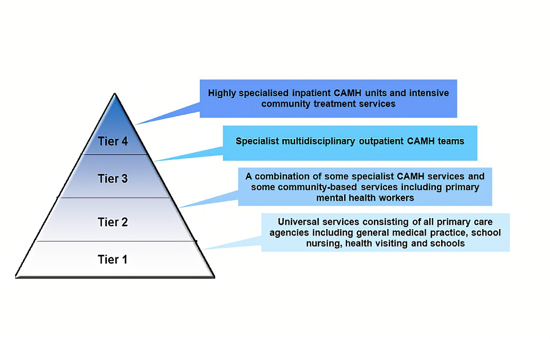
CAMHS

Slide 13
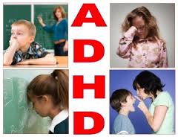
Anhwylder diffyg canolbwyntio a gorfywiogrwydd
Attention Deficit and Hyperactivity Disorder (ADHD)
Persistent pattern of inattention , hyperactivity and impulsivity
Is the child predominantly inattentive? Hyperactive / impulsive? Or combination of both?
Patrwm parhaus o ddiffyg canolbwyntio, gorfywiogrwydd a diffyg amynedd
A yw'r plentyn yn ddigyswllt yn bennaf? Goractif / byrbwyll? Neu gyfuniad o'r ddau?

Slide 14

Anhwylder diffyg canolbwyntio a gorfywiogrwydd
Attention Deficit and Hyperactivity Disorder (ADHD)
Y math mwyaf cyffredin o Oedi Niwro-ddatblygiadol yn y DU
Amcangyfrifon o nifer yr achosion yn ymddangos fel eu bod wedi codi dros amser
OND... yn rhannol o leiaf, yn gysylltiedig â mwy o gydnabyddiaeth ag arferion diagnostig.
Amcangyfrifon o nifer yr achosion yn amrywio yn dibynnu ar y meini prawf diagnostig a ddefnyddir.
Most common form of Neuro- developmental delay in the UK
Estimates of prevalence appear to have risen over time
BUT… at least in part, associated with increased recognition and diagnostic practices.
Estimates of prevalence varies depending on the diagnostic criteria used.

Slide 15
Materion ADHD Issues
Bydd 1/3 neu 2/3 o blant ag ADHD yn parhau i arddangos symptomau anhwylder drwy gydol eu hoes
Mae gorfywiogrwydd a diffyg amynedd yn gostwng gydag oedran; OND... mae diffyg sylw a gwrthdyniad yn tueddu i barhau
MAE POBL IFANC ag ADHD mewn mwy o berygl o gael problemau academaidd; perthnasoedd rhyngbersonol anodd; hunan-barch isel; damweiniau ceir; mwy o achosion o anhwylderau seiciatrig; defnyddio sylweddau ac ymddygiad gwrthgymdeithasol
(Wilmshurst, 2015)
1/3 or 2/3 of children with ADHD will continue to exhibit symptoms of disorder throughout their lifetime
Hyperactivity and impulsivity decline with age; BUT… inattention and distractibility tend to persist
ADOLESCENTS with ADHD are at increased risk for academic problems; difficult interpersonal relationships; low self-esteem; car accidents; higher incidence of psychiatric disorders; substance use and antisocial behaviour
(Wilmshurst, 2015)

Slide 16
ADHD and cognitive ability
Problemau prosesu gwybyddol sy'n ymyrryd â'r gallu i ddysgu mewn lleoliadau academaidd traddodiadol
Enghraifft:
Gwybodaeth ar goll a gyflwynir gan athrawon
Colli cyfleoedd i ymarfer sgiliau academaidd sydd newydd eu dysgu
Cronfa is gyffredinol o wybodaeth
diffyg mewn cof gwaith
trefnu gwybodaeth a rhannu gwybodaeth ag eraill
Cognitive processing problems that interfere with the ability to learn in traditional academic settings
Example:
Missing information presented by teachers
Missing opportunities to practice newly learned academic skills
General lower fund of information
deficit in working memory
organizing information and relating information to others

Slide 17

Anhwylderau a nodweddion cysylltiedig
Associated disorders and features
44% o blant ag ADHD gydag o leiaf un comorbid seiciatrig arall; 31% gydag o leiaf ddau anhwylder arall; ac 11% gydag o leiaf dri anhwylder
Anhwylderau/problemau eraill
  Anhwylderau ymddygiad
  ODD
  Defnyddio Sylweddau yn ystod y glasoed
    Cael eu gwrthod gan gyd-ddisgyblion/cyfoedion
    Pwysau gan gyfoedion
Ysmygu – nicotin i helpu i wella canolbwyntio ac atal ymddygiad
Anhwylderau Gorbryder a Hwyliau
44% of children with ADHD with at least one other psychiatric comorbid; 31% with at least two other disorders; and 11% with at least three disorders
Other disorders/problems
  Conduct disorders
  Oppositional Defiant Disorder (ODD)
  Substance Use /peersduring adolescence
    Rejection by classmates
    Peer pressure
  Smoking – nicotine to help improve concentration and behavioural inhibition
  Anxiety and Mood Disorders

Slide 18
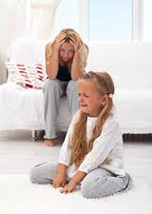
Effaith yn y cartref / Impact at home
Perthynas rhwng rhieni a phlant – yn aml yn anodd
Mamau plant ag ADHD yn fwy gelyniaethus a negyddol – mae plant yn eu tro yn cymryd rhan mewn ymddygiad mwy gwrthnysig a di-gystadleuol (CYFATEBOL)
Pam? Rhwystredigaeth (mam); disgyblaeth gosbol (plentyn)
Mamau ag ADHD – risg arbennig ar gyfer anhwylderau HWYL a phroblemau sylweddau
Beio eu hunain; amheuaeth o’u cymhwysedd ac effeithiolrwydd
Iselder
Parent-child relationship – often problematic
Mothers of children with ADHD are more hostile and negative – children in turn engage in more aversive and noncompliant behaviour (RECIPROCAL)
  Why? Frustration (mother); punitive discipline (child)
Mothers with ADHD – particular risk for MOOD disorders and substance problems
  Blame selves; doubt selves of competence and efficacy
  Depression

Slide 19

Effaith yn yr ysgol / Impact in school
Mae plant ag ADHD yn dangos anawsterau ar draws meysydd academaidd
Darllen a Mathemateg
56% - gofyn am diwtora
30% - 49% - yn derbyn gwasanaethau arbennig
30% - gradd/lefel ailadroddus
10% - 35% - peidiwch â chwblhau addysg uwchradd
Astudiaeth hydredol – rhagfynegydd cyflawniad academaidd
OND... dim esboniad uniongyrchol na chlir sut mae ADHD yn effeithio ar berfformiad academaidd
Damcaniaeth – problemau ymddygiad
Children with ADHD show difficulties across academic domains
Reading and Maths
56% - require tutoring
30% - 49% - receive special services
30% - repeat grade/level
10% - 35% - do not complete secondary education
Longitudinal study – predictor of academic achievement
BUT… no direct or clear explanation how ADHD affect academic performance
Hypothesis – conduct problems

Slide 20


Sut fyddech chi yn cefnogi?
How would you support?
Tasg Ymcwhil / Research Task
ADHD and mental health - Mind

Slide 21
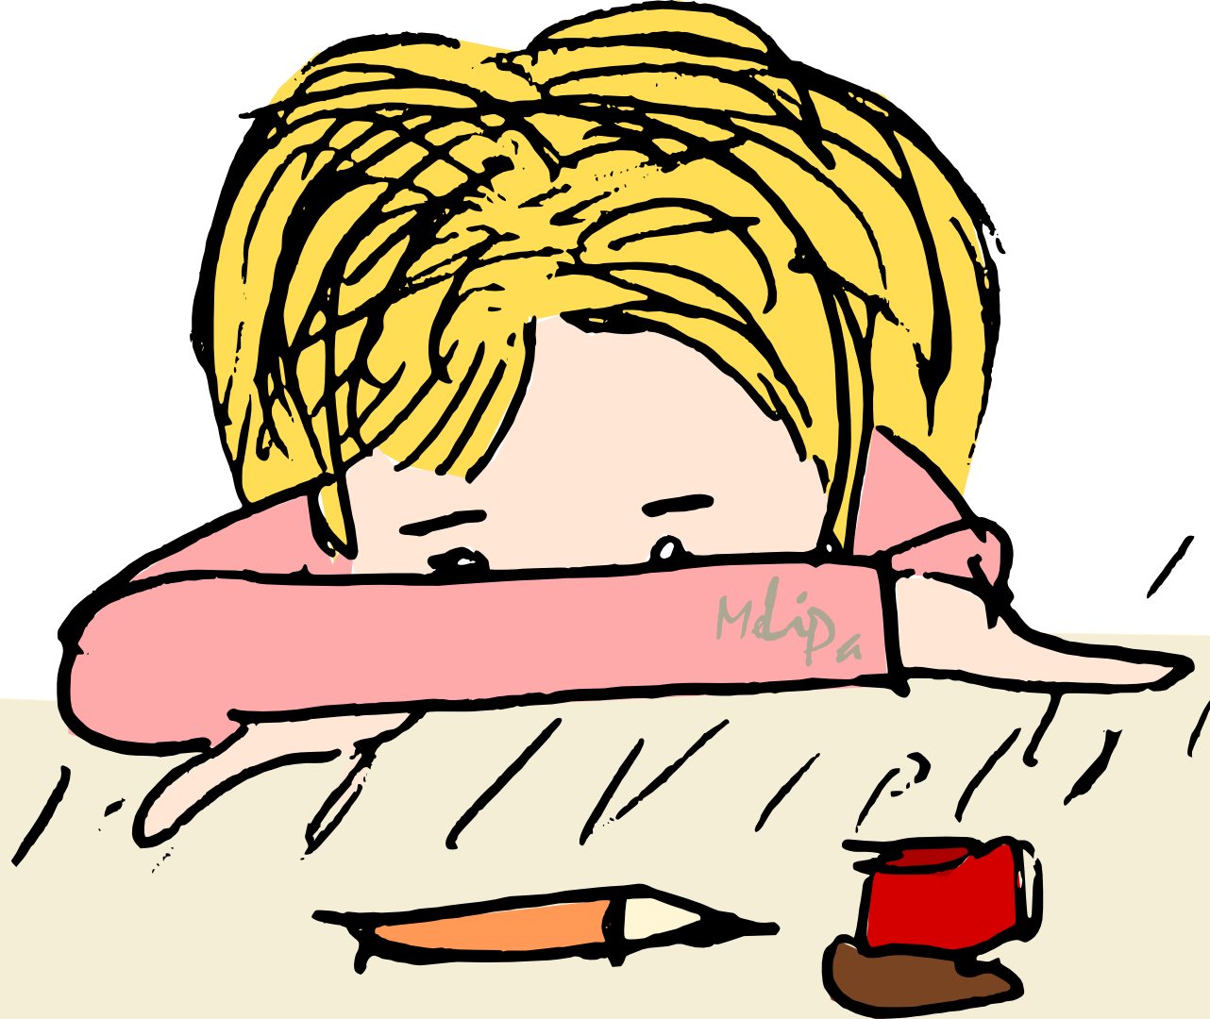
Pryder / Anxiety
From around 6 months to 3 years very common for young children to have separation anxiety. May become clingy and cry when separated from parents/ carers. Normal stage in child's development and should stop at around age 2 to 3.
Anxiety becomes a problem for children when it starts to get in the way of their everyday life.
At exam time, all children will be anxious, but some may be so anxious that they don't manage to get to school that morning.
Severe anxiety can harm children's mental and emotional well-being, affecting self-esteem and confidence. May become withdrawn and go to great lengths to avoid things or situations that make them feel anxious.
O tua 6 mis i 3 blynedd yn gyffredin iawn i blant ifanc gael pryder gwahanu. Gall fod yn glyd ac yn crio pan fyddant wedi'u gwahanu oddi wrth rieni/gofalwyr. Cam arferol yn natblygiad y plentyn a dylai ddod i ben tua 2 i 3 oed.
Mae gorbryder yn dod yn broblem i blant pan fydd yn dechrau mynd yn y ffordd o'u bywyd bob dydd.
Ar adeg arholiadau, bydd pob plentyn yn bryderus, ond efallai bod rhai mor bryderus fel nad ydyn nhw'n llwyddo i gyrraedd yr ysgol y bore hwnnw.
Gall pryder difrifol niweidio lles meddyliol ac emosiynol plant, gan effeithio ar hunan-barch a hyder. Gall gael ei dynnu'n ôl a mynd i drafferthion mawr i osgoi pethau neu sefyllfaoedd sy'n gwneud iddynt deimlo'n bryderus.

Slide 22

Symptomau gorbryder mewn plant
Symptoms of anxiety in children
anodd canolbwyntio
methu cysgu, neu deffro yn y nos gyda breuddwydion drwg
dim yn bwyta'n iawn
mynd yn ddig/yn flin yn gyflym, a bod allan o reolaeth yn ystod y tu allan
poeni'n gyson neu gael meddyliau negyddol
teimlo o dan straen, neu ddefnyddio'r toiled yn aml
bob amser yn crio
cydio yn eraill
cwyno am boenau bol a theimlo'n sâl
Pryder gwahanu yn gyffredin mewn plant iau, tra bod plant hŷn a phobl ifanc yn eu harddegau yn tueddu i boeni mwy am yr ysgol neu fod â phryder cymdeithasol.
difficulty concentrating
not sleeping, or waking in the night with bad dreams
not eating properly
quickly getting angry or irritable, and being out of control during outbursts
constantly worrying/having negative thoughts
feeling tense and fidgety/using the toilet often
always crying
being clingy
complaining of tummy aches/feeling unwell
Separation anxiety is common in younger children, whereas older children and teenagers tend to worry more about school or have social anxiety.

Slide 23
Triniaethau ar gyfer anhwylderau gorbryder ymhlith plant
Treatments for anxiety disorders in children
Bydd y math o driniaeth a gynigir yn dibynnu ar oedran ac achos pryder y plentyn.
Gall cwnsela helpu plant i ddeall beth sy'n eu gwneud yn bryderus a chaniatáu iddynt weithio drwy'r sefyllfa.
Therapi ymddygiad gwybyddol (CBT) - therapi siarad a all helpu plentyn i reoli ei bryder drwy newid y ffordd y maent yn meddwl ac yn ymddwyn.
Gellir cynnig meddyginiaethau gorbryder os yw pryder yn ddifrifol neu os nad yw'n gwella gyda therapïau siarad.
Type of treatment offered will depend on child's age and cause of anxiety.
Counselling can help child understand what's making them anxious and allow them to work through the situation.
Cognitive behavioural therapy (CBT) - a talking therapy that can help a child manage their anxiety by changing the way they think and behave.
Anxiety medicines may be offered if anxiety is severe or does not improve with talking therapies.

Slide 24

Heriau / Challenges?

Slide 25
Beth sy’n achosi anhwylderau gorbryder mewn plant
What causes anxiety disorders in children
Rhai plant yn cael eu geni'n fwy pryderus ac yn llai abl i ymdopi â straen.
Gall plant godi ymddygiad pryderus o fod o gwmpas pobl bryderus.
Rhai plant yn datblygu pryder ar ôl digwyddiadau llawn straen, megis:
Symud tŷ neu ysgol yn aml
rhieni'n ymladd neu'n dadlau
marwolaeth perthynas neu ffrind agos
mynd yn ddifrifol wael neu'n cael anaf mewn damwain
materion ysgolion e.e. arholiadau / fwlio
cael eu cam-drin neu eu hesgeuluso
Some children simply born more anxious/less able to cope with stress.
Can pick up anxious behaviour from being around anxious people.
Some children develop anxiety after stressful events, such as:
frequently moving house or school
parents fighting or arguing
death of a close relative or friend
serious illness or getting injured in an accident
school-related issues e.g. exams / bullying
being abused or neglected

Slide 26

Ystyriwch… Consider…
Mae plant ag anhwylder diffyg canolbwyntio a gorfywiogrwydd (ADHD) ac anhwylderau'r sbectrwm awtistig yn fwy tebygol o gael problemau gyda phryder.
Pam?
Children with attention deficit hyperactivity disorder (ADHD) and autistic spectrum disorders are more likely to have problems with anxiety.
Why?
Autism and mental health - Mind

Slide 27

Mae angen newid yr iaith…
We need all teachers, parents and students emphasising the following:
Lles meddyliol yn gysylltiedig â'n canlyniadau academaidd ac mae angen i ni sicrhau, fel cymdeithas, nad ydym yn esgeuluso'r cyntaf wrth fynd ar drywydd yr ail.
Gellir gweld methiant fel llwybr i lwyddiant. Yr hyn a ddysgwn o'n methiannau sy'n bwysig.
Nid yw hunanwerth a llwyddiant yn cael eu mesur gan ganlyniadau academaidd.
Our mental well-being is linked to our academic results and we need to ensure that as a society we don’t neglect the first in pursuing the second.
Failure can be seen as a route to success. It’s what we learn that from our failures that is important.
Self-worth and success are not dictated by academic results.

Slide 28
Mae angen newid yr iaith…
We need all teachers, parents and students emphasising the following:
Mae gwerth i'r person cyfan, nid dim ond sut maen nhw'n perfformio mewn arholiadau.
Gall materion lles meddyliol sy'n codi yn yr ysgol ddilyn myfyriwr i fywyd fel oedolyn.
Erasmus ( 2019 )
The whole person has value, not just how they perform in exams.
Mental well-being issues arising in school can follow a student into adult life.
Erasmus ( 2019 )

Slide 29

Things students with anxiety wished their teacher understood
Pa 3 strategaeth y byddech chi yn ystyried defnyddio gyda phlant/pobl ifanc sy’n profi symptomau gorbryder?
Pa dystiolaeth sydd i gefnogi’r defnydd o’r math yma o strategaeth?
Which 3 support strategies would you consider using with children/young people experiencing anxiety symptoms?
What evidence is there to support the use of this type of strategy?

Slide 30
Cyfeirnodau / References
Erasmus, C. (2019) The Mental Health and Wellbeing Handbook for Schools, Jessica Kingsley Publishers
Office for National Statistics: Insights into children's mental health and well-being (2015) Available at http://backup.ons.gov.uk/2015/10/20/insights-into-childrens-mental-health-and-well-being/ (Accessed 19.11.25)
Welsh Government: Wellbeing of Future Generations (Wales) Act 2015. Available at http://www.legislation.gov.uk/anaw/2015/2/contents/enacted (Accessed 19.11.25)
Youngminds (2015) Available at http://www.youngminds.org.uk/ (Accessed 19.11.25)

