Slide 1

The Importance of Communication Skills in the Workplace
Overview:
Communication is the backbone of any successful organization.
Facilitates effective collaboration, decision-making, and problem-solving.
Objectives:
Explore the critical role of communication in the workplace.
Discuss key communication skills and their impact on organizational success.
Share real-world examples and personal experiences.
Shah uddin
2019661
Notes:
Greetings, everyone! Today, we're delving into the significance of communication in the workplace. Think of it as the sturdy backbone that keeps a successful organization standing tall. Effective communication is like the glue that helps us collaborate smoothly, make smart choices, and tackle challenges head-on. When communication falters, even the most brilliant ideas can stumble due to misunderstandings.
Our aims for today are straightforward. First off, we'll explore why communication is vital at work. This involves grasping how clear and effective communication can enhance every aspect of a workplace. Next, we'll dive into various communication skills and their role in organizational success. We'll cover basics like speaking clearly, writing effectively, understanding body language, and creating impactful visuals. Lastly, we'll share real-life stories and personal experiences to demonstrate how these skills play out in real-world scenarios.
Throughout our discussion, we'll unpack different forms of communication, highlighting why they're important and how they contribute to a company's overall performance. By drawing on tangible examples and personal anecdotes, we'll shed light on the practical side of these concepts.
In essence, today's journey will illuminate the power of communication in the workplace. It's not just about talking and writing—it's about fostering understanding, building connections, and driving success. So, let's embark on this exploration together, uncovering the ways in which effective communication shapes the destiny of organizations.

Slide 2
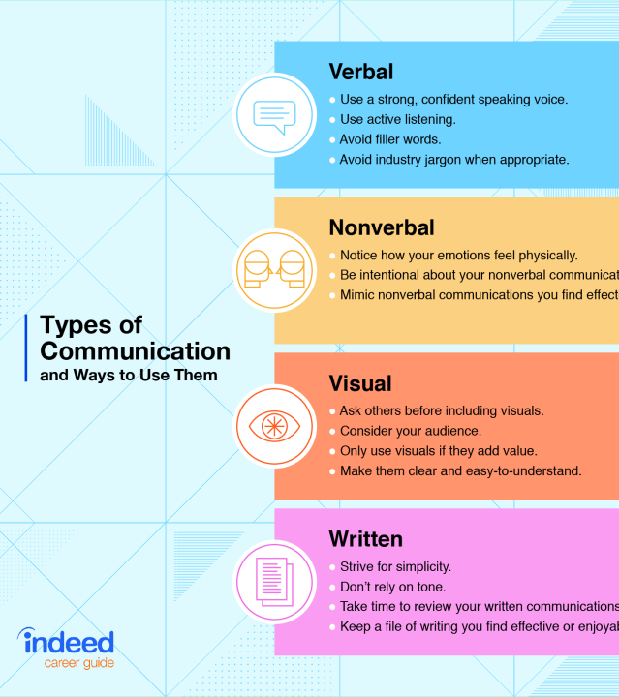
Types of Communications
1. Verbal Communication
Key Aspects:
  Clarity and conciseness.
  Tone and pitch.
  Active listening.
Reference: Adams, S. (2018) Effective Verbal Communication in the Workplace. London: Routledge.
2. Nonverbal Communication
Key Aspects:
  Eye contact.
  Posture and gestures.
  Facial expressions.
Reference: Mehrabian, A. (2017) Nonverbal Communication. New York: Aldine Transaction.
3. Written Communication
Key Aspects:
  Clarity and coherence.
  Proper grammar and punctuation.
  Structured format.
Reference: Johnson, P. (2019) 'The Importance of Written Communication in Business', Journal of Business Studies, 45(1), pp. 33-45.
4. Visual Communication
Key Aspects:
  Use of visuals to enhance understanding.
  Design and layout.
  Integration with verbal or written content.
Reference: Williams, K. (2020) Visual Communication in the Digital Age. Boston: McGraw-Hill.
Notes:
we embark on a journey through the diverse landscape of communication within the workplace. As we navigate through the intricacies of verbal, nonverbal, written, and visual communication, we shall unravel the threads that bind effective communication to organizational success.
Firstly, let us cast our gaze upon the realm of verbal communication. It is a realm where clarity and conciseness reign supreme, where the tone and pitch of our words wield profound influence. Effective verbal communication is not merely about speaking, but also about active listening—a skill that underpins meaningful dialogue and fosters mutual understanding. As noted by Adams in his seminal work, "Effective Verbal Communication in the Workplace," mastering these key aspects is essential for navigating the channels of communication within organizations.
Next, we venture into the realm of nonverbal communication, where words fade into the background, and gestures take center stage. Here, the nuances of eye contact, posture, and facial expressions speak volumes, often conveying more than words ever could. As Mehrabian aptly illustrates in his work on nonverbal communication, these subtle cues shape perceptions, establish rapport, and forge connections in the intricate dance of human interaction.
Turning our attention to the written word, we discover a world where clarity, coherence, and proper grammar reign supreme. In the digital age, where emails, reports, and memos abound, the importance of written communication cannot be overstated. As Johnson highlights in his research on the significance of written communication in business, a well-crafted message can spell the difference between success and failure, clarity and confusion.
Lastly, we venture into the realm of visual communication, where images and design converge to convey messages with striking clarity and impact. From infographics to presentations, visual communication serves as a powerful tool for enhancing understanding and engagement. As Williams elucidates in his work on visual communication in the digital age, the judicious use of visuals, coupled with thoughtful design and integration with verbal or written content, can captivate audiences and drive home key messages with lasting resonance.
In conclusion, the tapestry of communication within the workplace is rich and multifaceted, woven from threads of verbal articulation, nonverbal cues, written discourse, and visual imagery. By honing our skills in each of these domains, we unlock the potential to foster collaboration, drive innovation, and propel our organizations towards success. Let us heed the lessons gleaned from these insights, embracing the power of communication as a catalyst for positive change in the ever-evolving landscape of the modern workplace.

Slide 3
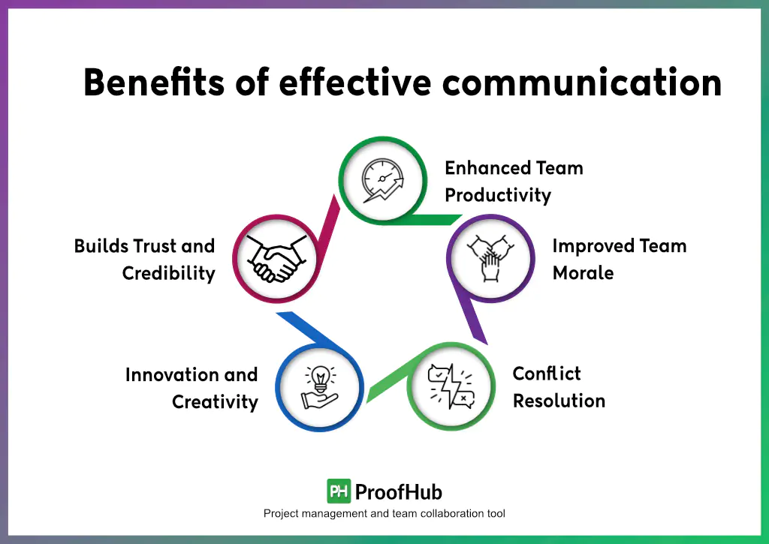
Importance of Communication Skills in the Workplace
Enhances Productivity:
Clear communication ensures tasks are understood and completed efficiently, reducing errors and increasing efficiency.
Example: A project team with regular, clear updates can meet deadlines more effectively.
Reference: Smith, J. (2018) Effective Workplace Communication, New York: Business Press.
Fosters Teamwork:
Open communication encourages collaboration, idea sharing, and problem-solving among team members.
Example: A brainstorming session where all members feel comfortable sharing ideas leads to innovative solutions.
Reference: Brown, L. (2019) 'The Role of Communication in Team Dynamics', Journal of Business Communication, 56(2), pp. 145-160.
Notes:
Now we'll be discussing how talking well and working together can make a big difference at work. Let's start by looking at how clear communication helps get things done faster and better. Imagine if every task was explained clearly, so everyone understood what to do. That would mean fewer mistakes and more efficiency. For example, if a project team keeps each other updated regularly and clearly, they can finish their work on time without any problems. This is what Smith talks about in his book about how to communicate well at work.
Now, let's talk about how good communication helps teams work together better. When everyone talks openly and shares their ideas, teams can solve problems and come up with new and better ways to do things. Brown's research shows that when teams communicate well, they trust each other more and can think of new ideas together.
Imagine a meeting where everyone feels comfortable sharing their thoughts. In that kind of environment, people can come up with really cool ideas and solve problems together. This is what teamwork is all about!
But it's not just about talking. It's about listening, too. When we listen carefully to each other, we understand better and can work together more effectively. It's like playing on a sports team—you need to listen to your teammates to win the game.
Communication is also important when things go wrong. If there's a problem, it's important to talk about it openly and find a solution together. This way, we can learn from our mistakes and make things better in the future.
In the end, good communication helps us work better together and get things done faster. So, let's keep talking and sharing ideas, because that's how we'll make our workplace even better.
As we reflect on the significance of effective communication in the workplace, it becomes apparent that clarity and collaboration are the cornerstones of success. By articulating our thoughts clearly and listening attentively to others, we lay the groundwork for efficient teamwork and problem-solving. In essence, communication isn't just about talking—it's about fostering understanding, building trust, and driving collective achievement.
Consider a scenario where a project team is faced with a complex task. Through clear and regular communication, each team member knows their role and responsibilities, enabling them to work together seamlessly towards a common goal. Deadlines are met, objectives achieved, and success attained—all thanks to the power of effective communication.
Furthermore, let us not overlook the role of communication in fostering a culture of openness and innovation within teams. When individuals feel empowered to share their ideas and perspectives, the possibilities for creative problem-solving become endless. By creating an environment where every voice is heard and valued, we unlock the potential for breakthrough ideas and transformative change.
However, it's important to recognize that effective communication isn't just about sharing ideas—it's also about resolving conflicts and addressing challenges. When issues arise, open and honest communication allows us to confront them head-on, rather than letting them fester and grow. By addressing problems proactively and collaboratively, we cultivate a culture of continuous improvement and resilience.
In conclusion, the importance of effective communication in the workplace cannot be overstated. It is the catalyst for productivity, the fuel for teamwork, and the cornerstone of success. By embracing clear communication and fostering a culture of collaboration, we pave the way for innovation, growth, and collective achievement.
So, let us continue to communicate openly, listen attentively, and collaborate effectively, for it is through these actions that we will propel our organizations towards greater heights of success.

Slide 4
Importance of Communication Skills in the Workplace
Builds Strong Client Relationships
Consistent and transparent communication helps in understanding client needs and expectations.
Example: A client relationship manager at ABC Inc. regularly updates clients on project progress, resulting in high client retention rates.
Reference: Johnson, K. (2020) 'Client Communication Strategies for Success', International Journal of Management Studies, 62(3), pp. 223-240.
Reduces Misunderstandings
Clear communication minimizes the risk of misinterpreting client requirements, ensuring project outcomes meet client expectations.
Example: Detailed project proposals and follow-up meetings help align client and team expectations.
Reference: Martin, R. (2021) Business Communication Today, London: Pearson Education.
Notes:
Now we're exploring the cautious approach to the role of clear communication in both building strong client relationships and minimizing misunderstandings.
Consider the scenario of a client relationship manager at a company. Their responsibility is pivotal, serving as the intermediary between the organization and its clients. Within this role, maintaining consistent and transparent communication emerges as paramount. By providing regular and honest updates to clients, the manager gains a deeper understanding of their needs and expectations. For instance, at ABC Inc., the client relationship manager prioritizes keeping clients informed about project progress, resulting in commendable client retention rates. Johnson's research in the 'International Journal of Management Studies' underscores the significance of these cautious client communication strategies for success.
Now, let's delve into how clear communication serves to mitigate misunderstandings. In any business interaction, misunderstandings can prove detrimental, leading to costly errors and strained relationships. Hence, it is imperative to ensure that all parties involved have a clear understanding of each other's expectations. Thorough project proposals and follow-up meetings play a crucial role in aligning client and team expectations. By meticulously outlining project requirements and facilitating detailed discussions, the likelihood of misinterpreting client needs is significantly reduced. Martin's insights in 'Business Communication Today' underscore the cautious approach needed to ensure that project outcomes align with client expectations.
In summary, adopting a cautious stance towards clear communication is indispensable in fostering strong client relationships and averting misunderstandings. By exercising prudence in keeping clients informed and diligently aligning expectations, businesses can cultivate trust, satisfaction, and sustained success.

Slide 5
References:
Adams, S. (2018) Effective Verbal Communication in the Workplace. London: Routledge.
Mehrabian, A. (2017) Nonverbal Communication. New York: Aldine Transaction.
Johnson, P. (2019) 'The Importance of Written Communication in Business', Journal of Business Studies, 45(1), pp. 33-45.
Williams, K. (2020) Visual Communication in the Digital Age. Boston: McGraw-Hill.
Smith, J. (2018) Effective Workplace Communication, New York: Business Press.
Brown, L. (2019) 'The Role of Communication in Team Dynamics', Journal of Business Communication, 56(2), pp. 145-160.
Johnson, K. (2020) 'Client Communication Strategies for Success', International Journal of Management Studies, 62(3), pp. 223-240.
Martin, R. (2021) Business Communication Today, London: Pearson Education.

