Slide 1

How to create and record a presentation?
By Zita Draper

Slide 2
Content
Aims and learning objectives.
What is a presentation?
How to create a presentation?
How to insert a text box?
How to insert pictures?
How to write in PowerPoint?
How to save content?
How to record in PowerPoint?

Slide 3
Continued
Activity
Summary
Thank you, any questions?

Slide 4

Aims and learning objectives
The aim of today's session is for student to be able at the end of the session to be able to create a PowerPoint presentation and to record a PowerPoint presentation.
By the end of today's lesson students should be able to demonstrate that they understand how to create a PowerPoint and record over one.

Slide 5

What is a presentation?
A way to present your work.
It allows you to be creative.
Allows for graphs.
Helps you demonstrate what you are explaining.
Presenting is a life skill and one that you will use as you move through this course.
It is also a skill you will need to utilise during your future career.

Slide 6
How to create a PowerPoint presentation?
Go to UWTSD HWB.
Log in and click on the tab that says one drive, it will have a cloud option on it.
It will look like this;

Slide 7
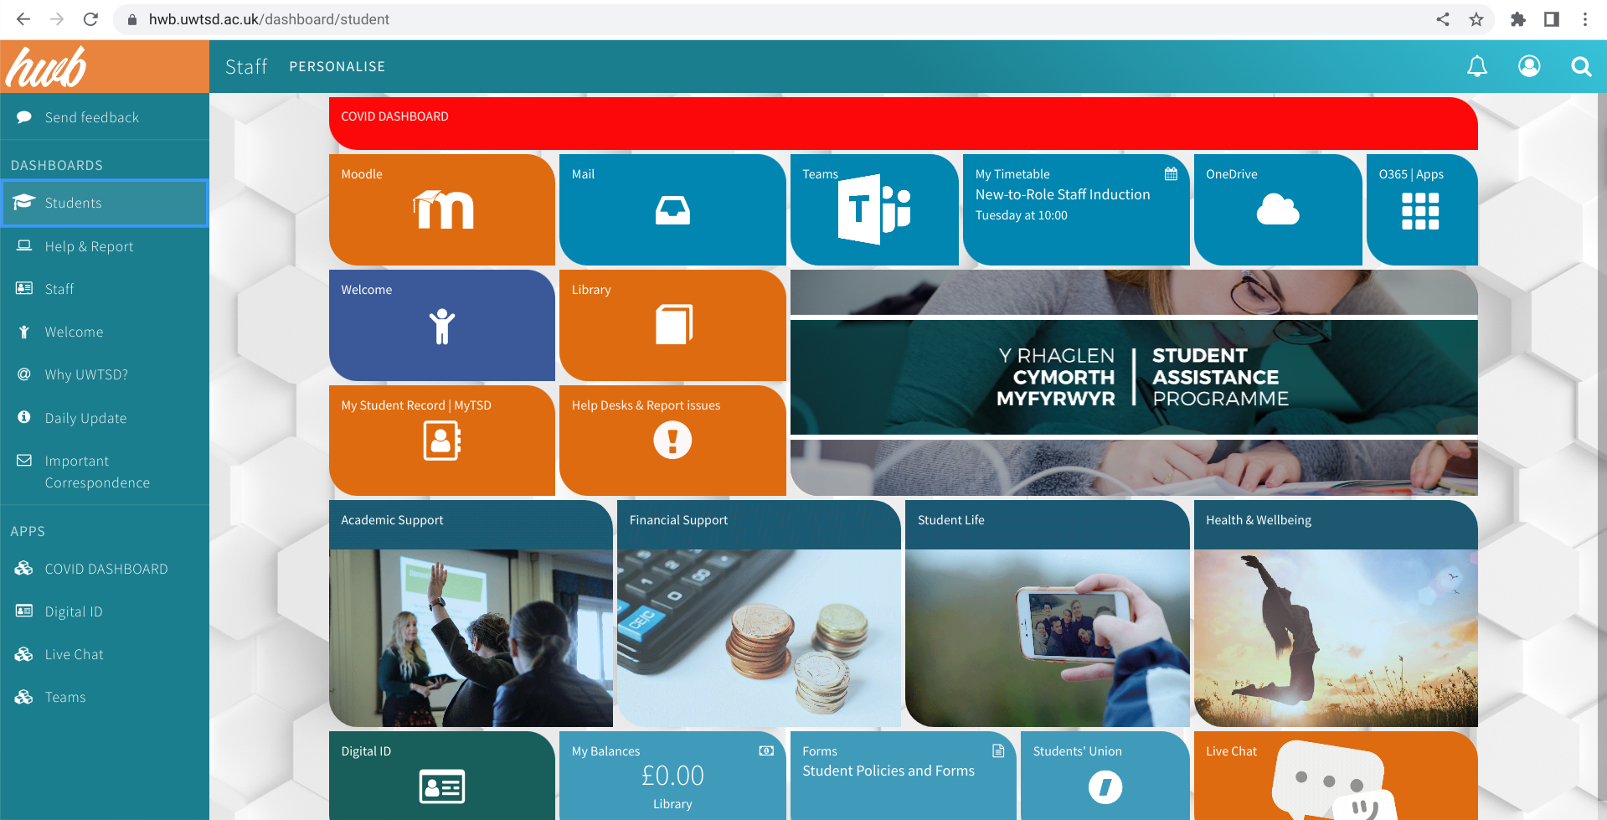
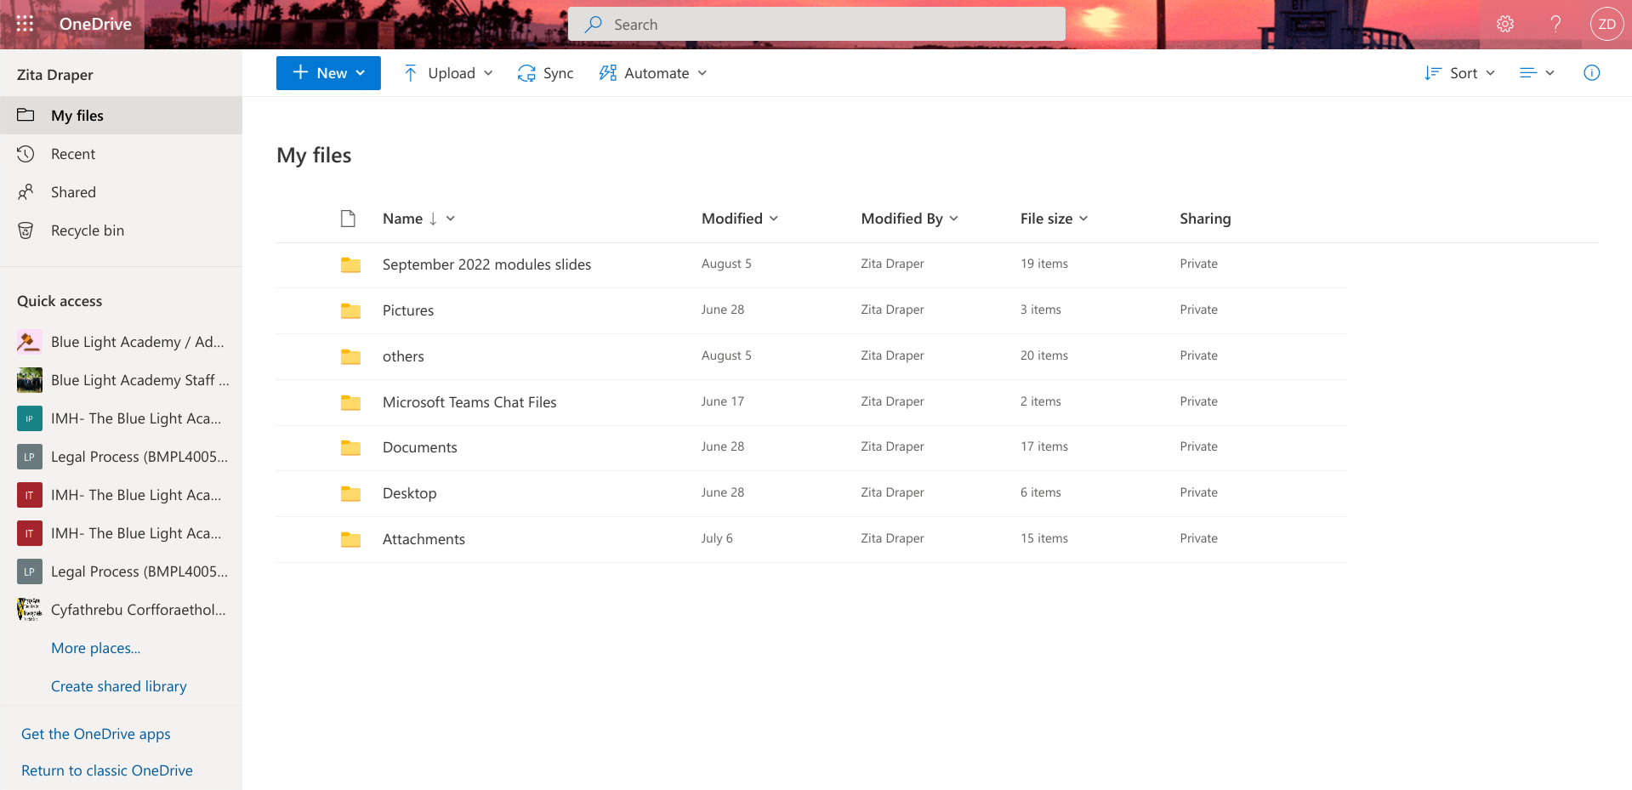
Open the HWB, and log in, the circle with the person in at the top allows you to sign in. Enter you email address and password and then authenticate the log in. Next, once logged in click on the fifth tile across, the one that says '' ONE DRIVE''. It has a picture of a cloud on it.
Once you have opened the one drive, you may have to log in again. You will see the following;

Slide 8
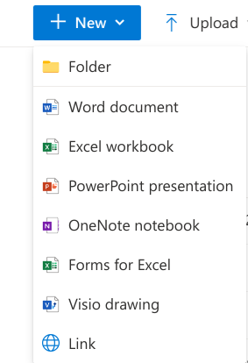
On the one drive, you will see a button that says '' new''.
Once you have clicked the '' New'' button. You will see a drop-down list.
You next need to click PowerPoint.

Slide 9
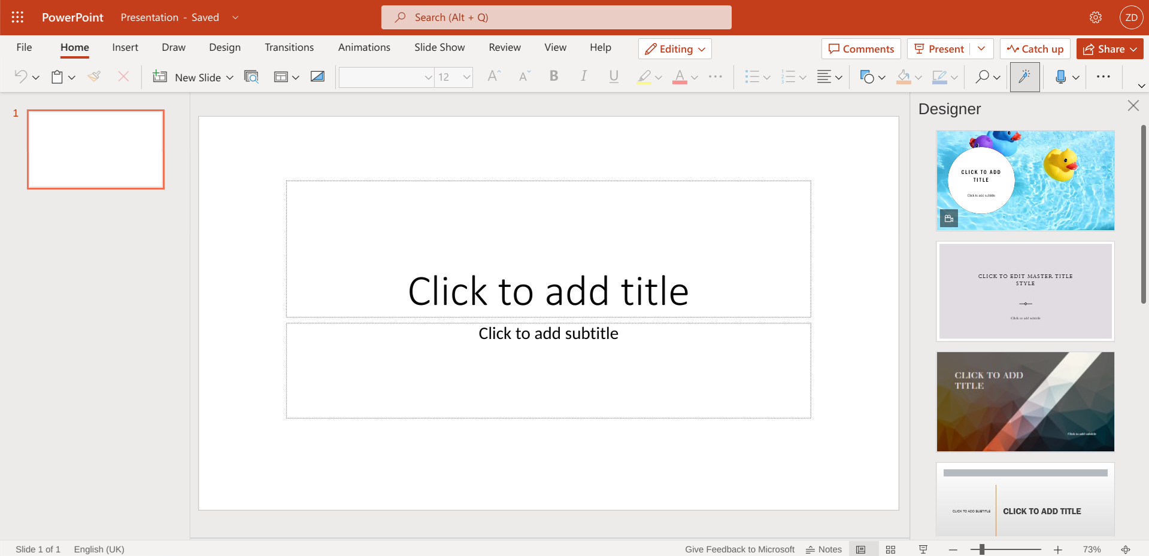
This page will then open.
Any changes you make will save automatically.
Let look at backgrounds.

Slide 10
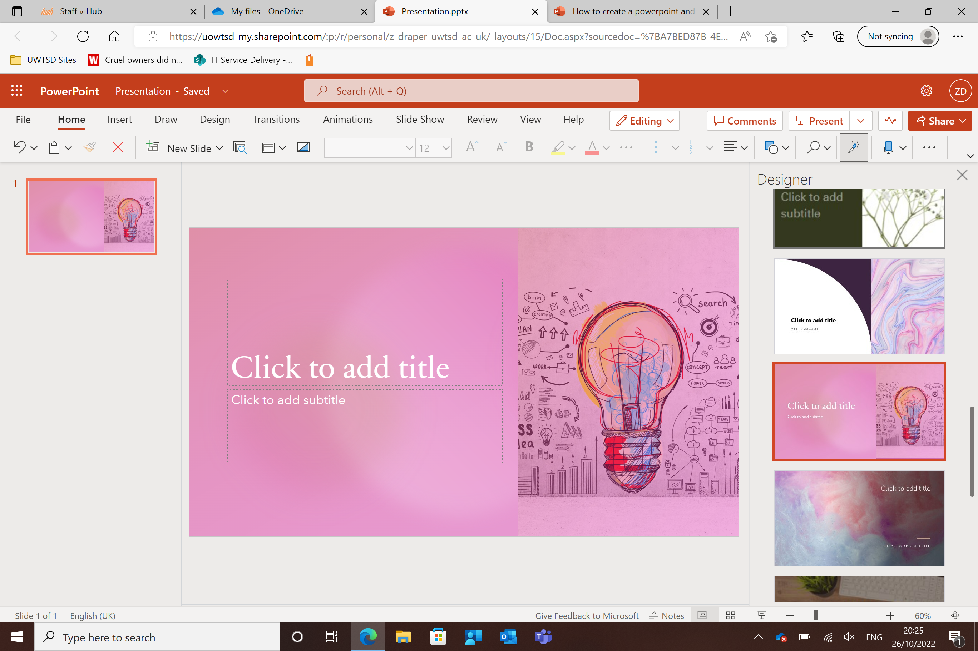
Click the design you want, and it will apply it.
Click the boxes and you can type in them.

Slide 11
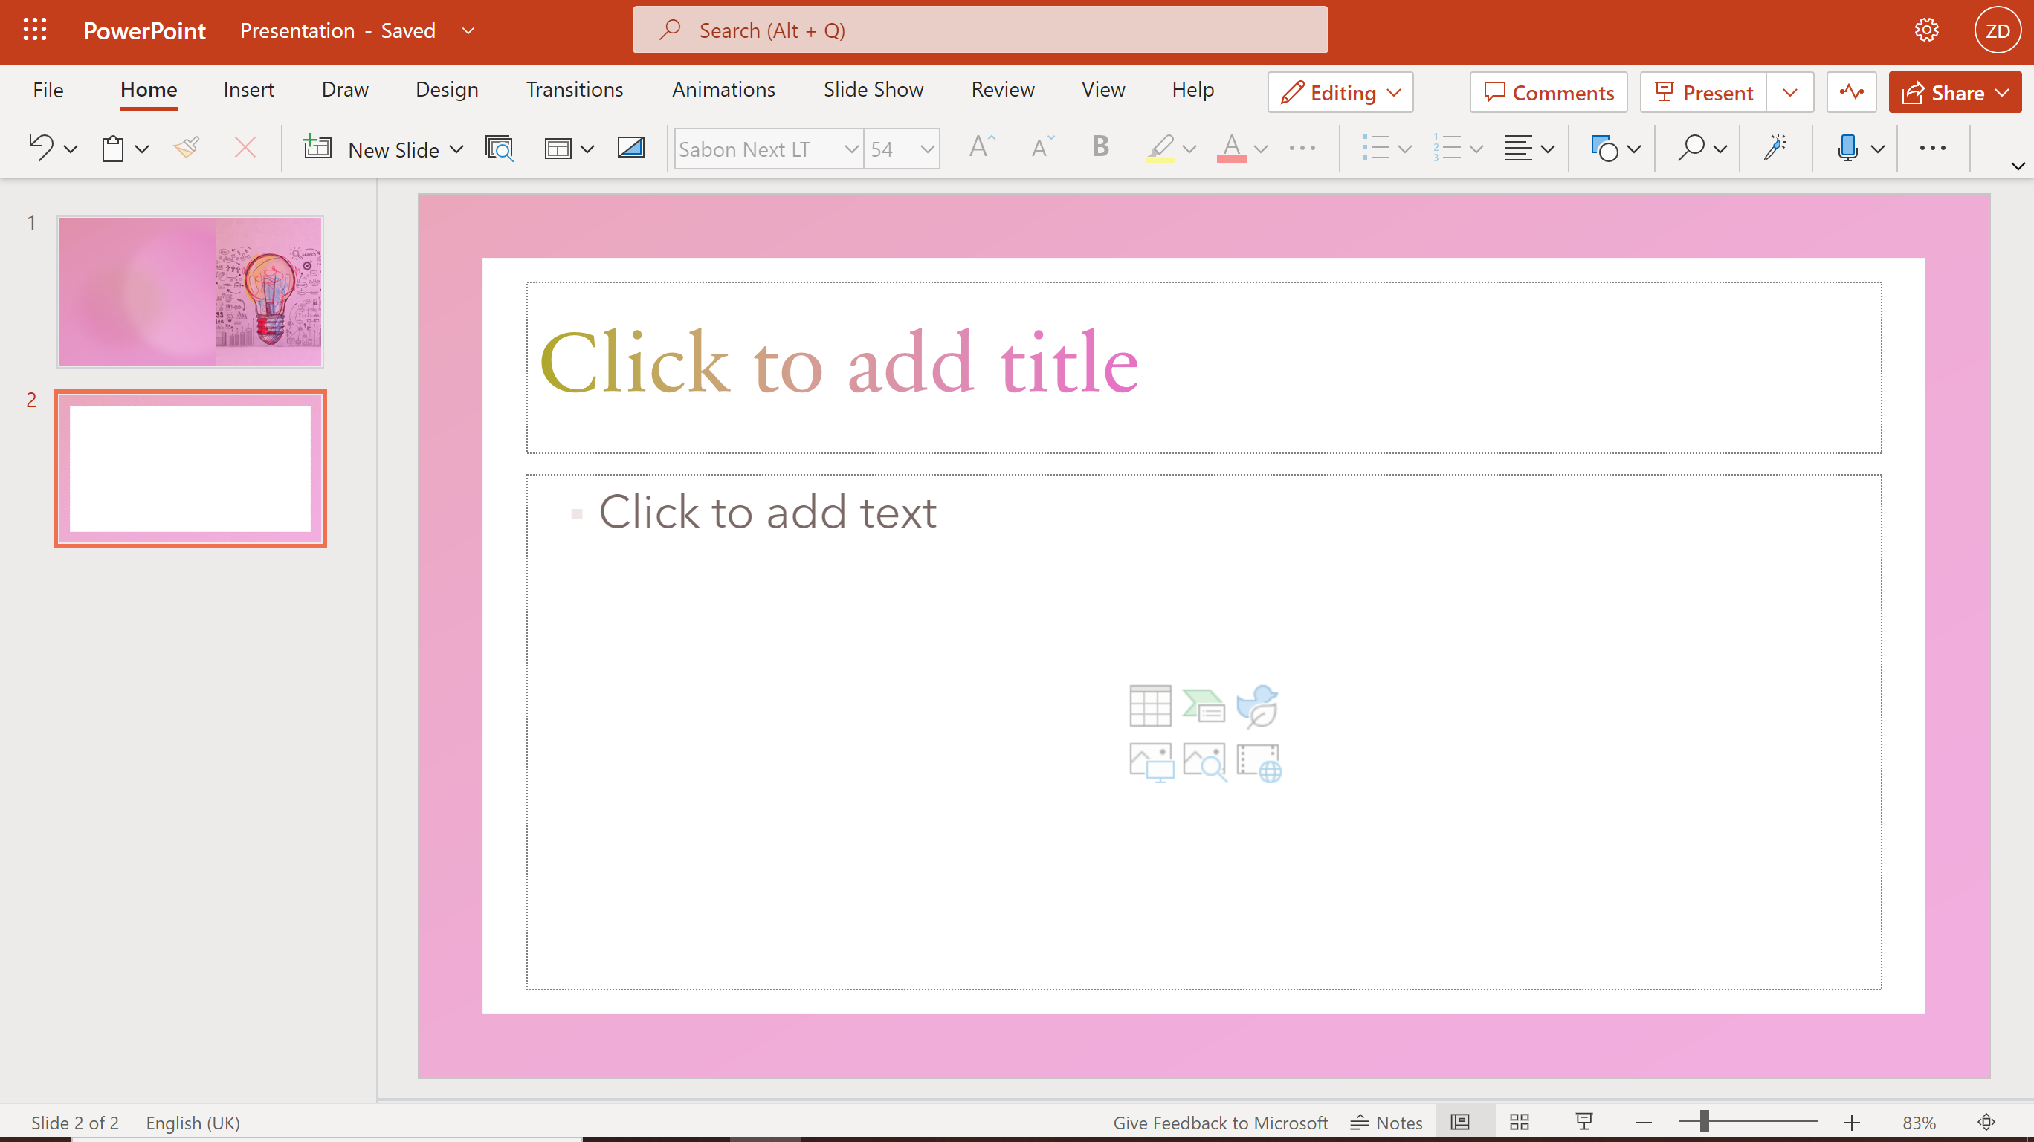

Slide 12

TIPS
Explore Microsoft presentation.
Insert pictures.
Be as creative as you wish to.

Slide 13
How to record on teams?

Slide 14


Slide 15

Turn on camera and Mic
Click to record

Slide 16
Notes
- Once recorded it will save automatically.
- You then need to embed the link into the word document.
- Or share the link with me and put the link on the word document.
- You can also record it on teams.

Slide 17
Teams recording
Set up
Set up a meeting link for yourself.
Record
Record the meeting and put the link within the document so that I can access it.
Let
Let's take a look.

Slide 18

Activity
Create a PowerPoint slide or two.
Concerning- '' Who you are?, What career you want? Why you want that career?''.
You have 10 Minutes to do this.
Include pictures, Icons and words.
You may wish to include animations.

Slide 19

Homework
For homework I would like you to record over the PowerPoint that you have created.
Please note that you cannot use this PowerPoint for your assignment.
Next week, I will ask you how you found recording in PowerPoint.

Slide 20

Summary
Be as creative as possible with your presentation.
Use Icons.
Use pictures.
Little information on slides.
Check grammar and punctuation.

Slide 21
Thank you!
Any questions?

