Slide 1

Social and Ethical Marketing
Zoe Vaughan
BMSP5003

Slide 2
The LOAF Project
A charity project that represents Local, Organic and Fair-trade produce.
The Aim
Encourage the community to work together by making sustainable life decisions for future generations.
Prevention of poverty
Improving climate.
LOAF ‘S Marketing Strategies
Lack of internet presence
No clear message
Confusing Logo.

Slide 3
Today I present a strong marketing plan not only to benefit education within all age groups, but also a project capable of reducing poverty within local communities through working together towards a sustainable and organic future.

Slide 4
Main Project Goals.
Enable the opportunity for children to grow fresh fruit and vegetables at schools and community centers
Teach children the importance of caring for something learning through hands on activities.
Educating children and adults on the health benefits and money saving advantages of growing their own fruit and veg.
Encourage children and adults to share and be kind with those who are in poverty or in need by donating the produce.
Carmarthen could become an example for other communities.

Slide 5

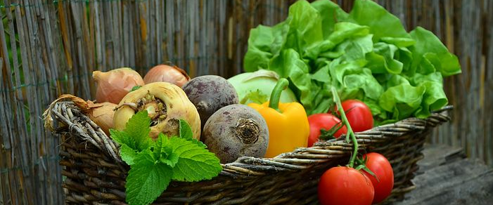
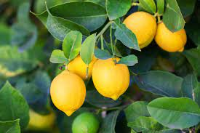
Growing Together

Slide 6
Marketing Audience
Schools Governors (There are 95 schools in Carmarthenshire)
Teachers
Children
Parents
Local residents/ the elderly
Churches
Charities
Local MPS
Local councillors
Social Media Influencers
Total population in Carmarthenshire is just under 191,000 people!! Carmarthenshire has the fourths highest population in Wales.
Carmarthenshire has the 5th highest levels of children who are overweight or obese.
Over 25,000 pupils within Carmarthenshire.
In 2020, Just over 27,000 homes in Carmarthenshire were classed as living in poverty. including nearly 10,500 children.

Slide 7
Segmentation, Targeting and Positioning
Firstly I would segment my market in to 4 groups.
Demographic
Dividing the market.
Geographic
Research the region, climate and the natural resources.
Psychographic
Study behaviour regarding health, beliefs, motivation and priorities.
Behavioural
Observe purchase behaviour and the response to money saving tips etc.

Slide 8
Methods of Marketing.
School board meetings
Training with teachers
Word of mouth
Marketing Strategies
Leaflets/ Magazines
Events/ Market Stalls
Social media/apps
Marketing Internally (Micro Environment) –
School capacity.
Parental perceptions.
Number of pupils etc.
Marketing Externally (Macro Environment) –
Relationship with the public.
Legal requirements.
Technology etc.

Slide 9
The 4 E’s.
There are 4 E’s to consider in Marketing.
Experience – People are looking for something in which captures their attention, a product or service which can be of benefit in some way to them.
Every place – knowing where to target and how you will approach the marketing strategy by engaging with people frequently.
Exchange – What customers get in exchange if they buy a product or participate in services.
Evangelism – Word of mouth can promotes a business, positive feedback encourages others to participate in a product or service.

Slide 10
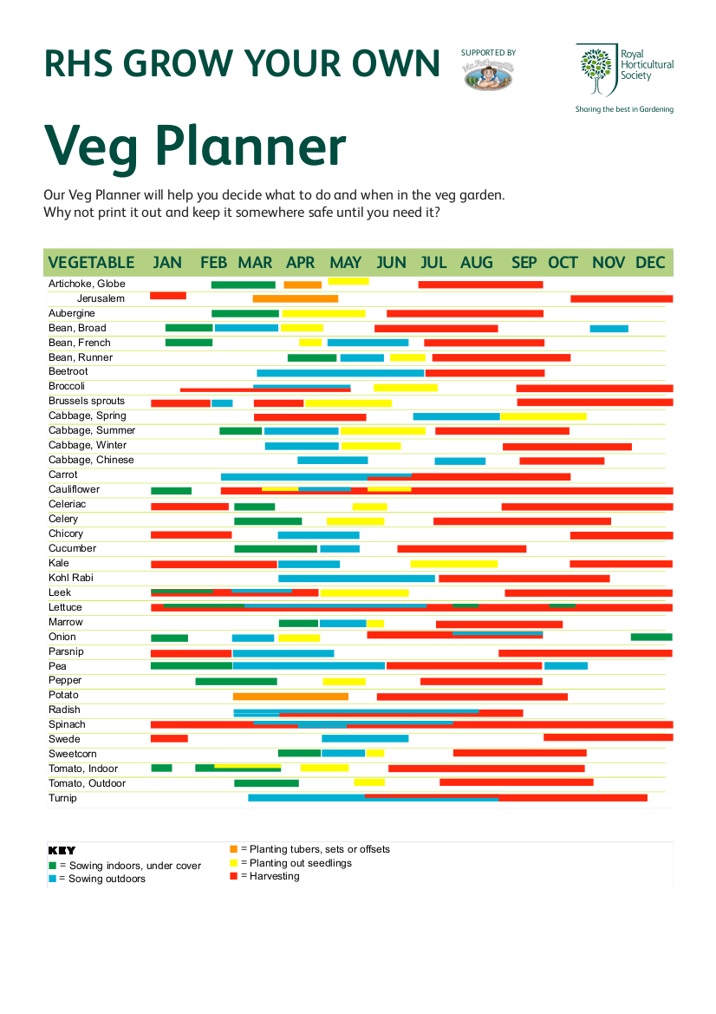
Funding for Marketing.
Friut & Veg patches on school grounds.
Starter packs for parents to grow at home such as:
Magazines including seeds and Veg planners.
Advice following What to do , how to do and what it takes.
Healthy Recipes.
Leaflets with information on how to recycle and regrow vegetable seeds and the peelings.
Funding for equipment such as,
bed systems
planting pots
poly tunnels,
Fruit trees
Seeds
Website

Slide 11
Positives and End Goals.
Vegetables grow quickly ensuring there is no waste throughout school holidays.
Fresh produce can be used within schools for breakfast lunches, etc.
People will save money.
Fresh fruit and veg can be donated to help the residents/elderly to ensure there is no waste
Better education
Health benefits.
Reduce poverty.
Let’s make Carmarthenshire stand out and be an example for other communities to follow.

Slide 12
References
Carmarthenshire County Council. (Oct, 2020). Population. https://www.carmarthenshire.gov.wales/home/council-democracy/research-statistics/population/#.YYRGPFCnzIU.
Carmarthenshire County Council. Wellbeing in Carmarthenshire, what we know. https://www.carmarthenshire.gov.wales/media/1226250/wellbeing-in-carmarthenshire.pdf.
Free online image. https://pixabay.com/photos/vegetables-basket-vegetable-basket-752153/.
Free online image https://carrottopslondon.files.wordpress.com/2017/01/rhs-veg-planner.png.
Free online image. https://www.istockphoto.com/photos/lemon-tree.
Free online image. https://www.pngwing.com/en/free-png-zltic
(Oberst,L. 2015). Food revolution network. 19 foods you can regrow from scraps. https://foodrevolution.org/blog/reduce-food-waste-regrow-from-scraps/.
RHS campaignfor school gardening. Growing vegetables in school gardens. https://schoolgardening.rhs.org.uk/Resources/Info-Sheet/Growing-Vegetables-in-Schools.
Stokes, D, R 1999. Kingston University. The marketing of primary schools. https://eprints.kingston.ac.uk/id/eprint/20639/.
TylerNet Retail solutions (May, 2020). The 4E’S of marketing success. https://www.tylernet.com/blog/the-4-es-of-marketing-success/

