Slide 1
Step-by-Step
Seminar
Relationship Identification Stages

Slide 2
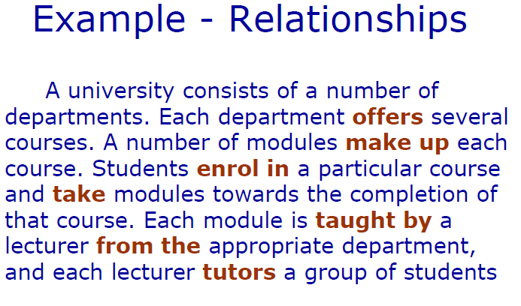
Scenario with relationships identified
©NAlechina

Slide 3
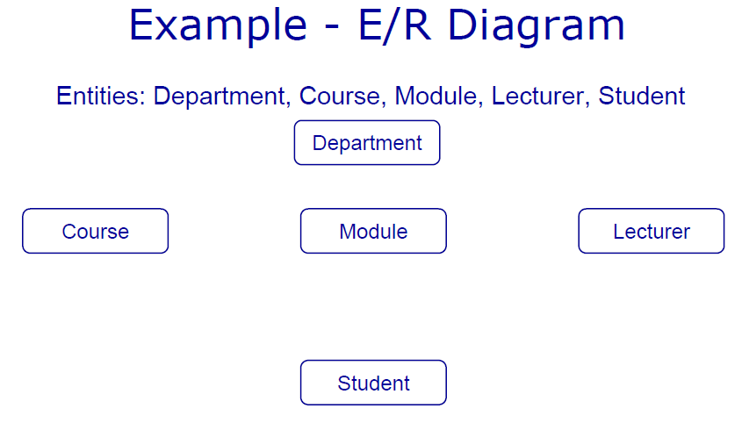
Scenario with relationships identified Step 1
©NAlechina

Slide 4
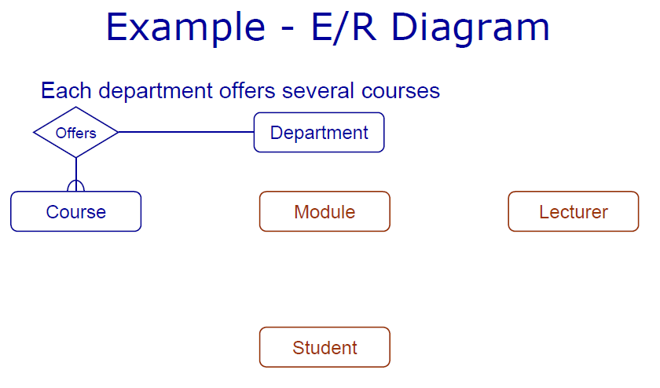
Scenario with relationships identified Step 2
©NAlechina

Slide 5
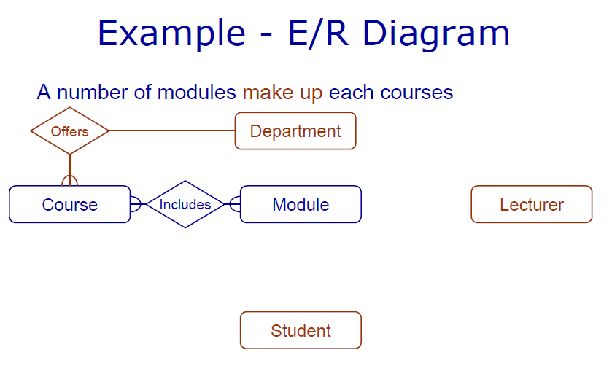
Scenario with relationships identified Step 3
©NAlechina

Slide 6
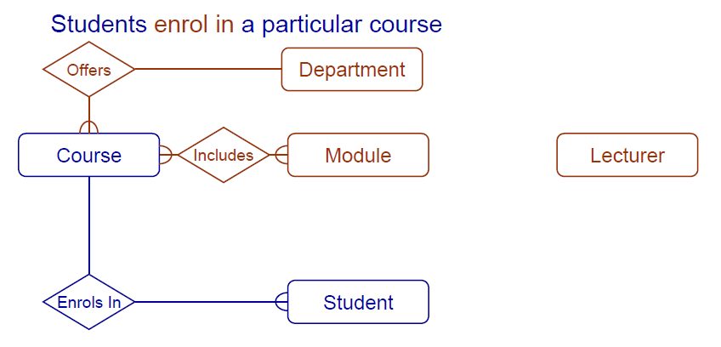
Scenario with relationships identified Step 4
©NAlechina

Slide 7
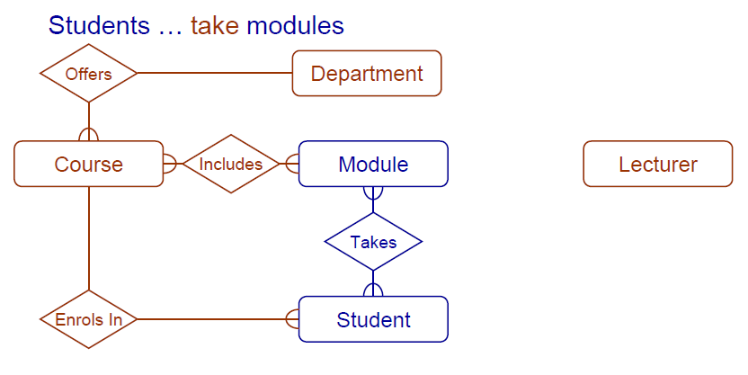
Scenario with relationships identified Step 5
©NAlechina

Slide 8
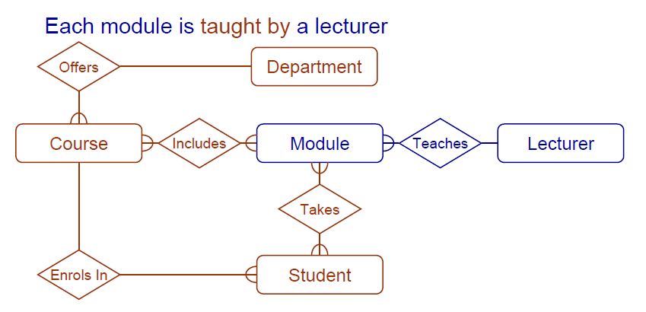
Scenario with relationships identified Step 6
©NAlechina

Slide 9
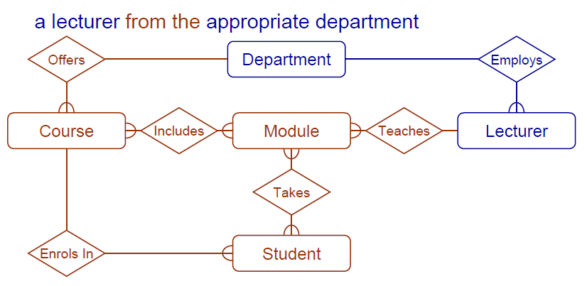
Scenario with relationships identified Step 7
©NAlechina

Slide 10
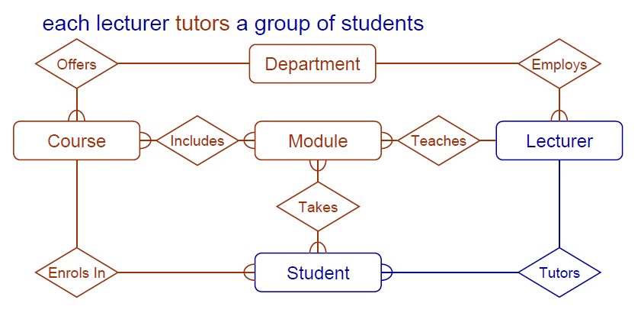
Scenario with relationships identified Step 8
©NAlechina

Slide 11
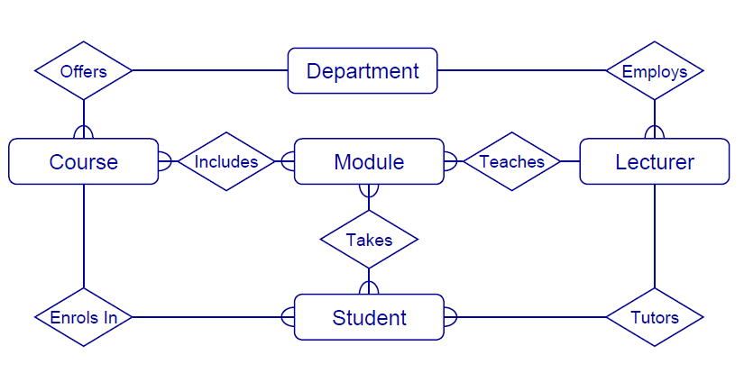
Scenario with relationships identified – all Steps
©NAlechina

Slide 12
What ER stages did you undertake?
Identify the attributes associated with the entities?
Resolve the M : M relationships?
What other entities are associated with the University?

