Slide 1
CIPD Level 7
Managing Employment Relations
Deborah Rees
deborah.rees@uwtsd.ac.uk
Week 3

Slide 2
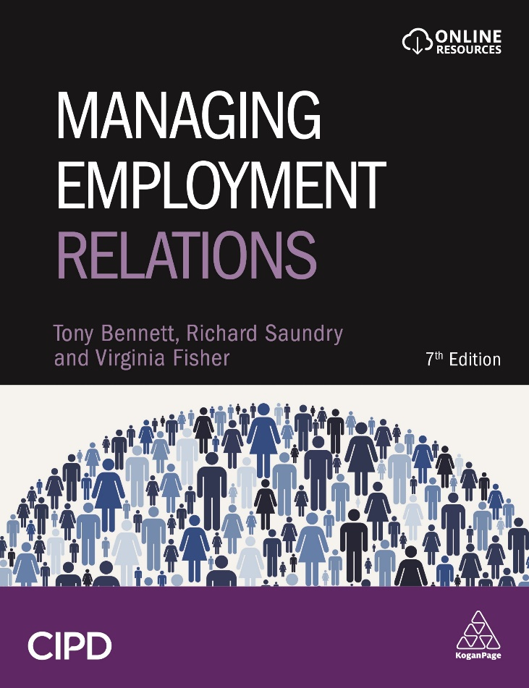
Managing Employment Relations, 7e
Chapter 4
Managing Employment Relations
Notes:
Welcome to Chapter 4, in the last session we covered the “Dynamic Context of Employment Relations”, and today we are going to discuss “Managing Employment Relations”.

Slide 3
Session outline
Who manages employment relations and what do they do?
Managing with and without trade unions
The role of employers’ associations
Managerial approaches and style
HRM and the management of employment relations

Slide 4
Learning Outcomes
When you have completed this chapter, you should be able to:
Understand and describe the main roles undertaken by line managers in the context of employment relations
Critically assess recent developments in the management of employment relations
Understand how employers’ organisations support managers in their day-to-day work
Identify different management styles and use these to critically evaluate organisational approaches to the management of employment relations
Critically analyse the implications for employment relations of the greater devolution of HR duties to frontline managers

Slide 5
Who Manages Employment Relations?
Most managers who deal with employment relations do so as part of a wider role within the organisation.
  86% of those responsible for ER employed in a more general role (van Wanrooy et al., 2013)
  More likely in larger organisations
  ER specialists found in almost three-quarters of workplaces with 100+ employees but just 15% of those with 5-19
Women make up almost half of employment relations managers
Little evidence of growth in the number of managers with specialist HR knowledge
Line managers have increasing discretion to manage employment relations’ issues
Notes:
Many HR Professionals today are lacking in Employment Relations expertise – there are a number of reasons for this, less Unionised organisations but also a move towards HR Business Partner models according to some – see Andy Cook article on this on Moodle.
Large traditional sectors are occasionally found to still have ER specialists – Tata Steel is a local example. Do any of your organisations still have Employment Relations experts within?

Slide 6
What Do Managers Do?
Clarification of the objectives of their team
Controlling performance
Planning of work
Organisation of activities
Directing and guiding
Notes:
What else could you add to this? – Collaboration, innovation, growing leaders, demonstrating resilience, demonstrating adaptability and grit in the face of adversity, being tech savvy and able to analyse Data will be key in the future.

Slide 7
Managing Employee Relations - Objectives
Prime objectives – profitability, efficiency, productivity and quality
Objectives shaped by context – quality may be less important in certain settings
Objectives of ‘managers’ may diverge and be different from those of shareholders
However, research (Zeitlin, 1989) suggests that views of managers and owners are similar
Managers tend to hold ‘unitaristic’ views
Notes:
Are these outdated?? – With more emphasis on social enterprising organisations and CSR perhaps there should be objectives around sustainability, ethical practice.
Pure Wafer example that I talked about in the last session, was a small hi-tec start of up around 200 employees, there was a unitarist culture – Managers there believed that Management set the business objectives and targets and that the workforce should be onside, and pull together in the same direction to achieve them – and for the most part this did happen, but how realistic is this? As that company would grow is such a straight forward paradigm realistic or should the Senior Management Team expect that conflict would be inherent?
Tata Steel – pluralist management (H&S is just one area that provides a very good reason for managers/employees/TU’s to be able to challenge the shareholders and strategic aims of the business in this particular sector) ? South Wales Police – pluralist management (being ‘community serving’ this means many very different stakeholder views must be considered on all decision making).

Slide 8
What views do your managers hold? Do they reflect unitaristic or pluralistic perspectives?
Notes:
Unitarist – Managers pull in the same direction as the shareholders, ee conflicts are seen as unpalatable and dealt with.
Pluralistic – Managers challenge the strategic objectives for reasons of H&S, ethical practice, competition, etc Stakeholders express views, Whistleblowing mechanisms etc.

Slide 9
Managerial Approaches and Strategies
Control and compliance
  Organisational rules
  Disciplinary policies and procedures
  Performance management and appraisal
Co-operation and commitment
  Consultation and communication
  Employee engagement
  Reward and remuneration
Distinction between control of labour process and securing commitment is much too simplistic
There is a clear contradiction between the goals of securing control and consent (Hyman, 1987)
Traditionally, one way of trying to navigate this has been through collective bargaining
Notes:
Despite the leadership and management literature pointing towards a move away from command and control / authoritarian / high process low control styles of management – in recent years in the UK we have seen very much a command and control style of leadership at the Government level – see Telegraph article on Moodle (“Whether Boris will learn the lessons from his first year at the helm”), conduct your own research in to the actions of the Government Leader over the last 12 months.
Information and Consultation of Employees Regulations (2004), this has just been extended to apply - The Taylor Review highlighted the need for workers to have a voice. It noted that high levels of employee engagement improve organisational performance and boost productivity. Following the publication of the Good Work Plan, the Government introduced regulations lowering the threshold required to set up information and consultation arrangements from 10% to 2% of employees. This will come into effect from the 6th April 2020 – See the Croner Guide on the Good Work Plan on Moodle.
The debate about human capital advantage and discretionary effort is a complex one, and there has been over ten years extensive research – see the “Engage for Success” website for seminal research on this topic and also the CIPD Thought Piece Collection on Employee Engagement. We will be covering this in more detail in later Powerpoints.
John Lewis is a good example of a ‘partnership’

Slide 10
Managing With Unions
Significant growth in union recognition and collective bargaining in the 1940s and 1950s
  Collective bargaining seen as a way of controlling the ‘threat’ of industrial action
  Bargaining collectively reduces transaction costs
  Employee voice underpins trust and improved performance
Percentage of employees with pay determined by collective bargaining fell from 80% in 1970 to 23% in 2011
Within unionised organisations, scale and scope of bargaining has receded
  Reduced union influence
  Direct channels of communication with staff more commonplace
  Shift to partnership approach
Notes:
Refer to the below on Moodle.
Sports Direct Panorama Programme
Amazon x 2 Panorma Programmes
Gig economy worker case law and amendments to statute – See articles on Moodle “The tiny Union beating the Gig economy”. – See the article “How the Legal Concept of a Worker is Evolving due to the Gig Economy” on Moodle and also the People Management article “A Whistle-stop guide to the law of the modern Gig economy” also on Moodle.
Good Work Plan – we’ve already talked about.
See the Trade Unions as Joint Change Agents on Moodle
List of Trade Unions in the UK on Moodle is worth a look if you have not already done so, just to appreciate the volume of Trade Union organisations within the UK.

Slide 11
Managing Without Unions
Managers’ attitudes to unions are contradictory
  Only 17% managers were not in favour of union membership
  80% would rather consult directly with employees than unions
  24% believe that unions help to improve workplace performance (van Wanrooy et al., 2013)
Large non-union firms based around union substitution – sophisticated HR approaches, good terms and conditions, employee voice mechanisms
  But this may mask more crude attempts to repress unions and intensify work
Small non-union organisations often hostile to unionisation (Rainnie, 1989)
  Based on informal, personal relationships – on-going negotiation of order (Ram et al., 2001)
Notes:
SWP Employee Associations
Christian Police Association
Black Police Association
Ability Staff Network
Gay Staff Network
Transgender Police Association
Female Police Association
Each of these associations held their own financial budget, held quarterly committee meetings and were responsible for proactively progressing the Agenda for their particular area of interest. This could include things such as Specific Leadership Training for female officers, it would not be restricted only to female officers, but it would be promoted by that particular association.

Slide 12
Changing Role of Employers’ Associations
Employers’ associations are voluntary, private bodies which exist to provide information and co-ordination
  Developed to respond to the increasing power and influence of newly formed trade unions
Traditionally played a key role in industry wide collective bargaining
  Now, only 7% of all British workplaces, and only 2% of private sector workplaces covered by multi-employer collective bargaining (van Wanrooy et al., 2013)
Employers’ associations have seen their influence fade in recent years
New focus on HR advice provision, business consultancy and campaigning
Notes:
In considering the more recent literature on Management Styles refer to:
Bock – Work Place Rules
Covey – the 7 habits of highly effective leaders
Sinek – Start with why
Pink – Drive: the surprising truth ( I have not read this one yet).
Eades – Building the Best
“Corporate Rebels” – Make Work More Fun
Patagonia’s CEO – “Let my People go Surfing” by Yvon Chouinard (I have not read this one yet)
Lucy Adams – HR Disrupted
McCord - Powerful

Slide 13
Management Styles
Authoritarian
Paternalistic
Consultative
Constitutional
Opportunist
Notes:
Page 101 to 104 of the core test sets out various Management Styles. You can also consider the work of McGregor’s X and Y styles of Management, autocratic v laissez-faire, hard v soft, and so on an so forth.

Slide 14
HRM and Employee Relations
People management central to business strategy
HRM seen as a way of delivering commitment (soft) and flexibility and efficiency (hard)
Promotes identification of individual and work-group with the organisation - implies essentially unitaristic philosophy
Emphasis on engagement and involvement as opposed to collective bargaining and consultation
Within unionised workplaces HR professionals play a key role in maintaining and developing relationships with union representatives
In non-unionised workplaces HR professionals focus on managing conflict and employee engagement
Notes:
At this point it is worth putting your critical thinking hat on, and take the time to really evaluate the HR function in your own organisation, what are the strengths, weaknesses, opportunities and threats of your HR function. Are they strategic? Do they just tow the line of the SMT without questioning things rightfully from the employee perspective? Is the function structured correctly, resourced correctly, does it have support from other functions? Make some notes on all of this in readiness for your assignment.

Slide 15
The Changing HR Function and Employment Relations
Key shift in HR function – devolution of responsibility to line and operational managers
  Reduction in HR resource
  Shift to more strategic advisory role
Some evidence of a shift towards outsourcing and shared services – ‘function promoting its own marginalisation’ (Thompson, 2011:9)
Threatens existing workplace relationships and therefore could hamper attempts to boost engagement (see Purcell and Hutchinson, 2007)
  Managers often uncomfortable with dealing with trade unions
  Lack of confidence and capability in handling ‘difficult’ employee relations issues
Notes:
There is often a capability gap for Line Managers having to deal with complex ER matters.
Shared services / HR Business Partner Models have contributed to a loss of ER expertise in the HR Profession. Look back at the CIPD Festival of Work programme for July 2020 – there was no specific entry on an employee relations topic. The CIPD employee relations professional module has not run for at least the last two years. There is not an abundance of credible employee relations training courses / conferences / qualifications.
See CIPD ER roles document – on Moodle.
See CIPD Psychological Contract Factsheet on Moodle.
With your critical thinking hat on; why are managers often uncomfortable in dealing with employee relations issues? What can be done to improve this?
See the article “Good Employee Relations starts with L&D” on Moodle
See the CIPD Factsheet / ACAS guidance on collaborative working – remember the link back to the ‘BIG’ problems businesses will face in the future, and how a creative and collaborative approach will be needed.
See the “Many meanings of cooperation” report on Moodle

Slide 16
Conclusion
The management of employee relations essentially revolves around trying to both control labour and secure their consent
Traditionally, this has been largely conducted through collective bargaining
Specific managerial approaches are largely conditioned by contextual factors
Decline of trade unions and the emergence of HRM has placed much greater emphasis on relationship between the individual and the organisation
Changes to the HR function threatens to undermine attempts to increase employee engagement
Notes:
There has been extensive research on the topic of Employee Engagement for more than the last 10 years. See the “Engage for Success” website for research reports, consultations and blogs on the latest thinking.
Some of the notable authors on the topic of Employee Engagement 1. Macleod and Clarke, 2. Matthew Taylor, 3. Rob Brine, 4. Perry Timms (advocates “employee energy” for the future), and 5. the CIPD amended their CIPD Map to “employee experience” from ‘employee engagement’.
See the Deloitte report on “Navigating to Employee Relationship Transformation” on Moodle
Refer to Block Two on Moodle and work your way through the resources I have signposted you to, make a not of any question or queries and we can cover these in the Tutorial session, and I loo forward to seeing you then.

Slide 17
References and Further Reading
Hyman, R. (1987) ‘Strategy or structure? Capital, labour and control’, Work, Employment and Society, 1:1, 25-55.
Purcell, J. (1987) ‘Mapping management styles in employee relations’, Journal of Management Studies, Vol. 24, No. 5: 533-548.
Purcell, J. and Hutchinson, S. (2007). ‘Front-line managers as agents in the HRM-performance causal chain: theory, analysis and evidence’. Human Resource Management Journal, 17: 1, 3–20.
Rainnie, A. (1989) Industrial Relations in Small Firms, London: Routledge.
Ram, M., Edwards, P., Gilman, M. and Arrowsmith, J. (2001) ‘The dynamics of informality: employment relations in small firms and the effects of regulatory change’, Work, Employment and Society, 15:4, 856-61.

Slide 18
References and Further Reading
Thompson, P. (2011) ‘The trouble with HRM’. Human Resource Management Journal doi: 10.1111/j.1748-8583.2011.00180.x
Van Wanrooy, B., Bewley, H., Bryson, A., Forth, J., Freeth, S., Stokes, S. and Wood, S. (2013) Employment Relations in the Shadow of Recession: Findings from the 2011 Workplace Employment Relations Study, London: Palgrave Macmillan.
Zeitlin, M. (1989) The Large Corporation and Contemporary Classes, Oxford: Polity Press.

