Slide 1

My Digital Skills Portfolio
By Mya Hillocks

Slide 2
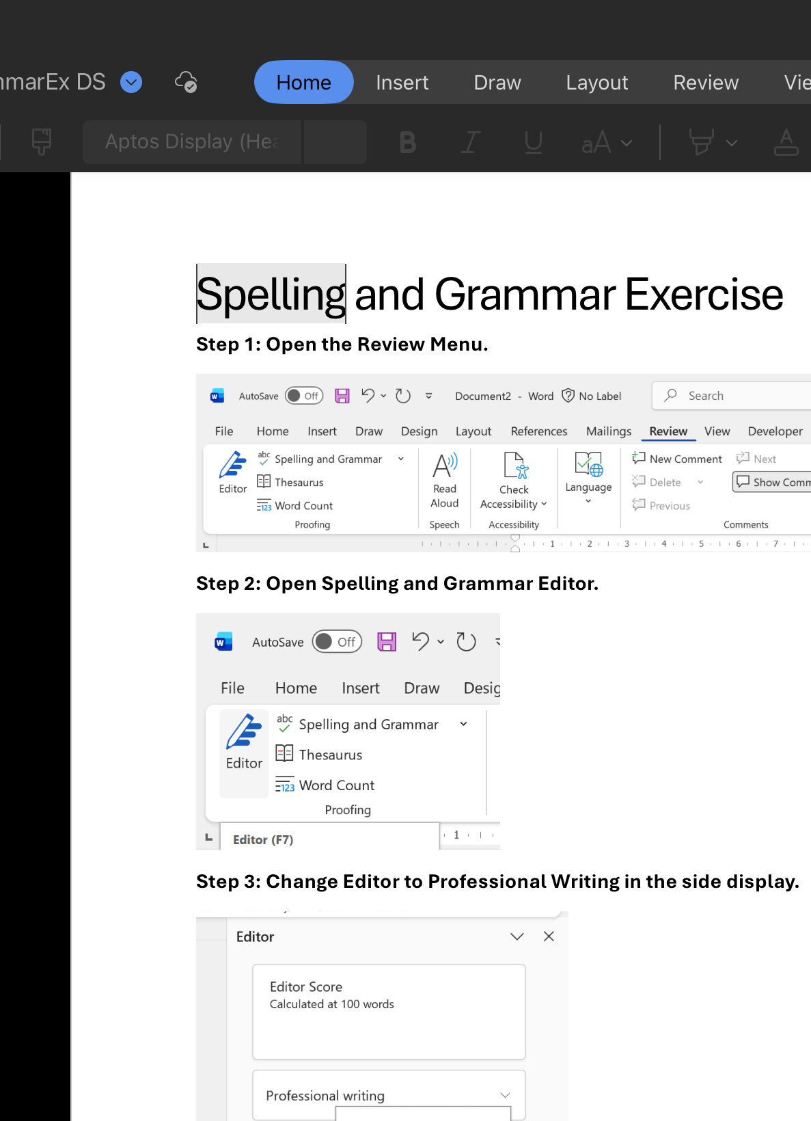
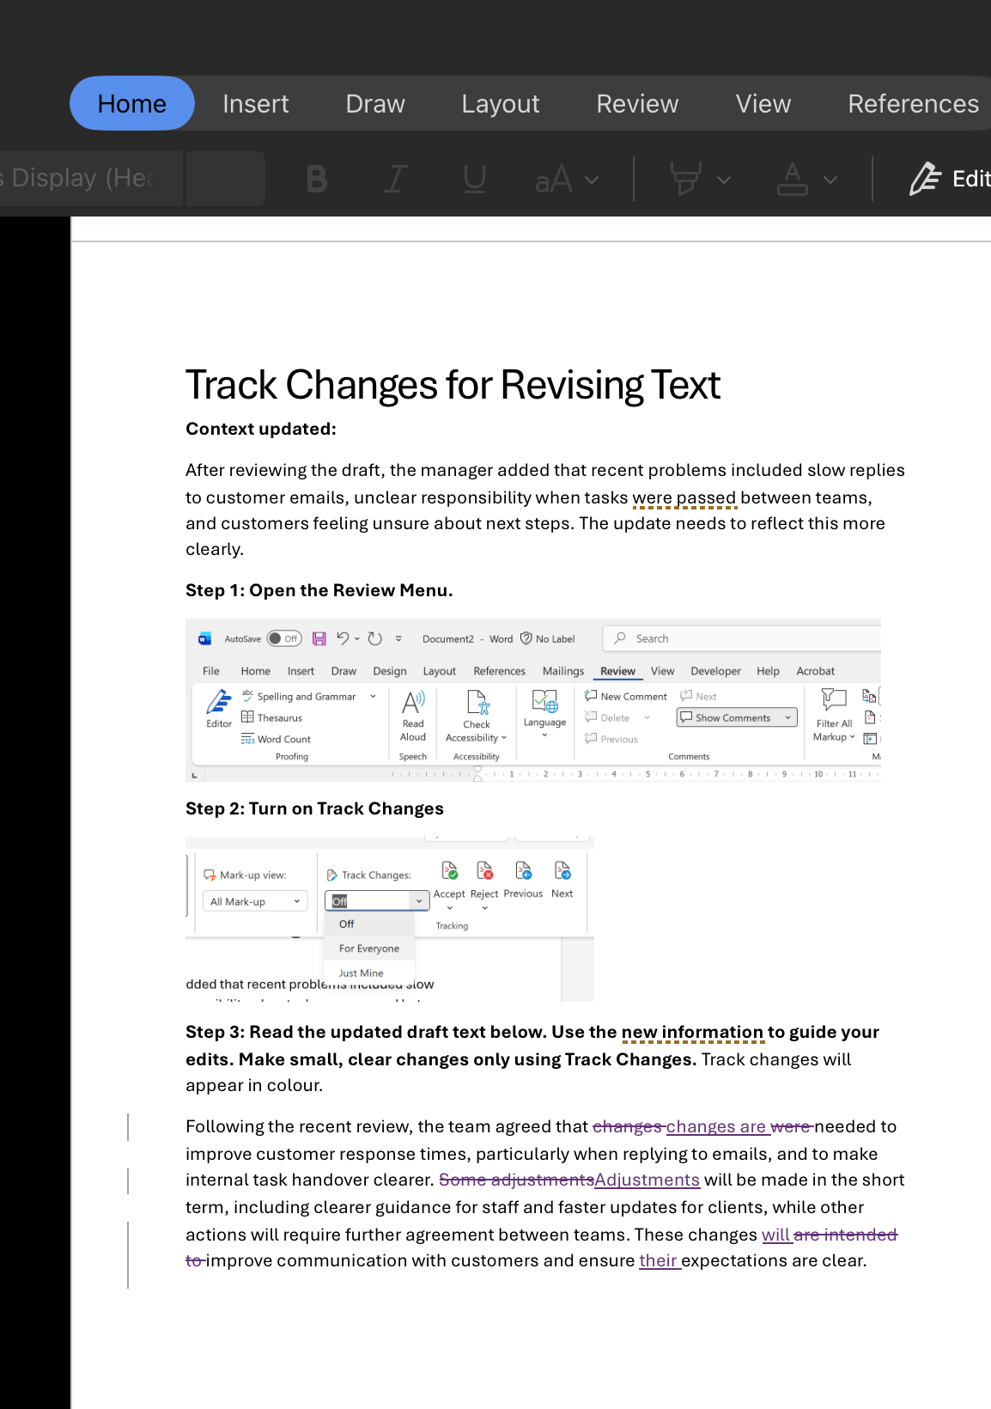
Class Exercise –
Learning Word tools
These are examples of the work I did in class to develop my understanding of different tools available in Microsoft Word.
In particular, the second image shows that I can now understand how to check grammar and spellings using the editor tool. It also shows that I can now use the track changes tool to clearly show any amendments made to my own work and when reviewing peers work.
Before learning these features in class, I was unaware of how to use Word effectively. Developing these skills has now made me more confident in producing more professional work in future assignments and in the workplace.

Slide 3
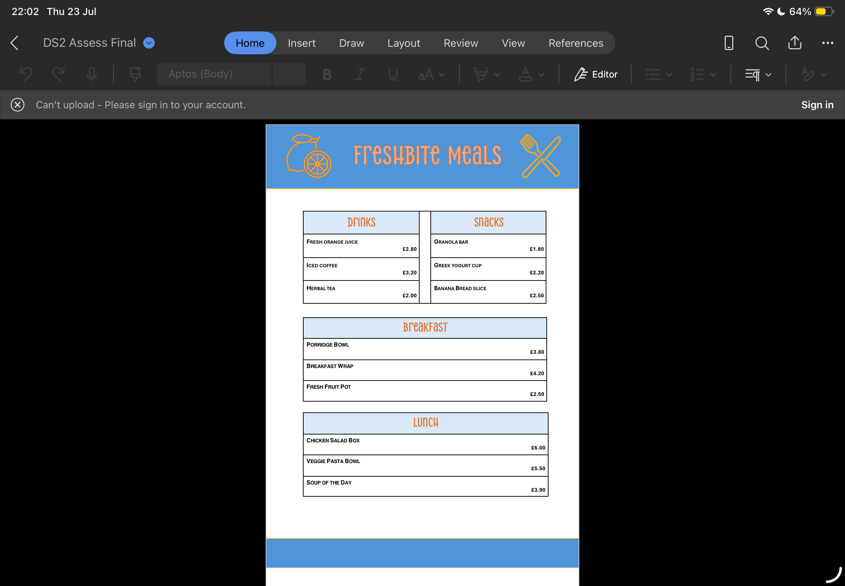
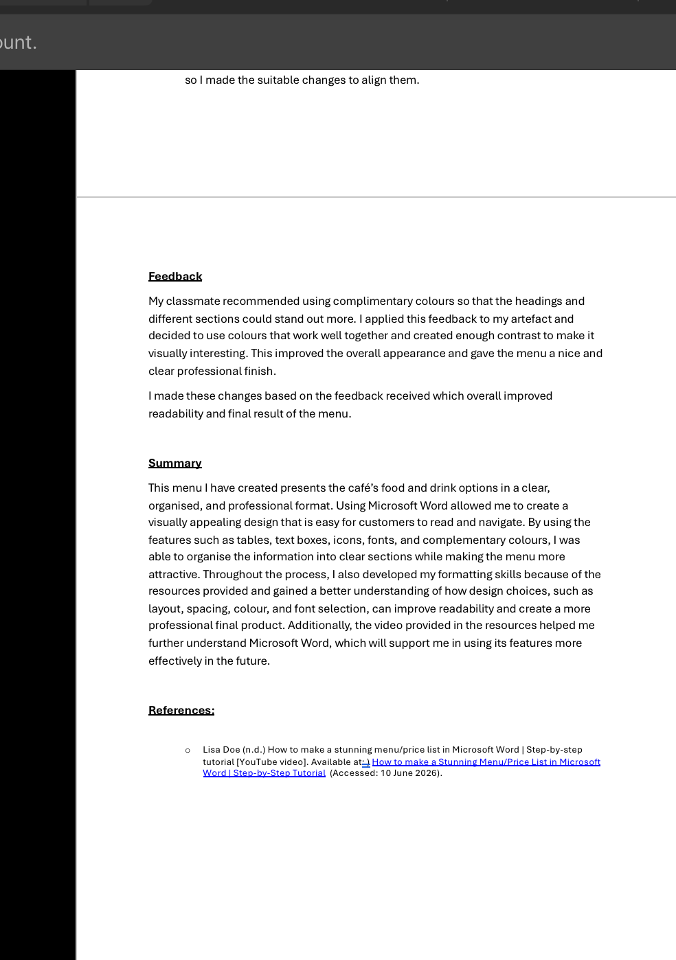
DS2 Assignment-
Menu & Log
In these images it shows the menu I had made for my DS2 assignment and part of the log I did explaining the process behind the menu.
To create this artefact, I developed my Microsoft Word skills on by following a tutorial video provided on Moodle. These included using tables to create even and clear sections for the menu and then also using shapes, fonts and graphics to ensure the menu was visually appealing .
Completing this artefact helps increase my confidence in using Microsoft Word tools and features. I gained a better understanding on improving the layout and presentation of a document which will be a valuable skill going forward in both professional and academic life.

Slide 4
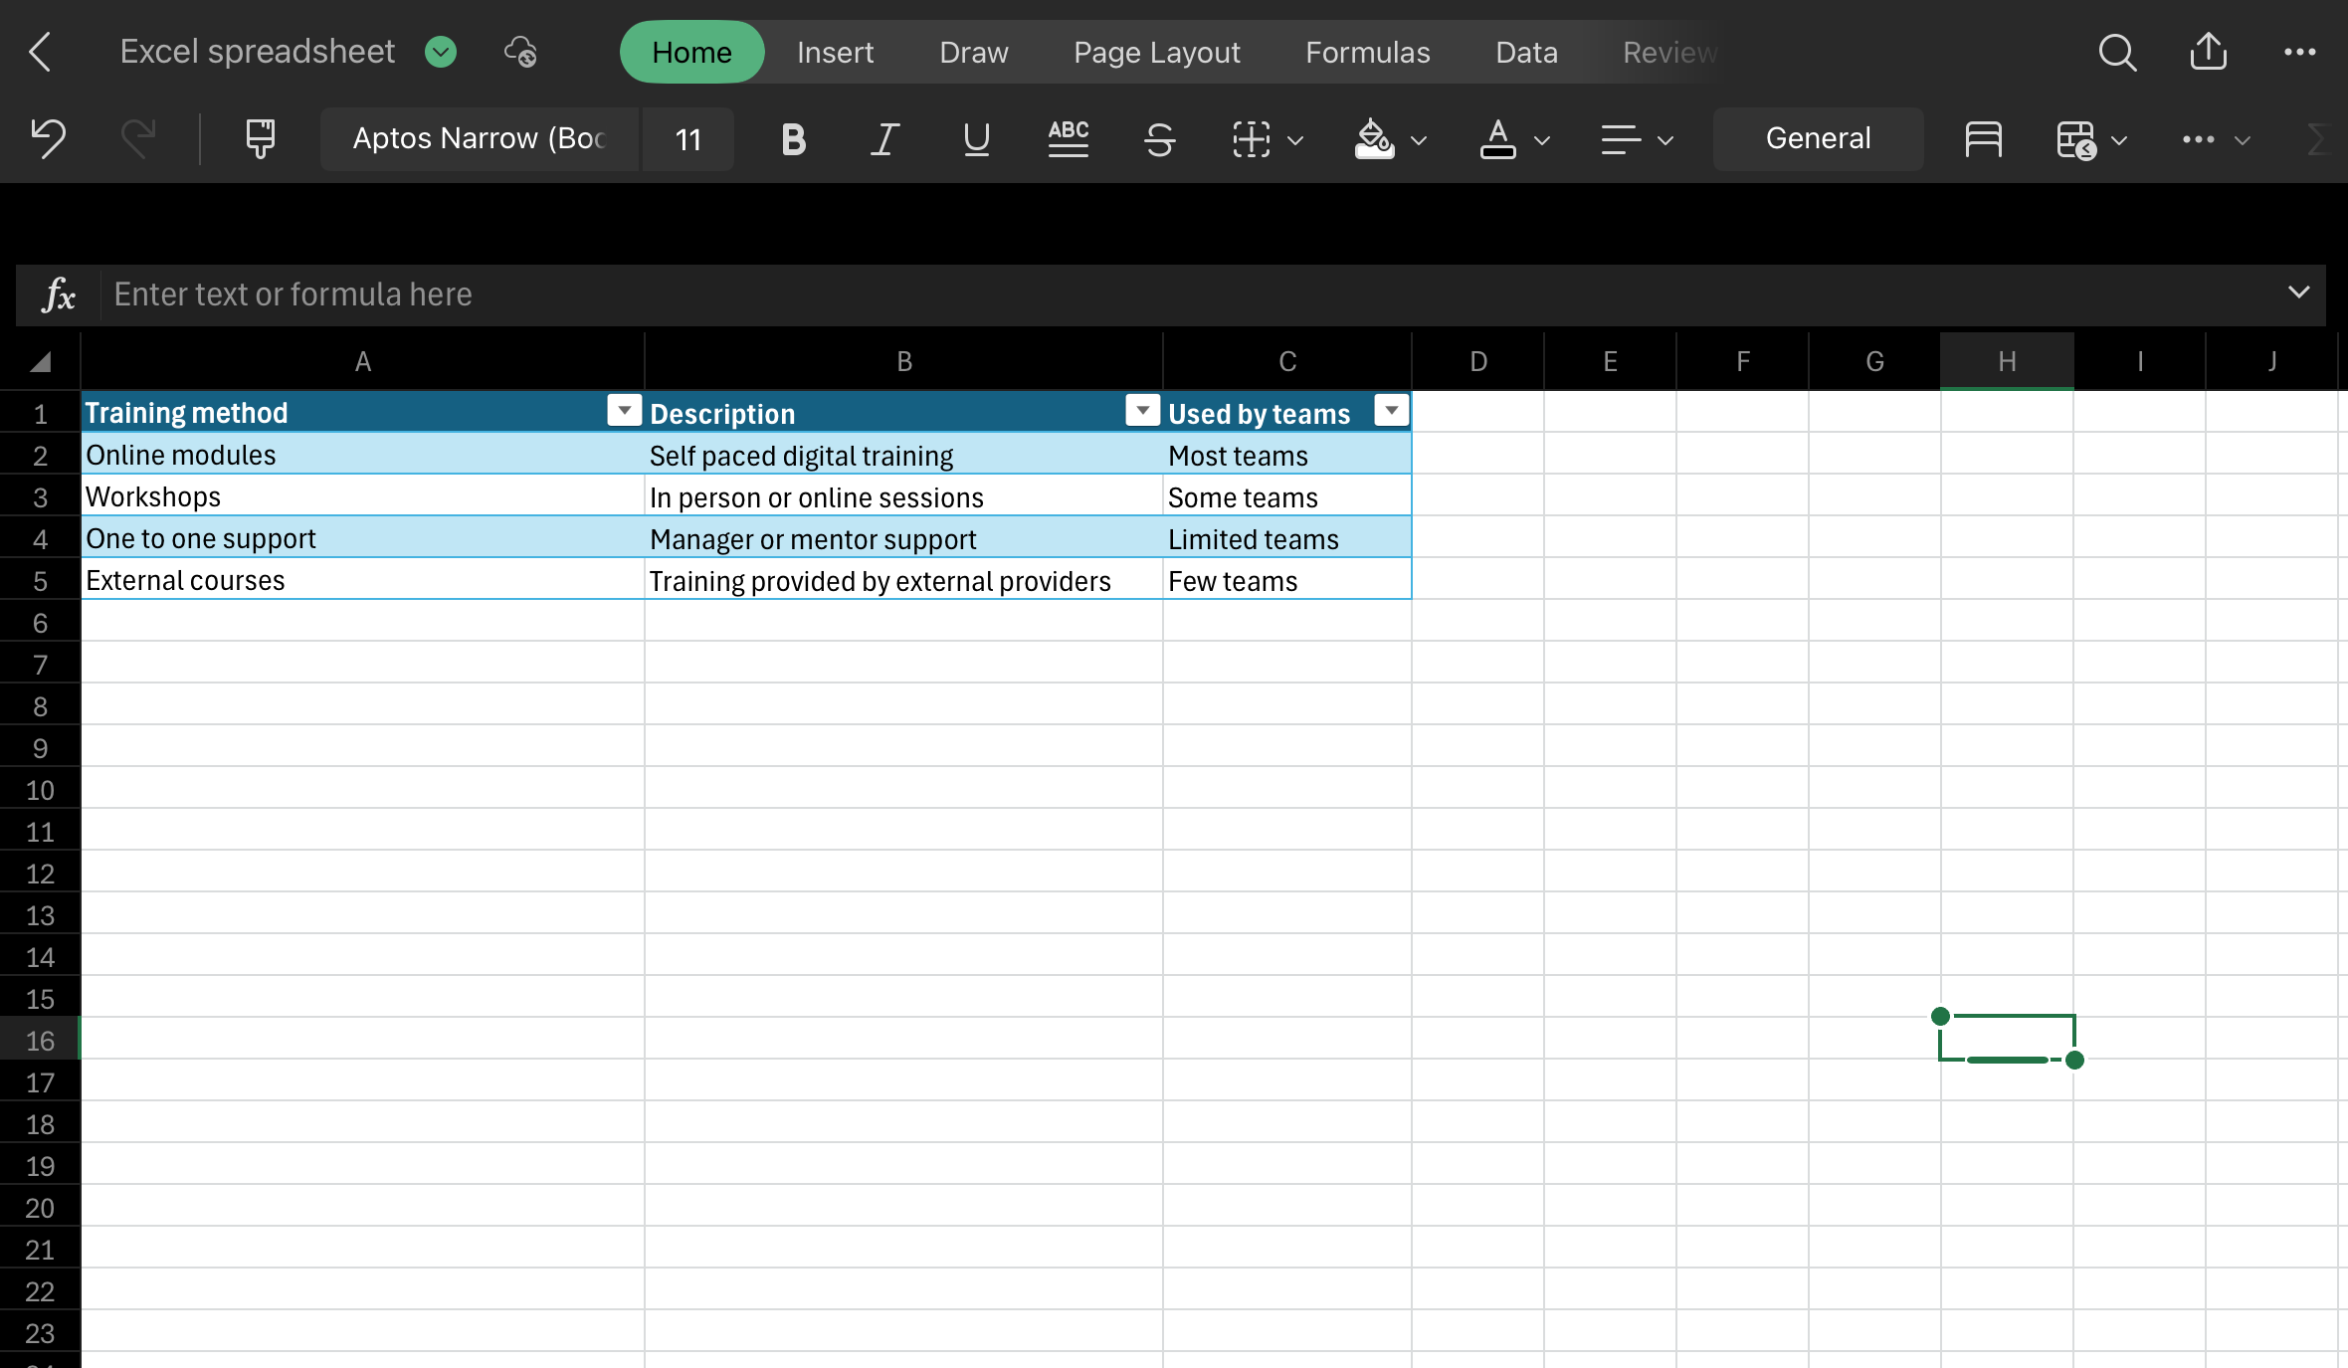
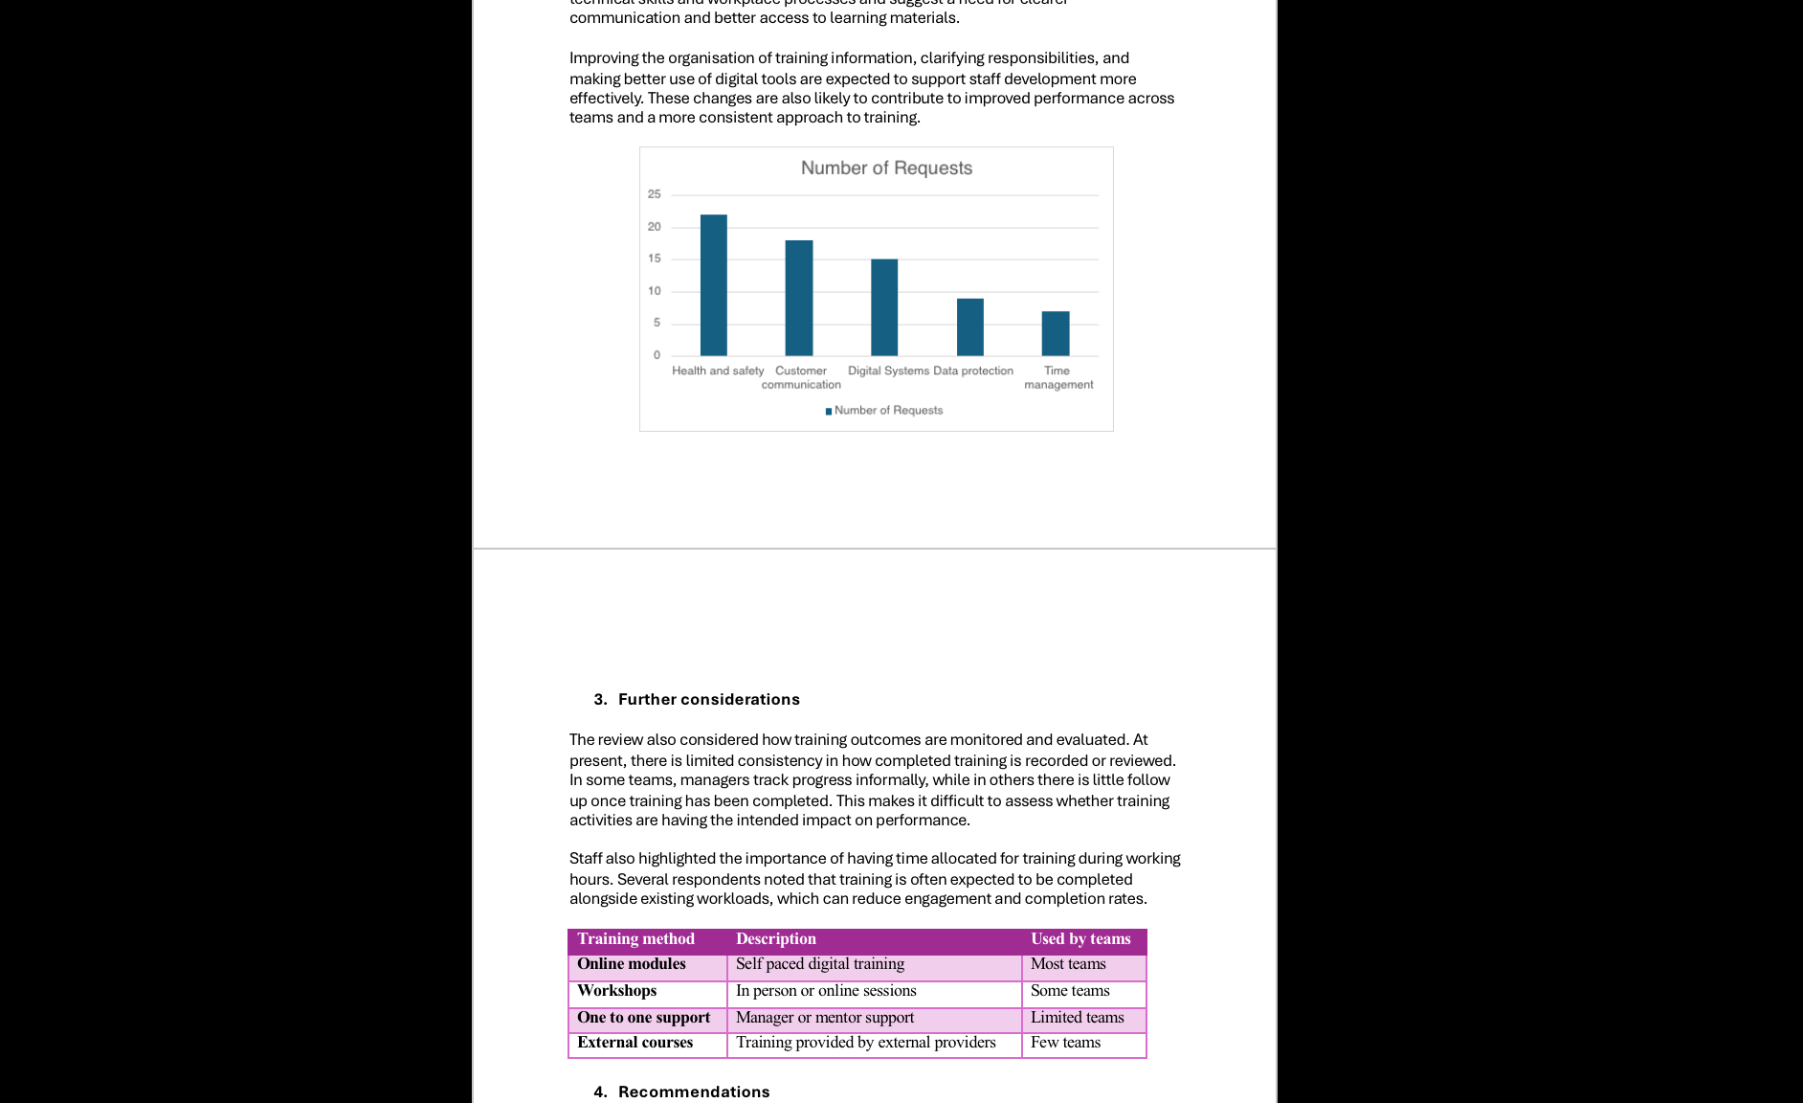
Excel & Word -
Tables & Charts
In these images it shows how I used Microsoft Excel to organise data and create a chart and table.
Through was activity I gained my skills in excel by learning how to create and format charts from spreadsheet data. I also learnt how to transfer content between Microsoft Excel and Word.
Before this task, I had very limited knowledge on how to use Excel, but now I can say I have definitely gained the basic tools to create professional tables and charts. I believe this will help me in the future when needing to add visual representation of certain information.

Slide 5
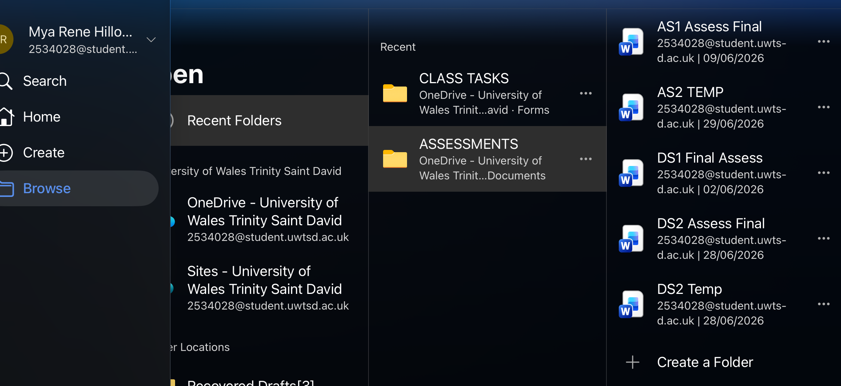
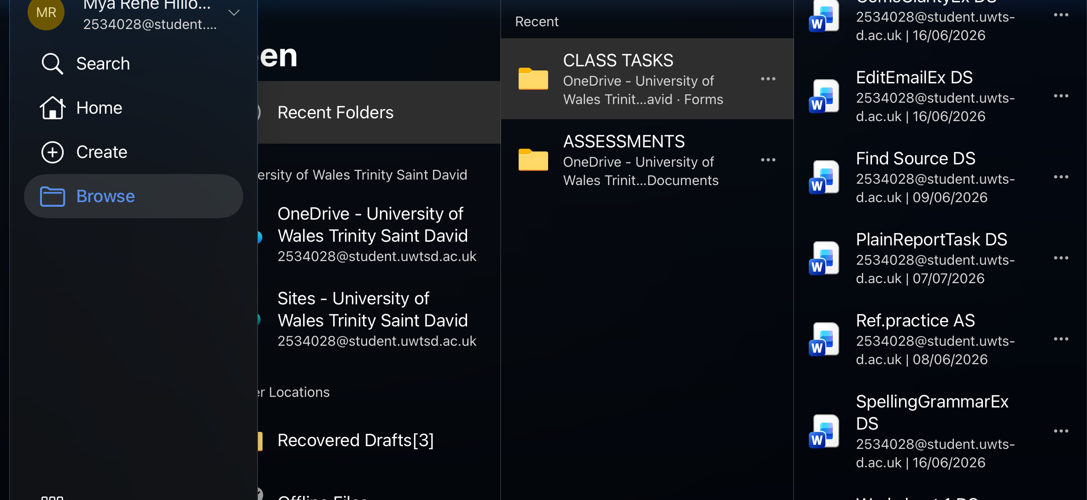
Organised Files &
Documents
These images demonstrate how I have now developed my organisational skills with my files and documents.
Using clearly labelled files and documents has helped me to maintain a well structured system where I can clearly access the documents I am looking for. This was one of the first lessons we learnt in class, was that professional environments require an efficient and clear access to files when needed.
Before starting this module, I rarely organise my files or save documents with clear or descriptive names. Throughout this I have now recognise the importance of maintaining organisation to maximise efficiency, avoid confusion and to have easy access to documents when needed.

