Slide 1

Amir Pervaiz-2028687
BMSW4003 - Digital Skills And Research Methods
Koushik Modak
Impact of Virtual Learning Environment (VLE)

Slide 2
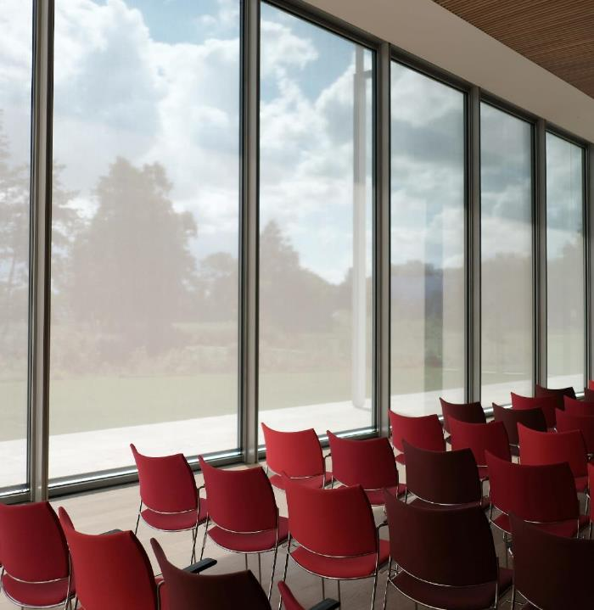
ABSTRACT
This is my research report on the impact of Virtual Learning Environment (VLE) experience at the University of Wales Trinity Saint David London Campus.

Slide 3

The aim of this report is to see the impact of implementing Virtual learning environment. I have gathered the data based of 6 student and one teacher who will remain anonymous for their privacy. As per the instruction to protect the privacy of participants the standards of confidentiality and anonymity have been applied for this research. I have tried my level best to figure out different questionnaires, Surveys teacher's stories , my own online learning observation. This research have provided me with different perspectives and approaches towards virtual learning environment. Virtual learning environment an be of two types. Where one of the type of a Virtual learning environment can contain software sold by a corporation to an educational organization, where the teacher are following the uploaded happenings and resources. On the other hand, a Virtual learning environment can be set up by the teacher within free software.
However, some teachers find Virtual learning environment captivating and eloquent, others find them very challenging and even scratchy. Some educators may fear showing a apparent technological feebleness when using the Virtual learning environment platform in front of students who might be more digitally savvy.
The phase (covid 19) we all faced in the almost last two years have a big impact of virtual learning. In class or face to face learning was almost vanished in these 2 years.

Slide 4



Institution Of Virtual learning environments (VLEs)
With the fast-paced world things have rapidly changed and the development of Information and communication technology plays a massive role in the existence on virtual learning environment.
Virtual learning environment provides the students and the teachers a place where they can both share different opportunities and accomplishments and at the same time interact with one another. This platform is now a days used as a complete way to accomplish a course, or to have a virtual face to face support.
The main goal of Virtual learning environment is to effortlessly provide a learning platform that goes way above the classroom experience.
Despite many benefits of Virtual learning environment there are opinions that are not in favor of implementing this platform in the education field.
Therefor in order to confirm the impact of weather Virtual learning environment is negative, positive or not hurtful I have done my research to classify the rewards and drawbacks of using a VLE from both the teachers and the student's standpoint.
4

Slide 5




Research is based on 6 Student and 1 teacher all will remain anonymous
Questionnaires
I prepared a questionnaire that inquired about the implementation and experience with Virtual learning environment. These questions were asked by both students and teachers. There were ten questions which I will share below for reference. The format of the questions was multiple choice so that I would not take too much of anyone's time.
Class observation
Classroom observation is solely based on my opinion.
My focus was to see how may students are active and responsive and also to observe if our teacher was paying any attention to those who are not actively participating. This research was based on 4-6 online classes which includes all the number of student present in the virtual class and one teacher.
Surveys
Based on my questionnaires I chose to randomly call my fellow classmates at the end of few virtual classes and conducted a survey with all those students their opinions .
My main intend was to have a instant response right after the class. This helped me gathered raw opinions and great outcome.
5

Slide 6
Questionnaires:
Questions | Choice 1 | Choice 2 | Choice 3
1. Feelings about Virtual learning environment | Yes | Average, It could be better | Not my kind of environment
2. Do you have your own devise for Virtual learning | Yes | Yes, but I am not comfortable with using technology | No OR I share with friends or family.
3. Are the teachers helpful while studying Virtually | Yes | Discreetly helpful | No very helpful or gadget friendly
4. Is online learning Fun | Yes | Sometimes, but there are quite a few challenges | Not at all , I rather go to in class
5. Is the University helpful in offering recourses | Yes | Reasonably helpful | Not at all , its so complicated
6. Is remote learning effective | Yes | Sometimes, but there are quite a few challenges | Not at all, waste of time
7. Time spend each day on virtual learning | 1-3 hours | 3-5 hours | 7-10 hours OR More
8. Device that you use for virtual learning | Laptop | Desktop | Smartphone
9. Do you have good internet | Yes | No, I had to upgrade my package | No, I struggle Its hard to concentrate
10. Do you have a full-time job along side | Yes | Yes, but I work part time now | No, I prefer to concentrate on E-learning

Slide 7
Questionnaires: Chart

Slide 8
Below is a Pie Chart that I discovered with my survey showing the attitude of student towards Virtual learning environment

Slide 9


CONCLUSIONS
As per my research and doing a survey I came to understand that students perceptions are different, some of them are very happy as Virtual learning environment allows them to divide the time according to their ow needs. However as some of the students who were not very happy thinks that Virtual learning environment is waste of time and they are not finding it very helpful. Most learners attitude that I figure out was that the student felt very enthused and passionate for Virtual learning environment. It helped the student perform better in their tasks and gave them a lot of confidence in developing public speaking skills. Most of the students had courage to participate in groups tasks. Students who were not very familiar with the technology tends to learn more and more about it. Despite of some technical difficulties the experience of Virtual learning environment for most of the students was very satisfactory and students tends to share their learning with others who are struggling . The struggle of using electronic gadgets is still a issue with a number of students however the study made me learn that it was temporary and was resolved in the early few lectures. Things started to get better and in the flow after few classes. I also realize that not all teachers can me very informative in communication technology as mentioned it is a fast passed industries not all teacher have a full knowledge of using technology and helping students.
9

Slide 10


CONCLUSIONS….(cont)
With different opinion I respect that everyone have a right to say. But with this research I realized that more that 60-70 % students are very happy as Virtual learning environment allows them to keep their full time jobs, allow them to be a father, mother, husband and a lot more in their daily lives.
When is comes to take about the disadvantage's technology continues to threat the implementation of Virtual learning environment as it can easily cause so much distraction for instance social media and other networks that are know for entertainment. Teachers play a very vital role in keeping all the student attentive so that they are concentrating on the provided lessons. Students displayed development in class contribution and performance most of the part they were on task through the procedure and inclined to connect experience with new acquaintance. The students displayed attention in the technical possessions and happenings due maybe to the interactivity and accessibility of wisdom tasks, meaning they had enduring access they got instant response on their presentation.
In Assumption besides the limitations described it can be easity stated that the implementation of Virtual learning environment in any course was very functional , in today's world it has been highly recommended an many educational processes. Not only universities now a days are implementing Virtual learning environment we have seen small kids age from 4 and above now a days practicing virtual learning and has been successful. World have changed and so do we have to change as well. The show must carry on.
10

Slide 11
Recommendation
Irrespective of the low interest of some teachers in Virtual learning environment some teachers are willing to learn the use of modern technologies. Virtual learning environment is a unavoidable parts of our students' lives and implementing it in todays classrooms is becoming very important.
As the teachers projected in their surveys, university bureaucrats need to continue reassuring for the distillation of new educational technologies and training for their faculty, students and staff over-all.
Online learning is quickly becoming one of the most cost-effective ways to educate the world’s swiftly expanding workforce.
“There can be infinite uses of the computer and of new technology [in training], but if the instructors themselves are not able to bring it to the learners and make it work, then it fails.”- U.S. Senator Nancy Kassebaum
Finally, I can be more than happy to talk about the exquisiteness of modern technologies, but eventually, their assistances rely moderately on the speculation university administrators make in their distillation into curricula. If i talk about the present study the need for additional stashes is quite obvious. The implementation of Virtual learning environment and advancement of technological facilities and possessions will unquestionably advantage the academic community. Similarly, the university administration and IT officers are predictable to accompaniment the technology mixture with enduring training programs that allow for better manipulation of the assets.
11

Slide 12
Amir Pervaiz-2028687
BMSW4003 - Digital Skills And Research Methods
Koushik Modak
Thanks, I hope my research will provide some insight about what the students feel and what are some essential things that can play an important role in the future to have a better experience.

