Slide 1
CV Essentials

Slide 2
What we will cover
To tailor or not to tailor?
Considering our reader(s)
Content
How we effectively use our CV

Slide 3
Who is reading my CV?
Imagine you are an employer and you have 100 or more CVs to read.
Would you get bored of doing it?
What would attract your interest?
Notes:
ATS is also a reader of your CV, this software looks for very specific things and reads a CV differently from a human reader.

Slide 4
Why do we tailor our CVs
To attract our readers attention
To highlight different skills and abilities
To stand out from the crowd

Slide 5
How do we know what to say / write?

Slide 6
Readers
Helen
Manager at Birmingham Council
Phil
Area HR Lead for the West Midlands Police
Dave
Manager at ALDI
Sian
Recruitment Consultant, Hays

Slide 7
What to include
Do
Contact details
An introduction or personal statement / profile
Qualifications
Skills
Experience
Attributes
Don’t
Age / date of birth
Ethnicity or religion
Sexual preference, marital status, whether you have children
National Insurance Number

Slide 8



Personal Statement
Tell your reader why they are reading your CV
Tell them why you want to work for them
Tell them why they should interview you

Slide 9

Qualifications
Most relevant first / Most recent first
Keep it short
Avoid duplication, Level 1, 2, 3

Slide 10
Skills
Communication
Problem Solving
Organisation
Creativity
Teamwork
Research
Are there skills that are specific to a reader?
How can we find out?
Notes:
Taking that one step further we can look at another of the employability skills of report writing that may seem simplistic at first glance and understand that there are lots of different elements that must be combined to be effective and successful. Something you may find useful in your studies.
Research: Gathering relevant and credible information is crucial. This involves finding data, statistics, and other sources that support your report’s content.
Planning: Organizing your thoughts and structuring the report into sections like the introduction, body, and conclusion helps in presenting the information logically1.
Writing: Effective communication through clear and professional language is essential. This includes proper grammar, punctuation, and coherent sentence structures1.
Analysis: Interpreting the data and information you’ve gathered to draw meaningful conclusions or recommendations1.
Brevity: Being concise and to the point ensures that the report is easy to read and understand1.
Editing: Reviewing and refining your report to eliminate errors and improve clarity and readability1.

Slide 11
Say What, when, and where
Volunteering is experience, caring is experience, studying is experience
Think about your reader, what are they searching for
Experience

Slide 12
What about hobbies?

Slide 13
Do I add a photo?

Slide 14



How long should it be?
Two Pages, good.
One page, better.
Three pages, never!

Slide 15
What about my references?

Slide 16
Questions?
Ideas?
Comments?

Slide 17
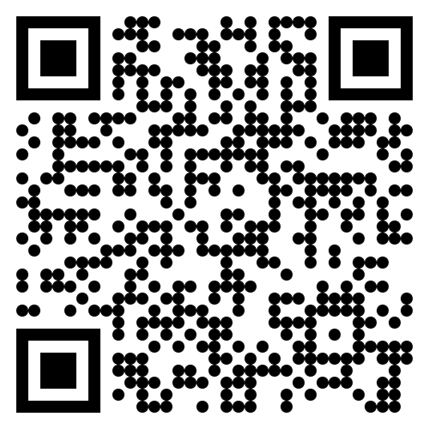
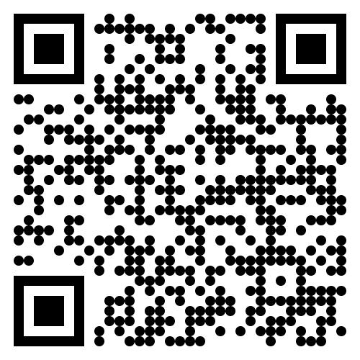
Where can I find help?
www.uwtsd.ac.uk
careers@uwtsd.ac.uk
CV Builder
CV360

