Slide 1
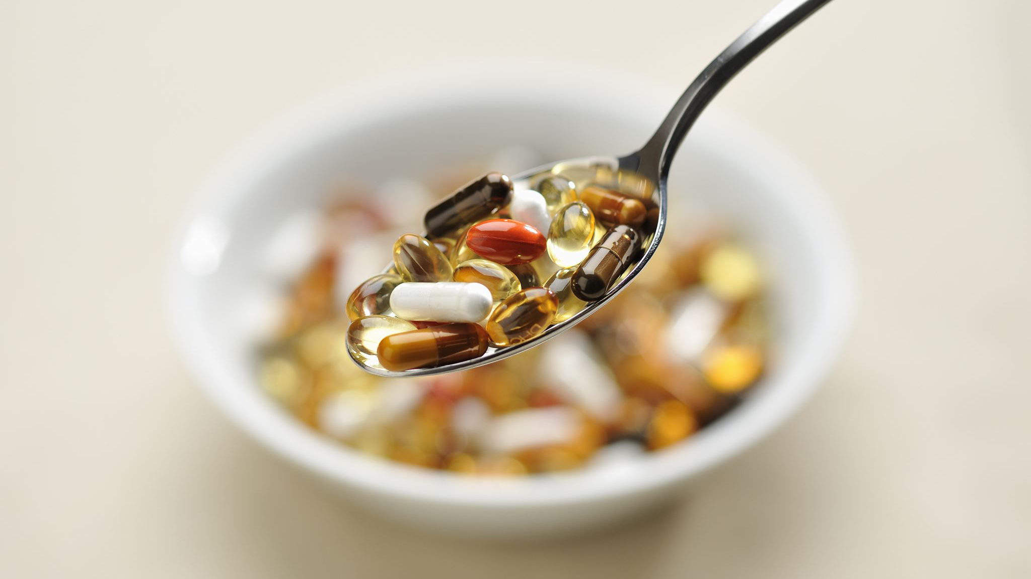
Drug related harm
The role of gender, age, class and ethnicity

Slide 2
Learning objectives
By the end of the session, you should be able to . . .
- Explain how drug use and drug related harm differs between age, ethnicity and gender.

Slide 3
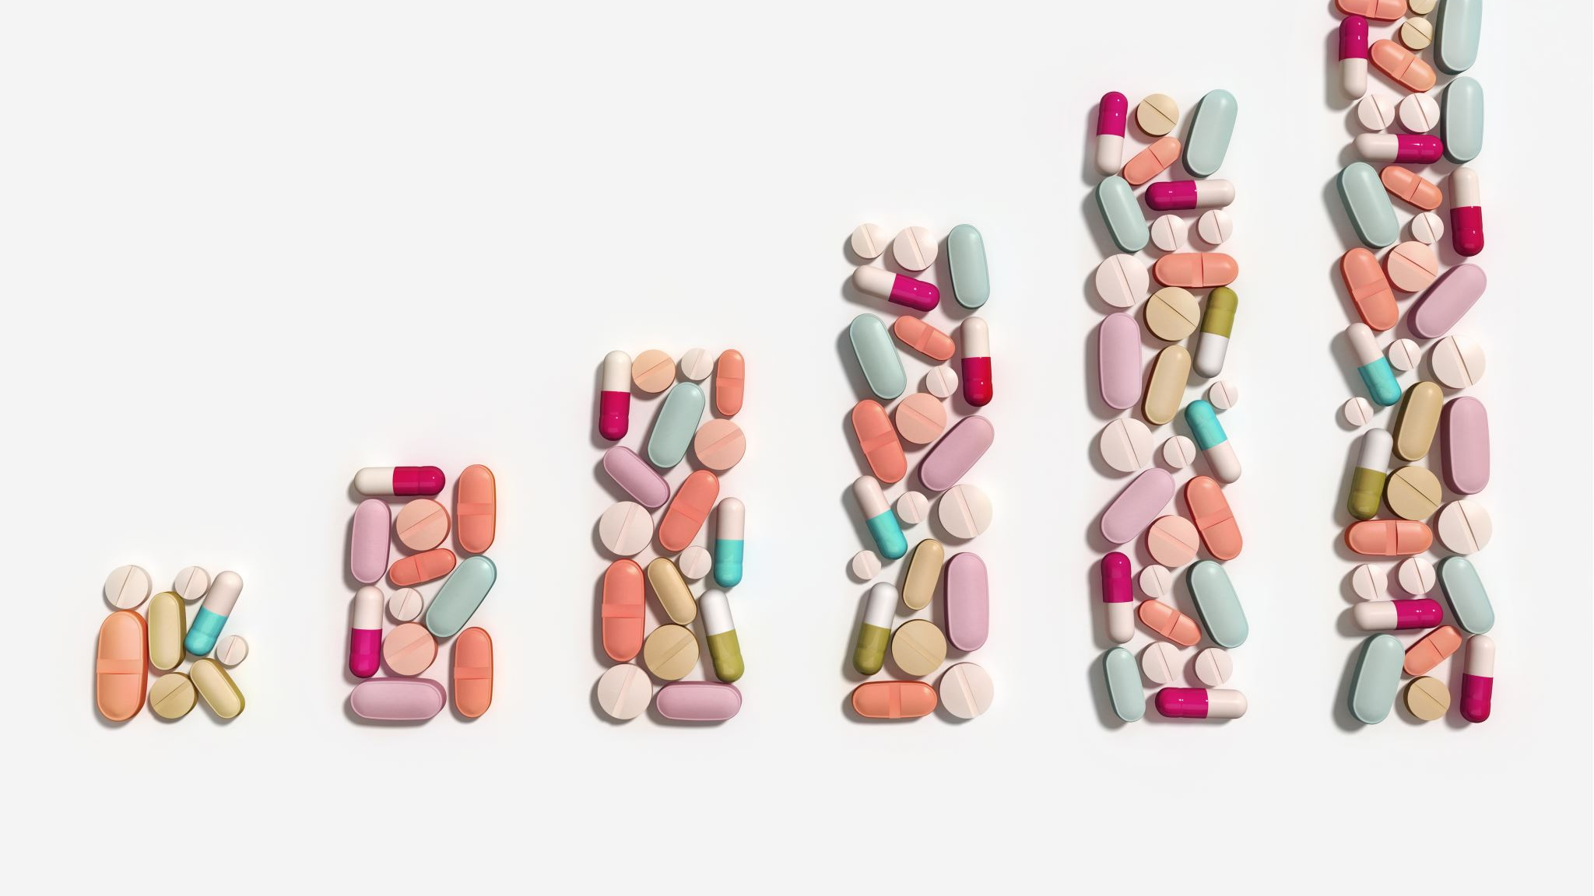
WHO USES DRUGS?

Slide 4
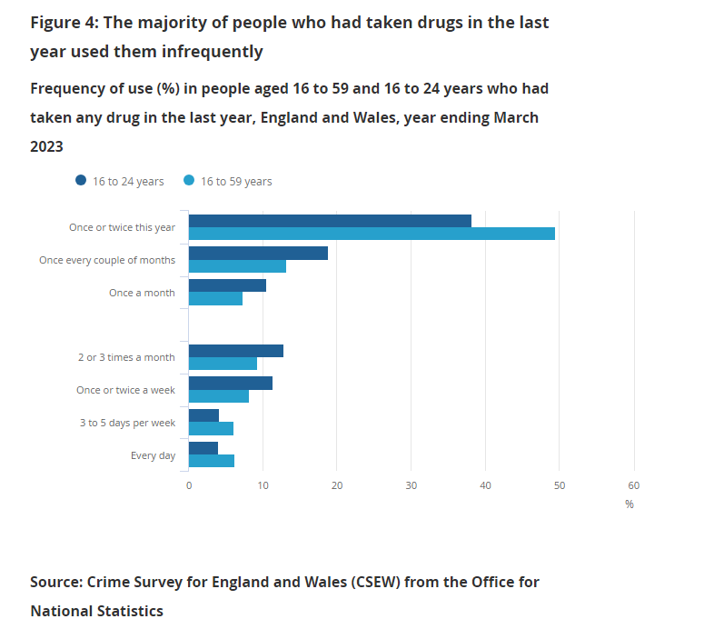
Main points:
9.5% of people aged 16 to 59 reported using a drug in the last 12 months.
For most individual drug types, there were no changes in use compared with the year ending March 2020
Approximately 777,000 people were frequent drug users (they had taken a drug more than once in the last year).
The prevalence of drug use was higher in people aged 16 to 24 years, with 17.6% (around one million people) reporting any drug use, a decrease compared with the year ending March 2020 (21.0%); this was largely a result of falls in cannabis use (from 18.7% to 15.4%) in this age group.

Slide 5
TASK: Why do we need to be cautious with the CSEW data?

Slide 6
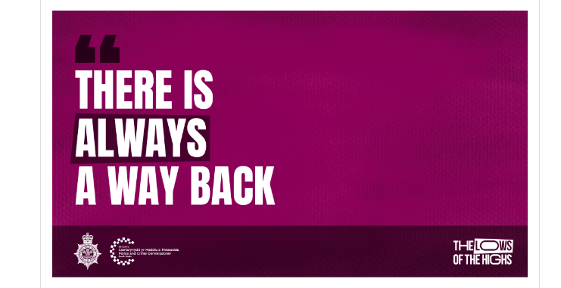
Notes:
The lows of the highs: Tackling drug supply | South Wales Police (south-wales.police.uk)

Slide 7
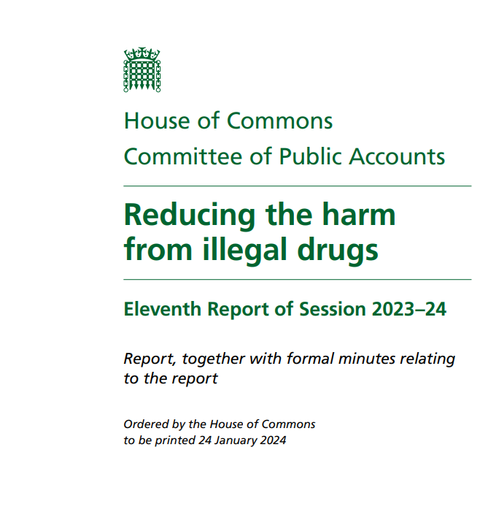
Drug related harm in the UK
Estimated 3 million people in England and Wales take illegal drugs each year, with the highest rates among young adults.
Estimated cost to society of £20 billion.
Funding for drug and alcohol treatment services decreased by 40% between 14/15 to 21/22.
Due to the significant increase of drug related deaths to record levels, Dame Carol Black 2021 review.
House of Commons Committee of Public Accounts, 2024
Notes:
Reducing the harm from illegal drugs (parliament.uk)

Slide 8
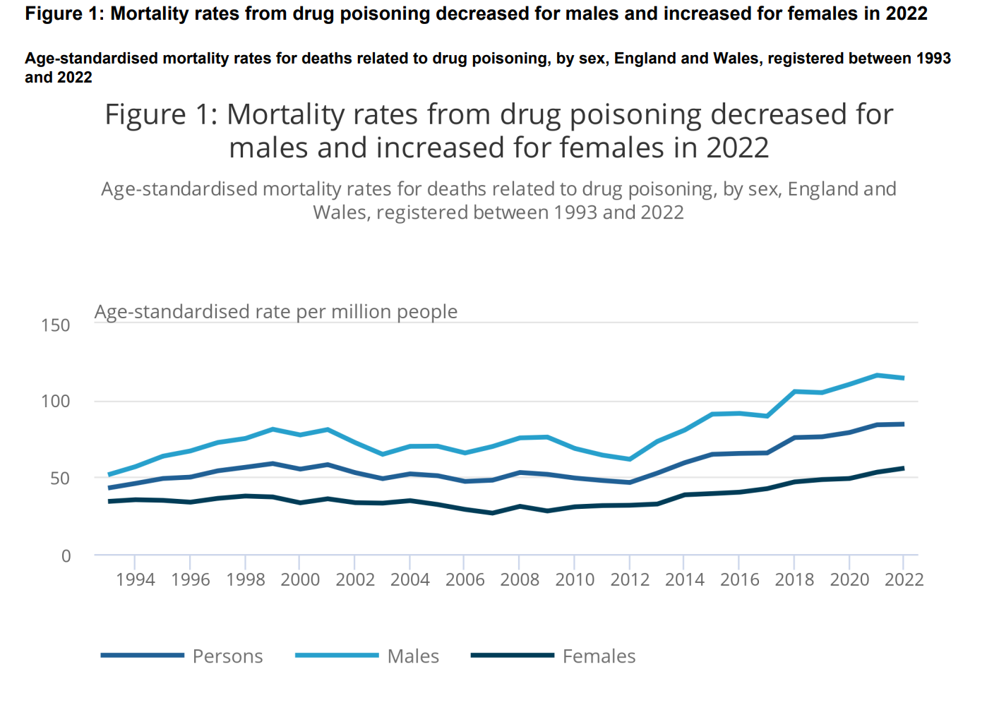
Understanding drug related harm
In England and Wales, 4907 deaths relating to drug poisoning were registered in 2022 (similar to 2021).
Among males, there were 114.3 drug-poisoning deaths registered per mission in 2022.
Compared to 55.8 deaths per million among females.
Rates of drug misuse deaths continue to be elevated among those born in the 1970s. Highest rate is those aged 40-49.
46.1% of deaths involved an opiate
The North East continues to have the highest rates of death relating to drug poisoning and drug misuse.

Slide 9
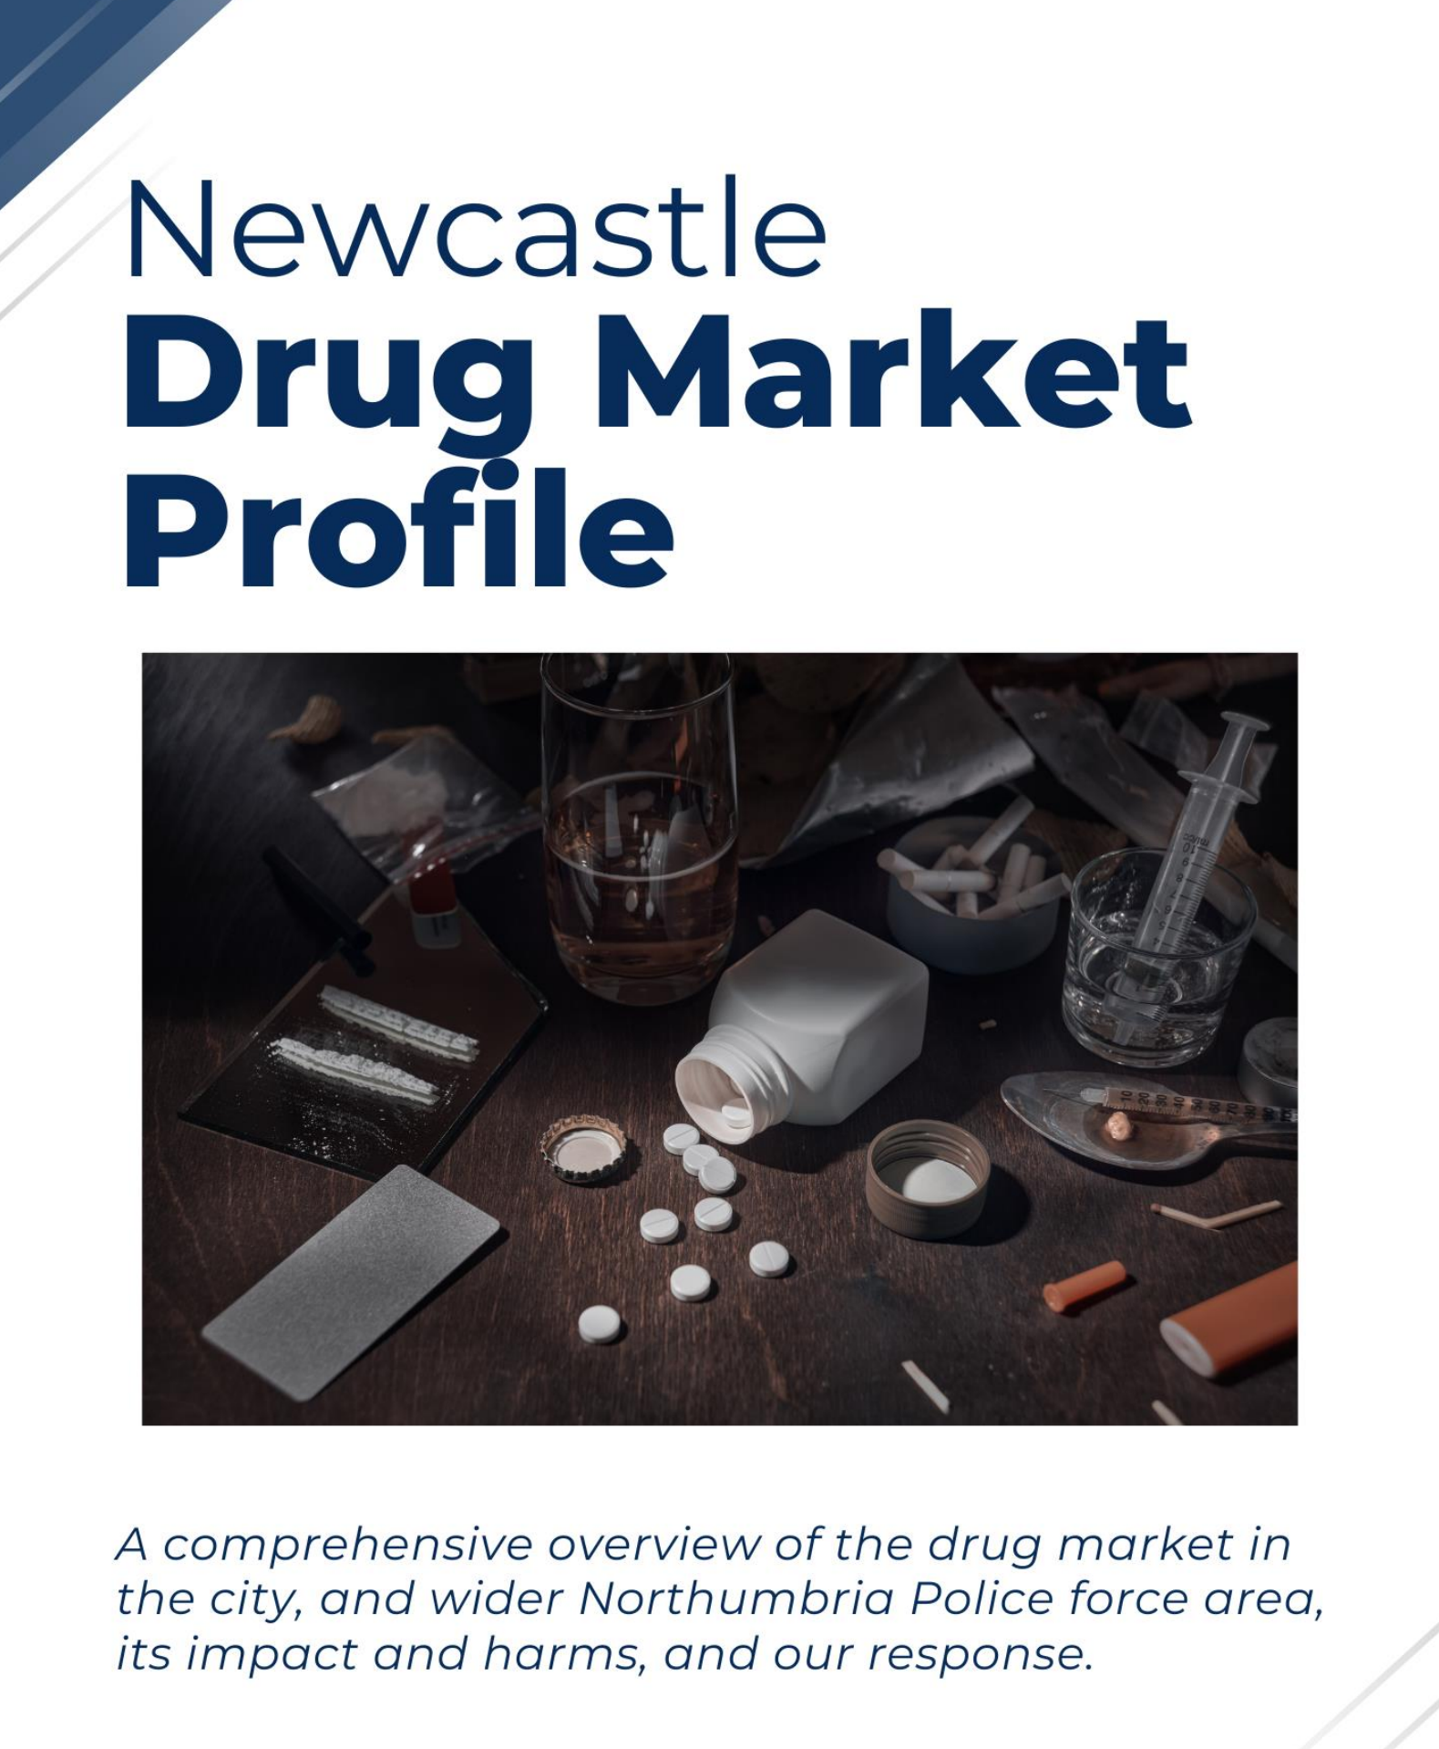
RESEARCH TASK
According to the ONS (2023), the North East of England continues to have the highest rates of death relating to drug poisoning and drug misuse.
What potential explanations can you find for this data?

Slide 10
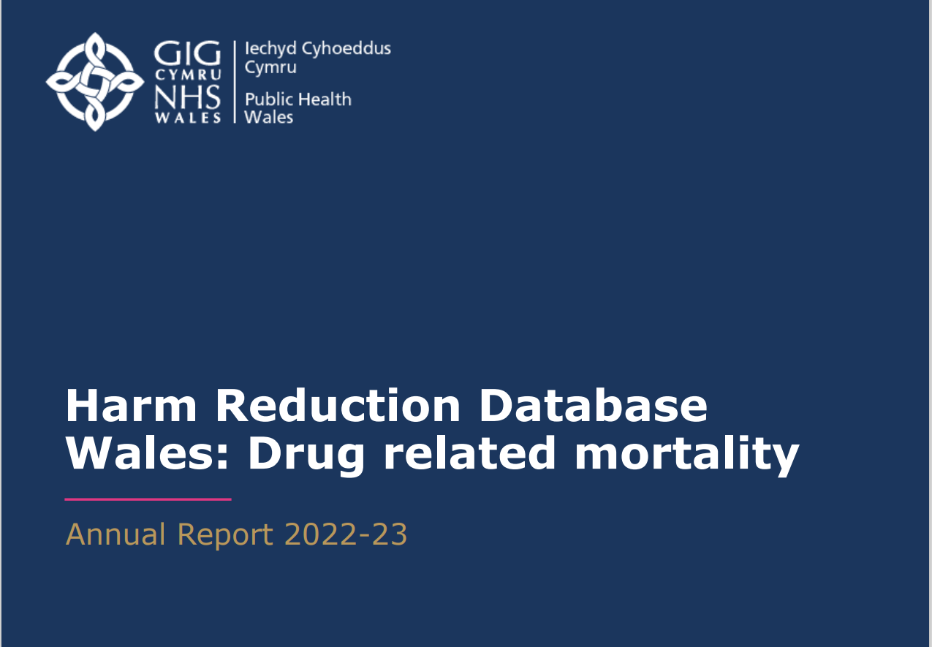
Drug related harm in Wales
In 2022, 318 deaths due to drug poisoning were registered in Wales.
Most commonly reported substance group was opioids (reported in 61% of deaths).
In 2022, the ratio of deaths amongst males and females was 3:1.
• Drug misuse deaths were over 5 times higher amongst those living in the 20 per cent most deprived areas compared with the 20 per cent least deprived areas in Wales.

Slide 11
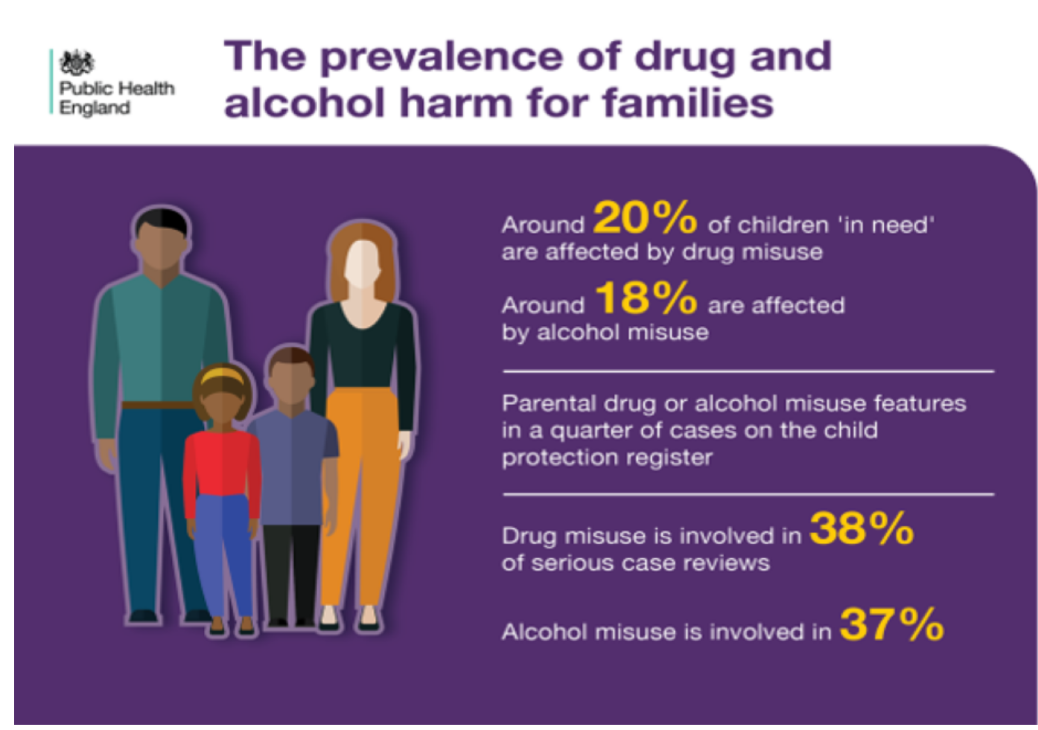
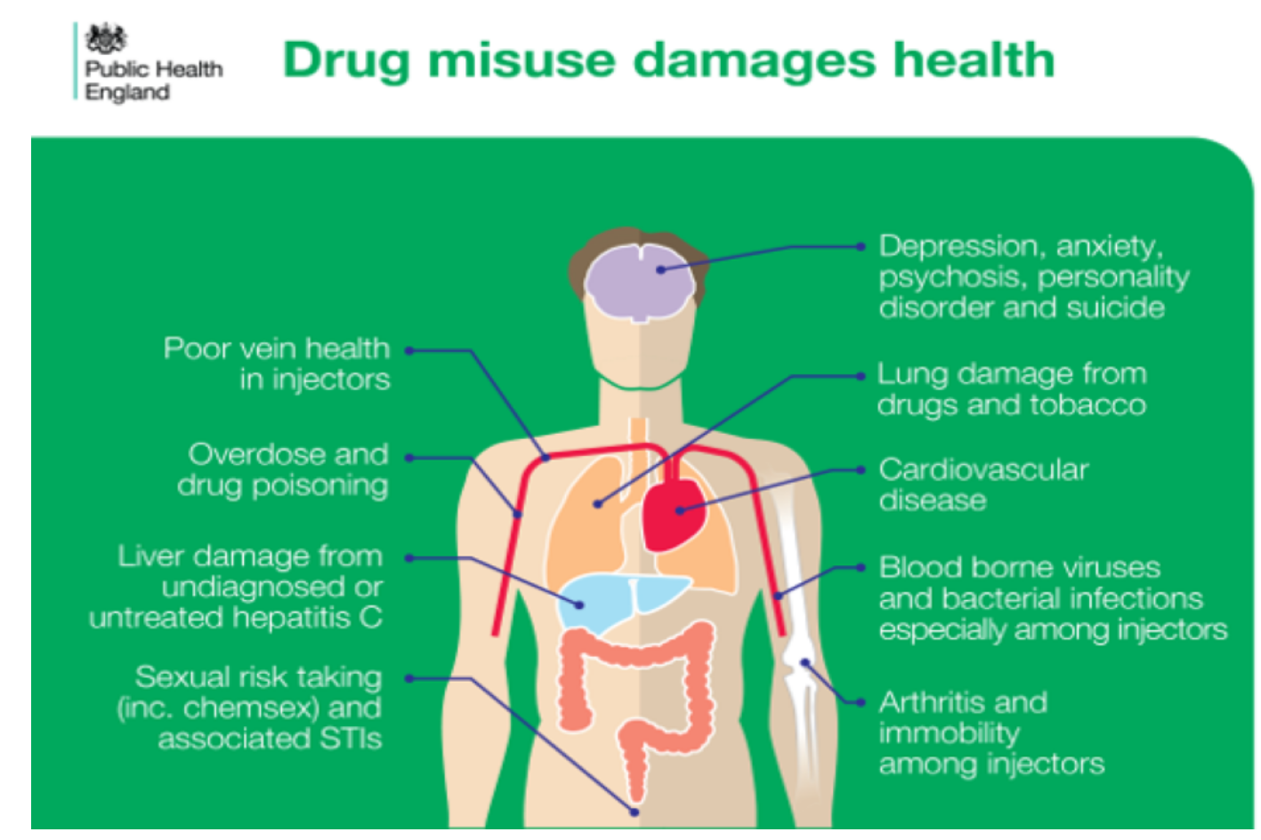
Drug related harm – the consequences

Slide 12
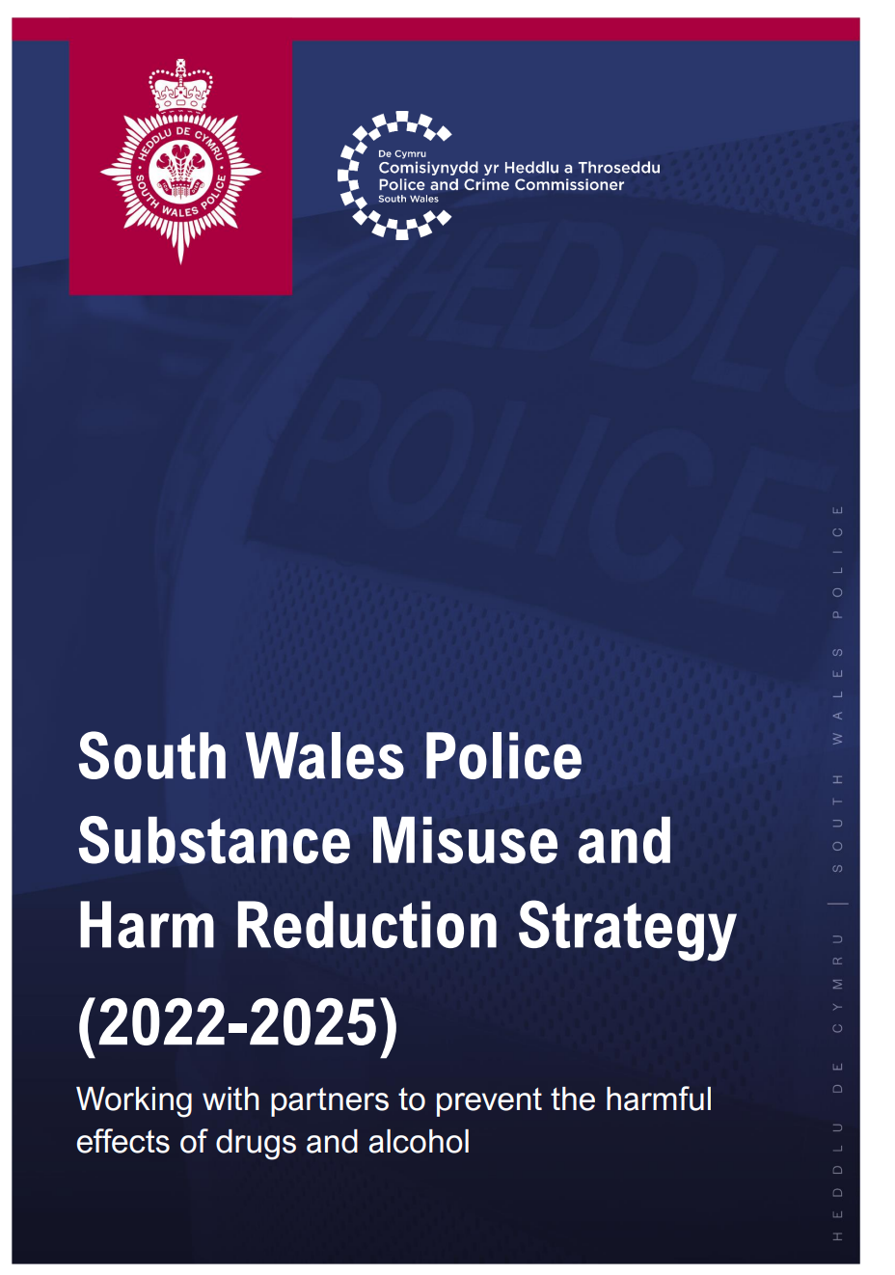
Drug related harm – social consequences
£20 billion a year cost to society
The drug trade generates significant levels of violence
Drug trade is said to be responsible for around 50% of all murders in England and Wales.
County lines has seen increased levels of exploitation.

Slide 13
AGE and drug related harm

Slide 14
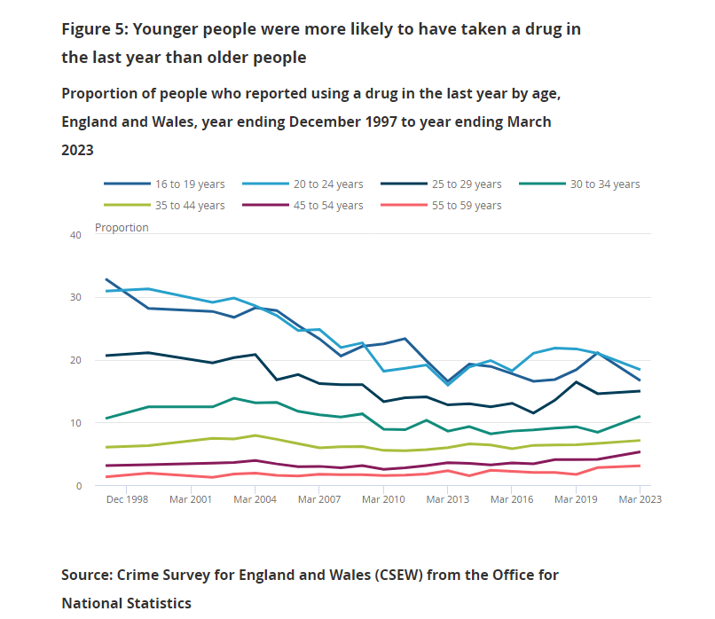
Drug user characteristics
Drug use higher among younger age groups
17.6% of those aged 16 to 24 compared with 7.7% of those aged 25 to 59 years
The fall in drug use among those aged 16 to 24 years compared with the year ending March 2020, was only seen in men (from 25.1% to 19.1%), and was mainly because of a decrease in cannabis use.
Notes:
Drug misuse in England and Wales - Office for National Statistics (ons.gov.uk)

Slide 15
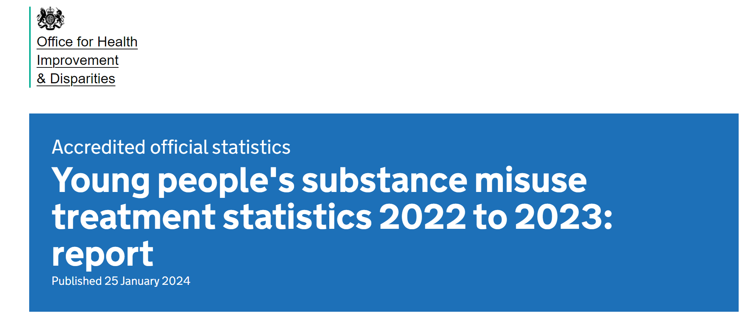
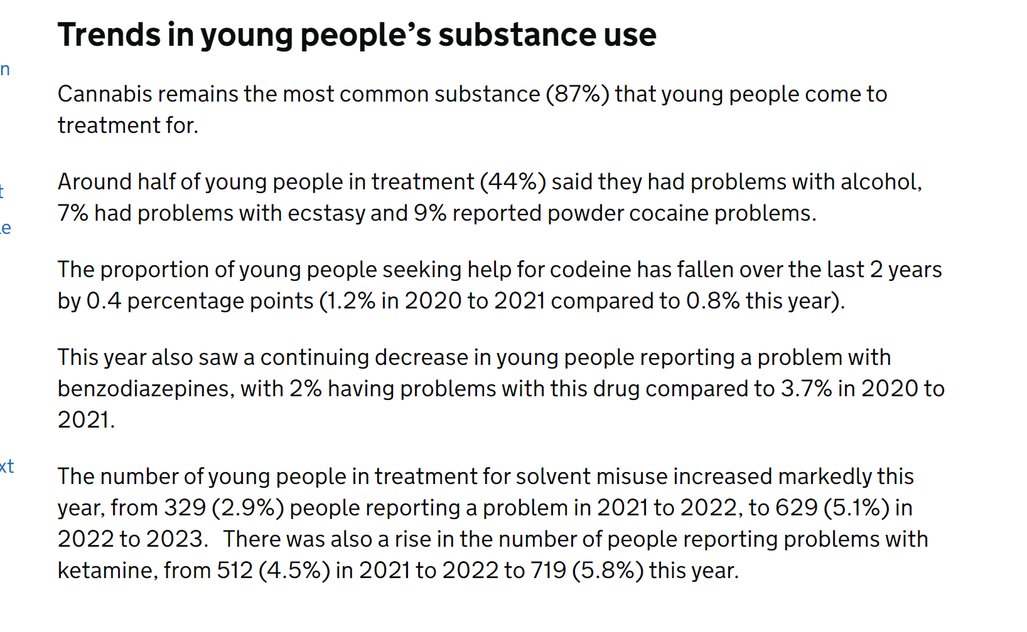
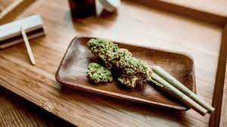
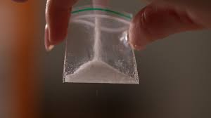
Trends in young people’s substance use

Slide 16

Notes:
Young drug user – case study

Slide 17
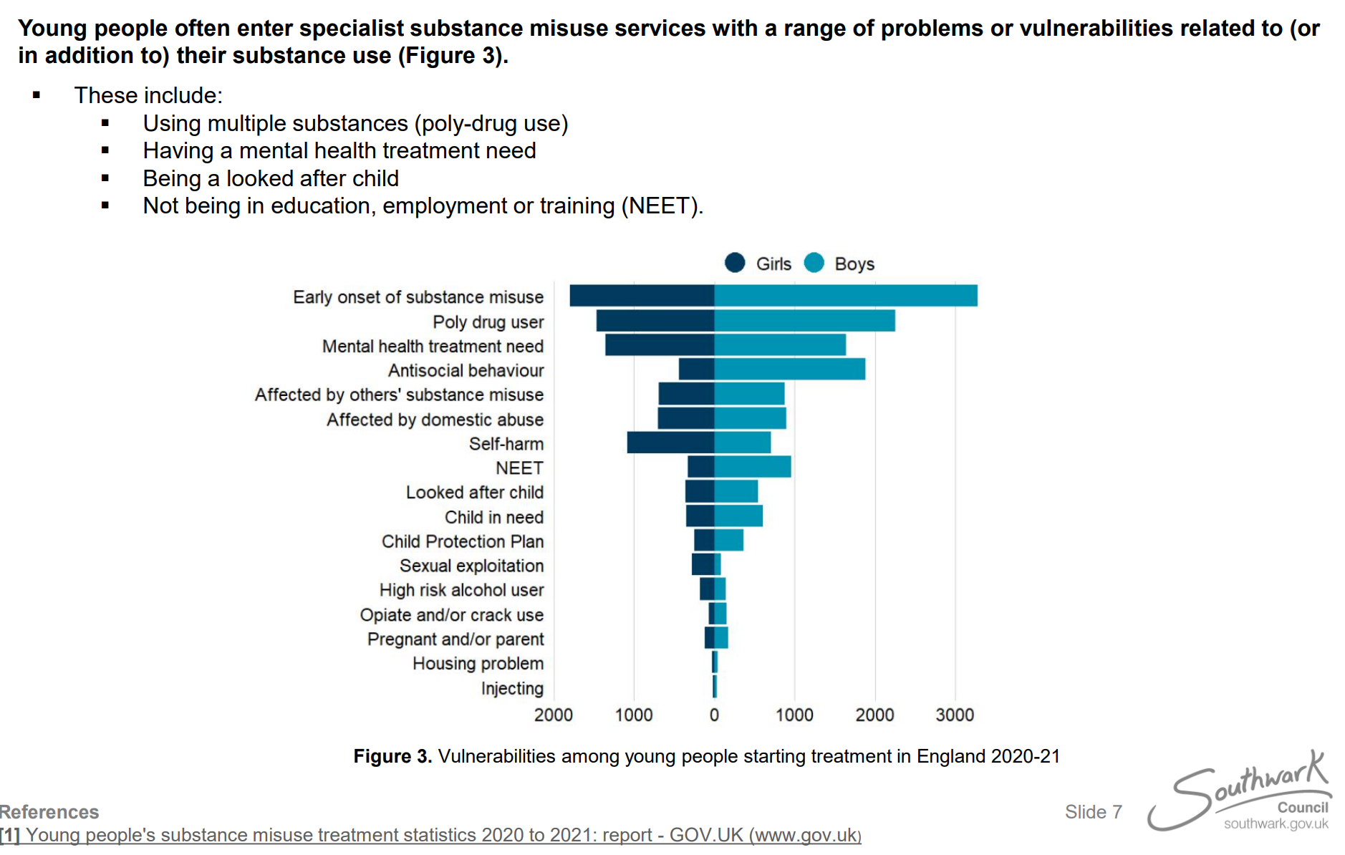
Substance misuse among young people - vulnerabilities
What vulnerabilities could make a young person more likely to misuse substances?
Notes:
PowerPoint Presentation (southwark.gov.uk)

Slide 18
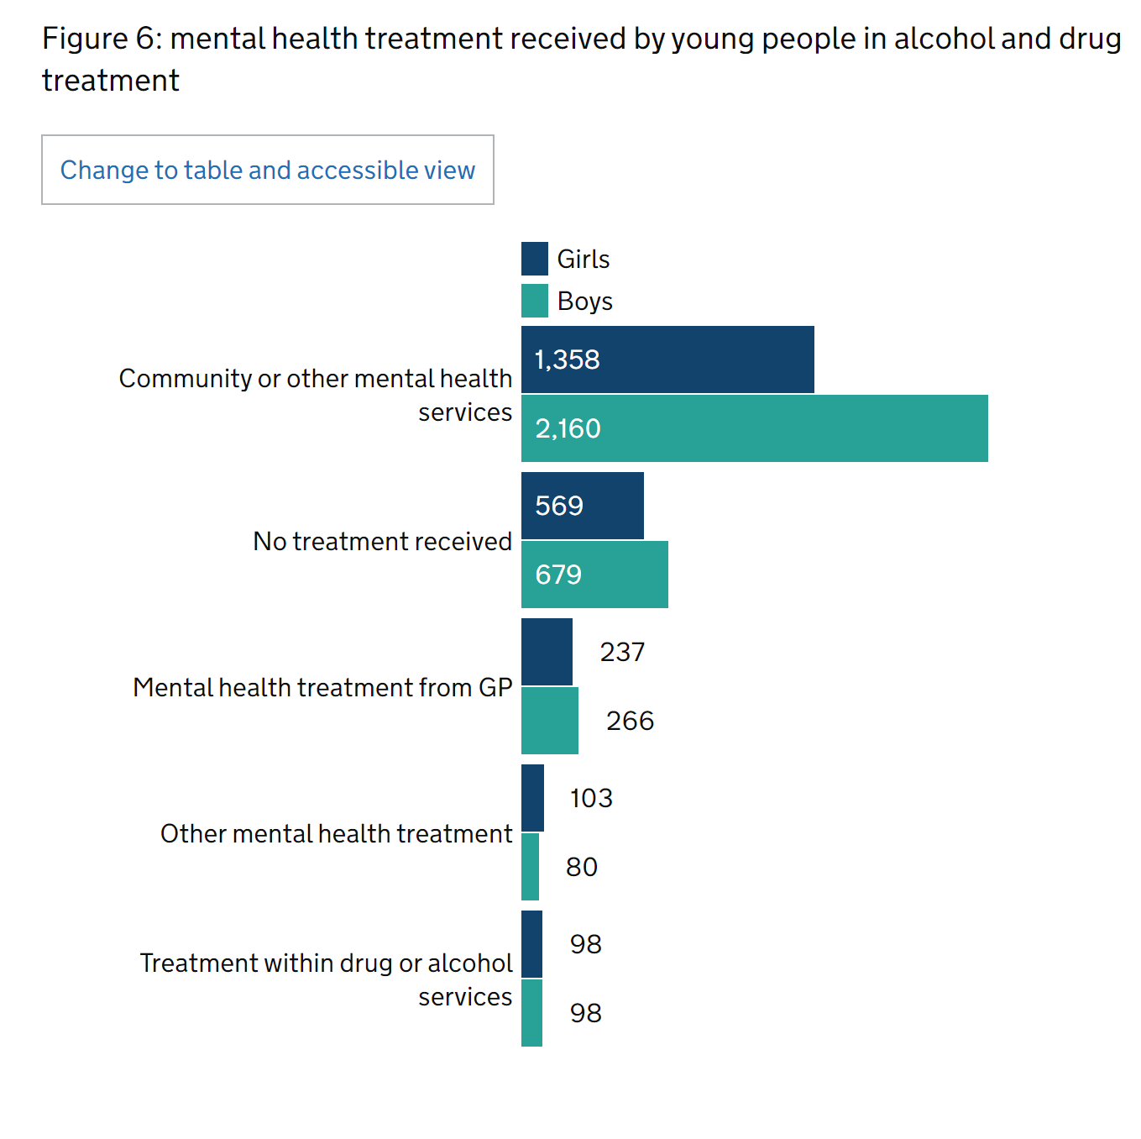
Mental health needs: young people
48% of young people who started treatment in 22/23 said they needed mental health treatment
65% of girls reported needing mental health treatment compared to 39% of boys
Figure 6 shows that 1,358 girls and 1,207 boys were already engaging with community or other mental health services when starting treatment in 2022 to 2023.

Slide 19
Middle age and older adults: patterns of drug use
Colliver et al (2020) - Aging may increase vulnerability to substance misuse.
Prescription Medicines – Qato et al (2008). Study of 3000 adults aged 57-85 showed common mixing of prescription medicines, non- prescription drugs and dietary supplements. More than 80% of the participants used at least one prescription medication daily.
Opioid Pain Medicines - Between 4-9% of adults age 65 or older use prescription opioid medications for pain relief (Lehmann & Fingerhood, 2018).
Nicotine - The Centers for Disease Control and Prevention (CDC) reports that in 2017, about 8 of every 100 adults aged 65 and older smoked cigarettes, increasing their risk for heart disease and cancer.
Notes:
Substance Use in Older Adults DrugFacts | National Institute on Drug Abuse (NIDA) (nih.gov)

Slide 20
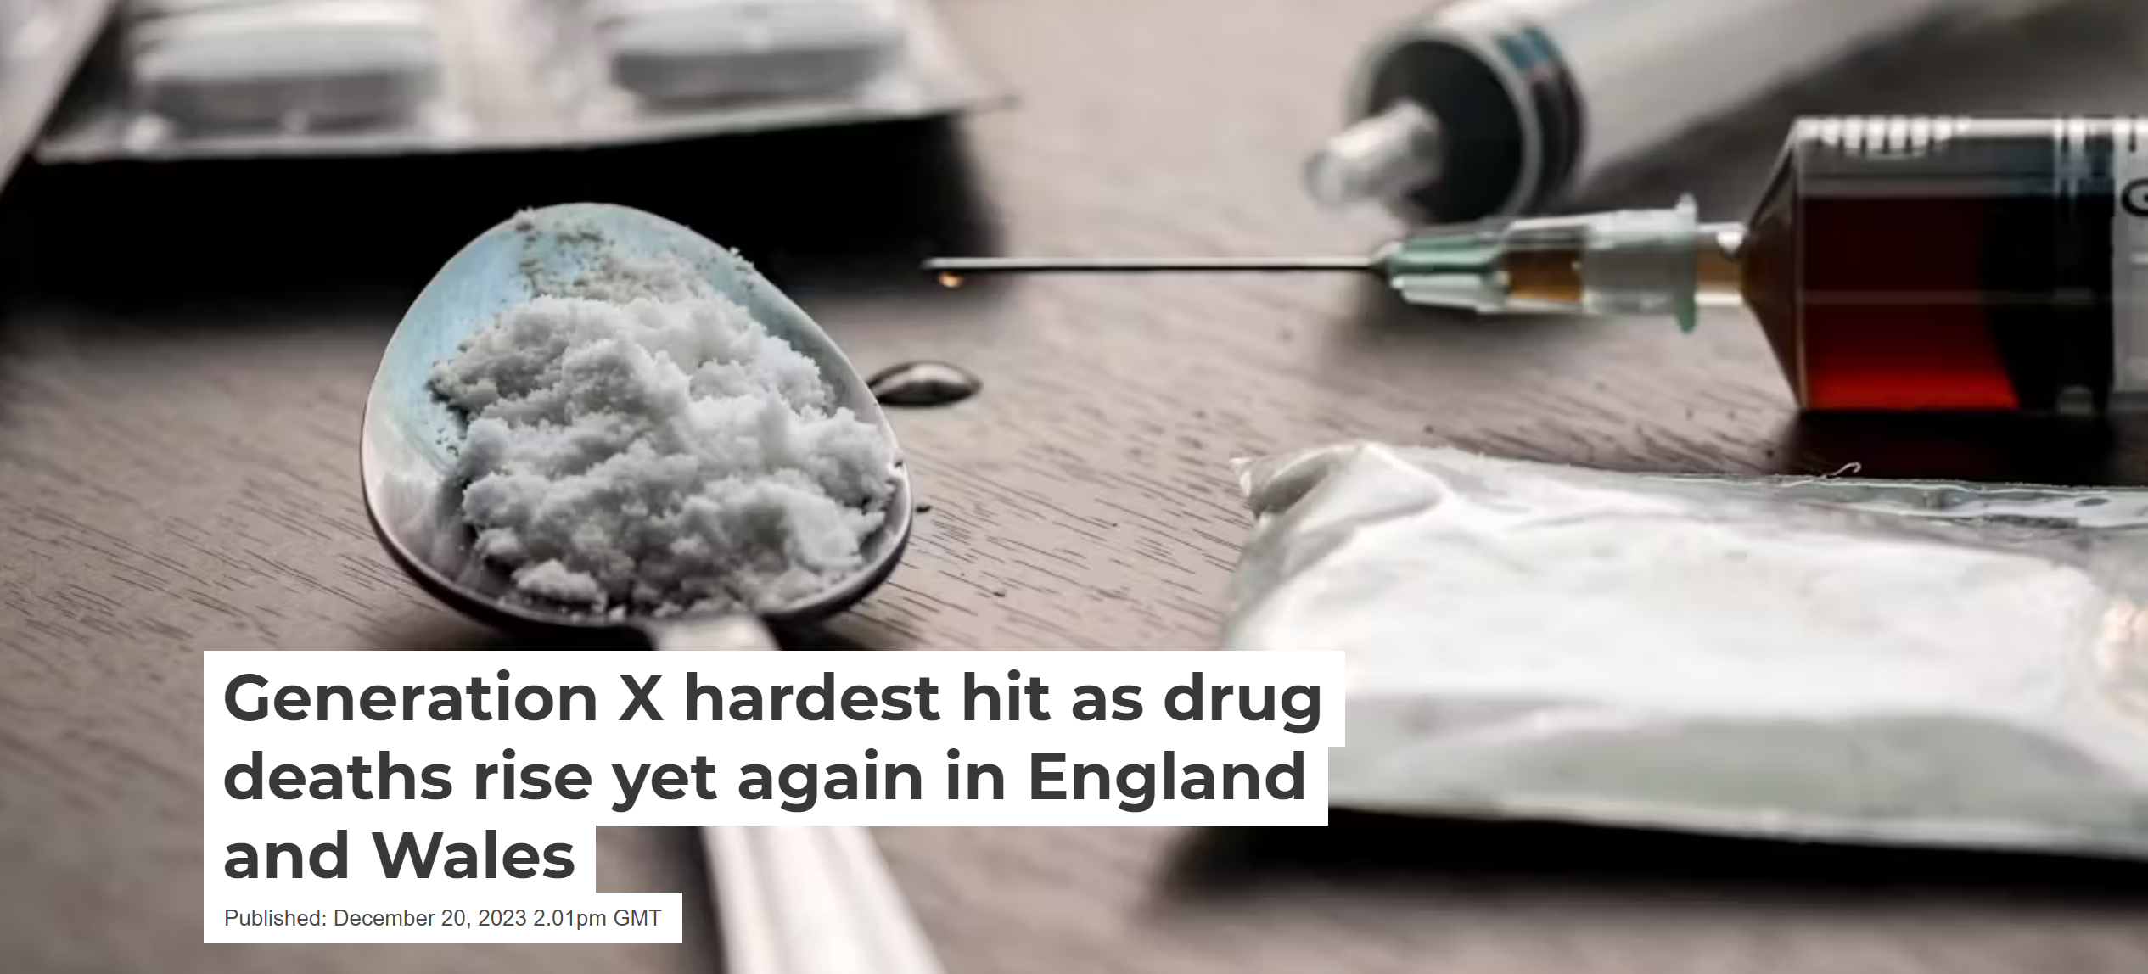
- The highest rate of deaths occurred in the 40- to 49-year-old age group, and the average age at death continued to rise. This is mainly the “Generation X” cohort born in the 1970s, who came of age when there was a rapid rise in the availability of heroin, and when general population rates of drug use were at their highest in the 1990s.
These premature deaths reflect poorer physical and psychological health, such as compromised respiratory and cardiovascular functioning, which increases the risk of dying from drugs. Many of these health problems could be treated if people accessed health services, but unfortunately too few do – adding to the risk of premature death.
AGE AS A RISK FACTOR

Slide 21
ETHNICITY and drug related harm

Slide 22
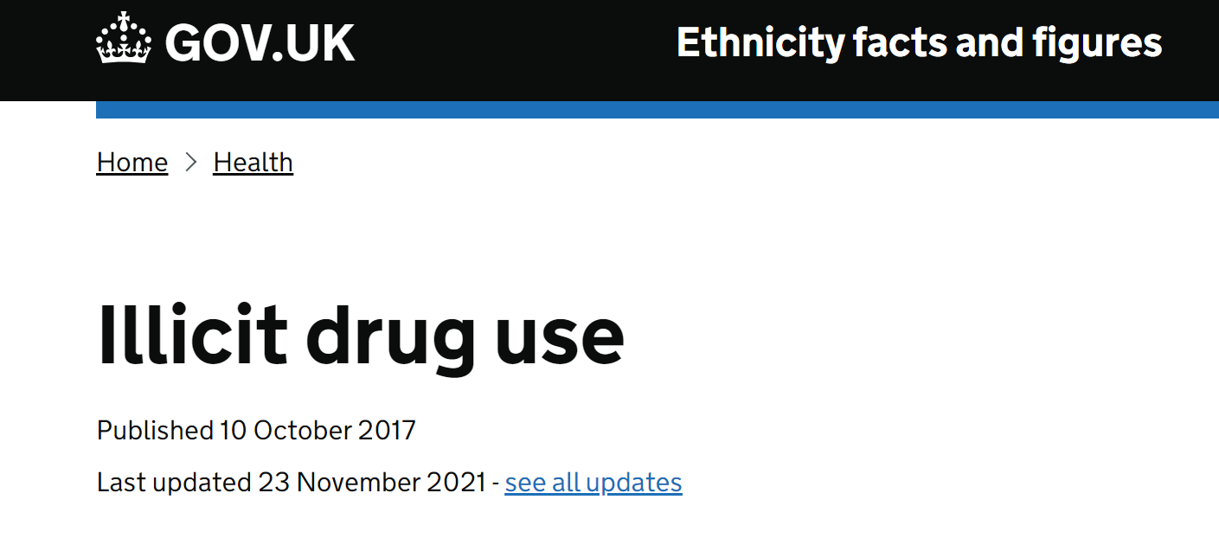

Ethnicity and drug related harm: Main findings
White British adults and Black adults were more likely to have used illicit drugs in the year before being surveyed than Asian adults.
White British men were more likely to have used illicit drugs compared with White British women.
Black women, White British women and women from the White Other group were more likely to have used illicit drugs, compared with Asian women.
Notes:
DATA WARNING:

Slide 23
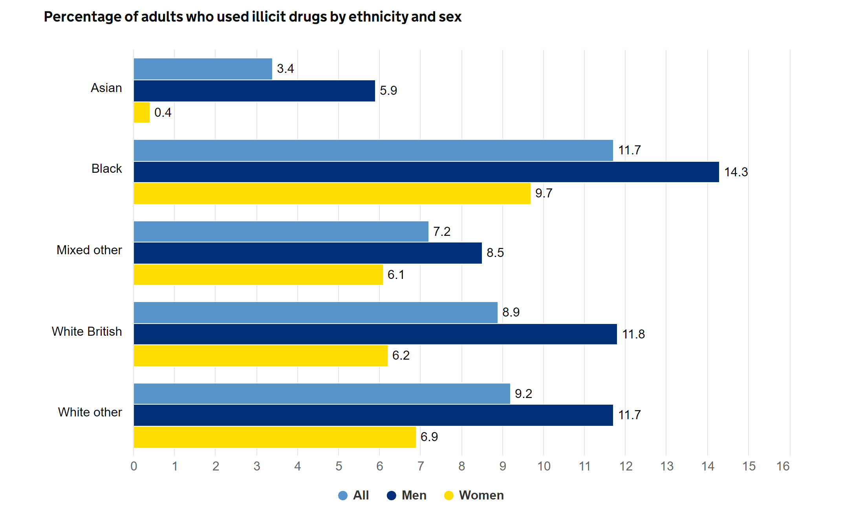
Notes:
Illicit drug use - GOV.UK Ethnicity facts and figures (ethnicity-facts-figures.service.gov.uk)

Slide 24
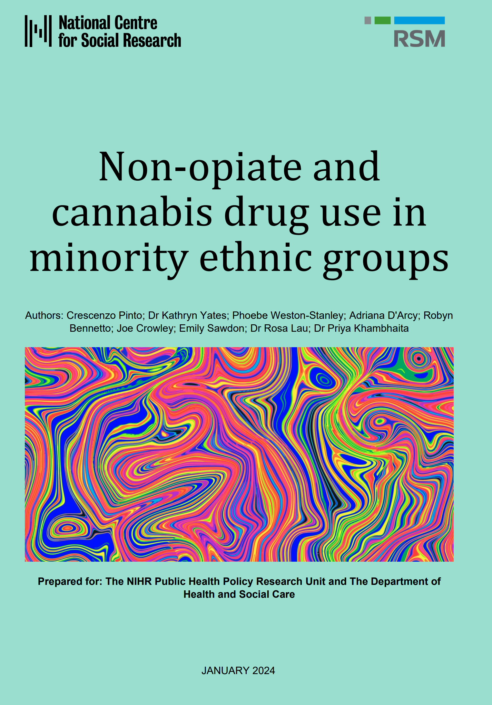
RESEARCH TASK:
Key findings…..
The numbers of people from minority ethnic groups who have used drugs vary when comparing minority ethnic groups to the White British population.
Age explained some of the differences in likelihood of past year drug use between minority ethnic groups and the White British majority.
The findings highlight that experiences of drug use are driven by a range of intersecting factors, including culture, gender, mental health, and migration experiences.
Minority ethnic groups face specific barriers to accessing and engaging with treatment and support services.

Slide 25
GENDER and drug related harm
*The gender discussion will be in relation to male and female drug related harm

Slide 26
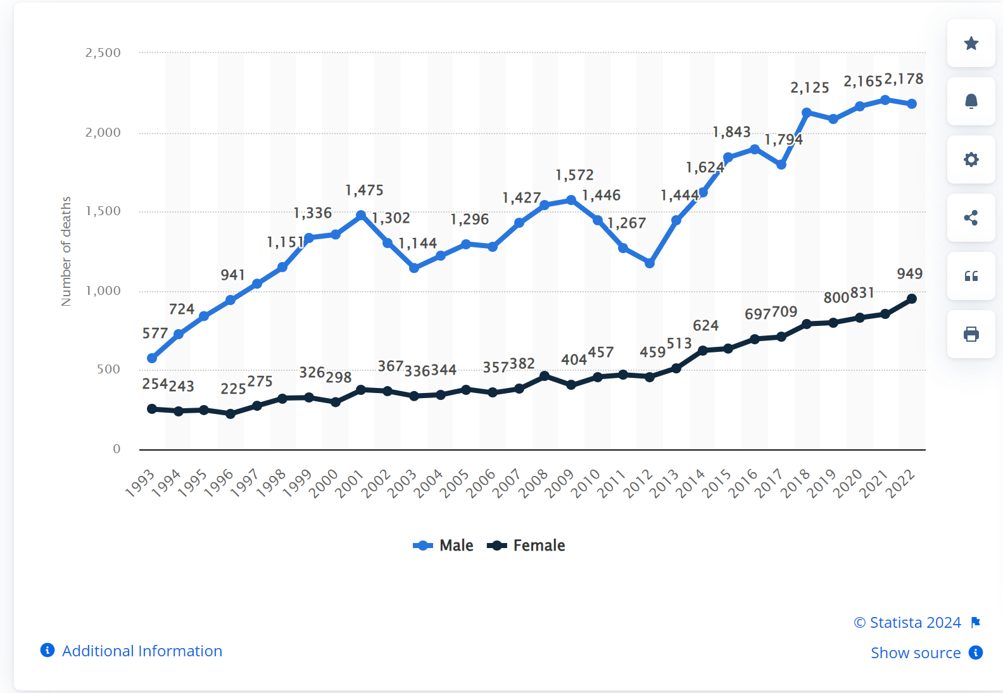
What does the data tell us?
Men are more likely than women to use almost all types of illicit drugs,and illicit drug use is more likely to result in emergency department visits or overdose deaths for men than for women (National Institute for Drug abuse, 2020).
Number of deaths from drug misuse by gender in England and Wales from 1993 to 2022
Notes:
Why are drug-related deaths among women increasing in Scotland? A mixed-methods analysis of possible explanations - PMC (nih.gov)

Slide 27

Men's substance use and societal pressures
What factors may make men more likely to use substances than women?
Group membership
Risk-taking behaviour
Societal stigma and shame
Social pressures
Sexuality
Cultural expectations

Slide 28


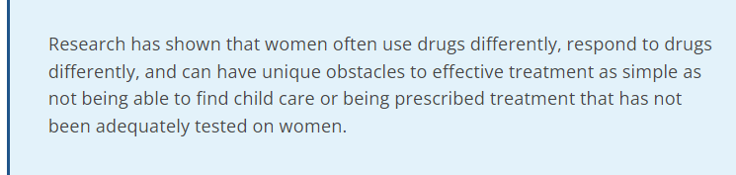

‘Women make up approximately a quarter of all people with serious drug problems in Europe and around one-fifth of all entrants to drug treatment. Yet much still needs to be done to provide interventions tailored to their needs, with many drug services remaining male-oriented.’
Can you think of barriers that women may face?

Slide 29
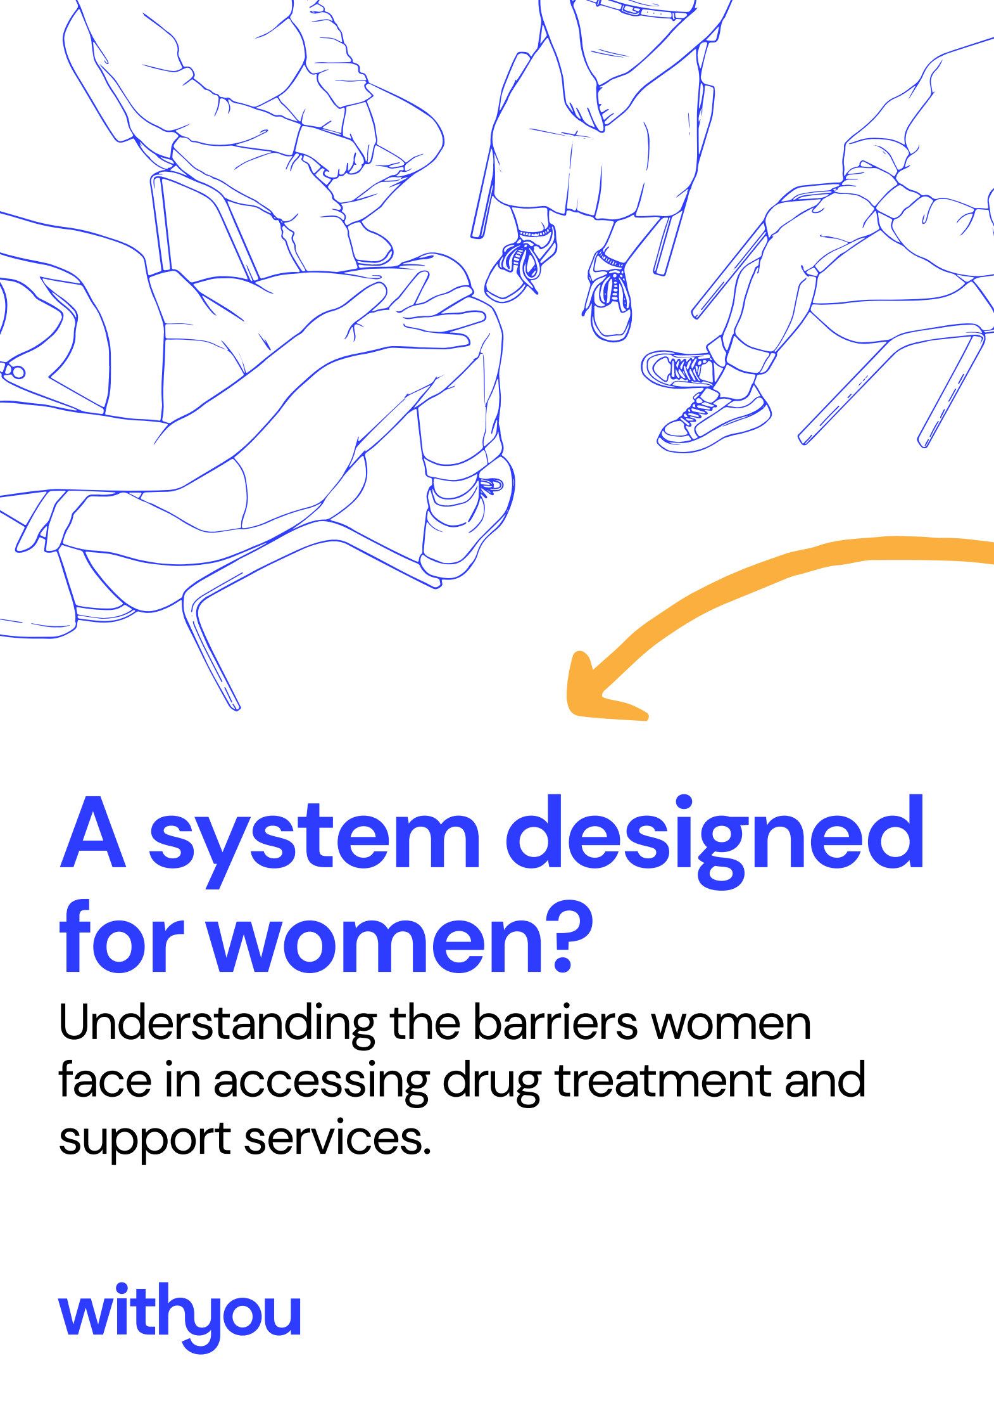
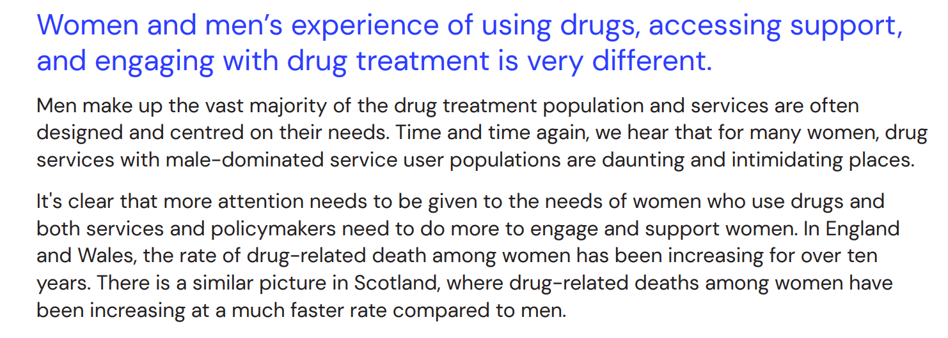
Male dominated services can be intimidating for women.
Fear of losing child custody if drug use is disclosed.
Stigma around disclosing drug use
Missed opportunities to engage women

Slide 30
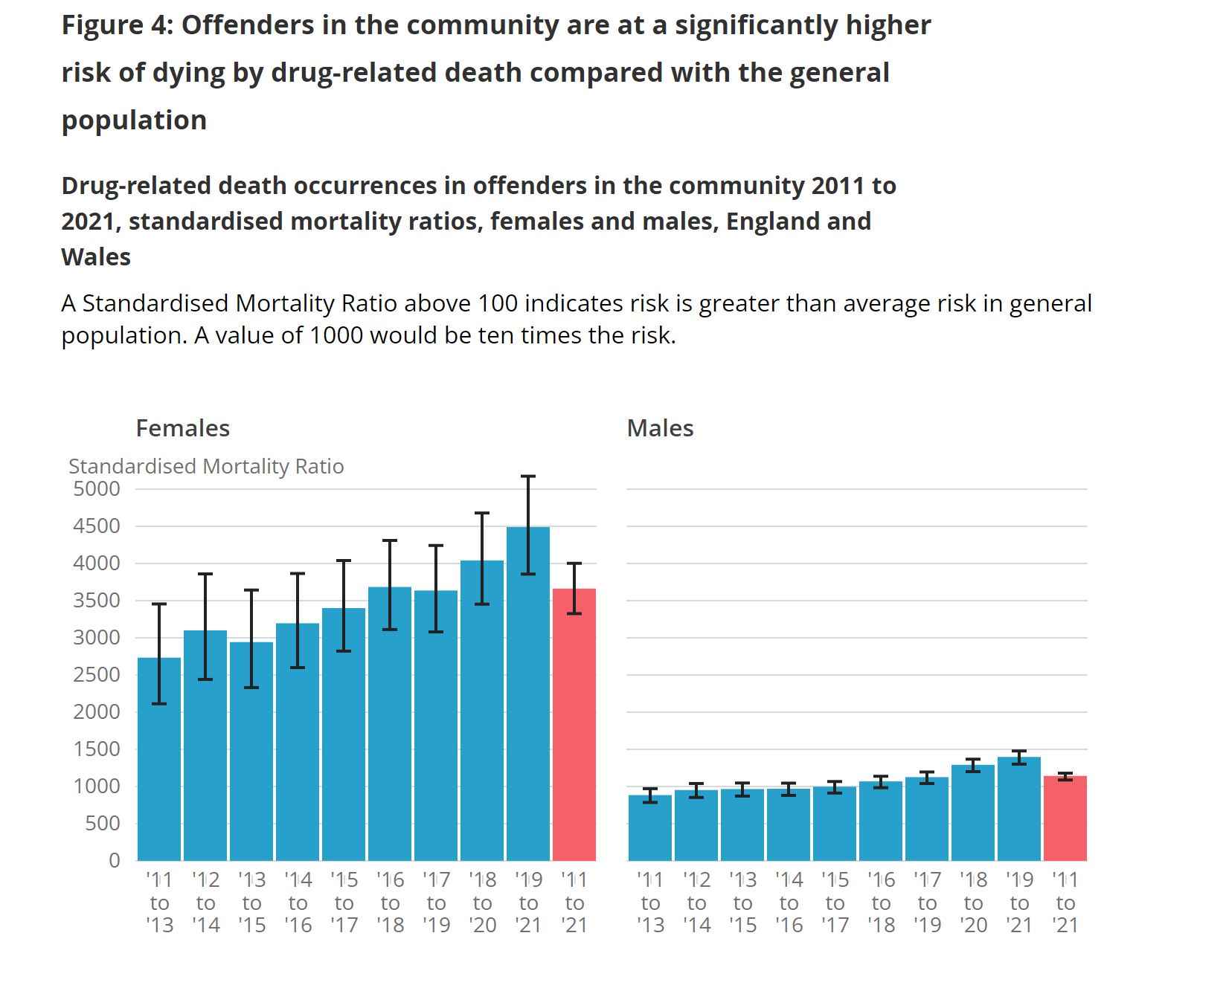
Drug related deaths and gender
Of the total drug-related deaths in offenders the community between 2011 to 2021 (2,801 deaths), 2,345 were male (84%) and 456 were female (16%). This equates to 255 drug-related deaths in offenders in the community each year.
In male offenders, the risk of drug-related death was around 11 times greater than in the general population, while the risk for female offenders was around 36 times greater.
Notes:
Drug-related deaths and suicide in offenders in the community, England and Wales - Office for National Statistics (ons.gov.uk)

Slide 31
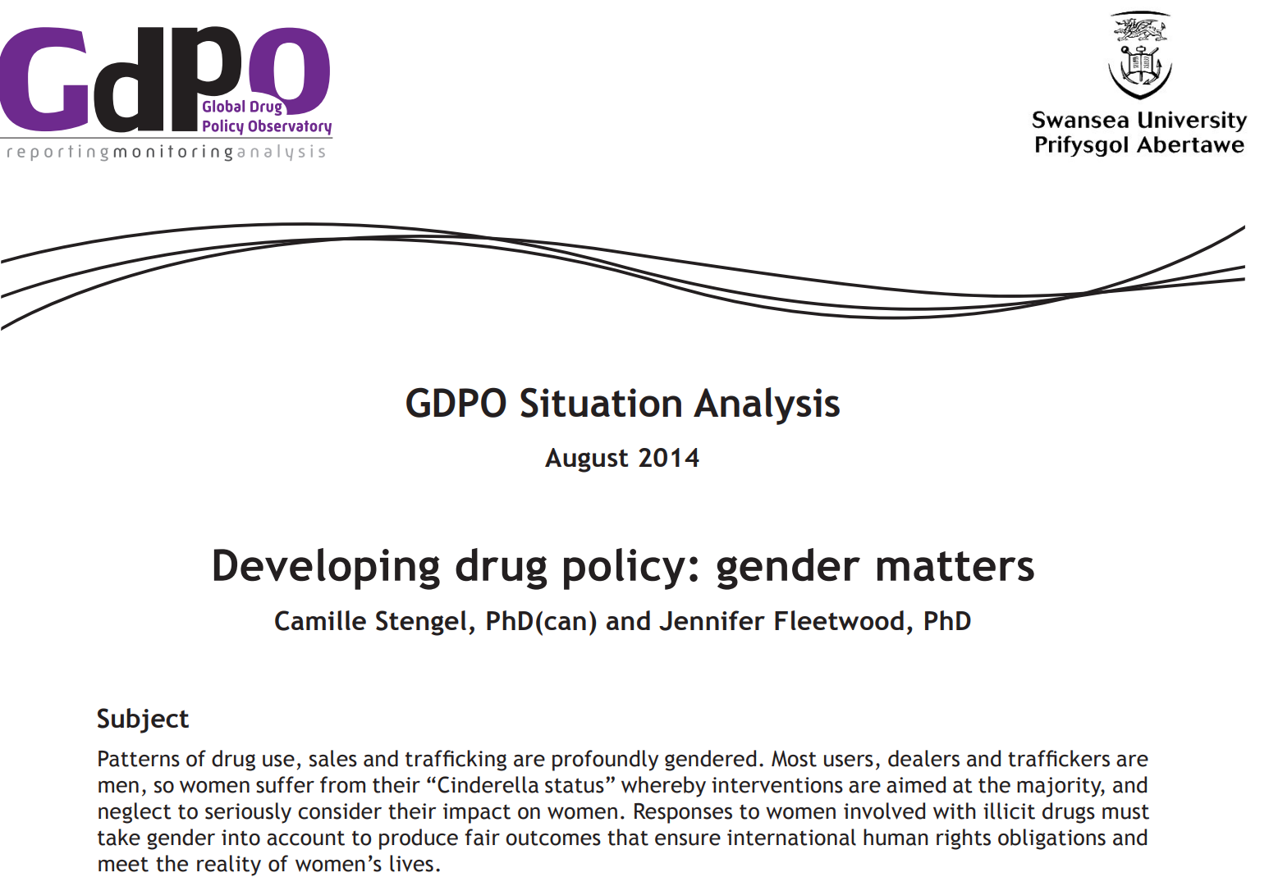
Drug policy and gender
‘Responses to women involved with illicit drugs must take gender into account to produce fair outcomes that ensure international human rights obligations and meet the reality of women’s lives’ (Stengel & Fleetwood, 2014).

Slide 32
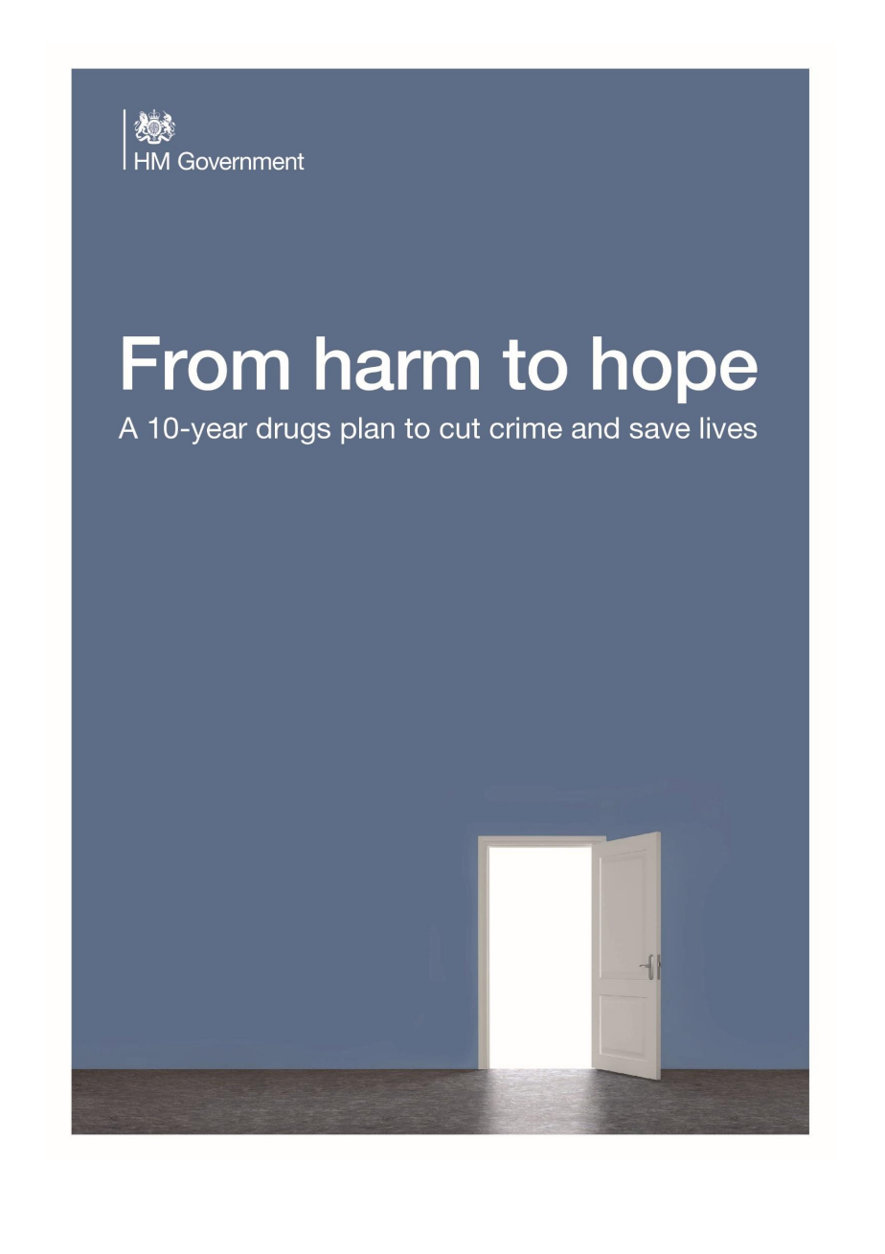
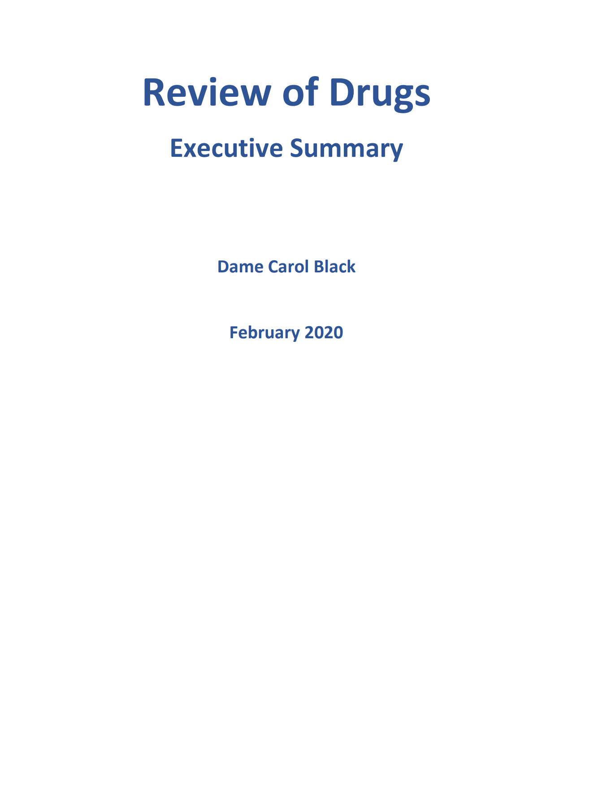
Research task: Review the findings of the Dame Carol Black review and the Government response

Slide 33
Notes:
Microsoft Word - SummaryPhaseOne+foreword200219 (publishing.service.gov.uk)
On 8 February 2019 Professor Dame Carol Black was appointed to lead a major 2-part review that looked into:
the ways in which drugs are fuelling serious violence
treatment, recovery and prevention

Slide 34
Government response to Dame Carol Blacks review
Notes:
Government response to the independent review of drugs by Dame Carol Black - GOV.UK (www.gov.uk)

Slide 35
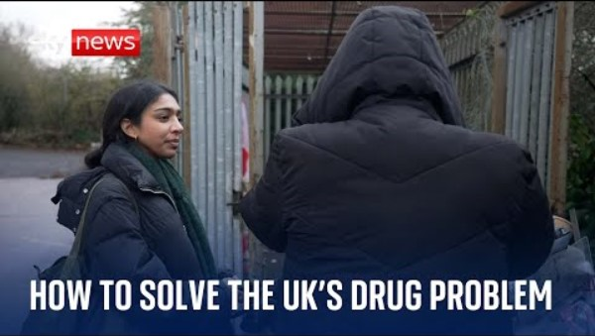

Slide 36
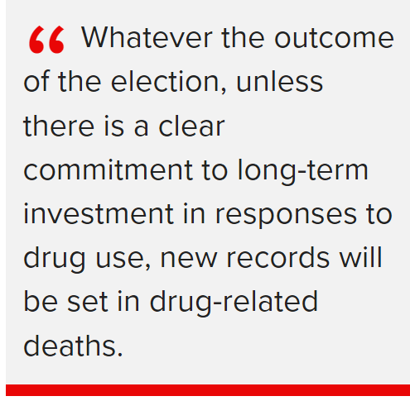
Can we prevent drug harms?
Hamilton (2024)

Slide 37
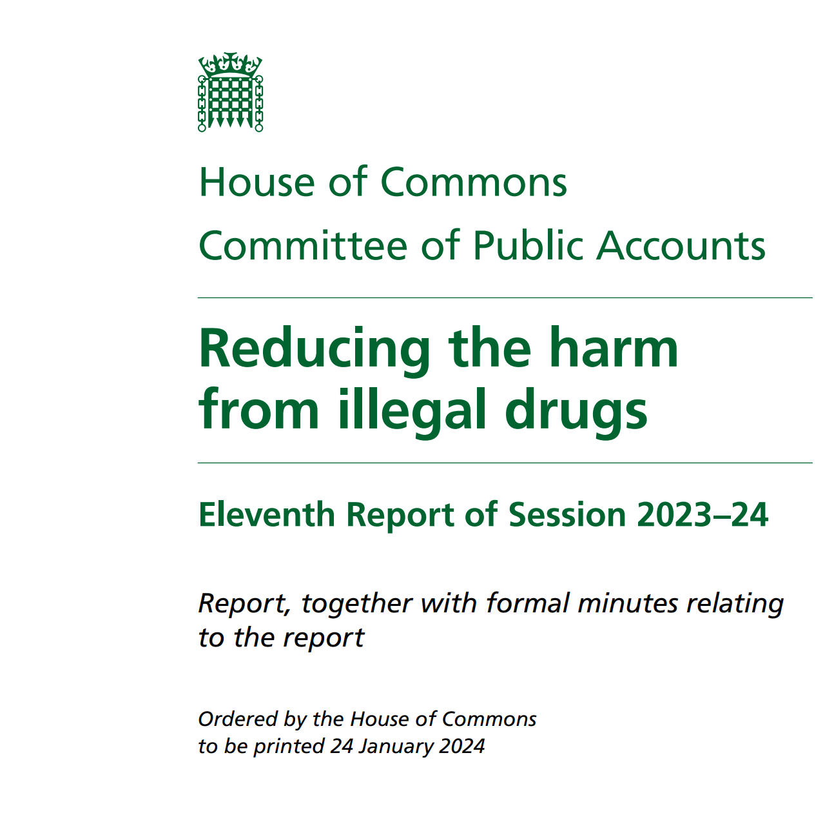
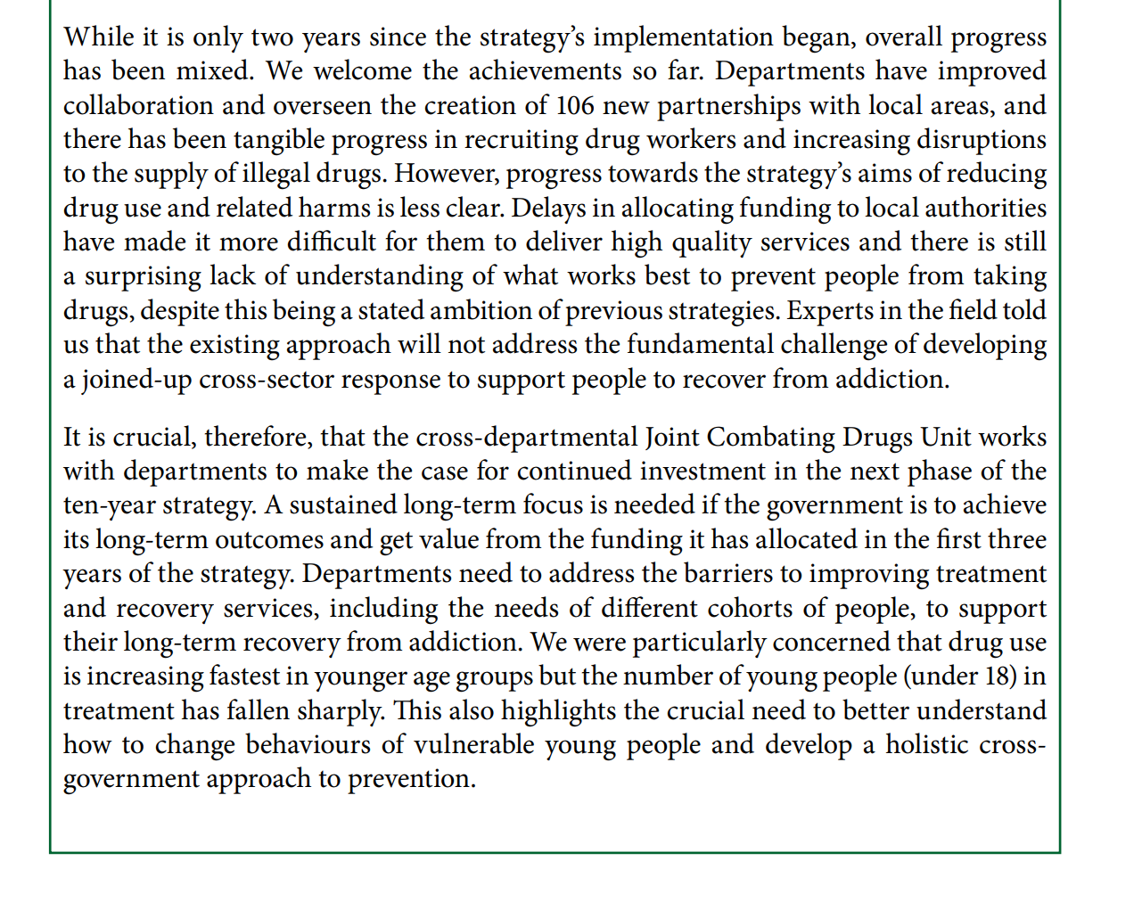
LASTING THOUGHT
House of Commons Committee of Public Accounts (2024, P.3)
Notes:
How age, ethnicity, gender, and social class interact to shape drug-related harm
Importance of an intersectional approach in research and policy
Discussion of holistic intervention strategies

Slide 38

Further reading……

Slide 39


Further watching……

Slide 40


