Slide 1

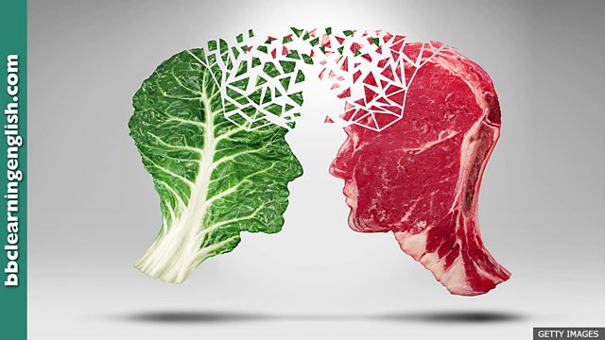
Veganism vs Meat: An Investigation into sustainable agriculture and global depletion for food.
By Carys fuller
Image 1

Slide 2
Literature review
Theories
My literature review will be included in each chapter of my dissertation.
But will include:
Oppenlander. R. A. (2012) Comfortably Unaware: what we choose to eat is killing us and our planet. New York: Beaufort books.
Watson. M (2019) Should we all be Vegan? London: Thames & Hudson Ltd.
Hellin. J & Higman. S (2003) Feeding the market: South American farmers, Trade and Globalization. London: ITDG Publishing.
Tait. A (2019) How the new veganism went global. In: New Statesman. [online article] available at: https://web-b-ebscohost-com.ezproxy.uwtsd.ac.uk/ehost/pdfviewer/pdfviewer?vid=1&sid=b8fba467-73d2-4d7a-a5ad-3533d48711ce%40pdc-v-sessmgr06 [accessed on 16/11/19]
Globalisation
ethics
Resource curse theory*
Neo-liberalism
Post modernism
Post-development*

Slide 3
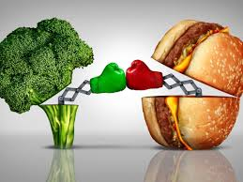
Veganism Vs Meat
Image 2
Exploring the three main categories of veganism: ‘ethical, ecological and personal health’ (Watson 2019, P:11)
‘ The diet of prosperity has turned out to be a killer. A high-fat, animal-based diet is the single most significant cause of death from heart disease.’ (Marcus 2001: P3)

Slide 4
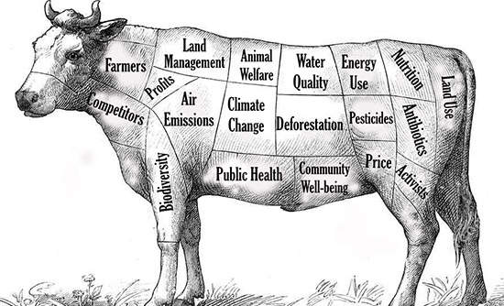
Global depletion of resources for food.
‘Our current food choices detrimentally affect climate change and global warming more so than do all the cars, planes trucks, buses and trains used worldwide.’ (Oppenlander 2012 P2)
‘we collectively raise, feed, water, kill and eat over 70 billion animals each year for food’ (Oppenlander 2012 P11)
‘The real blame for the depletion of our vital rainforests lies with the consumer who creates the demand for animal products.’ (Oppenlander 2012 P:26)
Image 3
https://www.undp.org/content/undp/en/home/sustainable-development-goals.html

Slide 5
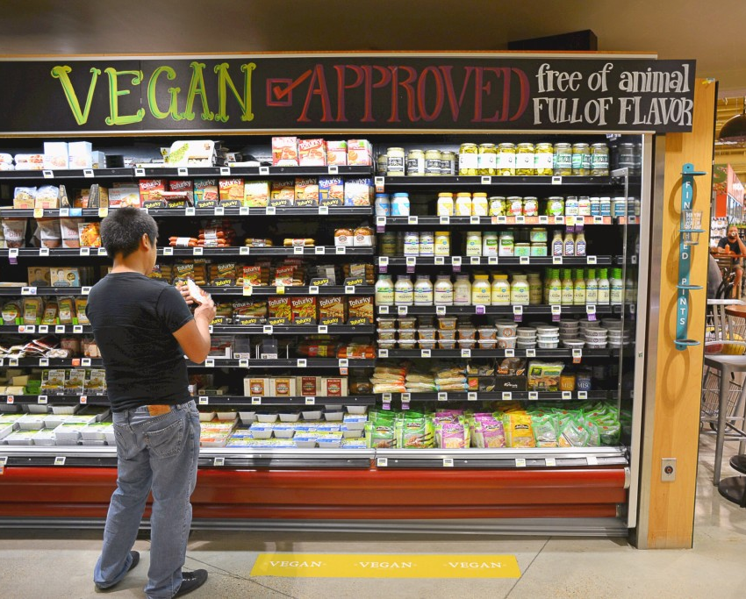
The Supermarket
‘Around the world, the labels ‘vegetarian’ or ‘vegan’ on food are more of a marketing tool than a regulatory one: manufactures are responsible for their own definitions and held to account by consumers, not third-party verification.’ (Watson 2019 P: 84)
Greggs vegan sausage roll.
The cauliflower stake controversy
Image 4

Slide 6
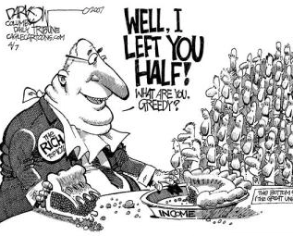
Inequality in food
‘The inability to access nutritious food due to poverty is the main reason people face food insecurity’ (Swinnen 2015)
‘But what do vegans do when it comes to receiving support from a foodbank, when sometimes, ethical food choices may not be an option when the only thing offered is a can of hotdogs?’ (VeganLife 2018)
Image 5

Slide 7
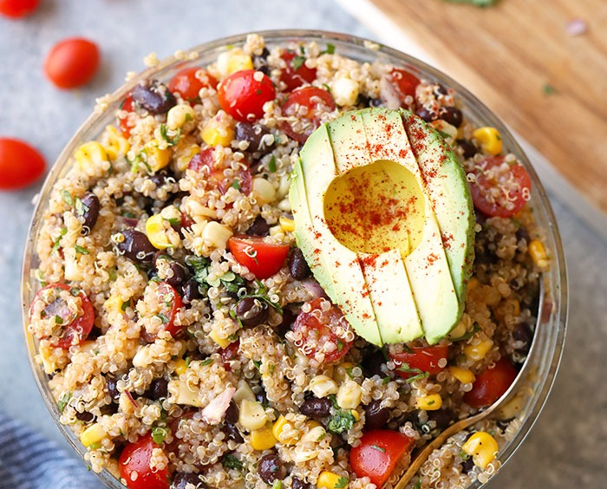
Quinoa
Quinoa case study.
Quinoa is often referred to as the ‘mother-grain’.
‘This section will look at the affects of the growing interest and the production of Quinoa.
Hellin. J & Higman. S (2003) Feeding the market: South American farmers, Trade and Globalization. London: ITDG Publishing.
Chapter 5: Quinoa and food security.
Image 6

Slide 8
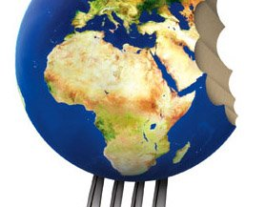
Globalisation of veganism and its impact on farmers
Can veganism realistically challenge the meat industry?
A look into the impact of veganism on farmers.
What policies are in place to protect farmers/ protect the environment.
Image 7

Slide 9
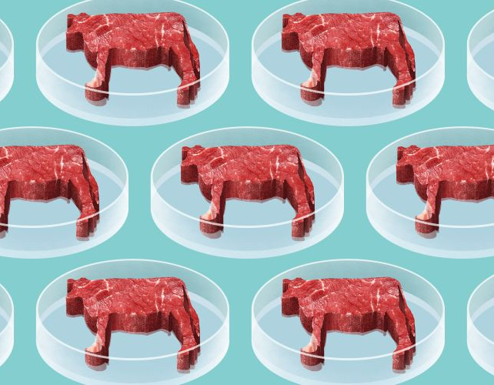
The future of meat?
Is lab grown cultured meat the future?
Symbolism of meat to people.
Also wan to analysis whether veganism is a realistic future.
What does the future hold for unsustainable agriculture?
Policies and politics.
Image 8

Slide 10
Reference List
Hellin. J & Higman. S (2003) Feeding the market: South American farmers, Trade and Globalization. London: ITDG Publishing.
Marcus. E (2001) Vegan: the new ethics of eating. (revised ed.) New York: McBooks Press, Inc.
Oppenlander. R. A. (2012) Comfortably Unaware: what we choose to eat is killing us and our planet. New York: Beaufort books.
Swinnen. J (2015) Inequality, not unavailability, is the main driver of food insecurity. [online article] available at: https://horizon-magazine.eu/article/inequality-not-unavailability-main-driver-food-insecurity-prof-johan-swinnen.html [accessed on 01/12/19]
Tait. A (2019) How the new veganism went global. In: New Statesman. [online article] available at: https://web-b-ebscohost-com.ezproxy.uwtsd.ac.uk/ehost/pdfviewer/pdfviewer?vid=1&sid=b8fba467-73d2-4d7a-a5ad-3533d48711ce%40pdc-v-sessmgr06 [accessed on 16/11/19]
UN (2019) Sustainable development Goals. [online webpage] Available at: https://www.undp.org/content/undp/en/home/sustainable-development-goals.html [accessed on 01/12/19]
Vegan life (2018) Vegan food banks. [online article] available at: https://www.veganlifemag.com/vegan-food-banks/ [accessed on 15/11/19]
Watson. M (2019) Should we all be Vegan? London: Thames & Hudson Ltd.

Slide 11
http://ichef.bbci.co.uk/images/ic/640x360/p06zssvd.jpg (image 1)
https://fitfoodiefinds.com/wp-content/uploads/2018/06/southwest-quinoa-salad.jpg (image 6)
http://www.kfm.co.za/articles/2019/09/19/listen-the-flash-drive-i-m-so-hungry-i-could-eat-a-bagel (image 2)
https://insiderlouisville.com/wp-content/uploads/2012/08/000GlobalFood2.jpg (image 7)
https://www.greenbiz.com/sites/default/files/styles/gbz_article_primary_breakpoints_kalapicture_screen-md_1x/public/images/articles/featured/cow3.jpg?itok=WQ7Rd9h0&timestamp=1389576484 (image 3)
https://i.kinja-img.com/gawker-media/image/upload/s--mtjXUK0o--/c_scale,fl_progressive,q_80,w_800/vx42nun7txysxnr1wqoh.jpg (image 8)
https://www.addresschic.com/blog/wp-content/uploads/2018/10/Vegan-food-demand-growing-in-UK-Vegan-Waitrose-Vegan-supermarket.jpg (image 4)
https://larspsyll.wordpress.com/2014/06/03/robert-lucas-on-the-unimportance-of-inequality/ (image 5)

