Slide 1
Student name: Joyce Kumi
Student ID: 2515780
Lecturer Name: Annamarie Dufficy
Module Code: LCLM 4004
Module Name: Problem Solving and Decision-Making
Component 1: Green Haven Florists

Slide 2
Good morning/afternoon. My name is Joyce Kumi
In my presentation I will:
  Green Haven Florists is a floral retailer offering fresh flowers, arrangements, and event floristry. They face a mix of operational, strategic, and market‑driven challenges.
  Application of the 5W2H model
  A critique and application of the PESTEL framework.
  A critique and application of the Cause-and-Effect model.
  A summary of the key findings.

Slide 3
Green Haven Florists
It is a small independent Florist based in Norwich and it was founded in 2016.
It is a personalised service
Eco – Friendly practices
Strong community focus

Slide 4
Nature and Scope of the Problem
30% decline in in-store sales
Reduced high street footfall
Online sales not compensating
Rising supplier and sustainability costs
Increased competition
Internal problems: Weak online performance, limited digital capability
External problems: Declining footfall, rising costs, increased competition
Mixed‑influence problems: Decline in in‑store sales
Control levels range from high (online sales performance) to very low (footfall and supplier costs)
Overall scope: These problems collectively affect revenue, competitiveness, and the business’s ability to adapt to market changes.

Slide 5
5W2H Model
Identify the Root Problem
What? | Where? | When? | Who? | Why? | How? | How much?
What effect is it having? | Where is the problem occurring? | When was the problem first noticed? | Who is impacted by the problem? | Why is the problem happening? | How serious is the problem? | How much money is being lost?
Decline in in-store lanes | Physical store in Norwich | Past 12 months | Liam and Priya, staff, loyal customers | Shift to online shopping, rising costs, competition | Reduced Footfall, Outdated website, weak digital marketing | 30% Sales decline

Slide 6
P-[ESTEL Analysis
Political Factors | Economic Factors | Social Factors | Technological Factors | Legal Factors | Environmental Factors
Import regulations affecting flower supply Economic Inflation increasing flower and operating costs | Social Growing demand for subscriptions Preference for convenience and online shopping | Shift towards convenience led shopping | Preference for online ordering and home delivery. | Legal Employment and supplier regulations | Environmental High cost of sustainable materials Pressure to maintain eco – friendly reputation

Slide 7
What is the cause and affect model
The Cause and‑Effect Model often called the Fishbone diagram, is a visual problem‑solving tool used to identify and organise the potential root causes of a specific issue by grouping them into categories such as People, Methods, Machines, Materials, Environment, and Measurement. It is widely used across industries including manufacturing, services, healthcare, and retail because it supports structured brainstorming, encourages teams to explore all possible contributing factors, and helps distinguish underlying causes from surface‑level symptoms. The model is typically applied by defining a problem, mapping out major cause categories, brainstorming contributing factors, and analysing the diagram to pinpoint the most likely root causes for further investigation. Its benefits include simplicity, clarity, adaptability, and its ability to promote collaborative analysis and continuous improvement. However, it is also criticised for relying heavily on subjective judgement, lacking prioritisation or quantification of causes, and sometimes oversimplifying complex or multi‑layered problems. Despite these limitations, it remains a valuable tool for root‑cause analysis and quality improvement.

Slide 8
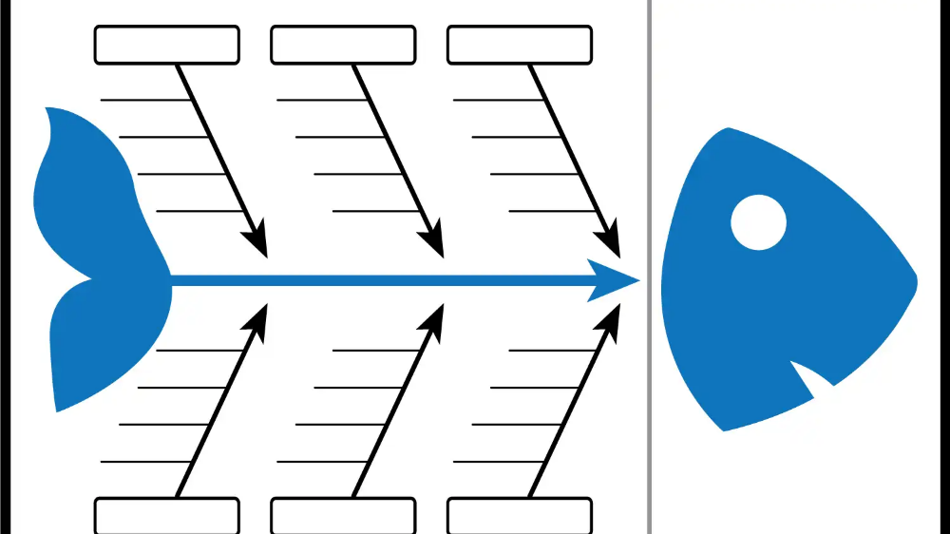
Methods
Machines
People
No structured process for evaluating supplier performance
Delivery vehicles not temperature‑controlled
Limited digital marketing skills
No standardised ordering schedule
POS system frequently crashes or lags
Lack of communication
Inconsistent pricing strategy across products
Limited workspace causing inefficient workflow
poor leadership communication from management
Poor planning leading to rush orders
Old tools (cutters, hydration buckets) slowing down production
Staff shortages during busy periods
Poor supplier reliability
No system for monitoring delivery performance
reduced high street activity
No benchmarking against competitors
Seasonal festivals causing unpredictable spikes in demand
Over - ordering
Inconsistent flower quality batches
Lack of financial KPIs
Competitors offering aggressive discounts
Packaging materials frequently out of stock
Inaccurate manual stock counts
Weather extremes reducing customer footfall
Materials
Measurements
Environment

Slide 9
Key Finding 1: Operational Inefficiencies
Weak inventory control and poor stock rotation
Outdated equipment contributing to waste
Inefficient workflows reducing productivity
Key Finding 2: External Pressures
Rising costs and supply chain instability
Shifting customer expectations toward sustainability and convenience
Competitive pressure from supermarkets and online florists
Key Finding 3: Digital and Marketing Weaknesses
Outdated website and limited online ordering
Low digital visibility and minimal marketing activity
Reduced ability to attract and retain customers online
Key Finding 4: Lack of Strategic Direction
No clear long‑term growth plan
Poor internal communication and coordination
Reactive decision‑making instead of proactive planning

Slide 10
Reference List
Reference List
Ishikawa, K. (1985) What Is Total Quality Control? The Japanese Way. Englewood Cliffs: Prentice-Hall.
Johnson, G., Whittington, R. and Scholes, K. (2017) Exploring Strategy. 11th ed. Harlow: Pearson.
Slack, N., Brandon‑Jones, A. and Burgess, N. (2022) Operations Management. 10th ed. Harlow: Pearson.
Office for National Statistics (2023) Retail Sales, Great Britain. Available at: https://www.ons.gov.uk
British Retail Consortium (2023) Retail Trends Report. Available at: https://brc.org.uk
Mintel (2023) UK Florist and Flower Retailing Market Report.
IBISWorld (2023) Florists in the UK – Market Research Report.

Slide 11
Thank you for listening

Slide 12


