Slide 1
The Olympic Games – Legacy?
Alison Connaughton
Week 4 – Tuesday

Slide 2
Legacy planning – IOC (2017)
The term legacy has different meanings for different people, languages and cultures, and since legacy was introduced into the Olympic Charter in 2003, several definitions have coexisted within the Olympic Movement.
The following definition of legacy is conceived as a tool for alignment within the Olympic Movement:
“Olympic legacy is the result of a vision. It encompasses all the tangible and intangible long-term benefits initiated or accelerated by the hosting of the Olympic Games/sport events for people, cities/territories and the Olympic Movement.”

Slide 3
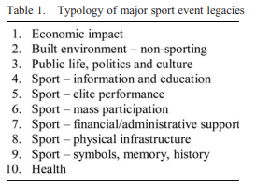
The legacy of an international sporting event can take many forms (Veal et al., 2012)

Slide 4
Inspiration for future athletes…(Veal et al., 2012)
Sebastian Coe in his speech to the IOC in July 2005 in support of the London bid for the 2012 Summer Games. He spoke of his experience as a 12-year-old watching, on a black and white television set in a school hall, British athletes John and Shelia Sherwood performing at the 1968 Mexico City Olympics and declared:
‘That day a window to a new world opened for me. By the time I was back in my classroom, I knew what I wanted to be and what I wanted to do’.
The following week I stood in line for hours at my local track to catch a glimpse of the medals the Sherwood's had brought home. It didn’t stop there.
Two days later, I joined their club. Two years later, Sheila gave me my first pair of running spikes. Thirty-five years on, I stand before you with these memories still fresh, still inspired by this great movement’.

Slide 5
Physical Activity in the General Population – Impact of Olympics?

Slide 6
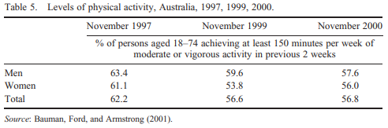
Levels of physical activity in general population – post Sydney 2000 Olympics
The table shows a significant decline in male participation rates between 1999 and 2000 and a significant increase in female participation
When added together, the small overall increase is not statistically significant, so the male increase cancelled out the female increase.
However, given the substantial earlier fall in the total participation rate of 5.6% between 1997 and 1999, it is just possible that the Olympic Games halted a longer-term decline in participation.
The 2000 survey also asked respondents whether they had changed their ‘own participation in physical activity or sport in response to the Olympics’: only 4% of respondents said that they had done so

Slide 7
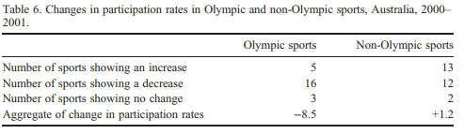
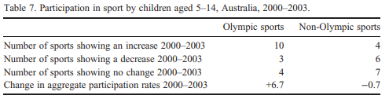
Further evidence…

Slide 8
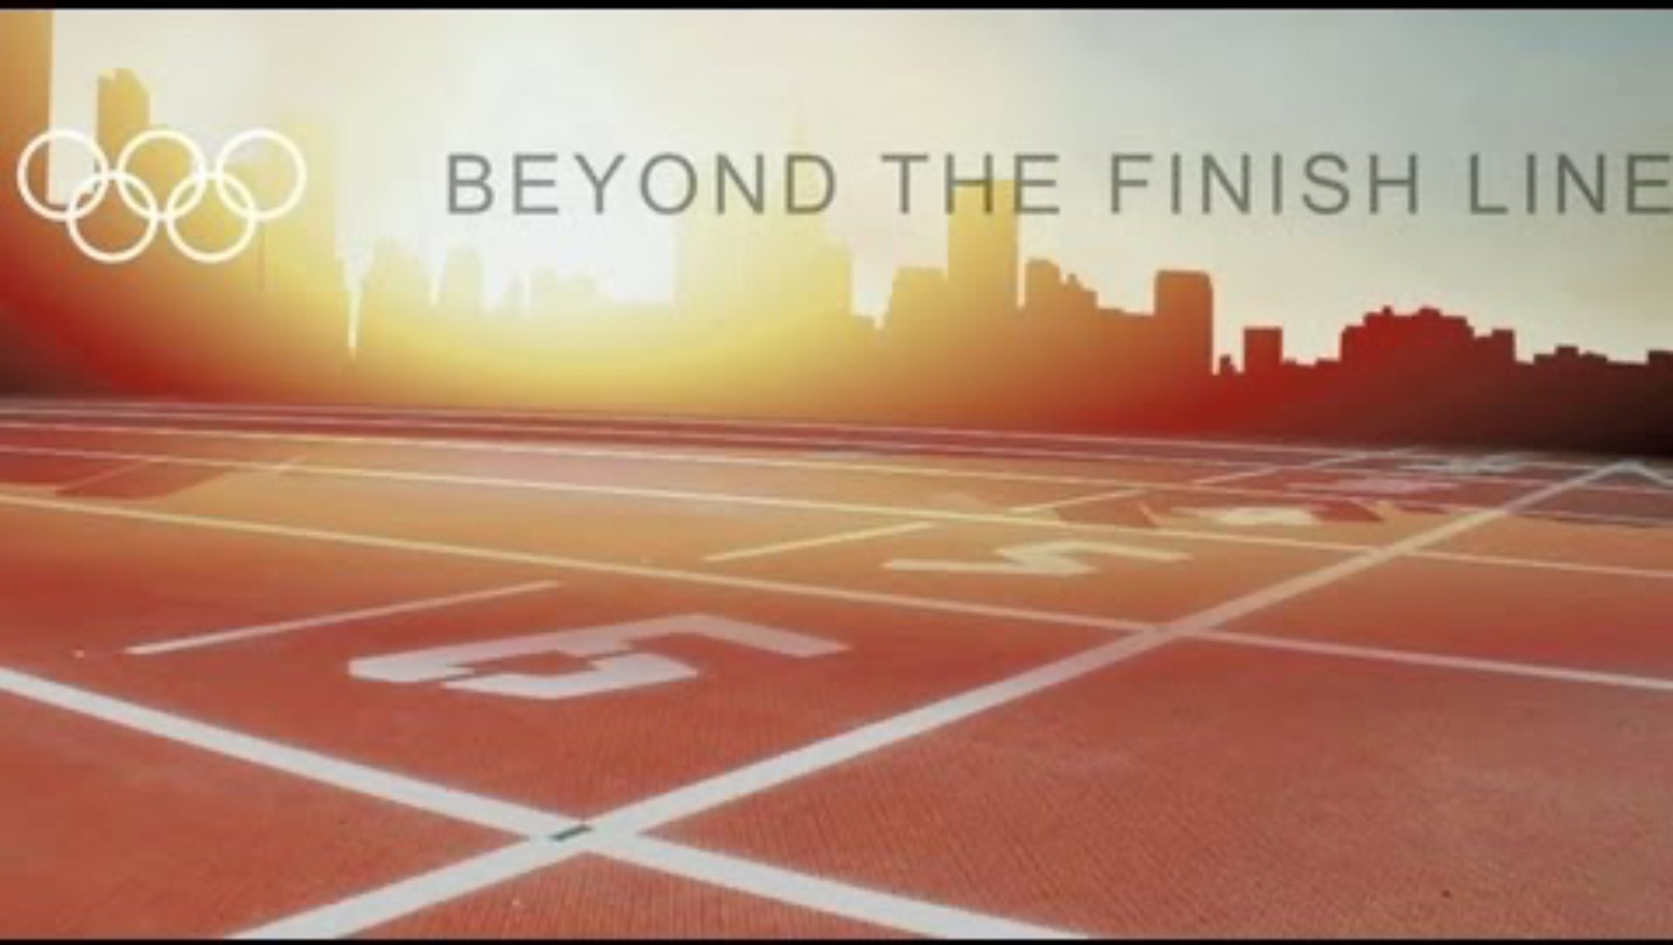
30 mins in total.
1-9 mins https://www.youtube.com/watch?v=d4b1Ny2pKYA

Slide 9
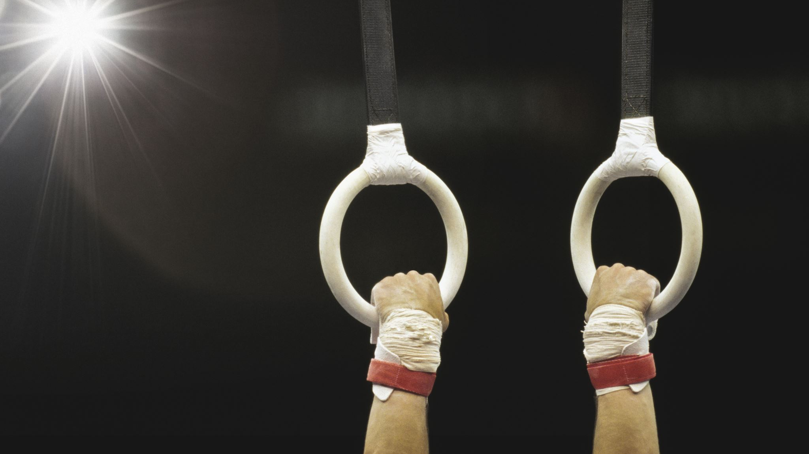
The London Olympics - 2012

Slide 10
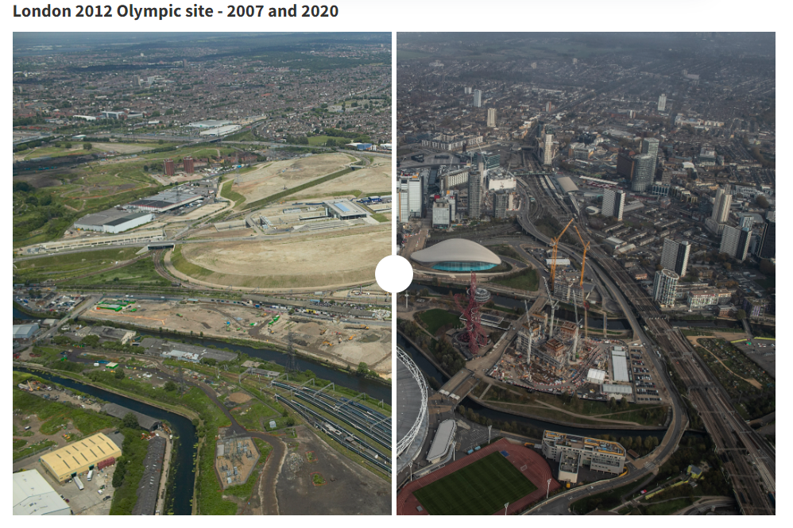
In what is now the Queen Elizabeth Olympic Park, two million tonnes of soil were cleaned of the pollution left behind by 200 years of coal barges, railway works and electric pylons dominating the industrial landscape.
Before the Olympics, “it was a place where nobody would want to go at night,” said Peter Tudor, head of venues at the London Legacy Development Corporation. “Now: six million visits a year and beautiful green parkland that was a lifesaver during the pandemic.”

Slide 11
London 2012 – Legacy stories
https://youtu.be/Hfzq_C4OJ0Q
Apprenticeships
Volunteering
Sports participation
Education programme – Get Set programme

Slide 12
Volunteering behaviour post games
London – 70,000 Games Makers volunteers
Reported that over 35,000 were continuing to volunteer after the games
Empirical work has identified a range of common and key benefits that individuals perceive from volunteering at different sporting events, including skill enrichment, social enrichment, and positive life experience (Doherty, 2009).
Nichols and Ralston (2012) reported that volunteers continued to perceive the benefits from volunteering even 7 years after their experience at the 2002 Manchester Commonwealth Games.
Hoff and Leopkey’s (2021) study, which they conducted 22 years after the 1996 Atlanta Olympic Games using archival materials andinterviews, further supported the idea that the perceived benefits could be durable.

Slide 13
Wang, Y. (2022) - Leveraging the Olympic volunteer legacy: From perceived benefits to sustained volunteer behavior.
Social Behavior and Personality: An international journal, 50(8)
Volunteering at other Games…
Participants were 353 volunteers who had been involved with the Beijing 2008, Singapore 2010, or Nanjing 2014 Games.
The results of an online survey reveal that perceived benefits directly influenced sustained volunteering.
A critical relationship between the development of volunteers’ role identity and volunteering afterwards was confirmed.
Perceived benefits were positively associated with role identity and, thus, indirectly promoted sustained volunteering behaviour.
Perceived benefits arising from Olympic volunteering are the key to volunteer identity and sustained volunteering.

Slide 14
London 2012
https://www.skysports.com/olympics/news/12040/12659301/2012-olympics-organisers-athletes-speak-about-a-legacy-of-inspiration-top-venues-regrets-and-missed-opportunities
Multiple Olympic champions praised the impact of the facilities in London, with two volunteers saying the home Games inspired them to become elite medal-winning athletes.
Lord Coe and Sir Keith Mills who led the successful bid spoke about their regrets over school sport and levels of grassroots participation.
"I really do think there was a missed opportunity there. I think there was a lot of focus on delivering a great Olympic Games and not enough focus on what we were going to do in terms of turning that into a sporting legacy."
"We hoped that would be raised as a result of the Olympic and Paralympic Games. It hasn't. There have been successes in among them, but overall sport participation has been flat or slightly declining."

Slide 15
London 2012
Positives
Negatives
Socially
Athletes village created the East Village housing thousands of people in ‘affordable housing’.
Assisted the development of new schools in the area – previously shortage of places.
Aquatic centre – facilities for the community as well as elite athletes.
Unemployment in London dropped during the games.
Socially
Affordable housing not ‘affordable’ to many.
Properties were demolished to make way for new housing (hundreds of housing association flats).
Unemployment increased in the poorer areas during the Olympics.

Slide 16
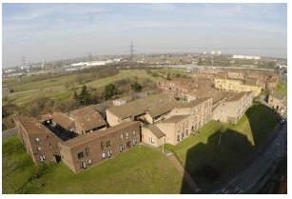
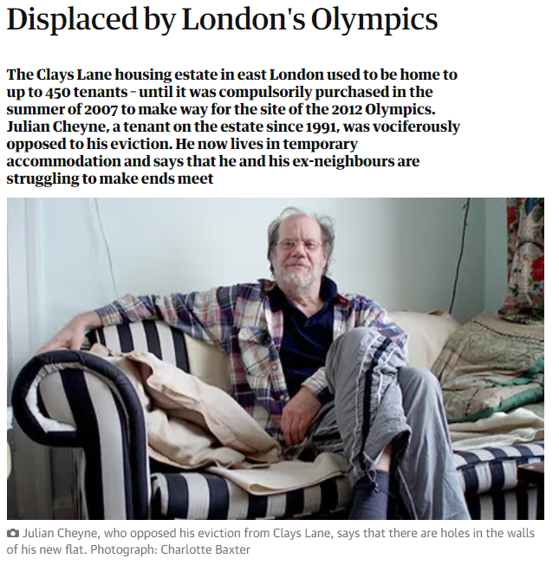
‘We didn't have much media attention on our relocation. I don't know why. My feeling is that people were so wrapped up in the Olympics that they felt hostile towards the people who were in the way’.

Slide 17
Five years after London Olympics, Games' legacy is off-track for locals
Reuters article (2017)
A medical researcher, working on treatments for diabetes and heart disease, was among a set of locals including nurses and teachers, chosen after the games for reduced-cost housing schemes to help “key workers” afford London’s high rents.
Moved to live in the apartments built for the games’ sporting stars.
However, an Olympic legacy of massive inflation in local rents later forced them out of their home city altogether.
O’Callaghan-Evans said the two-bed apartment in the athletes’ village, amid the landscaped hills of the Olympic Park, was a dream - but one that would be short-lived, as the mushrooming costs of the so-called affordable homes became apparent.
After a year, she was forced to give up her flat after her rents were hiked by nearly a quarter - from 15,000 pounds a year to more than 18,500 pounds.
“It wasn’t what they told us it would be - it was a lie,” said O’Callaghan-Evans, 53, who now lives more than a 100 miles from London, near the town of Yeovil in rural Somerset.

Slide 18
London 2012
Positives
Negatives
Economically
New tube station – Stratford
£9bn of investment to an area of London that wouldn’t otherwise have had this.
All buildings now sold off.
Environmentally
Ground of the Olympic Park are now public parkland.
Especially important during Covid – access to outdoor green space.
Urban wasteland cleaned up – previously contaminated.
  Largely built on brownfield sites.
Economically
The enormous cost!
Existing businesses had to move from the site.
Environmentally
Wildlife had to be re-located
  Newts, toads, fish
Materials for the games came from overseas – carbon footprint.

Slide 19
Task: What were the issues surrounding the run up to / during the Rio 2016 Olympic Games?

Slide 20
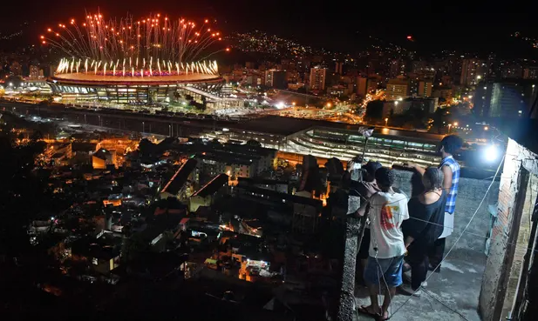
Rio de Janeiro - 2016
Positive…Legacy - Renovated port and improved transport links.
Problems during the games:
Games dogged with issues…
Poverty hidden from the cameras
Corruption - Rio state’s former governor Sérgio Cabral jailed for leading a gang that pocked R$217m in bribes on public works
Zica virus
Transport . Infrastructure issues
Athlete village uninhabitable – blocked toilets / exposed wires
Water safety – raw sewage at venues (e.g. sailing)
  https://www.youtube.com/watch?v=NCRdYNyJJTw
Air pollution
British athletes told not to complain – in case it was seen as British arrogance after success of London 2012!

Slide 21
Olympic venues post event…

Slide 22
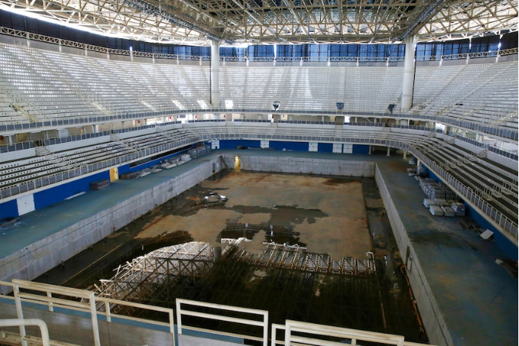
Aquatic centre – Rio
Unused and dilapidated
Year after the games.

Slide 23
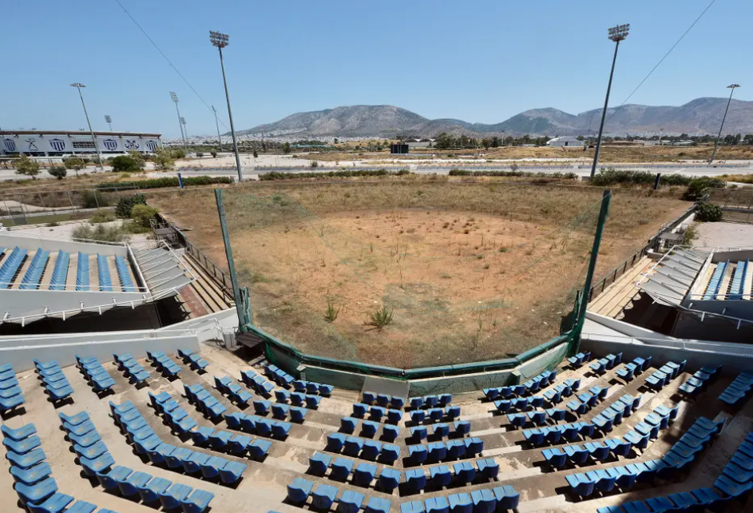
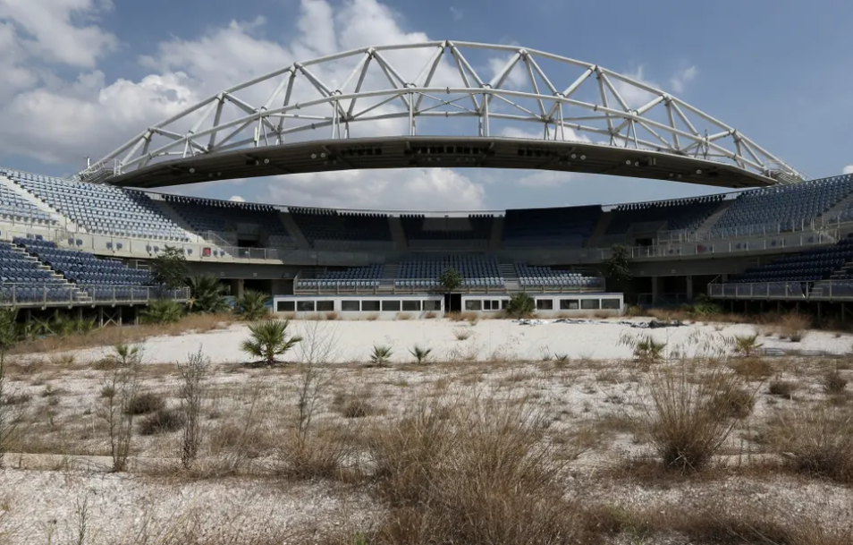
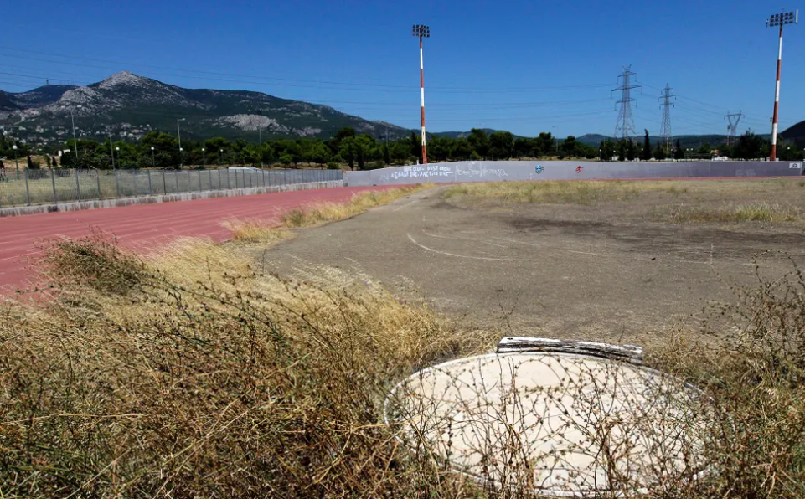
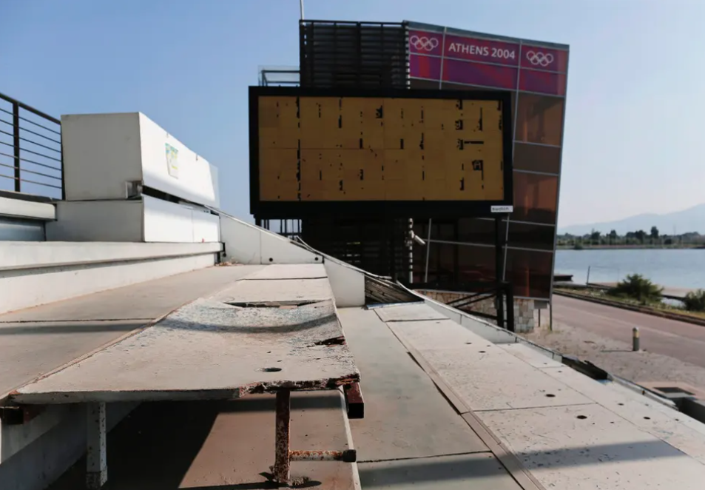
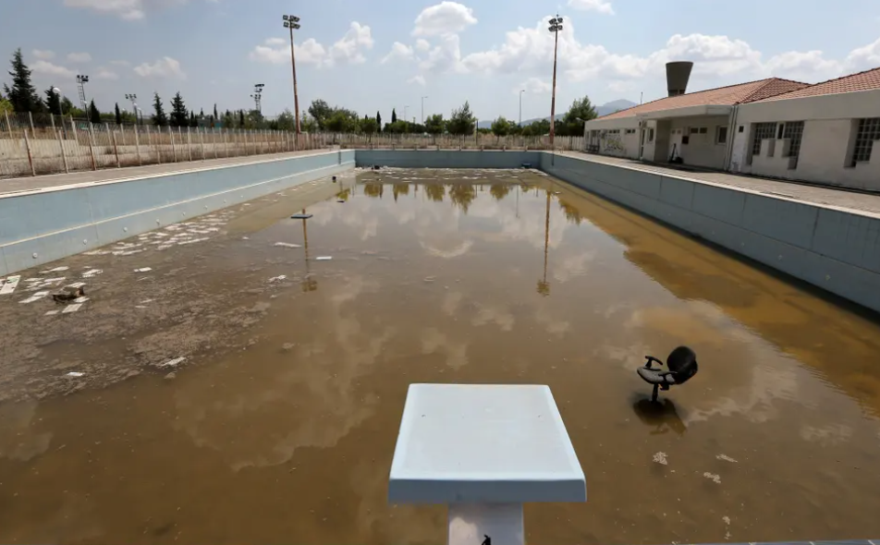
Athens – 2004
Sites 10 years on…

Slide 24
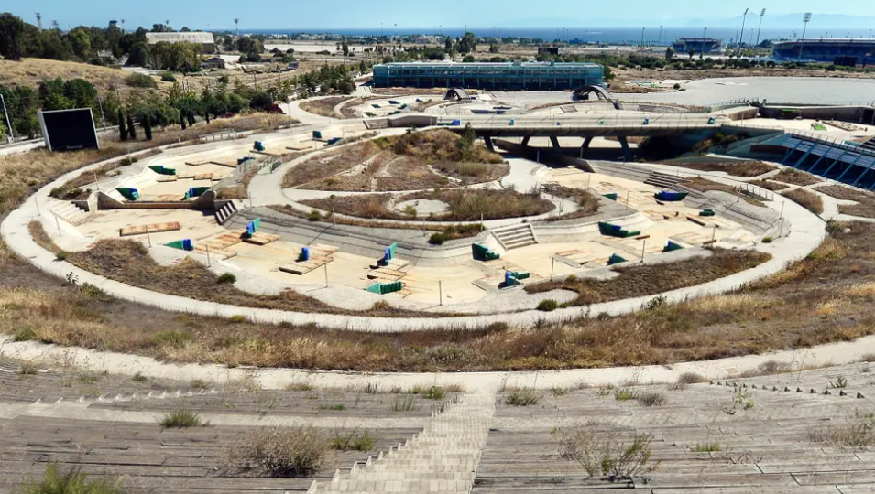
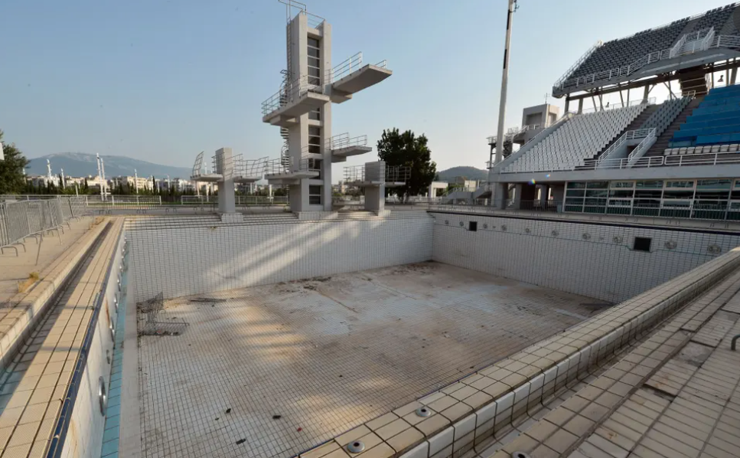
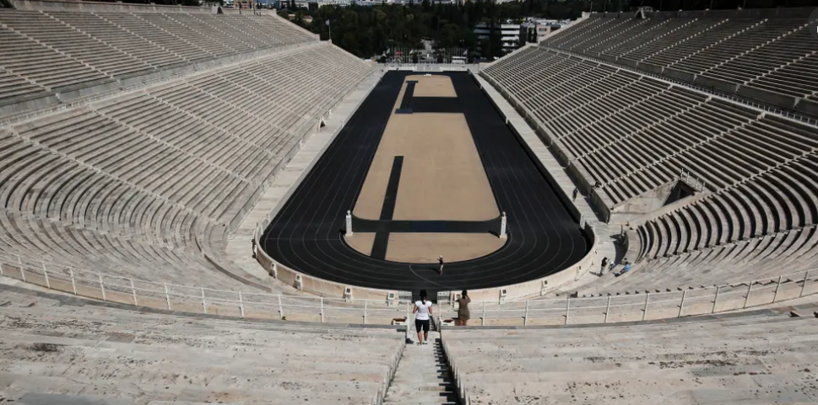
One venue that has done well post-Games is the Panathenaic stadium in Athens.
The old Olympic Stadium of Athens, a marble reconstruction of the city’s ancient stadium built for the first modern Olympics held in Athens, is open to ticket-paying visitors who can also visit a small Olympic museum on the site.
Morning ‘jogging’ 7:30-8:30
Entry – 10Euro

Slide 25
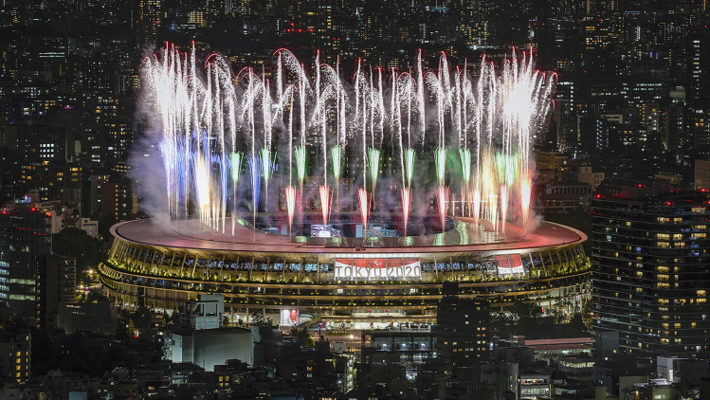
Tokyo 2020 Legacy:
Wang, N., & Jiang, Y. (2021). Legacy of the Tokyo 2020 Summer Olympic Games. Innovation (Cambridge (Mass.)), 2(4), 100178. https://doi.org/10.1016/j.xinn.2021.100178

Slide 26
Tokyo 2020 Legacy
Tokyo 2020 Legacy
Key points:
Pandemic management and adaptability
Technological and environmental innovations (e.g. hydrogen energy, robotics)
Digital broadcasting advancements due to empty stadiums
Resources:
Legacy of the Tokyo 2020 Summer Olympic Games
Tokyo 2020 Legacy Report https://www.2020games.metro.tokyo.lg.jp/docs/Tokyo2020LegacyReport_EN.pdf
Points to consider:
1. In what ways did Tokyo 2020 redefine large-scale event management during global crises?
2. How might Tokyo’s technological innovations shape future Olympics or global events?
3. Did Tokyo’s lack of physical spectators weaken or strengthen its legacy impact?

Slide 27
1. In what ways did Tokyo 2020 redefine large-scale event management during global crises?
Tokyo 2020 became a global benchmark for organizing mega-events amid a public health crisis.
The Games introduced rigorous infection control protocols including a “bubble” system, daily testing regimes, and restricted mobility for athletes and staff, which effectively limited COVID-19 transmission despite the global Delta variant surge.
Organizers combined epidemiological models with logistical planning, creating risk assessment frameworks that have since guided subsequent events such as Beijing 2022 and large-scale summits.
Yao, Y., Wang, P., & Zhang, H. (2023). The Impact of Preventive Strategies Adopted during Large Events on the COVID-19 Pandemic: A Case Study of the Tokyo Olympics to Provide Guidance for Future Large Events. International journal of environmental research and public health, 20(3), 2408. https://doi.org/10.3390/ijerph20032408

Slide 28
2. How might Tokyo’s technological innovations shape future Olympics or global events?
Tokyo 2020 was branded as the most technologically advanced Games in Olympic history.
Key innovations included 5G broadcasting, AI-driven robotics, and sustainable hydrogen energy systems.
Robots developed by Toyota such as Field Support Robots (FSRs) and Human Support Robots (HSRs) demonstrated how automation could reduce staff workload and human contact during pandemics while improving operational efficiency.​
The Games also introduced virtual fan engagement technologies, such as “Fan Walls” and “Virtual Cheers,” to replace in-person spectatorship, logging over 250 million digital interactions globally.
These achievements positioned Tokyo as a model for hybrid event formats that blend physical and digital experiences an approach expected to influence Los Angeles 2028 where AI, VR, and sustainability integration will be central to planning.
https://www.japan.go.jp/kizuna/2021/10/tech_innovations_at_tokyo_2020.html

Slide 29
3. Did Tokyo’s lack of physical spectators weaken or strengthen its legacy impact?
Despite initial fears, the absence of spectators did not diminish the symbolic or technological legacy of Tokyo 2020.
While athletes like Simone Biles and Adam Peaty noted emotional challenges due to empty stands , the Games achieved record-breaking digital engagement, marking a cultural shift in how Olympic audiences connect remotely.​
From a legacy standpoint, this transformation broadened accessibility, allowing millions worldwide to participate virtually thus strengthening the intangible legacy of inclusivity and global unity amid isolation.
However, Japan’s tourism and local economic gains were limited, leading some researchers to describe the outcome as a “digital rather than economic legacy”.
Overall, Tokyo’s spectator-free model redefined participation in global events and demonstrated resilience through innovation rather than attendance.
https://www.mmu.ac.uk/news-and-events/news/story/how-has-absence-crowds-affected-athletes-tokyo-2020-0

Slide 30
Other Olympic games…
If you have not already done so, pick an Olympic games of your choice and examine the legacy of this…

Slide 31
Finally…
Moving forward to 2028
“If you were advising Los Angeles 2028, what lessons would you take from Tokyo and Paris?”
Think about:
Resilience to challenges…
Use of technology
Community impact
Are there any issues you can foresee with the location for this Olympic games?

Slide 32
Reading
Scheu et al. (2021) The Legacy of the Olympic Games: A Review
On Moodle (plus other articles)

