Slide 1

Evaluating the Interfaces I
Prepared by:
Dr. Fahad Ahmed

Slide 2
Topics of Discussion
  Personas
    Why needed?
    How to make them?
  Interface Evaluation
    What is Interface Evaluation?
    Heuristic Evaluation
  How to use the data collected?
    Quantitative Analysis
    Qualitative Analysis

Slide 3
Recap: What We Know So Far
You now have two complementary toolkits — this week they combine to evaluate a real interface.
🗣 Asking People (Lecture 4)
👁 Watching People (Lecture 5)
Questionnaires & SUS
Think-Aloud Protocol
ACCB6017 Usability Engineering
Structured scales that quantify user satisfaction
Participants narrate reasoning — makes invisible thought visible
Interviews
Direct Observation
One-to-one exploration of goals, frustrations, and mental models
Naturalistic, controlled, or structured watching in context
Focus Groups
Analytics & Log Data
Group discussion surfaces shared attitudes and priorities
Behavioural patterns at scale: completion, error, drop-off rates
💡 Evaluation applies both toolkits to a specific target — an interface — to answer: Does it work for the people who use it?
[1] Preece, J., Rogers, Y. and Sharp, H. (2015). Interaction Design: Beyond Human-Computer Interaction. 4th edn. Chichester: Wiley. [2] Sharp, H., Preece, J. and Rogers, Y. (2019). Interaction Design. 5th edn. Chichester: Wiley.
15/07/2026
3

Slide 4
What is a Persona?
A research-based fictional character representing a real user type — not a stereotype, but a synthesis of observed behaviour [1, 2].
"Personas are user archetypes you can use to help guide decisions about product features, navigation, interactions, and even visual design."
— Cooper et al. (2014) [1]
✓ What a persona IS
✗ What a persona is NOT
ACCB6017 Usability Engineering
Data-driven
Not a stereotype
📊
🚫
Built from real user research — interviews, observations, surveys. Every detail should be traceable to a finding, not invented.
"Tech-savvy millennial" or "elderly technophobe" — these are assumptions, not research. Personas challenge stereotypes, they don't encode them.
👤
Goal-oriented
🚫
Not a made-up character
Defined by what the user is trying to achieve, not just who they are. Goals drive design decisions more than demographics.
Inventing a persona without research gives the team a fictional user who validates whatever you already wanted to build.
🔁
Repeatable
🚫
Not a marketing segment
A shared reference across the whole team — designer, developer, and stakeholder all mean the same user when they say 'Brenda'.
Market segments describe buying behaviour. Personas describe usage behaviour — what people do, not what they buy.
📍
Contextual
🚫
Not permanent
Includes the environment, constraints, and tools the user actually works with — not an idealised context.
Personas become outdated. If your user research changes, your personas must change too.
[1] Cooper, A., Reimann, R., Cronin, D. and Noessel, C. (2014). About Face: The Essentials of Interaction Design. 4th edn. Indianapolis: Wiley.
[2] Pruitt, J. and Adlin, T. (2006). The Persona Lifecycle. San Francisco: Morgan Kaufmann.
15/07/2026
2

Slide 5
How to Build a Persona
Six steps from raw research data to a usable, team-facing persona document [1, 3].
1
Conduct user research
2
Identify behavioural variables
Interviews, observations, surveys — minimum 5 participants per major user group. Collect goals, frustrations, workflows, and mental models. Don't start a persona without real data.
Look for axes of difference: experience level, frequency of use, primary goal, attitude to technology, context of use. These become the dimensions that separate your user types.
ACCB6017 Usability Engineering
3
Cluster users into types
4
Build the skeleton
Group participants who share similar behaviours along your variables. Aim for 2–4 distinct clusters — one per major user type. Avoid forcing everyone into one cluster.
Give the cluster a name, photo, age, role, and a one-line goal. Add primary and secondary goals. Include a direct quote from a real participant that captures their mindset.
5
Add context and detail
6
Validate and circulate
What tools do they use? What environment do they work in? What are their pain points with current systems? What would success look like for them? Every detail should earn its place.
Check the persona against your raw data — does it feel true? Share with the team and check for recognition. Personas that surprise your participants are probably wrong.
[1] Cooper et al. (2014). About Face. 4th edn. Wiley.
[3] Goodwin, K. (2009). Designing for the Digital Age. Indianapolis: Wiley. (Ch. 6 — Creating Personas)
15/07/2026
3

Slide 6
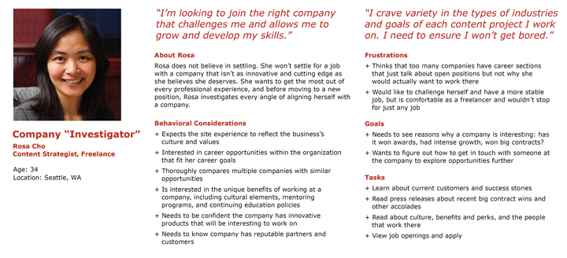
Worked Example — WardWatch Persona
Built from interview data collected with staff from a job site. Each detail maps to a real research finding [4].
ACCB6017 Usability Engineering
[4] https://www.nngroup.com/articles/persona/
15/07/2026
4

Slide 7
Worked Example — WardWatch Persona
Built from interview data collected with ward staff across two NHS sites. Each detail maps to a real research finding.
😤 Pain Points (from interview data)
👩‍⚕️
· "The search function makes me click three times to find a patient I've been looking after all week."
· Navigating between screens during a handover causes errors — she loses her place and has to start again.
ACCB6017 Usability Engineering
· Audit log exports take 40 seconds — long enough that she gives up and writes on paper instead.
👁 Observed Behaviours
Brenda Okafor
· Keeps a paper backup of the handover template — does not trust the system to save mid-entry.
Senior Ward Nurse · 14 years NHS experience · Age 38
· Uses keyboard shortcuts exclusively; never uses the mouse for navigation tasks under time pressure.
Tech comfort
Shift pattern
Primary device
Team size
· Teaches new staff the workarounds before she teaches them the system itself.
Medium
Rotating
Desktop
12 staff
"I don't need it to be pretty — I need it to work when I'm in the middle of a handover with five things happening at once."
💡 Design Implications for WardWatch
Speed over aesthetics:
Every interaction must be completable in ≤2 clicks. Remove decorative elements that increase cognitive load.
PRIMARY GOAL
Auto-save, always:
Any unsaved state that can be lost to a navigation error is a safety risk, not just a UX inconvenience.
Complete handovers accurately in under 5 minutes — zero missed tasks.
SECONDARY GOAL
Help junior staff find information without interrupting her.
15/07/2026
[1] Cooper et al. (2014). About Face. 4th edn. Wiley.
[3] Goodwin, K. (2009). Designing for the Digital Age. Wiley. (Ch. 6) Note: name and image are fictional composites; research data is illustrative.
4

Slide 8
Using Personas Effectively
A persona on a shelf is useless. These practices make them a living design tool [1, 2, 5].
✓ Practical Tips
✗ Common Mistakes to Avoid
🖼️
Print them and put them on the wall
🚫
The 'average user' persona
Personas kept only in a document get forgotten. Physical presence in your workspace keeps them in every conversation — especially during design reviews.
A persona built on mean values — average age, average experience, average goals — represents nobody. Cluster on behaviour, not averages.
🗣️
Use the persona's name in meetings
🚫
Too many personas
Don't say "the user". Say "Would Brenda be able to do this in a handover?" Naming forces specificity and stops abstract debates about hypothetical users.
More than 4–5 personas and teams stop using them. Each persona must represent a meaningfully different user type, or merge them.
🎯
One primary persona per design
🚫
Demographic-only personas
If you design for everyone you design for no one. Identify the one persona whose satisfaction is the primary success criterion. Secondary personas set constraints, not direction.
"Age 45, female, works in admin" tells designers nothing about what to build. Goals, frustrations, and behaviours are the actionable data — not the demographics.
📊
Return to the data when personas conflict
🚫
Skipping the quote
When two team members cite different personas to justify opposing decisions, go back to the research. The data resolves persona disputes — opinion does not.
A direct quote from a real participant anchors the persona in reality and stops the team projecting their own assumptions onto it.
🔄
Update after each research cycle
Run a new round of interviews every 6–12 months, or after a major product change. Personas that no longer match reality will lead you to design for users who no longer exist.
📍 Where personas fit in the Double Diamond
🔗
Link personas to user stories and tasks
DISCOVER
DEFINE
DEVELOP
DELIVER
"As Brenda, I need to complete a handover in under 5 minutes so that I do not make medication errors at shift change." Personas without tasks are just portraits.
Built from raw
research data
Used to frame
'How Might We' questions
Evaluate prototypes
against persona goals
Validate that the
shipped product serves them
15/07/2026
[1] Cooper et al. (2014). About Face. 4th edn. Wiley. [2] Pruitt, J. and Adlin, T. (2006). The Persona Lifecycle. Morgan Kaufmann.
[5] Blomquist, Å. and Arvola, M. (2002). Personas in action. Proc. NordiCHI. pp.197–200.
5

Slide 9
What is Interface Evaluation?
A systematic process for assessing whether an interface meets user needs [6, 7].
ISO 9241-11 (2018) defines usability as: effectiveness (can users complete tasks?), efficiency (at what cost?), and satisfaction (how pleasant is it?). Evaluation measures all three.
ACCB6017 Usability Engineering
WHEN do we evaluate?
WHAT do we evaluate?
HOW do we evaluate?
· Throughout the design lifecycle — not just at the end
· Task completion — can users reach their goal?
· Expert reviews (heuristic evaluation)
· Formative: during design to guide iterations
· Error frequency and severity
· User-based tests (think-aloud, observation)
· Summative: after deployment to measure performance
· Time on task — efficiency
· Questionnaires (SUS, custom surveys)
· Each Double Diamond phase calls for a different evaluation approach
· Learnability — can new users get started?
· Analytics (log data, session recordings)
· Subjective satisfaction — does it feel right?
· Often: multiple methods combined
[6] ISO 9241-11 (2018). Ergonomics of human-system interaction — Part 11: Usability: Definitions and concepts. Geneva: ISO.
[7] Dumas, J.S. and Redish, J.C. (1999). A Practical Guide to Usability Testing. Rev. edn. Exeter: Intellect Books.
15/07/2026
4

Slide 10
Heuristic Evaluation
Expert inspection against established usability principles — fast, cheap, and effective before user testing [8, 9].
What is it?
Nielsen's 10 Heuristics [5]
· 3–5 evaluators independently inspect the interface
H1
Visibility of system status
H6
Recognition rather than recall
ACCB6017 Usability Engineering
· Each evaluator checks the interface against Nielsen's 10 heuristics [5]
H2
Match between system and real world
H7
Flexibility and efficiency of use
· Problems are rated by severity (0 = not a problem → 4 = usability catastrophe)
H3
User control and freedom
H8
Aesthetic and minimalist design
· Evaluators consolidate findings after individual reviews
· No users required — makes it ideal for early rapid cycles
H4
Consistency and standards
H9
Help users recognise, diagnose, and recover from errors
· Finds ~75% of usability problems at low cost [6]
H5
Error prevention
H10
Help and documentation
[8] Nielsen, J. (1994). Heuristic evaluation. In: Nielsen, J. and Mack, R.L. (eds.) Usability Inspection Methods. New York: Wiley.
[9] Nielsen, J. (1994). Usability Engineering. San Francisco: Morgan Kaufmann.
15/07/2026
5

Slide 11
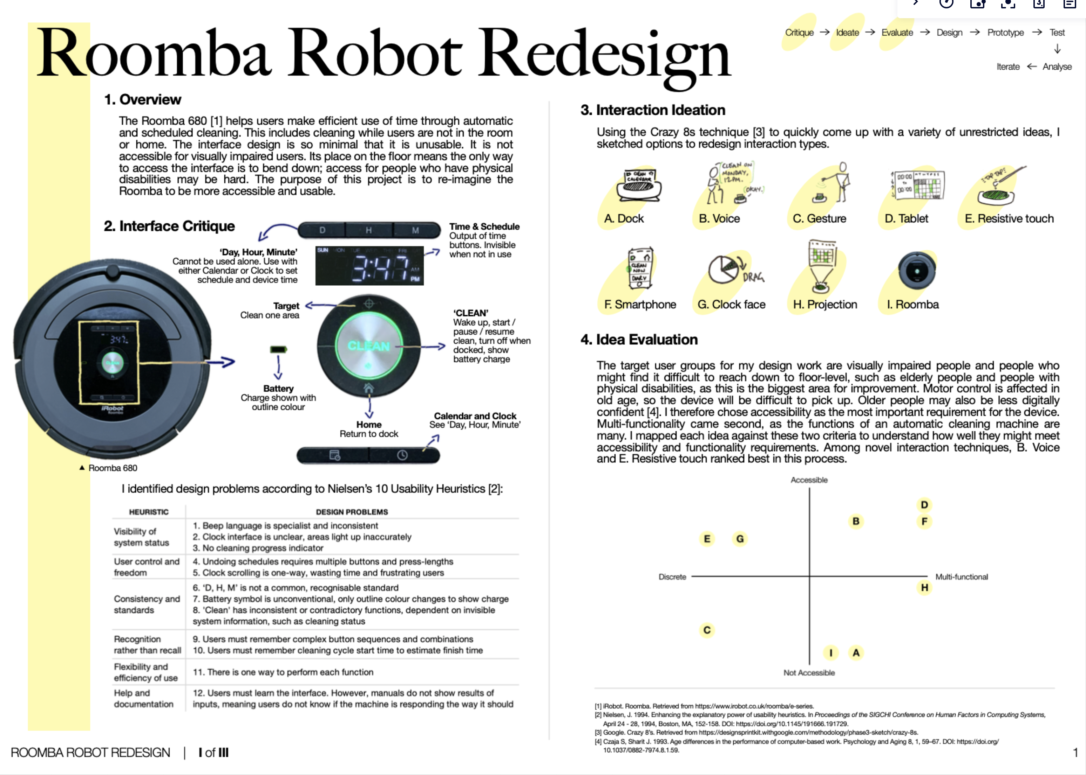
Heuristic Evaluation
ACCB6017 Usability Engineering
15/07/2026
6

Slide 12
Quantitative Analysis
Six methods for making sense of numbers from closed-ended questions and SUS scores — each illustrated with WardWatch / ShiftSmart data [10, 11, 12, 13].
1 Descriptive Statistics
2 Frequency Distribution
3 SUS Scoring Procedure
Summarise responses: mean, median, mode, standard deviation.
Count how many chose each Likert option per item — reveals spread, not just average.
10 items, 1–5 scale. Odd items: score − 1. Even items: 5 − score. Sum × 2.5 [7]
Participant
WardWatch
ShiftSmart
Diff
Q: "I found WardWatch easy to use" (1=Strongly Disagree → 5=Strongly Agree)
Item
Raw
Adjusted
P1
76
68
−8
8
Q1 (odd)
4
4 − 1 = 3
ACCB6017 Usability Engineering
Q2 (even)
2
5 − 2 = 3
P2
82
71
−11
P3
65
80
+15
Q3 (odd)
5
5 − 1 = 4
P4
78
75
−3
2
3
Q4 (even)
1
5 − 1 = 4
P5
70
83
+13
1
1
Q5 (odd)
4
4 − 1 = 3
Mean
74.2
75.4
+1.2
SD
(1)
D
(2)
N
(3)
A
(4)
SA
(5)
…Q10
–
…
SUS mean: WardWatch 74.2 (Good) · ShiftSmart 75.4 (Good) — near-identical means mask individual variation.
11/15 agreed or strongly agreed. Skew toward SA — positive usability signal.
Sum of adjusted scores = 29 → 29 × 2.5 =
72.5 = GOOD ✓
4 Cross-tabulation
5 Non-parametric Testing
6 Reliability — Cronbach's Alpha
Compare responses across subgroups — e.g. novice vs experienced users.
Likert data is ordinal — do not assume a normal distribution. Use Mann-Whitney U to compare two groups.
If you design a custom multi-item scale, alpha measures whether all items consistently measure the same construct.
Q: "I felt confident using the system" (% Agree / Strongly Agree)
Unacceptable
Acceptable
✗ t-test assumes interval data and normality — Likert scales are ordinal; avoid unless justified [3].
Good
Excellent
Group
WardWatch
ShiftSmart
Novice users
(n=8)
87.5%
50.0%
0.0
0.60
0.70
0.90
1.0
✓ Mann-Whitney U: ranks responses, no normality needed. Use for comparing two systems or two groups.
Experienced
(n=7)
57.1%
85.7%
Custom 6-item learnability scale applied to WardWatch:
Cronbach's α = 0.81 → Good internal consistency.
All 6 items reliably measure the same construct.
Example: SUS scores — WardWatch vs ShiftSmart
U = 31, p = 0.48 → No significant difference (α = 0.05)
All (n=15)
73.3%
66.7%
For correlation between two ordinal scales, use Spearman's ρ (rho), not Pearson's r.
Note: SUS is already validated — you only need alpha for your own custom scales.
Aggregated means hide subgroup differences — cross-tabs reveal that system preference depends on experience.
15/07/2026
[10] Brooke, J. (1986). SUS: A 'quick and dirty' usability scale. In: Jordan et al. (eds.) (1996). Usability Evaluation in Industry. London: Taylor & Francis.
[11] Field, A. (2018). Discovering Statistics Using IBM SPSS Statistics. 5th edn. London: Sage.
[12] Jamieson, S. (2004). Likert scales: how to (ab)use them. Medical Education, 38(12), pp.1217–1218.
[13] Norman, G. (2010). Likert scales, levels of measurement and the 'laws' of statistics. Advances in Health Sciences Education, 15(5), pp.625–632.
7

Slide 13
Qualitative Analysis: TA
Thematic Analysis (TA) :
  Can be inductive/deductive
ACCB6017 Usability Engineering
Inductive TA
Data
Codes
Themes
RQ(s)
Deductive TA

Slide 14
Qualitative Analysis: TA
TA : Coding
Observations: Participant 1
The participant mentioned that they would generally avoid digital banking due to literacy barriers. Sometimes the participant relied on family members for navigating the app.
When interacting with the app, the participant found it difficult to switch accounts on the app with single-handed operation. Apart from this, the participant also looked at recent transactions and transfer between accounts often, but all of these are at the top the app and the participant found it hard to reach in single-handed operation.
The participant also struggles to find loan application options, which are not present on the home page of the app but are buried behind Investment Options->Borrowing->Loans.
When shopping online, the participant hesitated before entering bank details on the website and also double checked the transaction amount when confirmation was asked from the banking app.
Sometimes the participant took longer than the 60 second time window to approve the transaction and so had to repeatedly try to complete a transaction but got errors on some occasions. The participant was not able to connect the errors to the cause in the first few times.
Literacy problems
ACCB6017 Usability Engineering
Single-handed operation issue
Cannot find loan option
Online Shopping issue
Online Shopping issue

Slide 15
Qualitative Analysis: TA
TA : Coding
Observations: Participant 1
The participant mentioned that they would generally avoid digital banking due to literacy barriers. Sometimes the participant relied on family members for navigating the app.
When interacting with the app, the participant found it difficult to switch accounts on the app with single-handed operation. Apart from this, the participant also looked at recent transactions and transfer between accounts often, but all of these are at the top the app and the participant found it hard to reach in single-handed operation.
The participant also struggles to find loan application options, which are not present on the home page of the app but are buried behind Investment Options->Borrowing->Loans.
When shopping online, the participant hesitated before entering bank details on the website and also double checked the transaction amount when confirmation was asked from the banking app.
Sometimes the participant took longer than the 60 second time window to approve the transaction and so had to repeatedly try to complete a transaction but got errors on some occasions. The participant was not able to connect the errors to the cause in the first few times.
Literacy problems
Navigation not intuitive
ACCB6017 Usability Engineering
Single-handed operation issue
Similar features not grouped together
Important features not accessible directly
Fear of Fraud
Fear of Fraud
Error Messages are not clear

Slide 16
Qualitative Analysis: TA
TA : Themes
ACCB6017 Usability Engineering
Codes | Themes
Literacy problems | User Demographic Barriers
Fear of Fraud
Navigation not intuitive | Usability Challenges
Single-handed operation issue
Similar features not grouped together
Important features not accessible directly
Error Messages are not clear

Slide 17

Thank you for your attention!
Questions?

Slide 18
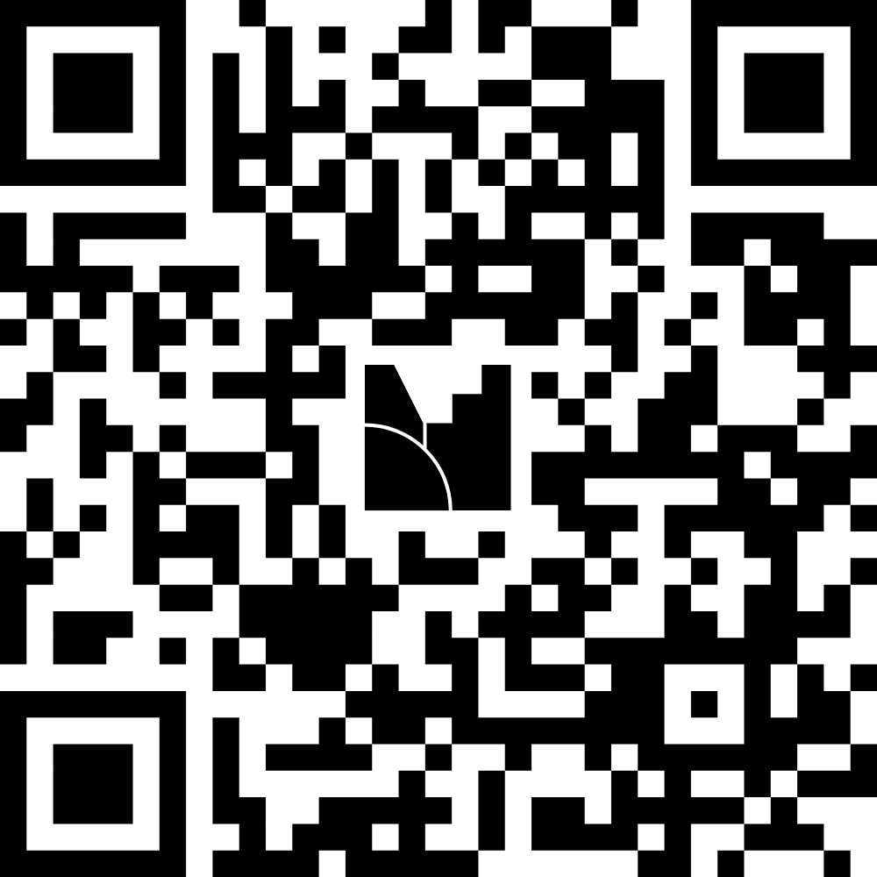
Feedback
Menti Link: https://www.menti.com/alpy3vccybur
Menti Code: 5647 6463

