Slide 1
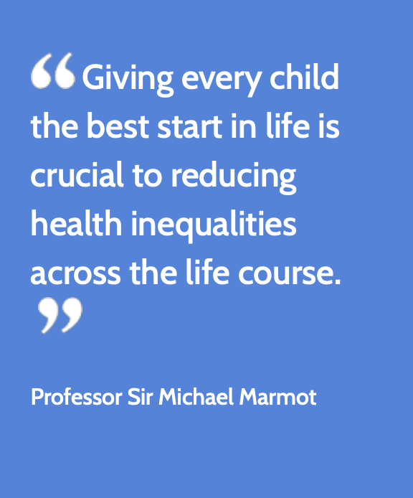
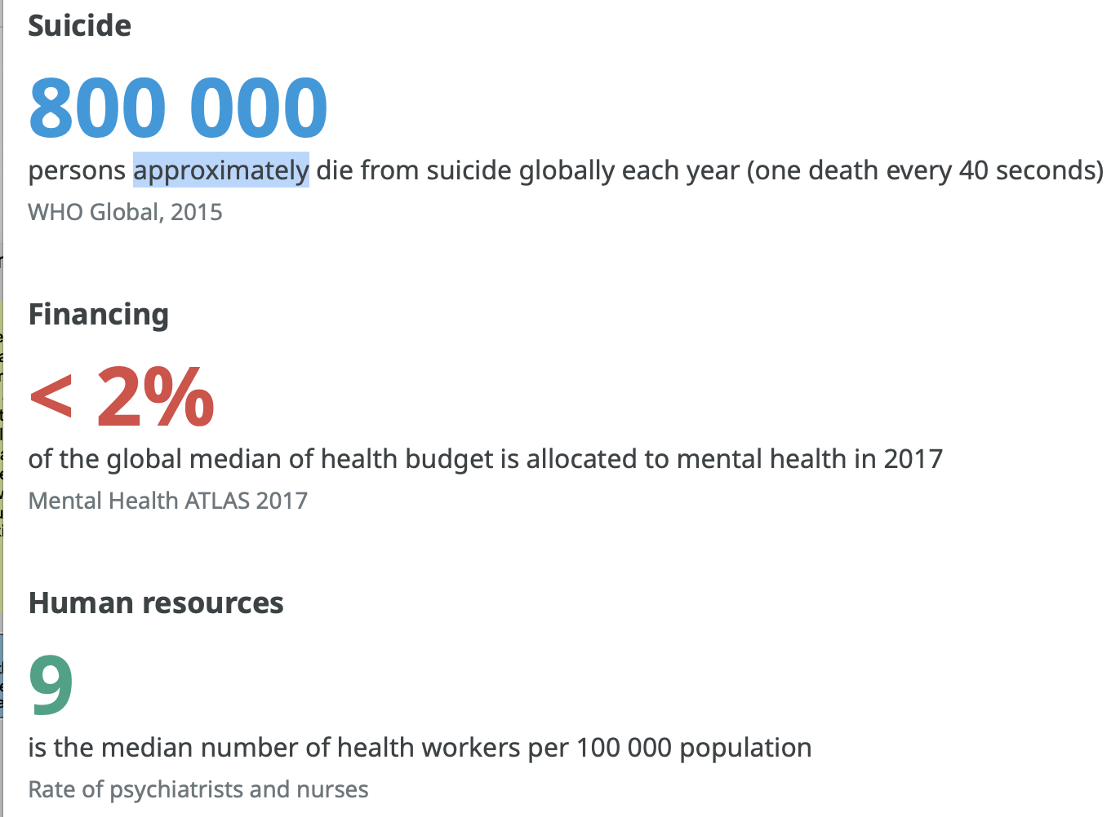
2405438
ECEY5009
Word count: 2018
I have NOT used AI in my work.
Health, Well-being and Lifestyles.
Introduction
This academic poster aims to highlight the significance of promoting children’s health, well-being, and lifestyles in the early years sector. It will define and build positive perceptions of health, well-being, and lifestyles while gaining knowledge on how practitioners can assist both children and adults in becoming content and healthy individuals. This idea is backed by Robert (2010), who believes that nurturing well-being from birth establishes a foundation of knowledge that is essential for supporting mental health and well-being throughout an individual's life, from infancy to adulthood.
Concepts to Health
Bradshaw (2016) states that health and the well-being of the child is at the forefront of their lives these two factors are vital in order support the happiness and confidence of the children. Moreover Bradshaw (2016) also suggests by living with poor lifestyle choices as a child this often poses a significant on the child as they grow into young adults, due to having a negative attitude towards managing better choices for their health, well-being and creating positive lifestyles. Musgrave (2017) states that practitioners are required to support the child’s health whilst attending a early years setting also a schooling environment. Moreover Musgrave (2017) also states that if the early years practitioner is not being supportive when caring for the child’s health and well-being this may result in the practitioner not fulfilling their job role meaning this could turn into a safeguarding issue due to the practitioner not fulfilling their job in order to support all the needs of the child.
Health
Musgrave (2017) states that health is complicated to define due to the umbrella of categories that branch off the description of the word health. "Health is a state of complete physical, mental and social well-being and not merely the absence of disease or infirmity” (World Health Organization, No date) . World health organization (no date) states in most recent years due to children, teenagers and adults not taking chair of their health to the extent needed to thrive this is causing a significant risk due to the incline of their mental health . In which the who organization collected reliable information which can be seen in the photo provided on how health is changing in importance for individuals they noted there has been a rise in numbers of children, teenagers and young adults committing suicide due to the lack of governmental funds in providing support for mental health. Furthermore they suggest low mental health often stems from a lack of understanding on how to support their health in order to thrive positively. However on the other hand Musgrave (2017) states that in order for the child to understand how to care for their health that they require a enabling adult to guide them to understand what makes them happy and how to avoid triggers in which may cause them to become unwell due to prior knowledge of a medical illness for example . Mohammadnezhad et al. (2020) states that attitude towards health often stems possibly mother is pregnant with the embryo and is displaying poor health choices this often corresponds to the poor health habits with the children due to what they are witnessing by their closest enabling adults. Moreover Mohammadnezhad et al. (2020) suggests that good quality of health underpins good quality of life as it is vital to become healthy not only for physical health benefits but also for mental health and well-being as if the individuals mental health and well-being is not being supported the practitioners will see a decline in the child’s health habits. The Welsh government (2024) states that the Healthy Child Program (2016) was created in order to support the health rights of the child ages from birth to 7 years old. The Healthy Child Program (2016) was created in order to gain the child’s understanding towards what is health and what it means to be a healthy individual two of the main example are what their pack lunches contain also if the child has been immunized with life saving medical vaccinations. Moreover the Healthy Child Program (2016) is considered a valuable resource by the Welsh government (2024) In order for early years practitioners to gain reliable knowledge based on how to implement a balanced healthy lifestyles through ensuring the child is being given the opportunity to eat a balanced diet also endless opportunities to develop their physical development through play and exercise.
Source: healthy start and brighter futures (2025).
source: world health organization (no date).

Slide 2
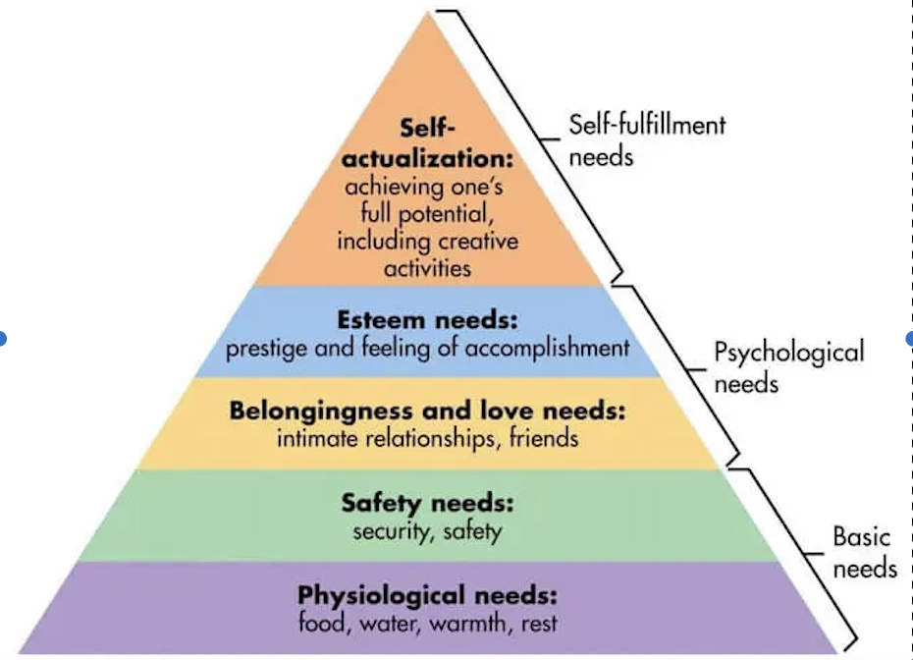
Concepts of Well-Being
Statham et al (2010) state that the quality of life individuals create for themselves is fundamental in determining what is best for their well-being and personal needs. Moreover, the OECD (2021) highlights four key elements of well-being first, the child's physical health, second their cognitive development third, emotional and social well-being and fourth material well-being. Material well-being is often overlooked in research due to the children's well-being conducted by enabling professionals. It is observed that material well-being is affected by the lack of resources available to support children’s physical health, as well as their mental and emotional well-being on a daily basis.
​​​
Well-Being
McLeod (2018) refers to Maslow’s hierarchy of needs, which is a five-tier model based on fundamental needs of a human in which are necessary for individuals to thrive. Additionally it is noted that a child's well-being is part of their fundamental human rights and must be catered to daily to ensure that all aspects of their health, well-being, and lifestyle are being supported appropriately. The image linked of Maslow's pyramid of needs illustrates multiple sections that he identified as essential needs for a human to develop. Each layer of the pyramid explains the requirements of the child, ensuring that not only are their basic rights being fulfilled but also their psychological and self-fulfilment needs, this is aiding children in becoming confident and achieving their fullest potential in life. Maslow's hierarchy of needs supports the children’s right to eat balanced meals, to drink milk and water also personal hygiene for example the rights to shower, clean their hair and most importantly the rights to have a clean nappy. Moreover UNICEF (2013) working in line with the the OECD (no date) states that there is a measuring tool which is separated into four different categories first being their name, second being family income, third being the individuals health needs and fourth being their education and how they participate during their life and social gatherings where required to participate in group activities. Furthermore UNICEF (2013) states that the child’s mental health and wellbeing requires to be supported by a enabling adult to ensure they are happy and thriving within their lives. However on the other hand UNICEF (2013) also states that children who lacks the love from their parent a carers are more inclined to suffer with their mental health due to feeling the rejection. Due to feeling rejected this can cause a drastic incline in the child’s physical wellbeing and also their emotional wellbeing due to not feeling wanted by their enabling adult this may effect the way the child will thrive to grow up to become later in life. This is supported by NSPCC (2021) based from Bowlby’s attachment theory (1977) as he stated the importance of that every child requires a emotional bond and attachment to feel loved and secure without this it will negatively effect their emotional wellbeing which will then lead to psychological issues being carried through their adult life if not put into effect during childhood experiences.
Source: Help children live better (no date).

Slide 3
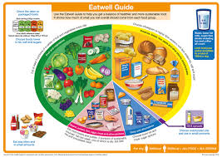
Lifestyles Concepts
The NHS ( no date) explains the need for parents and caregivers to learn and build their knowledge about health and what a suitable meal sizes looks like for children as this will help them to maintain a healthy weight. It also points out the significance of physical activity for children, which aids in their gross motor skills and core development through physical education through attending physical education classes during their early years of childhood also at secondary school this allows the children to gain a positive love in becoming a active member of their friendship groups.
lifestyles
On the other hand NHS (no date)states that in order for the children to gain a positive relationships with food it is deemed as important if the parent and guardians become a enabling role model in order for the child to understand the difference between what is healthy and what is unhealthy as this will ensure the children gain a positive relationships with foods. This will lower the numbers of individuals who are being labelled as obese by being labelled as obese this causes a negative relationships with food as the become binge eaters and are less active physically. However on the other hand healthy start and brighter futures (2025) states that a 1 in 10 children diagnosed as obese by the age go 5 years old however by using a balanced diet and becoming more active they often return to a healthy weight by the age of 11 years old. To support healthy start and brighter futures (2025) opinion The Food Standard Scotland (no date) states that the eat well plate is a beneficial guidance tool in order to gain a understand what is classified as a healthy portion of fruit and vegetables in comparison to food with a high sugar content. The eat well place shows guidance on how many portions of fruit and vegetables should be consumed daily however each person classifies a portion size differently based on personal opinion however health professionals state that a average portion is roughly the palm of a hand worth. Another factor that may contribute to lifestyle issues is coronavirus. According to Zengin et al. (2021) due to a recent illness outbreak called coronavirus disease 2019 also known as COVID-19 this has caused drastic life changing after effects on roughly 91.9% of children. Furthermore to the research Zengin et al. (2021) carried out during 2021 noted the changes in the child’s nutrition, sleep patterns and also the lifestyle differences compared to prior to the spread of the infectious disease, this has caused a negative impact of peoples social and mental wellbeing moreover their physical wellbeing has been effected also due to the worry that they may become unwell due to a unfamiliar illness. Within a early years setting it has become more apparent in recent years on the importance of deep cleaning in order for the illness to subside this has worked well in a way to support people who may feel anxious due to the fear of becoming unwell.
In conclusion, the health, wellbeing, and lifestyles of children play a crucial role in their development into adulthood. “The foundations for virtually every aspect of human development are laid in early life. A healthy, happy start in life - from conception to adolescence - paves the way for a brighter and healthier future”- Healthy start and brighter future (2025)
Source: Food standard Scotland (no date).

Slide 4
Reference list:
Bradshaw. J (2016). “The Well-Being of Children in the UK”. Bristol: Policy Press. Available at: https://research-ebsco-com.ezproxy.uwtsd.ac.uk/linkprocessor/plink?id=08585a2e-2c02-32a6-9ddd-cd6037ef29fb. (Accessed: 7 June 2025)
Food Standard Scotland (no date). “ the eat well guide”. Scotland: Food Standards Scotland. Available at: https://www.foodstandards.gov.scot/consumers/healthy-eating/eatwell. (Accessed: 12 June 2025).
Healthy start and brighter futures (2025). “ Why a healthy, happy childhood matters”. Available at: https://www.henry.org.uk/whyahealthystartmatters#:~:text=Why a healthy, happy childhood,of key national policy recommendations. (Accessed: 12 June 2025).
Help children live better (no date). “ Maslow’s hierarchy of needs”. Available at: https://helpchildrenlivebetter.co.uk/maslows-hierarchy-of-needs/. (Accessed: 9 June 2025).
McLeod.S (2018). “ Maslow’s hierarchy of needs”. Available at: https://helpchildrenlivebetter.co.uk/maslows-hierarchy-of-needs/. (Accessed: 9 June 2025).
Mohammadnezhad M and Huq N (2020). “Maternal and Child Health Matters Around the World”. IntechOpen.
Musgrave.J (2017). “Supporting Children’s Health and Wellbeing”. Los Angeles: SAGE Publications Ltd.
NHS (no date”. “Advice for parents of healthy weight children”. United kingdom: NHS. Available at: https://www.nhs.uk/live-well/healthy-weight/childrens-weight/healthy-weight-children-advice-for-parents/. (Accessed: 11 June 2025).

Slide 5
NSPCC (2021). “ Attachment and child development”. Available at: https://learning.nspcc.org.uk/child-health-development/attachment-early-years. (Accessed 11 June 2025).
OECD (No date). “ Child well-being document”. Available at: https://www.unicef.org/turkiye/media/4141/file/Child Well-Being Document.pdf. (accessed: 10 June 2025).
Roberts.R (2010). “Wellbeing From Birth”. Los Angeles: SAGE Publications Ltd. Available at: https://research-ebsco-com.ezproxy.uwtsd.ac.uk/linkprocessor/plink?id=f9d9db34-9c7b-3f6f-820b-c94e732d149c. (Accessed: 7 June 2025).
Statham. J and Chase.E (2010). “ childhood wellbeing: a brief overview”. England: childhood wellbeing research centre . Available at: https://assets.publishing.service.gov.uk/media/5a7acd89ed915d71db8b2946/Child-Wellbeing-Brief.pdf. (accessed: 8 June 2025).
The Healthy child project (2016). “Healthy Child Wales Programme: for school aged children”. Wales: Welsh government. Available at: https://www.gov.wales/healthy-child-wales-programme-school-aged-children-introduction-html. (Accessed: 8 June 2025).
UNICEF (2013). “ Child well-being document”. Available at: https://www.unicef.org/turkiye/media/4141/file/Child Well-Being Document.pdf. (accessed: 10 June 2025).
Welsh government (2024). “Healthy Child Wales Programme: for school aged children”. Wales: Welsh government. Available at: https://www.gov.wales/healthy-child-wales-programme-school-aged-children-introduction-html. (Accessed: 8 June 2025).
World Health Organization (no date). “health and Well-Being”. Available at: https://www.who.int/data/gho/data/major-themes/health-and-well-being. (Accessed: 7 June 2025).
World Health Organization (no date). “health and Well-Being”. Available at: https://www.who.int/data/gho/data/major-themes/health-and-well-being. ( Image Accessed: 7 June 2025).
Zengin. M, yayan. H.E and Vicneiloglu.E (2021). “The effects of the COVID-19 pandemic on children's lifestyles and anxiety levels”. Available at: https://onlinelibrary.wiley.com/doi/abs/10.1111/jcap.12316. (accessed: 12 June 2025).

