Slide 1
The Importance of Emotional Intelligence in the Workplace
Critical Exploration and Model Application
Student name & ID: Lecturer:
Natalia Rupet 2109475 Dr. Essa Bah
14.07.2024

Slide 2

Will…
1. Critically explore the importance of emotional intelligence (EI) in the workplace.
2. Use an EI model and justify selection of the model.

Slide 3
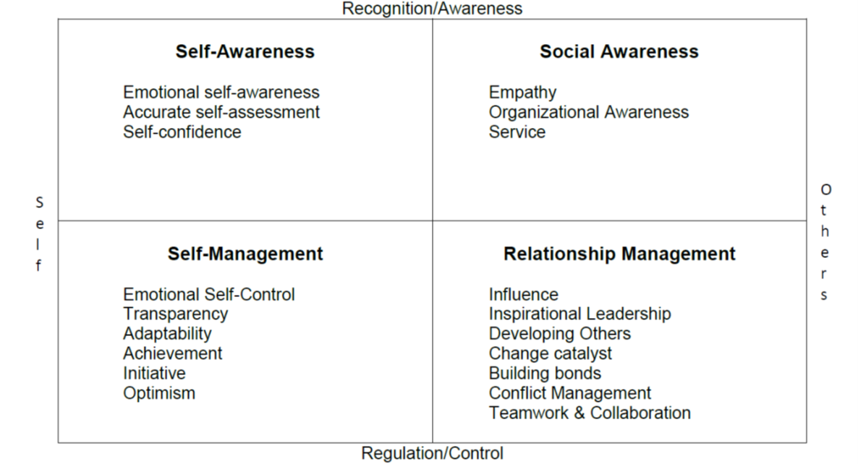
Introduction to Emotional Intelligence (EI)
Definition of EI:
The ability to understand and manage your own emotions, and those of the people around you. (Parmar A., 2021)
Importance in the Workplace: Enhances leadership, improves team performance, and fosters a positive work environment.
Components:
(Goleman D.,2002)

Slide 4

Importance of EI in Management and Leadership
Leaders and managers need to connect with employees on a personal level, beyond hierarchical structures.
EI helps in understanding and addressing employee concerns, leading to better motivation and productivity.
(Fripp G. 2023)
Empathy allows leaders to understand their team's perspectives and challenges.
Promotes trust, loyalty, and a supportive culture.
(Sehgal S., 2024)

Slide 5
Selected EI Model and Justification
Selected EI Model:
Goleman's Model of Emotional Intelligence.
Components of the Model:
Self-awareness,
Self-regulation,
Motivation,
Empathy, and
Social skills.
Justification for Selection:
Comprehensive and widely recognized.
Directly applicable to leadership and management contexts.
Emphasizes both personal and social competencies, crucial for workplace dynamics.
(Goleman D. ,1998)

Slide 6
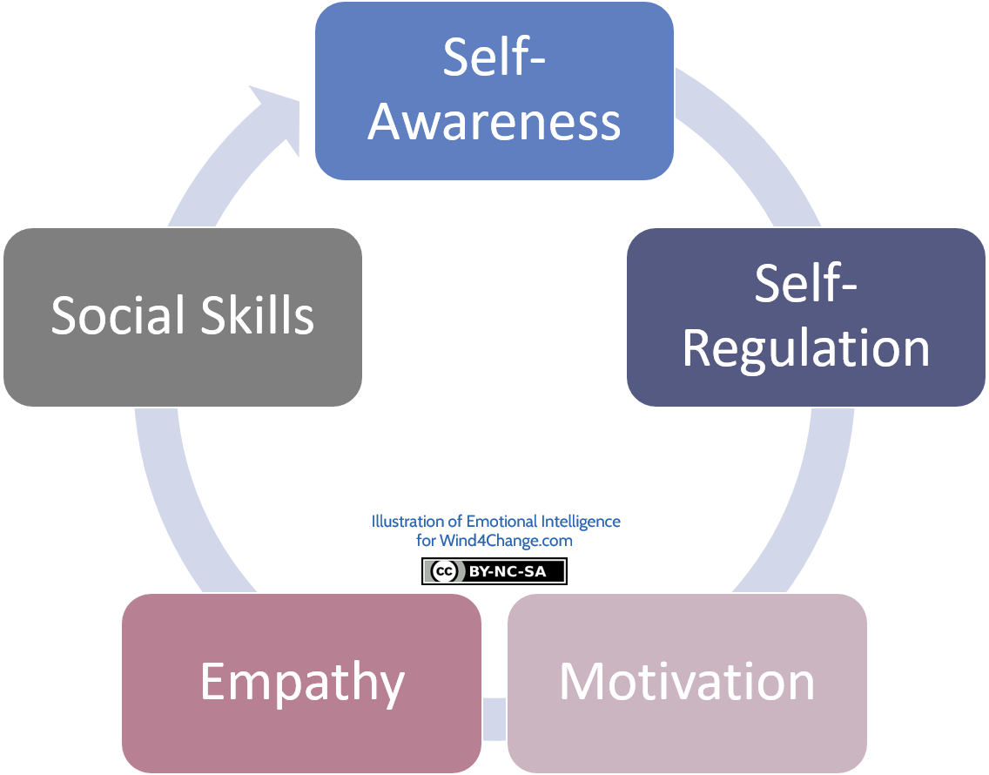
Application of Goleman’s EI Model in the Workplace
Self-awareness:
Managers can better understand their strengths and weaknesses.
Leads to more authentic leadership.
Self-regulation:
Helps in managing stress and maintaining professionalism under pressure.
Motivation:
Drives leaders to set and achieve higher goals, inspiring their teams.
Empathy:
Critical for conflict resolution and understanding team needs.
Enhances communication and team cohesion.
Social Skills:
Essential for effective collaboration, negotiation, and conflict management.

Slide 7

Conclusion and Critical Appraisal
EI is essential in the workplace for leadership, team dynamics, and stress management. Goleman's model provides a robust framework for understanding and applying EI.
EI and mindfulness are critical for enhancing workplace productivity and employee satisfaction. Future organizational success will increasingly rely on these competencies.
Emphasizing EI in professional development can lead to a more harmonious and effective workplace.

Slide 8

References
Fripp, G. (2023) Goleman’s Emotional Intelligence Framework‍ - Organizational Behavior, www.myorganisationalbehaviour.com. Available at: https://www.myorganisationalbehaviour.com/golemans-emotional-intelligence-framework/ (Accessed: 13 July 2024).
Goleman, D. (2002). Emotional Intelligence Framework
Goleman, D. (1998). Working with Emotional Intelligence.
Parmar, A. (2021) The five components of emotional intelligence, ThinkPsych. Available at: https://thinkpsych.com/blog/the-five-components-of-emotional-intelligence/ (Accessed: 13 July 2024).
Seghal S. (2024) Council post; why emotional intelligence is crucial for effective leadership, Forbes. Available at: https://www.forbes.com/sites/forbesbusinesscouncil/2023/07/25/why-emotional-intelligence-is-crucial-for-effective-leadership/#:~:text=Emotional%20intelligence%20in%20leadership%20can%20be%20beneficial%20in,strong%20bond%20between%20the%20leader%20and%20team%20members (Accessed: 13 July 2024).

