Slide 1

HPFY3001: Academic Survival Skills
Session 17: Sources Part 2
Dr Rhian Elinor Keyse
Lecturer in Global Historical Studies

Slide 2

Last session - review
Approaching sources

Slide 3

In this session:
More on sources
Films, objects…others

Slide 4

Films as sources
Watch the following trailer:
What do you now think you know about the reality of fishing?

Slide 5
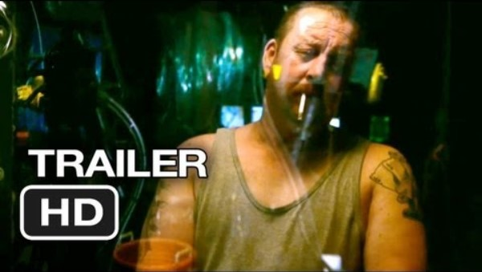

Slide 6
Films as sources
Now compare with the following trailer
What information do both films give about debates re: the ocean and fishing?
Which is more effective for raising awareness?

Slide 7


Slide 8
Films as sources
As with all sources: think about who/when/where/how it was produced
Think about sensationalism
Racist/colonialist/sexist ways of thinking – as with any source!

Slide 9
Objects as sources
Tell us about the time they were made in
What does the object tell us about the people who made and used it?
Look at objects - shape/colour/size/materials
Handling objects – weight, texture, smell, maker’s skills, techniques, materials
But this is limited – how do we find out more?

Slide 10
Objects as sources
Secondary sources?
Interviews?

Slide 11
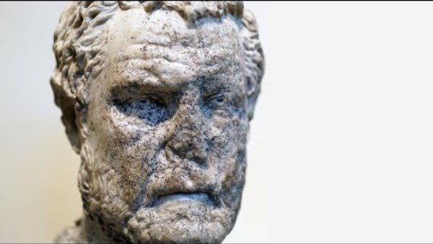
Objects as sources

Slide 12

Images as sources
Lots of kinds!
Photos
Posters
Artwork - paintings

Slide 13
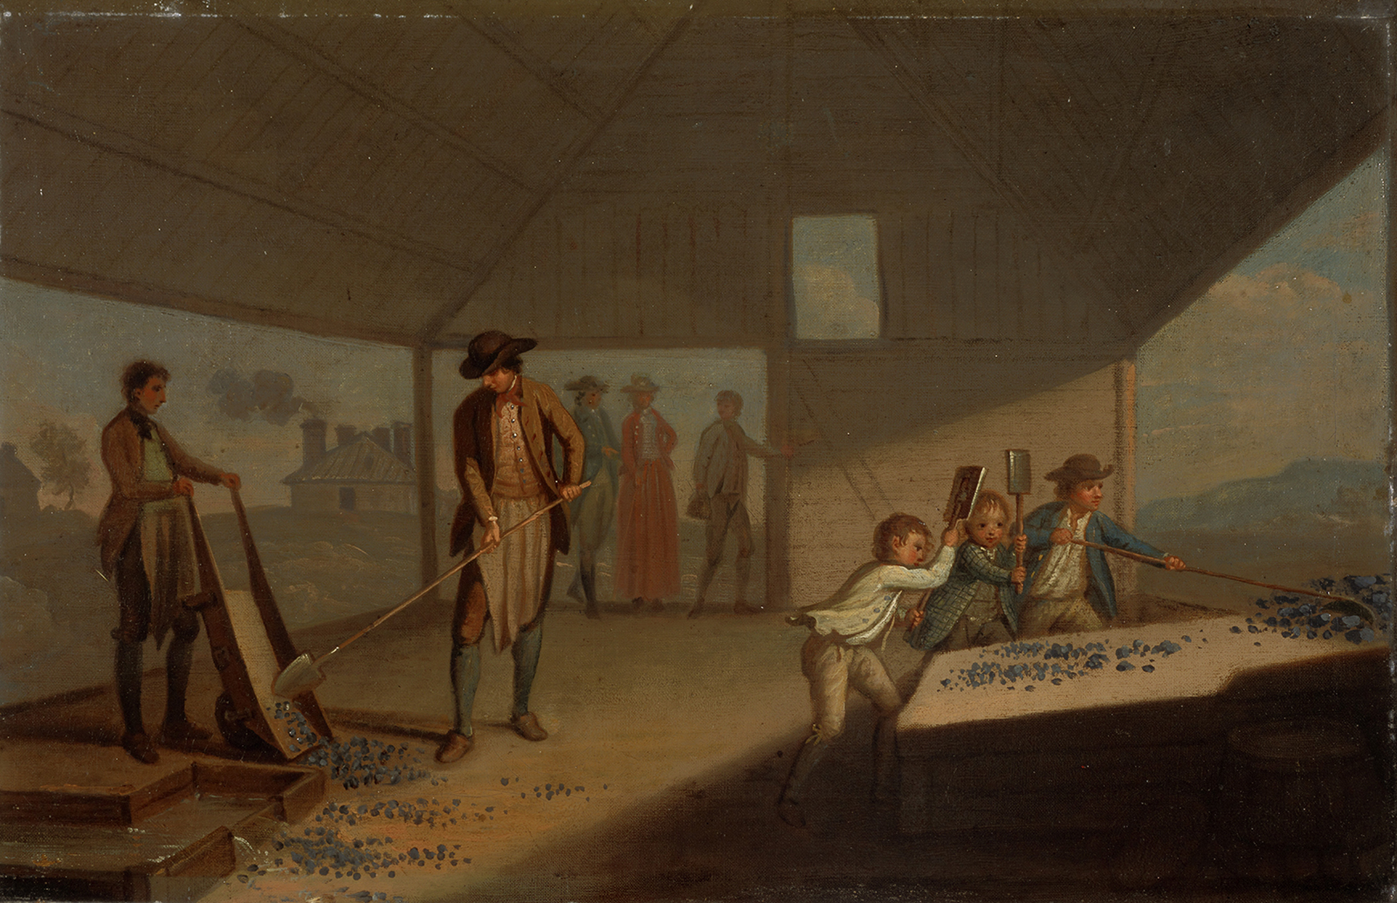
Images as sources
Notes:
1780s.
David Allan painted a fascinating set of pictures when the Industrial Revolution was taking hold in Scotland. The setting is the famous lead mines at Leadhills in South Lanarkshire, owned by the 3rd Earl of Hopetoun, who commissioned these paintings. They show the four key stages in lead processing, of which this is the first. The company’s junior employees are engaged in the simplest stage of the process, observed by the Earl and his Countess. Once pounded and broken down by the young boys, who were frequently as young as nine, the lumps of crude ore were sent to be sieved and washed.

Slide 14
Images as sources
Photographs – visual insight into times and places, activities
Snapshot – restricted by perspective, topic, size
Organised – composed by a photographer

Slide 15
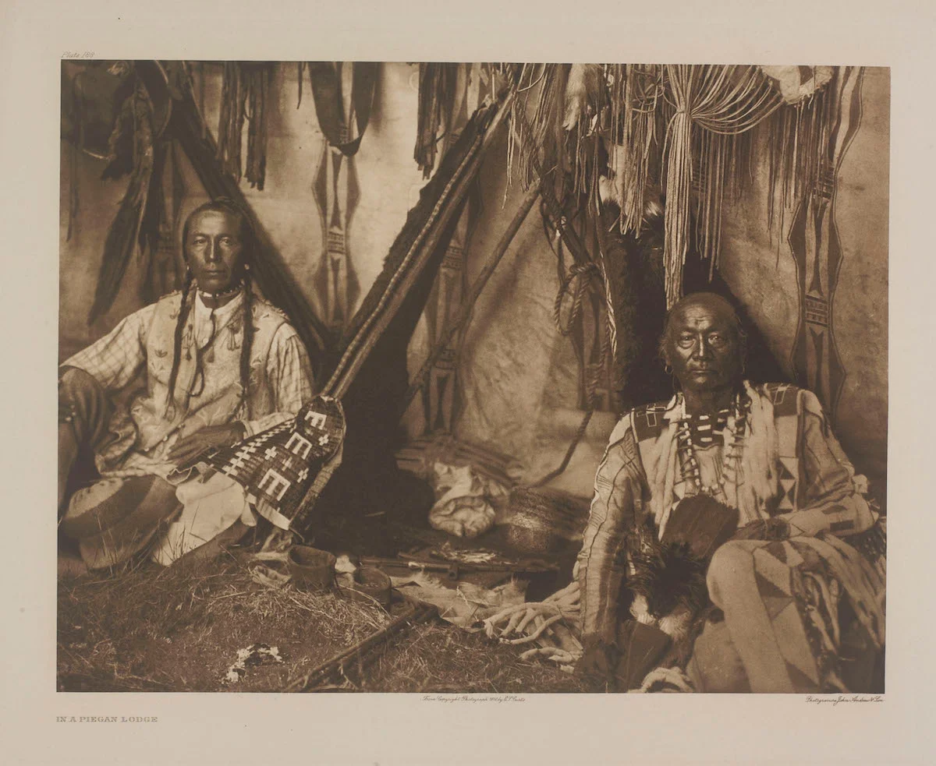
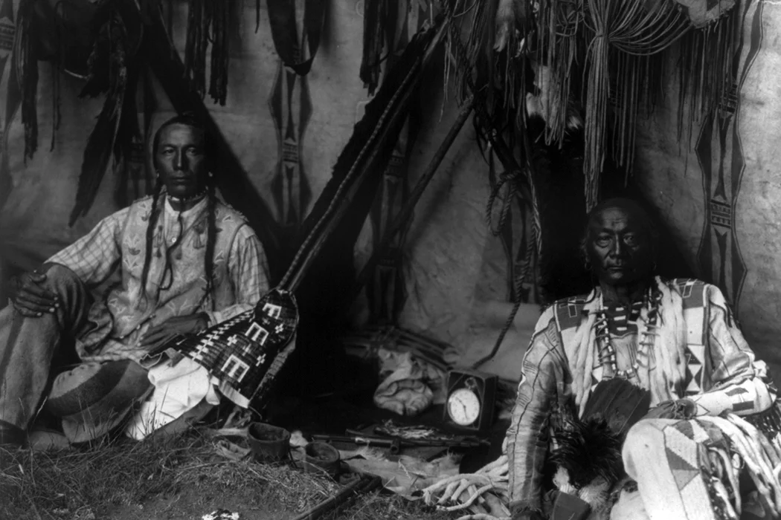
Edward S. Curtis, ‘In a Piegan Lodge’ (1910)

Slide 16
Next week: Presentation Skills
We’ll look at what makes an effective presentation
The following week will be practice presentations in small groups with your peers.

Slide 17

Over to you: any questions?

