Slide 2

An Introduction to Critical Reflection…
Notes:
DEFINE IT CLASS?
Let me disabuse you of something at the outset reflection is not sitting on the edge of a beach & dreaming.
M&S Galaxy milk chocolate
Impacts upon every aspect of modern working
Engages with our need to make sense of the world in which we work
Engages with the two uppermost needs in Maslow’s
As such it impacts on most aspects of our professional and organisational lives
Widely used in professions – so much so that some practitioners abuse it (junior doctor – the dark side) me included – BUT it gives us an insight into our organisations as well as us personally
My purpose is to introduce the concept of critical thinking & to outline some of the available tools to enable you to include original and critical thinking into your course work. So, the key prefix for us at the outset is…
2

Slide 3
Aim:
Discuss the concept of reflection as a learning strategy
Objectives:
Discuss:
  The concept and purposes of reflection;
  Models of reflection;
  Levels of reflection.
Notes:
3

Slide 4

Q – What is self-reflection?
A – Self reflection involves reviewing teaching and learning.
‘Looking at ourselves and our work with a critical eye and responding to what we see in a positive and professional way.’ (Tolley et.al.1996)
Notes:
4

Slide 5
Q – What is reflective writing?
Reflective writing is evidence of reflective thinking. It may involve:
Looking back at something (often an event but it could also be an idea or object.
Analysing the event or ides (thinking in depth from different perspectives, and trying to explain, often with reference to a model or theory)
Thinking carefully about what the event or ides means for you and your ongoing progress as a learner and/or practising professional.
Notes:
5

Slide 6
Some theorists...
Gibbs
Dewey
Kolb
Boud
Schon
Reynolds
Mezirow
Woerkom
Notes:
R
Dewey – past experience and relevant knowledge are applied to resolve uncertain situations
Kolb -
Boud - Attending to feelings
Schon - Reflection in action and reflection on action
Reynolds - Woerkom -
Mezirow - A commitment to questioning the taken for granted assumptions
6

Slide 7

Definitions
Dewey (1933)
An active persistent and careful consideration of any belief or supposed form of knowledge in the light of the grounds that support it and the further conclusion to which it tends.
Dewey, J., How we think, Chicago 9:Henrey Regney, 1933.
Notes:
7

Slide 8
Definitions
Boud et al (1985) take a different perspective and define it as:
A generic term for those intellectual and effective activities in which individuals engage to explore their experiences in order to lead a new understanding and appreciation.
Boud D., Keough, R., Reflection: Turning Experience into Learning, London: Kogan Page, 1985.
Notes:
8

Slide 9
Definitions
Schön (1987) in his work identifies two types of reflection, these are reflection-in-action (thinking on your feet) and reflection-on-action (retrospective thinking). He suggests that reflection is used by practitioners when they encounter situations that are unique, and when individuals may not be able to apply theories or techniques previously learnt through formal education.
Schön, D., Educating the reflective Practitioner, San Francisco: Josey Bass, 1987.
Notes:
9

Slide 10
Definitions
Reid (1993) in her definition also noted reflection as an active process rather than passive thinking. She states: ‘Reflection is a process of reviewing an experience of practice in order to describe, analyse, evaluate and so inform learning about practice’.
Reid, B., “But we’re doing it already” Exploring a response to the concept of reflective practice in order to improve its facilitation. Nurse Ed Today 13:305-309, 1993.
Notes:
10

Slide 11
Models of Reflection
Peters (1991) describes a four-step
protocol called “DATA”
(Describe, Analyse, Theorise, Act)
Describe – the basic elements of the problem, task or situation;
Analyse – identify assumption, beliefs, rules, motives and any other factors underlying the current approach;
Theorize – what alternatives are possible? Comparative merits and drawbacks?
Act – try out a new approach, evaluate the results.
Peters, J., “Strategies for Reflective Practice.” In Professional Development for Educators of Adult and Continuing Education. No.51, edited by R. Brockett. San Francisco: Jossey-Bass, Fall 1991.
Notes:
11

Slide 12
Gibbs’ Model of Reflection (1988)
Description
(What happened?)
Feelings
(What were you thinking & feeling)
Action Plan
(What will happen next time?)
Conclusions
(What else could you have done?)
Evaluation
(What was good & bad about the experience?)
Analysis
(What sense can you make of what happened?)
Notes:
All models share similar elements – eg Kolb – Lewin cycle in which we have four steps
CONCRETE EXPERIENCE / REFLECTIVE OBSERVATION / ABSTRACT CONCEPTUALISING / ACTIVE EXPERIMENTATION
Much of the literature on reflection refers to situations that learners had issues with, what Dewey called ‘ a state of perplexity, hesitation, doubt ‘
What I have referred to in the past as ‘crucible moments’.
So we move on to critical reflection:
EXAMPLE BAGLAN:
Class to consider inspector’s perspective, sergeant’s perspective, constables’ perspective, family’s perspective.

Slide 13
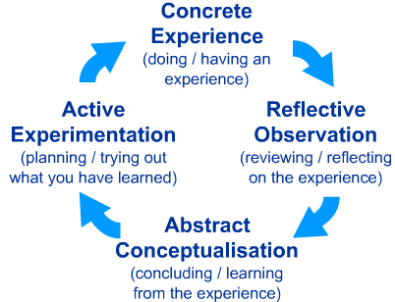
Kolb’s Learning Cycle (1984)

Slide 14
The What? Model of Structured Reflection
The model (Driscoll 1994, 2000), contains three elements of reflection:
What? A description of the event
So What? An analysis of the event
Now What? Proposed actions following the event
Driscoll, J., Practising clinical supervision. Edinburgh: Balliere Tindall, 2000.

Slide 15
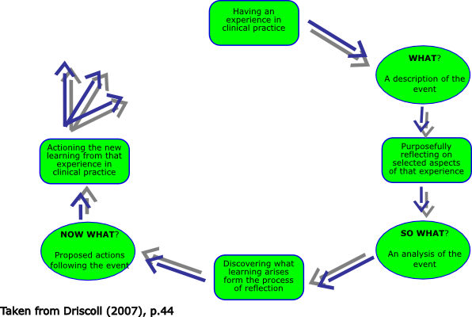

Slide 16
Levels of Reflection:
Descriptive
Descriptive with some reflection/evaluation
Catalogue reflection with some practical evidence/examples
Critical reflection with recommendations and practical and literary evidence

Slide 17
Focus on Learning
S Set learning objectives – what would you like to get out of this?
H How did it go? What went well and why?
A Address concerns what went wrong & why?
R Review learning points – was S achieved above?
P Plan ahead – how can we improve in future?
  From Imperial London deanery – review in a medical setting saved to diamond stick

Slide 18
Critical (Reflective) Writing
What argument am I making?
Are my claims supported by evidence?
How credible and appropriate is my evidence?
Are my conclusions logical and reasonable?
Have I clarified expressions, claims and meanings of key terms and concepts?
Have I considered alternative arguments?

Slide 19
Characteristics of critical reflection
Selection: of an appropriate experience etc.
Changing perspective: analysed from a different point of view or level of detail
Returning to experience: as best fits the issue
Analysis of own role: look at reasons for and consequences of your actions
Drawing on received wisdom: make use of theory, research, best practice
Deepening your understanding: look actively for meaning by recognising what is significant
Using insight to effect change: ideally to the benefit of others and yourself

Slide 20
Reflecting on non routine actions
What is the usual course of action in these circumstances?
What is the rationale for doing things that way?
What was different on this occasion such that these guidelines were inappropriate?
What might have been the impact of such a change?
Which aspects could/should still have been followed?
Why was it essential to do so?
Which aspects could be over-ruled or adapted?
What could have happened – what were the risks & to whom?
What were the immediate effects & consequences?
What if anything would you do differently next time?

Slide 21
Knowing your Audience
(1st and 2nd Markers /External Examiner)
Attitudes – fair (concerned only with the argument)
Sceptical but empathetic
Knowledge of the field – variable, that’s why they …
Like - logic, referencing, evidence that you’ve met the criteria
Signposting – the bits fit together
Pet hates – waffle, insufficient justifications, avoidable errors, generalisations, plagiarism
A belief that – everything should be relevant, conclusions must be warranted
Notes:
As a student you need to know something about us when planning your writing – here’s a summary

Slide 22
Richard Boyatzis Theory of Self Directed Learning
1. My Ideal Self
Who do I want to be?
4. Experimenting
New behaviours & thoughts
5. Trusting relationships
Building networks
2. My Real Self
Who am I?
3. My Learning Agenda
Building on my strengths & reducing my gaps
My Strengths
Where my ideal & real selves overlap
My Gaps
Where my real and ideal selves differ
Notes:
How can I focus on what needs to be done amidst all this complexity?
22

Slide 23
Structure / questions for the essay
Introduction
Using the Learning Plan module as the platform for the qualification in Professional Practice, I intend to use this Reflective Review to explore….
  What am I aiming to achieve from completing the Professional Practice qualification? (My motivation)
  How have I arrived at this point in my own personal development? (My journey so far)
  Where am I coming from in terms of my own personal type and preferences? (My own personal type, style and preferences)
  What development do I need for my current role? (Current skills gap)
  Where do I want to go & what development do I need to get there? (My future development)
  How I intend to get there? (Covered in your PDP)

Slide 24
Activity
Start writing your reflective essay
45 minutes

Slide 25
Agenda
CV and JD progress report (You)
Personal Development Plan
Develop your TNA
Develop your PDP
Structure for your reflective essay

Slide 26
Action Plan
Annotated CV
Annotated JD
Training needs analysis
Reflection
  Read out aloud
  Spell-check
  References – check
  Learning styles
Personal Development Plan

Slide 27
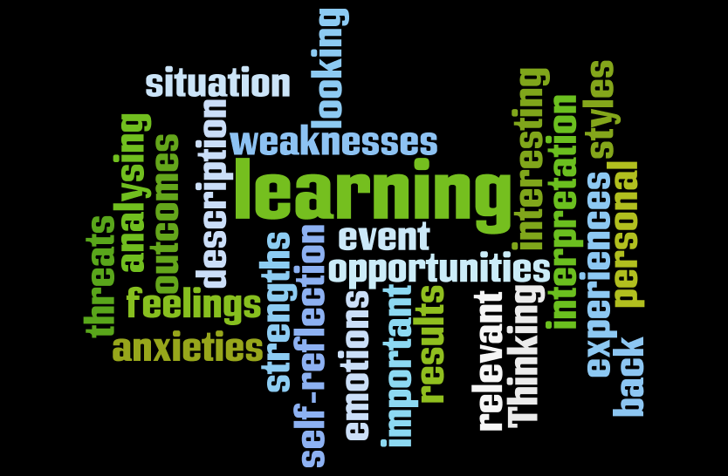
Notes:
In summary
1. Reflection is an exploration and an explanation of events – not just a description
2. Reflective writing often involves ‘revealing’ anxieties, errors and weaknesses, as well as strengths and successes. This is fine as long as you show some understanding of possible causes, and explain how you plan to improve.
3. When reflecting on an event or an idea - select just the most significant parts. If you try to tell ‘the whole story’ you will use exceed your number of words allocation.

