Slide 1

Student name: Ioana Popa
Student ID: 2313594
Module name: Psychopathological Classifications and Provisions
Module code: (BMHP6029_LON)
Acknowledgement of the use/non-use of AI:
Name Dr White Wiita

Slide 2
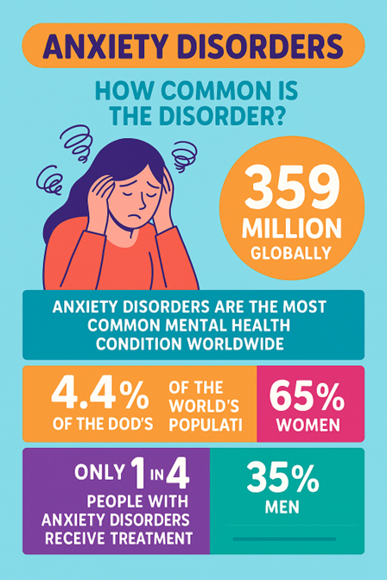
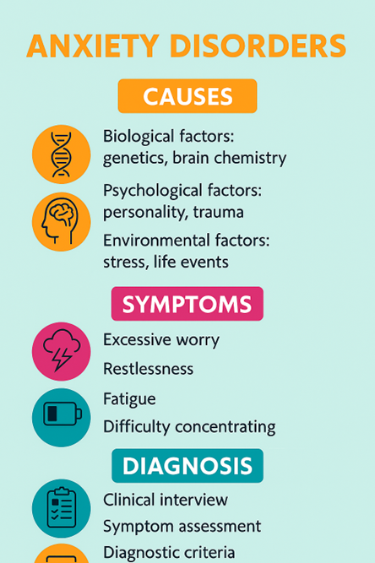
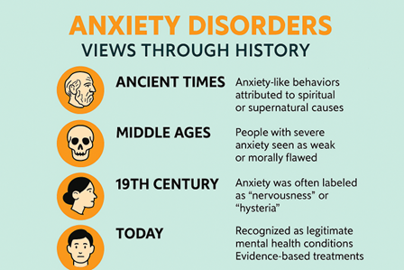
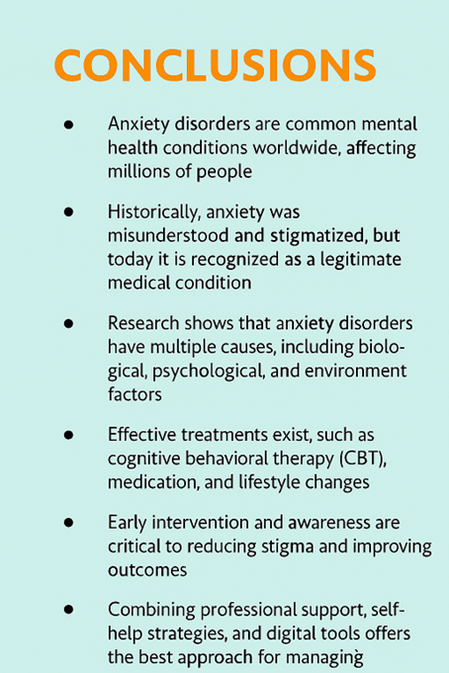
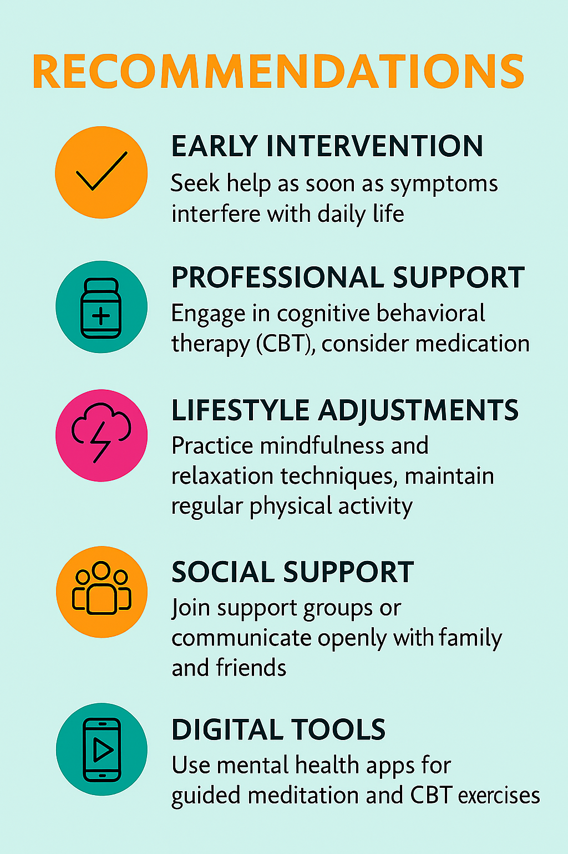
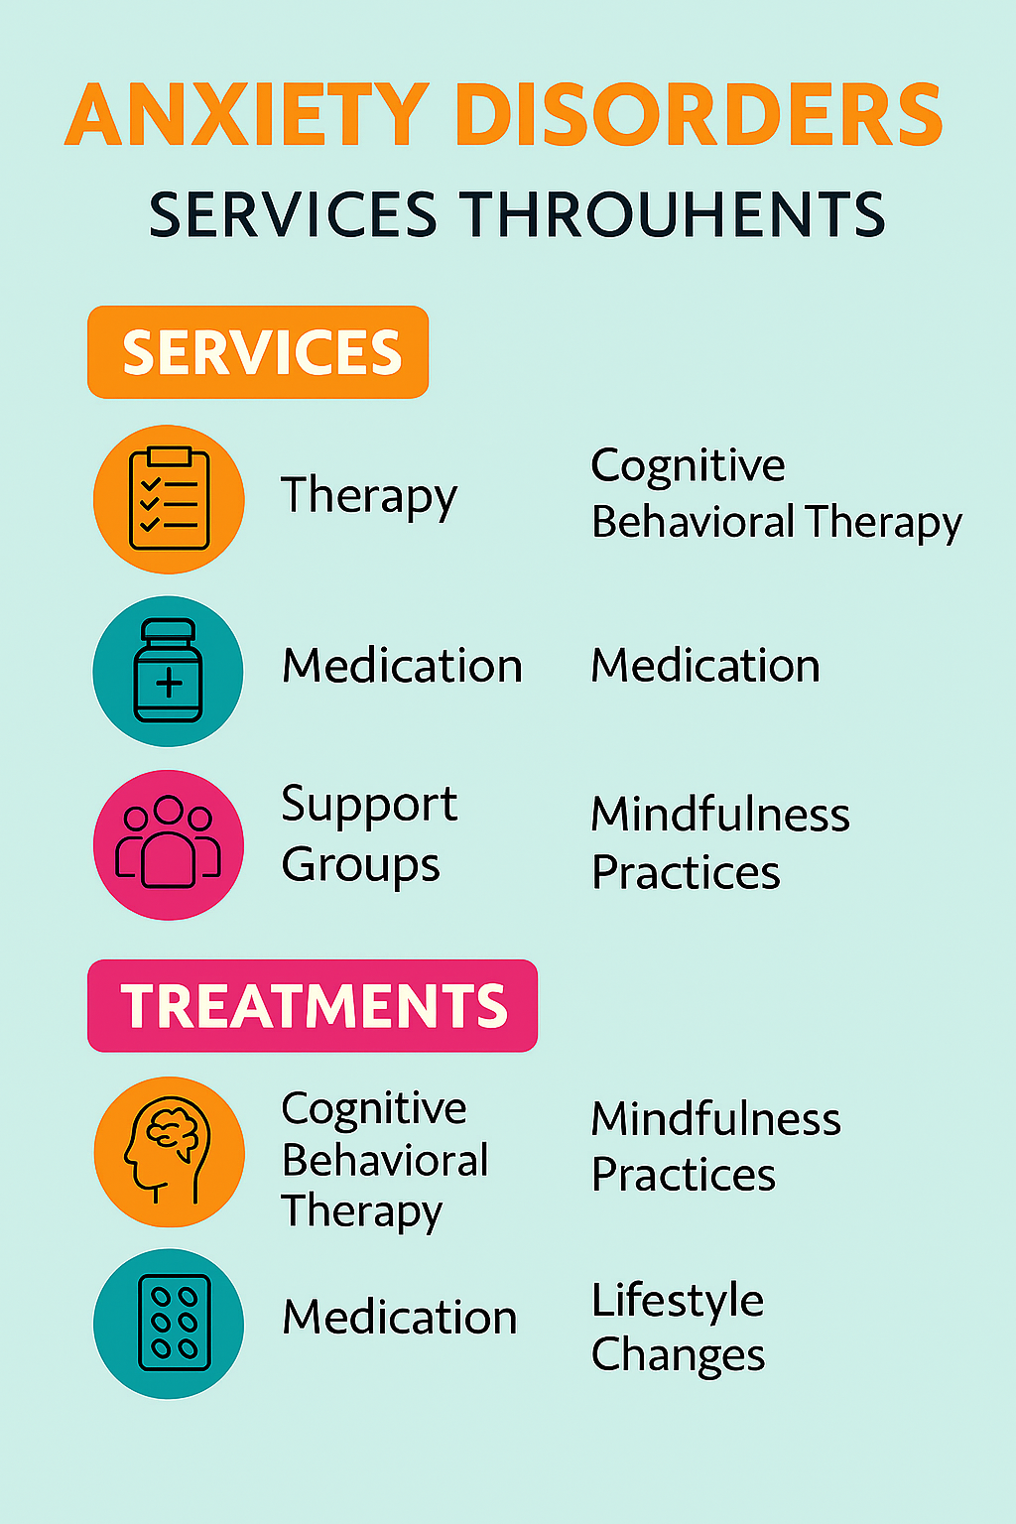
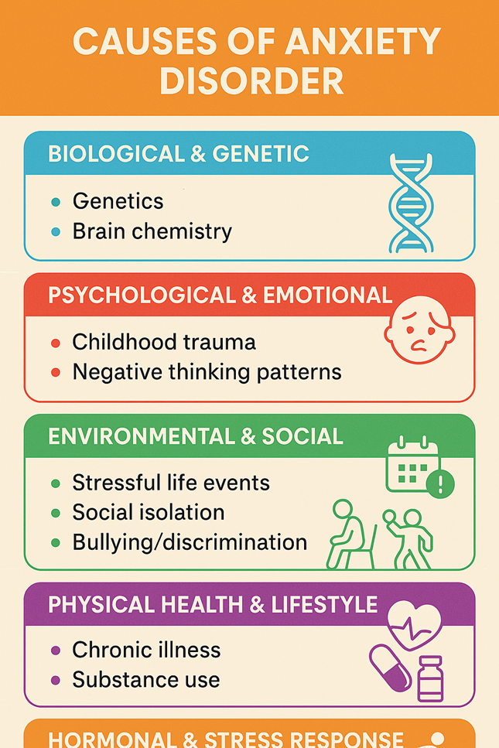
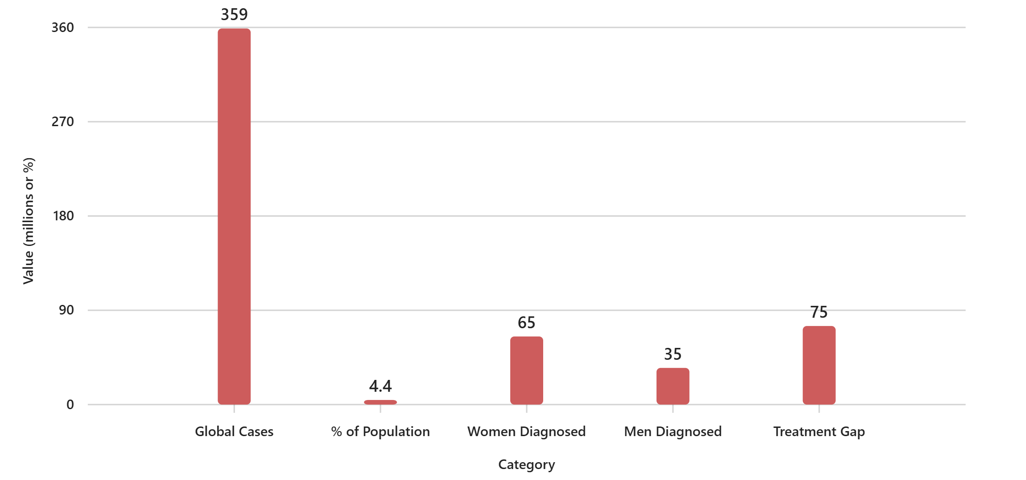
ANXIETY PSYCHOLOGY RESEARCH POSTER 6B00
Anxiety is a feeling of fear, worry, or unease that can be mild or severe. It is a normal response to stress or perceived danger, but when it becomes excessive

Slide 3
Referens
Harold, Prof.D.G. and Nel, Rev.E. (2022) ‘An Investigation on Demonic influences on human beings: Demonic Oppression or Demonic Possession: The Role of the Holy Spirit’, Pharos Journal of Theology, 103(103(2)). Available at: https://doi.org/10.46222/pharosjot.103.2033.
JIANG, Xiaoli, P.H. (2024) ‘Effectiveness Evaluation of Contracted Residents’ First Contact in Primary Care in the Context of Contracted Family Doctor Services’, Zhongguo quanke yixue, 27(10), pp. 1231–1237. Available at: https://doi.org/10.12114/j.issn.1007-9572.2023.0232.
Levin‐Rector, A. et al. (2018) ‘Predictors of Posttraumatic Stress Disorder, Anxiety Disorders, Depressive Disorders, and Any Mental Health Condition Among U.S. Soldiers and Marines, 2001–2011’, Journal of Traumatic Stress, 31(4), pp. 568–578. Available at: https://doi.org/10.1002/jts.22316.
Mindfulness-based cognitive therapy versus treatment as usual after non-remission with NHS Talking Therapies high-intensity psychological therapy for depression: a UK-based clinical effectiveness and cost-effectiveness randomised, controlled, superiority trial (2025) The Lancet Psychiatry [Preprint]. Available at: https://doi.org/10.1016/s2215-0366(25)00105-1.
Niles, A.N. et al. (2015) ‘Anxiety and depressive symptoms and medical illness among adults with anxiety disorders’, Journal of Psychosomatic Research, 78(2), pp. 109–115. Available at: https://doi.org/10.1016/j.jpsychores.2014.11.018.
. Harold, Prof.D.G. and Nel, Rev.E. (2022) ‘An Investigation on Demonic influences on human beings: Demonic Oppression or Demonic Possession: The Role of the Holy Spirit’, Pharos Journal of Theology, 103(103(2)). Available at: https://doi.org/10.46222/pharosjot.103.2033.
JIANG, Xiaoli, P.H. (2024) ‘Effectiveness Evaluation of Contracted Residents’ First Contact in Primary Care in the Context of Contracted Family Doctor Services’, Zhongguo quanke yixue, 27(10), pp. 1231–1237. Available at: https://doi.org/10.12114/j.issn.1007-9572.2023.0232.
Levin‐Rector, A. et al. (2018) ‘Predictors of Posttraumatic Stress Disorder, Anxiety Disorders, Depressive Disorders, and Any Mental Health Condition Among U.S. Soldiers and Marines, 2001–2011’, Journal of Traumatic Stress, 31(4), pp. 568–578. Available at: https://doi.org/10.1002/jts.22316.
Mindfulness-based cognitive therapy versus treatment as usual after non-remission with NHS Talking Therapies high-intensity psychological therapy for depression: a UK-based clinical effectiveness and cost-effectiveness randomised, controlled, superiority trial (2025) The Lancet Psychiatry [Preprint]. Available at: https://doi.org/10.1016/s2215-0366(25)00105-1.
Niles, A.N. et al. (2015) ‘Anxiety and depressive symptoms and medical illness among adults with anxiety disorders’, Journal of Psychosomatic Research, 78(2), pp. 109–115. Available at: https://doi.org/10.1016/j.jpsychores.2014.11.018.
. Sharma, M.K. et al. (2022) ‘Case-based evidence for cognitive behavioral therapy & naltrexone treatment of internet pornography’, Asian Journal of Psychiatry, 68. Available at: https://doi.org/10.1016/j.ajp.2021.102943.
Song, J. (2015) ‘Official relocation and self-help development: Three housing strategies under ambiguous property rights in China’s rural land development’, Urban Studies (Edinburgh, Scotland), 52(1), pp. 121–137. Available at: https://doi.org/10.1177/0042098014524612.
Scholten, W. et al. (2023) ‘Baseline Severity as a Moderator of the Waiting List-Controlled Association of Cognitive Behavioral Therapy With Symptom Change in Social Anxiety Disorder: A Systematic Review and Individual Patient Data Meta-analysis’, JAMA Psychiatry (Chicago, Ill.), 80(8), p. 822. Available at: https://doi.org/10.1001/jamapsychiatry.2023.1291.
Steel, Z. et al. (2014) ‘The global prevalence of common mental disorders: a systematic review and meta-analysis 1980–2013’, International Journal of Epidemiology, 43(2), pp. 476–493. Available at: https://doi.org/10.1093/ije/dyu038.
Thivisol, U.M.C.C. et al. (2023) ‘Loss of Tyro3 causes anxiety-relevant behavioural changes in female mice’, Brain Research, 1807. Available at: https://doi.org/10.1016/j.brainres.2023.148319.

