Slide 1

BUSINESS
Samia Assebab
My role as a business analysts is working alongside marketing to strengthen product image​
The middle-man between departments​
​Conceptualize ideas ​
Measure expectations
In this section I will discuss my role in detail and the importance of business analysis as well as legal classification, business projection and long term objectives.

Slide 2

Our slogan
"Scan, Identify and Store"

Slide 3
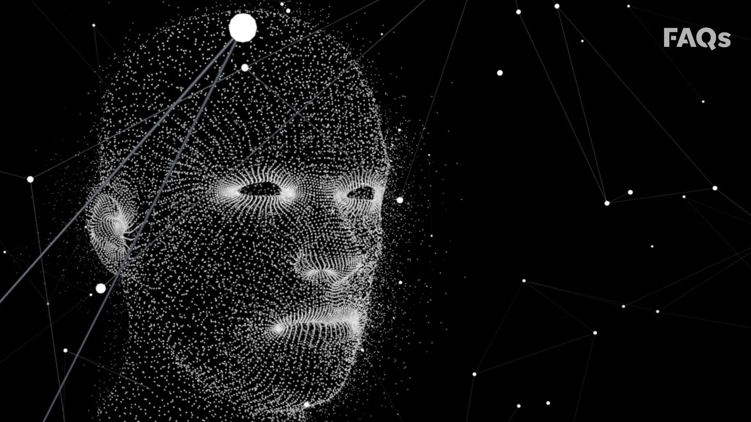
MISSION STATEMENT
“Revolutionise and replace all attendance and registry systems by 2030 with FIRNN”

Slide 4
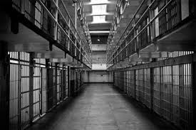
PRISONS[3]

Slide 5

HEALTH AND WELLNESS ORGANISATIONS[6]

Slide 6


UNIVERSITIES, SCHOOLS AND EMPLOYMENT[1][2]

Slide 7

DATA [4][7]

Slide 8
Conclusion
From the brief business analysis it is evident there is a need from this product as well as great benefit for example;
The possibility of integration into multiple registration dependant industries
The potential to expand into secure infrastructures
the data collected could help industries improve protocols and security measures

Slide 9

References
Kei Nagai, Hiroaki Kikuchi, Wakaha Ogata, Masakatsu Nishigaki, "ZeroBio - Evaluation and Development of Asymmetric Fingerprint Authentication System Using Oblivious Neural Network Evaluation Protocol", Availability Reliability and Security 2007. ARES 2007. The Second International Conference on, pp. 1155-1159, 2007
. N. K. Ratha, J. H. Connell, R. M. Bolle, "Enhancing security and privacy in biometrics-based authentication systems", IBM Systems Journal, vol. 40, no. 3, 2001
PS Anu, V Shibu, KVT Jabir, Mathew Preetha, "A High Security Prison Management System Implementation Using RFID CARD", International Journal of Computer Technology and Applications (IJCTA), vol. 6, no. 1, pp. 89-92, Jan-Feb 2015
Das, Ravi (2005a) The Application of Biometric Technologies: Fingerprint Recognition. Technology Executives Club [Online]. http://www.technologyexecutivesclub.com/Articles/ artBiometricsFingerprintRecognition.htm
S. Gleni, C. Maple and Y. Yue, "Biometrics Health Care Information Systems and Secure Clinical Messaging: The Case of the NHS," 2009 International Conference on Computing, Engineering and Information, Fullerton, CA, 2009, pp. 104-111
https://www.nhs.uk/using-the-nhs/nhs-services/the-nhs-app/help/app-login/biometric-login/
S. G. H D, M. Imran and H. K. G, "Feature level fusion of Face and Iris using Deep Features based on Convolutional Neural Networks," 2018 International Conference on Advances in Computing, Communications and Informatics (ICACCI), Bangalore, 2018, pp. 116-119

