Slide 1

Understanding Early Childhood Development: Application of Bowlby’s Attachment Theory
Module:
Psychology in Health and Social Care (LCHS4010)
Student name: Munaza sakindar
ID: 2419348

Slide 2
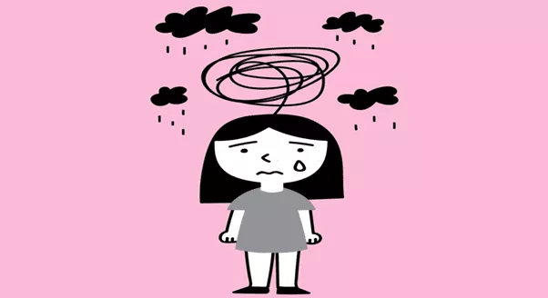
Introduction
Scenario:
Amira, 3 years old, newly joined nursery, shows separation anxiety, limited speech, and difficulty joining group play.
Aim:
Understand Amira’s needs and support her emotional, social, and cognitive development.
Why This Theory:
Bowlby’s Attachment Theory explains early bonds, security, and confidence in children (Bosmans et al., 2022).
Focus: Apply the theory to Amira, propose evidence-based interventions, and consider nature and nurture influences.
(Psychiatric care, 2021)

Slide 3
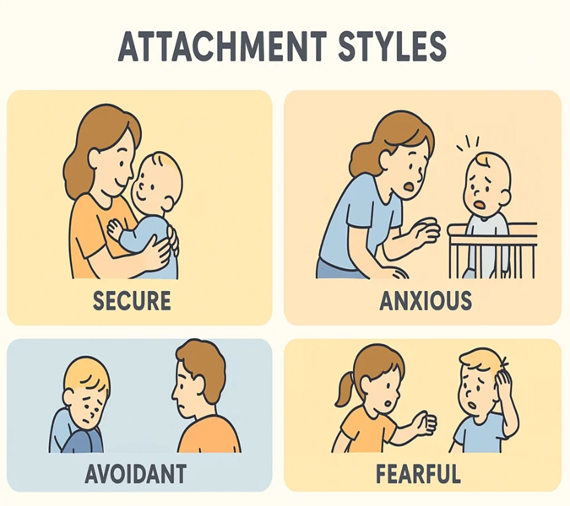
Introduction to Bowlby’s Attachment Theory
Developed by John Bowlby (1969) – early emotional bonds essential for survival.
Children have a biological drive to seek attachment for safety (Cadman et al., 2023).
Ainsworth (1978) expanded the theory: secure, insecure-avoidant, and insecure-ambivalent attachments (Groh et al., 2021).
Attachment shapes emotional, social, and cognitive development (Degotardi et al., 2023).
(Groh et al., 2021)

Slide 4
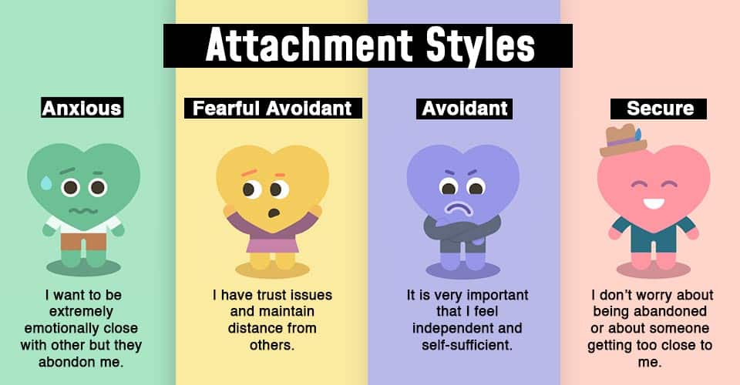
Key Concepts
Secure base & proximity seeking (Bosmans et al., 2022).
Internal working models – mental templates of relationships (Groh et al., 2021).
Separation anxiety & emotional regulation (Cadman et al., 2023).
How it Works
Children form attachments with caregivers for safety and comfort (Degotardi et al., 2023).
Secure attachment supports exploration, confidence, and learning (Murray et al., 2022).
Relevance to Early Years
Explains behavior during transitions and separation (Ahnert et al., 2023).
Supports emotional, social, and cognitive outcomes (Bosmans et al., 2022).
Biological & Environmental Links
Biological: Brain stress systems, cortisol, temperament, emotional regulation (Bernard et al., 2021; Belsky & Pluess, 2022).
Environmental: Caregiver sensitivity, consistency, routines, cultural context (Degotardi et al., 2023; Ahnert et al., 2023).
Interaction of both shapes attachment security (Cadman et al., 2023).
(Mikulincer, 2007)

Slide 5
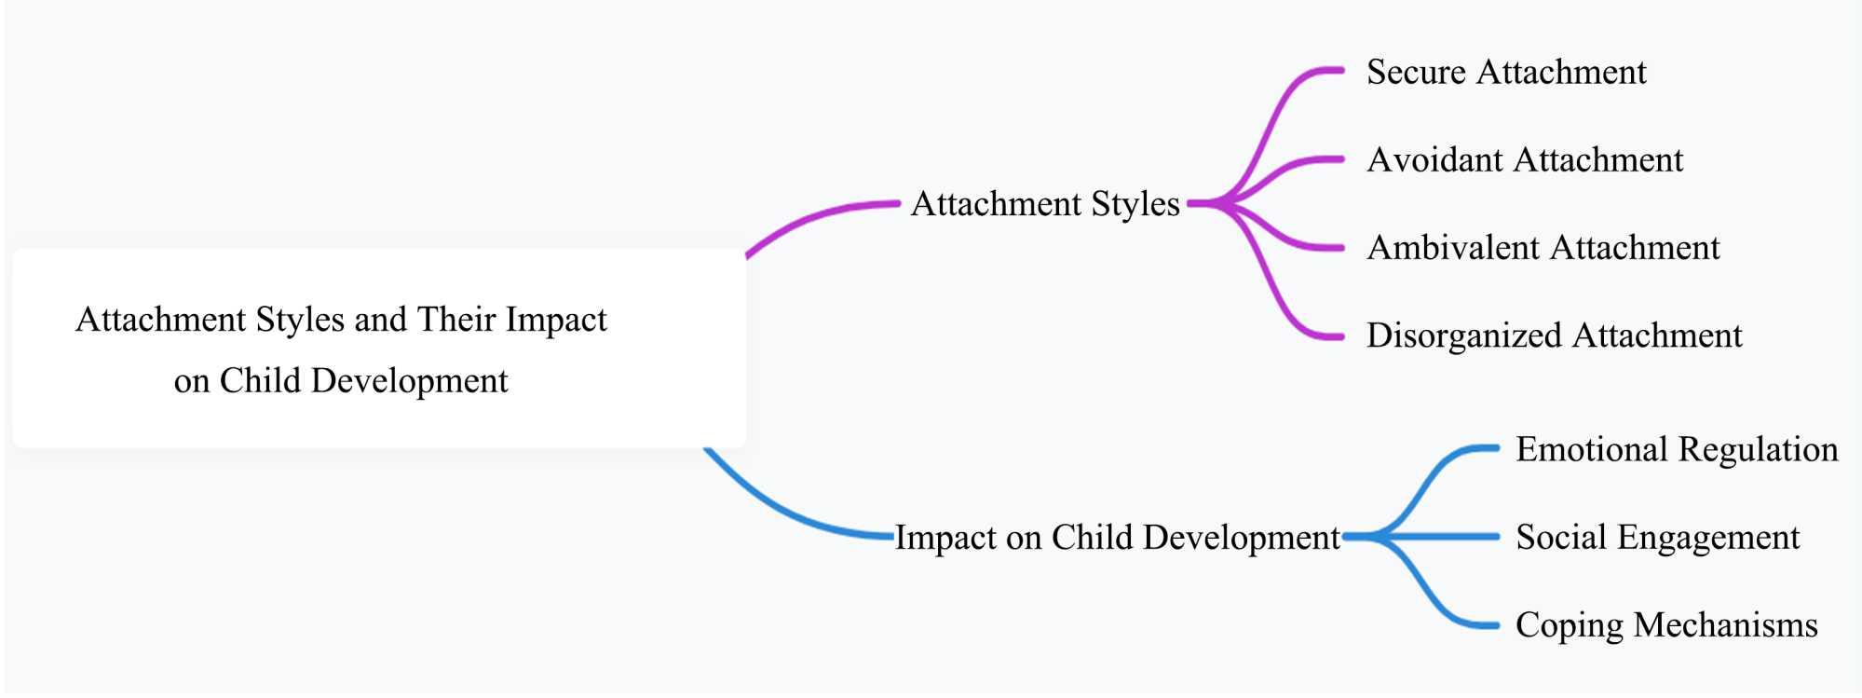
Relevance to Early Childhood Development
Emotional Wellbeing
Secure attachment lowers anxiety and builds resilience (Bosmans et al., 2022).
Social Development
Promotes cooperation, peer play, and empathy (Groh et al., 2021).
Cognitive Growth
Secure children explore more confidently, supporting problem-solving and learning (Dagan & Sagi-Schwartz, 2021).
Physical Development
Lower stress improves brain development and overall health (Cadman et al., 2023).
Overall Impact
Attachment security in early years predicts school readiness and long-term relationships (Fearon & Schuengel, 2021).
(Sandoval, 2024)

Slide 6
Application of Attachment Theory to Amira’s Situation
Separation Anxiety: Clings and cries when carers leave → indicates insecure attachment (Cadman et al., 2023).
Secure base Seeking: Relies on nursery staff for reassurance → needs a trusted caregiver (Degotardi et al., 2023).
Limited Peer Interaction: Avoids group play → reflects emotional insecurity limiting exploration (Ahnert et al., 2023).
Reduced Verbal Communication: Limited speech → linked to low confidence and anxiety (Murray et al., 2022).
Overall Developmental Needs: Requires stable relationships, emotional support, and trust-building to promote social, emotional, and cognitive growth (Bosmans et al., 2022).

Slide 7
Bowlby’s 4 Stages of Attachment Theory Applied to Nursery Setting And Amira
Stage | Age Range | Key Features | Nursery Implications | Application to Amira
Pre-Attachment | Birth–6 weeks | Infants respond to comfort but show no preference for specific caregiver. | Provide calm, gentle routines; safe spaces with soft furnishings. | Amira has passed this stage, but her nursery should still ensure predictable routines to support comfort.
Indiscriminate Attachment | 6 weeks–8 months | Preference for familiar adults emerges, but child still accepts comfort from many. | Assign a consistent key worker; display family photos; create continuity between home and nursery. | Though older, Amira benefits from continuity of care with a key worker to build trust in her new setting.
Discriminate Attachment | 6–24 months | Strong bond with primary caregiver; separation anxiety common. | Use goodbye rituals, gradual separation, comfort objects, and safe retreat areas. | Amira’s separation anxiety reflects difficulty transitioning beyond this stage. Structured goodbyes and comfort strategies can help.
Multiple Attachments | 24 months+ | Bonds expand to peers and multiple adults; more social interaction. | Provide group play opportunities, shared reading spaces, and collaborative activities. | At 3 years, Amira should be forming multiple attachments, but her anxiety hinders this. Supported peer play and trusted adult presence can scaffold her progress.

Slide 8
Practical Strategies & Interventions
Key Person Approach: Assign a consistent caregiver to provide security (Degotardi et al., 2023).
Gradual Separation: Introduce short separations, increasing duration over time (Ahnert et al., 2023).
Emotionally Responsive Care: Comfort and validate feelings during distress (Cadman et al., 2023).
Scaffolded Peer Play: Support structured peer interactions to build confidence (Barrett et al., 2021).
Language Support: Use secure interactions to encourage verbal communication (Murray et al., 2022).
Parent–Nursery Partnership: Ensure consistent strategies across home and nursery (Degotardi et al., 2023).

Slide 9
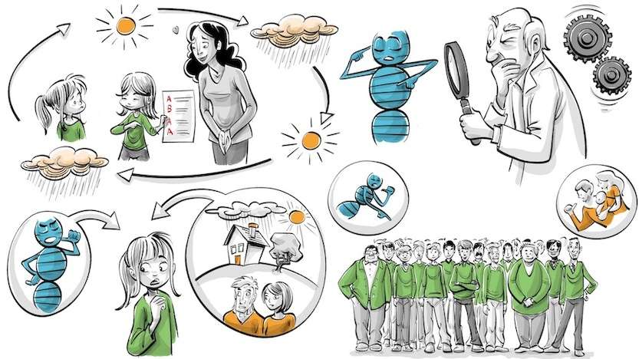
Nature and Nurture Influences
Biological Factors:
Environmental Factors:
Child’s temperament influences sensitivity to separation (Bernard et al., 2021).
Stress response (cortisol levels) affects anxiety and emotional regulation (Belsky & Pluess, 2022).
Caregiver sensitivity and responsiveness promote emotional security (Degotardi et al., 2023).
Consistent routines and supportive nursery environment reduce stress (Ahnert et al., 2023).
Parental engagement and home consistency strengthen attachment patterns.
Interaction:
Secure attachment emerges from the interplay of biological predispositions and environmental support (Cadman et al., 2023).
(Koblin, 2022)

Slide 10
Strengths and Limitations of Bowlby’s Theory
Limitations:
Strengths:
Overemphasizes mother–child bond; less focus on multiple caregivers (Schuengel et al., 2022).
Limited explanation of cognitive and language development (Howes & Spieker, 2022).
Environmental and cultural factors underexplored (Howes & Spieker, 2022).
Explains emotional and social development in early childhood (Bosmans et al., 2022).
Informs early years practice (key person model) (Degotardi et al., 2023).
Cross-cultural evidence supports universality of attachment needs (Groh et al., 2021).
Comparison to Vygotsky:
Vygotsky emphasizes social learning and scaffolding.
Bowlby focuses on emotional bonds and security.
Both highlight the importance of relationships, but from different perspectives.
Conclusion:
Bowlby’s theory shows that secure attachment is the foundation of emotional, social, and cognitive growth. By applying this framework to Amira, we see that consistent, nurturing care is essential for reducing her anxiety, strengthening trust, and enabling her to thrive in the nursery setting.

Slide 11
References
Ahnert, L., Eckstein-Madry, T., Datler, W., Deichmann, F. and Piskernik, B. (2023) ‘Stress during transition from home to public childcare’, Applied Developmental Science, 27(4), pp. 320–335. doi:10.1080/10888691.2021.1950745.
Bakermans-Kranenburg, M.J. and Van IJzendoorn, M.H. (2021) ‘Attachment transmission and intervention: A meta-analytic update’, Attachment & Human Development, 23(4), pp. 622–647. doi:10.1080/14616734.2020.1846602.
Belsky, J. and Pluess, M. (2022) ‘Differential susceptibility to environmental influences: Developmental origins and mechanisms’, Development and Psychopathology, 34(2), pp. 409–423. doi:10.1017/S0954579421000923.
Bernard, K., Dozier, M., Bick, J. and Gordon, M.K. (2021) ‘Cortisol regulation in early childhood: The role of caregiving environments’, Developmental Science, 24(6), pp. 1–12. doi:10.1111/desc.13105.
Bosmans, G., Bakermans-Kranenburg, M.J., Vervoort, E. and Verhees, M.W.F.T. (2022) ‘Attachment and child development: State of the science and future directions’, Child Development Perspectives, 16(2), pp. 101–107. doi:10.1111/cdep.12446.
Cadman, T., Diamond, A. and Fearon, R.P. (2023) ‘Stress regulation and attachment in early childhood: Implications for health and development’, Frontiers in Psychology, 14, pp. 116–125. doi:10.3389/fpsyg.2023.1138612.
Degotardi, S., Torr, J. and Nguyen, N. (2023) ‘The significance of attachment-informed practice in early childhood education’, Early Childhood Research Quarterly, 62, pp. 250–261. doi:10.1016/j.ecresq.2022.11.003.
Fearon, R.P., Schuengel, C. and Van IJzendoorn, M.H. (2022) ‘The significance of insecure attachment and disorganization in the development of children’s externalizing behavior: A meta-analytic study’, Child Development, 93(1), pp. 18–32. doi:10.1111/cdev.13759.
Groh, A.M., Fearon, R.P. and Bakermans-Kranenburg, M.J. (2021) ‘The significance of attachment security for children’s socioemotional development’, Development and Psychopathology, 33(2), pp. 497–511. doi:10.1017/S0954579420001535.
Murray, E., Heard, C. and Freeman, E. (2022) ‘Supporting language development through responsive relationships in early years settings’, Journal of Early Childhood Literacy, 22(2), pp. 203–220. doi:10.1177/1468798420988759.

