Slide 1

Jake Weeks Assignment 2
“Critically discuss the impact the media has on UK policing”

Slide 2
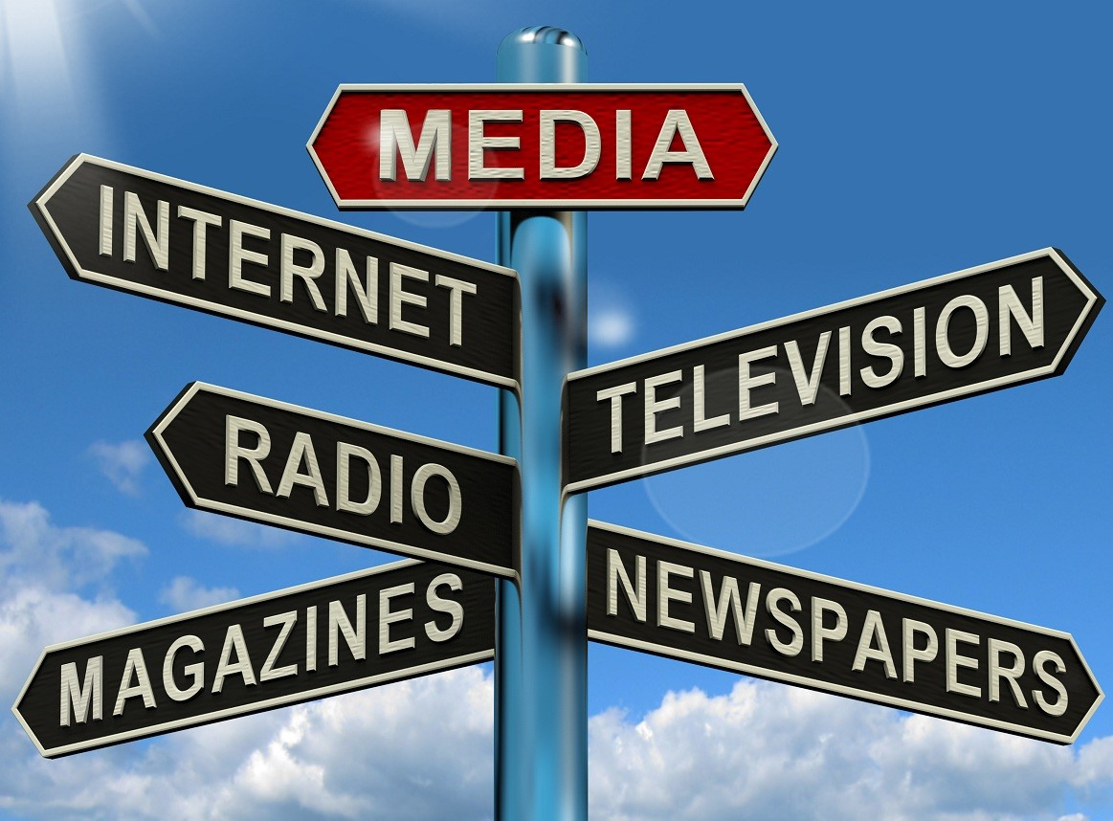
Types of media
The media, including newspapers, television, and social media, plays a crucial role in shaping public opinion and attitudes towards various issues, including policing (Reiner 2010).
The media's coverage of policing issues can influence-
The public's perceptions of the police
Their trust in the police
The way they interact with the police.

Slide 3
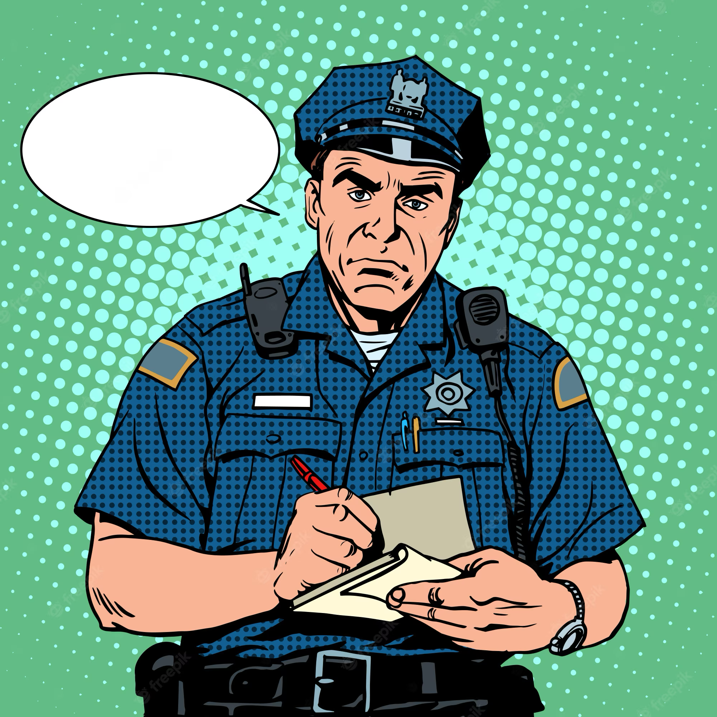
Media's impact on police operations:
Negative media portrayals can also contribute to a sense of low morale and job dissatisfaction among police officers (Thompson, 2019).
This can lead to higher levels of-
-Absenteeism
-Reduced productivity
-Increased turnover

Slide 4
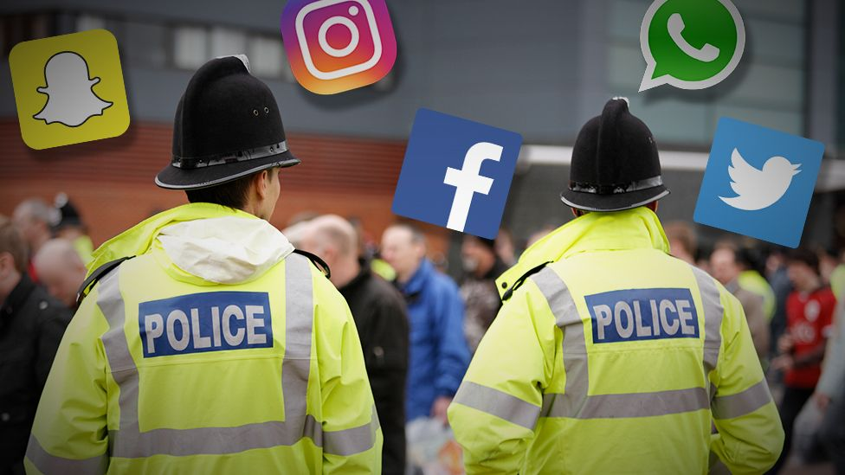
The media can have big influences on the way that the police operate.
The media can effect the decision making of the police.
Police officers may use less force or it may be used with more caution because of concern of negative media portrayal (Gau & Brunson, 2010).
Police officers may be discouraged from using force when it's required to defend themselves or others, even while it may lessen the use of excessive force (Terrill, 2015).

Slide 5
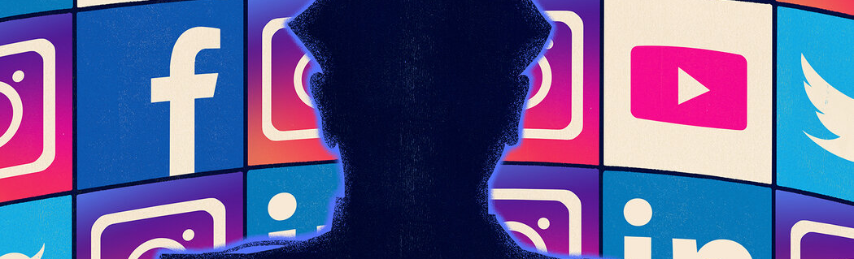
Media's role in police accountability
The media also plays a crucial role in police accountability.
The media can highlight cases of-
-Police misconduct
-Corruption
-Brutality

Slide 6
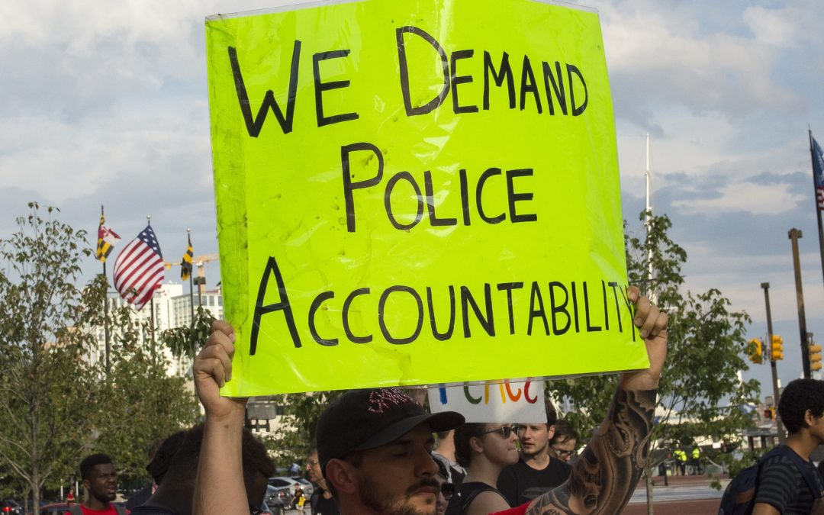
The medias role in police accountability
According to Newburn (2008), the media has a significant impact on how the public perceives the police in the UK, particularly in cases of police misconduct and the use of force.
Skolnick and Fyfe (1993) also highlight the media's role in bringing attention to cases of police brutality and excessive force, and how media coverage can lead to increased public scrutiny and accountability for the police.

Slide 7
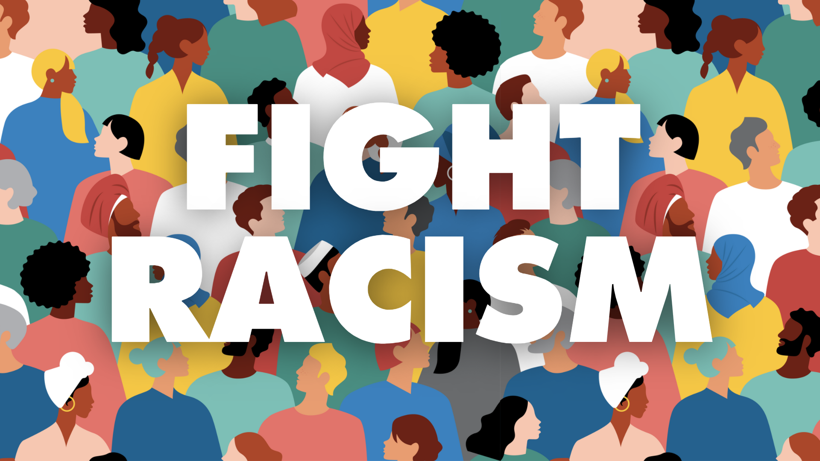
How the media brings attention to racism
Recent occurrences like George Floyd's passing have brought attention to the influence of the media on UK policing.
An example of this being when the media significantly contributed to bringing attention to problems of systematic racism in UK policing and to concerns about police violence (The Guardian, 2020).
2019 investigation by the Home Affairs Select Committee discovered that black individuals were 9.5 times more likely than white people to be stopped and searched by the police
Media has the power to shape public opinion and influence policy decisions (Lawrence 2000)

Slide 8
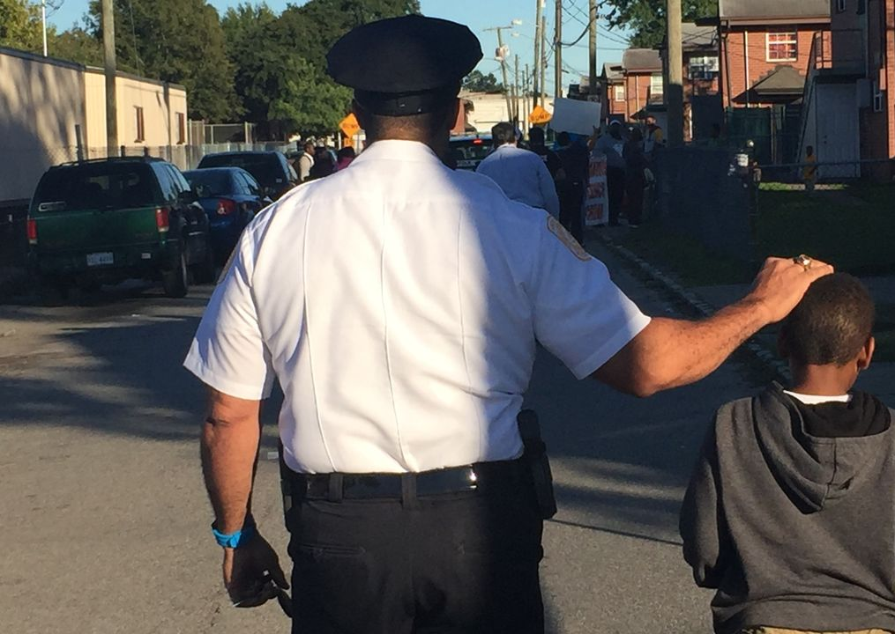
Media's impact on police-community relations:
Negative media coverage of the police can lead to the public losing trust in the police
positive media coverage of the police can enhance public trust in the police
The success of policing in the UK depends on maintaining public trust (Kapardis, 2017).

Slide 9
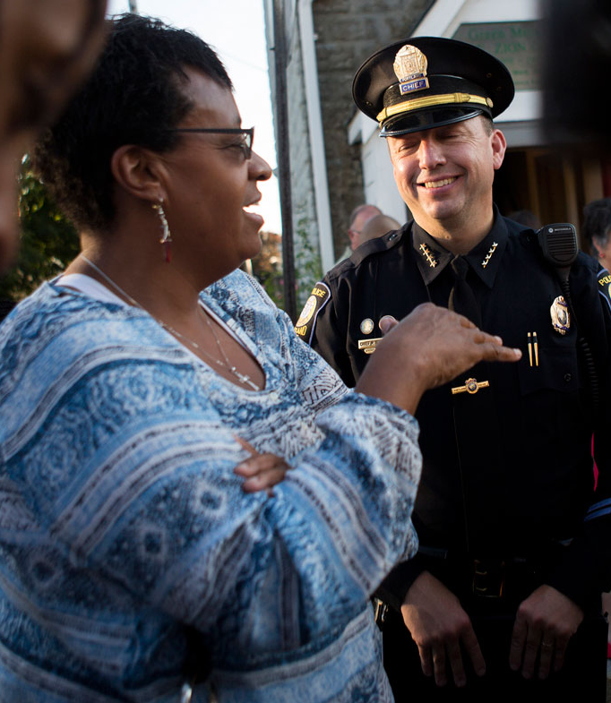
The media is extremely important in influencing how the general public feels about the police and what they do.
According to Jones and Newburn (2006), positive media coverage of police work can increase public trust and confidence while unfavourable coverage might erode those feelings.
For instance, by reporting on instances involving the police, the media can foster or legitimise ideas of police bias, wrongdoing, and brutality (Reiner, 2010).
On the other hand, unfavourable media coverage of interactions between police and the community can sour ties and thwart efforts to foster trust and cooperation (Gillham & Marx, 2015).

Slide 10
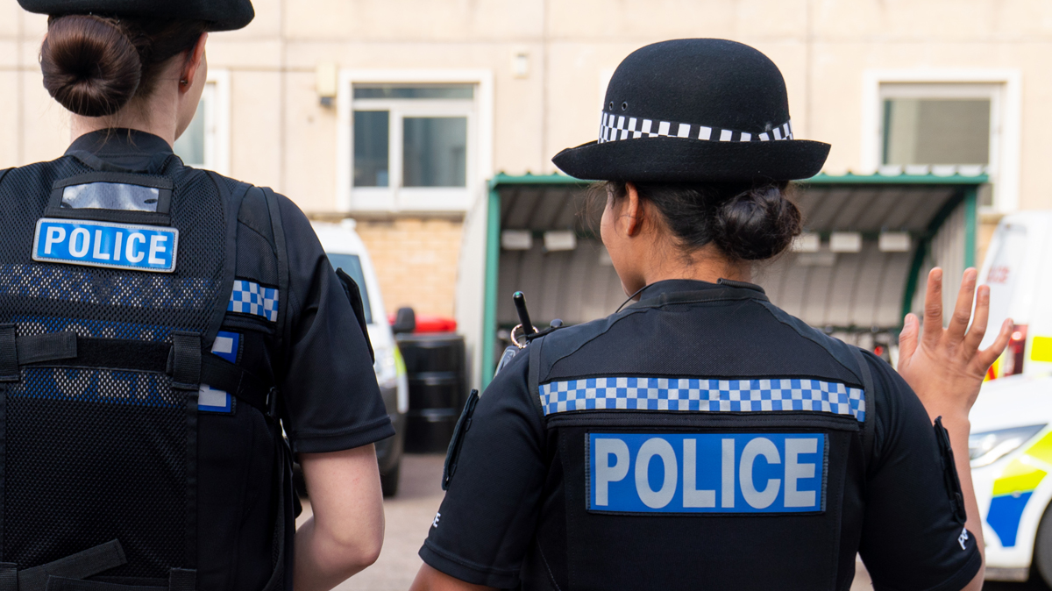
Implications of media's impact on policing
Social media can both amplify and distort public perceptions of the police (Cockcroft 2017).
The media's impact on policing has several implications.
-The media has the power to shape public opinion.
-The media's coverage of policing activities can impact police accountability and transparency.
-The media's coverage of policing activities can impact police-community relations.

Slide 11
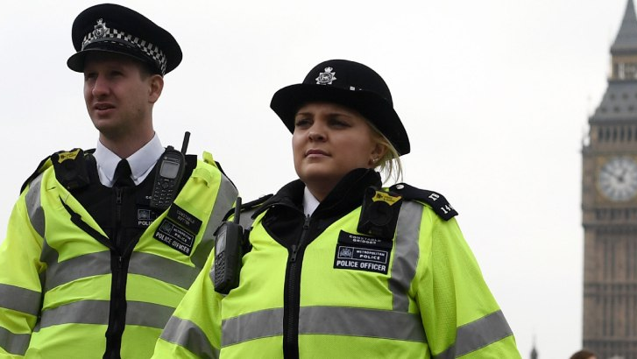
The media can shape public perceptions of the police by highlighting incidents of police misconduct and excessive use of force (Bradford et al. 2014).
For police personnel, the media can be a useful source of information and can be used to locate suspects or witnesses (Maguire, Morgan, & Reiner, 2002).
The integrity of the legal system can be jeopardised by inaccurate or sensationalistic reporting (Ericson & Haggerty, 1997).

Slide 12
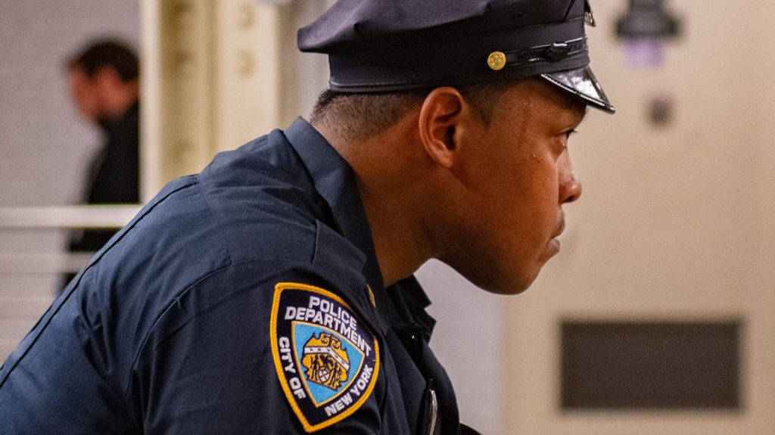
How negative media portrayals effect the police officers health mentally
Negative media coverage of police can lead to:
  Feelings of stress, anxiety, and depression among officers
  Officers feeling unfairly judged and criticized for the actions of a few bad actors
  A sense of collective guilt and shame among officers
  (Seltzer & Yarhi-Milo, 2020)
Negative outcomes include:
  Decreased job satisfaction
  Increased cynicism
  Higher likelihood of burnout
  (Cochran & Warren, 2013)

Slide 13
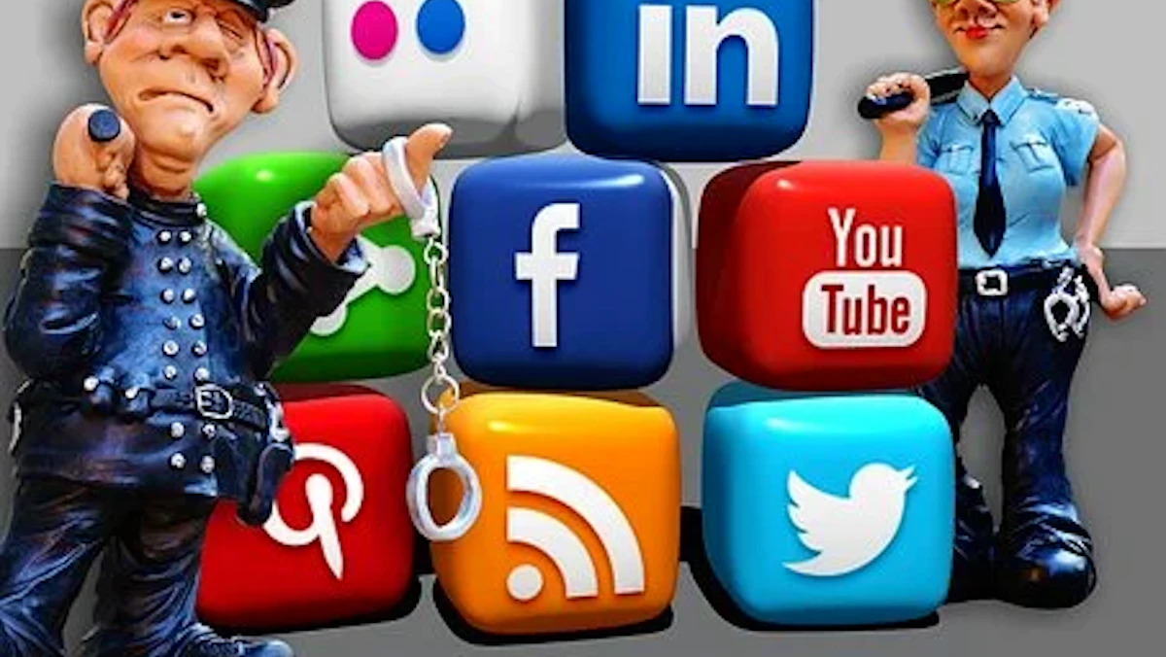
Negative media coverage can:
  Erode trust between police officers and communities they serve
  Contribute to feelings of isolation and alienation among officers
  Make officers feel unsupported by the public or their superiors
  (Seltzer & Yarhi-Milo, 2020)
Negative outcomes include:
  Officers becoming more defensive
  Officers being less willing to engage with community members
  Tensions being exacerbated and leading to further negative interactions

Slide 14
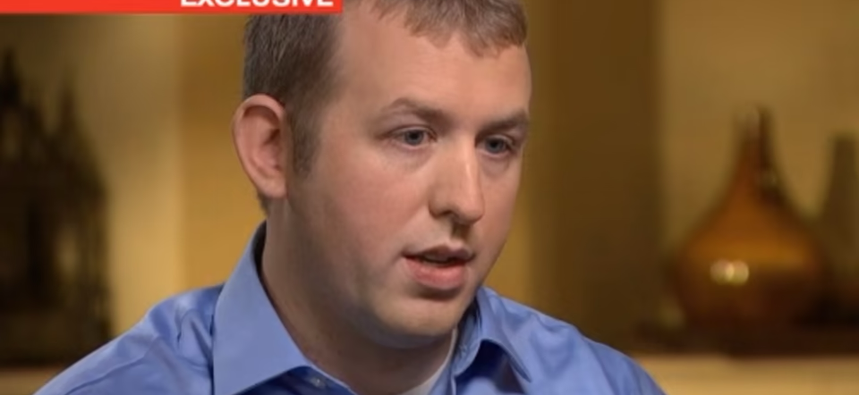
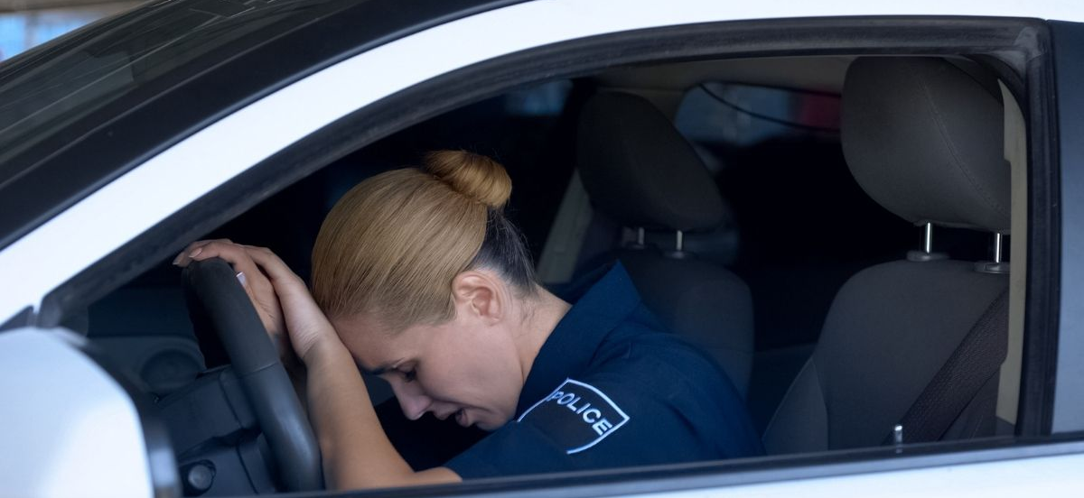
How media misinformation can effect police officers career
Example of Negative Media Coverage on Police - Darren Wilson Case
Darren Wilson, police officer in Ferguson, Missouri
Accused of shooting and killing an unarmed black teenager, Michael Brown in 2014
Grand jury investigation found no wrongdoing on Wilson's part
Media spread false information and insinuations about the case
Resulted in widespread public outcry and protests
Wilson forced to resign from his position
Reputation and career irreparably damaged
(Buchanan, 2014)

Slide 15
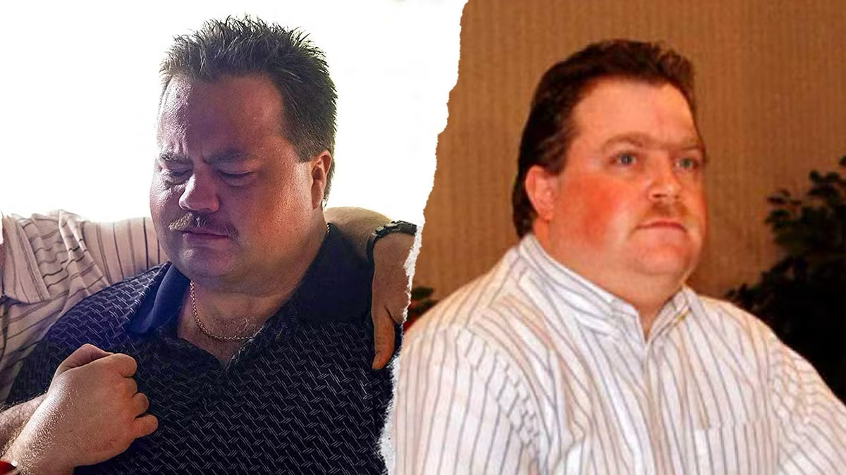
Example of Negative Media Coverage - Richard Jewell Case
Richard Jewell, security guard falsely accused of being responsible for 1996 Summer Olympics bombing in Atlanta, Georgia
Media initially reported Jewell as a suspect and portrayed him as a "lone bomber"
No evidence to support the claim
False accusations caused Jewell to be fired from his job
Subjected to intense scrutiny and public ridicule
Later discovered that Jewell had nothing to do with the bombing
Damage to reputation and career had already been done
(Ostrow, 2000)

Slide 16
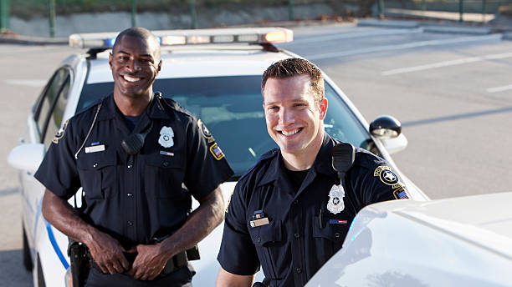
What needs to change
Ways Media Can Improve Coverage of Police
Focusing on positive stories:
  Highlight positive work of police officers
  Include efforts to build community relationships and reduce crime
  Helps to build trust between police and public
  (Cockcroft, 2017)
Providing context:
  Include information on challenges faced by officers
  Share policies and procedures that guide their actions
  Helps public understand complexities of policing
  (Reiner, 2010)

Slide 17
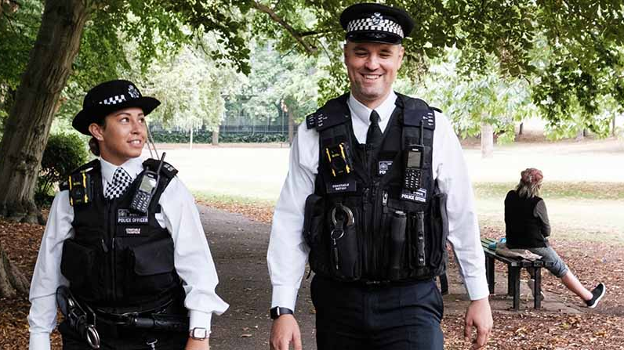
Holding police accountable:
  Media must hold police accountable for misconduct or abuses of power
  Ensures police follow proper procedures and behave ethically
  (Cockcroft, 2017)
Engaging with police:
  Seek to understand work and challenges faced by police departments and officers
  Builds relationships between police and media
  Promotes accurate and balanced coverage
  (Thompson, 2019)
Rebuilding trust:
  Work to rebuild trust with the public and police departments
  Achieved through transparency and commitment to accurate and responsible reporting
  (Reiner, 2010)

Slide 18
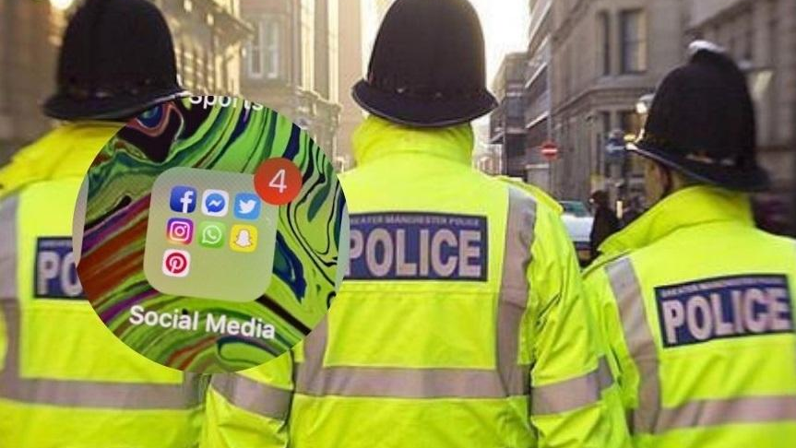
Conclusion
Media's Impact on Policing in the UK
The media's impact on policing in the UK is significant
Media coverage of policing activities can:
  Influence public perceptions of the police
  Impact police decision-making processes
  Impact police accountability and transparency
Media coverage can also impact police-community relations
  Far-reaching implications for public safety and security

Slide 19
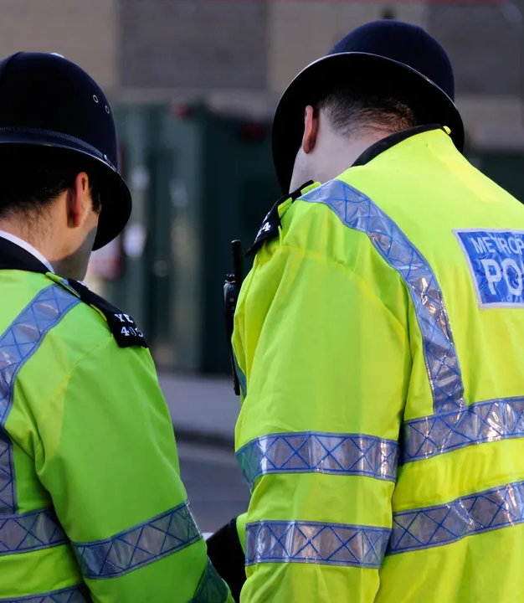
Need for balanced coverage that includes positive stories and holds police accountable
Accurate and unbiased reporting is crucial
  Prevents media from jeopardizing ongoing investigations
  Prevents undermining fairness of legal system
  Prevents harm to police-community relations

Slide 20
References
Bradford, B., Jackson, J., Hough, M., & Myhill, A. (2014). (Accessed April 25)
Buchanan, L. (2014, November 24). Darren Wilson Is Cleared of Rights Violations in Ferguson Shooting. The New York Times. Retrieved from https://www.nytimes.com/2014/11/25/us/ferguson-darren-wilson-shooting-michael-brown-grand-jury.html (Accessed April 24)
Cochran, J. K., & Warren, J. I. (2013). Police stressors and health: A review of the literature. Journal of Police and Criminal Psychology, 28(1), 1-10. (Accessed April 26)
Cockcroft, T. (2017). The impact of social media on policing. European Journal of Policing Studies, 4(1), 1-21. (Accessed April 25)
Ronald J. Ostrow (2000) Richard Jewell Case Study. Available at http://www.columbia.edu/itc/journalism/j6075/edit/readings/jewell.html (Accessed April 24)
Ericson, R. V., & Haggerty, K. D. (1997). Policing the risk society. Oxford, UK: Clarendon Press. (Accessed April 25)
Gau, J. M., & Brunson, R. K. (2010). Procedural justice and order maintenance policing: A study of inner-city young men's perceptions of police legitimacy. Justice Quarterly, 27(2), 255-279. (Accessed April 25)
Gillham, P., & Marx, G. T. (2015). Complexity, accountability, and policing: Editorial introduction. Policing: A Journal of Policy and Practice, 9(3), 195-201. (Accessed April 21)
House of Commons Home Affairs Committee. (2019). Home Office delivery of Brexit: Policing and security cooperation. Retrieved from https://committees.parliament.uk/work/3183/home-office-delivery-of-brexit-policing-and-security-cooperation-inquiry/ (Accessed 21 April 2023).

Slide 21
References
Jones, T., & Newburn, T. (2006). Understanding the role of the media in reporting crime. (Accessed April 24)
T. Newburn, T. Williamson, & A. Wright (Eds.), Handbook of criminal investigation (pp. 348-367). Devon, UK: Willan Publishing. (Accessed April 24)
Kapardis, A. (2017). Police and human rights: A manual for teachers and trainers. Strasbourg, France: Council of Europe Publishing. (Accessed April 22)
Lawrence, R. G. (2000). The politics of force: Media and the construction of police brutality. University of California Press. (Accessed April 21)
Maguire, M., Morgan, R., & Reiner, R. (2002). The Oxford handbook of criminology (2nd ed.). Oxford, UK: Oxford University Press. (Accessed April 25)
Newburn, T. (2008). Handbook of Policing. Willan Publishing. (Accessed April 24)
Reiner, R. (2010). The politics of the police (4th ed.). Oxford, UK: Oxford University Press. (Accessed April 24)
Seltzer, J., & Yarhi-Milo, K. (2020). Policing in the age of negative media portrayals. Annual Review of Political Science, 23, 437-454. (Accessed April 24)
Skolnick, J. H., & Fyfe, J. J. (1993). Above the law: Police and the excessive use of force. Free Press. (Accessed April 25)
Terrill, W. (2015). Police use of force: The impact of media coverage on public perceptions of law enforcement. Journal of Criminal Justice and Law Review, 3(1), 34-43. (Accessed April 25)
The Guardian. (2020, June 3). George Floyd protests: UK police urged to take a knee in solidarity. Retrieved from https://www.theguardian.com/us-news/2020/jun/03/thousands-gather-in-london-for-george-floyd-protest (Accessed April 22)
Thompson, A. (2019). ‘The only people who understand are us’: Policing, media, and trauma. Critical Criminology, 27(1), 61-75. (Accessed April 22)

