Slide 1
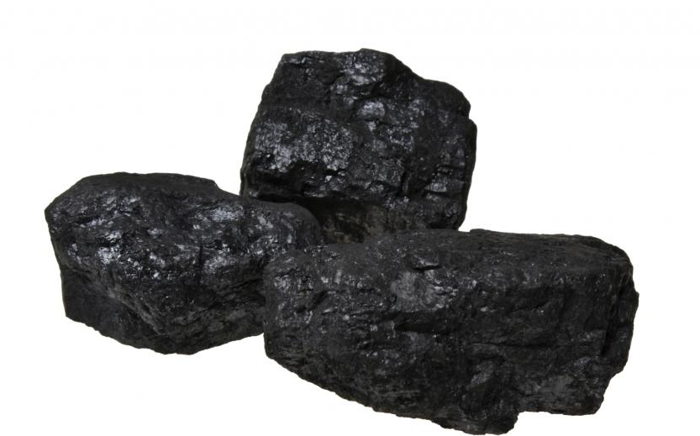
Blaenafon and Coal

Slide 2
Coal
What is coal
Coal is the largest source of generating electricity in the world currently
What was Blaenafon coal used for by the end of 18th century
Much coal was transported by rail to Newport and exported
Notes:
Coal is a black or brownish-black sedimentary rock that can be burned for fuel and used to generate electricity. It is composed mostly of carbon and hydrocarbons, which contain energy that can be released through combustion (burning).
Coal is the largest source of energy for generating electricity in the world, and the most abundant fossil fuel in the United States.
The end of the 18th century saw the beginnings of a canal and rail network across south Wales.
This enabled the transport of coal, extracted with the help of new steam engines for pumping and winding, to the coast or cities.
Much coal was transported by rail to Newport and exported to other UK cities or abroad for use in steel making or power steam engines.

Slide 3
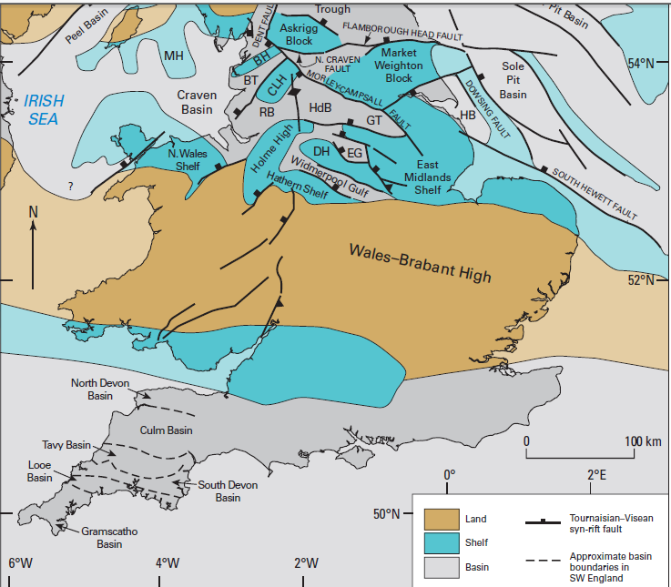
Coal formation South Wales
UK situ during the Carboniferous period 300 million years ago
Notes:
DEVONIAN RIVERS AND CARBONIFEROUS SWAMPS
390-290 million years ago
By the middle of the Devonian period, the former Welsh Basin had therefore become part of a range of mountains. The climate was arid, with occasional rainfall eroding the mountains away and generating new sediments in the process. Rivers carried debris away towards the Midlands and South Wales, depositing sands over the plains. The sands eventually consolidated, to form what is today called the Old Red Sandstone. These strata give the characteristic red colour to the soils of parts of South and East Wales.
The Devonian period has been called the "age of fishes". It marked the major evolutionary burst that established these creatures in their full diversity - bony fish, sharks, lungfish - in seas, lakes and rivers worldwide. And from the lungfish there evolved the first amphibians to crawl onto the land, where the colonisation by plants was already well underway.
With the onset of the Carboniferous period, shallow warm seas invaded areas of NE and South Wales, once again allowing coral reefs to flourish and lay down the limestones in which Wale's caves were later formed.
But by the Upper Carboniferous, and particularly in South Wales, extensive coastal deltas and swamps dominated the landscape. These were dense with tree-sized club mosses while ferns, seed-ferns, and other plant life lived on the raised river levees. Great thicknesses of peaty matter accumulated in these swamps, which, under the higher pressures and temperatures of deeper and deeper burial, were slowly converted into coal seams. In South Wales, Rhondda Heritage Centre and Big Pit are places to find out everything you need to know about coal and coal mining. Some impressive mineral specimens are also known from cavities in coalfield ironstones.
Later Carboniferous rocks in South Wales include river-deposited sandstones containing pellets of coal. These show that, by that time, the strata deposited in the coal-swamps had been uplifted and was already being eroded. This is evidence for the early phases of the next mountain-building episode - the Variscan orogeny.

Slide 4

Coal formation
The conditions that created coal about 300 million years ago in the Carboniferous period
Notes:
The conditions that would eventually create coal began to develop about 300 million years ago, during the Carboniferous period. During this time, the Earth was covered in wide, shallow seas and dense forests. The seas occasionally flooded the forested areas, trapping plants and algae at the bottom of a swampy wetland.

Slide 5

Coal formation
When these plants died the stems and leaves would sink to the bottom of the water
Notes:
The seas occasionally flooded the forested areas, trapping plants and algae at the bottom of a swampy wetland.
Layers and layers of these dead plants gathered under the water.

Slide 6
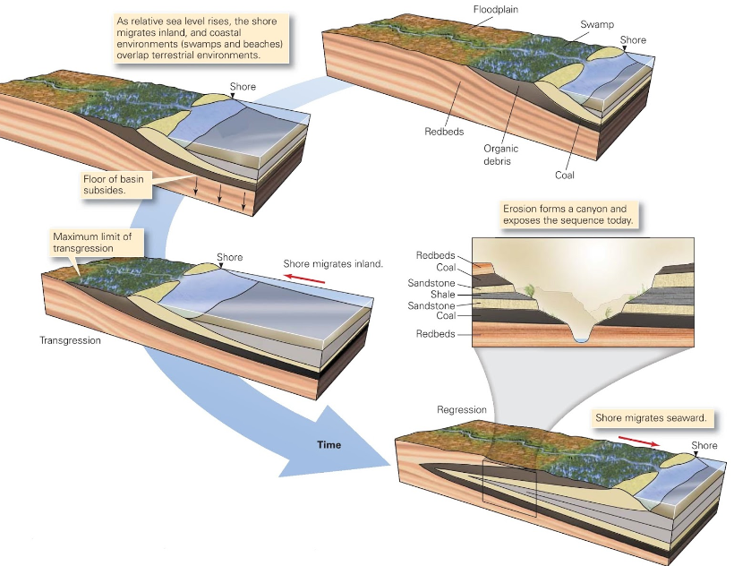
Coal formation
Notes:
Sea level went up and down slightly and river channels moved burying some of this organic matter.

Slide 7
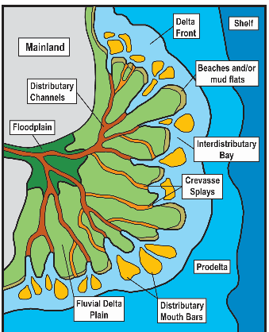
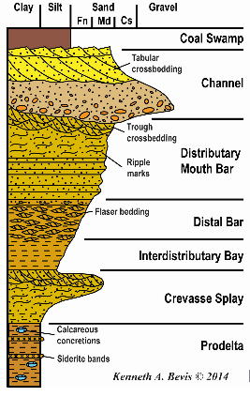
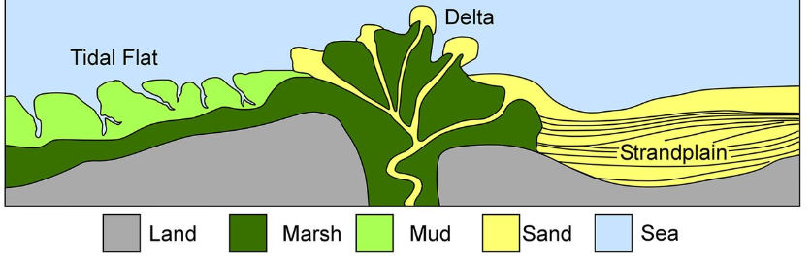
Coal formation - Cylothems
Notes:
Cyclothem, complex, repetitive stratigraphic succession of marine and nonmarine strata that are indicative of cyclic depositional regimes. Ideal cyclothem successions are rare, and reconstructions of generalized sequences result from the study of examples in which typical beds of limestone, clastic sediments, or coal seams may be missing.
Different sedimentary rocks are often stacked on top of one another in recognizable patterns that suggest an orderliness in formation. In particular,coal-bearing sequences not only show a repetition of coal seams, through sometimes hundreds of metres, but also other rocks in a more or less regular order. The coal seam is underlain by a seat-earth (underclay). Above the coal, a limestone or a claystone (shale or mudstone) with marine shells is often found. The marine shells disappear in the succeeding shales, to be replaced occasionally by nonmarine bivalves. Before another seat-earth and coal appears, a siltstone or a sandstone or both may be present.
In Great Britain this type of cycle was described in the 1830s, and some Carboniferous sequences (those about 359 million to 299 million years old) may be conveniently described as composed of repetitions of the cycle limestone–shale–siltstone–sandstone–seat-earth–coal, in which the coal is taken to define the point at which the sequence is repeated. A similar sequence was recognized in the United States in which an erosional break below the sandstone was identified and the sandstone was recognized as the significant repeated feature initiating the new cycle.
The main problem with regard to Carboniferous cyclothems is to explain sea extensions (transgressions) over a delta plain in an area that is undergoing progressive subsidence. One tectonic mechanism invokes jerky subsidence of the basin of sedimentation. Marine incursions would take place after sudden sinkings. A rise in sea-level and incursion could also be caused by the growth of oceanic ridges. Equally, transgressions of the sea might be due to climatic changes, which, for example, might cause the periodic melting of polar icecaps; or delta out-building might be active during climatic periods of rapid debris supply to the basin, followed by marine transgressions during dry periods with little sediment supply. The mechanisms that have received most recent support are sedimentological. In these, delta out-building is thought to be ended by a switch in the locus of depostion when the river finds a shorter route to the sea. The starved delta-lobe, still subject to continuous regional subsidence, is then flooded by the sea to begin a new cyclothem. Later, the locus of deposition switches back to the former area, sedimentation returns, and a cyclothem is completed by renewed out-building.
In both cases the cycle is defined in terms of recurring rock types. The rocks and fossils suggest alternating open-sea (the limestone and shales with marine shells) and terrestrial conditions (the coal). Processes forming the sediments were oscillatory or cyclic. Furthermore, this oscillation took place through time.

Slide 8
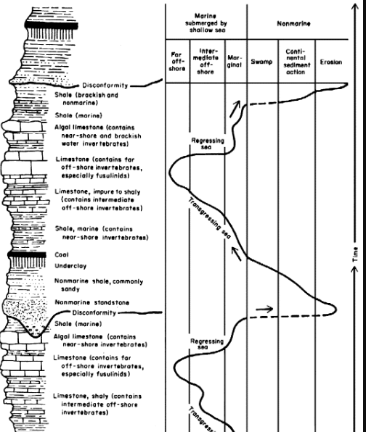
Coal formation - Cyclothems
Notes:
When the sea level went up possibly due to ice caps melting the sea level would go up swamping the coalfields around South Wales and the swamps were submerged and marine clays and muds would be put down on top of the organic matter which had previously been put down in the swamps. As the ice caps freeze up again the sea level regresses and the South Wales coalfields become swamp deltas again with organic matter being deposited on top of the marine muds, clays and sands deposited.
This cycle continues giving your cyolothems of rosk strata.
During much of the Carboniferous Period, world sea-levels were fluctuating in response to the growth and decline of a series of major ice-caps over the continents then clustered around the South Pole. Britain lay in the equatorial region. At times of high sea-level, silt and mud accumulated within the Pennine basin whilst at times of low sea-level, major deltas prograded across the region, their legacy being the thick sandstone beds of the Millstone Grit Group (Sandstone).
In Devoniain times before the Carboniferous time the UK was a large body of contient called St Georges land as Ice caps melted it began to become submerged with central wales being a land mass and south Wales and North Wales forming coastal areas and shallow seas. From about 300 million years ago, large rivers from adjacent continents to the North began to drain into the sea and deposit silt, which was gradually compressed to form rocks. The first layers of silt were fine and formed rocks now known as shale as can be seen, but later deposits were very coarse with large lumps of gravel in them and they laid down thick layers of sediment which was hardened to form Millstone Grit. As the ice caps partially refroze the sea level rose again a bit islands of land formed and became richly vegetated, with trees and huge ferns. However, in this period the land was constantly sinking and rivers were changing their course, so areas of land often would subside and become covered in water again. This laid down a series of layers of alternating shale and vegetable deposits which are now known as the Coal Measures.

Slide 9
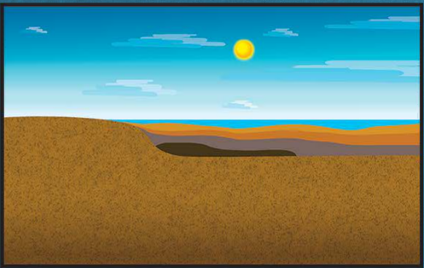
Coal formation
As time passed, the forests and swamps dried up
Notes:
As time passed, the forests and swamps dried up.
Over time, the plants (mostly mosses) and algae were buried and compressed under the weight of overlying mud and vegetation. Over time, the plants (mostly mosses) and algae were buried and compressed under the weight of overlying mud and vegetation. Those plants then turned into peat, which is a soggy, sponge like material. These areas of buried plant matter are called peat bogs. Peat bogs store massive amounts of carbon many meters underground. Peat itself can be burned for fuel, and is a major source of heat energy in countries such as Scotland, Ireland, and Russia.
As the plant debris sifted deeper under Earth’s surface, it encountered increased temperatures and higher pressure. Mud and acidic water prevented the plant matter from coming into contact with oxygen. Due to this, the plant matter decomposed at a very slow rate and retained most of its carbon (source of energy).
The peat changed into Lignite, as soft coal that is brown in colour. As it got buried to a certain level due to pressure over overlying debris and heat. Under the right conditions, peat transforms into coal through a process called carbonization. Carbonization takes place under incredible heat and pressure. About 3 meters (10 feet) of layered vegetation eventually compresses into a third of a meter (1 foot) of coal!

Slide 10
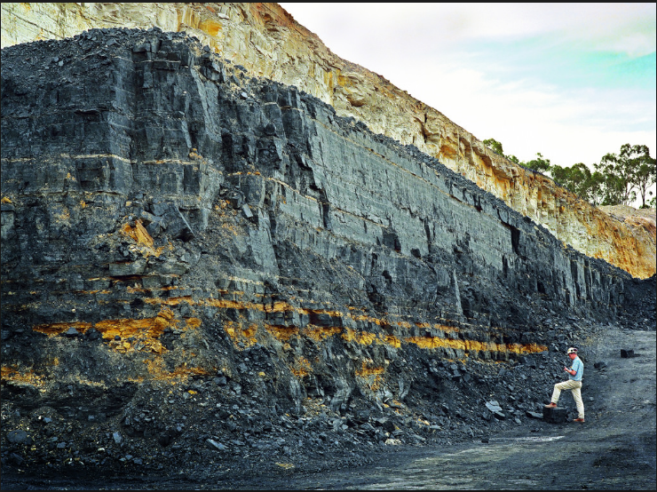
Coal formation
Coal forms in seams (Lignite)
Notes:
This formed coal seams of lignite
Coal exists in underground formations called “coal seams” or “coal beds.” A coal seam can be as thick as 30 meters (90 feet) and stretch 1,500 kilometers (920 miles).
Coal seams exist on every continent. The largest coal reserves are in the United States, Russia, China, Australia, and India.

Slide 11
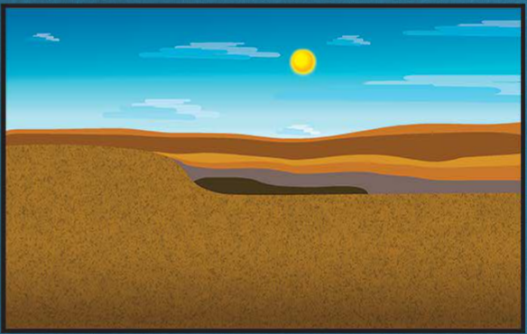
Coal formation
The lignite was covered in more layers of sand, clay, and other materials

Slide 12
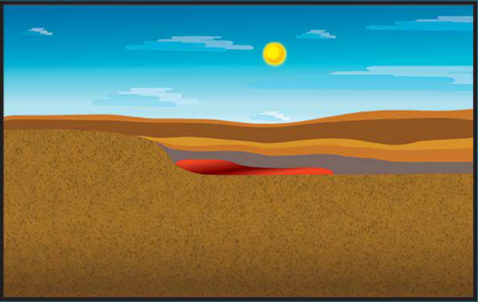
Coal formation
As the Lignite was buried further and further underground it was exposed to heat and pressure

Slide 13
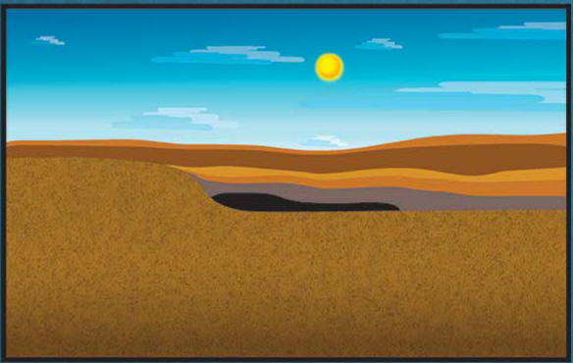
Coal formation
The pressure and heat made the Lignite become harder and darker
Notes:
The pressure and heat made the Lignite become harder and darker
It first transformed into sub-bituminous coal, then into bituminous coal, and then eventually anthricite, the final stage of coal.

Slide 14
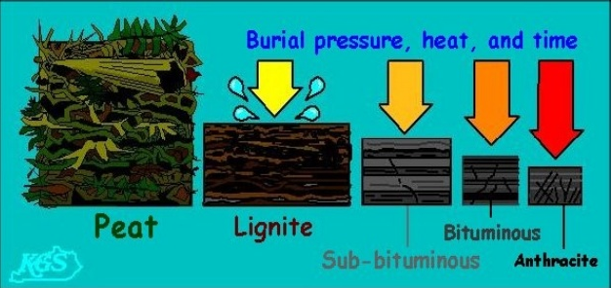
Coal formation

Slide 15
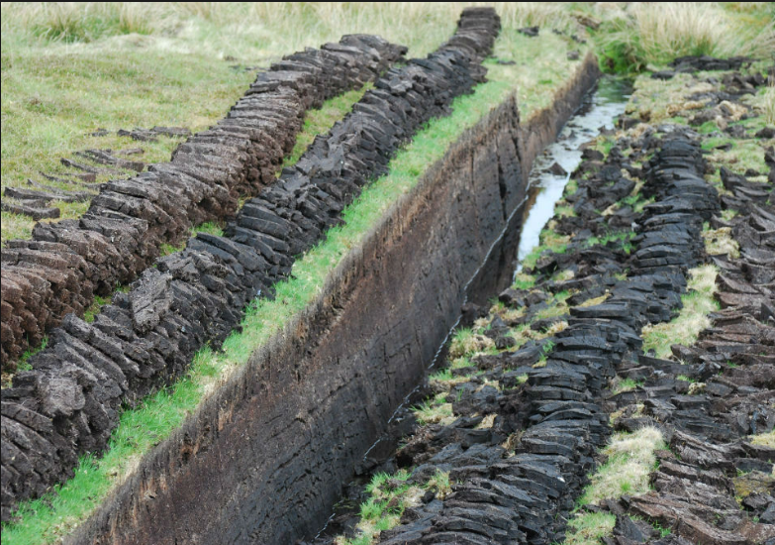
Coal formation
The physical phases we go through to form coal as it gets buried
Peat
Notes:
Coal is very different from mineral rocks, which are made of inorganic material. Coal is made of fragile plant matter, and undergoes many changes before it becomes the familiar black and shiny substance burned as fuel.
Coal goes through different phases of carbonization over millions of years, and can be found at all stages of development in different parts of the world.
Coal is ranked according to how much it has changed over time. Hilt's Lawstates that the deeper the coal seam, the higher its rank. At deeper depths, the material encounters greater temperatures and pressure, and more plant debris is transformed into carbon.
Peat
Peat is not coal, but can eventually transform into coal under the right circumstances. Peat is an accumulation of partly decayed vegetation that has gone through a small amount of carbonization.
However, peat is still considered part of the coal “family” because it contains energy that its original plants contained. It also contains high amounts of volatile matter and gases such as methane and mercury, which are environmentally hazardous when burned.
Peat retains enough moisture to be spongy. It can absorb water and expand the bog to form more peat. This makes it a valuable environmental defense against flooding. Peat can also be integrated into soil to help it retain and slowly release water and nutrients. For this reason, peat and so-called “peat moss” are valuable to gardeners.
Peat is an important source of energy in many countries, including Ireland, Scotland, and Finland, where it is dehydrated and burned for heat.

Slide 16
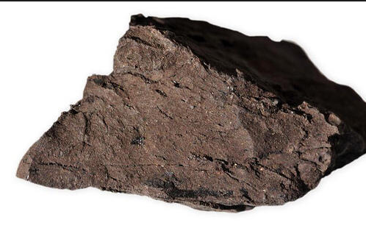
Coal formation
The phases of coal formation.
2. Lignite
Notes:
Lignite
Lignite coal is the lowest rank of coal. It has carbonized past the point of being peat, but contains low amounts of energy—its carbon content is about 25-35%. It comes from relatively young coal deposits, about 250 million years old.
Lignite, a crumbly brown rock also called brown coal or rosebud coal, retains more moisture than other types of coal. This makes it expensive and dangerous to mine, store, and transport. It is susceptible to accidential combustion and has very high carbon emissions when burned. Most lignite coal is used in power stations very close to where it was mined.
Lignite is mainly combusted and used to generate electricity. In Germany and Greece, lignite provides 25-50% of electricity generated by coal. In the U.S., lignite deposits generate electricity mostly in the states of North Dakota and Texas.

Slide 17
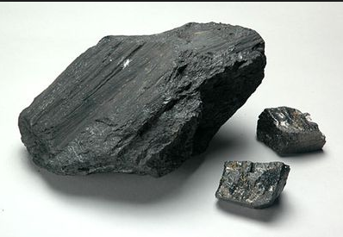
Coal formation
The phases of coal formation
3. Sub-Bituminous coal
Notes:
Sub-Bituminous Coal
Sub-bituminous coal is about 100 million years old. It contains more carbon than lignite, about 35-45%. In many parts of the world, sub-bituminous coal is considered “brown coal,” along with lignite. Like lignite, sub-bituminous coal is mainly used as fuel for generating electricity.
Most sub-bituminous coal in the U.S. is mined in the state of Wyoming, and makes up about 47% of all of the coal produced in the United States. Outside the U.S., China is a leading producer of sub-bituminous coal.

Slide 18
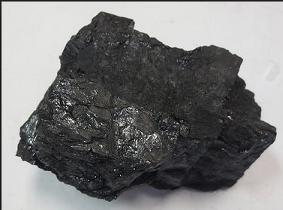
Coal formation
The phases of coal formation
4. Bituminous Coal
Notes:
Bituminous Coal
Coal is a sedimentary rock, and bituminous coal frequently contains “bands,” or strips, of different consistency that mark the layers of plant material that were compressed.
Bituminous coal is divided into three major types: smithing coal, cannel coal, and coking coal. Smithing coal has very low ash content, and is ideal for forges, where metals are heated and shaped.
Cannel coal was extensively used as a source of coal oil in the 19th century. Coal oil is made by heating cannel coal with a controlled amount of oxygen, a process called pyrolysis. Coal oil was used primarily as fuel for streetlights and other illumination. The widespread use of kerosene reduced the use of coal oil in the 20th century.
Coking coal is used in large-scale industrial processes. The coal is coked, a process of heating the rock in the absense of oxygen. This reduces the moisture content and makes it a more stable product. The steel industry relies on coking coal.
Bituminous coal accounts for almost half of all the coal that is used for energy in the United States. It is mainly mined in Kentucky, Pennsylvania, and West Virginia. Outside the U.S., nations such as Russia and Colombia rely on bituminous coal for energy and industrial fuel.

Slide 19
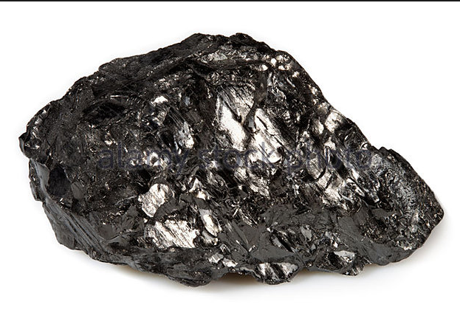
Coal formation
The phases of coal formation
5. Anthricite
Notes:
Anthracite is the highest rank of coal. It has the most amount of carbon, up to 97%, and therefore contains the most energy. It is harder, more dense, and more lustrous than other types of coal. Almost all the water and carbon dioxide have been expelled, and it does not contain the soft or fibroussections found in bituminous coal or lignite.
Because anthracite is a high-quality coal, it burns cleanly, with very little soot. It is more expensive than other coals, and is rarely used in power plants. Instead, anthracite is mainly used in stoves and furnaces.
Anthracite is also used in water-filtration systems. It has tinier pores than sand, so more harmful particles are trapped. This makes water safer for drinking, sanitation, and industry.
Anthracite can typically be found in geographical areas that have undergone particularly stressful geologic activity. For example, the coal reserves on the Allegheny Plateau in Kentucky and West Virginia stretch to the base of the Appalachian Mountains. Here, the process of orogeny, or mountain formation, contributed to temperatures and pressures high enough to create anthracite.
China dominates the mining of anthracite, accounting for almost three-quarters of anthracite coal production. Other anthracite-mining countries include Russia, Ukraine, Vietnam, and the United States (mostly Pennsylvania).

Slide 20
Blaenafon coal – Big Pit
King Coal – used to fuel trains and engines
It was a Bituminous coal (Steam coal)
In the early 1920’s big Pit employed 1,300 men.
Notes:
King Coal The South Wales Coalfield was at the height of production between the 1880s and 1913. In 1913 Wales recorded its highest ever output; 57,000,000 tons of coal was produced by nearly a quarter of a million Welsh miners. Big Pit was a massive employer in Blaenavon, some 1,300 men worked at the mine during the early 1920s. Blaenavon coal was shipped around the world, to as far a field as South America. It was also used by the Great Western Railway to fuel trains and engines.

Slide 21
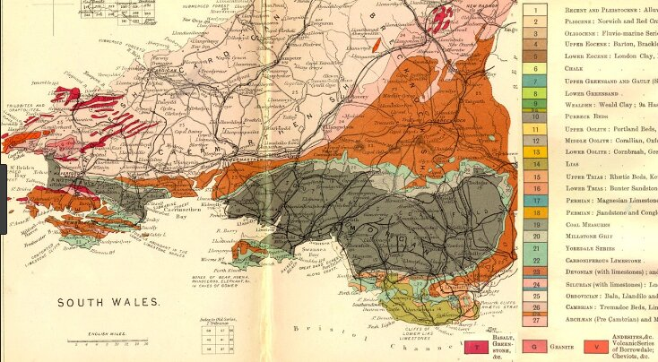
Coal Seams South Wales

Slide 22
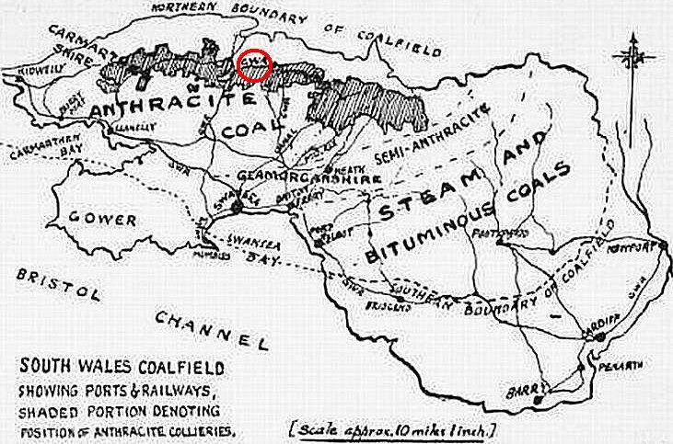
Coal Seams South Wales

Slide 23
Coal Industry demise in UK/South Wales
1913 232,00 men worked in 620 mines in Wales
1920 largest number of men ever employed in Wales mining 271,000
1936 – oil power and shipping causes 140,000 men to be laid off, 241 mines shut
Coal industry nationalised in 1947
Between 1957 – 1964 oil caused 50 collieries to close
By 1980s it was almost all over.
Notes:
Steady increases in output and manpower meant that the early 20th century gave Wales its peak production figures.
No less than 57m tons of coal was produced in 1913, by 232,000 men working in 620 mines.
The largest number of men ever to work in the Welsh coal mines was 271,000 in 1920.
Post war, there was a recession in the coal market, due to a combination of a move to oil power by shipping and the development of coal industries overseas.
Men were laid off: 140,000 by 1936. South Wales lost 241 mines in the same period.
World War Two didn't buck the trend in terms of production, but indirectly it had the effect of instilling some optimism. The Labour government of 1945 - the Welfare State government - nationalised the coal industry on 1 January 1947, taking it out of the hands of private firms.
It was thought that this move would safeguard jobs and mines, as the government would be less likely than private owners to cut and run or make a quick sale.
At the time, there were still 135 collieries with over 250 workers each and, although exports through Cardiff had fallen from 25m tons in 1913 to 750,000 tons in 1947, there was much needed modernisation and investment coming.
Investment meant better and more machinery and a greater emphasis on safety, but couldn't safeguard the coal industry in Wales.
The rise of the oil industry and other factors meant that 50 collieries closed in south Wales between 1957 and 1964. Although there was some respite in the 1970s due to the oil crisis, by the 1980s it was almost all over for the coal industry in Wales and the rest of the UK.
A last gasp of industrial action, the 1984 miners' strike, was not enough to prevent the death of an industry that was once the biggest single employer in Wales and held the most powerful workforce.

Slide 24
Coal Formation
Coal formation video
https://www.youtube.com/watch?v=MBeXRRTGjNE

