Slide 1
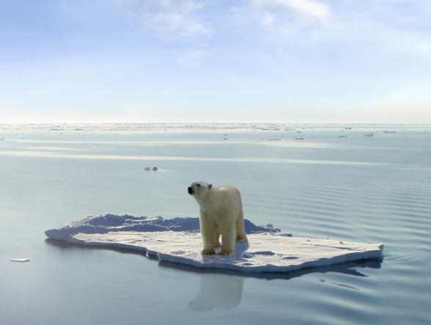
“The relationship between an individuals experience and perception of Climate change”
Research Proposal by Natalie Jordan
Photo (Will, n.d.)

Slide 2

Global Climate Change
The term ‘climate change’ describes the large-scale, long-term shift in the earths average temperature or weather patterns
The planets climate has always changed but it is the rate of change in recent years which is concerning (University Corporation for Atmospheric Research, n.d)
Human activity has been linked with accelerating climate change
(Met Office, n.d)
Photo (World Green Building Council, n.d.)

Slide 3
Scepticism is growing
As far as you know, do you personally think that the world’s climate is changing?
 | 2005 | 2010 | 2012 | 2013
Yes (%) | 91 | 78 | 79 | 72
No (%) | 4 | 15 | 11 | 19
Don’t Know (%) | 5 | 6 | 11 | 9
Note: The percentage in the table may not always add up to 100% due to rounding
The British public are becoming increasingly sceptical about climate change
Even though 97% of published climate researches now agree that climate change is happening and being enhanced by humans
Data & Info (The Carbon Brief, 2013)

Slide 4

Factors that can affect an individuals scepticism towards Climate Change
AGE
GENDER
INCOME
POLITICAL AFFILIATION
MEDIA
RELIGION
ENVIRONMENTAL
VALUES
EDUCATION
(Whitmarsh, 2011)

Slide 5
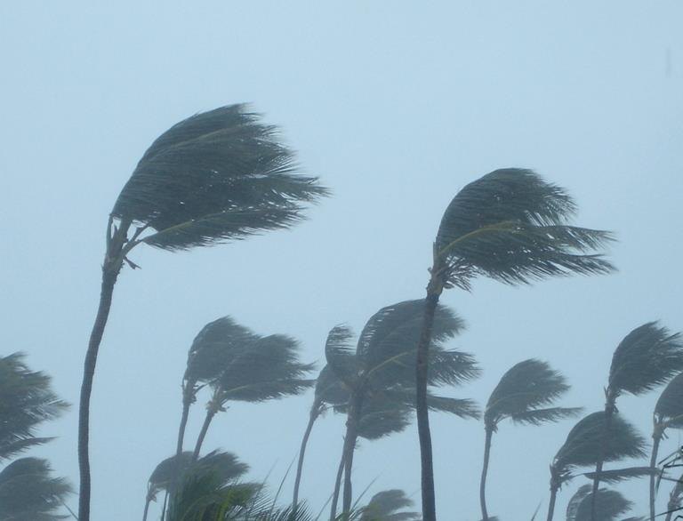
BUT do extreme weather events influence people’s opinion?
Only very recently being investigated
Some research done in US after Hurricanes Irene and Sandy
Residents expressed a larger belief that climate change is caused by human activity (Association for Psychological Science, 2013)
No major published research in UK
Image (Phil, 2012)

Slide 6
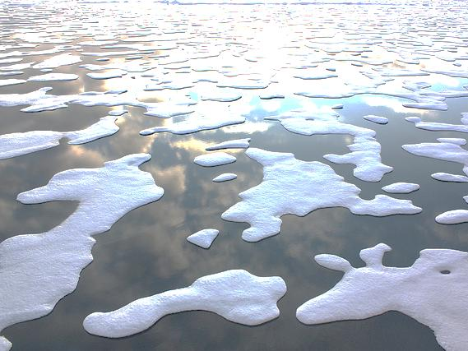
Research Objectives
To assess what people perceive to be their risk from climate change
To explore what relationship this perceived risk has with an individuals scepticism
To investigate where climate change comes in people’s hierarchy of concerns
To gain valuable information to aid the campaign to slow climate change
Photo (NASA Goddard Photo and Video, n.d.)

Slide 7
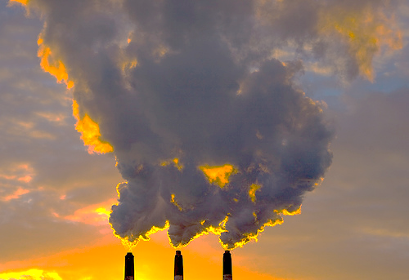
Methodology
Use Environment Agency Flood Map to assess towns in Neath Port Talbot County with high and low risks of flooding
Previously developed questionnaire known as ‘The Scepticism Scale’ which measures the publics scepticism towards climate change
Compare responses from those in an area of high flood risk with those of a lower flood risk
Independent variable = Flooding or the risk of flooding
Dependent variable = People’s scepticism
Text (Whitmarsh, 2011) Photo (Byrne,n.d)

Slide 8
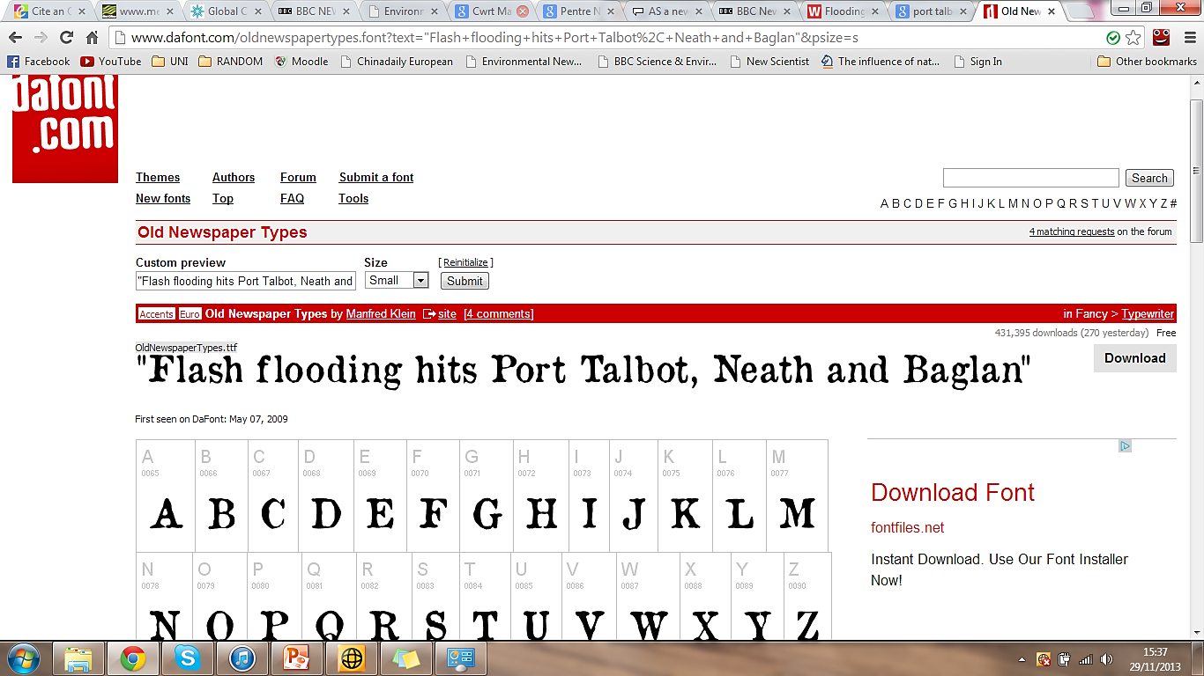
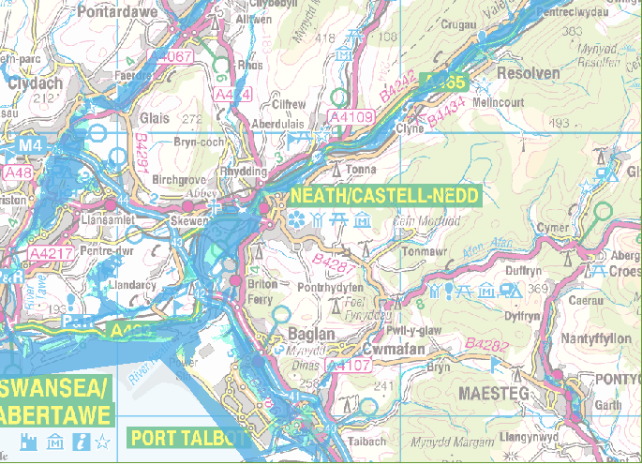
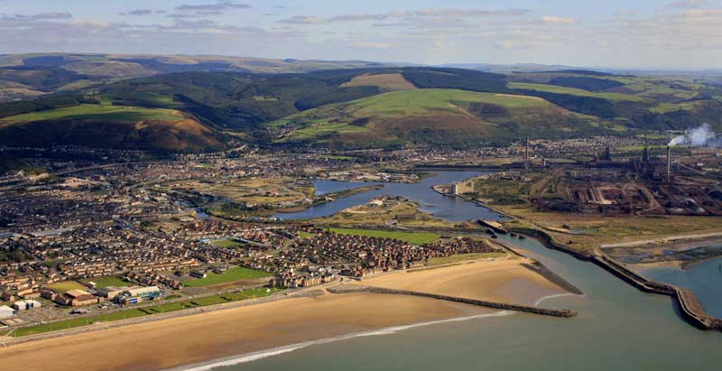
Sample
(BBC,2011)
A transect will start at the coast and work its way back through Neath Port Talbot reaching the higher area’s where flooding is less of an issue.
(Environment Agency, 2013)
= high flood risk
= low flood risk
= risk of flooding from river and sea
(Webb, 2009)

Slide 9

Prediction
Those who have experienced what is perceived to be caused by climate change e.g. flooding, will be less sceptical of climate change
In summary:
    High risk of flooding = people are less sceptical
    Low or no flooding = people are more sceptical
(HD Wallpapers, 2012)

Slide 10
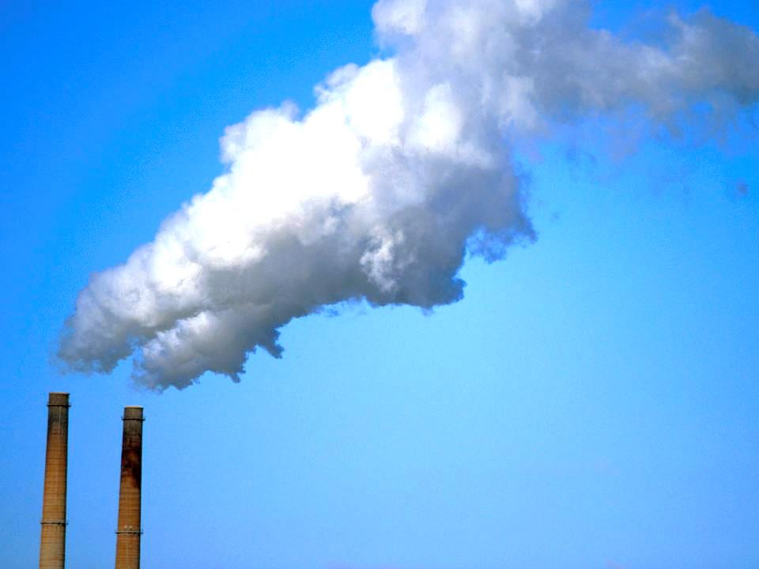
Rationale
Climate change is of global importance and will never be ‘old news’. As time goes on, climate change will increasingly become more important
In this field of research, this study on people’s experience and perception of climate change is unique. There have been some recent studies in the US but little in the UK
Photo (Kennan, 2013)

Slide 11
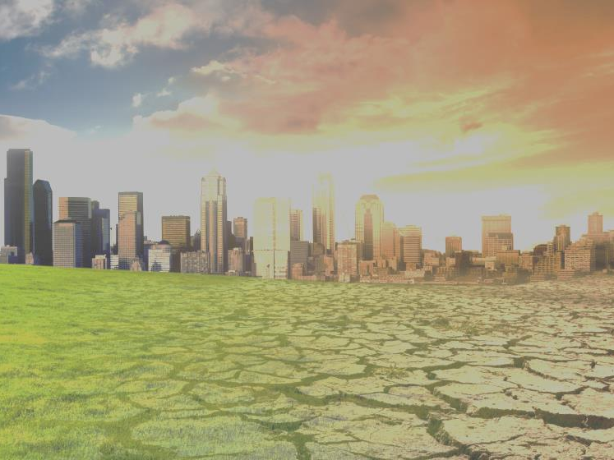
Relevant Literature
“Scepticism and uncertainty about climate change: Dimensions, determinants and change over time” Lorraine Whitmarsh, 2011
“The influence of national temperature change on opinions about climate change in the US since 1990” Simon D. Donner & Jeremy McDaniels, 2013
“When Truth Is Personally Inconvenient, Attitudes Change: The Impact of Extreme Weather on Implicit Support for Green Politicians and Explicit Climate-Change Beliefs” Laurie Rudman et al, 2013
Photo (Organic Lifestyle Magazine, 2009)

Slide 12
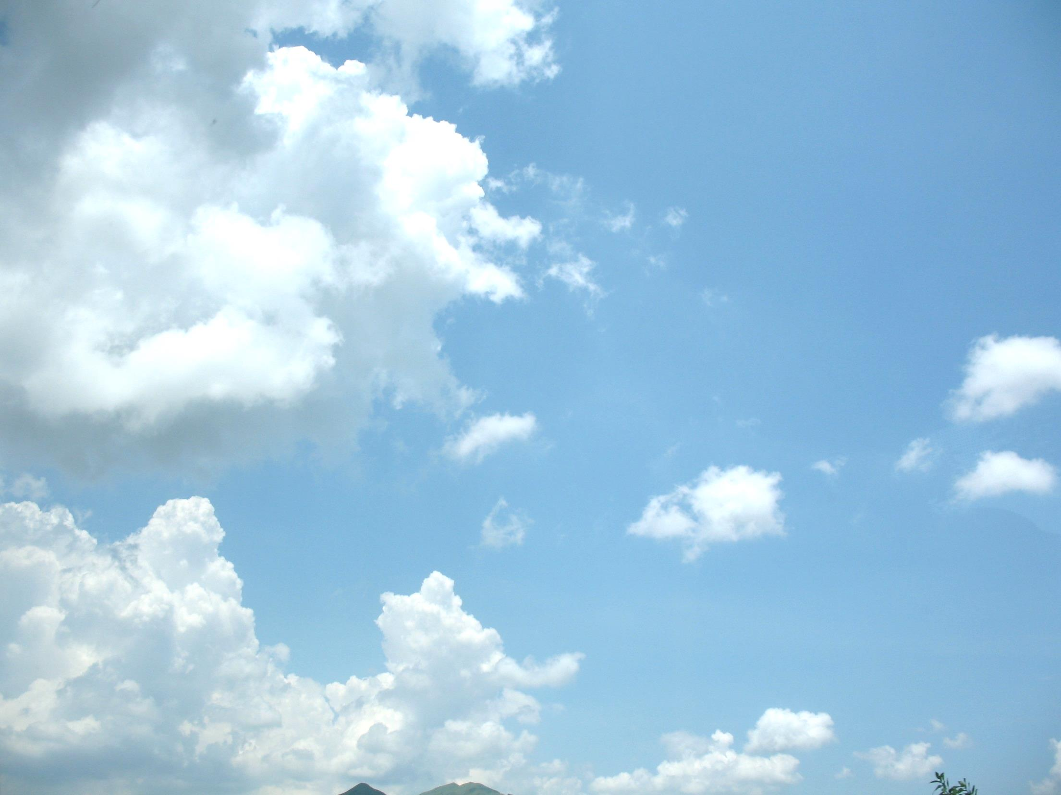
References
Association for Psychological Science 2013. After the Storms, A Different Opinion on Climate Change. [press release] September 19, 2013.
BBC News. 2011. Towns are hit by flash flooding. [online] Available at: http://www.bbc.co.uk/news/uk-wales-14683964 [Accessed: 29 Nov 2013].
Byrne, O. n.d. Atmospheric Emissions. [image online] Available at: http://www.tropical-rainforest-animals.com/image-files/airpollution.jpg [Accessed: 27 Nov 2013].
Donner, S. and Mcdaniels, J. 2013. The influence of national temperature fluctuations on opinions about climate change in the US since 1990. Climatic Change, 118 (3-4), pp. 537--550.
Environment Agency. 2013. Risk of flooding from rivers and sea. [image online] Available at: http://maps.environment-agency.gov.uk/wiyby/wiybyController?ep=ajaxmap&topic=floodmap&layerGroups=1%2C&minx=230832.9166666664&maxx=290364.1666666664&miny=177799.2500000001&maxy=217486.7500000001&scale=4 [Accessed: 29 Nov 2013].
HD Wallpapers. 2012. Plain Backgrounds wallpaper. [image online] Available at: http://www.wallsave.com/wallpapers/1920x1080/plain/474670/plain-wincustomize-explore-logonstudio-underwater-hd-474670.jpg [Accessed: 1 Dec 2013].
Kennan, H. 2013. CO2 added through human activity. [image online] Available at: http://i.livescience.com/images/i/000/055/300/iFF/LS_100316_carbon-capture2-VS.jpg?1375139328 [Accessed: 26 Nov 2013].
Metoffice. n.d. What is climate change? - Met Office. [online] Available at: http://www.metoffice.gov.uk/climate-guide/climate-change [Accessed: 1 Dec 2013].
NASA Goddard Photo and Video. n.d. Arctic Sea Ice. [image online] Available at: http://farm8.staticflickr.com/7084/7163119469_73ce1bbe74_m.jpg [Accessed: 1 Dec 2013].
Organic Lifestyle Magazine. 2009. Landscape affects of climate change. [image online] Available at: https://encrypted-tbn3.gstatic.com/images?q=tbn:ANd9GcSSZOgZTLiTJVHgQ_07wNJz_zxUgT7g-YLJtVsMGkR2NK_xki1r [Accessed: 26 Nov 2013].
Phil, M. 2012. Palm trees bending in the wind of an approaching tropical system. [image online] Available at: http://1.bp.blogspot.com/-X4YswmQIe0M/T8pnvEUKFgI/AAAAAAAAJ3c/ruj2dIwuqWA/s1600/Hurricane+Palm+Trees+3.jpg [Accessed: 26 Nov 2013].
Suguru, M. 2007. Clear sky. [image online] Available at: http://upload.imedia.org/commons/thumb/3/3e/Clear_sky.JPG/800px-Clear_sky.JPG [Accessed: 29 Nov 2013].
The Carbon Brief. 2013. Poll appears to show growth in climate skepticism - but what kind is it? | Carbon Brief. [online] Available at: http://www.carbonbrief.org/blog/2013/09/poll-appears-to-show-growth-in-climate-skepticism-but-what-kind-is-it/ [Accessed: 26 Nov 2013].
University Corporation for Atmospheric Research. n.d. Global Climate Change: Background Material. [online] Available at: http://www.ucar.edu/learn/1_4_1.htm [Accessed: 1 Dec 2013].
Webb, J. 2009. Port Talbot aerial photograph. [image online] Available at: http://www.webbaviation.co.uk/gallery/d/42844-1/porttalbot-db72027.jpg [Accessed: 29 Nov 2013].
Whitmarsh, L. 2011. Scepticism and uncertainty about climate change: dimensions, determinants and change over time. Global Environmental Change, 21 (2), pp. 690--700.
Will, J. n.d. The last polar bear. [image online] Available at: http://www.futuretimeline.net/21stcentury/images/polar-bears-global-warming.jpg [Accessed: 27 Nov 2013].
World Green Building Council. n.d. World Map. [image online] Available at: http://worldgbc.org/files/4213/5789/8394/americas.png [Accessed: 1 Dec 2013].
Photo (Suguru, 2007)

