Slide 2
Heddiw
Today
9-11am: Mewnbwn aseiniad.
1-3pm: Amrywiaeth ac amgylchedd sy’n galluogi.
3-5pm: Arfer dda yng Nghymru.
9-11am: Assignment input.
1-3pm: Diversity and an enabling environment.
3-5pm: Good practice in Wales.

Slide 3
Amcan
Aim
Rhoi amrywiaeth o gyfleoedd i fyfyrwyr ddeall natur amrywiol y cyd-destunau y byddant yn addysgu ynddynt.
To provide students with a range of opportunities to understand the varied nature of the contexts in which they will teach.

Slide 4
Amrywiaeth ac amgylcheddau sy’n galluogi dysgu
Diversity and environments that enable learning

Slide 5
Deilliant dysgu
Learning outcome
Dylai’r darpar athro allu dangos y gallu i wneud y canlynol:
dangos dealltwriaeth glir o’r ffyrdd y trefnir ysgolion a sut y cynllunnir y cwricwlwm i fodloni anghenion y dysgwyr.
The student-teacher should be able to demonstrate the ability to:
evidence a clear understanding of the ways in which schools are organised and how the curriculum is designed to meet the needs of the learners

Slide 6
Amrywiaeth
Diversity
Iaith
Ethnigrwydd
Crefydd
Cymdeithasol-economaidd
Beth arall?
Language
Ethnicity
Religion
Socio-economic
What else?
Notes:
We are by now all aware that there is a diverse range of needs within our schools. We touched upon this in session 1, 2 & 6 where we explored our own primary education, how schools are organised in Wales, and the inclusive nature of the Foundation Phase Framework.
What else – gender, ALN, culture…

Slide 7
Data – Ysgolion Cymru 2018/19
Nifer ysgolion Cynradd yng Nghymru
Nifer sy’n siarad Cymraeg/Saesneg fel iaith gyntaf
Nifer ieithoedd heblaw Cymraeg/Saesneg sy'n iaith gyntaf i'r disgyblion
Nifer disgyblion sydd â Pwyleg fel iaith gyntaf
Nifer disgyblion sydd â Arabeb fel iaith gyntaf
369,275
1,238
99
3,206
4,855
Notes:
Ffynhonell data defnyddiol – StatsWales
Ieithoedd heblaw Cy/Saes – mewn trefn niferoedd – Pwyleg, Arabeg, Bengaleg, Tseineeg, Wrdw, Panjabeg

Slide 8
Data – Ysgolion Cymru 2018/19
Nifer ysgolion Cynradd yng Nghymru | 1,238
Nifer sy’n siarad Cymraeg/Saesneg fel iaith gyntaf | 369,275
Nifer ieithoedd heblaw Cymraeg/Saesneg sy'n iaith gyntaf i'r disgyblion | 99
Nifer disgyblion sydd â Pwyleg fel iaith gyntaf | 4,855
Nifer disgyblion sydd â Arabeb fel iaith gyntaf | 3,206
Ffynhonell: https://statscymru.llyw.cymru/Catalogue/Education-and-Skills/Schools-and-Teachers/Schools-Census/Pupil-Level-Annual-School-Census

Slide 9
Data – School in Wales 2018/19
Number of Primary schools in Wales
Number speaking English or Welsh as a first language
Number of languages apart from English/Welsh that are first lanuages for pupils
Number of Polish first language pupils
Number of Arabic first language pupils
369,275
1,238
99
3,206
4,855

Slide 10
Data – School in Wales 2018/19
Number of Primary schools in Wales | 1,238
Number speaking English or Welsh as a first language | 369,275
Number of languages apart from English/Welsh that are first lanuages for pupils | 99
Number of Polish first language pupils | 4,855
Number of Arabic first language pupils | 3,206
Source: https://statscymru.llyw.cymru/Catalogue/Education-and-Skills/Schools-and-Teachers/Schools-Census/Pupil-Level-Annual-School-Census

Slide 11
Amgylchedd sy’n galluogi
An enabling environment
amrywiaeth yr ardaloedd
eu maint a’u lleoliad
yr adnoddau
defnydd o wagle
rolau’r oedolion
variety of areas
size and layout of spaces
the resources
use of space
adult roles
Amgylchedd = ‘Y 3ydd athro’
Environment = ‘The 3rd teacher’
Reggio Emilia
Notes:
Taken from ECAD4005 (2019)
Explain that the meaning of the ‘learning environment’ will be looked at in more depth and practical terms during Friday’s session 12 and Bridging 5.
The idea of the environment as the 3rd teacher comes from the city of Reggio Emilia in Northern Italy (the Reggio influence) –
https://eyts.wp.derby.ac.uk/2016/12/06/the-environment-as-the-third-teacher/

Slide 12
O le daw’r syniad hwn?
Where does this idea come from?
Damcaniaeth Systemau Ecolegol am Ddatblygiad
Ecological Systems Theory of Development
Urie Bronfenbrenner
Notes:
Information on next slide.

Slide 13


Beth ydych chi’n cofio
o
ECAD4007?
What do you remember from ECAD4007?
Tasg: Mewn parau, cwblhewch y daflen A3 gyda’r hyn rydych yn ei gofio o ECAD4007, a’r hyn rydych wedi’i ddysgu yn y modiwl hwn.
Task: In pairs, complete the A3 sheet with what you remember from ECAD4007, and what you’ve learned in this module.
Notes:
Direct link here between this module and ECAD4007C ‘Who am I teaching?’ (Bridging 4 in particular). What do the students already know? APK. 10 minutes in total.
Mae cyswllt uniongyrchol rhwng hwn a modiwl ECAD4007C ‘Pwy ydw I’n addysgu?’ (Pontio 4 yn benodol). Beth mae’r myfyrwyr yn gwybod? Deffro Gwybodaeth Flaenorol. 10 munud yn unig.
The mesosystem (y system feso) refers to the point in which two social microsystems merge. One example of a mesosystem is the combination of the home and school environments. These intersect and become a mesosystem when events, situations, work and friendships cross back and forth between both environments.
Exosystem (y system ecso): Involves links between social settings that do not involve the child. For example, a child's experience at home may be influenced by their parent's experiences at work. A parent might receive a promotion that requires more travel, which in turn increases conflict with the other parent resulting in changes in their patterns of interaction with the child.
The macrosystem (y system facro) includes things such as the relative freedoms permitted by the national government, cultural values, the economy, wars, etc. These things can also affect a child either positively or negatively.
The microsystem (y system feicro) are things that a child may encounter on a daily basis in an immediate surrounding.
Moreover, a child’s biological and socially influenced characteristics like habits, temperaments, physical characteristics and capabilities influence the child’s behaviour and also the people who are around the child.

Slide 14

Beth am ddamcaniaethau eraill?
What about other theories?
Montessori
https://www.learning-theories.com/montessori-method-montessori.html
Rousseau
http://www.froebelweb.org/web7003.html
Bronfenbrenner
Jan White
http://outdoormatters.co.uk/wp-content/uploads/2011/04/Article.-Creating-an-outdoor-learning-environment-for-the-early-years.pdf
Notes:
Activity: What do these theorists tell us about the learning environment? Complete the A5 fact file by using the websites on this slide as a starting point. 15 minutes.
Gweithgaredd: Beth mae’r damcaniaethwyr hyn yn dweud wrthym am yr amgylchedd dysgu? Cwblhewch y ffeiloffaith A5 gan ddefnyddio’r gwefannau ar y sleid fel man cychwyn. 15 munud.

Slide 15


Cysylltiadau gyda diwygio’r cwricwlwm…
Links to curriculum reform…
Notes:
Quotes on the next slides.
Dyfyniadau ar y sleidiau nesaf.

Slide 16
yn ymwneud â’r ffordd y mae amgylchedd yr ysgol yn hybu iechyd a lles plant a phobl ifanc o safbwynt cymdeithasol, emosiynol, ysbrydol a chorfforol (t.45)
…concerned with how the school environment supports children and young people’s social, emotional, spiritual and physical health and well-being (p.45)

Slide 17
astudio’r amgylchedd lleol a dysgu o brofiad pobl, sefydliadau a busnesau yn y gymuned (t.46)
exploring the local environment and learning from the experience of people and organisations and businesses in the community (p.46)

Slide 18
Er mwyn iddynt ymroddi i ddysgu, mae angen amgylcheddau cyfoethog, symbylol ar blant a phobl ifanc lle y gallant ymchwilio ac arbrofi â syniadau ac adnoddau, cydweithio â’u cyfoedion a chreu cysylltiadau dynamig gan deimlo bod diben clir i hynny er mwyn llunio ystyr (t.66)
In order to fully engage with learning, children and young people require rich, stimulating environments where they can explore and experiment with ideas and resources, collaborate actively with their peers and make dynamic connections with a clear sense of purpose to construct meaning (p.66)

Slide 19
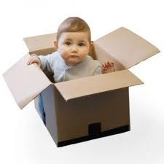
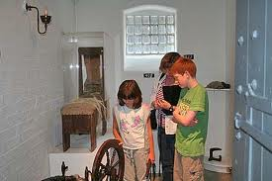
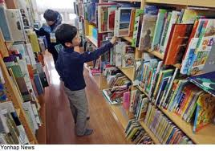
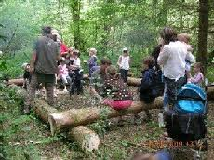
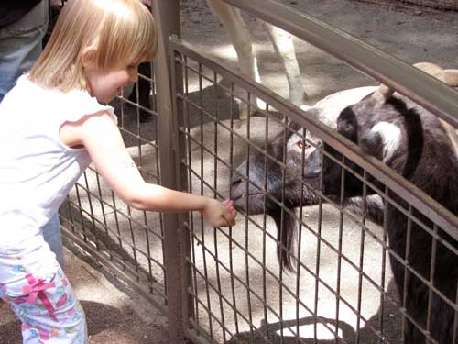
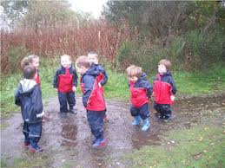
Ble mae plant yn dysgu?
Where do children learn?
Notes:
Where there are opportunities to explore, play, collaborate and construct knowledge.
Lle mae yna gyfleoedd i archwilio, chwarae, cydweithio ac adeiladu gwybodaeth.

Slide 20
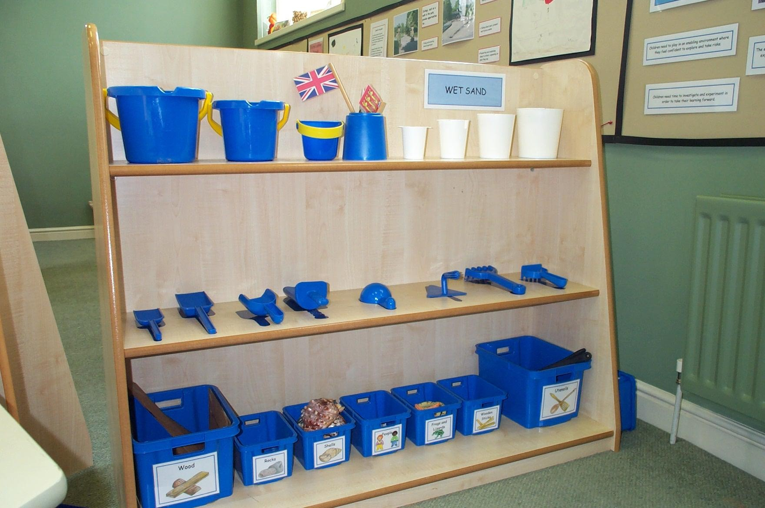
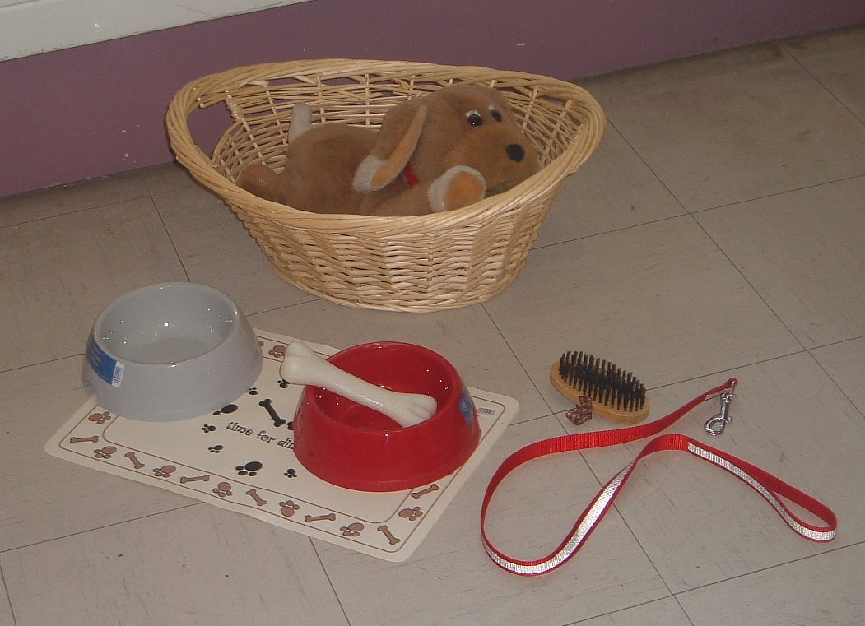
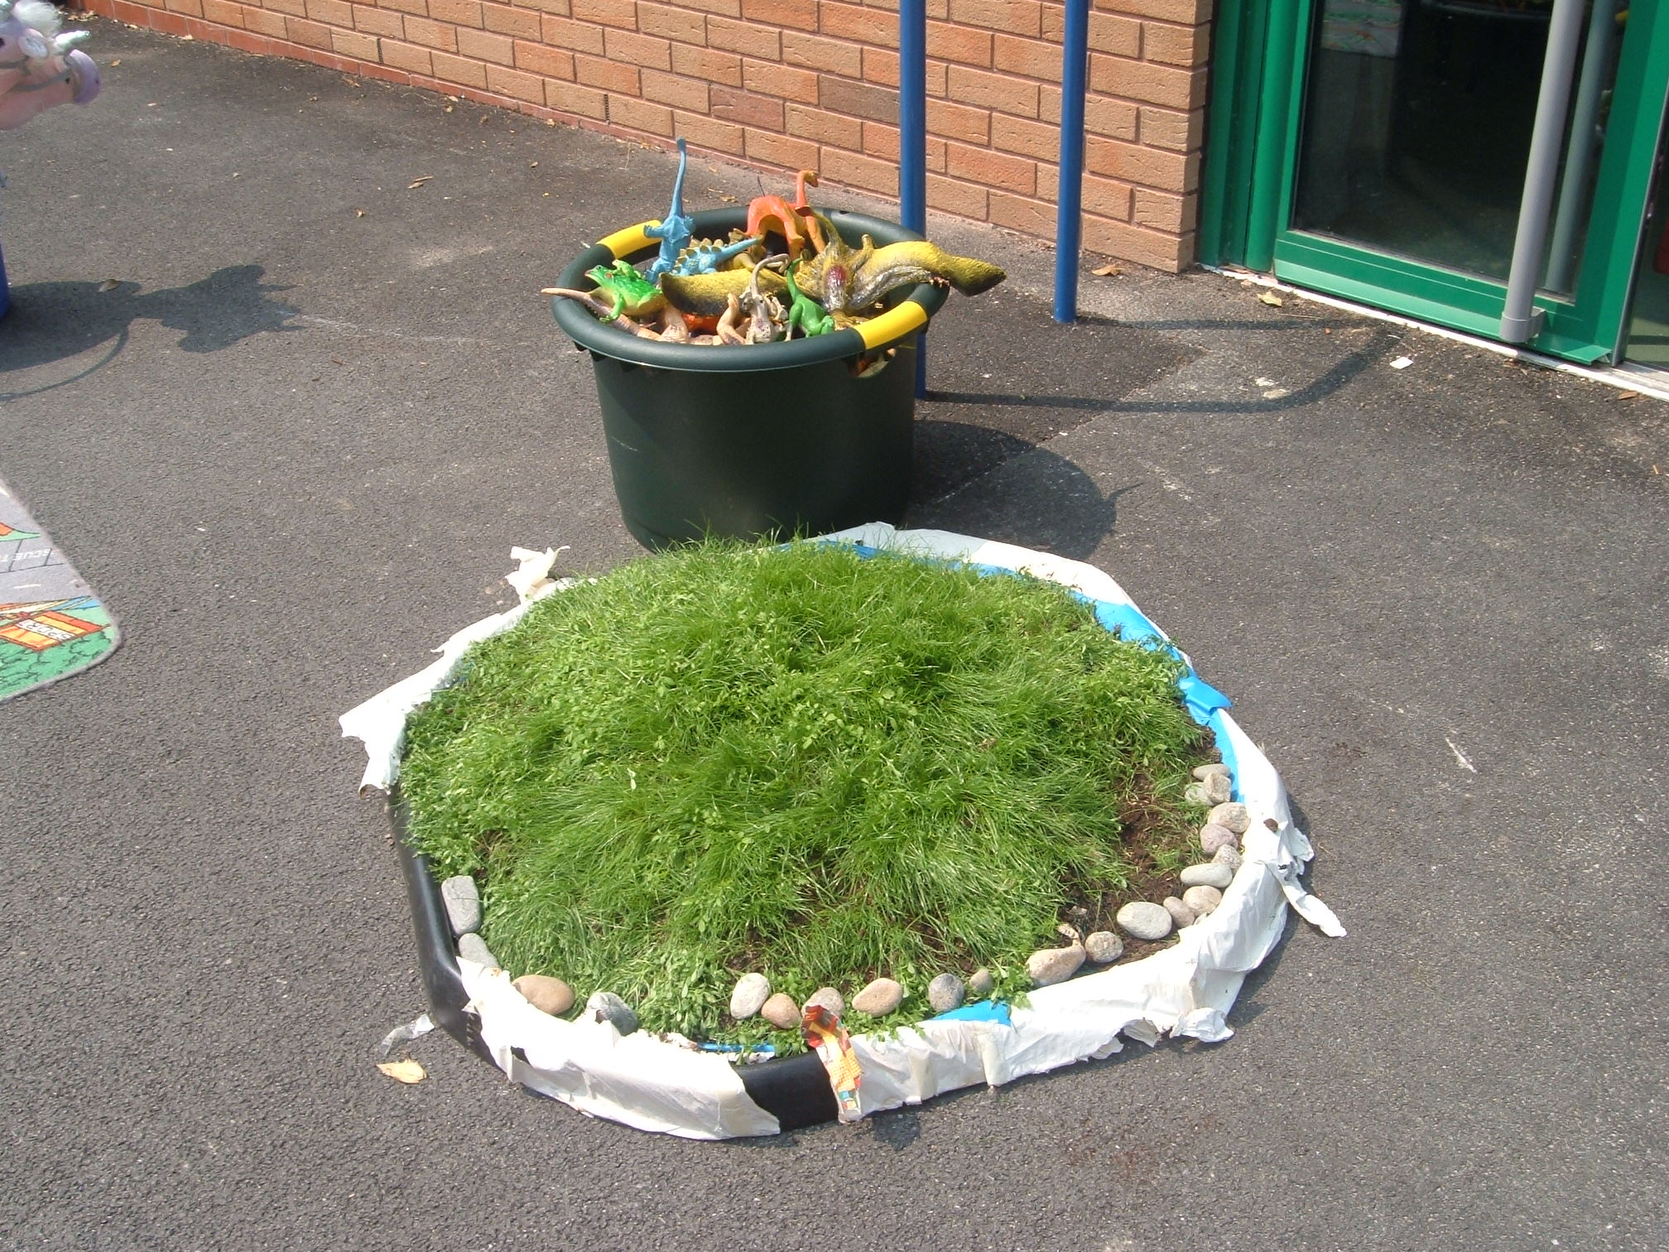
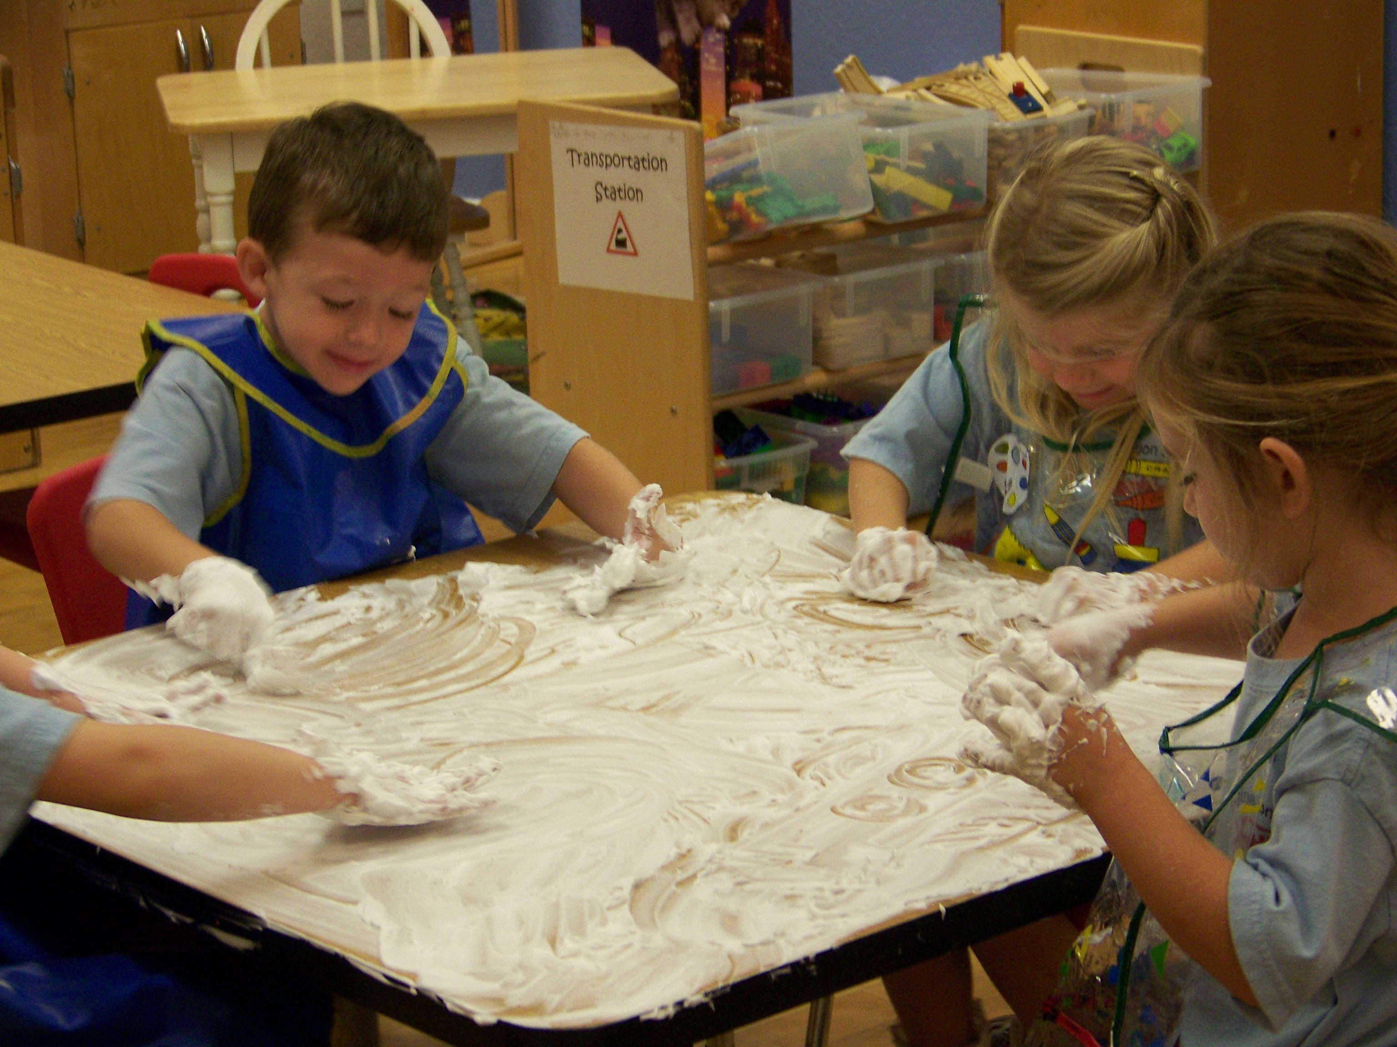
Notes:
Edrychwch ar y lluniau. Beth mae’r offer a’r ardaloedd yma’n cynnig i blant o ran eu galluogi?
Silff- gwneud penderfyniadau’n annibynnol
dewis/ tacluso
adnabod gwrthrychau amrywiol
Ci – I ddatblygu ymwybyddiaeth o anghenion anifeiliaid
gofal a pharch tuag at eraill
Byd bach- creu bydoedd ffantasiol
cyd chwarae a datblygu syniadau
trosi’r hyn a wydddant/ a ddysgant i sefyllfa greadigol
Ewin sebon- cyfathrebu
rheoli’r corff
datblygu’r synhwyrau

Slide 21
Gweithgaredd grŵp
Group activity
Grwpiau o 3-5.
Dewiswch UN o’r lluniau o flaen yr ystafell.
Fel grŵp, anodwch y llun gyda’r wybodaeth ganlynol:
Sut y byddech yn defnyddio’r amgylchedd hon i alluogi dysgu.
Rhannau’r FfCS byddech yn ffocysu ar ddatblygu.
Eich defnydd ohono mewn ffordd gynhwysiol.
Y damcaniaethau sydd wedi dylanwadu ar eich dewisiadau.
Groups of 3-5.
Select ONE of the images from the front of the room.
As a group, annotate the image with the following information:
1. How you would use this environment to enable learning.
2. Which part(s) of the FPF you would focus on developing.
3. How you would use it in an inclusive way.
4. Which theories have influenced your choices.
Notes:
Students can stay in the teaching room or go elsewhere to work. 30 minutes for completion of the task, 20 minutes for feedback. All groups to come to the front of the class to present their work. Work can be completed on A3 sheets provided, or as a PowerPoint – the images are available on this PowerPoint on Moodle if students wish to use them electronically.

Slide 22
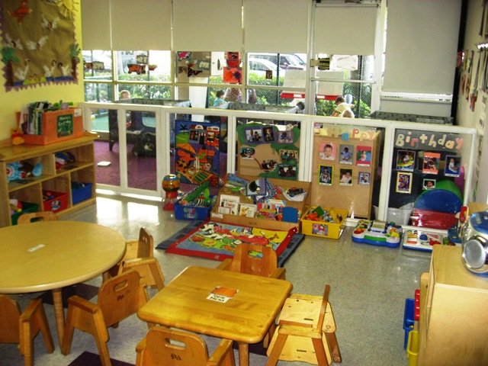

Slide 23
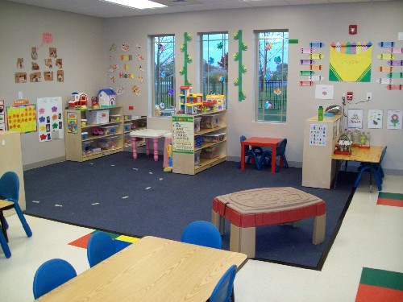

Slide 24
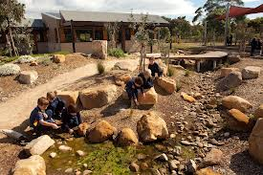

Slide 25
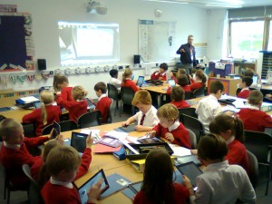

Slide 26
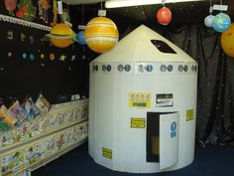

Slide 27
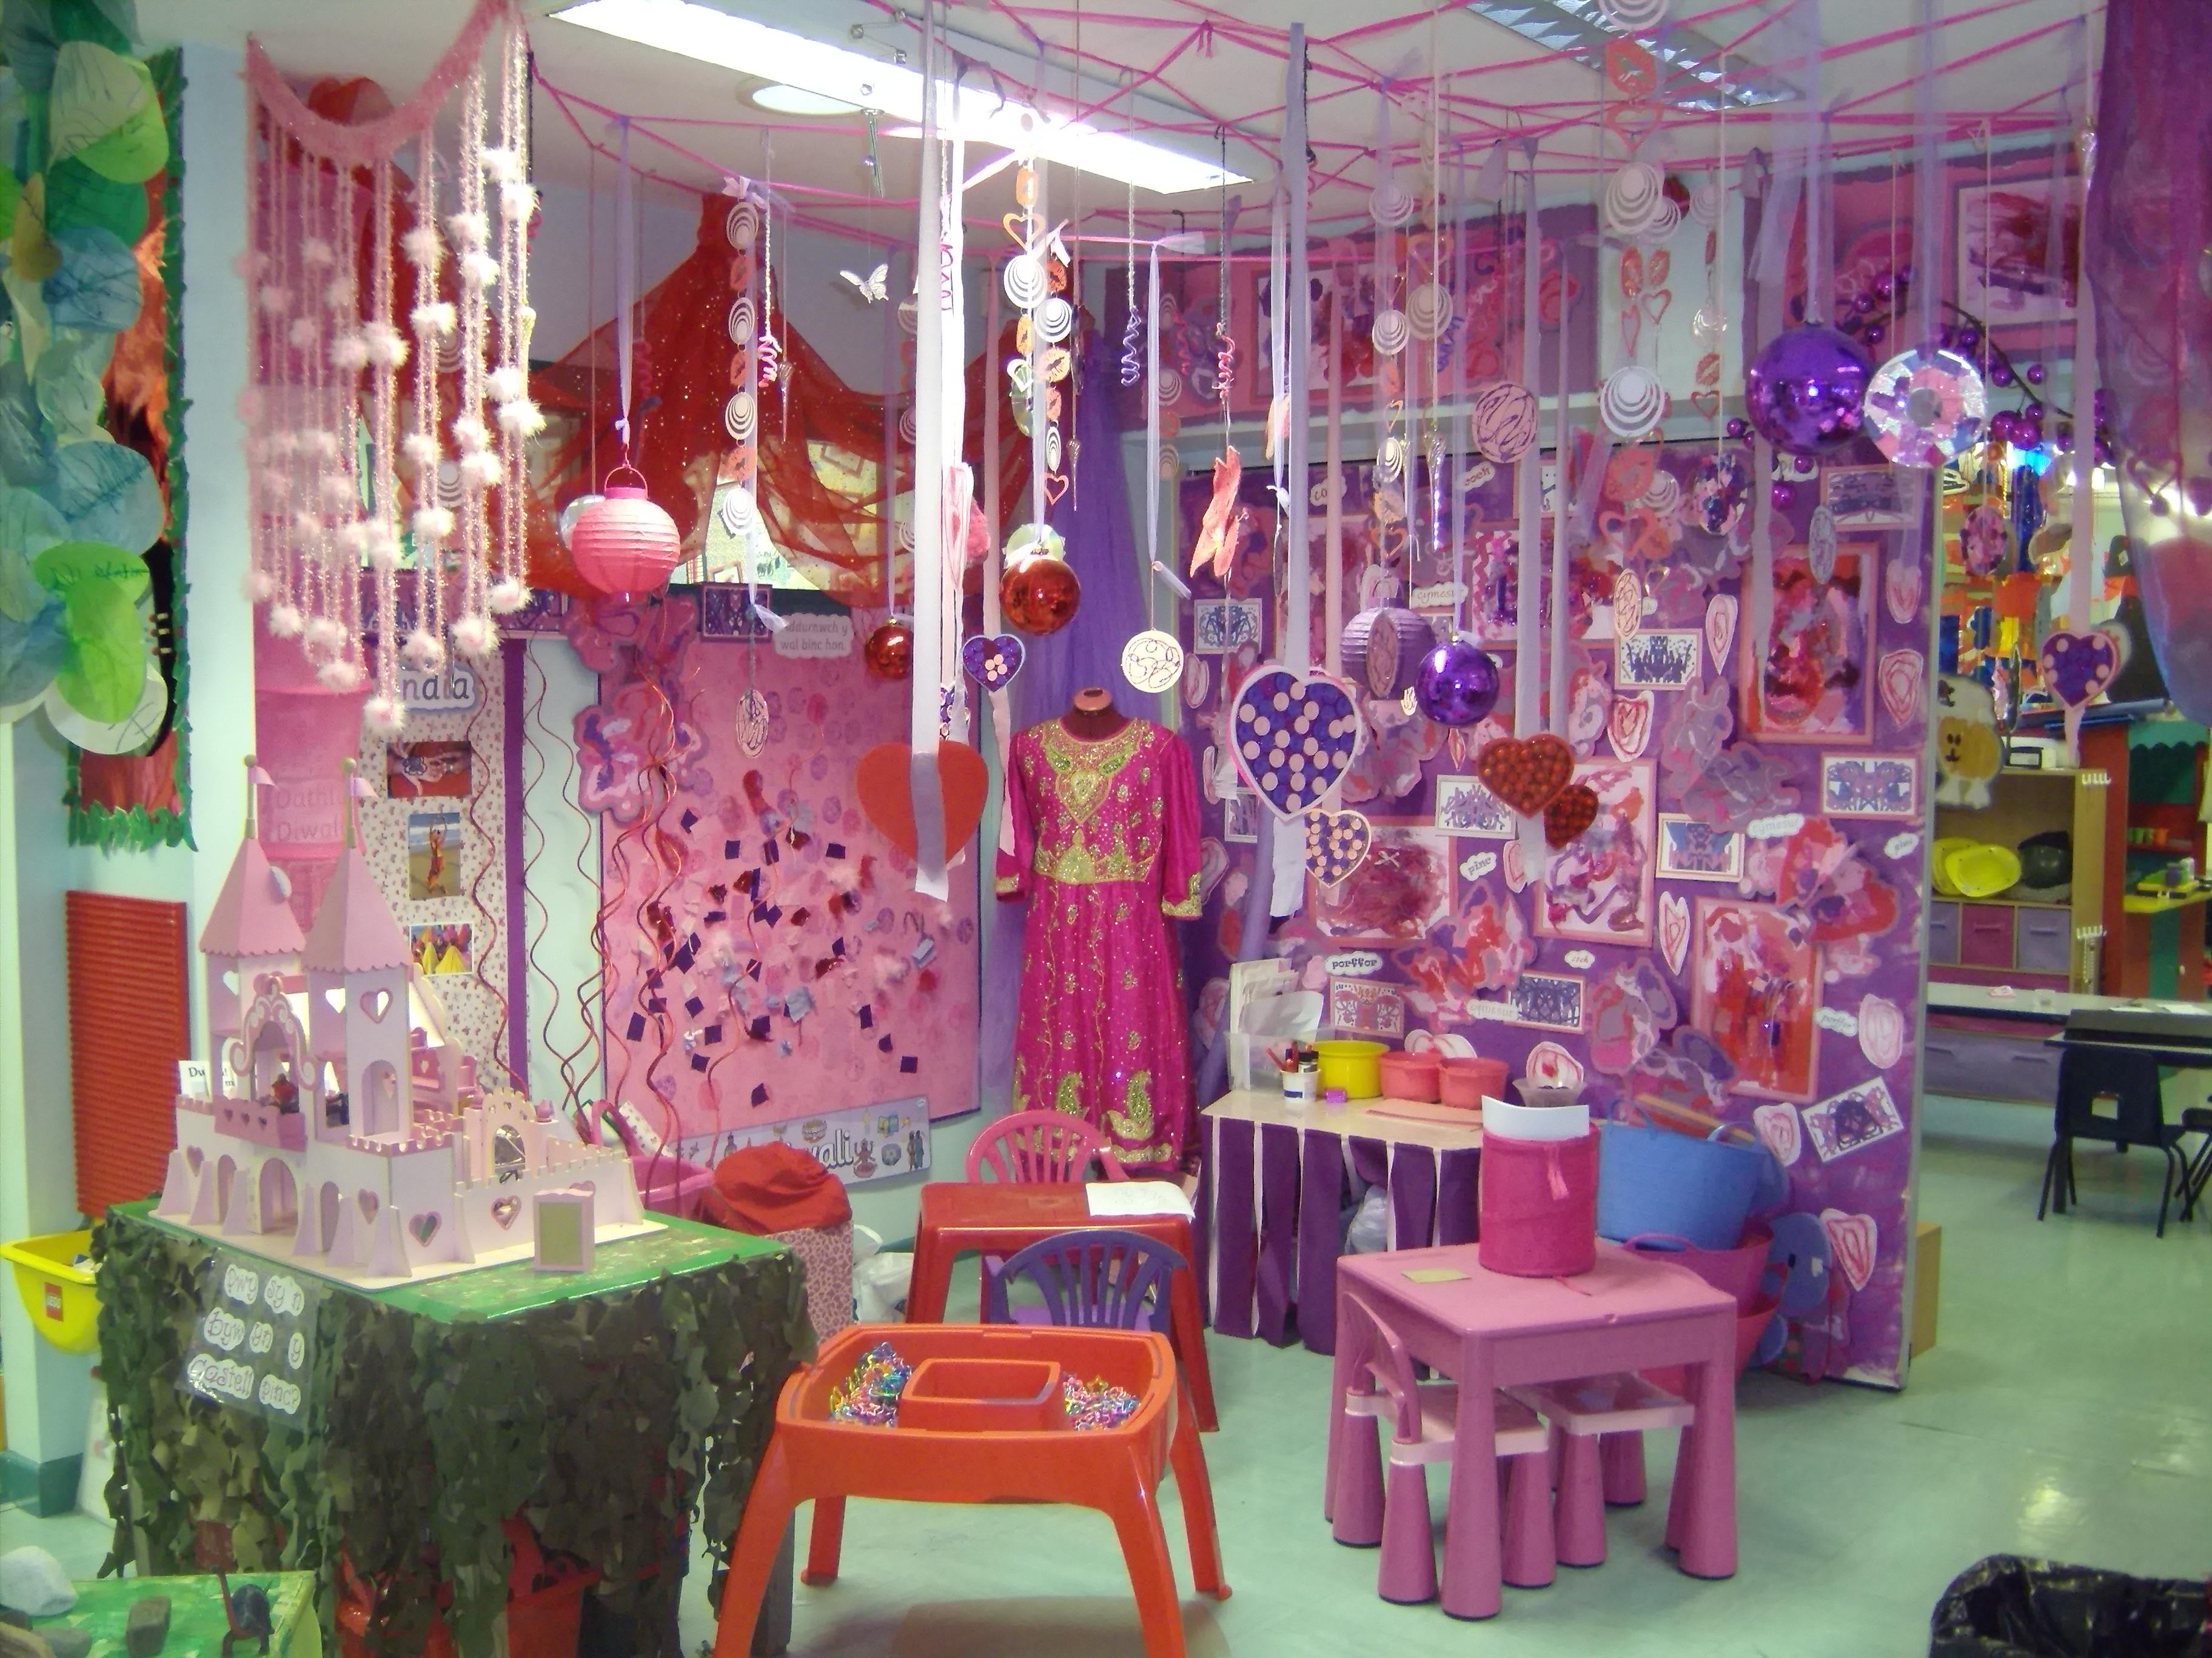

Slide 28
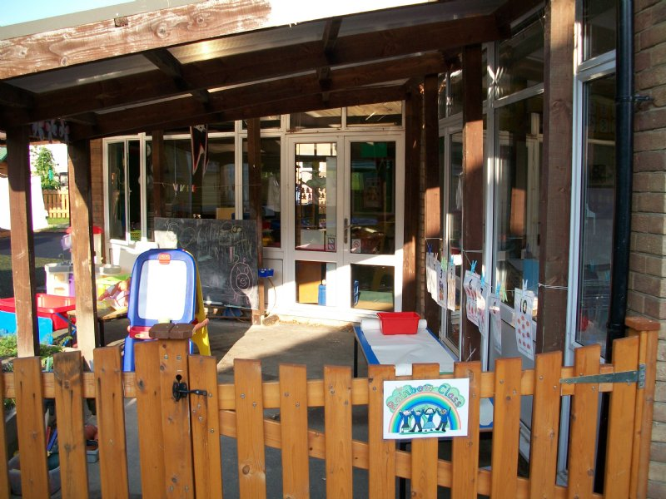

Slide 29
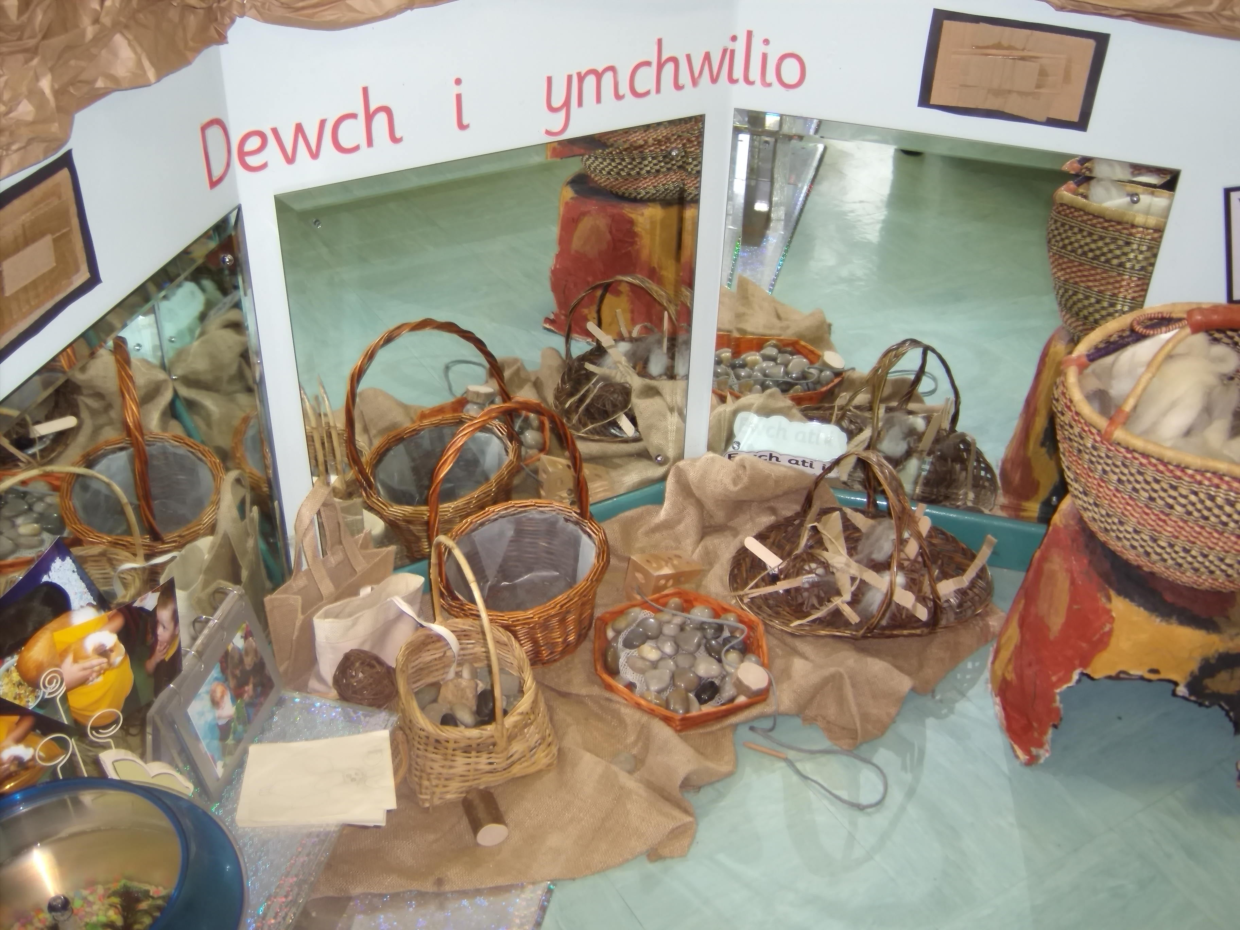

Slide 30
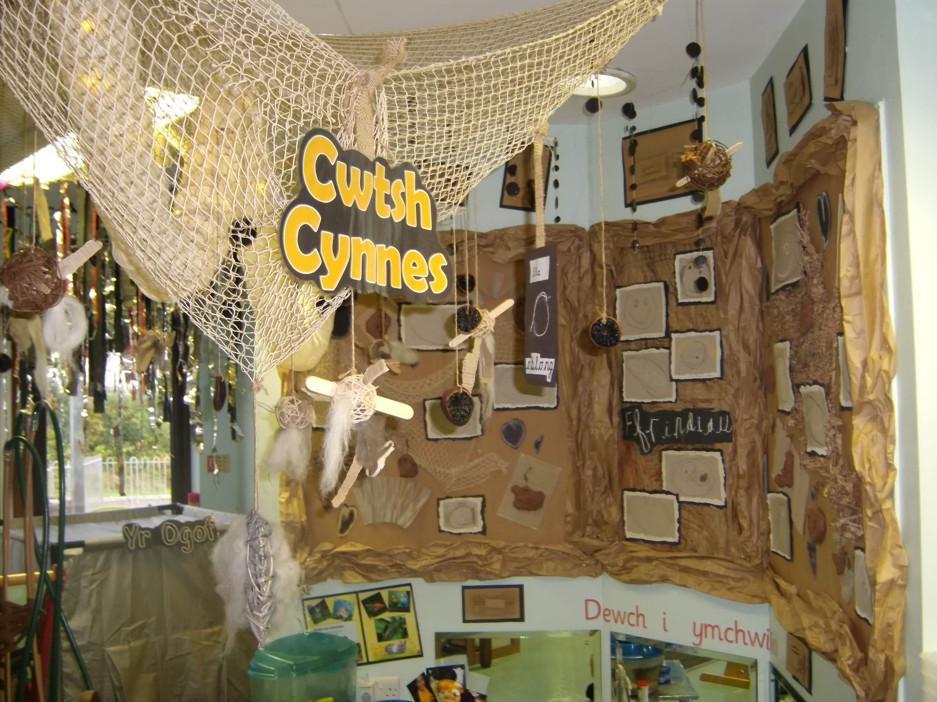

Slide 31
Amcan
Aim
Rhoi amrywiaeth o gyfleoedd i fyfyrwyr ddeall natur amrywiol y cyd-destunau y byddant yn addysgu ynddynt.
To provide students with a range of opportunities to understand the varied nature of the contexts in which they will teach.

Slide 32
Deilliant dysgu
Learning outcome
dylai’r darpar athro allu dangos y gallu i wneud y canlynol:
dangos dealltwriaeth glir o’r ffyrdd y trefnir ysgolion a sut y cynllunnir y cwricwlwm i fodloni anghenion y dysgwyr.
the student-teacher should be able to demonstrate the ability to:
evidence a clear understanding of the ways in which schools are organised and how the curriculum is designed to meet the needs of the learners

Slide 33
Tasg gyfeiriol – erbyn 17/01/20
Directed task – by 17/01/20
Ffeindiwch mas am y damcaniaethwyr canlynol a’u cyfraniadau i’n dealltwriaeth ni o amgylcheddau sy’n galluogi dysgu:
Fredrich Froebel
Prof. Tina Bruce
Rudolf Steiner
Lilian Katz
Janet Moyles
Find out about the following theorists and their contributions to our understanding of environments that enable learning:
Fredrich Froebel
Prof. Tina Bruce
Rudolf Steiner
Lilian Katz
Janet Moyles

