Slide 1


NATIONAL SATURDAY
ONE
Responding to the effects of poverty and disadvantage in education
DYDD SADWRN CENEDLAETHOL
UN
Ymateb i dlodi ac anfantais mewn addysg

Slide 2
MA GENEDLAETHOL ADDYSG
Ymateb i effaith tlodi ac anfantais mewn addysg
Cynhadledd Genedlaethol dydd Sadwrn gyntaf!

Slide 3
NATIONAL MA EDUCATION
Responding to the effects of poverty and disadvantage in education Module
First National Conference Saturday!

Slide 4
Nodyn atgoffa a “rheolau sylfaenol”
Arhoswch yn yr un cyfarfod Teams drwy’r dydd tan y sesiwn olaf
Digon o seibiannau o'r sgrin ar gyfer eich lles
Mae croeso i chi gadw camerâu ymlaen ond byddwn yn recordio prif sesiynau
Defnyddiwch y mudydd a chodwch law i ofyn cwestiwn
  Peidiwch â siarad dros eich gilydd (mae hyn yn aml yn digwydd pan rydyn ni'n gyffrous ac yn angerddol am y pethau rydyn ni'n eu trafod!)
  Parchwch safbwyntiau, cefndiroedd a phrofiadau eraill
Cadw amser – efallai y bydd angen i ni dynnu sesiynau i ben er mwyn cadw at amser
Mewn achos o faterion technegol:
  Peidiwch â phanicio!
  Os oes problem ar ein hochr ni – arhoswch ar Teams a byddwn yn ail-ymuno. Os yw problemau'n parhau, gwiriwch eich e-byst.
  Os oes problem ar eich ochr chi – ceisiwch ail-ymuno pan fo' hynny'n bosibl.
  E-bostiwch arweinydd y modiwl, os ydych yn cael trafferth

Slide 5
A few reminders and “ground-rules”
Remain in the same Teams meeting all day until final HEI session*
Plenty of screen breaks for your well-being
You are welcome to keep cameras on but we will be recording the main room sessions
Please mute and use the hand-up or chat function to ask a question
  Please do not talk over each other (this often happens when we get excited and passionate about the things we discuss!)
  Please respect other’s viewpoints, backgrounds and experiences
Time-keeping – we may need to draw sessions to a close to keep to time
In the event of technical issues:
  Don’t panic!
  If our side – stay on Teams and we will re-join. If ongoing, please check your emails.
  If your side- try to re-join when you can
  Email the module leader, if you are having trouble.

Slide 6
Amserlen y Dydd Schedule of the Day
09:30 – 10:00 | Croeso a chynllun y dydd | Welcome and plan of the day
10:00-11:00 | LlC 1 Sesiwn 1: Diffinio tlodi a deall ei oblygiadau ar gyfer arfer | CS1 Session 1: Defining poverty and understanding its implication for practice
11-11:15 | EGWYL | BREAK
11:15 – 12:00 | LlC 1 Sesiwn 2: Goblygiadau i ddysgwyr bregus | CS1 Session 2:The implications for vulnerable learners
12.00-12.30 | Cinio | Lunch
12:30 – 1.15pm | Holi arbenigwr Emma Holden and Megan Roberts – FEO Ysgolion Bro / Cymunedau Ymarfer CNPT | ASK the Expert Emma Holden and Megan Roberts FEO Community Focussed Schools / Communities of Practice NPT
1:15 – 2:15 | LLC2 Sesiwn 3: Gwerthuso arfer a mesuriadau dysgu a datblygiad sy'n gysylltiedig â thlodi ac anfantais | CS2 Session 3: Evaluating practice and measurements of learning and development related to poverty and disadvantage.
2.15- 2:30 | EGWYL | BREAK
2.30-3.15 | LlC2 Sesiwn 4 Damcaniaethau tlodi ac anfantais | CS2 Session 4 theories of poverty and disadvantage
3.15-3.30 | Holi ac Ateb Crynodeb o'r aseiniad | Q&A Recap of assignment

Slide 7
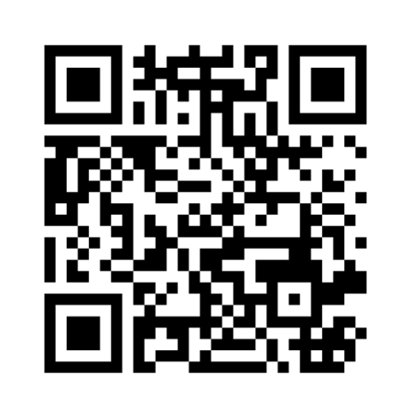
Dysgu Proffesiynol yn ystod y Modiwl
Professional Learning During the Module
Sut mae trawsnewid profiadau addysgol pobl ifanc ac ymarferwyr yng Nghymru?
How do we transform the educational experiences of young people and practitioners in Wales?
www.menti.com: code 4194 0884

Slide 8
Dysgu Proffesiynol yn ystod y Modiwl
Sut mae trawsnewid profiadau addysgol pobl ifanc ac ymarferwyr yng Nghymru?
Mae trawsnewid yn golygu ymholi proffesiynol cydweithredol beirniadol, myfyrio ar ein profiadau ein hunain, bod yn agored i safbwyntiau newydd ac amgen, a datblygu ffyrdd newydd o feddwl am ymarfer a ‘gweld’ yr ystafell ddosbarth – barn broffesiynol.
Mae dysgu gwirioneddol drawsnewidiol yn rhoi'r posibilrwydd o arwain newid mewn ymarfer.

Slide 9
Professional Learning During the Module
How do we transform the educational experiences of young people and practitioners in Wales?
Transformation involves critical collaborative professional enquiry, reflecting on our own experiences, being open to new and alternative perspectives, and developing new ways of thinking about practice and ‘seeing’ the classroom – professional judgement.
Truly transformative learning affords the possibility of leading change in practice.
See https://hwb.gov.wales/professional-development/national-approach-to-professional-learning/individual-professional-learning-journey/

Slide 10
Trosolwg Asesu
Asesiad: Adroddiad 4,000 o eiriau
Un aseiniad sydd i'r modiwl hwn. Mae’r aseiniad cyfwerth â 100% o’r radd derfynol.
Dylai'r adroddiad fyfyrio ar fater sy’n rhan o arfer y myfyriwr lle gallai tlodi ac anfantais effeithio ar leoliad addysgol y dysgwr. Dylai’r adroddiad fod wedi’i anelu at gynulleidfa darged a ddewiswyd (e.e. staff, cyflwyniad i lywodraethwyr, Penaethiaid Gwasanaeth, uwch dîm rheoli ac ati) a bydd yn cael ei ysgrifennu mewn arddull briodol.
Rhan 1: (2,000 o eiriau)
Gan ddefnyddio llenyddiaeth a damcaniaeth, gofynnir i chi fyfyrio'n feirniadol ar effaith tlodi ac anfantais ar ddysgwyr yn eich lleoliad addysgol. Gofynnir i chi archwilio’n feirniadol y mesuriadau a ddefnyddir i ddangos cynnydd a datblygiad y dysgwr yn eich lleoliad addysgol, gan archwilio’n feirniadol a yw’r rhain yn llwyddo i nodi a chefnogi dysgwyr y mae tlodi ac anfantais yn effeithio arnynt.
Rhan 2: Cynllun Gweithredu (2,000 o eiriau)
Bydd angen i chi ystyried sut y byddech yn ymateb i’r mater / materion a nodwyd ac a archwiliwyd yn Rhan 1 yn eich arfer eich hun. Bydd angen i chi gyfiawnhau'n feirniadol eich cynllun gweithredu arfaethedig, ac os caiff ei weithredu, arddangos pam eich bod yn credu y gallai gyfrannu at fynd i'r afael â'r materion a nodwyd. Bydd angen i chi hefyd ystyried sut y byddech chi’n gwerthuso’r newidiadau y byddech chi’n eu rhoi ar waith.

Slide 11
Assessment overview
Assessment: Report (4000 words)
This module offers one assessment. This is worth 100% of the overall module grade.
Part 1 (2,000 words)
The report reflects on an issue in the student’s practice where poverty and disadvantage impact on the learner’s educational setting. The report should be aimed at a chosen target audience (e.g. staff, presentation to governors, Heads of Service, senior management team, etc.) and should be written in an appropriate style. The content and design of a report and action plan will be discussed in your initial session.
Part 2: Action plan (2,000 words)
Drawing from literature and theory, you are asked to critically reflect on the impact of poverty and disadvantage on learners in your educational setting. You are asked to critically examine the role of measurements used in your educational setting to show the learner’s progress and development, critically exploring whether these successfully identify and support learners who are impacted by poverty and disadvantage.

Slide 12
Ni fyddwch yn casglu, dadansoddi na chyflwyno data cynradd ar gyfer yr aseiniad hwn.
Dyddiad cau ar gyfer cyflwyno: cyn a hyd at 11:59 (23:59 awr) ar ddydd Iau 29/8/24
Dychwelyd - Dydd Iau 26/9/2024 am 14:00
You will not be collecting, analysing or presenting primary data for this assignment.
Submission deadline: before and up to 11:59 (23:59 hours) by Thursday 29/8/24
Return - Thursday 26/9/2024 @14:00

Slide 13
Deilliannau Dysgu
Arddangos dealltwriaeth feirniadol o dlodi ac anfantais ar ddysgwyr.
Gwerthuso’n feirniadol arfer a mesuriadau dysgu a datblygiad dysgwyr y mae tlodi ac anfantais yn effeithio arnynt.
Archwilio’n feirniadol y dull systemau cyfan a sut mae hyn yn effeithio ar arfer.
Archwilio’n feirniadol sut i gynllunio, gweithredu a gwerthuso newid mewn arfer a fydd o fudd i ddysgwyr y mae tlodi ac anfantais yn effeithio arnynt mewn lleoliadau addysgol.

Slide 14
Assessment overview
Demonstrate a critical understanding of poverty and disadvantage on learners.
Critically evaluate the practice and measurements of learning and development with learners who are impacted by poverty and disadvantage.
Critically explore the whole systems approach and how this affects practice.
Critically examine how to plan, implement, and evaluate a change in practice that will benefit learners who are impacted by poverty and disadvantage in educational settings.

Slide 15
Sesiwn 1: 10yb-11yb
Diffinio tlodi a deall ei effaith ar addysg
Session 1: 10am-11am
Defining poverty & understanding its impact on education

Slide 16
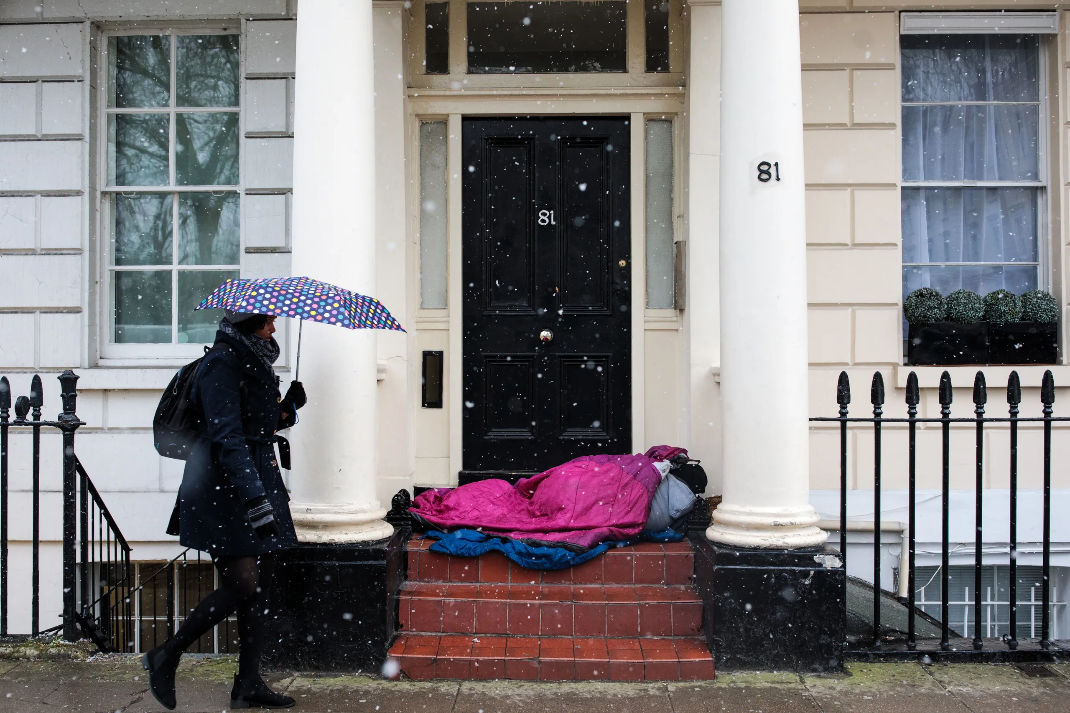
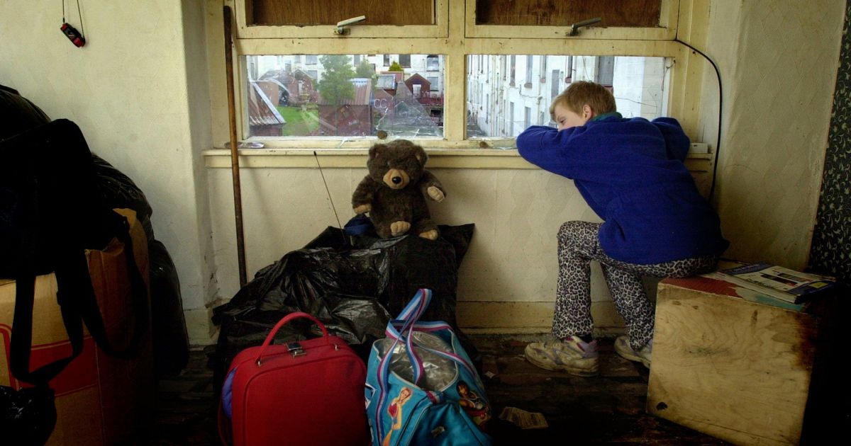
Diffinio'r broblem: Beth yw tlodi?
l
Dehongliadau gwahanol o dlodi: absoliwt neu gymharol
Mesuriadau gwahanol: beth sy’n cael ei ystyried neu ei hepgor (ar ôl costau tai; incwm y cartref cyn neu ar ôl budd-daliadau; effeithiau chwyddiant)

Slide 17
Defining the problem: What is poverty?
Different interpretations of poverty: absolute, relative
Different measurements: what is considered or left out (after housing costs; household income before or after benefits; inflationary effects)
Notes:
In this first session, we’re going to review and consider in more depth some of definitions and information presented in the Core Strand 1 materials on Pebblepad relating to definitions of poverty and measurements of it.

Slide 18
Y Llinell tlodi
Diffinnir y llinell dlodi gan y Swyddfa Ystadegau Gwladol fel 60% o ganolrif cyfwerth incwm gwario (sy’n cyfrif am gostau tai mewn perthynas â maint y teulu) (tua £20,400)
Incwm cartref ar ôl costau tai sydd o dan 50% o'r cyfartaledd = tlodi dwfn.
Incwm cartref o dan 40% o’r cyfartaledd = tlodi dwfn iawn (tua £13,600)
Beth yw canolrif cyfredol incwm gwario y cartref? Amcangyfrifir ei fod oddeutu £34,000. Oddeutu cyflog cyn treth blynyddol o £28,000.
Notes:
Joseph Rowntree Foundation Report 2023 & Destitution in the UK report
Fitzpatrick, S., Bramley, G., Treanor, M., Blenkinsopp, J., McIntyre, J., Johnsen, S., & McMordie, L. (2023). Destitution in the UK 2023 [full report].
The median equivalised disposable income represents the income level at which half of the population has higher income and half has lower income, after adjusting for household size and composition. Equivalisation is used to account for differences in household needs based on factors such as the number of adults and children in the household. Disposable income refers to the income remaining after taxes and other mandatory deductions have been subtracted.

Slide 19
Poverty line
The poverty line is defined by the ONS as 60% of the median equivalised disposable income (accounting for housing costs in relation to size of family) (approx. £20,400)
Household income after housing costs that are below 50% of the average = deep poverty.
Household income under 40% of the average = very deep poverty (approx. £13,600)
What is the current median equivalised disposable household income? Estimated at approximately £34,000. Annual pre-tax salary is approx. £28,000.
Notes:
Joseph Rowntree Foundation Report 2023 & Destitution in the UK report
Fitzpatrick, S., Bramley, G., Treanor, M., Blenkinsopp, J., McIntyre, J., Johnsen, S., & McMordie, L. (2023). Destitution in the UK 2023 [full report].
The median equivalised disposable income represents the income level at which half of the population has higher income and half has lower income, after adjusting for household size and composition. Equivalisation is used to account for differences in household needs based on factors such as the number of adults and children in the household. Disposable income refers to the income remaining after taxes and other mandatory deductions have been subtracted.

Slide 20
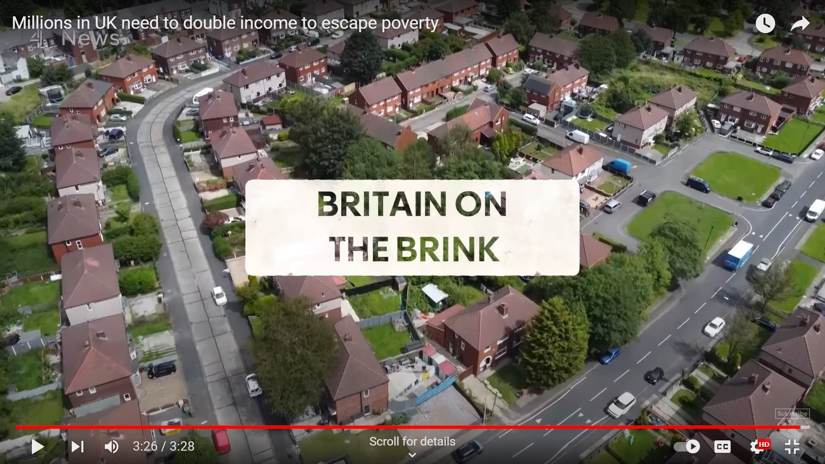
Gweithwyr tlawd
Beth yw’r ffactorau a grybwyllir yn y clip hwn sy’n ychwanegu at broblemau llawer o bobl yn y llinell dlodi neu’n agos ati?
Notes:
If you work 40 hours per week on the minimum wage, before tax, your annual income will be just over £21,000
Housing costs
Wages
Caring responsibilities
Inflation

Slide 21
Working poor
What are the factors mentioned in this clip that add to the problems of many people in or close to the poverty line?
Notes:
If you work 40 hours per week on the minimum wage, before tax, your annual income will be just over £21,000
Housing costs
Wages
Caring responsibilities
Inflation

Slide 22
Plant a thlodi yng Nghymru
Mae tystiolaeth ddiweddar yn awgrymu bod 28% o blant Cymru yn byw mewn tlodi incwm cymharol (ar ôl ystyried costau tai)
Mae 81% o blant sy'n byw mewn tlodi incwm cymharol yn byw ar aelwydydd sy'n gweithio.
Mae 38% o aelwydydd un rhiant yn debygol o fod mewn tlodi incwm cymharol.
Tebygolrwydd o 40% bod pobl y mae eu deiliad tŷ sy’n ennill fwyaf yn dod o grŵp Du, Asiaidd neu leiafrifoedd ethnig yn byw mewn tlodi incwm cymharol – o gymharu â 22% lle mae deiliad y tŷ yn dod o grŵp ethnig gwyn.
Mae 31% o blant sy'n byw mewn teulu lle mae person anabl mewn tlodi incwm cymharol - o gymharu â 26% o'r rhai mewn teuluoedd lle nad oes neb yn anabl

Slide 23
Children & poverty in Wales
Recent evidence suggests that 28% of children in Wales were living in relative income poverty (after housing costs have been taken into account)
81% of children living in relative income poverty live in working households.
38% lone parent households are likely to be in relative income poverty.
40% likelihood of people whose highest earning householder comes from a Black, Asian or minority ethnic group living in relative income poverty – compared to 22% where the householder comes from a white ethnic group.
31% of children who live in a family where there is a disabled person are in relative income poverty- compared with 26% of those in families where no-one is disabled.
Notes:
Relative income poverty: April 2021 to March 2022 | GOV.WALES (latest, published March 2023)
Also see PHW-Cost-of-Living-report-Eng-04_10_23.pdf (phwwhocc.co.uk)
“The biggest issue affecting children in Wales” – tackling child poverty (senedd.wales)
Consultation on the draft Child Poverty Strategy for Wales 2023

Slide 24
Ffactorau croestoriadol
Gall pob un o’r grwpiau sy’n fwy tebygol o fod yn profi tlodi brofi ffactorau eraill, yn uniongyrchol neu’n anuniongyrchol, a allai effeithio ar addysg plant. Myfyriwch ar beth allai'r rhain fod ar ei gyfer:
Plant y mae eu rhieni yn gweithio
Plant o deuluoedd un rhiant
Plant o gefndiroedd lleiafrifoedd ethnig
Plant gyda rhiant anabl
Statws mewnfudo
Pan fyddwn yn meddwl am y ffyrdd y mae gwahanol ffactorau yn cyfuno i effeithio ar addysg plentyn, rydym yn edrych ar groestoriadedd. Gallai'r ffactorau arwyddocaol effeithio ar ddysgwr yn seicolegol neu'n faterol.

Slide 25
Intersectional factors
Each of the groups more likely to be experiencing poverty may experience other factors, directly or indirectly, that may impact children’s education. Reflect on what these might be for:
Children whose parents are working
Children from single-parent families
Children from ethnic minority backgrounds
Children with a disabled parent
Migration status
When we think about the ways different factors combine to affect a child’s education, we are looking at intersectionality. The significant factors might affect a learner psychologically or materially.
Notes:
In Equity and Diversity module we discussed intersectionality, the ways that individuals or groups experience various forms of discrimination, disadvantage, or privilege that result from the intersection of multiple social identities, such as race, gender, class, sexuality, ability, and others. It emphasises that these identities are interconnected and cannot be understood or addressed in isolation. Essentially, intersectionality prompts us to consider how different aspects of a person's identity and social position intersect and interact to shape their experiences and opportunities in education.

Slide 26
Sut mae ysgolion yn adnabod plant sy'n byw mewn tlodi?
.
Cymhwysedd ar gyfer Prydau Ysgol Am Ddim (PYDd) yw'r mesuriad mwyaf cyffredin a ddefnyddir.
Mae cymhwysedd yn seiliedig ar deuluoedd sy’n gymwys ar gyfer budd-daliadau’r wladwriaeth fel lwfans Ceisio Gwaith (Jobseekers Allowance), Credyd Cynhwysol (Universal Credit) ac ati.
Faint o blant yn y DU sy'n gymwys i gael Prydau Ysgol am Ddim?
Roedd 24.6% o ddisgyblion yn gymwys i gael PYDd yn 2023, 23.8% yn fwy na 2022. Mae hynny'n cynrychioli 2.1 miliwn o ddisgyblion ar draws y DU.
Notes:
Mae prydau ysgol am ddim ar gael i blant cymwys sy’n mynychu ysgol a gynhelir yng Nghymru. Mae’r cynllun prydau ysgol am ddim i holl blant ysgolion cynradd yn cael ei gyflwyno ar hyn o bryd ar draws Cymru, gan ddechrau gyda’r dysgwyr ieuengaf yn ein hysgolion cynradd.
Pwy sy'n gymwys
Mae'n bosibl y gall eich plentyn gael prydau ysgol am ddim os ydych yn cael unrhyw un o'r canlynol:
Cymhorthdal Incwm
Lwfans Ceisio Gwaith yn seiliedig ar Incwm
Lwfans Cyflogaeth a Chymorth yn gysylltiedig ag Incwm
Cymorth o dan Ran VI o Ddeddf Mewnfudo a Lloches 1999
Elfen gwarant Credyd Pensiwn
Credyd Treth Plant (ar yr amod nad oes gennych hawl i gael Credyd Treth Gwaith hefyd ac nad yw eich incwm blynyddol yn fwy nag £16,190 cyn treth)
Credyd Treth Gwaith am gyfnod ychwanegol – a delir am bedair wythnos pan nad ydych yn gymwys i gael Credyd Treth Gwaith mwyach
Credyd Cynhwysol – rhaid i enillion eich aelwyd fod yn llai na £7,400 y flwyddyn ar ôl treth. Nid yw hyn yn cynnwys incwm o fudd-daliadau.
Mae’r awdurdod lleol lle mae’r dysgwr yn mynd i’r ysgol (nid lle mae’n byw) yn gyfrifol am y canlynol:
darparu pryd ysgol am ddim
asesu cymhwysedd
Mae deddfwriaeth prydau ysgol am ddim yn galluogi rhieni maeth i hawlio prydau ysgol am ddim. Cyn belled â bod rhiant yn gymwys i hawlio prydau ysgol am ddim, gall y plentyn eu cael. Mae'n bosibl y gall fod gan blentyn bedwar rhiant; dau riant maeth a dau riant naturiol.

Slide 27
How do schools identify children living in poverty?
Eligibility for Free School Meals (eFSM) is the most common measurement used.
Eligibility is based on families qualifying for state benefits such as Jobseekers’ allowance, Universal Credit etc. unless in Primary School where it is now free
How many children in UK are eligible for Free School Meals?
24.6% of pupils were eligible for free school meals in 2023, up from 23.8% in 2022. This represents 2.1 million pupils UK.
Notes:
Your child may be able to get free school meals if you get any of the following:
Income Support
income-based Jobseeker’s Allowance
income-related Employment and Support Allowance
support under Part VI of the Immigration and Asylum Act 1999
Child Tax Credit (as long as you don't also get Working Tax Credit and your annual income is £16,190 or less before tax)
the guaranteed element of Pension Credit
Working Tax Credit run-on - paid for 4 weeks after you stop qualifying for Working Tax Credit
Universal Credit - your household earnings must be less than £7,400 a year after tax. This does not include any income from benefits.

Slide 28
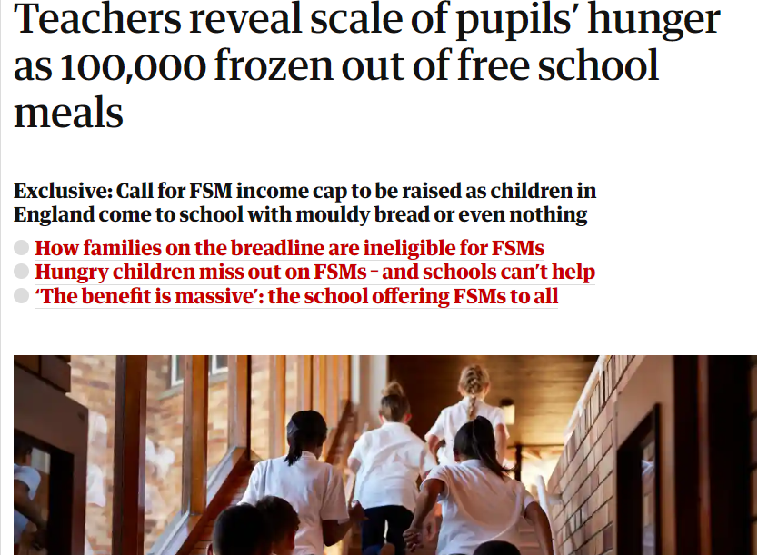
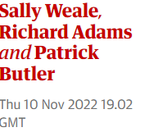
Notes:
Welsh Government has said: “All primary school children in Wales will get free school meals by 2024”.
This policy is already being rolled out and is now being implemented in many primary school year groups.
However, the threshold is very low, meaning families may still be experiencing considerable financial hardship yet not eligible for FSM at secondary level.

Slide 29
Defnyddio PYDd a Stigma
Gall statws mewnfudo, swyddi cyflog isel a swyddi dros dro wneud cymhwysedd yn anodd ei asesu, a/neu osod teuluoedd ychydig yn uwch na'r terfyn (isel) ar gyfer cymhwysedd;
Mae hawl i brydiau ysgol am ddim, â’i natur wedi'i thargedu ac ar sail prawf, yn effeithio ar geisiadau rhai teuluoedd am y cymorth;
Potensial ar gyfer stigma, yn enwedig mewn cyd-destunau â lefelau cymwys is;
Lleoliad ysgol, ffyrdd y caiff PYDd ei hyrwyddo, prosesau i sicrhau anhysbysrwydd i ddisgyblion, dylanwadu ar nifer y disgyblion sy'n manteisio arnynt;
Pwysau ar ddisgyblion i gydymffurfio â phatrymau defnydd ac arferion y boblogaeth ehangach o ddisgyblion.

Slide 30
Take-up & stigma
Immigration status, low-paid & temporary jobs may make eligibility hard to assess, and/or place families just above the (low) cut-off point for eligibility;
Targeted and means tested nature of free school meal entitlement effects some families' applications for the support;
Potential for stigma, particularly in contexts with lower levels of entitlement;
School setting, ways FSM are promoted, processes to ensure anonymity for pupils, influence uptake;
Pressure for pupils to conform to the consumption patterns and practices of the wider pupil population.
Notes:
Not all families eligible for Free School Meals apply for it and even of those who do might not then take it up. The reasons for these are complex but include issues around the process of applying and stigma associated with being on FSM.
Addis, S., & Murphy, S. (2018). Free school meals: socio-ecological influences on school level take up of entitlement. British Journal of School Nursing, 13(8), 394-402.
Montemaggi, F., Bullivant, S., & Glackin, M. (2017). The take-up of free school meals in Catholic schools in England and Wales.

Slide 31
Mesurau amgen o dlodi
Perthynas wan â chyrhaeddiad o gymharu ag ARh a SRh.
Anodd i'w gasglu ond ynghyd â SRh, perthynas ychydig yn fwy arwyddocaol â chyrhaeddiad.
Nid yw'n caniatáu ar gyfer cymorth wedi'i dargedu
Ddim yn ddirprwyydd cadarn
Incwm y cartref
Addysg rhieni
Galwedigaeth rhieni
Cod post (lefelau ardal o amddifadedd)
Notes:
Taylor, C. (2018). The reliability of free school meal eligibility as a measure of socio-economic disadvantage: Evidence from the millennium cohort study in Wales. British journal of educational studies, 66(1), 29-51.
Ilie, S., Sutherland, A., & Vignoles, A. (2017). Revisiting free school meal eligibility as a proxy for pupil socio‐economic deprivation. British Educational Research Journal, 43(2), 253-274.
Engzell, P. (2021). What do books in the home proxy for? A cautionary tale. Sociological Methods & Research, 50(4), 1487-1514.

Slide 32
Alternative measures of poverty
Household income
Parental education
Parental occupation
Postcode (area levels of deprivation)
Number of books in the house
Weaker relationship to attainment than PE & PO.
Difficult to collect but along with PO, slightly more significant relationship to attainment.
Doesn’t allow for targeted support
Not a robust proxy
Notes:
Taylor, C. (2018). The reliability of free school meal eligibility as a measure of socio-economic disadvantage: Evidence from the millennium cohort study in Wales. British journal of educational studies, 66(1), 29-51.
Ilie, S., Sutherland, A., & Vignoles, A. (2017). Revisiting free school meal eligibility as a proxy for pupil socio‐economic deprivation. British Educational Research Journal, 43(2), 253-274.
Engzell, P. (2021). What do books in the home proxy for? A cautionary tale. Sociological Methods & Research, 50(4), 1487-1514.

Slide 33
Canfyddiadau athrawon o dlodi
Nid yw llawer o athrawon (yn enwedig hyfforddeion) yn ymwybodol o'r graddau a'r anawsterau a wynebir gan deuluoedd sy'n byw mewn tlodi.
Ceir tystiolaeth ei bod yn well gan lawer o athrawon dan hyfforddiant weithio mewn ysgolion y canfyddir bod ganddynt ddemograffeg disgyblion agosach at gyfartaledd.
Gall credoau ffug ddylanwadu ar ganfyddiadau negyddol
  a) gellir priodoli anghydraddoldeb addysgol i ffactorau y gellir eu rheoli
  b) deallusrwydd yn sefydlog,
  c) mae addysg yn wirioneddol deilwng. (Doyle a Easterbrook, 2023)
Notes:
Teachers’ perceptions of poverty
Doyle, L., & Easterbrook, M. J. (2023). Biased career choices? It depends what you believe: Trainee teachers' aversions to working in low-income schools are moderated by beliefs about inequality, meritocracy, and growth mindsets. Preprint retrieved from PsyArXiv
Ellis, S., Thompson, I., McNicholl, J., & Thomson, J. (2019). Student teachers’ perceptions of the effects of poverty on learners’ educational attainment and well-being: perspectives from England and Scotland. In Poverty Discourses in Teacher Education (pp. 110-126). Routledge.
Robson, D., Mtika, P., Graham, A., & MacDougall, L. (2021). Student teachers’ understandings of poverty: insights for initial teacher education. Journal of Education for Teaching, 47(1), 104-117. (factors that influencing negative feelings towards teaching in below medium income schools; mitigations through training input on poverty)

Slide 34
Teachers’ perceptions of poverty
Many teachers (especially trainee) are not aware of the extent and difficulties faced by families living in poverty.
There is evidence that many trainee teachers prefer working in schools perceived to have closer to average pupil demographics.
False beliefs can influence negative perceptions
a) educational inequality can be attributed to controllable factors;
b) intelligence is fixed, and
c) schooling is truly meritocratic. (Doyle & Easterbrook, 2023)
Notes:
Teachers’ perceptions of poverty
Doyle, L., & Easterbrook, M. J. (2023). Biased career choices? It depends what you believe: Trainee teachers' aversions to working in low-income schools are moderated by beliefs about inequality, meritocracy, and growth mindsets. Preprint retrieved from PsyArXiv
Ellis, S., Thompson, I., McNicholl, J., & Thomson, J. (2019). Student teachers’ perceptions of the effects of poverty on learners’ educational attainment and well-being: perspectives from England and Scotland. In Poverty Discourses in Teacher Education (pp. 110-126). Routledge.
Robson, D., Mtika, P., Graham, A., & MacDougall, L. (2021). Student teachers’ understandings of poverty: insights for initial teacher education. Journal of Education for Teaching, 47(1), 104-117. (factors that influencing negative feelings towards teaching in below medium income schools; mitigations through training input on poverty)

Slide 35
Sut mae anfantais yn effeithio ar ddysgwyr?
Parodrwydd a phrofiadau blaenorol
Ymwneud ag addysgu (addysgeg anweledig), perthnasoedd
Prosesau dysgu (cyfle, amser, adnoddau) o fewn/tu allan i'r ystafell ddosbarth
Safbwyntiau ar yr ysgol/cymwysterau/llwybrau
Gwerth canlyniadau
Ymdeimlad o hunan yn yr ysgol (micro-gywilyddio oherwydd cyfoeth ac adnoddau teuluol)
Notes:
Ridge, T. (2011). The everyday costs of poverty in childhood: A review of qualitative research exploring the lives and experiences of low‐income children in the UK. Children & society, 25(1), 73-84.
Pollack, T. M. (2012). The miseducation of a beginning teacher: One educator's critical reflections on the functions and power of deficit narratives. Multicultural Perspectives, 14(2), 93-98.
White, M. L., & Murray, J. (2019). Seeing disadvantage in schools: Exploring student teachers’ perceptions of poverty and disadvantage using visual pedagogy. In Poverty Discourses in Teacher Education (pp. 127-142). Routledge.
Goodall, J. (2021). Parental engagement and deficit discourses: Absolving the system and solving parents. Educational Review, 73(1), 98-110.

Slide 36
How does disadvantage affect learners?
Preparedness & prior-experiences
Engagement with teaching (invisible pedagogy), relationships
Processes of learning (opportunity, time, resources) inside/outside classroom
Perspectives on school/qualifications/pathways
Value of outcomes
Sense of self within school (micro-shaming due to family wealth & resources)
Notes:
Ridge, T. (2011). The everyday costs of poverty in childhood: A review of qualitative research exploring the lives and experiences of low‐income children in the UK. Children & society, 25(1), 73-84.
Pollack, T. M. (2012). The miseducation of a beginning teacher: One educator's critical reflections on the functions and power of deficit narratives. Multicultural Perspectives, 14(2), 93-98.
White, M. L., & Murray, J. (2019). Seeing disadvantage in schools: Exploring student teachers’ perceptions of poverty and disadvantage using visual pedagogy. In Poverty Discourses in Teacher Education (pp. 127-142). Routledge.
Goodall, J. (2021). Parental engagement and deficit discourses: Absolving the system and solving parents. Educational Review, 73(1), 98-110.

Slide 37
Trafodaeth grwp
1. Heriau cefnogi plant sy'n byw mewn tlodi
2. Camau y gellid eu cymryd i fynd i’r afael â’r rhain (lefelau athrawon ysgol ac ystafell ddosbarth)
Ystyriwch: Beth yw'r dangosyddion effaith ansoddol a meintiol?
Sut gallwn ni ddeall yn well effeithiau anfantais pan fo llawer o'r profiad o anfantais yn oddrychol ac yn anodd ei fesur?
Sut ydyn ni'n nodi effeithiau anfantais heb greu naratifau diffyg?
Mae Padlet ar gael i nodi eich syniadau a'ch ymatebion
Supporting Children Living in Poverty/Cefnogi plant sy’n byw mewn tlodi (padlet.org)

Slide 38
Group discussion
The challenges of supporting children living in poverty
Actions that could be taken to address these (school and classroom teacher levels)
Consider:
What are the qualitative and quantitative indicators of impact?
How can we better understand the impacts of disadvantage when much of the experience of disadvantage is subjective and difficult to measure?
How do we identify impacts of disadvantage without creating deficit narratives?
Padlet available to note your ideas and responses
Supporting Children Living in Poverty/Cefnogi plant sy’n byw mewn tlodi (padlet.org)

Slide 39


Egwyl
Comfort Break

Slide 40
Dysgwr sy’n agored i niwed ac o dan anfantais (LlC, 2020)
Dysgwyr sydd ag anghenion dysgu ychwanegol (ADY)
Dysgwyr o grwpiau lleiafrifoedd ethnig sydd â Chymraeg neu Saesneg fel iaith ychwanegol (CIY/SIY)
Plant sydd â phrofiad o ofal, gan gynnwys plant sy’n derbyn gofal
Dysgwyr sy’n derbyn addysg heblaw yn yr ysgol (EOTAS)
Plant ffoaduriaid a cheiswyr lloches
Plant Sipsiwn, Roma a Theithwyr
Dysgwyr sy’n gymwys i gael prydau ysgol am ddim
Gofalwyr ifanc
Plant sy’n wynebu risg o niwed, camdriniaeth neu esgeulustod.

Slide 41
Vulnerable learners (WG, 2020)
Learners with Additional Learning needs.
Learners from minority ethnic groups who have English or Welsh as an additional language (EAL/WAL).
Care-experienced children, including looked after children.
Learners educated other than at school (EOTAS).
Children of refugees and asylum seekers.
Gypsy, Roma and Traveller children.
Learners eligible for free school meals (eFSM)
Young carers.
Children at risk of harm, abuse or neglect.
Welsh Government (2020)
Notes:
As well as children living in poverty, there are many other conditions and factors that can make children vulnerable which with poverty may mean that this is an issue for some children and families. We’re going to explore one of these groups of vulnerable learners, those who are refugees and asylum seekers, to illustrate some of the issues facing supporting them within the education system
This document was released during the pandemic but can show some of the intersections that may place stress on those who live in poverty or disadvantage.

Slide 42
Croestoriadoldeb
Mae anfantais economaidd-gymdeithasol yn groestoriadol iawn – mae amddifadedd yn bodoli ochr yn ochr â nodweddion eraill ac yn rhyngweithio â nhw.
Mae rhai pobl a chymunedau yn profi canlyniadau gwaeth o ganlyniad i rwystrau y maent yn eu hwynebu oherwydd nodweddion eraill yn ogystal ag anfantais economaidd-gymdeithasol e.e. lleiafrifoedd ethnig, ffoaduriaid, cymunedau teithwyr.
Mae gan y bobl hyn anghydraddoldebau lluosog.

Slide 43
Intersectionality
Socio-economic disadvantage is highly intersectional – deprivation exists alongside and interacts with other characteristics.
Certain people and communities experience worse outcomes as a result of barriers they face because of other characteristics as well as socio-economic disadvantage e.g. ethnic minorities, refugees, traveller communities.
These people have multiple inequalities.

Slide 44
Ffoaduriaid a cheiswyr lloches
Mae niferoedd mewnfudwyr (gan gynnwys ffoaduriaid a cheiswyr lloches) yn cynyddu ym mhob rhan o’r DU – mae polisïau’r llywodraeth yn gwrth-ddweud ei gilydd – agweddau gelyniaethus – yn cael eu hystyried yn rhannol fel goresgynwyr ond hefyd agweddau tosturiol i groesawu’r rhai sydd wedi’u trawmateiddio gan ryfel – ymatebion gwahanol i wahanol grwpiau e.e. Trigolion Wcrain v Afghanistan.
Cynllun Adsefydlu Pobl Bregus 2016-2020 - wedi addo dod ag 20,000 o ffoaduriaid o Syria i mewn.
Rhyfel yn yr Wcrain 2022- 120,000 o fisas wedi'u cyhoeddi i drigolion Wcrain ddod i'r DU
Polisi Adleoli a Chymorth Afghanistan (ARAP) i helpu Affganiaid a oedd wedi bod yn gweithio i Lywodraeth Prydain. Cafodd llawer o'r bobl hyn eu cludo mewn hofrennydd.
Cynllun Adsefydlu Dinasyddion Afghanistan (ACRS) i ailsefydlu hyd at 20,000 o unigolion agored i niwed ac mewn perygl sydd wedi cael eu targedu gan y Taliban.

Slide 45
Refugees and asylum seekers
Numbers of immigrants (including refugees and asylum seekers) are increasing in all parts of the UK - government policies are contradictory - hostile attitudes – partly viewed as invaders but also compassionate attitudes to welcome those traumatised by war - different responses to different groups e.g. Ukrainians vs Afghans
Vulnerable Persons Resettlement Scheme 2016-2020 - pledged to bring in 20,000 Syrian refugees.
War in Ukraine 2022- 120,000 visas issued for Ukrainians to come to the UK
Afghan Relocations and Assistance Policy (ARAP) to help Afghans who had been working for the British Government. Many of these people were airlifted out.
Afghan Citizens Resettlement Scheme (ACRS) to resettle up to 20,000 vulnerable and at-risk individuals who have been targeted by the Taliban.

Slide 46
Plant sy'n ffoaduriaid mewn ysgolion
Mae mewnlifiad sydyn o fewnfudwyr i rai ysgolion - yn aml heb wybodaeth na hyfforddiant blaenorol - yn golygu bod yn rhaid i ysgolion ymdopi â pha bynnag adnoddau sydd ar gael - efallai 1 arbenigwr SIY mewn un ysgol, tîm o 4 neu 5 mewn un arall.
Mae ffoaduriaid/ mudwyr yn cael eu trochi yn yr amserlen brif ffrwd o’r dechrau mewn rhai achosion, mae cwricwlwm wedi’i deilwra’n arbennig mewn eraill – mae’n cymryd amser i ddatblygu sgiliau iaith a dal i fyny â’r addysg a gollwyd
Cynorthwywyr addysgu dwyieithog a gyflogir mewn ysgolion - gall Gwasanaethau Cyrhaeddiad Lleiafrifoedd Ethnig hefyd ddarparu cymorth, gan gynnwys uwchsgilio teuluoedd o ffoaduriaid a’u haddysgu sut mae’r system yn gweithio yn y DU.
Weithiau mae'n anodd gwybod pa anghenion sydd gan y myfyrwyr hyn - trawma dadleoli, rhyfel, colli cartrefi ac ati.

Slide 47
Refugee children in schools
Sudden influx of migrants into some schools- often without prior knowledge or training – means schools must cope with whatever resources are available – maybe 1 EAL specialist in one school, a team of 4 or 5 in another.
Refugees/ migrants are immersed in mainstream timetable from the beginning in some cases, there is a specially tailored curriculum in others – it takes time to develop language skills and catch up with education missed.
Bilingual teaching assistants employed in schools - Ethnic Minority Achievement Services can also provide support, including upskilling refugee families and teaching them how the system works in the UK.
Sometimes hard to know what needs these students have - trauma of displacement, war, loss of homes etc.

Slide 48
Beth gall ysgolion wneud?
Gall ysgolion ddarparu amgylchedd croesawgar, cynhwysol
Gallant ddarparu cymorth academaidd ac ieithyddol i bob myfyriwr sy'n newydd i'r Saesneg (dysgwyr SIY).
Mae ganddynt rywfaint o ymreolaeth i ddylunio eu cwricwla, gan integreiddio amrywiaeth ddiwylliannol, ffydd ac ethnig, a chaniatáu gwahanol godau gwisg a gwyliau ffydd.

Slide 49
What can schools do?
Schools can provide a welcoming, inclusive environment.
They can provide academic and linguistic support for all students new to English (EAL learners).
They have some autonomy to design their curricula, integrating cultural, faith and ethnic diversity, and to allow different dress codes and faith holidays.

Slide 50
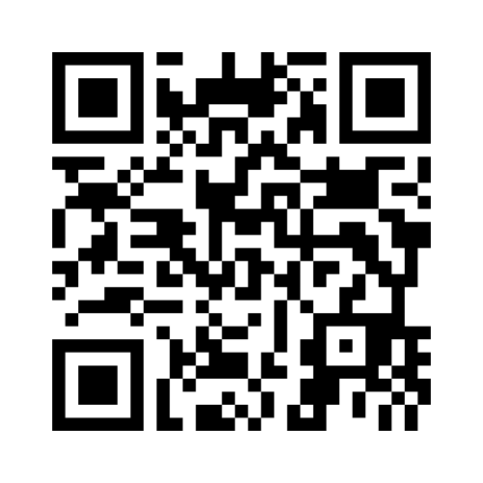
Beth gall ysgolion wneud?
What can schools do?
www.menti.com
4194 0884
Notes:
https://www.menti.com/alugx8hn88y1

Slide 51
Beth allai hyn ei olygu i ysgolion/athrawon?
Hyfforddiant ymwybyddiaeth ddiwylliannol – ymwybyddiaeth o wahanol ddiwylliannau/cefndiroedd drwy’r ysgol - “Mae amrywiaeth yn fwy na dim ond cael posteri amlddiwylliannol yn y cyntedd”
Rhoi cyfleoedd rheolaidd i staff a myfyrwyr archwilio materion byd-eang a gwahanol ffyrdd o weld pethau
Rhyngweithio â phobl sy'n wahanol i ni ein hunain
Dulliau trawsieithu (defnydd o ieithoedd gwahanol) + Cynorthwywyr Addysgu Dwyieithog
Bod yn ymwybodol o arwyddion trawma a nodi anghenion dysgu ychwanegol

Slide 52
What might this mean for schools/ teachers?
Cultural awareness training- awareness of different cultures/ backgrounds throughout the school - “Diversity is more than just having multicultural posters in the foyer”
Providing staff and students with regular opportunities to explore global issues and different ways of seeing things
Interactions with people who are different to ourselves
Trans-languaging approaches(use of different languages) + Bilingual Teaching Assistants
Being aware of signs of trauma and identifying additional learning needs

Slide 53
I ba raddau y mae'n gyfrifoldeb ar ysgolion ac athrawon i fynd i'r afael â materion cymdeithasol ac anghyfiawnder?
To what extent is it the responsibility of schools and teachers to tackle social issues and injustices?

Slide 54
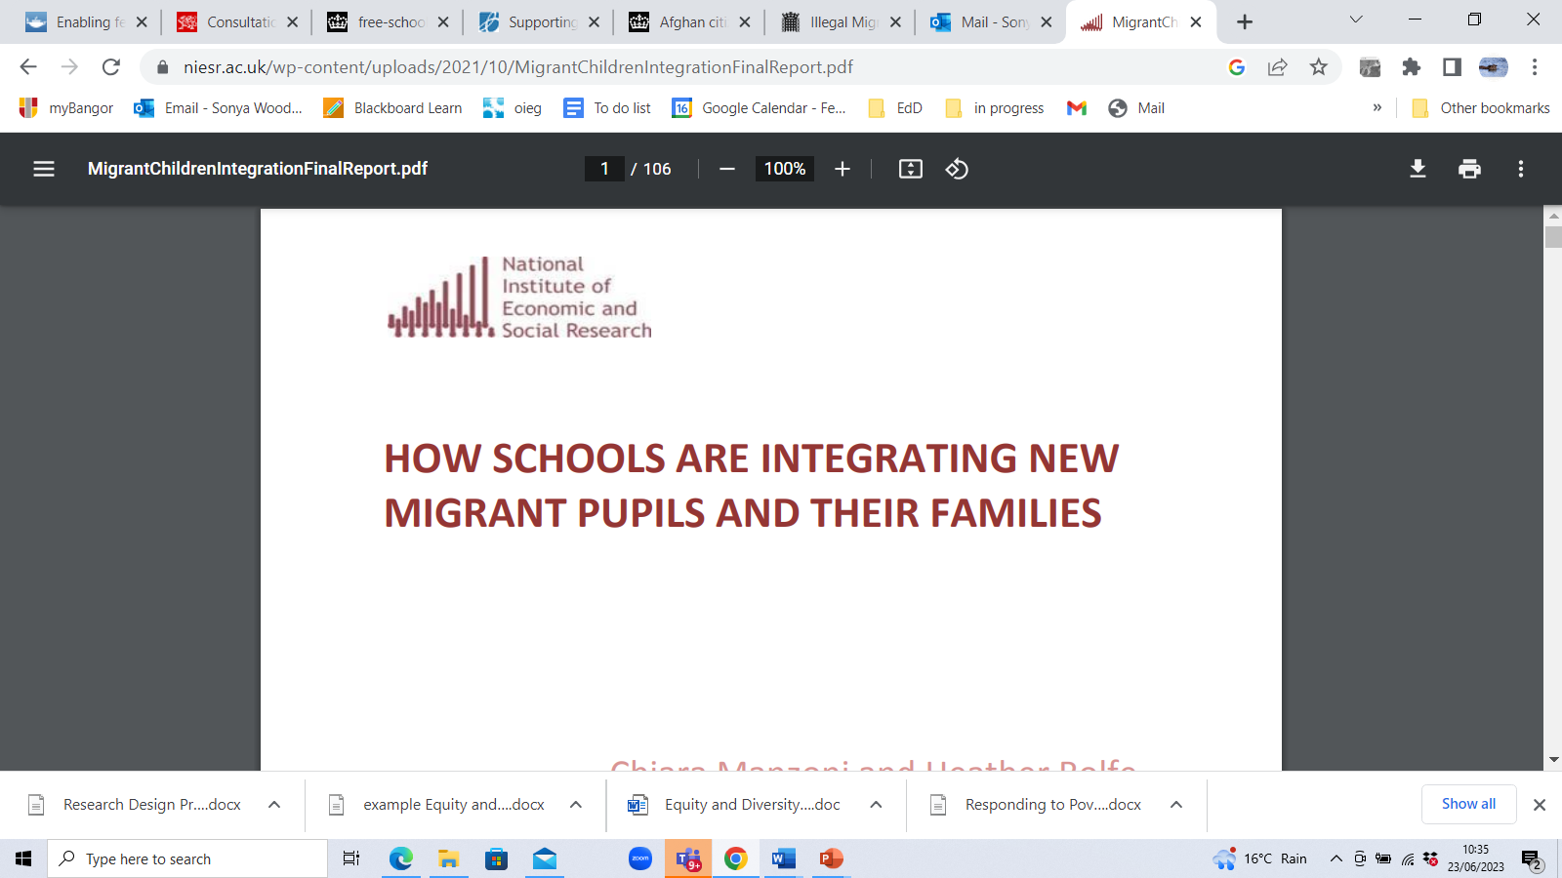

Slide 55
Cyfrifoldebau ysgolion ac athrawon - beth yw arfer dda?
Mae gan ysgolion rywfaint o ymreolaeth i ddylunio eu cwricwla, gan integreiddio amrywiaeth ddiwylliannol, ffydd ac ethnig, a chaniatáu gwahanol godau gwisg a gwyliau ffydd.
Gallant ddarparu amgylchedd croesawgar, cynhwysol.
Darperir cefnogaeth academaidd ac ieithyddol i bob disgybl SIY.
Ai cyfrifoldeb ysgolion ac athrawon yw mynd i’r afael ag anghyfiawnder cymdeithasol ac ymdopi ag amrywiaeth ethnig gynyddol?
Profiad cyfyngedig sydd gan rai ysgolion o ymateb i ffoaduriaid, ac adnoddau cyfyngedig.
Mae gan eraill fwy o brofiad ond nid ydynt yn arbenigwyr.

Slide 56
Responsibilities of schools and teachers- what is good practice?
Is it the responsibility of schools and teachers to tackle social injustices and to cope with growing ethnic diversity?
Some schools have limited experience of responding to refugees, and restricted resources.
Others have more experience but are not experts
Schools have some autonomy to design their curricula, integrating cultural, faith and ethnic diversity, and to allow different dress codes and faith holidays.
They can provide a welcoming, inclusive environment.
Academic and linguistic support is provided for all EAL pupils.

Slide 57
Dirgelwch ideolegol
Cyrhaeddiad addysg yn llwybr allan o dlodi; ond mae llunio polisi yn tueddu i beidio â mynd i'r afael â'r anghydraddoldebau strwythurol sy'n effeithio ar gyrhaeddiad.
Mae dadansoddiad cymdeithasegol yn amlygu'r anfanteision hyn, ond anaml y mae'n rhoi disgrifiad o sut y gall addysg fod yn drawsnewidiol wrth atal atgynhyrchu anghydraddoldeb.
(Terzi et al., 2023)
Terzi, L., Unterhalter, E., & Suissa, J. (2023). Philosophical Reflections on Child Poverty and Education. Studies in Philosophy and Education, 42(1), 49-63
.
Whitty, G. (1985/2017) Sociology and school knowledge: Curriculum theory, research and politics.
Notes:
Roedd Terzi et al. (2023) yn ddiweddar wedi crynhoi'r tensiynau y mae'r persbectif neoryddfrydol yn eu creu fel hyn: mae cyrhaeddiad addysgol yn llwybr allan o dlodi; ond mae llunio polisi addysg yn tueddu i beidio â mynd i'r afael â'r anfanteision sydd wedi hen ennill eu plwyf sy'n gysylltiedig â thlodi sy'n effeithio ar gyrhaeddiad (anghydraddoldebau strwythurol). Maen nhw'n dadlau bod dadansoddiad cymdeithasegol yn amlygu'r anfanteision hyn ond anaml y mae'n rhoi disgrifiad o sut y gall addysg fod yn drawsnewidiol wrth atal anghydraddoldeb rhag atgynhyrchu. Gallem ddweud yma fod y tensiynau hyn wedi’u cydnabod a’u trafod yn helaeth yn nhestun arloesol y diweddar Geoff Whitty.
Sociology and school knowledge: Curriculum theory, research and politics. (1985/2017)
Mae eu papur yn datblygu beirniadaeth o’r sefyllfa hon gan ddefnyddio gallu cysyniadol, sy’n deillio o Robeyns (2017). Mae hyn yn canolbwyntio ar les mewn perthynas â’r cyfleoedd gwirioneddol sydd gan bobl mewn cymdeithas sy’n mynd â ni yn ôl at syniadau a ddatblygwyd gan Sen – beth yw’r ffactorau ymarferol a seicolegol sy’n caniatáu i unigolyn wneud y mwyaf o’r cyfleoedd sydd ar gael iddynt. Gellir uniaethu’r hyn yr wyf yn ei ddisgrifio yma hefyd â’r hyn, mewn termau Marcsaidd, a elwir yn ddirgelwch ideolegol. Nod 5: Sefydliadau dominyddol yn lluosogi disgyrsiau sy’n cuddio’r wybodaeth sydd ei hangen ar y gorthrymedig i weld y cyflwr y maent ynddo gan yr union sefydliadau (cyfunol) sy’n dweud wrthynt eu bod yn cael eu cefnogi. (Beck, 2013

Slide 58
Ideological mystification
Education attainment a route out of poverty; but policy making tends not to address the structural inequalities that impact attainment.
Sociological analysis highlights these disadvantages, but rarely offers an account of how education can be transformative in stopping the reproduction of inequality.
(Terzi et al., 2023)
Terzi, L., Unterhalter, E., & Suissa, J. (2023). Philosophical Reflections on Child Poverty and Education. Studies in Philosophy and Education, 42(1), 49-63.
Whitty, G. (1985/2017) Sociology and school knowledge: Curriculum theory, research and politics.
Notes:
Terzi et al. (2023) have recently summarised the tensions the neoliberal perspective creates thus: education attainment is a route out of poverty; but education policy making tends not to address the entrenched disadvantages associated with poverty that impact attainment (structural inequalities). They argue that sociological analysis highlights these disadvantages but rarely offers an account of how education can be transformative in stopping the reproduction of inequality.
We could say here that these tensions have long been recognised and discussed at length in the late Geoff Whitty’s seminal text: Sociology and school knowledge: Curriculum theory, research and politics. (1985/2017)
Structure and agency/personal and public spheres
Their paper develops a critique of this situation drawing on conceptualising capability, derived from Robeyns (2017). This focuses on wellbeing in relation to the real opportunities people have in society which takes us back to ideas developed by Sen – what are the factors both practical and psychological that allow an individual to make the most of the opportunities available to them.
What I am describing here can also be identified with what, in Marxist terms, is called ideological mystification. Node 5: Dominant institutions propagating discourses that obfuscate the knowledge required by the oppressed to see the state they are in by the very (combined) institutions which are telling them they are being supported. (Beck, 2013)

Slide 59
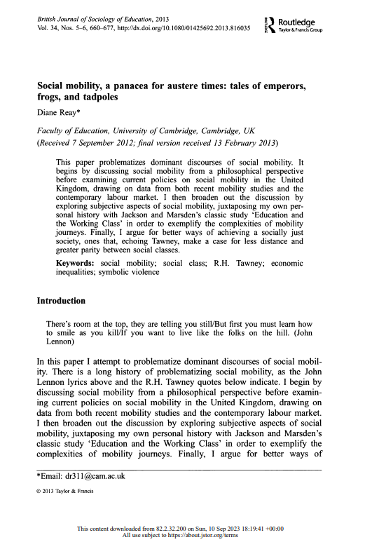
TGAU, cymhwysterau a’u dibenion cymdeithasol
[T]here has been a general endorsement rather than challenge of social mobility as the main mechanism of social justice in education, an acceptance of private schools, and an influential movement within the discipline that promotes the notion of knowledge as power rather than any strong concern with analysing and understanding the workings of power within education. (Reay, 2022)
Reay, D. (2017). Social mobility, a panacea for austere times: Tales of emperors, frogs, and tadpoles. In Education and Social Mobility (pp. 42-59). Routledge.
Reay, D. (2022). Measuring and understanding contemporary English educational inequalities. Institute for Fiscal Studies.
Notes:
We come back to a conundrum well-rehearsed in relation to social mobility (Reay, 2017; Jin & Ball, 2020 (China)). For some to move upwards, others need to go down, (but those who are already up are very tenacious is maintaining their family’s positional advantages; plus, the few who do go up, token examples to maintain meritocratic myths, feel detached, alienated from their communities, reducing the long-term benefits their position may have achieved to the wider landscape of equality. These themes have been summarised by Diane Reay, whose comments also touch on the issue of how we conceive curriculum content: Quote)
Rydyn ni'n dod yn ôl at benbleth sydd wedi'i ymarfer yn dda mewn perthynas â symudedd cymdeithasol (Reay, 2017; Jin & Ball, 2020 (Tsieina)). Er mwyn i rai symud i fyny, mae angen i eraill fynd i lawr, (ond mae'r rhai sydd eisoes i fyny yn ddygn iawn yn cynnal manteision lleoliadol eu teulu; yn ogystal, mae'r ychydig sy'n mynd i fyny, yn enghreifftiau amlwg i gynnal mythau teilyngdod, yn teimlo'n ddatgysylltiedig, wedi'u dieithrio rhag eu cymunedau, gan leihau'r manteision hirdymor y gallai eu sefyllfa fod wedi'u cyflawni i'r dirwedd ehangach o gydraddoldeb.

Slide 60
GCSEs, qualifications and their social purposes
[T]here has been a general endorsement rather than challenge of social mobility as the main mechanism of social justice in education, an acceptance of private schools, and an influential movement within the discipline that promotes the notion of knowledge as power rather than any strong concern with analysing and understanding the workings of power within education. (Reay, 2022)
Reay, D. (2017). Social mobility, a panacea for austere times: Tales of emperors, frogs, and tadpoles. In Education and Social Mobility (pp. 42-59). Routledge.
Reay, D. (2022). Measuring and understanding contemporary English educational inequalities. Institute for Fiscal Studies.
Notes:
We come back to a conundrum well-rehearsed in relation to social mobility (Reay, 2017; Jin & Ball, 2020 (China)). For some to move upwards, others need to go down, (but those who are already up are very tenacious is maintaining their family’s positional advantages; plus, the few who do go up, token examples to maintain meritocratic myths, feel detached, alienated from their communities, reducing the long-term benefits their position may have achieved to the wider landscape of equality. These themes have been summarised by Diane Reay, whose comments also touch on the issue of how we conceive curriculum content: Quote)

Slide 61
A ddylem ni fod yn ceisio datrys pethau?
"Cwestiwn anodd arall y mae angen inni fynd i’r afael ag ef, fel ymarferwyr ac ymchwilwyr, yw’r berthynas rhwng canlyniadau tymor byr a hirdymor"
Os yw ein gwaith gyda rhieni yn helpu i godi cyrhaeddiad plant mewn ysgolion nawr, a yw’n dal yn werth gwneud y gwaith hwn os yw’r union ffordd y mae gwaith yn cael ei fynegi a’i wneud yn cynnal y sefyllfa bresennol – e.e. y gymdeithas anghyfartal a wnaeth y gwaith yn angenrheidiol yn y lle cyntaf?
A yw pryder ynghylch goblygiadau ehangach ein gwaith yn foethusrwydd na allwn ei fforddio – neu rwymedigaeth na ddylem ei hesgeuluso?”
Goodall, J. (2021). Parental engagement and deficit discourses: Absolving the system and solving parents. Educational Review, 73(1), 98-110.

Slide 62
Should we be trying to fix things?
“A further difficult question we need to address, both as practitioners and researchers, is the relationship between short and long-term outcomes.
If our work with parents helps to raise achievement for children in schools now, is it still worth doing this work if the very way that work is couched and undertaken serves to maintain the status quo – e.g. the unequal society that made the work necessary in the first place?
Is a concern for the wider ramifications of our work a luxury we cannot afford – or an obligation we must not shirk?”
Goodall, J. (2021). Parental engagement and deficit discourses: Absolving the system and solving parents. Educational Review, 73(1), 98-110.

Slide 63
Paulo Freire
“There’s no such thing as neutral education. Education either functions as an instrument to bring about conformity or freedom.”
“The more students work at storing the deposits entrusted to them, the less they develop the critical consciousness which would result from their intervention in the world as transformers of that world.”
Pedagogy of the Oppressed, 1970
“Washing one's hands of the conflict between the powerful and the powerless means to side with the powerful, not to be neutral.”
The Politics of Education, 1984

Slide 64
Supported reading
Fitzpatrick, S., Bramley, G., Treanor, M., Blenkinsopp, J., McIntyre, J., Johnsen, S., & McMordie, L. (2023). Destitution in the UK 2023 [full report].
Reay, D. (2017). Social mobility, a panacea for austere times: Tales of emperors, frogs, and tadpoles. In Education and Social Mobility (pp. 42-59). Routledge.
Robson, D., Mtika, P., Graham, A., & MacDougall, L. (2021). Student teachers’ understandings of poverty: insights for initial teacher education. Journal of Education for Teaching, 47(1), 104-117.
https://research.senedd.wales/research-articles/the-biggest-issue-affecting-children-in-wales-tackling-child-poverty/#:~:text=Child%20poverty%20affects%20children%27s%20life,eligible%20for%20free%20school%20meals.
Taylor, C. (2018). The reliability of free school meal eligibility as a measure of socio-economic disadvantage: Evidence from the millennium cohort study in Wales. British journal of educational studies, 66(1), 29-51.
Terzi, L., Unterhalter, E., & Suissa, J. (2023). Philosophical Reflections on Child Poverty and Education. Studies in Philosophy and Education, 42(1), 49-63.

Slide 65
LUNCH 12pm
12.30pm -1.15pm
GOFYNNWCH YR ARBENIGWR
ASK THE EXPERT

Slide 66

Core Strand 2: Educational and theoretical positions of poverty
Llinyn Craidd 2:
Safbwyntiau addysgol a damcaniaethol o dlodi

Slide 67
Llinyn Craidd 2: Safbwyntiau addysgol a damcaniaethol tlodi
DD 2 Gwerthuso'n feirniadol arfer a mesuriadau dysgu a datblygiad gyda dysgwyr y mae tlodi ac anfantais yn effeithio arnynt.
Is-haen 1: Archwilio ffyrdd o fesur dysgu a datblygiad gyda dysgwyr y mae tlodi ac anfantais yn effeithio arnynt
Is-haen 2: Dadansoddi’n feirniadol ddamcaniaethau tlodi ac anfantais i nodi manteision ac anfanteision yr arfer a mesuriadau dysgu a datblygu wrth nodi a chefnogi dysgwyr y mae tlodi ac anfantais yn effeithio arnynt.

Slide 68
Core Strand 2: Educational and theoretical positions of poverty
LO 2 Critically evaluate the practice and measurements of learning and development with learners who are impacted by poverty and disadvantage.
Sub strand 1: Examining ways of measuring learning and development with learners impacted by poverty and disadvantage
Sub strand 2: Critically analysing theories of poverty and disadvantage to identify the advantages and drawbacks of the practice and measurements of learning and development in identifying and supporting learners impacted by poverty and disadvantage.

Slide 69
Is-haen 1: Archwilio ffyrdd o fesur dysgu a datblygiad gyda dysgwyr y mae tlodi ac anfantais yn effeithio arnynt
Sub strand 1: Examining ways of measuring learning and development with learners impacted by poverty and disadvantage
Notes:
In handbook looed at ways across the world for measuring learning and development in learners impacted by poverty and disadvantage. There are many ways in which this can be done but it focusses on different ways of looking at

Slide 70
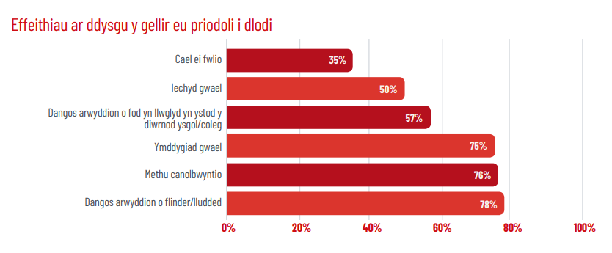
Plant yng Nghymru (2019)
Notes:
Gall profiadau dysgwyr o dlodi yn yr ysgol gael eu heffeithio gan bolisïau ysgol, a allai yn anfwriadol stigmateiddio plant o deuluoedd incwm isel neu deuluoedd difreintiedig. Enghreifftiau o’r polisïau hyn yw gwisg ysgol a dillad, prydau ysgol, ymddygiad, cynhwysiant, iechyd a lles emosiynol, parch ar gyfer cydraddoldeb ac amrywiaeth, bwlio a diogelu. Yn aml gall ysgolion wahaniaethu rhwng plant y mae eu rhieni’n ei chael hi’n anodd yn ariannol a’r rhai hynny y mae eu rhieni/gofalwyr yn gwneud yr hyn a ystyrir yn ddewisiadau ariannol neu ddewisiadau bywyd gwael. Gall hyn arwain at staff yn teimlo’n rhwystredig oherwydd beth bynnag fo’r camau maen nhw’n eu cymryd yn yr ysgol i helpu, ni allant newid y sefyllfa yn y cartref yn sylweddol. Fodd bynnag, mae llawer iawn y gall ysgolion ei wneud i liniaru effaith tlodi a gwella lles a phrofiad plant mewn ysgolion

Slide 71
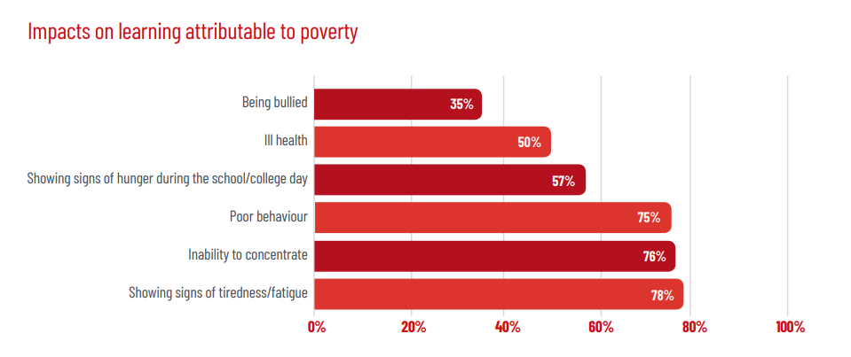
Children in Wales (2019)
Notes:
Learners’ experiences of poverty in school can be affected by school policies, which may unintentionally stigmatise children from low income or disadvantaged families. Examples of these policies are uniform and dress, school meals, trips, behaviour, inclusion, emotional health and wellbeing, respect for equality and diversity, bullying and safeguarding. Schools can often make a distinction between children whose parents are struggling financially and those whose parents/carers make what are seen as poor lifestyle or financial choices. This can lead to staff feeling frustrated because whatever actions they take in school to help, they cannot substantially change the situation at home. However, there is a great deal that schools can do to help mitigate the impact of poverty and enhance children’s wellbeing and experience in schools.

Slide 72
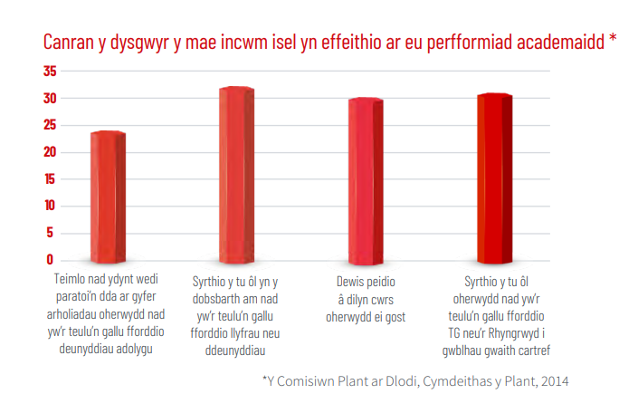
Plant yng Nghymru( 2019)
Notes:
Gall y pynciau y mae dysgwyr yn dewis eu gwneud ar lefel TGAU neu ‘safon uwch’ fod yn ddibynnol iawn ar gostau ategol cymryd y pwnc hwnnw. Er enghraifft, efallai na fydd plentyn sy’n dalentog mewn celf, dylunio a thechnoleg, neu gerddoriaeth a drama yn gallu cymryd y pwnc oherwydd costau ychwanegol adnoddau a deunyddiau, na all eu teulu eu fforddio. Mae tua 30% o blant o deuluoedd incwm isel wedi syrthio ar ei hôl hi yn y pynciau craidd am na allai eu teulu fforddio’r llyfrau neu’r deunyddiau angenrheidiol.

Slide 73
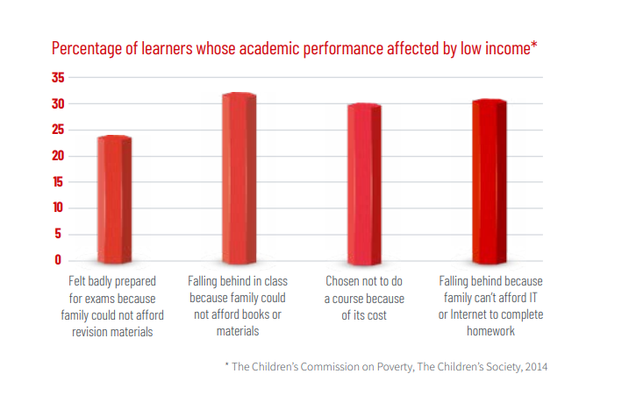
Examining ways of measuring learning and development with learners impacted by poverty and disadvantage
Children in Wales (2019)
Notes:
The subjects that learners choose to do at GCSE or ‘A’ level can be hugely dependent on the ancillary costs of taking that subject. For example, a child who is talented in art, design and technology, or music and drama may be unable to take up the subject because of the extra costs of resources and materials, which their family cannot afford. Around 30% of children from low income families have fallen behind in core subjects because their family could not afford the necessary books or materials
Pupils have reported feeling embarrassed by having to ask teachers for help with paying for the costs of a school trip, and the ‘additional extras’ often associated with residential trips, such as appropriate clothing, equipment and sleeping bags. Even where schools are able to subsidise or pay in full for excursions, there are typically the extra costs of spending money required for extra activities, food and snacks. It is not unknown for parents to go into debt and take out high interest loans to enable their children to attend. Some funding for school trips has been made available through the Welsh Government’s PDG-Access to help cover additional equipment for such trips

Slide 74
Asesiadau Personol fel ffordd o fesur dysgu a datblygiad gyda dysgwyr yr effeithir arnynt gan dlodi ac anfantais
Personalised Assessments as a way of measuring learning and development with learners impacted by poverty and disadvantage

Slide 75

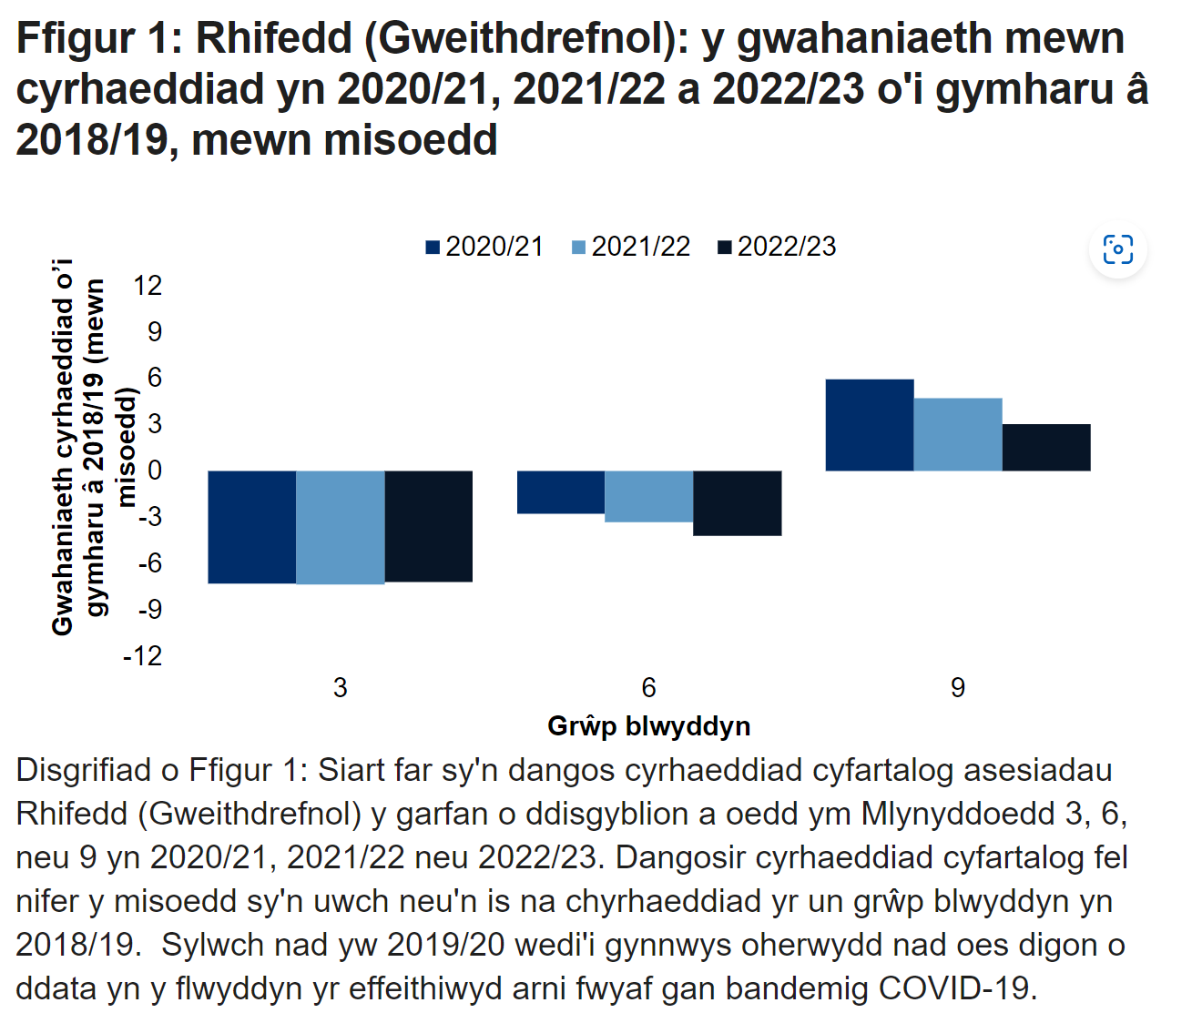
Asesiadau Personol – Trosolwg
Cefndir deddfwriaethol
Darparodd Deddf Cwricwlwm ac Asesu (Cymru) 2021 y sail ddeddfwriaethol ar gyfer y Cwricwlwm i Gymru a’i asesiadau personol cysylltiedig, gan adeiladu ar argymhellion diwygio blaenorol megis adroddiad Dyfodol Llwyddiannus 2015 (Llywodraeth Cymru, 2021).
Pwrpas
Nod y system Asesu Personol yw darparu dull mwy teg o asesu sy’n canolbwyntio ar y dysgwr ac sy’n cefnogi cynnydd dysgu pob myfyriwr, gan gynnwys y rhai sydd dan anfantais oherwydd tlodi (Llywodraeth Cymru, 2021a; 2021b; 2021c).
Manteision posib
Mae profion addasol yn darparu cwestiynau heriol priodol ac adborth wedi'i dargedu yn seiliedig ar lefel cyrhaeddiad presennol pob dysgwr, waeth beth fo'i gefndir (Llywodraeth Cymru, 2021a).
Gallai’r dull asesu cyfran isel helpu i leihau effaith straen a phryder ar berfformiad (Llywodraeth Cymru, 2021b).
Yn cynnig data manwl ar gynnydd dysgwyr unigol, y gallai ysgolion eu defnyddio i lywio ymyriadau wedi’u targedu a chymorth i fyfyrwyr difreintiedig (Llywodraeth Cymru, 2021c)
Yn seiliedig ar y wybodaeth a ddarparwyd, a fyddech cystal â rhestru yn y sgwrs unrhyw gyfyngiadau posibl yr ydych wedi’u nodi hyd yn hyn o ran y system Asesu Personol yng Nghymru.
Patrymau cyrhaeddiad mewn darllen a rhifedd: o 2018/19 i 2022/23 | LLYW.CYMRU
Notes:
This slide contextualises the Personalised Assessment system in Wales, which measures learning and development for all students, including those affected by poverty and disadvantage.
It is important to note that empirical evidence specifically evaluating the impact of Personalised Assessments on learning outcomes for disadvantaged students is still emerging as of 2024. Ongoing evaluation and refinement of the system will be crucial to ensure it effectively fulfils its intended purpose of promoting educational equity.
Click here for further context
Active learning task possible answers:
1. Limited empirical evidence on the specific impact on disadvantaged students' outcomes, as the system is relatively new.
2. Specific to Reading and Numeracy only.
3. Challenges in ensuring all schools, particularly those in disadvantaged areas, have the necessary resources and training to effectively implement the system.
4. Potential digital divide affecting students' access to online assessments, especially those from low-income backgrounds.
5. Difficulty in isolating the influence of poverty from other factors when measuring learning and development.
6. Need for ongoing evaluation and refinement to maximise the system's benefits for educational equity.
References:
Welsh Government. (2021a). Personalised assessments: information for parents and carers. https://hwb.gov.wales/personalised-assessments-information-for-parents-and-carers/
Welsh Government. (2021b). Personalised assessments: information for schools. https://hwb.gov.wales/personalised-assessments-information-for-schools/
Welsh Government. (2021c). Personalised assessments: supporting learner progression. https://hwb.gov.wales/personalised-assessments-supporting-learner-progression/

Slide 76
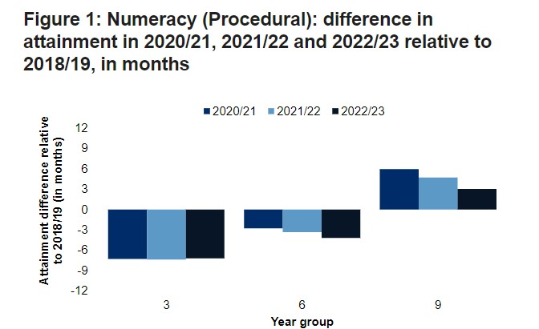
Personalised Assessments – An Overview
Legislative background
The Curriculum and Assessment (Wales) Act of 2021 provided the legislative basis for the Curriculum for Wales and its associated personalised assessments, building on prior reform recommendations such as the 2015 Successful Futures report (Welsh Government, 2021).
Purpose
The Personalised Assessment system aims to provide a more equitable, learner-centered approach to assessment that supports the learning progress of all students, including those disadvantaged by poverty (Welsh Government, 2021a; 2021b; 2021c).
Possible advantages
Adaptive testing provides appropriately challenging questions and targeted feedback based on each learner's current attainment level, irrespective of background (Welsh Government, 2021a).
The low-stakes assessment approach may help reduce the impact of stress and anxiety on performance (Welsh Government, 2021b).
Offers detailed data on individual learner progress, which schools could utilise to inform targeted interventions and support for disadvantaged students (Welsh Government, 2021c)
Based on the information provided, please list in the chat any potential limitations you have identified so far regarding the Personalised Assessment system in Wales.
Patterns in reading and numeracy attainment: from 2018/19 to 2022/23 | GOV.WALES
Notes:
This slide contextualises the Personalised Assessment system in Wales, which measures learning and development for all students, including those affected by poverty and disadvantage.
It is important to note that empirical evidence specifically evaluating the impact of Personalised Assessments on learning outcomes for disadvantaged students is still emerging as of 2024. Ongoing evaluation and refinement of the system will be crucial to ensure it effectively fulfils its intended purpose of promoting educational equity.
Click here for further context
Active learning task possible answers:
1. Limited empirical evidence on the specific impact on disadvantaged students' outcomes, as the system is relatively new.
2. Specific to Reading and Numeracy only.
3. Challenges in ensuring all schools, particularly those in disadvantaged areas, have the necessary resources and training to effectively implement the system.
4. Potential digital divide affecting students' access to online assessments, especially those from low-income backgrounds.
5. Difficulty in isolating the influence of poverty from other factors when measuring learning and development.
6. Need for ongoing evaluation and refinement to maximise the system's benefits for educational equity.
References:
Welsh Government. (2021a). Personalised assessments: information for parents and carers. https://hwb.gov.wales/personalised-assessments-information-for-parents-and-carers/
Welsh Government. (2021b). Personalised assessments: information for schools. https://hwb.gov.wales/personalised-assessments-information-for-schools/
Welsh Government. (2021c). Personalised assessments: supporting learner progression. https://hwb.gov.wales/personalised-assessments-supporting-learner-progression/

Slide 77
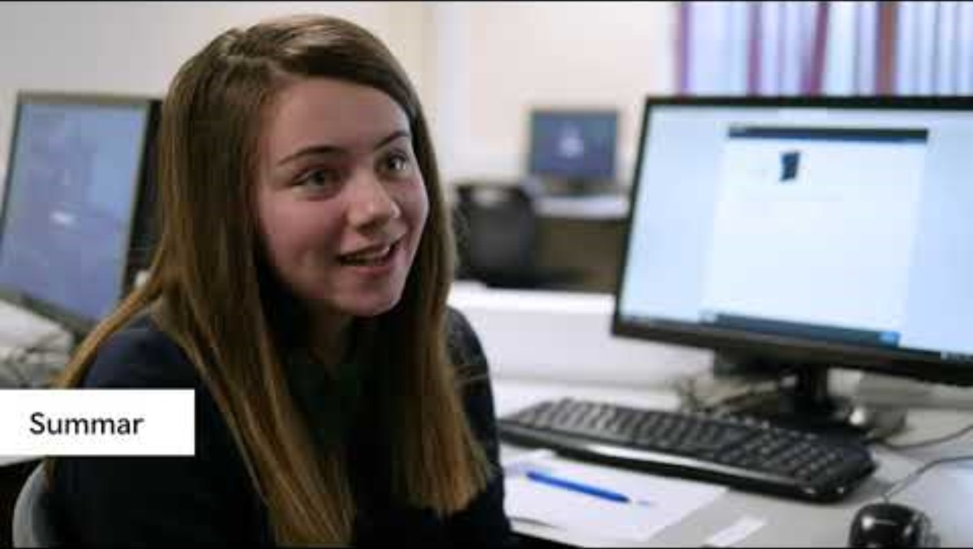
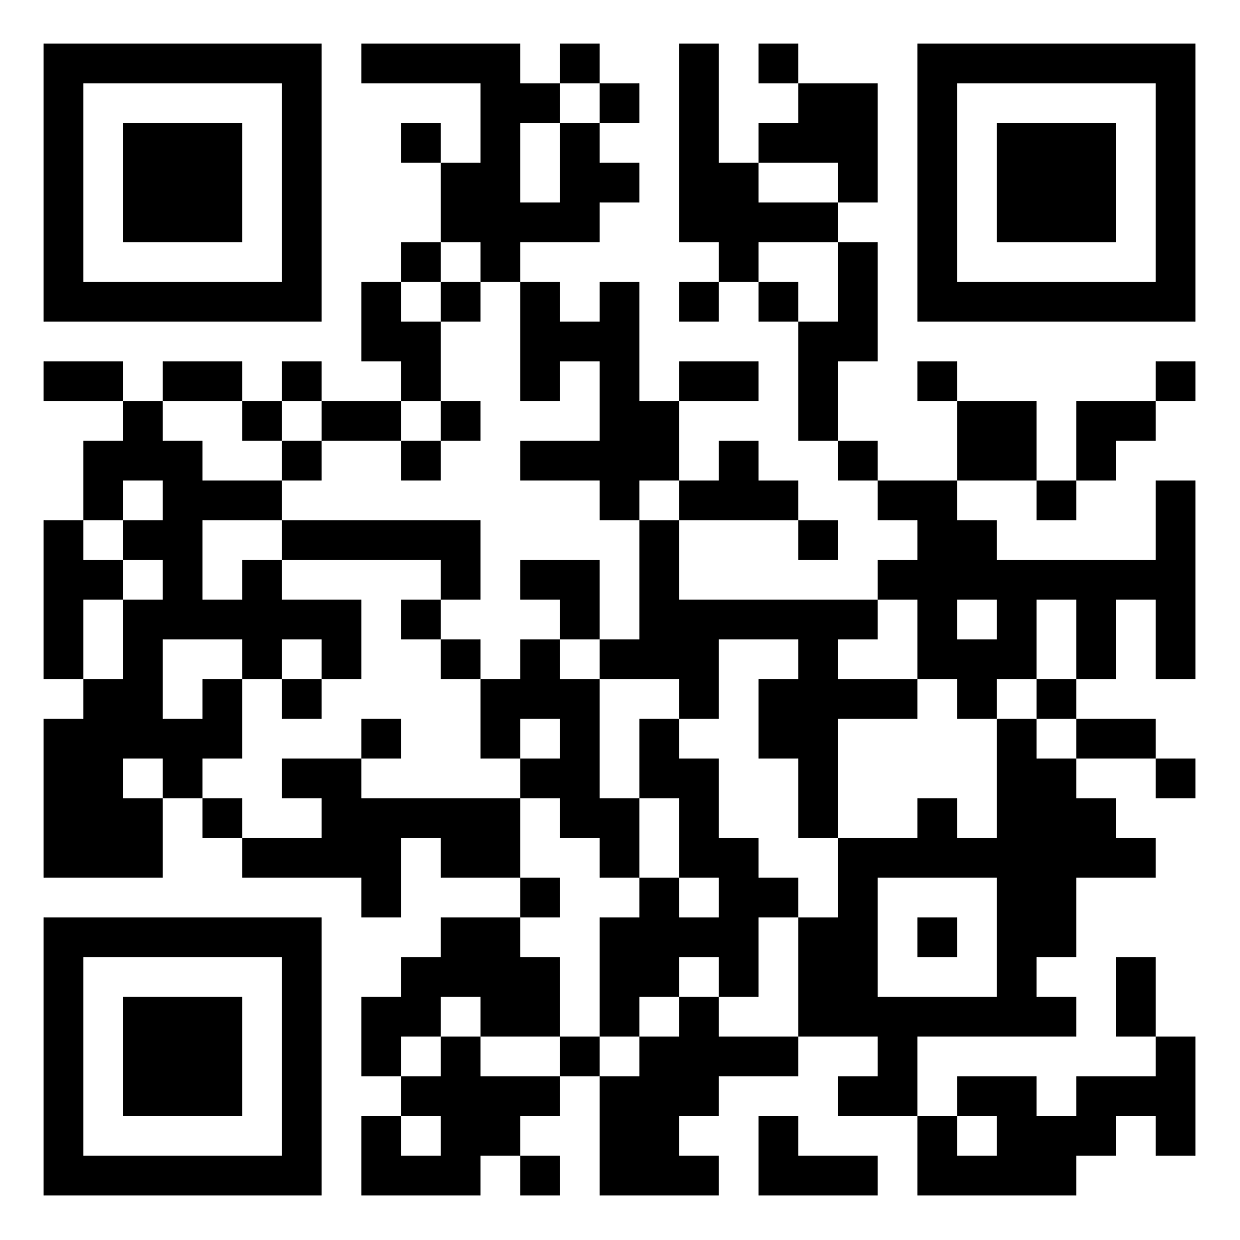
Asesiadau Personol – Myfyrdod Beirniadol
GWEITHGAREDD 1 (20 munud).
Dadansoddi’n feirniadol effeithiolrwydd ‘Asesiadau Personol’ (Llywodraeth Cymru, 2019) mewn mesur dysgu a datblygiad dysgwyr y mae tlodi ac anfantais yn effeithio arnynt
Asesiadau personol: profiad dysgwyr, athrawon ac arbenigwyr – Ysgol Gymunedol Ferndale
Mewn ystafelloedd grŵp, adolygwch y Fideo 'Asesiad Personol' (Llinyn Craidd 1) a myfyriwch ar eich profiad proffesiynol o Asesiadau Personol a gwybodaeth am ei ddiben, ei gynnwys, ei fformat, a'r canlyniadau a fwriedir (5 munud). Yna myfyriwch yn feirniadol ar effeithiolrwydd Asesiadau Personol wrth fesur dysgu a datblygiad dysgwyr y mae tlodi ac anfantais yn effeithio arnynt. Yna defnyddiwch Padlet i ysgrifennu dadansoddiad myfyriol unigol o 200 gair yn mynd i’r afael â’r cwestiynau (10 munud). Yna adolygwch waith o leiaf un post Padlet arall, gan gynnig mewnwelediadau ychwanegol, cwestiynau neu safbwyntiau amgen (5 munud).
Cliciwch ar y ddolen hon i fynd at y wal Padlet i ysgrifennu'r dadansoddiad adlewyrchol unigol
Click this link to access the Padlet wall for writing the individual reflective analysis
Notes:
The activity in breakout rooms allows students to engage critically with Personalised Assessments and reflect on its effectiveness for learners impacted by poverty and disadvantage. This activity promotes autonomy, self-directed learning, critical thinking, and peer interaction which are Level 7 skills and relevant to the assignment for this module.

Slide 78
Personalised Assessments – A Critical Reflection
ACTIVITY 1 (20 minutes)
Critically analyse the effectiveness of 'Personalised Assessments' (Welsh Government, 2019) in
measuring the learning and development of learners impacted by poverty and disadvantage.
Personalised assessments: experience of learners, teachers and experts – Ferndale Community School
In breakout rooms, review the
'Personalised Assessment' video (Core Strand 1) and reflect on your professional experience of Personalised Assessments and information on its purpose, content, format, and intended outcomes (5 minutes). Then critically reflect on the effectiveness of Personalised Assessments in measuring the learning and development of learners impacted by poverty and disadvantage. Then use Padlet to write an individual reflective analysis of 200 words addressing the questions (10 minutes). Then peer review at least one other Padlet post, offering additional insights, questions or alternative perspectives (5 minutes).
Click this link to access the Padlet wall for writing the individual reflective analysis
Notes:
The activity in breakout rooms allows students to engage critically with Personalised Assessments and reflect on its effectiveness for learners impacted by poverty and disadvantage. This activity promotes autonomy, self-directed learning, critical thinking, and peer interaction which are Level 7 skills and relevant to the assignment for this module.

Slide 79
Asesiadau Personol – Ffactorau i'w hystyried
Gallai’r system Asesiad Personol fod â’r potensial i ddarparu data gwerthfawr ar gyfer gwerthuso effaith y Grant Amddifadedd Disgyblion (GAD) ar gyrhaeddiad dysgwyr mewn darllen a mathemateg ar gyfer dysgwyr y mae tlodi ac anfantais yn effeithio arnynt, ond dylid ystyried sawl ffactor wrth ddehongli data yr Asesiad Personol:
Gall y system Asesu Personol blotio cyrhaeddiad cymharol y gwahanol ddysgwyr mewn grŵp ynghyd â chyfartaledd y grŵp. Gellir gweld enwau’r dysgwyr a gynrychiolir drwy hofran dros y gwahanol bwyntiau ac mae sgorau safonedig a sgoriau safonedig yn ôl oedran hefyd ar gael (Llywodraeth Cymru, 2022 t.62).
Mae’r system Asesu Personol wedi’i chynllunio i fesur cynnydd dros amser, felly mae’n ddull olrhain hydredol a gallai roi mewnwelediad i weld a yw unrhyw fwlch cyrhaeddiad rhwng dysgwyr difreintiedig a’u cyfoedion yn culhau dros gyfnod yr ymyriadau GAD.
Beth yw eich barn am ddata’r system Asesiad Personol o ran pa mor werthfawr y gallai fod o ran olrhain dysgu a datblygiad dysgwyr sy’n cael y Grant Amddifadedd Disgyblion?

Slide 80
Personalised Assessments – Factors to consider
The Personalised Assessment system could have the potential to provide valuable data for evaluating the impact of the Pupil Deprivation Grant (PDG) on learner attainment in reading and maths for learners impacted by poverty and disadvantage, but several factors should be considered when interpreting the Personalised Assessment data:
The Personalised Assessment system can plot the relative attainment of the different learners in a group along with the group average. The names of the learners represented can be seen by hovering over the different points and standardised scores and age standardised scores are also available (Welsh Government, 2022 p.62).
The Personalised Assessment system is designed to measure progress over time, so it is a longitudinal tracking method and could provide insights into whether any attainment gap between disadvantaged learners and their peers is narrowing over the course of the PDG interventions.
What do you think about the Personalised Assessment system data in relation to how valuable it could be in tracking the learning and development of learners in receipt of the PDG?
Notes:
This slide is a summary of the usefulness of the Personalised Assessment system data in assessing the impact of the Pupils Deprivation Grant (PDG) on learner attainment in reading and maths for those impacted by poverty and disadvantage.

Slide 81
Asesiadau Personol – Ffactorau i'w hystyried
Er y gallai data’r system Asesiadau Personol gynnig mewnwelediadau gwerthfawr, efallai na fydd yn dal effaith y GAD yn llawn oherwydd dylanwad ffactorau cyd-destunol eraill, megis newidiadau mewn arferion ysgol, staffio, neu amodau cymdeithasol-economaidd allanol.
Nid yw plentyn yn bodoli mewn gwagle ac mae’n bwysig ystyried y cyd-destunau a’r systemau ehangach sy’n amgylchynu ac yn dylanwadu ar fywyd plentyn.
Nid yw data’r system Asesiad Personol yn casglu’r ystod lawn o ganlyniadau dysgu a datblygiadol y gall y GAD ddylanwadu arnynt, megis llesiant myfyrwyr, ymgysylltiad, neu ddysgu a datblygu ehangach.
Byddai angen dehongli data System Asesu Personol ochr yn ochr â gwybodaeth gyd-destunol arall mewn perthynas ag effaith y GAD.

Slide 82
Personalised Assessments – Factors to consider
While the Personalised Assessments system data could offer valuable insights, it may not fully capture the PDG's impact due to the influence of other contextual factors, such as changes in school practices, staffing, or external socio-economic conditions.
A child does not exist in a vacuum and it is important to consider the broader contexts and systems that surround and influence a child's life.
The Personalised Assessment system data does not capture the full range of learning and developmental outcomes that the PDG may influence, such as student well-being, engagement, or broader learning and development.
Personalised Assessment System data would need to be interpreted alongside other contextual information in relation to the impact of the PDG.
Notes:
This slide is a summary of the wider context of the Personalised Assessment system data in assessing the impact of the Pupils Deprivation Grant (PDG) on learner attainment in reading and maths for those impacted by poverty and disadvantage.

Slide 83
Asesiadau Personol (yng nghyd-destun DD2 ar gyfer y modiwl hwn)
Cyn astudio ymhellach myfyriwch ar eich ymarfer proffesiynol
Mae Asesiadau Personol yn cynnig un dull o fesur dysgu a datblygiad dysgwyr y mae tlodi ac anfantais yn effeithio arnynt mewn ystafell ddosbarth. Fodd bynnag, wrth werthuso’n feirniadol arfer a mesur dysgu a datblygiad y dysgwyr hyn yn ehangach, ac o fewn cyd-destun penodol eich ymarfer proffesiynol eich hun, mae’n bwysig ystyried:
Beth yw’r ffyrdd o fesur dysgu a datblygiad dysgwyr y mae tlodi ac anfantais yn effeithio arnynt yn eich lleoliad?
Beth yw cryfderau’r ffyrdd o fesur dysgu a datblygiad dysgwyr y mae tlodi’n effeithio arnynt wrth nodi a chefnogi’r dysgwyr hyn yn llwyddiannus?
Pa gyfyngiadau a allai fodoli yn yr arferion presennol a’r ffordd y caiff dysgu a datblygu eu mesur gyda dysgwyr y mae tlodi ac anfantais yn effeithio arnynt, a sut y gellid mynd i’r afael â’r rhain?
Beth yw cyd-destun ehangach (polisïau, deddfwriaeth, persbectif damcaniaethol, persbectif athronyddol, sylfaen ymchwil a safbwynt annatod, ac ati) ar gyfer arfer a mesuriadau dysgu a datblygu gyda dysgwyr y mae tlodi ac anfantais yn effeithio arnynt?
Sut gallwch chi sicrhau bod eich arfer wrth fesur dysgu a datblygiad dysgwyr y mae tlodi ac anfantais yn effeithio arnynt yn ystyried y ffactorau cyd-destunol ehangach sy’n dylanwadu ar brofiadau a chanlyniadau’r dysgwyr hyn?

Slide 84
Personalised Assessments (in the context of LO2 for this module)
Before further study reflect on your professional practice
Personalised Assessments offers one approach to measuring the learning and development of learners impacted by poverty and disadvantage in a classroom setting. However, when critically evaluating the practice and measurement of learning and development for these learners more broadly, and within the specific context of your own professional practice, it is important to consider:
What are the ways of measuring the learning and development of learners impacted by poverty and disadvantage in your setting?
What are the strengths of the ways of measuring the learning and development of learners impacted by poverty in successfully identifying and supporting these learners?
What limitations might exist in the current practices and measurement of learning and development with learners who are impacted by poverty and disadvantage, and how might these be addressed?
What is the wider context (policies, legislation, theoretical perspective, philosophical perspective, research base and integral viewpoint, etc.) of the practice and measurements of learning and development with learners who are impacted by poverty and disadvantage?
How can you ensure that your practice when measuring the learning and development of learners impacted by poverty and disadvantage considers the wider contextual factors influencing these learners' experiences and outcomes?

Slide 85
Grant Datblygu Disgyblion
Nod cyllid y Grant Datblygu Disgyblion, Grant Datblygu Disgyblion y Blynyddoedd Cynnar a Grant Datblygu Disgyblion Addysg Heblaw yn yr Ysgol yw codi lefel cyrhaeddiad plant a phobl ifanc ar aelwydydd incwm isel.
Rhoddir y Grant Datblygu Disgyblion ar gyfer Plant sy'n Derbyn Gofal, plant sydd â phrofiad o fod mewn gofal neu blant sy'n derbyn gofal. Mae'r cyllid yn lleihau’r rhwystrau sy'n atal plant yn aml rhag cyflawni eu potensial llawn
Dylid ei ddefnyddio i wella cyrhaeddiad plant a phobl ifanc o gartrefi incwm isel
Caiff ei lywio gan dystiolaeth ar yr hyn sy'n effeithiol o ran gwella cyrhaeddiad dysgwyr
Mae ysgolion yn monitro’r defnydd o’r GAD i arfarnu’r effaith ar gyrhaeddiad dysgwyr
Notes:
Cyflwyniad
Cyllid a roddir i ysgolion a lleoliadau addysgol (lleoliadau) yw'r Grant Datblygu Disgyblion. Mae'r lleoliadau'n cynnwys meithrinfeydd, unedau cyfeirio disgyblion, a chartrefi sy'n tiwtora.
Nod cyllid y Grant Datblygu Disgyblion, Grant Datblygu Disgyblion y Blynyddoedd Cynnar a Grant Datblygu Disgyblion Addysg Heblaw yn yr Ysgol yw codi lefel cyrhaeddiad plant a phobl ifanc o aelwydydd incwm isel. Rhoddir y Grant Datblygu Disgyblion ar gyfer Plant sy'n Derbyn Gofal ar gyfer plant sydd â phrofiad o fod mewn gofal neu blant sy'n derbyn gofal. Mae'r cyllid yn lleihau'r rhwystrau sy'n atal plant yn aml rhag cyflawni eu potensial llawn.
Mae’r Grant Datblygu Disgyblion yn adnodd allweddol ar gyfer gwireddu uchelgais Llywodraeth Cymru i sicrhau safonau a dyheadau uchel i bawb.
Y Grant Datblygu Disgyblion
Mae'r Grant Datblygu Disgyblion yn cael ei ddarparu i ysgolion a lleoliadau ar gyfer plant a phobl ifanc rhwng 5 a 15 oed. Dylai'r defnydd o'r grant ganolbwyntio ar y meysydd allweddol canlynol:
dysgu ac addysgu o ansawdd uchel
Ysgolion Bro
chwarae, dysgu a gofal plentyndod cynnar
dyheadau uchel a gefnogir gan gydberthnasau cryf
iechyd a lles
arweinyddiaeth
Cwricwlwm i Gymru a chymwysterau
cefnogi cynnydd ôl-16
Grant Datblygu Disgyblion y Blynyddoedd Cynnar
Mae Grant Datblygu Disgyblion y Blynyddoedd Cynnar yn rhoi cefnogaeth debyg i blant 3 a 4 oed mewn ysgolion a meithrinfeydd. Mae hyn yn cynnwys lleoliadau a gynhelir a lleoliadau nas cynhelir. Mae'r cyllid hwn yn cael ei ddefnyddio i gefnogi:
lles emosiynol a chymdeithasol
datblygiad corfforol
lleferydd, iaith a chyfathrebu
Y Grant Datblygu Disgyblion ar gyfer Plant sy'n Derbyn Gofal
Bwriad y Grant Datblygu Disgyblion ar gyfer Plant sy'n Derbyn Gofal yw cefnogi cyrhaeddiad addysgol y canlynol:
plant sy'n derbyn gofal
plant sydd wedi cael eu mabwysiadu
plant sy'n destun Gorchymyn Gwarcheidiaeth Arbennig
Mae Llywodraeth Cymru yn gweithio gydag:
ysgolion
lleoliadau
awdurdodau lleol
partneriaethau a chonsortia rhanbarthol
Gyda'n gilydd, rydym yn ceisio canfod lle gall cyllid sicrhau'r budd mwyaf wrth i ni ddod dros bandemig COVID-19, ac yng ngoleuni heriau o ran costau byw.
Sut mae'r Grant Datblygu Disgyblion yn cael ei ddyrannu
Mae swm y Grant Datblygu Disgyblion, Grant Datblygu Disgyblion y Blynyddoedd Cynnar, Grant Datblygu Disgyblion Addysg Heblaw yn yr Ysgol a'r Grant Datblygu Disgyblion ar gyfer Plant sy'n Derbyn Gofal a roddir i awdurdodau lleol, ysgolion a lleoliadau yn seiliedig ar y canlynol:
nifer y plant a'r bobl ifanc 5 i 15 oed mewn ysgol neu leoliad (er enghraifft addysg heblaw yn yr ysgol neu uned cyfeirio disgyblion) sy'n gymwys i gael prydau ysgol am ddim, ar sail data'r cyfrifiad ysgolion diweddaraf (CYBLD)
nifer y plant a'r bobl ifanc sy'n derbyn gofal, ar sail y Cyfrifiad Plant sy'n Derbyn Gofal
nifer y plant rhwng 3 a 4 oed mewn ysgol neu leoliad nas cynhelir (er enghraifft meithrinfeydd) sy'n gymwys i gael prydau ysgol am ddim, ar sail data'r cyfrifiad ysgolion diweddaraf (CYBLD)
Caiff cyllid ei roi ar sail blwyddyn ariannol, yn seiliedig ar nifer y plant a'r bobl ifanc sy'n gymwys. Mae'n seiliedig ar y meini prawf uchod, nid gallu academaidd.
Sut mae'r Grant Datblygu Disgyblion yn cael ei ddosbarthu
Caiff y Grant Datblygu Disgyblion ei dalu'n uniongyrchol i awdurdodau lleol a'i ddosbarthu i ysgolion a lleoliadau. Mae awdurdodau lleol yn gweithio'n agos gyda phartneriaethau a chonsortia rhanbarthol (lle bo hynny'n berthnasol) yn ogystal ag ysgolion a lleoliadau i sicrhau bod y grant yn cael ei ddefnyddio at ei ddibenion arfaethedig. Rhoddir adroddiad i Lywodraeth Cymru am y gweithgarwch ac effaith y gwariant gan Gynghorwyr y Grant Datblygu Disgyblion (a Chydgysylltwyr Rhanbarthol y Grant Datblygu Disgyblion ar gyfer Plant sy'n Derbyn Gofal lle bo hynny'n berthnasol) ac awdurdodau lleol.
Sut mae'r Grant Datblygu Disgyblion yn cael ei ddefnyddio
Ysgolion a lleoliadau
Y Grant Datblygu Disgyblion
Disgwylir i ysgolion a lleoliadau ddefnyddio cyllid y Grant Datblygu Disgyblion i weithredu ar lefel ysgol neu leoliad cyfan. Gall hyn fod o fudd i'w holl blant a phobl ifanc. Fodd bynnag, mae'n rhaid i'r gweithgarwch gefnogi'n benodol anghenion dysgwyr cymwys yng ngoleuni'r anfantais sy'n eu hwynebu. Gall y gweithgarwch gynnwys:
dysgu proffesiynol i athrawon
ymyriadau dysgu ac addysgu wedi'u teilwra
Gall arweinwyr ysgolion benderfynu sut i wario’r arian y maent yn ei gael drwy gyllid y Grant Datblygu Disgyblion. Ond dylent sicrhau bod eu gwaith cynllunio a'i wariant yn unol â thelerau ac amodau'r grant, gan adlewyrchu'r canllaw i'r Grant Datblygu Disgyblion.
Dylai gwariant y Grant Datblygu Disgyblion ganolbwyntio'n arbennig ar:
ddarparu dysgu ac addysgu o ansawdd uchel
datblygu Ysgolion Bro
Grant Datblygu Disgyblion y Blynyddoedd Cynnar
Mae'r sylfeini ar gyfer gwneud cynnydd tuag at bedwar diben Cwricwlwm i Gymru yn dechrau yn y blynyddoedd cynnar. Nod Grant Datblygu Disgyblion y Blynyddoedd Cynnar yw darparu cefnogaeth ychwanegol i'n dysgwyr ieuengaf - plant 3 a 4 oed.
Wrth wario Grant Datblygu Disgyblion y Blynyddoedd Cynnar, dylid canolbwyntio'n benodol ar bwysigrwydd:
lles emosiynol a chymdeithasol, gan roi gwerth ar ryngweithio a chydberthnasau o ansawdd
anghenion corfforol, gan ganolbwyntio ar ddealltwriaeth gref o ddatblygiad plant
anghenion dysgu a datblygu, gan roi blaenoriaeth uchel i ddatblygiad iaith
Dylai Grant Datblygu Disgyblion y Blynyddoedd Cynnar ganolbwyntio ar ddod o hyd i anghenion yn gynnar a gweithredu dulliau effeithiol sy'n cyd-fynd ag addysgeg dysgu sylfaen sy'n cefnogi datblygiad plant.
Mae addysg feithrin o ansawdd uchel yn hanfodol i ddatblygiad plant.
Mae cydberthnasau yn allweddol i ddysgwyr ifanc, ac mae cael cyfleoedd da i ryngweithio mewn modd ystyrlon yn hollbwysig. Mae hynny'n golygu bod angen gwybodaeth a dealltwriaeth drylwyr o ddatblygiad plant ar yr oedolion sy’n galluogi’r dysgu. Bydd hyn yn cynnwys egwyddorion dysgu seiliedig ar chwarae a sut i gefnogi dysgu a arweinir gan y plentyn.
Mae Galluogi dysgu yn nodi nodweddion allweddol addysgeg lwyddiannus, â ffocws penodol ar ddysgwyr iau. Mae addysgeg effeithiol, sy'n canolbwyntio ar y plentyn, sy'n ymatebol, yn ddeinamig ac sy’n deillio o gydberthynas gref ag eraill, yn hanfodol. Mae hyn yn arbennig o wir yn achos datblygiad iaith plentyn. Mae angen amser ar blant i ddatblygu sgiliau siarad a gwrando da. Mae profiadau o ansawdd uchel yn hollbwysig er mwyn cefnogi plant i ddatblygu sgiliau cymdeithasol a chyfathrebu. Dylai eu hamgylcheddau fod yn llawn cyfathrebu. Mae chwarae yn hanfodol i ddatblygiad corfforol, deallusol a chreadigol.
Y Grant Datblygu Disgyblion ar gyfer Plant sy'n Derbyn Gofal
Mae plant sy'n derbyn gofal neu sydd â phrofiad o fod mewn gofal yn debygol o fod wedi profi anawsterau tebyg yn eu blynyddoedd cynnar. Mae effaith y profiadau negyddol cynnar hynny'n cynyddu'r risg y bydd eu cynnydd addysgol yn cymharu'n anffafriol â chynnydd plant eraill.
Wrth wario'r Grant Datblygu Disgyblion ar gyfer Plant sy'n Derbyn Gofal, dylid canolbwyntio ar:
sicrhau budd anghymesur fwy i blant sy'n derbyn gofal a phlant sydd â phrofiad o fod mewn gofal
cyfrannu at ddatblygu ysgolion a lleoliadau cynhwysol sydd wedi ymrwymo i degwch a lles
rhoi cyllid i glystyrau o ysgolion a lleoliadau er mwyn meithrin eu capasiti a darparu ymyriadau sydd wedi'u teilwra - mae angen i'r ddwy elfen hon gyflawni anghenion dysgwyr unigol a bod yn seiliedig ar dystiolaeth gadarn o effaith gadarnhaol ar ddeilliannau dysgu
rhoi'r lle canolog i'r unigolyn er mwyn gwrando ar safbwyntiau'r dysgwr fel sail i gynlluniau ysgolion, lleoliadau a chlystyrau, ynghyd â strategaeth yr awdurdod lleol neu ranbarth
Mae rhagor o wybodaeth ar gyfer arweinwyr ysgolion ar gael yn ein canllawiau ar ddefnyddio'r grant datblygu disgyblion.
Awdurdodau lleol
Disgwylir i awdurdodau lleol sicrhau y bydd cyllid y Grant Datblygu Disgyblion yn cael ei ddefnyddio i wella deilliannau plant a phobl ifanc o aelwydydd incwm isel a'r rhai sydd â phrofiad o fod mewn gofal. Y nod yw lleihau'r gwahaniaeth rhwng cyrhaeddiad y dysgwyr hyn a'u cyfoedion.
Y Grant Datblygu Disgyblion
Mae'n ofynnol i awdurdodau lleol basbortio'r Grant Datblygu Disgyblion yn llawn i ysgolion a lleoliadau, fel y nodir ym manylion y dyraniadau lefel ysgol a lleoliad. Mae hefyd yn ofynnol iddynt ddosbarthu unrhyw gyllid ychwanegol yn llawn. Bydd hyn yn lleddfu effaith gostyngiadau yn y Grant yn dilyn ailddilysu data CYBLD 2023, yn unol ag anghenion lleol. Mae hyblygrwydd yn bwysig mewn perthynas â'r elfen hon o'r cyllid er mwyn galluogi'r awdurdod lleol i ymateb i anghenion eu hardal. Fodd bynnag, rydym yn disgwyl i'r gwaith o ddyrannu'r Grant Datblygu Disgyblion gael ei ddatganoli'n llawn i ysgolion a lleoliadau.
Mae'n rhaid i awdurdodau lleol hefyd:
sicrhau bod ysgolion a lleoliadau yn ymwybodol o'r wybodaeth hon, canllawiau'r Grant Datblygu Disgyblion a thelerau ac amodau perthnasol y Grant
cefnogi ysgolion a lleoliadau i ymgysylltu â Chynghorwyr y Grant Datblygu Disgyblion wrth gynllunio a gwerthuso gwariant y Grant fel y nodir yn y canllawiau – mae hyn yn cynnwys sicrhau eu bod yn cyhoeddi eu datganiad ynghylch eu strategaeth mewn perthynas â'r Grant Datblygu Disgyblion ar eu gwefan
parhau i gyllido gweithgarwch Cynghorydd y Grant Datblygu Disgyblion, a Chydgysylltydd Rhanbarthol y Grant Datblygu Disgyblion ar gyfer Plant sy'n Derbyn Gofal (lle bo hynny'n berthnasol), cydweithio â nhw a hwyluso'r gweithgarwch, a rhoi adroddiad i Lywodraeth Cymru ar weithgarwch ysgolion, lleoliadau, yr awdurdod lleol a'r rhanbarth, ynghyd ag effaith gwariant y Grant
Mae'n ofynnol i awdurdodau lleol nodi cynlluniau ac adrodd yn ôl ar gyllid y Grant Datblygu Disgyblion drwy Gynghorwyr y Grant ac mewn ffurflenni safonol. Dylai'r rhain gynnwys pa ysgolion a lleoliadau sydd wedi'u targedu neu sydd wedi elwa o gyllid ychwanegol, a'r rhesymeg y tu ôl i hyn. Mae hyn yn helpu i sicrhau bod y Grant yn cael ei wario ar fentrau neu gefnogaeth a ategir gan dystiolaeth ar gyfer plant a phobl ifanc o aelwydydd incwm isel a'r rhai sydd â phrofiad o fod mewn gofal.
Grant Datblygu Disgyblion y Blynyddoedd Cynnar
Awdurdodau lleol sy'n gyfrifol am ddosbarthu'r Grant Datblygu Disgyblion ar gyfer y blynyddoedd cynnar i ysgolion a lleoliadau. Mae'r rôl hon yn cynnwys:
ymgysylltu â lleoliadau gofal plant sy'n darparu addysg feithrin a ariennir (er enghraifft Cylch Meithrin neu feithrinfa ddydd)
ymgysylltu ag Athrawon Ymgynghorol y Blynyddoedd Cynnar ac Arweinwyr Dysgu Sylfaen i sicrhau cysondeb a bod y ddarpariaeth yn seiliedig ar ddulliau addysgeg priodol ar gyfer addysg gynnar
helpu ysgolion a lleoliadau meithrin nas cynhelir i greu cysylltiadau agosach er mwyn sicrhau bod gwybodaeth ac arferion yn cael eu rhannu i raddau mwy, ac i gefnogi’r broses bontio i ddysgwyr unigol
cefnogi ysgolion a lleoliadau i weithio gydag asiantaethau eraill. Gallai hyn gynnwys cydweithio rhwng lleoliadau ac ysgolion sy'n eu bwydo, a chynnwys lleoliadau yng ngwaith clystyrau ysgolion lle bo hynny'n briodol
Y Grant Datblygu Disgyblion ar gyfer Plant sy'n Derbyn Gofal
O 2024 i 2025, mae awdurdodau lleol yn derbyn cyllid y Grant Datblygu Disgyblion a roddir i ysgolion a lleoliadau ar gyfer plant a phobl ifanc sydd â phrofiad o fod mewn gofal. Dylai awdurdodau lleol ystyried sut y byddant yn defnyddio'r grant yn effeithiol i gynllunio, pennu targedau ar gyfer dysgwyr sy'n derbyn gofal ac sydd â phrofiad o fod mewn gofal, a'u cefnogi.
Disgwylir i awdurdodau lleol sicrhau:
y bydd y cyllid (gan ei fod yn cael ei ddyrannu ar sail nifer y dysgwyr sydd yng ngofal yr awdurdod lleol) yn cael ei ddefnyddio i wella deilliannau plant a phobl ifanc sydd â phrofiad o fod mewn gofal, ac i leihau'r gwahaniaeth rhwng lefelau cyrhaeddiad y garfan hon a'u cyfoedion
y bydd yr elfen o'r Grant Datblygu Disgyblion a ddyrennir ar gyfer dysgwyr sydd â phrofiad o fod mewn gofal yn cael ei chadw a'i rheoli'n ganolog gan yr awdurdod lleol (neu'r consortiwm lle mae trefniadau eisoes ar waith)
Yn seiliedig ar anghenion lleol, gall awdurdodau lleol ddewis:
pasio'r holl arian ymlaen i ysgolion, lleoliadau a chlystyrau
cadw ychydig o'r arian ar gyfer gweithgareddau a fydd o fudd i grŵp o blant a phobl ifanc yr awdurdod sydd â phrofiad o fod mewn gofal, neu'r holl blant hyn
cadw rhannau o'r cyllid i gyflogi Cydgysylltwyr awdurdodau lleol neu ranbarthol y Grant Datblygu Disgyblion ar gyfer Plant sy'n Derbyn Gofal (lle mae swyddi rhanbarthol yn bodoli, mae disgwyl i'r rhain barhau i gael eu hariannu am gyfnod trosiannol)
Yn unol â chynllun addysg plant sy'n derbyn gofal Llywodraeth Cymru (Codi uchelgais a chyrhaeddiad addysgol plant sy'n derbyn gofal yng Nghymru), ein disgwyliad yw y gellir parhau i ddefnyddio'r Grant Datblygu Disgyblion i dalu'r costau sy'n gysylltiedig â chydlynu a goruchwylio'r grant yn strategol. Gall y costau hyn fod yn gysylltiedig â threfniadau presennol y rhanbarth neu'r awdurdod lleol. Bydd Cydgysylltwyr y Grant Datblygu Disgyblion ar gyfer Plant sy'n Derbyn Gofal yn gweithio gyda Llywodraeth Cymru, Cynghorwyr y Grant (os ydynt yn wahanol) ac ysgolion, lleoliadau ac awdurdodau lleol cyfatebol i wella deilliannau addysgol a lefelau cyrhaeddiad plant sydd â phrofiad o fod mewn gofal.
Disgwylir i awdurdodau lleol:
barhau i weithio gyda phartneriaethau a chonsortia rhanbarthol lle bo hynny'n berthnasol, a chydag ysgolion a lleoliadau yn eu hardal i sicrhau bod y cyllid yn helpu i gyflawni'r deilliannau a nodir yng nghynlluniau addysg personol plant a phobl ifanc. Dylid nodi'r cyllid ar gyfer blaenoriaethau awdurdodau lleol (a rhanbarthau lle bo hynny'n berthnasol) yn strategaeth yr awdurdod lleol neu'r rhanbarth, a dylid cytuno arno drwy'r strwythurau atebolrwydd
gweithio ar y cyd ag awdurdodau lleol eraill (a chonsortia neu bartneriaethau lle bo hynny'n berthnasol) ar ddull cydgysylltiedig, strategol o gefnogi deilliannau plant sydd â phrofiad o fod mewn gofal. Bydd hyn yn cael ei oruchwylio gan y cydgysylltydd arweiniol rhanbarthol a Chynghorydd y Grant Datblygu Disgyblion (lle bo hynny'n berthnasol). Ei rôl yw darparu cymorth (cydgysylltu gwybodaeth a chyfathrebu ynghylch arferion sy'n seiliedig ar dystiolaeth ar draws rhanbarthau) a rhoi gwybodaeth am y grant
cytuno ar drefniadau cydweithio rhwng awdurdodau lleol (a chonsortia neu bartneriaethau lle bo hynny'n berthnasol) ar lefelau priodol, gan gynnwys arweinwyr awdurdodau lleol ar gyfer plant sy'n derbyn gofal neu sydd â phrofiad o fod mewn gofal a Phenaethiaid Ysgolion Rhithiol lle bo hynny'n berthnasol, er mwyn deall anghenion lleol a sicrhau llinellau atebolrwydd a phenderfyniadau effeithiol, gan sicrhau bod plant a phobl ifanc sydd angen cymorth yn parhau i gael eu cefnogi, lle bynnag maent yn byw neu'n cael eu haddysgu
Grant Datblygu Disgyblion Addysg Heblaw yn yr Ysgol
Awdurdodau lleol sy'n gyfrifol am ddyrannu'r Grant Datblygu Disgyblion ar gyfer addysg heblaw yn yr ysgol. Mae'r rôl hon yn cynnwys:
ymgysylltu â lleoliadau (gan gynnwys unedau cyfeirio disgyblion) ac addysg heblaw yn yr ysgol
pennu trefniadau ar gyfer cynllunio a darparu cymorth i blant eu hawdurdod lleol (a'u rhanbarth) sy'n cael addysg heblaw yn yr ysgol, gan weithio gyda chydgysylltwyr addysg heblaw yn yr ysgol ar y cynigion hyn
Cynghorwyr y Grant Datblygu Disgyblion
Dylai Cynghorwyr y Grant Datblygu Disgyblion (a chydgysylltwyr rhanbarthol y Grant Datblygu Disgyblion ar gyfer Plant sy'n Derbyn Gofal, lle bo hynny'n berthnasol) ddarparu her gadarn, adeiladol a chefnogaeth o ansawdd uchel i alluogi arweinwyr ysgolion a lleoliadau, yn ogystal â chyrff llywodraethu, i wella deilliannau plant a phobl ifanc o aelwydydd incwm isel yn ogystal â phlant a phobl ifanc sydd â phrofiad o fod mewn gofal. Nod y dull hwn yw:
cryfhau trefniadau arwain rhanbarthol
sicrhau mwy o gysondeb cenedlaethol wrth gefnogi plant a phobl ifanc o aelwydydd incwm isel a'r rhai sydd â phrofiad o fod mewn gofal
ein helpu i gasglu tystiolaeth o effaith
Disgwylir i Gynghorwyr y Grant Datblygu Disgyblion barhau i weithio gydag awdurdodau lleol i roi'r cymorth angenrheidiol i ysgolion a lleoliadau i ddefnyddio'r grant yn y ffordd fwyaf effeithiol, ac yn unol â’r canllaw i'r Grant Datblygu Disgyblion.
Dylai’r gefnogaeth gynnwys:
her gadarn ac adeiladol i ysgolion a lleoliadau, gan sicrhau eu bod yn defnyddio dulliau seiliedig ar dystiolaeth
cymorth o ansawdd uchel i alluogi arweinwyr, penaethiaid a chyrff llywodraethu i wella'r deilliannau i ddysgwyr sy'n byw mewn aelwydydd incwm isel
cydweithio rhwng ysgolion, a rhwng ysgolion a lleoliadau
rhannu arferion effeithiol
monitro'r datganiadau blynyddol ynghylch eu strategaeth mewn perthynas â'r Grant Datblygu Disgyblion y mae angen i ysgolion eu cyhoeddi ar eu defnydd o'r Grant a'i effaith
sicrhau bod arweinydd dynodedig ar gyfer dysgwyr o aelwydydd incwm isel ym mhob ysgol neu leoliad sy'n derbyn y Grant Datblygu Disgyblion, ac adeiladu rhwydweithiau o arweinwyr allweddol a sefydlu 'rhwydweithiau lleol a rhanbarthol o arweinwyr’
gweithio gyda'r awdurdodau lleol i roi adroddiad i Lywodraeth Cymru ar weithgarwch lleol a rhanbarthol ac effaith gwariant y Grant
Cyfraddau cyllid ar gyfer 2024 i 2025
Mae'r Grant Datblygu Disgyblion a Grant Datblygu Disgyblion y Blynyddoedd Cynnar ar gael i ysgolion a lleoliadau, ar gyfradd o £1,150 y plentyn, ar gyfer:
plant a phobl ifanc rhwng 5 a 15 oed mewn blynyddoedd ysgol gorfodol sy'n gymwys i gael prydau ysgol am ddim
plant 3 a 4 oed mewn ysgolion neu leoliadau a ariennir nas cynhelir sy'n gymwys i gael prydau ysgol am ddim (Grant y Blynyddoedd Cynnar)
plant a phobl ifanc mewn unedau cyfeirio disgyblion neu sy'n derbyn addysg heblaw yn yr ysgol sy'n gymwys i gael prydau ysgol am ddim
plant a phobl ifanc rhwng 3 a 15 oed sydd â phrofiad o fod mewn gofal (y Grant Datblygu Disgyblion ar gyfer Plant sy'n Derbyn Gofal)
Mae dadansoddiad o ddyraniadau'r Grant Datblygu Disgyblion ar gyfer pob ysgol neu leoliad ar gael ar gyfer 2024 i 2025.
Yn ogystal, ar gyfer 2024 i 2025, bydd y Grant Datblygu Disgyblion yn:
darparu cyfran o £7.1m i awdurdodau lleol i'w dosbarthu'n llawn i ysgolion a lleoliadau
darparu cyfran o gyllid o £400,000 ar gyfer Cynghorydd yr awdurdod lleol neu'r rhanbarth ar gyfer y Grant

Slide 86
PDG – Pupil Deprivation Grant
PDG, Early Years PDG (EYPDG), Education other than at school PDG (EOTAS PDG) funding aim to raise the attainment of children and young people from low-income households.
PDG-LAC is given for care-experienced or looked after children (LAC). It does this by reducing the barriers that they often face to achieving their full potential.
Should be used to improve the attainment of children and young people from low- income households(LIH)
It is informed by evidence on what is effective in improving the attainment of learners in LIH
Schools monitor the use of PDG on evaluate the impact on learner attainment
Notes:
Introduction
The Pupil Development Grant (PDG) is funding given to schools and educational settings (settings). Settings include nurseries, pupil referral units, and home tuition.
PDG, Early Years PDG (EYPDG), and Education other than at school PDG (EOTAS PDG) funding aim to raise the attainment of children and young people from low-income households. PDG-LAC is given for care-experienced or looked after children (LAC). It does this by reducing the barriers that they often face to achieving their full potential.
The PDG is a key resource for realising the Welsh Government’s ambition of high standards and aspirations for all.
PDG
The PDG is provided to schools and settings for children and young people aged 5 to 15. Use of the grant should focus on the following key areas:
high-quality learning and teaching
Community Focused Schools
early childhood play, learning and care
high aspirations supported by strong relationships
health and wellbeing
leadership
Curriculum for Wales and qualifications
supporting post-16 progression
EYPDG
The EYPDG gives similar support to children aged 3 and 4 in schools and nurseries. This includes both maintained and non-maintained settings. This funding is used to support:
emotional and social wellbeing
physical development
speech, language and communication
PDG-LAC
The PDG-LAC is intended to support the educational attainment of:
looked after children (LAC or CLA)
children who have been adopted
children who are subject to a Special Guardianship Order (SGO)
The Welsh Government is working with:
schools
settings
local authorities
regional consortia and partnerships
Together we aim to find where funding can have the most benefit as we recover from the COVID-19 pandemic and in light of cost-of-living challenges.
How PDG is allocated
The amount of PDG, EYPDG, EOTAS PDG and PDG-LAC funding given to local authorities, schools and settings is based on the number of:
children and young people aged 5 to 15 in a school or setting (for example educated other than at school (EOTAS) or pupil referral unit (PRU)) who are eligible for free school meals (eFSM) based on the latest school census (PLASC) data
children and young people who are looked after, based on the Children Looked After Census
children aged 3 to 4 in a school or non-maintained setting (for example nurseries) who are eFSM based on the latest school census (PLASC) data
Funding is given on a financial-year basis, based on the number of eligible children and young people. Funding is based on the criteria above, not academic ability.
How PDG funding is distributed
PDG funding is paid directly to local authorities and distributed to schools and settings. Local authorities work closely with regional consortia and partnerships (where relevant) as well as schools and settings to ensure the grant is used for its intended purposes. Activity and impact of spend is reported to the Welsh Government by PDG Advisors (and PDG-LAC Regional Coordinators where relevant) and local authorities.
How the PDG is used
Schools and settings
PDG
Schools and settings are expected to use the PDG funding for ‘whole-school or setting approaches’. These approaches can benefit all of their children and young people. However, they must specifically support the needs of eligible learners in light of the disadvantage they face. Approaches can include:
professional learning for teachers
tailored learning and teaching interventions
School leaders can decide how to spend their PDG funding. However, they should ensure they plan and spend it in line with the grant terms and conditions and reflect the PDG guidance.
PDG spend should focus particularly on:
providing high-quality learning and teaching
developing Community Focused Schools
EYPDG
The foundations for progress towards the four purposes of Curriculum for Wales begins in the early years. The aim of the EYPDG is to provide additional support to our youngest learners, those aged 3 and 4.
EYPDG spend should have a particular focus on the importance of:
emotional and social wellbeing, valuing quality interactions and relationships
physical needs, focussing on a strong understanding of child development
learning and development needs, placing high priority on language development
The EYPDG should focus on early identification and effective approaches aligned with foundation learning pedagogy that support child development.
High-quality nursery education is essential to children’s development.
Relationships are key for young learners, and having opportunities for meaningful, quality interactions are essential. That means enabling adults need a thorough knowledge and understanding of child development. This will include the principles of play-based learning and how to support child-led learning.
Enabling learning sets out the key features of successful pedagogy with a particular focus on younger learners. Effective, child-centred pedagogy, which is responsive, dynamic and embedded in strong relationships, is essential. This is particularly the case with a child’s language development. Children need time to develop good speaking and listening skills. High-quality experiences are essential to supporting children to develop social and communication skills. Environments should be communication-rich. Play is fundamental to physical, intellectual and creative development.
PDG-LAC
Children who are looked after or care-experienced are likely to have experienced similar difficulties in their early years. The impact of those early negative experiences increases the risk of poor educational progress compared to other children.
PDG-LAC spend should focus on:
disproportionately benefitting looked after and care-experienced children
contributing to the development of inclusive schools and settings committed to equity and wellbeing
funding for clusters of schools and settings to build capacity and to provide bespoke interventions, both of which need to meet individual learners’ needs and be based on robust evidence of positive impact for their learning outcomes
a person-centred approach which captures the views of the learner to be used to inform school, setting and cluster plans and the local authority or regional strategy
Further information for school leaders is available in our guidance on using the pupil development grant.
Local authorities
Local authorities are expected to ensure PDG funding will be used to improve outcomes for children and young people from low-income households and those who are care-experienced. The aim is to reduce the difference in attainment between these learners and their peers.
PDG
Local authorities are required to passport PDG funding in full to schools and settings as set out in the school and settings level allocations. They are also required to distribute in full any additional funding. This will smooth the impact of reductions to PDG funding following PLASC 2023 data revalidation, in line with local needs. Flexibility is important for this element of the funding to enable the local authority to respond to needs in their area. However, we expect the PDG allocation to be devolved in full to schools and settings.
Local authorities must also:
ensure schools and settings are informed of this information, PDG guidance and relevant grant terms and conditions for the PDG
support schools and settings to engage with PDG Advisors in planning and evaluating PDG spend as set out in the PDG guidance – this includes ensuring that they publish their PDG strategy statement on their website
continue to fund, work with, and enable the effective delivery of activity of, the PDG Advisor, and PDG-LAC Regional Coordinator (where relevant), to report to Welsh Government on schools, settings, local authority and regional activity and impact of PDG spend
Local authorities are required to set out plans and report back on PDG funding via PDG Advisors and in regular returns. These should include which schools and settings have been targeted or have benefitted from additional funds, and the reasoning behind this. This helps to ensure that PDG funding is spent on initiatives or support backed up by evidence for children and young people from low-income households and those who are care-experienced.
EYPDG
Local authorities are responsible for distributing the PDG funding for early years to schools and settings. This role includes:
engaging with childcare settings delivering funded nursery education (for example Cylch Meithrin or day nurseries)
engaging with Early Years Advisory Teachers and Foundation Learning Leads to ensure consistency and embedded in appropriate early education pedagogical approaches
supporting schools and non-maintained nursery settings to forge closer links to ensure greater sharing of information and practice and to support the transition of individual learners
support schools and settings to work together with other agencies. This could include settings working together with feeder schools and settings being involved in school cluster work where appropriate
PDG-LAC
From 2024 to 2025, local authorities receive the PDG funding given to schools and settings for children and young people who are care-experienced. Local authorities should consider how they will use the grant effectively to plan, set targets for and support learners who looked after and care-experienced.
Local authorities are expected to ensure:
funding (as it is allocated based on the number of learners who are in the care of the local authority) will be used to improve outcomes for care-experienced children and young people, and reduce the difference in attainment between this cohort and their peers
that the element of the PDG allocated for care-experienced learners will be retained and managed centrally by the local authority (or consortium where existing arrangements are in place)
Based on local needs, local authorities can choose to:
pass all the funding on to schools, settings and clusters
keep some of the funding for activities that will benefit a group of, or all of, the authority’s children and young people who are care-experienced
keep parts of the funding to employ PDG-LAC local authority or Regional Coordinators (where regional posts exist, there is an expectation these continue to be funded for a transitional period)
In line with the Welsh Government’s looked after children education plan (Raising the ambitions and educational attainment of looked after children in Wales), our expectation is that the PDG funding can continue to be used to meet the costs associated with strategic coordination and oversight of the grant. These costs can be related to the local authority or the existing regional arrangements. Coordinators for PDG-LAC will work with the Welsh Government, PDG Advisers (if different) and with school, settings and counterpart local authorities to deliver improvements in the educational outcomes and attainment of care-experienced children.
Local authorities are expected to:
continue to work with regional consortia and partnerships where relevant, and with schools and settings in their area to ensure the funding helps to achieve the outcomes in children and young people’s personal education plans. Funding for local authority (and regional where relevant) priorities should be identified in the local authority or regional strategy and agreed through the accountability structures
work collaboratively with other local authorities (and consortia or partnerships where applicable) on a joined up, strategic approach to support care-experienced children’s outcomes. This will be overseen by the regional lead co-ordinator and PDG Advisor (where applicable) whose role is to provide support (join up knowledge and communicate evidence-based practice across regions) and report on the grant
agree collaborative working arrangements between local authorities (and consortia or partnerships where applicable) at appropriate levels including LA leads for LAC or CLA and Virtual School Heads where applicable, to understand local needs and ensure effective decision making and lines of accountability which ensure that children and young people remain supported irrespective of where they live or are educated if support is needed
EOTAS PDG
Local authorities are responsible for allocating the PDG funding for EOTAS. This role includes:
engaging with settings (including pupil referral units (PRUs)) and education otherwise than at school (EOTAS)
setting out arrangements for planning and delivering support to children in EOTAS in their local authorities (and regions), working with EOTAS Co-ordinators on these proposals
PDG Advisers
PDG Advisers (and PDG-LAC Regional Coordinators where relevant) should provide robust, constructive challenge and high-quality support to enable school and setting leaders, as well as governing bodies, to improve the outcomes of children and young people from low-income households as well as children and young people who are care-experienced. This approach aims to:
strengthen regional leadership arrangements
ensure greater national consistency in supporting children and young people from low-income households and those who are care-experienced
support our ability to gather evidence of impact
PDG Advisers are expected to continue to work with local authorities to provide schools and settings with the necessary support to use the grant in the most effective way and in line with the PDG guidance.
Support should include:
robust and constructive challenge to schools and settings ensuring that they use evidence-informed approaches
high quality support to enable leaders, headteachers and governing bodies to improve the outcomes for learners living in low-income households
collaboration between schools, and between schools and settings
sharing effective practice
monitoring the annual PDG strategy statements that schools need to publish on their use of the PDG and its impact
ensuring there is a designated lead for learners from low-income households in each school or setting in receipt of PDG, and building networks of key leads and establishing local and regional ‘networks of leaders’
working with the local authorities to report to the Welsh Government on local and regional activity and the impact of PDG spend
Funding rates for 2024 to 2025
The PDG and EYPDG are available to schools and settings, at a rate of £1,150 per child, for:
eFSM children and young people aged 5 to 15 in compulsory school years
eFSM children aged 3 and 4 in schools or funded non-maintained settings (EYPDG)
eFSM children and young people in PRUs or those who are EOTAS
children and young people aged 3 to 15 who are care-experienced (PDG-LAC)
A breakdown of PDG allocations for each school or setting is available for 2024 to 2025.
In addition, for 2024 to 2025, the PDG will:
provide a share of £7.1m to local authorities to be distributed in full to schools and settings
provide a share of funding of £400,000 for the local authority or regional PDG Adviser

Slide 87
Yr GAD - ydy en effeithiol?
Meini Prawf Cymhwysedd Eang
Adnabyddiaeth is (efallai na fydd rhai myfyrwyr sydd angen cymorth yn gymwys).
Diffyg metrigau clir – gall mesur canlyniadau fod yn anodd
Gall asesu effaith hirdymor y GAD fod yn heriol oherwydd cymaint o ffactorau sy’n dylanwadu ar lwyddiant myfyrwyr
Amrywiadau defnydd
Gallu ac arbenigedd?
Diffyg gwasanaethau cymorth
Pryderon ynghylch ecwiti – gwahaniaethau yn y dyraniad cyllid
Y ffocws ar PYDd
Fe'i defnyddir i lenwi bylchau yn y gyllideb graidd

Slide 88
The PDG – does it work?
Broad Eligibility Criteria
Under identification (some students who need support may not be eligible)
Lack of clear metrics – measuring outcomes can be difficult
Assessing long-term impact of the PDG can be challenging due to so many factors influencing student success
Variations of use
Capacity and expertise?
Lack of support services
Equity concerns – disparities in funding allocation
The focus on FSM.
Used to fill gaps in core budget

Slide 89
Fodd bynnag - PISA! IFS (2024)
Perfformiodd y disgybl cyffredin yng Nghymru ar yr un lefel â’r plant mwyaf difreintiedig yn Lloegr
Roedd y bwlch canlyniadau TGAU rhwng plant difreintiedig a phlant eraill yng Nghymru yn 2019 (sy’n cyfateb i 22-23 mis o gynnydd addysgol) yn fwy nag yn Lloegr (sy’n cyfateb i 18 mis o gynnydd addysgol).
Ni ellir esbonio sgoriau is yng Nghymru gan lefelau uwch o dlodi. Yn PISA, mae plant difreintiedig yn Lloegr yn sgorio tua 30 pwynt yn uwch, ar gyfartaledd, na phlant difreintiedig yng Nghymru. Mae hwn yn fwlch mawr ac yn cyfateb i tua 30% o wyriad safonol. Yn fwy rhyfeddol fyth, mae perfformiad plant difreintiedig yn Lloegr naill ai’n uwch neu’n debyg i’r cyfartaledd ar gyfer holl blant Cymru.
Beth sydd yn mynd ymlaen fan hyn?

Slide 90
However! PISA (2024)
The average pupil in Wales performed at the same level as the most disadvantaged children in England.
The gap in GCSE results between disadvantaged and other children in Wales in 2019 (equivalent to 22–23 months of educational progress) was larger than in England (equivalent to a still large 18 months of educational progress).
Lower scores in Wales cannot be explained by higher levels of poverty. In PISA, disadvantaged children in England score about 30 points higher, on average, than disadvantaged children in Wales. This is a large gap and equivalent to about 30% of a standard deviation. Even more remarkably, the performance of disadvantaged children in England is either above or similar to the average for all children in Wales.
(IFS, 2024)
Why do you think this is?
Notes:
Lower scores in Wales cannot be explained by higher levels of poverty. In PISA, disadvantaged children in England score about 30 points higher, on average, than disadvantaged children in Wales. This is a large gap and equivalent to about 30% of a standard deviation. Even more remarkably, the performance of disadvantaged children in England is either above or similar to the average for all children in Wales.
In PISA, the average pupil in Wales performed at the same level as the most disadvantaged children in England.
e gap in GCSE results between disadvantaged and other children in Wales in 2019 (equivalent to 22–23 months of educational progress) was larger than in England (equivalent to a still large 18 months of educational progress).
In PISA data, second-generation immigrants also tend to show lower levels of performance in Wales than in England.
Spending per pupil is similar in the two countries, in terms of current levels, recent cuts and recent trends over time.
here are also worse post-16 educational outcomes in Wales, with a higher share of young people not in education, employment or training than in the rest of the UK (11% compared with 5–9%), lower levels of participation in higher education (particularly amongst boys) and lower levels of employment and earnings for those from disadvantaged backgrounds.
The explanation for lower educational performance is more likely to reflect longstanding differences in policy and approach, such as lower levels of external accountability and less use of data. There are also important lessons for policymakers in Wales from across the UK.
The new Curriculum for Wales is partly based on the Scottish Curriculum for Excellence. Both aim to broaden the curriculum, improve well-being and focus on skills. However, there is now evidence that these quite general skills-based curricula might not be effective ways to develop those skills. In PISA, pupil well-being in Wales is also significantly below the OECD average.
New GCSEs are due to be taught in Wales from 2025, including greater use of continuous assessment, a broader range of subjects and the removal of triple science as an option. These reforms run the risk of widening inequalities, increasing teacher workload and limiting future education opportunities.
There is much greater use of data to understand differences in outcomes and inequalities in England. This could easily be emulated in Wales without any return to school league tables.
We recommend that policymakers and educators in Wales pause and rethink ongoing reforms in the following areas:
The new Curriculum for Wales should place greater emphasis on specific knowledge.
Reforms to GCSEs should be delayed to give proper time to consider their effects on long-term outcomes, teacher workload and inequalities.
More data on pupil skill levels and the degree of inequality in attainment are needed and should be published regularly.
A move towards school report cards, alongside existing school inspections, could be an effective way to provide greater information for parents without any return to league tables.

Slide 91
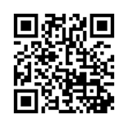
Mentimeter – A oes ffyrdd eraill o fesur dysgu a datblygu gyda dysgwyr y mae tlodi ac anfantais yn effeithio arnynt?
Mentimeter – Are there other ways to measure learning and development with learners who are impacted by poverty and disadvantage? www.menti.com: code 3438 1269

Slide 92
Is-haen 2: Dadansoddi'n feirniadol ddamcaniaethau tlodi ac anfantais er mwyn adnabod manteision ac anfanteision yr arfer a mesuriadau dysgu a datblygu wrth adnabod a chefnogi dysgwyr y mae tlodi ac anfantais yn effeithio arnynt.
Sub strand 2: Critically analysing theories of poverty and disadvantage to identify the advantages and drawbacks of the practice and measurements of learning and development in identifying and supporting learners impacted by poverty and disadvantage.

Slide 93
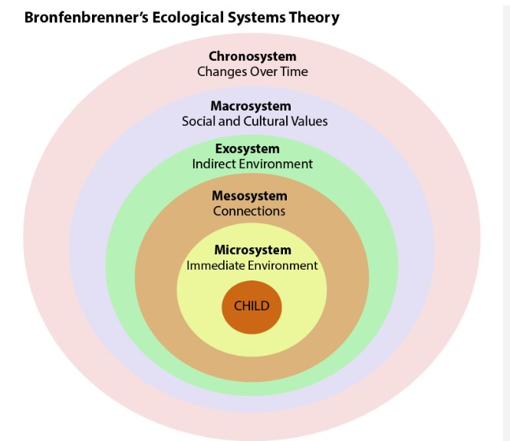
Damcaniaethau tlodi ac anfantais
Nid yw’r dysgwr yn bodoli mewn gwagle ac mae’n bwysig ystyried y cyd-destunau a’r systemau ehangach sy’n amgylchynu ac yn dylanwadu ar fywyd dysgwr.
Mae' r Exosystem, o fewn Damcaniaeth Systemau Ecolegol Bronfenbrenner, yn cynnwys materion cymdeithasol cymhleth sy'n effeithio'n anuniongyrchol ar ddatblygiad dysgwr ac a all arwain at allgáu cymdeithasol, gan amlygu pwysigrwydd ystyried y ffactorau ehangach hyn wrth werthuso effeithiolrwydd mesurau a ddefnyddir i nodi a chefnogi dysgwyr yr effeithir arnynt gan tlodi ac anfantais.

Slide 94
Theories of poverty and disadvantage
A learner does not exist in a vacuum and it is important to consider the broader contexts and systems that surround and influence a learner's life.
The Exosystem, a layer within Bronfenbrenner's Ecological Systems Theory, contains complex societal issues that indirectly impact a learner's development and can lead to social exclusion, highlighting the importance of considering these broader factors when evaluating the effectiveness of measures used to identify and support learners affected by poverty and disadvantage.

Slide 95
Safbwyntiau damcaniaethol addysg a thlodi
Terzi; Unterhalter; Judith Suissa, (2022).
Safbwynt plant/plentyndod o Ogledd Byd-eang â ‘hawliau’ sy’n ‘agored i niwed’ a De Byd-eang sy’n wydn ac yn ymreolaethol (Haines, 2019 yn cwestiynu safbwyntiau normadol ynghylch statws moesol plant fel rhai diamddiffyn a dibynnol.
Nodweddir 'addysgeg tlodi' a brofir gan ddysgwyr gan ffocws ar ddisgyblaeth, ymgysylltiad deallusol isel a ffocws ar gyrhaeddiad mewn profion.
Mae tlodi yn rym allanol – y tu allan i’r ysgol – drwy ddarparu addysgu ‘safonol’ ac ati bydd hyn yn ymateb i dlodi, neu mae elfennau camweithredol i’w cadw y tu allan i ffocws cynllunio addysg, nad yw ynddo’i hun yn ymgysylltu â phwrpas addysg y tu hwnt i ddysgu.
Theori Cyfiawnder gan John Rawls
Mae modelau gwahanol o blentyndod yn llywio’r holl ddamcaniaethau sy’n ymwneud â phlant, lle gall safbwyntiau delfrydol, arwain at bolisïau sydd, yn hytrach nag amddiffyn plant, yn eu rhoi dan anfantais bellach.

Slide 96
Theoretical positions of education and poverty
Terzi; Unterhalter; Judith Suissa, (2022)
Viewpoint of children/childhood from Global North with 'rights' who are 'vulnerable' and Global South which are resilient and autonomous (Haines, 2019 questions normative positions about the moral status of children as vulnerable and dependent.
'Pedagogy of poverty' experienced by learners is characterised by a focus on discipline, low intellectual engagement and a focus on attainment in tests.
Poverty is an outside force – external to school – by providing 'quality' teaching etc. this will respond to poverty poverty or dysfunctional elements are to be kept outside the focus of education planning, which itself does not engage with the purpose of education beyond ‘learning
Theory of Justice by John Rawls
Different models of childhood inform all theories dealing with children, where idealised views, can lead to policies that, instead of protecting children, end up further disadvantaging them.
Notes:
Theory of Justice by John Rawls, provide principled positions that can guide both the analysis of what constitutes disadvantage and ways to conceptualise it, as well as principles that can guide a fair distribution of resources. Although offering also important insights for education
Economic Capital Theory This theory posits that economic resources directly impact educational outcomes. Children from low-income families often lack access to educational resources such as books, technology, tutoring, and extracurricular activities, which can hinder their academic performance (Bradley & Corwyn, 2002).
Cultural Capital Theory (Bourdieu):
Pierre Bourdieu's theory of cultural capital suggests that children from wealthier families benefit from the cultural knowledge, skills, and attitudes that are valued by the educational system. These include language skills, familiarity with dominant cultural norms, and parental involvement in education, which can influence teachers' perceptions and students' academic success (Bourdieu, 1986).
Social Capital Theory (Coleman)
social capital theory emphasizes the role of social networks and relationships in education. Families with strong social networks can provide better support, more effective parental involvement, and access to valuable information and opportunities, which enhance educational outcomes (Coleman, 1988).
Human Capital Theory views education as an investment in human capital, where the returns are seen in the form of higher future earnings and improved socio-economic status. Children in poverty might not receive the same level of investment in their education, resulting in lower academic achievement and limited economic mobility (Becker, 1964).
Structural Inequality Theory Structural inequality theory highlights the broader socio-economic structures and policies that perpetuate inequality. It argues that systemic barriers, such as underfunded schools, discriminatory practices, and residential segregation, disproportionately affect disadvantaged students and limit their educational opportunities (Darling-Hammond, 2010).
Ecological Systems Theory Urie Bronfenbrenner's ecological systems theory examines how various environmental systems influence a child's development. Factors such as family dynamics, school environment, community context, and societal policies interact to impact educational outcomes, with poverty affecting multiple layers of these systems (Bronfenbrenner, 1979).
Intersectionality theory looks at how overlapping social identities, such as race, gender, and socio-economic status, combine to create unique experiences of disadvantage. This approach helps explain how children in poverty who also belong to other marginalized groups face compounded barriers in education (Crenshaw, 1989).
Critical Pedagogy Paulo Freire’s critical pedagogy advocates for an education system that empowers disadvantaged students by recognizing and addressing the socio-political context of their lives. It emphasizes the need for a transformative approach to education that challenges inequality and promotes social justice (Freire, 1970).

Slide 97
Safbwyntiau damcaniaethol addysg a thlodi
Theori Cyfiawnder gan John Rawls
Safbwynt plant/plentyndod o Ogledd Byd-eang â 'hawliau' sy'n 'agored i niwed' a De Byd-eang sy'n wydn ac yn annibynnol (Haines, 2019; Terzi; Unterhalter; Judith Suissa, 2022)
Damcaniaeth cyfalaf economaidd (Bradley a Chorwyn, 2002).
Damcaniaeth cyfalaf diwylliannol (Bourdieu, 1986).
Damcaniaeth cyfalaf dynol (Becker, 1964).
Damcaniaeth anghydraddoldeb strwythurol (Darling-Hammond, 2010).
Damcaniaeth systemau ecolegol (Bronfenbrenner, 1979).
Croestoriad (Crenshaw, 1989).
Addysgeg Feirniadol (Paulo Friere, 1971).
Notes:
Mae Theory of Justice gan John Rawls, yn darparu safbwyntiau egwyddorol a all arwain y dadansoddiad o'r hyn sy'n gyfystyr ag anfantais a ffyrdd o'i gysyniadoli, yn ogystal ag egwyddorion a all arwain dosbarthiad teg o adnoddau. Er ei fod hefyd yn cynnig mewnwelediadau pwysig ar gyfer addysg
Damcaniaeth Cyfalaf Economaidd Mae'r ddamcaniaeth hon yn awgrymu bod adnoddau economaidd yn effeithio'n uniongyrchol ar ddeilliannau addysgol. Yn aml nid oes gan blant o deuluoedd incwm isel fynediad at adnoddau addysgol megis llyfrau, technoleg, tiwtora, a gweithgareddau allgyrsiol, a all rwystro eu perfformiad academaidd (Bradley & Corwyn, 2002).
Damcaniaeth Prifddinas Ddiwylliannol (Bourdieu):
Mae damcaniaeth cyfalaf diwylliannol Pierre Bourdieu yn awgrymu bod plant o deuluoedd cyfoethocach yn elwa ar y wybodaeth ddiwylliannol, y sgiliau, a’r agweddau sy’n cael eu gwerthfawrogi gan y system addysg. Mae’r rhain yn cynnwys sgiliau iaith, bod yn gyfarwydd â normau diwylliannol amlycaf, ac ymwneud rhieni ag addysg, a all ddylanwadu ar ganfyddiadau athrawon a llwyddiant academaidd myfyrwyr (Bourdieu, 1986).
Damcaniaeth Cyfalaf Cymdeithasol (Coleman).
mae theori cyfalaf cymdeithasol yn pwysleisio rôl rhwydweithiau cymdeithasol a pherthnasoedd mewn addysg. Gall teuluoedd sydd â rhwydweithiau cymdeithasol cryf ddarparu gwell cymorth, cyfranogiad mwy effeithiol gan rieni, a mynediad at wybodaeth a chyfleoedd gwerthfawr, sy’n gwella canlyniadau addysgol (Coleman, 1988).
Mae Damcaniaeth Cyfalaf Dynol yn ystyried addysg fel buddsoddiad mewn cyfalaf dynol, lle gwelir yr enillion ar ffurf enillion uwch yn y dyfodol a gwell statws economaidd-gymdeithasol. Efallai na fydd plant mewn tlodi yn cael yr un lefel o fuddsoddiad yn eu haddysg, gan arwain at gyflawniad academaidd is a symudedd economaidd cyfyngedig (Becker, 1964).
Damcaniaeth Anghydraddoldeb Strwythurol Mae damcaniaeth anghydraddoldeb strwythurol yn amlygu'r strwythurau a'r polisïau economaidd-gymdeithasol ehangach sy'n parhau anghydraddoldeb. Mae’n dadlau bod rhwystrau systemig, fel ysgolion sy’n cael eu tanariannu, arferion gwahaniaethol, a gwahanu preswyl, yn effeithio’n anghymesur ar fyfyrwyr difreintiedig ac yn cyfyngu ar eu cyfleoedd addysgol (Darling-Hammond, 2010).
Damcaniaeth Systemau Ecolegol Mae damcaniaeth systemau ecolegol Urie Bronfenbrenner yn archwilio sut mae systemau amgylcheddol amrywiol yn dylanwadu ar ddatblygiad plentyn. Mae ffactorau fel dynameg teulu, amgylchedd yr ysgol, cyd-destun cymunedol, a pholisïau cymdeithasol yn rhyngweithio i effeithio ar ganlyniadau addysgol, gyda thlodi yn effeithio ar haenau lluosog o'r systemau hyn (Bronfenbrenner, 1979).
Mae damcaniaeth croestoriadol yn edrych ar sut mae hunaniaethau cymdeithasol sy'n gorgyffwrdd, megis hil, rhyw, a statws economaidd-gymdeithasol, yn cyfuno i greu profiadau unigryw o anfantais. Mae’r dull hwn yn helpu i egluro sut mae plant mewn tlodi sydd hefyd yn perthyn i grwpiau ymylol eraill yn wynebu rhwystrau cymhleth mewn addysg (Crenshaw, 1989).
Addysgeg Feirniadol Mae addysgeg feirniadol Paulo Freire yn eiriol dros system addysg sy’n grymuso myfyrwyr difreintiedig trwy gydnabod a mynd i’r afael â chyd-destun cymdeithasol-wleidyddol eu bywydau. Mae’n pwysleisio’r angen am ymagwedd drawsnewidiol at addysg sy’n herio anghydraddoldeb ac yn hyrwyddo cyfiawnder cymdeithasol (Freire, 1970).

Slide 98
Theoretical positions of education and poverty
Theory of Justice by John Rawls
Viewpoint of children/childhood from Global North with 'rights' who are 'vulnerable' and Global South which are resililent and autonomous (Haines, 2019; Terzi; Unterhalter; Judith Suissa, 2022)
Economic capital theory (Bradley and Corwyn, 2002)
Cultural capital theory (Bourdieu, 1986)
Human capital theory (Becker, 1964)
Structural inequality theory (Darling-Hammond, 2010)
Ecological systems theory (Bronfenbrenner, 1979)
Intersectionality (Crenshaw, 1989)
Critical Pedagogy (Paulo Friere, 1971)
Notes:
Theory of Justice by John Rawls, provide principled positions that can guide both the analysis of what constitutes disadvantage and ways to conceptualise it, as well as principles that can guide a fair distribution of resources. Although ofering also important insights for education
Economic Capital Theory This theory posits that economic resources directly impact educational outcomes. Children from low-income families often lack access to educational resources such as books, technology, tutoring, and extracurricular activities, which can hinder their academic performance (Bradley & Corwyn, 2002).
Cultural Capital Theory (Bourdieu):
Pierre Bourdieu's theory of cultural capital suggests that children from wealthier families benefit from the cultural knowledge, skills, and attitudes that are valued by the educational system. These include language skills, familiarity with dominant cultural norms, and parental involvement in education, which can influence teachers' perceptions and students' academic success (Bourdieu, 1986).
Social Capital Theory (Coleman)
social capital theory emphasizes the role of social networks and relationships in education. Families with strong social networks can provide better support, more effective parental involvement, and access to valuable information and opportunities, which enhance educational outcomes (Coleman, 1988).
Human Capital Theory views education as an investment in human capital, where the returns are seen in the form of higher future earnings and improved socio-economic status. Children in poverty might not receive the same level of investment in their education, resulting in lower academic achievement and limited economic mobility (Becker, 1964).
Structural Inequality Theory Structural inequality theory highlights the broader socio-economic structures and policies that perpetuate inequality. It argues that systemic barriers, such as underfunded schools, discriminatory practices, and residential segregation, disproportionately affect disadvantaged students and limit their educational opportunities (Darling-Hammond, 2010).
Ecological Systems Theory Urie Bronfenbrenner's ecological systems theory examines how various environmental systems influence a child's development. Factors such as family dynamics, school environment, community context, and societal policies interact to impact educational outcomes, with poverty affecting multiple layers of these systems (Bronfenbrenner, 1979).
Intersectionality theory looks at how overlapping social identities, such as race, gender, and socio-economic status, combine to create unique experiences of disadvantage. This approach helps explain how children in poverty who also belong to other marginalized groups face compounded barriers in education (Crenshaw, 1989).
Critical Pedagogy Paulo Freire’s critical pedagogy advocates for an education system that empowers disadvantaged students by recognizing and addressing the socio-political context of their lives. It emphasizes the need for a transformative approach to education that challenges inequality and promotes social justice (Freire, 1970).

Slide 99
Safbwyntiau damcaniaethol ac athronyddol tlodi ac anfantais mewn addysg
Gweithgaredd mewn ystafelloedd grŵp (20 munud).
Adolygwch eich nodiadau darllen ar waith Terzi, Unterhalter, a Suissa (2022) "Myfyrdodau Athronyddol ar Dlodi Plant ac Addysg" a'ch dealltwriaeth o'r Dull Gallu (Sen, 1990) o ddarlleniad Is-haen 2 i baratoi ar gyfer y sesiwn Sadwrn Cenedlaethol cyntaf hwn .
Mewn ystafelloedd grŵp, bydd gennych 20 munud i greu cynrychioliad dwy funud o'ch syniadau ar sut i gefnogi dysgwyr y mae tlodi ac anfantais yn effeithio arnynt yng nghyd-destun ymarfer a mesuriadau dysgu a datblygu. Defnyddiwch eich dealltwriaeth o'r Ddamcaniaeth Systemau Ecolegol, unrhyw ddamcaniaeth berthnasol arall a'r Ymagwedd Gallu i lywio eich gwaith. Gallwch wneud hyn yn unigol, fel grŵp bach neu fel grŵp cyfan.
Gall eich cynrychioliad fod ar unrhyw ffurf, megis llafar, ysgrifenedig neu weledol, a dylai ddangos eich dealltwriaeth o’r damcaniaethau a’u cymhwysiad ymarferol wrth gefnogi dysgwyr y mae tlodi ac anfantais yn effeithio arnynt mewn perthynas ag ymarfer a mesuriadau dysgu a datblygiad.
Ar ôl y sesiwn grŵp, byddwch yn dychwelyd i'r brif ystafell ac yn cael cyfle i gyflwyno'ch gwaith i'r grŵp felly gwnewch yn siŵr bod cynrychiolydd ar gael i rannu syniadau.
Mae enghraifft wedi'i chynnwys ar y sleid nesaf i ddangos beth yw ystyr 'cynrychioliad'.
Notes:
This slide will situate the practice and measurements of learning and development with learners who are impacted by poverty and disadvantage in the context of the educational setting, where students will need to consider how they could support learners who are impacted by poverty and disadvantage whilst considering theoretical and philosophical frameworks.

Slide 100
Theoretical and philosophical positions of poverty and disadvantage in education
Activity in breakout rooms (20 minutes).
Review your reading notes on Terzi, Unterhalter, and Suissa's (2022) work "Philosophical Reflections on Child Poverty and Education" and your understanding of the Capability Approach (Sen, 1990) from the Sub strand 2 reading in preparation for this first National Saturday session.
In breakout rooms, you will have 20 minutes to create a two-minute representation of your ideas on how to support learners impacted by poverty and disadvantage in the context of practice and measurements of learning and development. Use your understanding of the Ecological Systems Theory, any other relevant theory and the Capability Approach to inform your work. You can do this individually, as a small group or as an entire group.
Your representation can take any form, such as spoken, written, or visual, and should demonstrate your understanding of the theories and their practical application in supporting learners impacted by poverty and disadvantage in relation to practice and measurements of learning and development.
After the breakout session, you will return to the main room and have opportunity to present your work the group so please ensure there is a representative to share ideas.
An exemplar is included on the next slide to illustrate what is meant by a 'representation'.
Notes:
This slide will situate the practice and measurements of learning and development with learners who are impacted by poverty and disadvantage in the context of the educational setting, where students will need to consider how they could support learners who are impacted by poverty and disadvantage whilst considering theoretical and philosophical frameworks.

Slide 101
Enghraifft o weithgaredd – stori...
Un tro, roedd yna ddysgwr ifanc o'r enw Sam a oedd yn byw mewn cymuned yr effeithiwyd arni gan dlodi ac anfantais. Nid oedd stori Sam yn unigryw, gan fod llawer o'u cyd-ddisgyblion yn wynebu heriau tebyg. Un bore, cyrhaeddodd Sam yr ysgol heb gael brecwast, nid oherwydd eu bod wedi dewis hepgor y pryd o fwyd, ond oherwydd bod eu teulu’n cael trafferth cael dau ben llinyn ynghyd. Roedd mam Sam wedi’i sancsiynu’n ddiweddar am fethu apwyntiad anogwr gwaith, ac roedd y banc bwyd lleol wedi cau oherwydd diffyg cyllid (Exosystem; Bronfenbrenner, 1979).
Wrth i Sam eistedd yn eu dosbarth Mathemateg, yn newynog ac yn methu canolbwyntio, cawsant drafferth i berfformio'n dda ar y prawf. Cafodd y digwyddiad unigol hwn effaith barhaol ar farn eraill am allu mathemategol Sam (Microsystem; Bronfenbrenner, 1979). O’r diwrnod hwnnw ymlaen, gosodwyd Sam yn y grŵp gallu is, gan gyfyngu ar eu cyfleoedd i ddatblygu eu sgiliau a’u hyder yn y pwnc (Capability Approach; Sen, 1990).
Fodd bynnag, roedd yr ysgol yn cydnabod yr anghyfiawnder o ddal myfyrwyr yn atebol am faterion cymdeithasol y tu hwnt i'w rheolaeth. Roeddent yn deall nad oedd y ffactorau allanol hyn yn fai Sam, ac eto cawsant effaith sylweddol ar eu datblygiad a'u canlyniadau addysgol (Theori Allgáu Cymdeithasol; Burchardt, Le Grand, a Piachaud, 1999). Mewn ymateb, penderfynodd yr ysgol weithredu.
Gyda chefnogaeth Llywodraeth Cymru, gweithredodd yr ysgol raglen frecwast ym mhob dosbarth. Sicrhaodd y fenter hon fod pob dysgwr, waeth beth fo’u cefndir neu anghenion canfyddedig, yn gallu cael pryd o fwyd maethlon ar ddechrau pob diwrnod (Capability Approach; Sen, 1990). Trwy ddarparu’r angen sylfaenol hwn, anelodd yr ysgol at lefelu’r cae chwarae a chreu amgylchedd lle gallai pob plentyn ganolbwyntio ar eu dysgu heb atal newyn.
Roedd fforddiadwyedd yr ystafell ddosbarth (Theory of Affordances; Gibson, 1979) bellach yn cynnwys yr adnoddau hanfodol yr oedd eu hangen ar ddysgwyr i ganolbwyntio, waeth beth fo’r heriau yr oeddent yn eu hwynebu y tu allan i furiau’r ysgol.
Wrth i Sam eistedd i lawr i fwynhau eu brecwast gyda'u cyd-ddisgyblion, roedden nhw'n teimlo ymdeimlad o berthyn a gobaith. Roeddent yn gwybod bod pobl y tu allan i'w hysgol yn poeni am eu lles ac yn ymroddedig i'w cefnogi yn eu dysgu, ni waeth pa rwystrau oedd byth yn bresennol yn eu bywyd. yn

Slide 102
Once upon a time, there was a young learner named Sam who lived in a community impacted by poverty and disadvantage. Sam's story was not unique, as many of their classmates faced similar challenges. One morning, Sam arrived at school without having had breakfast, not because they chose to skip the meal, but because their family struggled to make ends meet. Sam's mother had recently been sanctioned for missing a work coach appointment, and the local food bank had closed due to lack of funding (Exosystem; Bronfenbrenner, 1979).
As Sam sat in their Maths class, hungry and unable to concentrate, they struggled to perform well on the test. This single event had a lasting impact on how others perceived Sam's mathematical ability (Microsystem; Bronfenbrenner, 1979). From that day forward, Sam was placed in the lower ability group, limiting their opportunities to develop their skills and confidence in the subject (Capability Approach; Sen, 1990).
However, the school recognised the injustice of holding students accountable for societal issues beyond their control. They understood that these external factors were not Sam's fault, yet they significantly impacted their development and educational outcomes (Social Exclusion Theory; Burchardt, Le Grand, & Piachaud, 1999). In response, the school decided to take action.
With the support of the Welsh Government, the school implemented a breakfast program in every classroom. This initiative ensured that all learners, regardless of their background or perceived needs, had access to a nutritious meal at the start of each day (Capability Approach; Sen, 1990). By providing this basic necessity, the school aimed to level the playing field and create an environment where every child could concentrate on their learning without the restraint of hunger.
The affordances of the classroom (Theory of Affordances; Gibson, 1979) now included the essential resources needed for learners to concentrate, regardless of the challenges they faced outside the school walls.
As Sam sat down to enjoy their breakfast with their classmates, they felt a sense of belonging and hope. They knew that folks beyond their school cared about their well-being and was committed to supporting them in their learning, no matter what obstacles were ever present in their life.
Activity exemplar – a story...
Notes:
References
References:
Bronfenbrenner, U. (1979). The ecology of human development: Experiments by nature and design. Harvard University Press.
Burchardt, T., Le Grand, J., & Piachaud, D. (1999). Social exclusion in Britain 1991—1995. Social Policy & Administration, 33(3), 227-244.
Gibson, J. J. (1979). The Ecological Approach to Visual Perception. Chapter 8, The Theory of Affordances.
Sen, A. (1990). Development as capability expansion. In K. Griffin & J. Knight (Eds.), Human development and the international development strategy for the 1990s (pp. 41-58). Macmillan.

Slide 103
References
Barrance, R. and Elwood, J. (2018). The human rights of children in Wales: An evidence review.
Bellani. L, and Bia. M (2019). The long‐run effect of childhood poverty and the mediating role of education. Journal of The Royal Statistical Society Series A-statistics in Society.
Bowden., S, and Mosley, P. (2008). Historical roots of poverty: A symposium. Journal of International Development. Volume 20, Issue 8 p. 987-995
Child Poverty Action Group (no date) Causes of Poverty [Online] Causes of poverty | CPAG
Children in Wales (2019) Price of pupil poverty guide Available at: Price_of_Pupil_Poverty_Guide.pdf (childreninwales.org.uk)
Delpier, T, Nelson, L, Crum, M, Klett, M, Smith, K, Crabb, J, and Puncochar, J. Comparison of Students’ Attitudes Towards Poverty Following an Interdisciplinary Poverty Simulation. Journal of Higher Education Theory and Practice Vol. 23(5) 2023.
Doyle, L., & Easterbrook, M. J. (2023). Biased career choices? It depends what you believe: Trainee teachers' aversions to working in low-income schools are moderated by beliefs about inequality, meritocracy, and growth mindsets. Preprint retrieved from PsyArXiv
Dunn. A. (2022). Equality Street: Ideology and attitudes towards the purely relative definition of poverty. Economic Affairs, 2022, vol. 42, issue 1, 13-29
Egan.D (2016). Educational Equity in Wales. Wales Journal of Education 18(1), 21-44.
Ellis, S., Thompson, I., McNicholl, J., & Thomson, J. (2019). Student teachers’ perceptions of the effects of poverty on learners’ educational attainment and well-being: perspectives from England and Scotland. In Poverty Discourses in Teacher Education (pp. 110-126). Routledge.
European Journalism Centre. (2021). A freelancer’s guide to reporting on poverty. [Online] A freelancer’s guide to reporting on poverty | EJC.net

Slide 104
References (Cont’d)
Fair by Design (no date) Ending the Extra Costs of Being Poor [Online] Poverty Premium – Fair By Design
Fontaine. A, Lidia, Panico. (2019). Many Kinds of Poverty: Three Dimensions of Economic Hardship, Their Combinations, and Children's Behavior Problems. Demography, Available from: Many Kinds of Poverty: Three Dimensions of Economic Hardship, Their Combinations, and Children’s Behavior Problems | Demography | Duke University Press (dukeupress.edu)
Gregg, P., Milburn, A., Attwood, T., Cleal, P., Shephard, G., Hamilton, D., Carrie, A. M., Guy, C., Williams, C. and Johnston, D., 2013. Public attitudes towards social mobility and in-work poverty. Other. London: Social Mobility & Child Poverty (SMCP) Commission.
Goodall, J. (2021). Parental engagement and deficit discourses: Absolving the system and solving parents. Educational Review, 73(1), 98-110.
Hewlett, K, Hesketh, R, Benson, R, Townend, S, and Duffy, B. (2022) Public attitudes to poverty [Online] attitudes-to-poverty.pdf (kcl.ac.uk)
Sibieta, L. (2024) Major challenges for education in Wales. Institute of Fiscal Studies Available at: Major challenges for education in Wales (ifs.org.uk)
Macnicol. J. (2017). Perspectives on the Idea of an 'Underclass’. Social Policy & Society (2017) 16:1, 99–108
Phillips. J. (2018). The Culture of Poverty: On Individual Choices and Infantilizing Bureaucracies. Schenck-
Pollack, T. M. (2012). The miseducation of a beginning teacher: One educator's critical reflections on the functions and power of deficit narratives. Multicultural Perspectives, 14(2), 93-98.

Slide 105
Ridge, T. (2011). The everyday costs of poverty in childhood: A review of qualitative research exploring the lives and experiences of low‐income children in the UK. Children & society, 25(1), 73-84.
Robson, D., Mtika, P., Graham, A., & MacDougall, L. (2021). Student teachers’ understandings of poverty: insights for initial teacher education. Journal of Education for Teaching, 47(1), 104-117. (factors that influencing negative feelings towards teaching in below medium income schools; mitigations through training input on poverty)
Stats Wales (no date) Welsh Index of Multiple Deprivation Welsh Index of Multiple Deprivation (gov.wales)
Stewart. K, and Roberts, N. (2019). Child poverty measurement in the UK: assessing support for the downgrading of income-based poverty measures. Social Indicators Research, Available from: Soc Indic Res (2019) 142:523–542
Wagle, UR. 2023. "Poverty measurement: evolving concepts and measurement frameworks," Chapters, in: Udaya R. Wagle (ed.), Research Handbook on Poverty and Inequality, chapter 2, pages 15-35, Edward Elgar Publishing.
Welsh Government (2023). Child Poverty Strategy Progress Report. [Online] Child poverty strategy 2015: 2022 progress report [HTML] | GOV.WALES
Welsh Government (2023) Personalised Assessments Practitioner guidance for individual learner feedback and progress reports Available at: Personalised Assessements 2023–2024 (gov.wales) Asesiadau personol 2023-2024 (gov.wales)
Welsh Government (2024) Child Poverty Strategy for Wales 2024 [Online] Child Poverty Strategy for Wales 2024 | GOV.WALES
White, M. L., & Murray, J. (2019). Seeing disadvantage in schools: Exploring student teachers’ perceptions of poverty and disadvantage using visual pedagogy. In Poverty Discourses in Teacher Education (pp. 127-142). Routledge.

Slide 106
Cwestiynau
Q & A

Slide 107
Crynhoi: ailymweld â’r aseiniad a chasgliadau terfynol
Summary: re-visiting the assignment and final reflections
(cyn cyfarfodydd SAU unigol)
(prior to individual HEI meetings)

Slide 108
Trosolwg Asesu
Asesiad: Adroddiad 4,000 o eiriau ​
Un aseiniad sydd i'r modiwl hwn. Mae’r aseiniad cyfwerth â 100% o’r radd derfynol. ​
Dylai'r adroddiad fyfyrio ar fater sy’n rhan o arfer y myfyriwr lle gallai tlodi ac anfantais effeithio ar leoliad addysgol y dysgwr. Dylai’r adroddiad fod wedi’i anelu at gynulleidfa darged a ddewiswyd (e.e. staff, cyflwyniad i lywodraethwyr, Penaethiaid Gwasanaeth, uwch dîm rheoli ac ati) a bydd yn cael ei ysgrifennu mewn arddull briodol.
Rhan 1: (2,000 o eiriau)
Gan ddefnyddio llenyddiaeth a damcaniaeth, gofynnir i chi fyfyrio'n feirniadol ar effaith tlodi ac anfantais ar ddysgwyr yn eich lleoliad addysgol. Gofynnir i chi archwilio’n feirniadol y mesuriadau a ddefnyddir i ddangos cynnydd a datblygiad y dysgwr yn eich lleoliad addysgol, gan archwilio’n feirniadol a yw’r rhain yn llwyddo i nodi a chefnogi dysgwyr y mae tlodi ac anfantais yn effeithio arnynt.
Rhan 2: Cynllun Gweithredu (2,000 o eiriau)
Bydd angen i chi ystyried sut y byddech yn ymateb i’r mater / materion a nodwyd ac a archwiliwyd yn Rhan 1 yn eich ymarfer eich hun. Bydd angen i chi gyfiawnhau'n feirniadol eich cynllun gweithredu arfaethedig, ac os caiff ei weithredu, arddangos pam eich bod yn credu y gallai gyfrannu at fynd i'r afael â'r materion a nodwyd. Bydd angen i chi hefyd ystyried sut byddech chi’n gwerthuso’r newidiadau y byddech chi’n eu rhoi ar waith.

Slide 109
Assessment overview
Assessment: Report (4000 words)
This module offers one assessment. This is worth 100% of the overall module grade.
Part 1 (2,000 words) 40%
The report reflects on an issue in the student’s practice where poverty and disadvantage impact on the learner’s educational setting. The report should be aimed at a chosen target audience (e.g. staff, presentation to governors, Heads of Service, senior management team, etc.) and should be written in an appropriate style. The content and design of a report and action plan will be discussed in your initial session.
Part 2: Action plan (2,000 words) 50%
Drawing from literature and theory, you are asked to critically reflect on the impact of poverty and disadvantage on learners in your educational setting. You are asked to critically examine the role of measurements used in your educational setting to show the learner’s progress and development, critically exploring whether these successfully identify and support learners who are impacted by poverty and disadvantage.

Slide 110
Casgliadau terfynol
Final reflections

Slide 111
CLOI
FINISH
3.30pm

