Slide 1
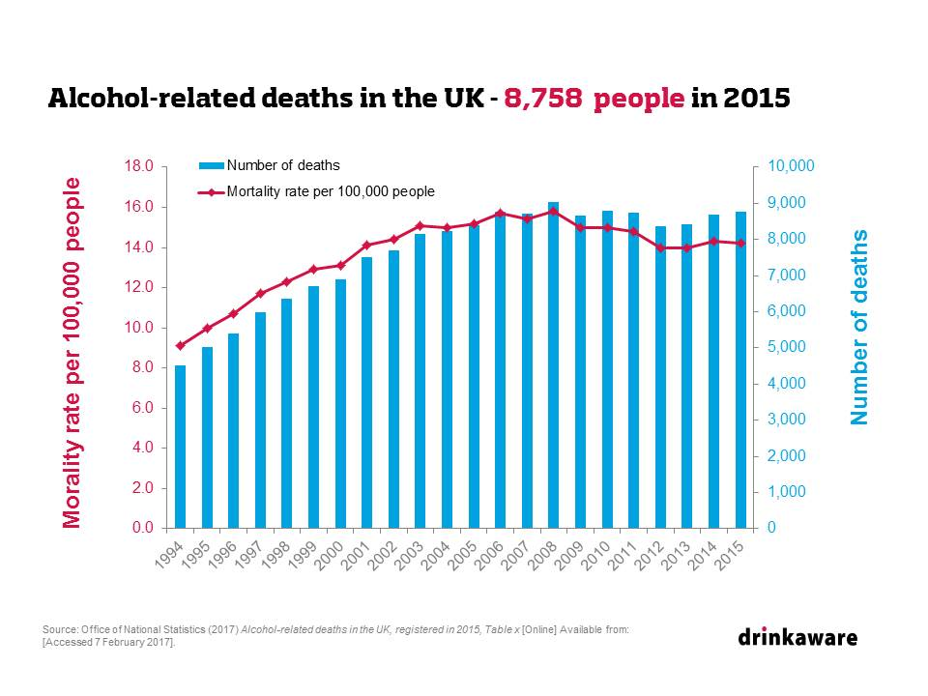
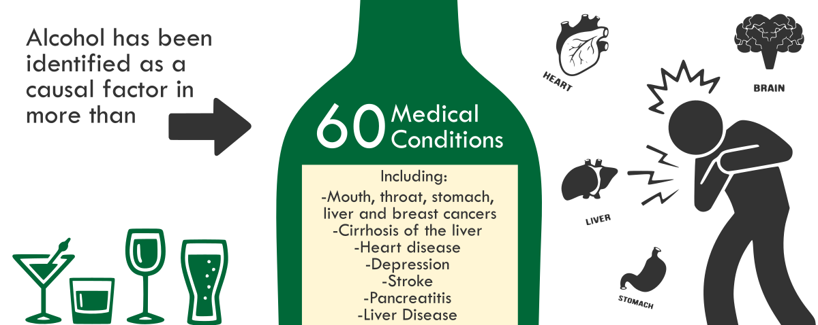
How is CBT used to treat Alcohol use Disorder and how does it compare to other treatments?
What is Alcohol Use Disorder?
The DSM 5th edition (2013), defines Alcohol Use Disorder (AUD) as ‘a problematic pattern of alcohol use leading to clinically significant impairment or distress’ (p.490).
What is Cognitive Behavioural Therapy (CBT)?
How can CBT help people with AUD?
CBT is based on the assumption that our emotions and behaviours are influenced by our thoughts, not outside stimuli. Circumstances may not change, however how we think about them can.
Recent studies suggest that CBT can significantly help individuals who are living with AUD and depressive or anxiety disorders (Baker, Thornton, Hiles, Hides and Lubman, 2012).
Teach individuals to recognise scenarios and situations that may lead to alcohol consumption and to avoid them if possible.
Create coping strategies to help with other behaviours or issues that may lead to alcohol abuse.
How does AUD impact people’s lives?
Rehm et al. (2015) suggests that AUD is one of the world’s most widespread mental disorders.
Alcohol affects every organ and causes both physical and mental issues.
Comparing CBT to the 12-step programme in regards to AUD
12-step programmes aims for total abstinence, however CBT allows the client to set their own goals, usually resulting in a greater will to achieve them.
Individuals may not like the sometimes religious or spiritual aspect of some 12-step programmes.
CBT can be provided in a number of formats including individual and group meetings, self-help books and computer programmes.
12-step programmes offer more social support due to sessions requiring people to come together for treatment.
Conclusion
Recent studies suggest that when comparing CBT to other therapeutic interventions, CBT comes out superior for many disorders and illnesses; however there is little evidence to suggest that CBT is superior to other therapies when treating alcohol or substance misuse disorders (Tolin, 2010).
CBT can be used to treat more than one disorder at a time e.g. alcohol use disorder can be treated simultaneously with depression or anxiety (Riper, Anderson, Hunter, Berking and Cuijpers, 2014).
Although there are both positives and negatives to CBT and 12-step programmes being used to treat AUD, it is evident that they are both successful treatments in their own ways. Everyone is individual and will respond to treatments differently.
References:
American Psychiatric Association. (2013).Alcohol-Related Disorders. In Diagnostic and Statistical Manual of Mental Disorders (5th ed.). Arlington, VA: American Psychiatric Publishing.
Baker, A. L., Thornton, L. K., Hiles, S., Hides, L., & Lubman, D. I. (2012). Psychological interventions for alcohol misuse among people with co-occurring depression or anxiety disorders: a systematic review. Journal of Affective Disorders, 139(3), 217-229.
Rehm, J., Anderson, P., Barry, J., Dimitrov, P., Elekes, Z., Feijão, F., ... & Marmet, S. (2015). Prevalence of and potential influencing factors for alcohol dependence in Europe. European addiction research, 21(1), 6-18.

Slide 2
Reference List
American Psychiatric Association. (2013).Alcohol-Related Disorders. In Diagnostic and Statistical Manual of Mental Disorders (5th ed.). Arlington, VA: American Psychiatric Publishing.
Baker, A. L., Thornton, L. K., Hiles, S., Hides, L., & Lubman, D. I. (2012). Psychological interventions for alcohol misuse among people with co-occurring depression or anxiety disorders: a systematic review. Journal of Affective Disorders, 139(3), 217-229.
Rehm, J., Anderson, P., Barry, J., Dimitrov, P., Elekes, Z., Feijão, F., ... & Marmet, S. (2015). Prevalence of and potential influencing factors for alcohol dependence in Europe. European addiction research, 21(1), 6-18.
Riper, H., Andersson, G., Hunter, S. B., Wit, J., Berking, M., & Cuijpers, P. (2014). Treatment of comorbid alcohol use disorders and depression with cognitive‐behavioural therapy and motivational interviewing: A meta‐analysis. Addiction, 109(3), 394-406.
Tolin, D. F. (2010). Is cognitive–behavioral therapy more effective than other therapies?: A meta-analytic review. Clinical psychology review, 30(6), 710-720.

